Slide 1
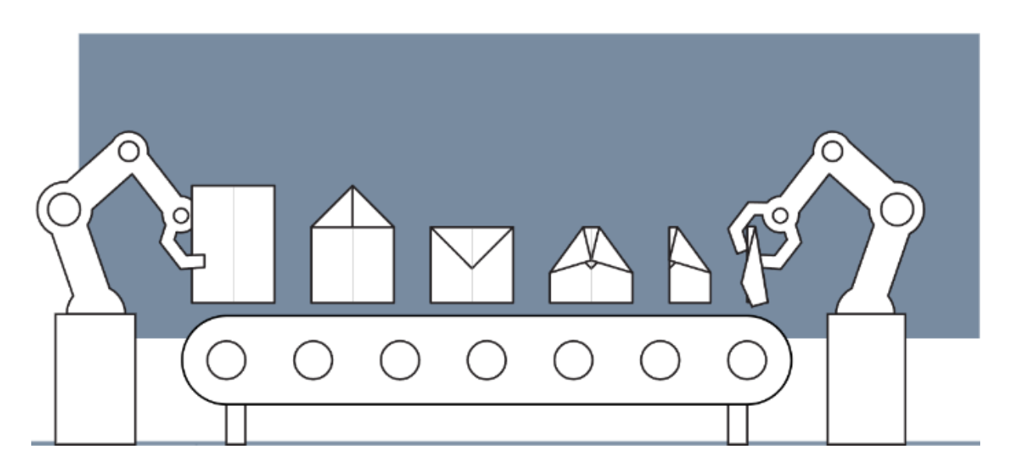
Design of Cyber-Physical Systems in Manufacturing
Development of a Digital Twin for a Robotic Paper Plane Production Line
Twente, 10.12.2024
Merve | Yating | Lukas | Shashang | Aly | Dogukan | Hakim

Slide 2
Agenda
What is a Digital Twin?
Definition and Concept
Discrete Model
Structure and Function
As Is State
Project Plan
Activity Diagram
MATLAB Simulation
Requirements
Where Do We Want to Go?
Long-term Goals and Vision
Necessary Steps to Achieve the Goals

Slide 3
Agenda
What is a Digital Twin?
Definition and Concept
Discrete Model
Structure and Function
As Is State
Project Plan
Activity Diagram
MATLAB Simulation
Requirements
Where Do We Want to Go?
Long-term Goals and Vision
Necessary Steps to Achieve the Goals

Slide 4
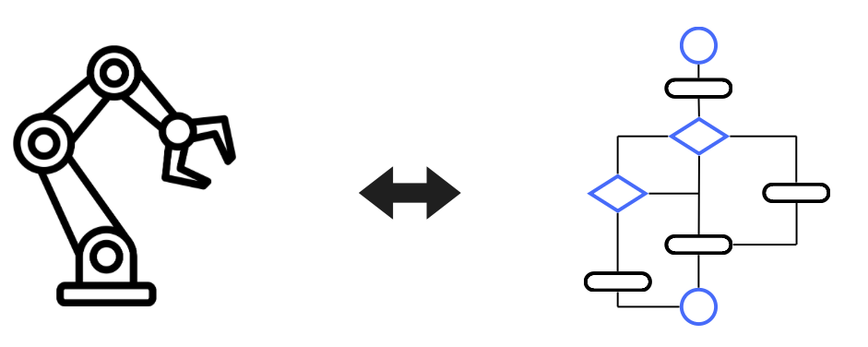
1. What is a Digital Twin: Definition and Concept
Physical model
Simulation model
Conveyor belt motion
Trigger of sensors
Activity diagramm
Simulink simulation
Multibody Simscape
Main optimization goals: - minimize human intervention
- optimize throughput time

Slide 5
Agenda
What is a Digital Twin?
Definition and Concept
Discrete Model
Structure and Function
As Is State
Project Plan
Activity Diagram
MATLAB Simulation
Requirements
Where Do We Want to Go?
Long-term Goals and Vision
Necessary Steps to Achieve the Goals

Slide 6
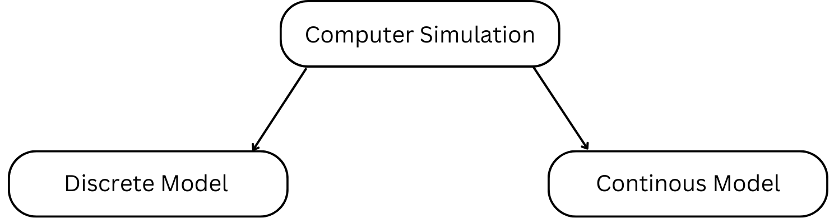
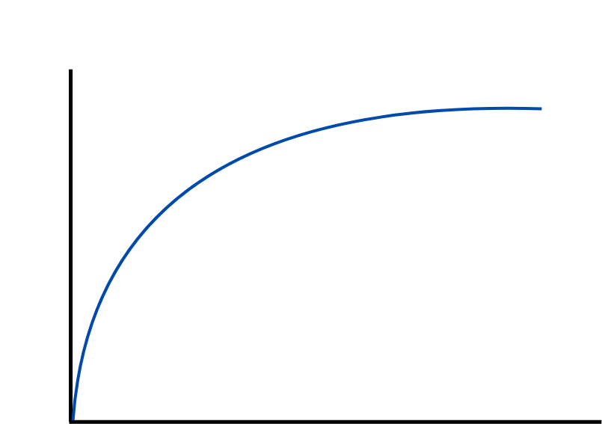
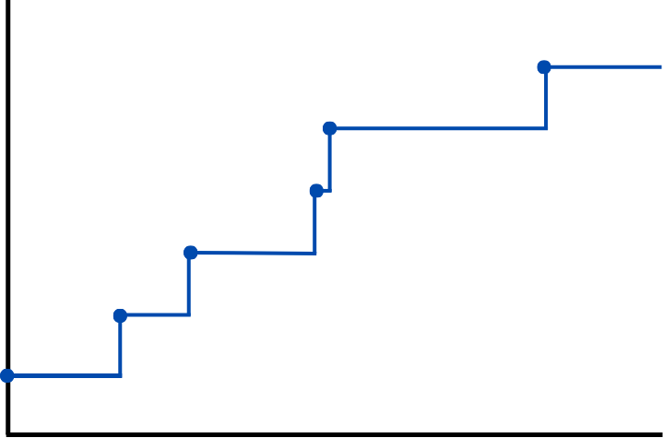
2. Discrete Model: Discrete Event System

Slide 7
Agenda
What is a Digital Twin?
Definition and Concept
Discrete Model
Structure and Function
As Is State
Project Plan
Activity Diagram
MATLAB Simulation
Requirements
Where Do We Want to Go?
Long-term Goals and Vision
Necessary Steps to Achieve the Goals

Slide 8
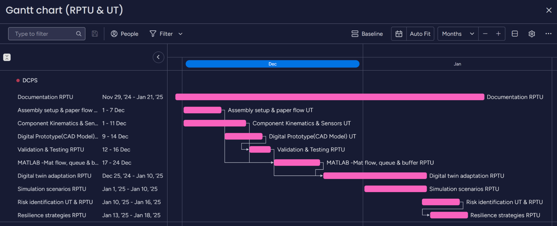
3. As Is State: Project Plan

Slide 9
Agenda
What is a Digital Twin?
Definition and Concept
Discrete Model
Structure and Function
As Is State
Project Plan
Activity Diagram
MATLAB Simulation
Requirements
Where Do We Want to Go?
Long-term Goals and Vision
Necessary Steps to Achieve the Goals

Slide 10
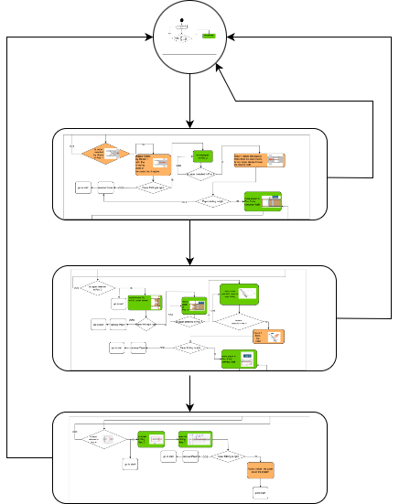
3. As Is State: Activity Diagram
Start
Github: Activity Diagram
Stage 1
Stage 2
Stage 3

Slide 11
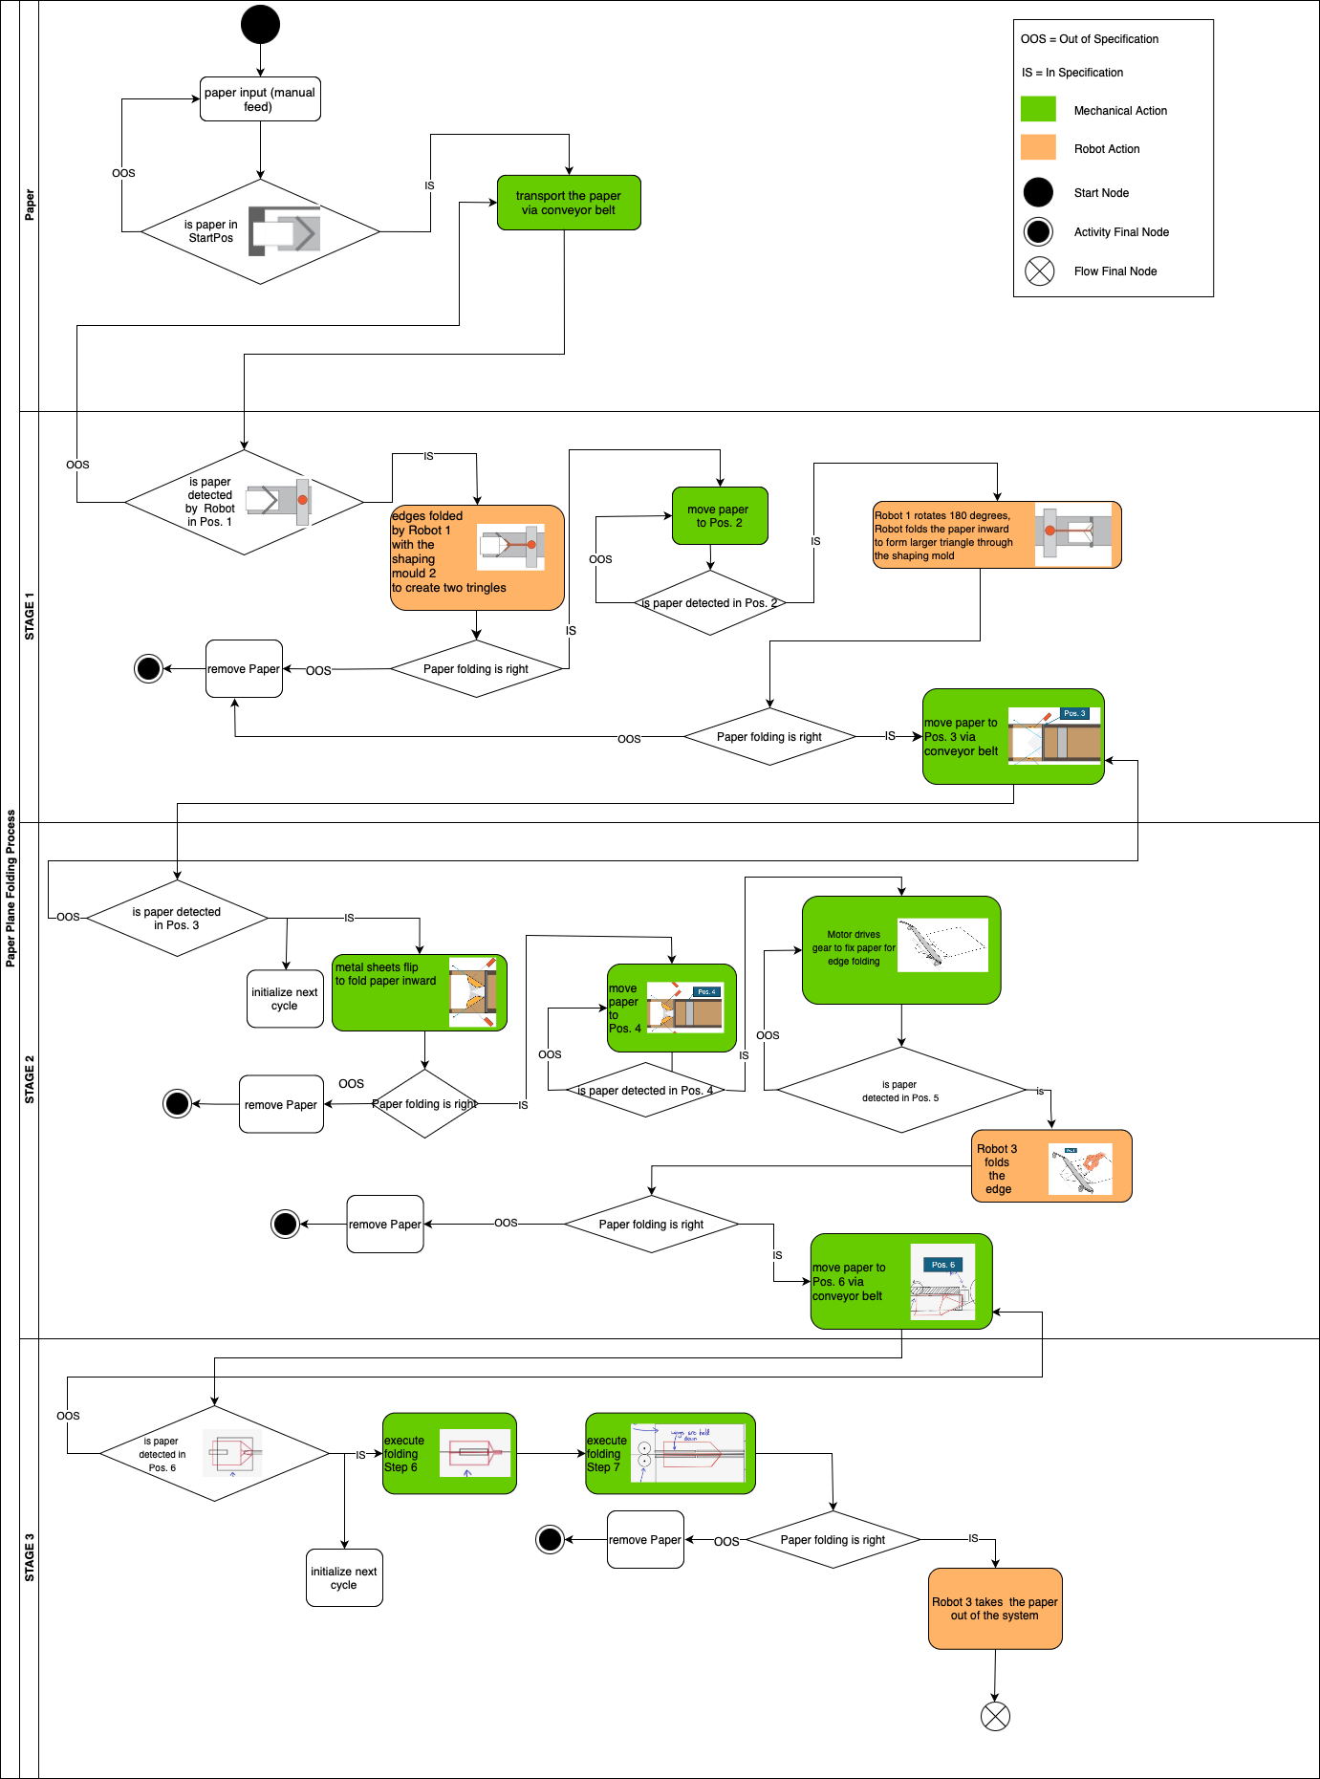
3. As Is State: Activity Diagram

Slide 12
3. As Is State: Activity Diagram

Slide 13
Agenda
What is a Digital Twin?
Definition and Concept
Discrete Model
Structure and Function
As Is State
Project Plan
Activity Diagram
MATLAB Simulation
Requirements
Where Do We Want to Go?
Long-term Goals and Vision
Necessary Steps to Achieve the Goals

Slide 14
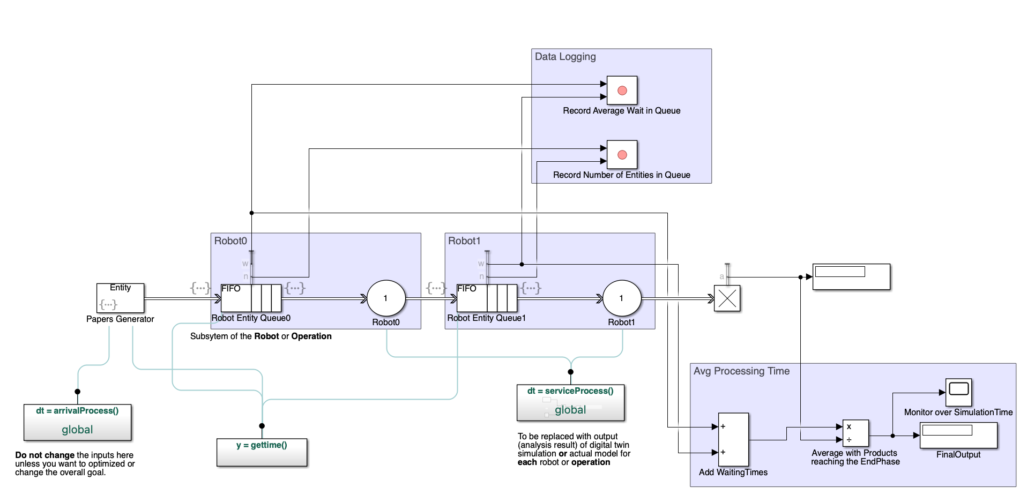
3. As Is State: MATLAB Simulation

Slide 15

3. As Is State: MATLAB Simulation
Time
 | ProcessingTimeArray0 | ProcessingTimeArray1 | waitTimeArray0 | waitTimeArray1
1 | 1.2292 | 1.0350 | 0 | 0
2 | 3.2987 | 0.3890 | 0.2292 | 0
⋮ | ⋮ | ⋮ | ⋮ | ⋮
84 | 0.2134 | 2.7117 | 6.7399 | 7.1484
85 | 0.7366 | - | 5.9533 | 9.1235
⋮ | ⋮ | - | ⋮ | -
89 | 1.1406 | - | 4.4385 | -
90 | 2.8739 | - | 4.5791 | -
91 | - | - | 6.4530 | -
Entity

Slide 16
Agenda
What is a Digital Twin?
Definition and Concept
Discrete Model
Structure and Function
As Is State
Project Plan
Activity Diagram
MATLAB Simulation
Requirements
Where Do We Want to Go?
Long-term Goals and Vision
Necessary Steps to Achieve the Goals

Slide 17
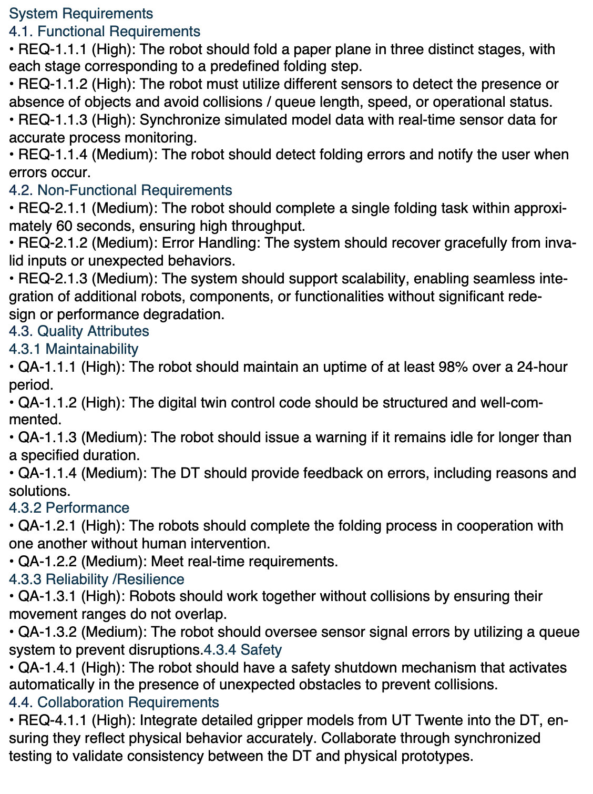
System Requirements (open)

Slide 18
Agenda
What is a Digital Twin?
Definition and Concept
Discrete Model
Structure and Function
As Is State
Project Plan
Activity Diagram
MATLAB Simulation
Requirements
Where Do We Want to Go?
Long-term Goals and Vision
Necessary Steps to Achieve the Goals

Slide 19
4. Where Do We Want to Go?
Needed input data from UT:
Assembly setup and paper flow:
sequence / action of each folding step
how long do the folding steps (1-7) take
define the action at each step clearly (which step the paper transferred / folded)
time of each action (transport/ folding/error action)
resilience: solution of error action
how is the method to feed the paper (mirror the activity diagram)
define, when a new process begin, which parallel to another process
sensor-type: exact action / description of the sensors
how to actuate / control / stop conveyor belt?
Expected output from RPTU:
Simulink model: whole processing time for one entity/batch/feasibility of multiple entities process
Analysis and Evaluation Report
Simulation Demo
Github: Data storage / version control

