Slide 1

Data analysis tool Interface
Core elements of Graphic User Interface

Slide 2
Core Interface Components - Summary
Category / Indicator selection panels
Choose data to represent
Bookmark second indicator
More on data organisation later
Graph panel
Choose how to display selected data
Time slider / player
Play as animation or use controls to go forward / back in time
Map legend
Choose colour schemes and number of intervals
Map display controls
Zoom & reset
Click-drag on map to pan
Region selection panel
Select regions
Zoom into map areas
Settings & customisations
Customization icons and panels; show or hide interface elements
Notes:
StatPlanet User Guide: 3.1, 3.2, 3.3, 3.5, 3.8

Slide 3
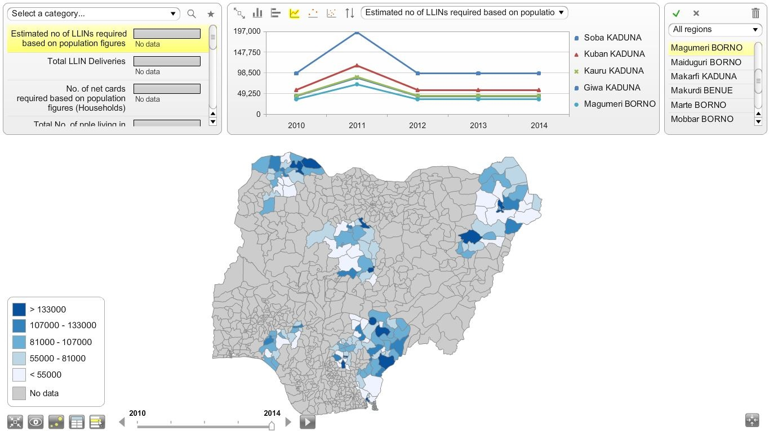
Category / Indicator Selection
Graph Panel
Region Selection Panel
Indicator Selection Panel
Map Popup
Map Legend
Customise, export, labels & tables
Map Display Controls
Time slider / player
Notes:
StatPlanet User Guide: 3.1 & 3.2

Slide 4
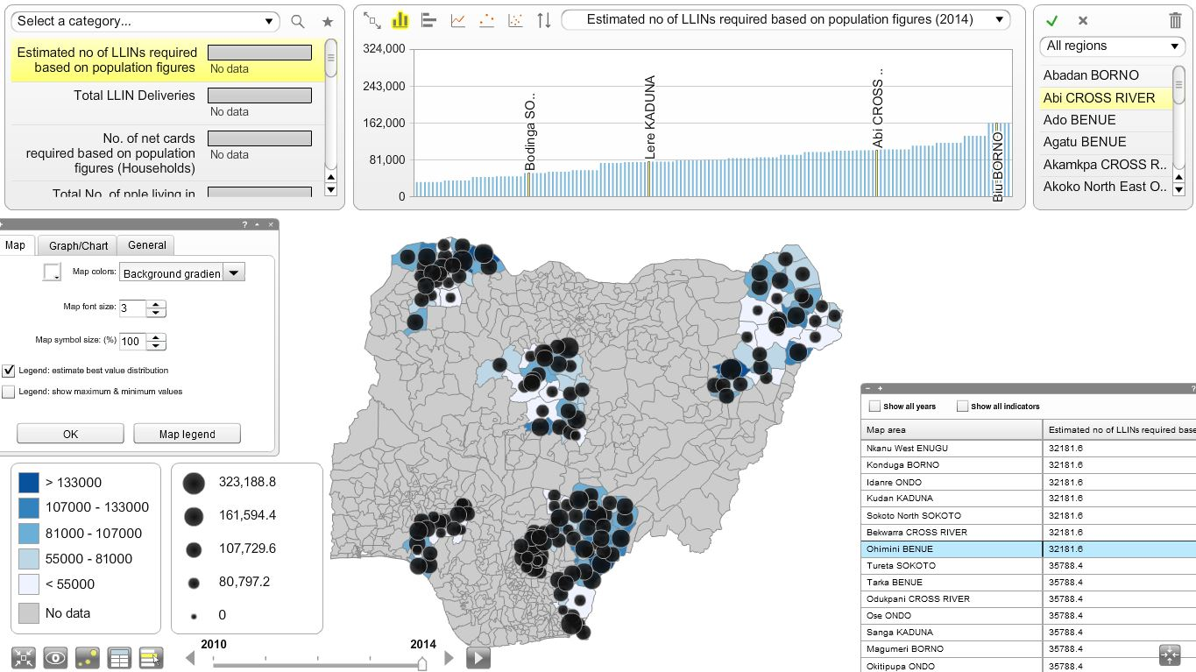
Graph Type Selection
Option/Symbology Panel
Data Table Panel
Proportional symbol map
Proportional symbol Legend
Notes:
StatPlanet User Guide: Chapter 3.1 Proportional Symbol Map; 3.2 Bookmark indicator; 3.3 Scatter plot (bubble chart)

Slide 5
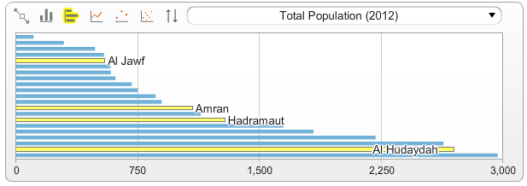
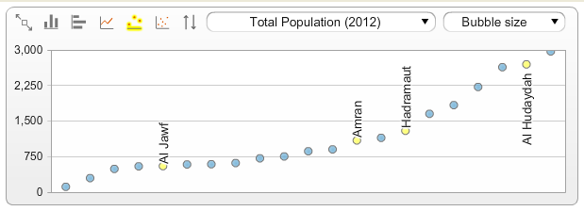
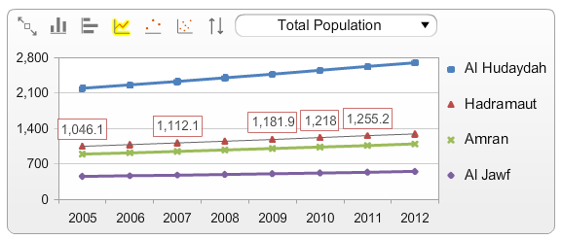
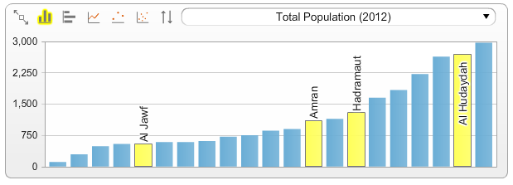
Graph Types
Column chart
Bar chart
Vertical bubble chart
Time series graph
Notes:
StatPlanet User Guide: 3.3 Graph Panel: Bar chart / Column chart, Time series, Vertical bubble chart.

Slide 6
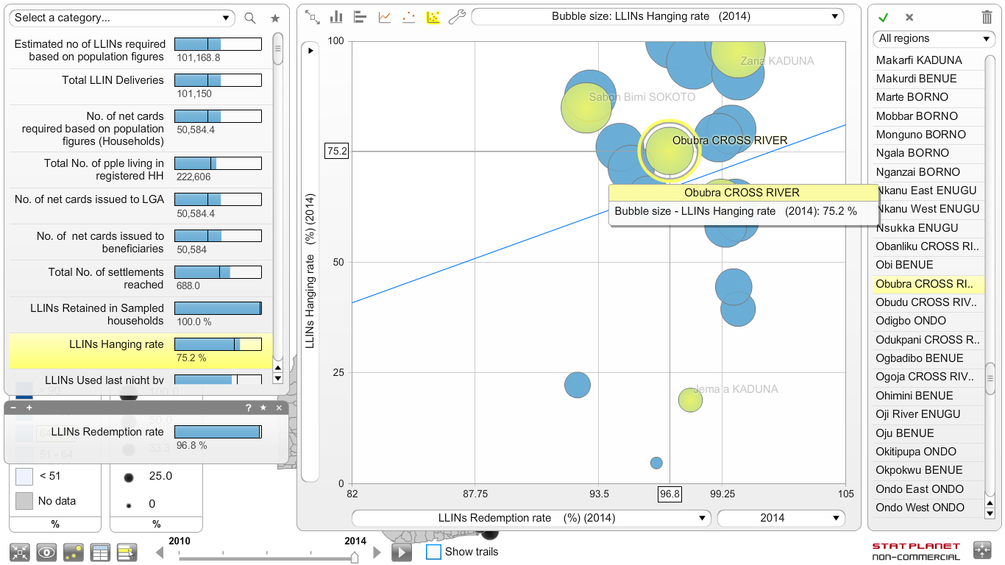
Bubble Chart
z-axis: symbol size
Y Axis selected
Region select
Time trails
Time choice
X Axis selected
Notes:
StatPlanet User Guide: 3.3 Graph Panel, 3.8 Time Slider

Slide 7
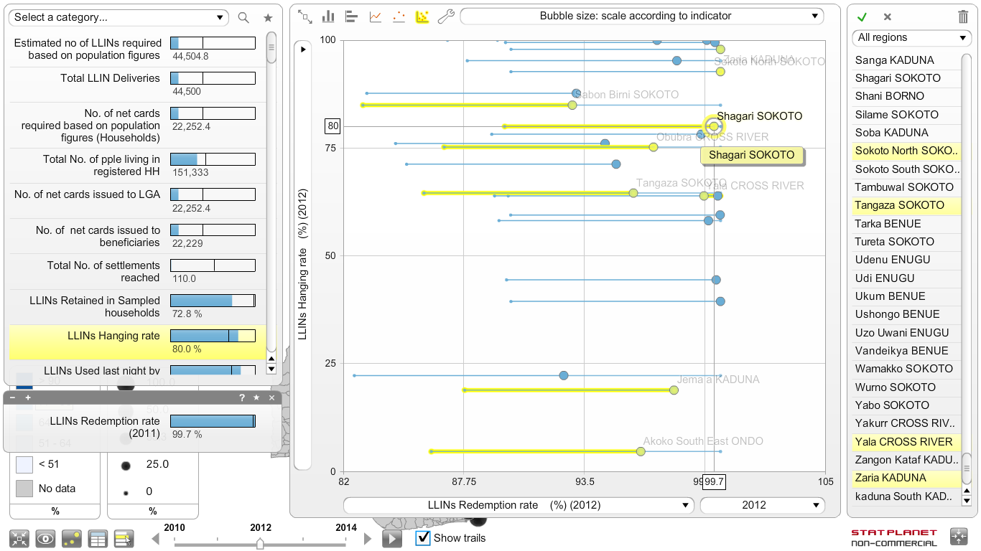
TIME TRAILS
Time trails 2011-2012
Time trails CHECKED
Time trails EFFECT from year to year

Slide 8

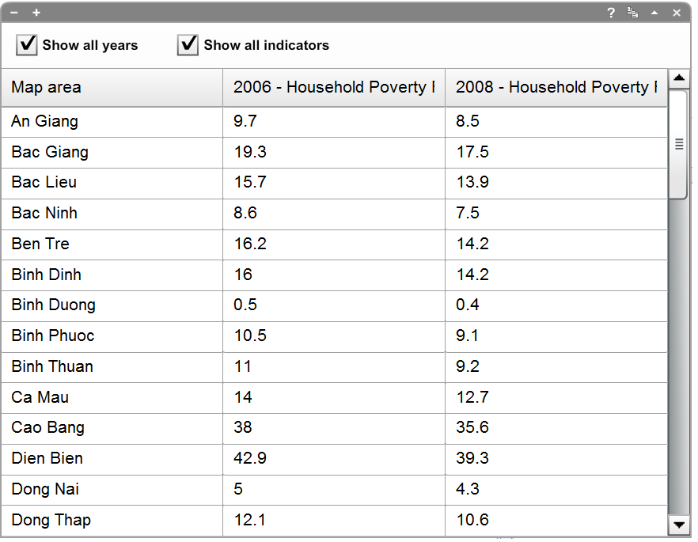
Displaying map data in a table
Click on column to sort
Option to show all years for multiple-period data
Option to show all indicators in category
Copy table to clipboard
Notes:
StatPlanet User Guide: 3.5 Data-table panel

Slide 9








Customisation Icons
Name | Purpose
Full-screen | Toggles full-screen mode on / off
View panel | Switch on a range of labels, panels and other display components
Proportional symbol map | Switches on the ‘bubble’ display of a second book-marked indicator
Options panel | Detailed custom options for maps, graph / chart , legend including main interface colours
Data-table panel | Shows a data table with main indicator & any book-marked indicators.
Selection panel | Toggles region selection panel on / off
Save / Export | Only available in the web-version. Permits export / saving of data, map & graphs
Link | Copy and share a link to the current indicator
Notes:
StatPlanet User Guide Chapter 3

Slide 10
Custom Regions
Custom regions can be defined so that groups or clusters of locations can be selected as one from the Region Selection Panel
Allows user to focus on a particular sub-set of the total map, reducing the amount displayed in graphs
Notes:
StatPlanet User Guide Chapter 6.4

Slide 11







Create a Temporary Custom Region
Icon | Purpose
Select regions | Select a map region selection or select a custom region Use shift-click to combine multiple custom regions
Select | Press the Select button to reduce the list to your selection. Any items which are not selected will be removed from view.
Deselect all | Press the Deselect All button to clear your selection.
Refresh | The Refresh button appears once you have created a custom region or group of items. It can be used to return to the original list.
Remove | To remove items from the list, select those you wish to remove and press the Remove button.
Show panel | If your selection panel is missing, select this button from the bottom left corner of the screen
Notes:
StatPlanet User Guide Chapter 3.6 (selection panel)

Slide 12
End-User Customisations
The application interface provides many options for the end-user to make changes to the display, appearance & behaviour of almost every visible element in the program.
These customisations are temporary and do not persist from use to use.
In a later session, we will practice on how to use this application.

Slide 13
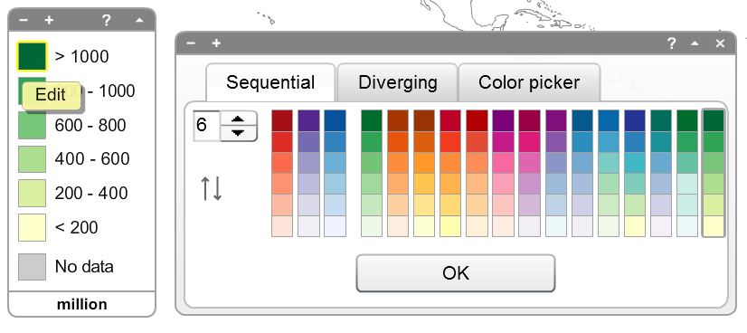
Legend Customisation

Slide 14
Practical session kindly download the videos on the site!

