Slide 1
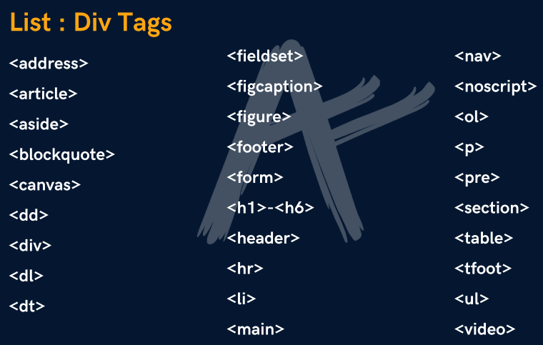


Block and Inline Elements
DIV TAG:
Div is a container used for other HTML elements
Block Element are takes full width(100%)

Slide 2
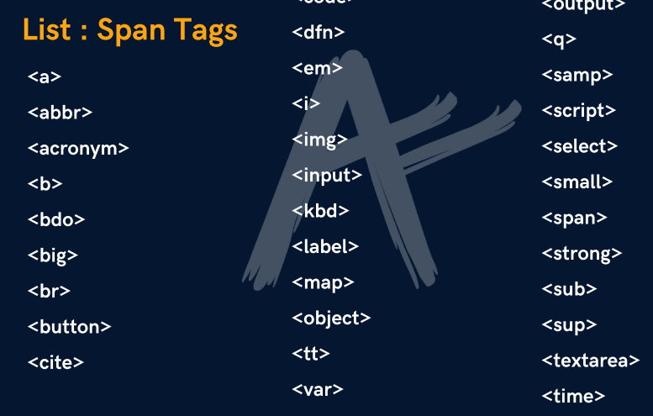
SPAN TAG:
Span is also a container for other HTML elements
Inline Elements takes width as per size

Slide 3
HTML Forms
HTML Forms are required when you want to collect some data from the site visitor.
For example during user registration you would like to collect information such as name, email address, credit card, etc.
Forms are used to pass data to a server.
The input tag <input> is use to take input from user.
There are many types of input.
Like if we want to confirm gender from user we will use radio button.
Below are the list of all types of input.
  Text, password, radio, checkbox, file, number, email, date, button, reset, submit, textarea, select, fieldset, legend, color, url, range, time etc.
The HTML <form> tag is used to create an HTML form.

Slide 4
HTML Forms(required)
Text
  <input type=“text” > value = “The Mentors Pakistan”
    autocomplete =“on”, “off” readonly = true / false
    Autofocus = true, false placeholder=“Text”
    Required *
    Disabled = true / false
    size=“20“ pattern="[A-Za-z]{3}
        pattern= “.{6,}”
Password
  <input type=“password”>
radio
  Gender:<input type=“radio”> checked = true / false
checkbox
  Languages:<input type=“checkbox”>
    Checked = true /false
file
  <input type=“file”>
    accept = audio/*, video/*, image/*
    Multiple = true / false
Web Programming By Muhammad Shafiq

Slide 5
HTML Forms(attributes)
number
  Age:<input type=“number”>
    min="1“, max="5“ step="3"
email
  <input type=“email”>
date
  <input type=“date”>
    max=“year-month-day“ , min="2002-05-08"
button
  <input type=“button”>
reset
  <input type=“reset”>
Web Programming By Muhammad Shafiq

Slide 6
HTML Forms(attributes)
submit
  <input type=“submit”>
Textarea
  <textarea>Text</ textarea >
    Cols=“10” row=“10”
    Placeholder = “text”
select
    <select>
    <option>item1</option>
    <option>item2</option>
    </select>
Web Programming By Muhammad Shafiq

Slide 7
HTML Forms(attributes)
Fieldset and legend
    < Fieldset>
    <legend>text</legend>
    <input type=“Text”>
    </ Fieldset>
    Align = left, right , center
color
  <input type=“color”>
url
    <input type=“url”>
Web Programming By Muhammad Shafiq

Slide 8
HTML Forms(attributes)
Range
    <input type=“range”>
      min="1“, max=“10“, step = “5”
time
  <input type=“time”>
Datalist
    <input type=“text” list="list1" >
    <datalist id=“list1">
      <option label=“test" value=“text1" />
      <option label=“test" value=“text2" />
    </datalist>

