Slide 1

CreditConnect
Prototype Banking Application

Slide 2
Agenda
Team Introduction
Challanges Faced
Project Objectives
App Demo
Tech Stack
QnA
Agile/Sprint Process

Slide 3
Team Introduction
Backend
Frontend
Full Stack
Hangwei
Harris
Azamat
Kiki
Iffah
Hakim
Justin
Wei Jie

Slide 4
Project Objectives
Build a prototype web site
Using Scrum for project management
Emphasize collaboration, adaptability, delivering value
Break down the development into Small tasks as user stories
With Reactjs for frontend
With Java Spring Boot for server
Notes:
Our goal is to develop an all-in-one solution for an online banking website that is specifically for managing bank accounts and credit cards, providing a simplified approach to financial management. Our aim is to create a user-friendly platform that can be accessed and utilized by individuals from all backgrounds.
To achieve our goals, we have decided to adopt the Scrum methodology as our project management framework. Scrum is an approach that emphasizes collaboration, adaptability, and delivering value to customers through shorter development cycles. By embracing Scrum, we were able to break down the development process into smaller, manageable tasks known as user stories. These user stories represent specific features or functionalities that our online banking website should include.
For our banking system, we have used React.js for the frontend and Java Spring Boot for the server, and will talk about the technology in details later.

Slide 5
Project Objectives
Core Features
User Mangement
Bank Account Operations
Registration
Login + Logout
Withdraw
Deposit
Transfer
View Transaction History
Apply for credit card
Dashboard
Bank Account
Credit Cards
Notes:
Regarding the core features of our website, users have the ability to register for new accounts and safely log in and log out with basic authentication. Once logged in, there is a dashboard for user bank account and credit cards. Users can navigate through the website and perform deposit and withdrawal operations on their accounts, which emulates the operations performed by ATM machines. Apart from that, users can also initiate transfers from their accounts to other bank accounts and conveniently review their transaction history in a table format. Moreover, we offer the option for users to apply for credit cards if they wish to make purchases with credit cards.

Slide 6
Project Objectives
Core Features
Credit Card Operations
Additional Credit Card Operations
Check balance and available limit
Purchases with specific credit card
Cashback
View Transaction History with Filter
Monthly bill generation for credit card
Late payment fees and interest charges after 25 days of bill generation
Bill Payment
Deduct cashback automatically from bills at the beginning of each month
Notes:
Our system offers a range of credit card operations to enhance the financial management experience for our users. With just a few clicks, users can effortlessly check their credit card balance and available limit, ensuring they have a clear understanding of their current financial standing. When it comes to making purchases, our system enables users to conveniently select their credit card to complete transactions. After making the transactions, they have the opportunity to earn cashback based on the merchant category codes. Also, our system allows users to easily view their transaction history with filter by period, providing a detailed record of all credit card activities.
Our credit card operations also include some advanced features designed to streamline the user experience. One such feature is our monthly bill generation process, allowing users to easily access and review their monthly credit card bills at the end of each month. To avoid late payment fees and interest charges, users are required to settle their bills within 25 days. This is where our system offers bill payment, allowing users to conveniently settle their credit card bills. Moreover, our system automatically deducts cashback from the bills at the beginning of each month, to provide users with the benefits they have earned.
So, these are the objectives that we aim to achieve.

Slide 7
Tech Stack
Version Control – Git​
Database – MySQL​
Frontend – React, HTML, CSS​
Testing – Postman​
Bootstrap CSS
Documentation - Swagger​
Backend – Java​
Spring Boot Framework
Log4j2

Slide 8
Frontend
REACT
Development of dynamic and responsive user interfaces
Via components
Seamless integration with backend
Via State Management
Communications with backend services
Via API

Slide 9
Backend
Authentication
Spring Security configured for basic authentication.
@AuthenticationPrincipal
Accessing authenticated user details
Secure access
Allowing only account owner to retrieve confidential data

Slide 10
Backend
Database Connectivity
Spring Data JPA
Simplified repository implementation
Seamless data access
Enhance application functionality
Postman Integration
Included Postman request collection JSON
Adhere to best practices
Regularly updated for accurate testing

Slide 11
Backend
Scheduling Task
Cron Jobs
Automated process for both monthly bill generation and late payment charges.

Slide 12
Agile/Sprint Process
Initial planning of product backlog​
Velocity estimation​
Sprint 1,2,3 backlog and results
Notes:
Sprint #: 4 (monday – wednesday, thursday – friday for 2 weeks)
Estimated Velocity:
Use one user story as an example: prioritize, acceptance criteria, technical tasks needed, assign story points
Onwards changes (integration , …)

Slide 13
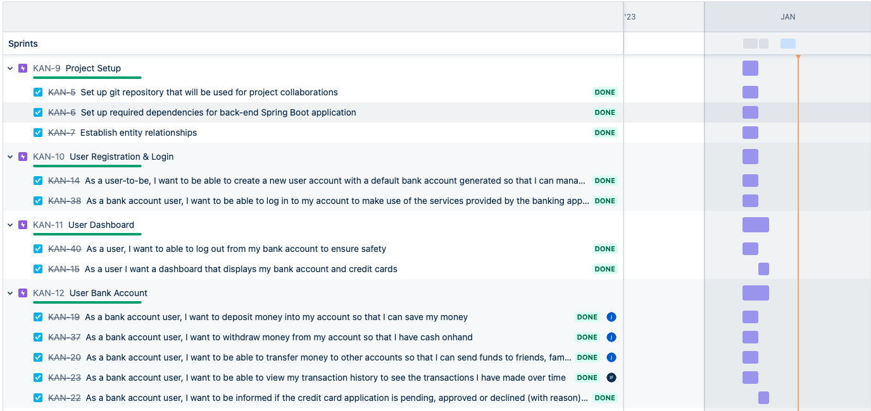
Agile/Sprint Process (cont'd)
Initial planning of product backlog​
Notes:
Sprint #: 4 (monday – wednesday, thursday – friday for 2 weeks)
Estimated Velocity:
Use one user story as an example: prioritize, acceptance criteria, technical tasks needed, assign story points
Onwards changes (integration , …)

Slide 14
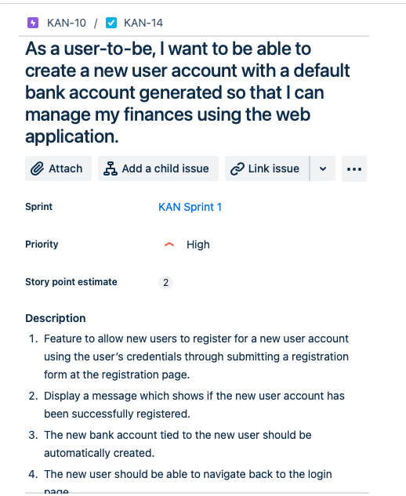
Agile/Sprint Process (cont'd)
Example of User story and its acceptance criteria​
Story point estimation was done by common decision (without Poker Planning)​
Hard/Long tasks were usually 3 story points
Easy tasks were 1 point​
In total 3 sprints were completed​
Several backlog items were not completed
Notes:
Sprint #: 4 (monday – wednesday, thursday – friday for 2 weeks)
Estimated Velocity:
Use one user story as an example: prioritize, acceptance criteria, technical tasks needed, assign story points
Onwards changes (integration , …)

Slide 15
Agile/Sprint Process (cont'd)
Stand-up meeting at 9:30am every day
Retrospective right after review
What we did yesterday
What we are going to do today
Ask for help/ advice
Discuss room for improvement regarding interactions and processes
e.g. git usage
Review in the afternoon at the end of each sprint​
Communication within the offshore team
Mark those finished as "completed”
Assess any unfinished user story and potentially create a new backlog item
e.g. Authentication System and API calls in frontend
Rapid updates lead to transparency
Readily available to receive and make calls at anytime
Notes:
"ensure that unfinished work is properly addressed"

Slide 16
Challenges Faced
Version Control
Lack of experience using git
Merge conflicts
Incomplete version history
Participation
Reluctance to speak up
Feedback avoidance
Notes:
Version Control
Lack of experience using git Merge conflicts
Incompletely version history
Communication
Reluctance to speak up
Feedback avoidance

Slide 17
Challenges Faced
Planning
Overlooked some requirements
Tasks splitting inefficient
Code quality/consistency
Styling
Duplication
Logging
Notes:
Planning
Not all project tasks was originally in our sprint planning, e.g. logging. Finished all other tasks in time and manage to finish the missing ones.
At first, majority working on frontend, velocity decreases, backend not enough devs working on, frontend too many devs working on lead to doing the same task => In sprint 2, putting more team members working in backend
Code quality/consistency
Design structure of frontend, everybody has different design styles, turns out different pages looks completely different => Discussed in sprint review to follow which design structure
Less efficient code, shared components, css lead to duplication of code => At the end have time to clean up the code
Logging different styles of message due to different team member working on it ==> Solved by discussing how the logging standard should be

Slide 18
App Demo

