Slide 1


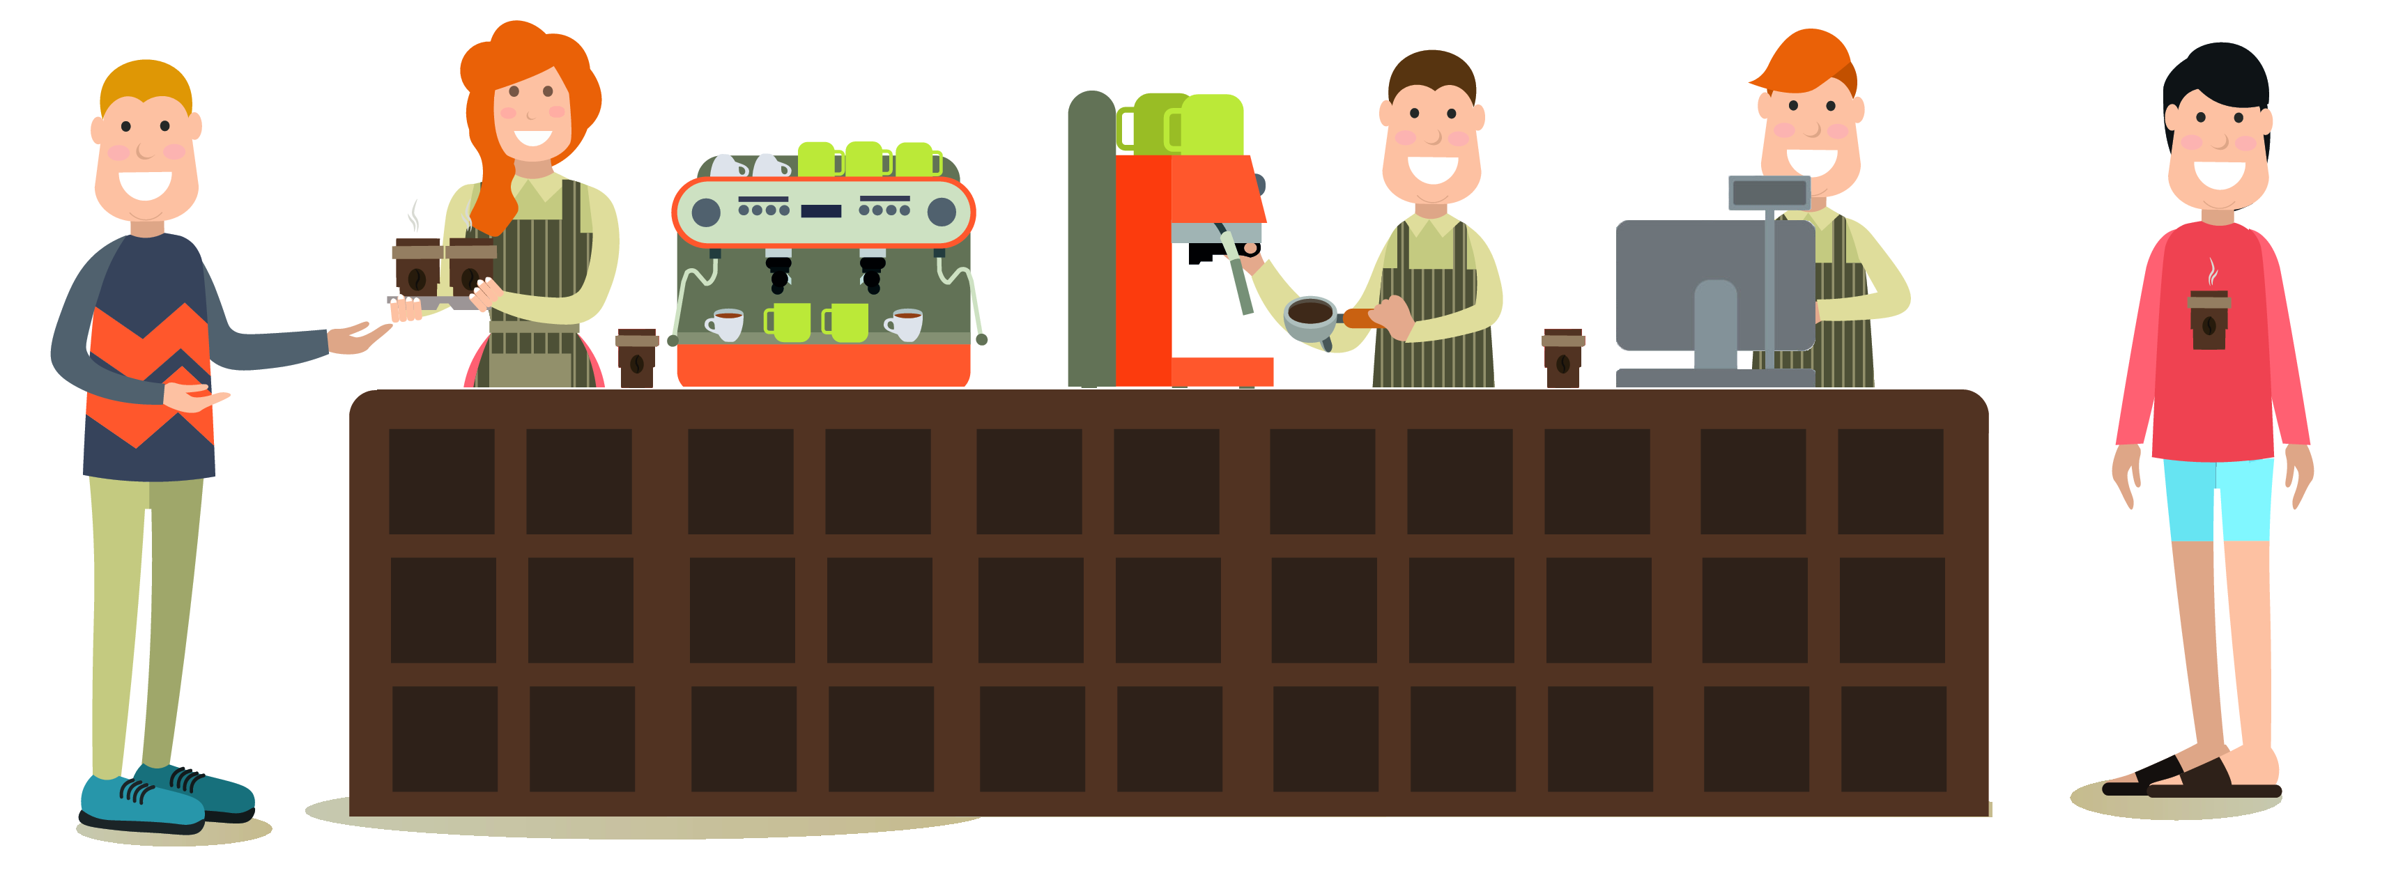
Microservices Café
4
3
2
1

Slide 2
Microservices Café
Dispatcher
Service
Barista
Service
Cashier
Service
Completed Queue
Pending Queue
5
4
3
2
1

Slide 3
Microservices Café
Dispatcher
Service
Barista
Service
Cashier
Service
Completed Queue
Pending Queue
5
4
3
2
1

Slide 4
Dispatcher
Service
Barista
Service
Cashier
Service
Completed Queue
Pending Queue
5
4
3
2
1

