Slide 1


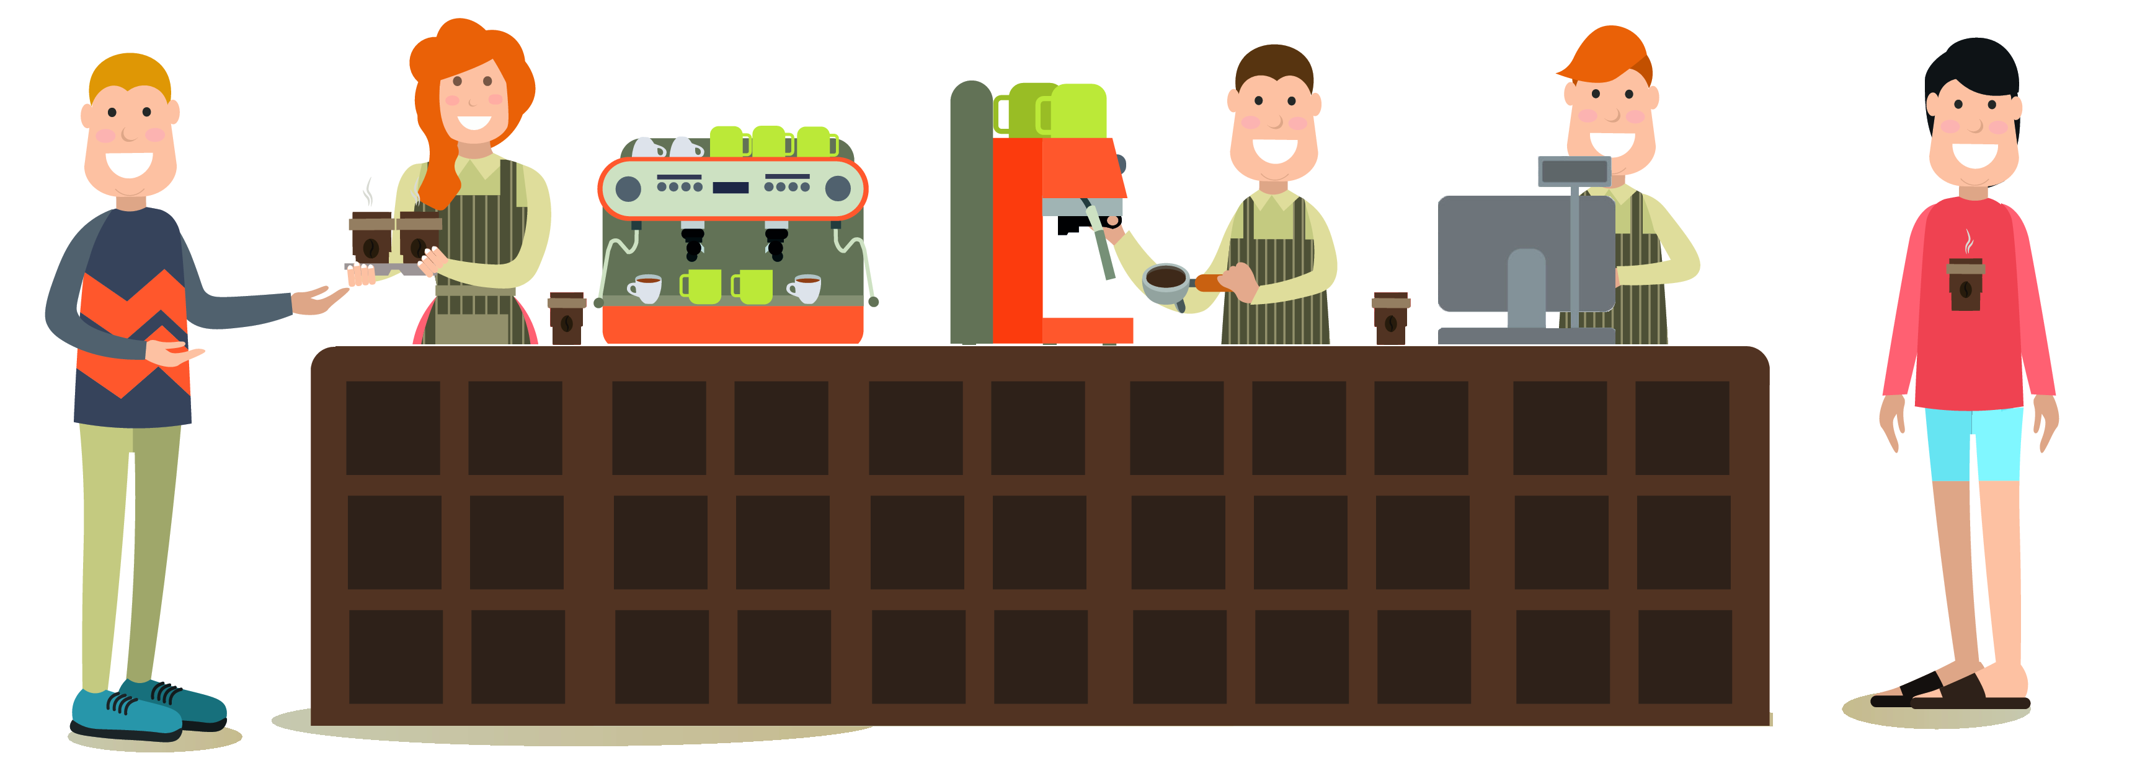
Microservices Café
4
3
2
1

Slide 2
Microservices Café
Dispatcher
Service
Barista
Service
Cashier
Service
Completed Queue
Pending Queue
5
4
3
2
1

Slide 3



Microservices Café Architecture
Dispatcher
Service
Barista
Service
Cashier
Service
Completed Queue
Pending Queue
Order
Client
Order
FrontEnd

Slide 4
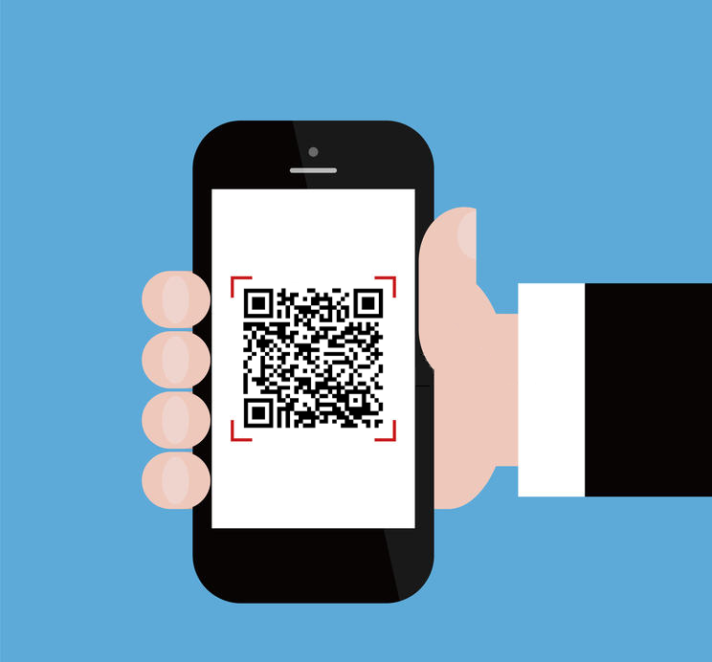
Microservices Café Demo
Hands On Lab:
http://aka.ms/microservices-cafe

