Slide 1
MCP Pulse for Auto Insurance
Streaming Claims Context
to AI Agents
Real-time FNOL, fraud & platform-incident intelligence with Kafka, WebSockets, Cedar & LLMs
github.com/hakohli/mcp-pulse · branch: usecase/auto-insurance
Notes:
Auto-insurance edition: the same streaming-MCP pattern, applied to an insurer's claims and telematics platform. All data in the demo is synthetic.

Slide 2
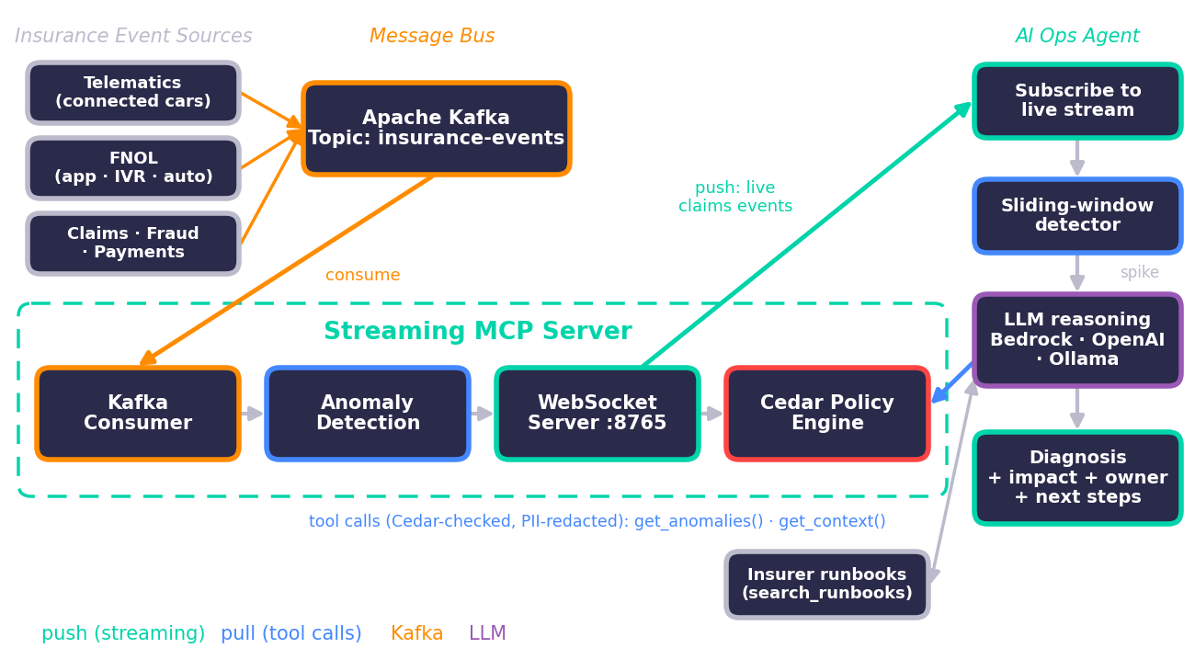
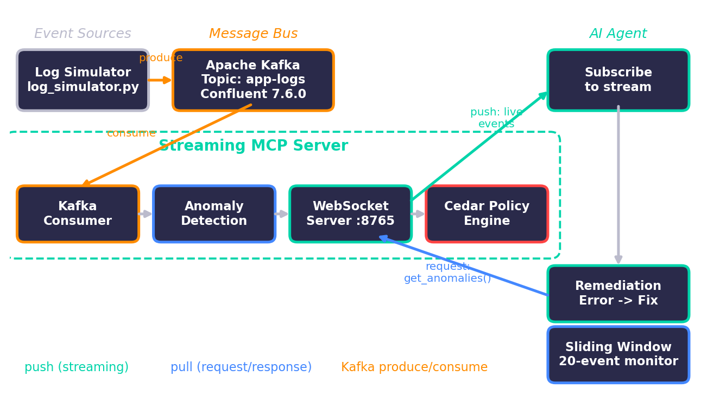
System Architecture — Claims & Telematics Platform
Notes:
Eight insurance services publish to the insurance-events topic. The MCP server pushes events to the AI ops agent; on a spike the LLM calls back through Cedar-checked, PII-redacted tools and consults the insurer's runbooks.

Slide 3
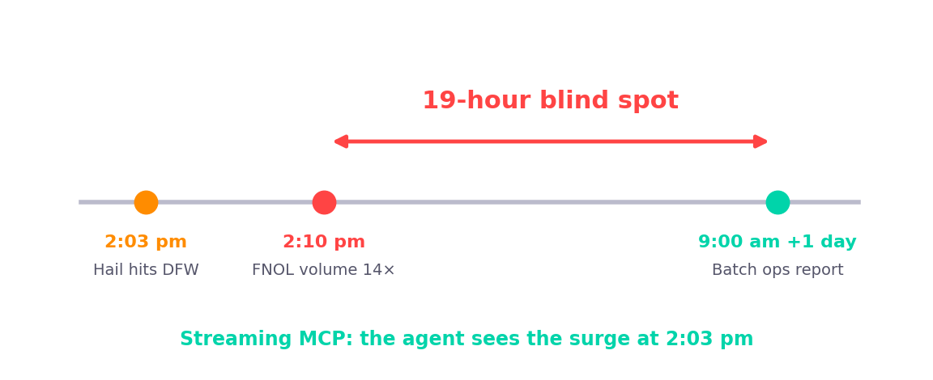
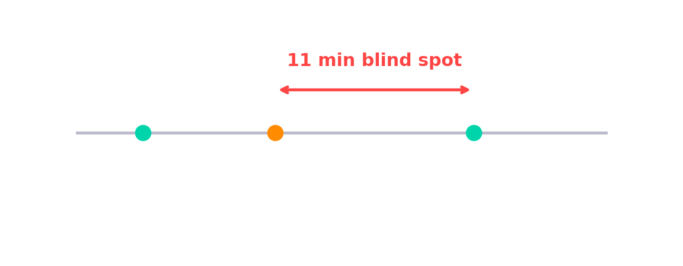
The Stale Context Problem in Claims
Claims & telematics platforms are still watched through dashboards and batch reports
2:03 pm hail hits DFW → 2:10 pm FNOL volume 14× → next-morning ops report
Payout failures and fraud rings often surface days later, in reconciliation
What if claims context came TO the agent, as it happened?
Notes:
TALKING POINTS:
- Today MCP works like a snapshot camera — the agent asks, gets a point-in-time answer, moves on.
- Real scenario: deploy at 2:03pm, errors spike at 2:04pm, agent doesn't know until 2:15pm. That's an 11-minute blind spot.
- The timeline diagram shows the red gap — the danger zone.
- In incident response, trading, security — 11 minutes is an eternity.
- Can we flip the model so context flows TO the agent continuously?

Slide 4
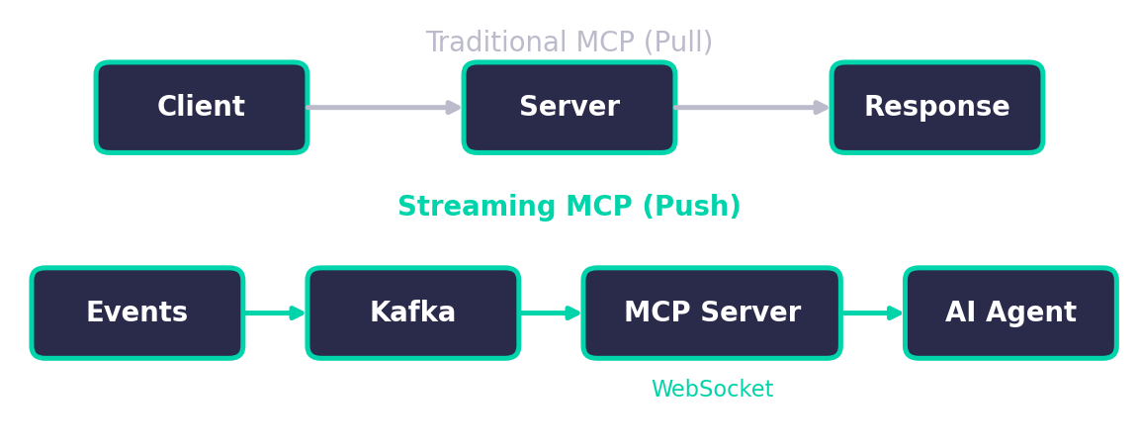
Streaming MCP for Insurers
Standard MCP: agent pulls claim / telematics snapshots (pull)
Streaming MCP: FNOL, telematics, fraud and payout events pushed as they happen
Why Kafka: durable and replayable — already the backbone of many telematics pipelines
Hybrid: live push + on-demand queries on one connection
Notes:
TALKING POINTS:
- Top row: traditional pull-based MCP. Bottom row: what we're building.
- Event sources feed Kafka, Kafka feeds the MCP server, server pushes to agents over WebSockets.
- Why Kafka? (1) Durability — events persisted for replay. (2) Backpressure — handles slow consumers. (3) Already in your infra.
- Key insight: hybrid protocol — streaming AND request/response on the same WebSocket. Zero changes to existing MCP tools.

Slide 5
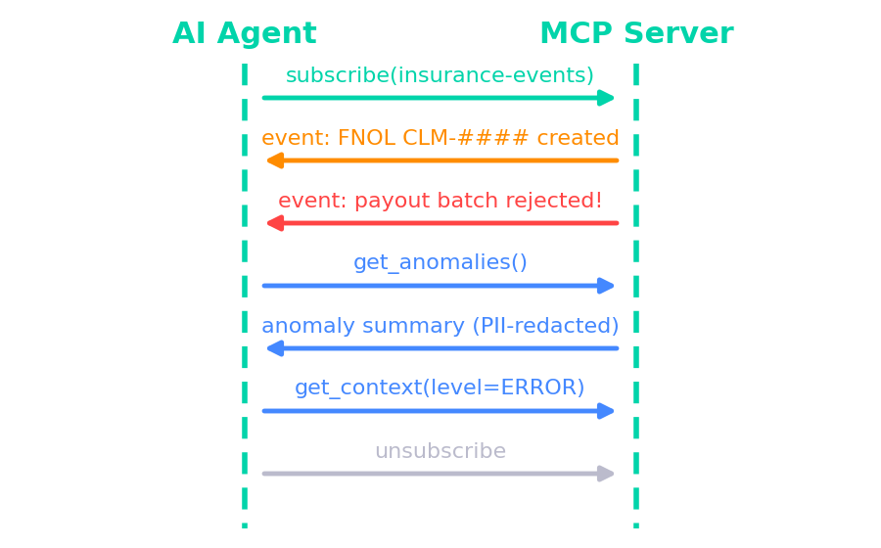
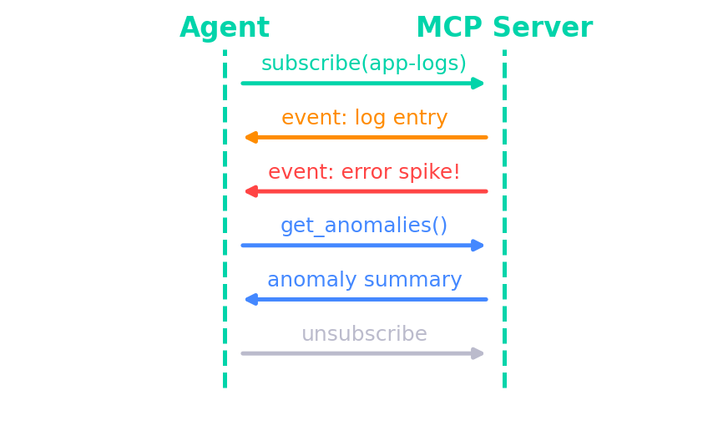
Key Protocol Extension: subscribe
subscribe / unsubscribe to the insurance-events stream for continuous push
get_anomalies, get_context answer the LLM's tool calls mid-stream
Every tool result is PII-redacted before it reaches the model
Bounded queues (500 events) absorb CAT-surge backpressure
Notes:
TALKING POINTS:
- Minimal extension — just two new methods: subscribe and unsubscribe.
- Sequence: Agent sends subscribe('app-logs'). Events flow continuously. Error spike arrives immediately.
- Mid-stream, agent sends get_anomalies() — hybrid protocol in action.
- Backpressure: 500-event bounded queue per subscriber. Slow consumers get oldest events dropped.
- Dead subscribers auto-cleaned — no resource leaks.

Slide 6
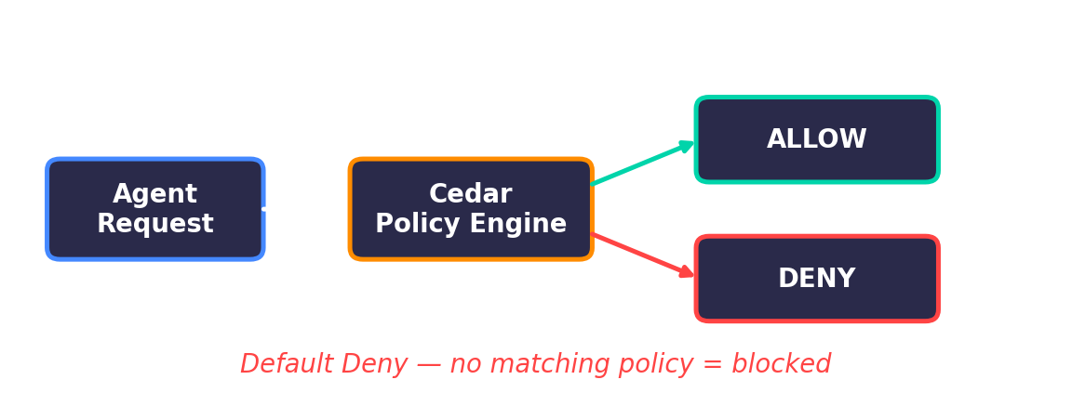
Cedar Authorization for Insurance Roles
Open-source policy language by AWS: permit / forbid(principal, action, resource)
ai-agent: anomaly summaries + redacted event context
claims-ops: summaries · siu-analyst: full event context
ai-agent is forbidden from the raw claimant-PII stream
Default deny — and forbid always wins
Notes:
TALKING POINTS:
- Streaming data to agents raises the question: who's allowed to see what?
- Cedar is open-source, now adopted in MCP ecosystem (Bedrock AgentCore, ToolHive).
- Simple model: permit/forbid(principal, action, resource).
- MCP actions: subscribe, get_anomalies, get_context, call_tool. Resources: streams like 'app-logs'.
- Default deny — no matching policy = blocked. Secure by default.

Slide 7
Cedar Policy Examples
permit(principal, action == Action::"subscribe", resource == Stream::"insurance-events");
permit(principal, action == Action::"get_context", resource)
when { principal.role == "siu-analyst" };
permit(principal, action == Action::"get_anomalies", resource)
when { principal.role == "claims-ops" };
forbid(principal, action == Action::"subscribe", resource == Stream::"claimant-pii")
when { principal.role == "ai-agent" };
Forbid always wins — the AI agent can never read raw claimant PII
Notes:
TALKING POINTS:
- Real Cedar policies from our demo.
- First: anyone can subscribe to app-logs (general observability).
- Second: only ops-agents can call get_anomalies (expensive operation).
- Third: readonly agents explicitly forbidden from audit-logs (compliance data).
- Forbid ALWAYS wins over permit. Human-readable, auditable, version-controllable.

Slide 8
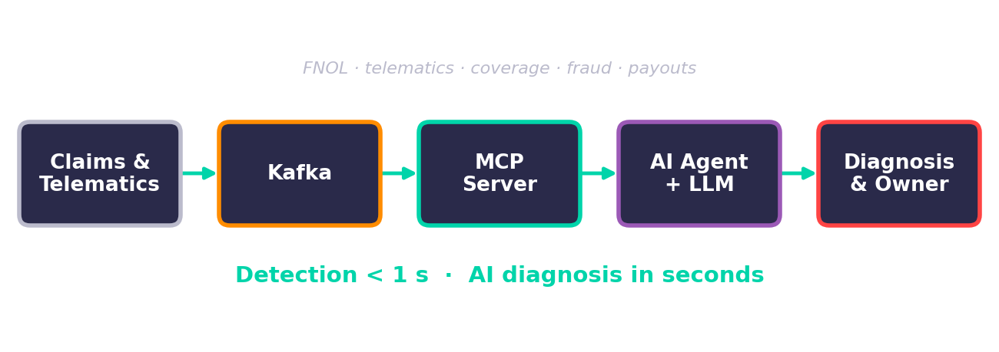
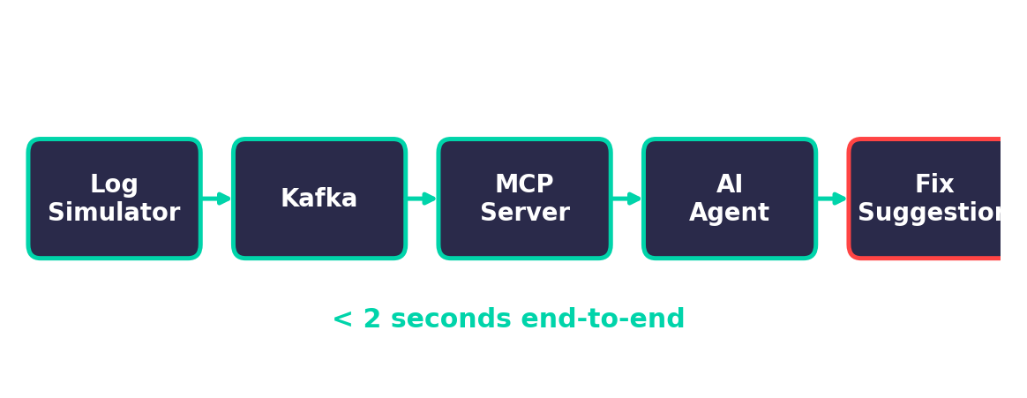
Live Demo: Real-time Claims & Telematics Monitoring
Simulated claims & telematics platform → Kafka → MCP server → AI agent
7 incidents: outages, vendor failure, bad deploy, CAT surge, fraud ring
Spike detected in < 1 s; the LLM diagnoses in seconds
Output: root cause, business impact, owner, next steps
Try it: make demo · --scenario staged_accident_ring
Notes:
TALKING POINTS:
- Stack: Confluent Kafka 7.6.0 in Docker, Python 3.9, confluent-kafka 2.13.2, websockets 15.0.1.
- Log simulator generates realistic logs, pushes to Kafka. MCP server consumes and pushes to agents.
- Normal traffic flows first. Then error spike hits.
- Agent detected 'ANOMALY DETECTED — error rate 60% in last 20 events' within 1 second.
- Automatic fixes: ConnectionRefused → check service; OOM → increase heap; Timeout → circuit breaker.
- End-to-end: error to fix suggestion under 2 seconds.

Slide 9
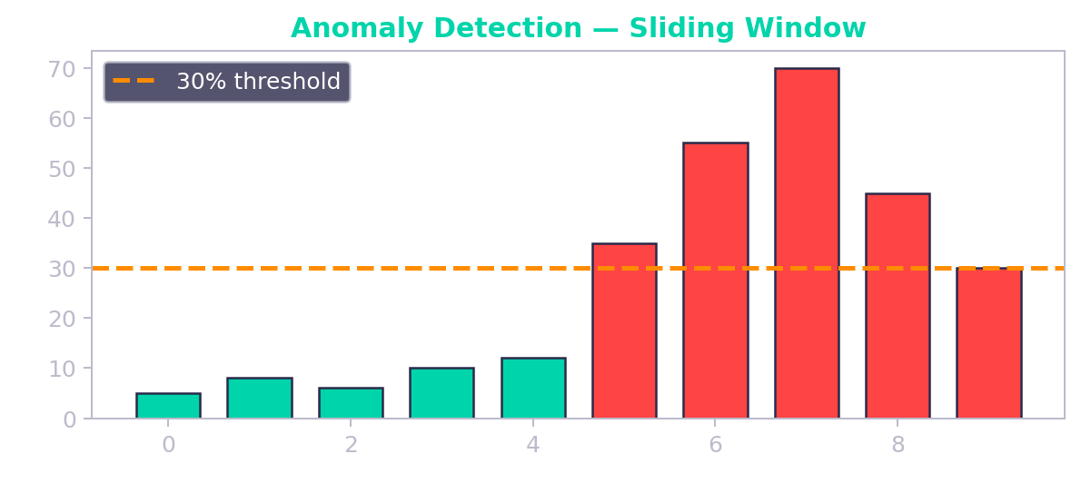
Anomaly Detection → AI Diagnosis
Server keeps a rolling 100-event window; IDs are normalized so errors group
Agent's 20-event window: > 30% errors triggers the LLM
Cooldown caps LLM calls — cost stays flat even during a CAT surge
LLM pulls context + runbooks, then recommends; humans decide
Notes:
TALKING POINTS:
- Server-side: rolling 100-event window for stable baseline.
- Agent-side: sliding 20-event window, 30% threshold triggers alert.
- Bar chart: green = normal, red = above threshold, orange line = trigger.
- Agent calls get_anomalies() for structured summary with top-N error patterns.
- Error → remediation mapping: ConnectionRefused → check connectivity; OOM → increase heap; SSL → renew certs.
- All within 1-2 seconds. Compare to the 11-minute blind spot.

Slide 10
Auto Insurance Use Cases
Use case | Streaming signal | What the AI agent does | Owner
Crash-triggered FNOL | Telematics impact events | Detects stalled auto-FNOL; routes crash alerts to manual intake | Claims ops · SRE
Catastrophe response | FNOL volume by region | Spots the surge at onset; recommends activating the CAT plan | CAT team
Fraud / SIU triage | Fraud scores, link analysis | Summarizes ring signals; recommends SIU referral (never auto-deny) | SIU
Claims cycle time | Estimate & vendor calls | Catches vendor / estimate failures before backlogs build | Vendor mgmt
Payout reliability | Payment batches | Ties payout rejections to the deploy that caused them | Payments eng
UBI pricing integrity | Trip ingestion, rating | Flags telematics gaps before premiums use partial data | Data · SRE
Notes:
Each row is a stream the insurer already has. The agent's job is the same in every row: notice fast, explain the impact, route to the right owner, recommend steps.

Slide 11
Incident Scenarios in the Demo
Scenario | Type | Owner | First recommended step
Telematics ingestion outage starves crash detection | platform | Platform SRE on-call | Check broker health and partition leadership for telematics-raw topics
Policy database connection pool exhausted | platform | Platform SRE on-call | Identify long-running/leaked connections on policy-db-primary and kill them
Fraud-scoring model endpoint down | platform | ML platform / model owners | Restore fraud-model-v7 capacity or roll back to the last healthy model version
Photo-estimate vendor integration failing (expired certificate) | third-party | Vendor management + integration engineering | Contact the vendor to renew the certificate (or update the pinned certificate if it was rotated)
Claim payouts rejected after a payments deploy | platform | Payments engineering | Roll back payments-service to v3.13.x
Catastrophe surge: hailstorm FNOL volume | business | Catastrophe (CAT) response team | Activate the catastrophe (CAT) response plan for the affected region
Suspected staged-accident fraud ring | fraud | Special Investigations Unit | Refer the linked claims to SIU for investigation (a human decision — never auto-deny)
Generated from mcp_streaming/domain/auto_insurance.py · run one: python -m mcp_streaming.demo --scenario <key> · --ai lets the LLM invent new ones

Slide 12
AI Diagnosis — Example Output
SPIKE 35% errors in last 20 events -> LLM investigating...
+-- AI DIAGNOSIS ------------------------------------------------------------
| Severity HIGH (confidence 80%) [platform]
| Root cause payments-service v3.14.0 shipped an invalid bank originator configuration; the
| bank gateway rejects every ACH payout batch
| Impact Settled claims are not paid; customers wait for funds, raising complaint and
| prompt-payment compliance risk
| Owner Payments engineering
| Next steps
| 1. Roll back payments-service to v3.13.x
| 2. Fix and validate the originator configuration in staging before redeploying
| 3. Re-submit rejected payout batches and confirm with the bank gateway
| 4. Have claims ops notify affected claimants of the delay
| Recommendations only - claim, coverage and fraud decisions stay with people.
+-----------------------------------------------------------------------------
Illustrative output for the payout-rejection scenario. A real LLM writes its own analysis after calling get_anomalies, get_context and search_runbooks.

Slide 13
Why It Matters for Insurers
Faster first notice of loss and claim acknowledgement
Lower loss-adjustment expense: vendor and estimate failures caught early
Earlier fraud signals: less leakage, fewer false positives
CAT response triggered in minutes, not the next morning
Fewer delayed payouts and complaints
Who benefits
Claims operations
Special Investigations Unit (SIU)
Catastrophe response
Payments & platform engineering
Customer experience
Compliance & audit
Notes:
Qualitative benefits — measure your own baseline (time-to-detect, cycle time, LAE, leakage) before and after a pilot.

Slide 14
Governance, Privacy & Compliance
PII (email, phone, SSN, VIN, card) is redacted before any event reaches the LLM
Read-only agent: recommends; never approves or denies claims, changes coverage or accuses claimants
Cedar least-privilege roles; the AI agent is forbidden from the raw claimant-PII stream
Event content is treated as untrusted input (prompt-injection defense)
Model hosting fits your data boundary: Amazon Bedrock in-region, or self-hosted (Ollama / vLLM)
Production also needs: real authentication, audit logging, model-risk governance (e.g. the NAIC model bulletin on insurers' use of AI), state claim-handling and privacy rules — with your compliance team
This is a reference demo on synthetic data, not a production system

Slide 15
Production Patterns & Gotchas
1. Backpressure: bounded queues, drop slow subscribers
2. Hybrid protocol: streaming AND on-demand on the same WebSocket
3. Kafka consumer groups: same = load balance, different = fan-out
4. Reconnection: exponential backoff + context snapshot
5. Be selective: stream errors & anomalies, batch normal metrics
6. Redact PII before the LLM; keep the agent read-only
7. Separate technical faults from business anomalies — different owners
Notes:
TALKING POINTS:
- Backpressure: 500-event asyncio queue per subscriber. Full = drop oldest. Consider dead-letter topics.
- Hybrid protocol: don't force everything into one model. Subscribe for live feeds, query for summaries.
- Consumer groups: same group ID = load balance (one consumer per event). Different = fan-out (all get every event).
- Reconnection: exponential backoff to avoid thundering herd. Context snapshot on reconnect.
- Be selective: stream errors and anomalies. Batch normal INFO metrics. Don't flood the pipe.

Slide 16
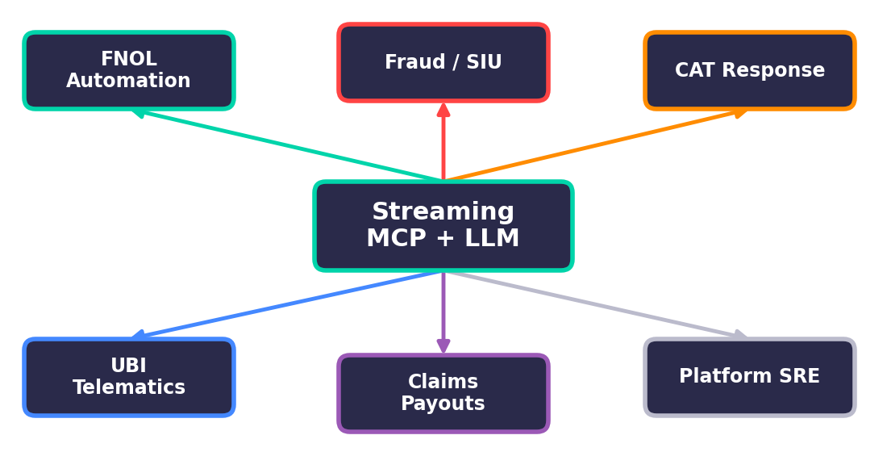
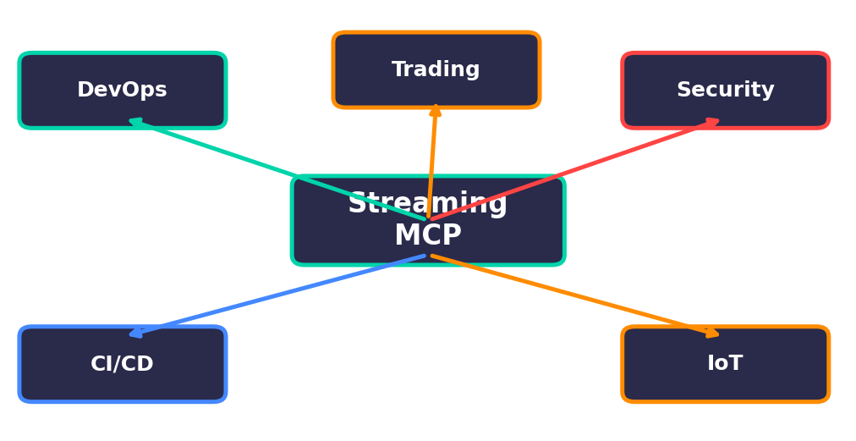
What Streaming MCP Unlocks for Auto Insurers
FNOL automation — crash events to claims in seconds
Fraud / SIU — ring signals surfaced as they form
CAT response — regional surges detected at onset
UBI telematics — data gaps flagged before pricing
Claims payouts — failures tied to their cause
Platform SRE — autonomous triage across 8 services
Notes:
TALKING POINTS:
- DevOps: what we demoed. Real-time incident detection, automated triage.
- Trading: live market data, latency matters, polling is not an option.
- Security: audit logs with Cedar access control. SOC agent gets alerts; readonly gets summaries.
- CI/CD: file watchers trigger agents on code changes. Auto-test, security check, update docs.
- IoT: sensor data to predictive maintenance. Detect anomalies before equipment fails.
- Common thread: any domain where waiting to be asked is too slow.

Slide 17
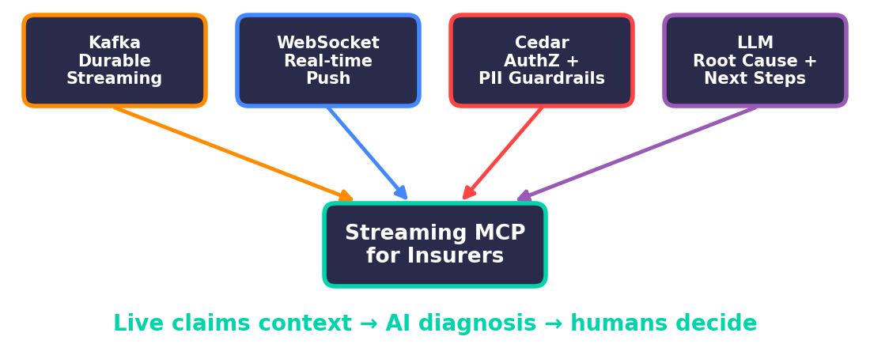
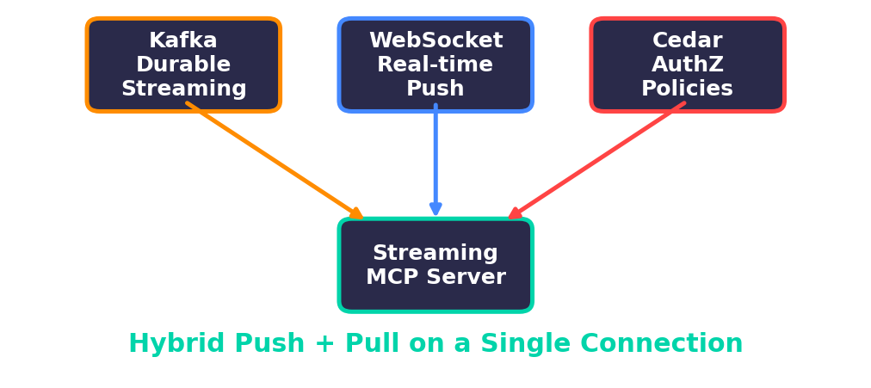
Key Takeaways
Claims context goes stale in minutes — stream it to the agent
Kafka + WebSocket: a durable, push-based bridge into MCP
LLM + runbooks: root cause, impact, owner and next steps in seconds
Cedar + PII redaction + read-only tools: governance by design
Open source, Python 3.9+, runs offline with make demo
Notes:
TALKING POINTS:
- MCP is extensible beyond request/response. Streaming is a natural extension.
- Kafka + WebSocket: battle-tested, widely deployed, well-understood.
- Cedar: declarative, auditable policies. Default deny = start secure, open up explicitly.
- Hybrid push + pull on one connection is the key design decision.
- The diagram shows Kafka + WebSocket + Cedar converging into the streaming MCP server.

Slide 18
Thank You & Q&A
github.com/hakohli/mcp-pulse · branch: usecase/auto-insurance
Synthetic data only · Kafka · Cedar · WebSockets · LLMs
Notes:
TALKING POINTS:
- Complete working code on GitHub: github.com/hakohli/mcp-streaming-demo
- Stack: Confluent Kafka 7.6.0, Cedar, WebSockets 15.0.1, Python 3.9+.
- To run: docker compose up -d, then streaming_mcp_server.py, log_simulator.py, agent_client.py.
- Happy to take questions on architecture, Cedar policies, Kafka integration.
- Interested in contributing? SSE transport, multi-topic subscriptions, persistent agent state — let's talk.

