Slide 1
MCP Live:
Streaming Context to AI Agents
Building Reactive MCP Servers with Kafka, WebSockets & Cedar
github.com/hakohli/mcp-streaming-demo
Notes:
TALKING POINTS:
- Welcome everyone. Today we're extending MCP beyond request/response.
- Core idea: what if MCP servers pushed real-time context to AI agents instead of waiting to be asked?
- We'll walk through a working implementation using Kafka, WebSockets, and Cedar.
- By the end, you'll see a live demo of an AI agent detecting a production incident in under 2 seconds.
- Everything is open source and available in the repo.

Slide 2
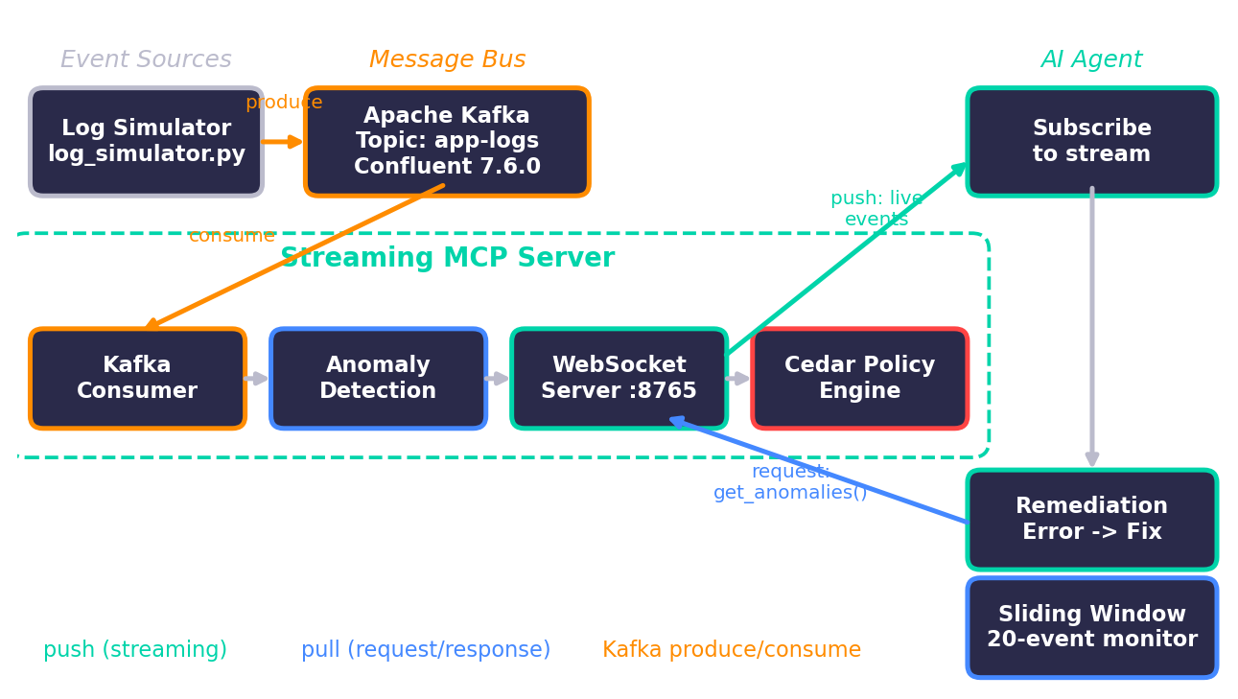
System Architecture
Notes:
TALKING POINTS:
- This is the full system architecture. Let me walk through each component.
- Left: Log Simulator generates realistic logs from five services. Every ~30s it triggers an error spike.
- Center-left: Apache Kafka (Confluent 7.6.0, KRaft mode) provides durability, replayability, and decoupling.
- Center: The Streaming MCP Server has four sub-components: Kafka Consumer (rolling 100-event window), Anomaly Detection (error pattern tracking), WebSocket Server on port 8765 (pushes to subscribers with 500-event bounded queues), and Cedar Policy Engine (permit/forbid on every action, default deny).
- Right: AI Agent subscribes once, runs a 20-event sliding window, flags anomalies at >30% error rate, and maps errors to fix suggestions.
- Two arrow colors: teal = streaming push, blue = request/response pull. Both coexist on the same WebSocket.

Slide 3
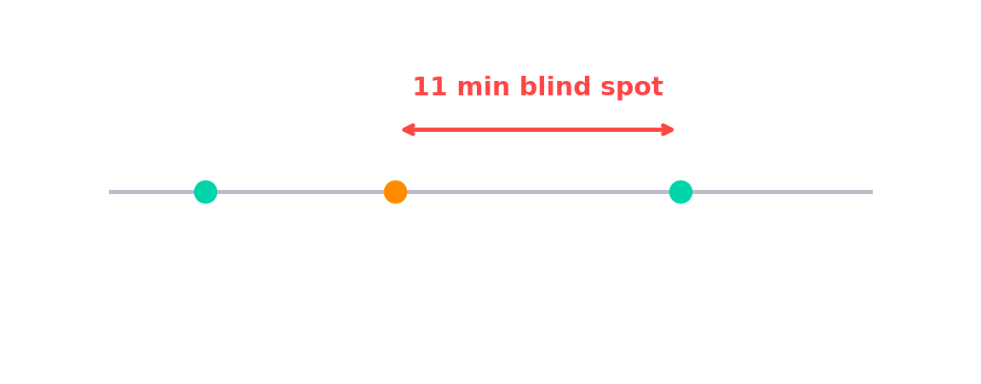
The Stale Context Problem
Traditional MCP = request/response snapshots
Agent asks for logs → gets point-in-time dump → stale data
Deploy at 2:03pm, errors at 2:04pm, agent polls at 2:15pm
What if context came TO the agent, as it happened?
Notes:
TALKING POINTS:
- Today MCP works like a snapshot camera — the agent asks, gets a point-in-time answer, moves on.
- Real scenario: deploy at 2:03pm, errors spike at 2:04pm, agent doesn't know until 2:15pm. That's an 11-minute blind spot.
- The timeline diagram shows the red gap — the danger zone.
- In incident response, trading, security — 11 minutes is an eternity.
- Can we flip the model so context flows TO the agent continuously?

Slide 4
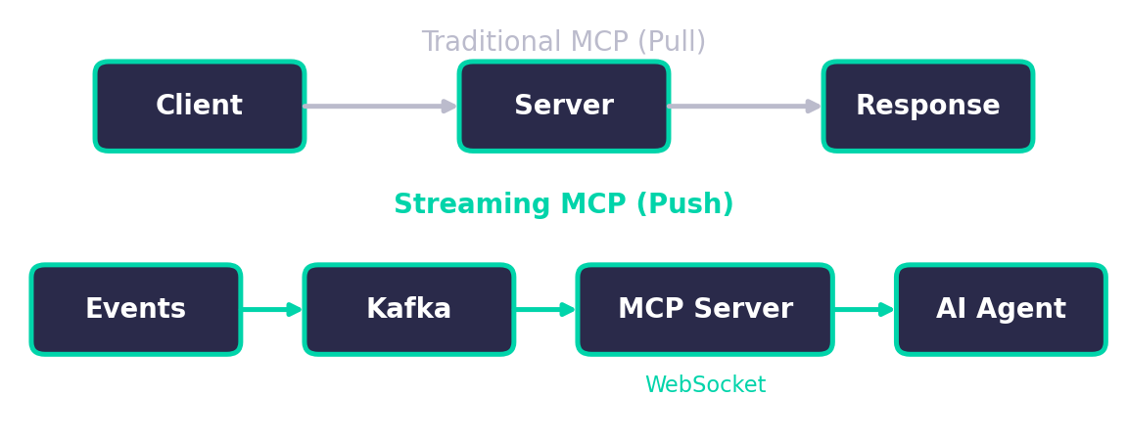
Streaming MCP Architecture
Standard MCP: Client → Server → Response (pull model)
Streaming MCP: Server → Client via subscriptions (push model)
Why Kafka: durable, replayable, backpressure handling
Hybrid protocol: streaming + request/response on same connection
Notes:
TALKING POINTS:
- Top row: traditional pull-based MCP. Bottom row: what we're building.
- Event sources feed Kafka, Kafka feeds the MCP server, server pushes to agents over WebSockets.
- Why Kafka? (1) Durability — events persisted for replay. (2) Backpressure — handles slow consumers. (3) Already in your infra.
- Key insight: hybrid protocol — streaming AND request/response on the same WebSocket. Zero changes to existing MCP tools.

Slide 5
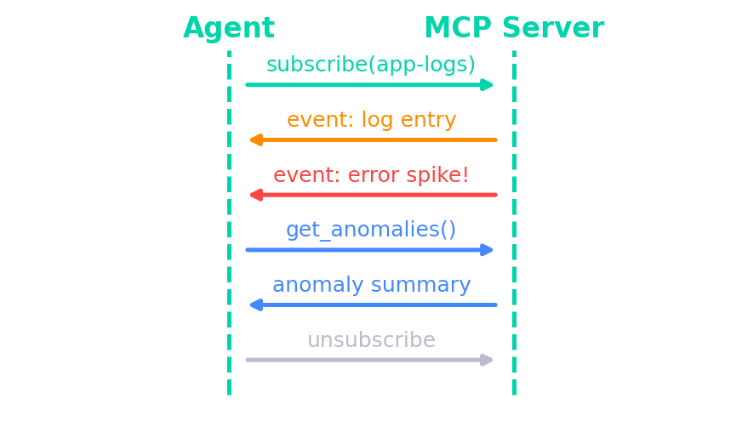
Key Protocol Extension: subscribe
New method: subscribe / unsubscribe for continuous push
Still supports get_anomalies, get_context (request/response)
Bounded queues (500 events) handle backpressure automatically
Notes:
TALKING POINTS:
- Minimal extension — just two new methods: subscribe and unsubscribe.
- Sequence: Agent sends subscribe('app-logs'). Events flow continuously. Error spike arrives immediately.
- Mid-stream, agent sends get_anomalies() — hybrid protocol in action.
- Backpressure: 500-event bounded queue per subscriber. Slow consumers get oldest events dropped.
- Dead subscribers auto-cleaned — no resource leaks.

Slide 6
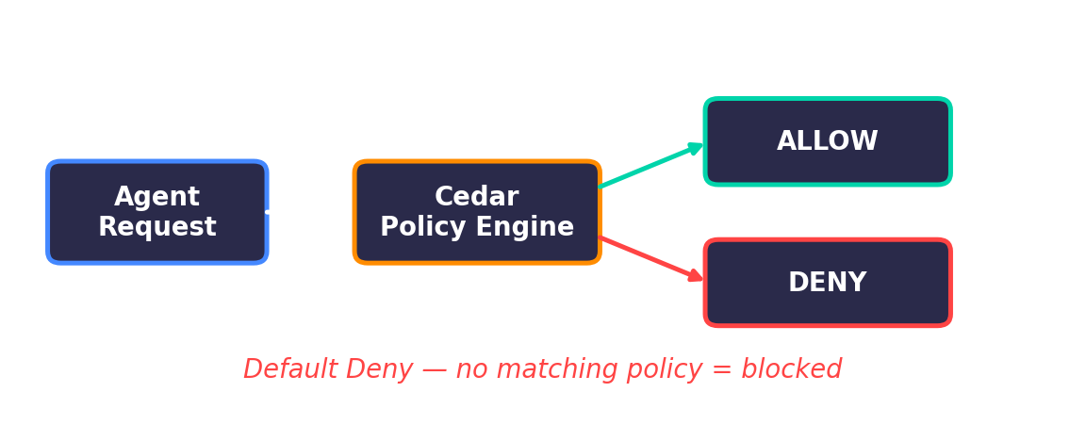
Cedar Authorization for MCP
Open-source policy language by AWS
Declarative: permit/forbid(principal, action, resource)
Role-based access control for MCP actions
Default deny — no matching policy = request denied
Notes:
TALKING POINTS:
- Streaming data to agents raises the question: who's allowed to see what?
- Cedar is open-source, now adopted in MCP ecosystem (Bedrock AgentCore, ToolHive).
- Simple model: permit/forbid(principal, action, resource).
- MCP actions: subscribe, get_anomalies, get_context, call_tool. Resources: streams like 'app-logs'.
- Default deny — no matching policy = blocked. Secure by default.

Slide 7
Cedar Policy Examples
permit(principal, action == Action::"subscribe", resource == Stream::"app-logs");
permit(principal, action == Action::"get_anomalies", resource) when { principal.role == "ops-agent" };
forbid(principal, action == Action::"subscribe", resource == Stream::"audit-logs") when { principal.role == "readonly" };
Forbid always wins over permit — secure by default
Notes:
TALKING POINTS:
- Real Cedar policies from our demo.
- First: anyone can subscribe to app-logs (general observability).
- Second: only ops-agents can call get_anomalies (expensive operation).
- Third: readonly agents explicitly forbidden from audit-logs (compliance data).
- Forbid ALWAYS wins over permit. Human-readable, auditable, version-controllable.

Slide 8
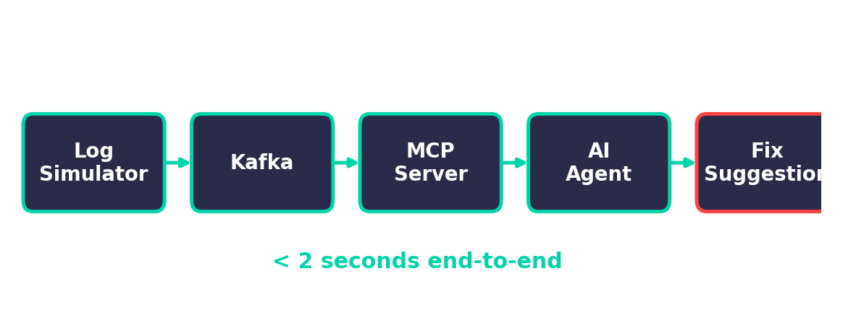
Live Demo: Real-time Log Monitoring
Log simulator → Kafka → MCP Server → AI Agent
Error spike → agent detects anomaly within 1 second
Agent queries for anomaly summary mid-stream
Cedar blocks unauthorized agents from sensitive streams
Notes:
TALKING POINTS:
- Stack: Confluent Kafka 7.6.0 in Docker, Python 3.9, confluent-kafka 2.13.2, websockets 15.0.1.
- Log simulator generates realistic logs, pushes to Kafka. MCP server consumes and pushes to agents.
- Normal traffic flows first. Then error spike hits.
- Agent detected 'ANOMALY DETECTED — error rate 60% in last 20 events' within 1 second.
- Automatic fixes: ConnectionRefused → check service; OOM → increase heap; Timeout → circuit breaker.
- End-to-end: error to fix suggestion under 2 seconds.

Slide 9
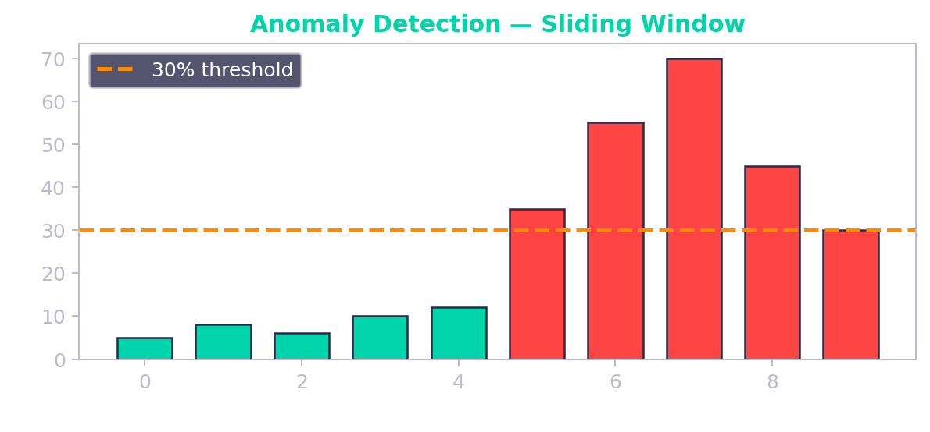
Anomaly Detection Flow
Rolling window of last 100 events maintained server-side
Error rate > 30% triggers anomaly alert
Agent maps error patterns to fix suggestions automatically
Notes:
TALKING POINTS:
- Server-side: rolling 100-event window for stable baseline.
- Agent-side: sliding 20-event window, 30% threshold triggers alert.
- Bar chart: green = normal, red = above threshold, orange line = trigger.
- Agent calls get_anomalies() for structured summary with top-N error patterns.
- Error → remediation mapping: ConnectionRefused → check connectivity; OOM → increase heap; SSL → renew certs.
- All within 1-2 seconds. Compare to the 11-minute blind spot.

Slide 10
Production Patterns & Gotchas
1. Backpressure: bounded queues, drop slow subscribers
2. Hybrid protocol: streaming AND on-demand on same WebSocket
3. Kafka consumer groups: same = load balance, different = fan-out
4. Reconnection: exponential backoff + context snapshot
5. Be selective: stream errors & anomalies, batch normal metrics
Notes:
TALKING POINTS:
- Backpressure: 500-event asyncio queue per subscriber. Full = drop oldest. Consider dead-letter topics.
- Hybrid protocol: don't force everything into one model. Subscribe for live feeds, query for summaries.
- Consumer groups: same group ID = load balance (one consumer per event). Different = fan-out (all get every event).
- Reconnection: exponential backoff to avoid thundering herd. Context snapshot on reconnect.
- Be selective: stream errors and anomalies. Batch normal INFO metrics. Don't flood the pipe.

Slide 11
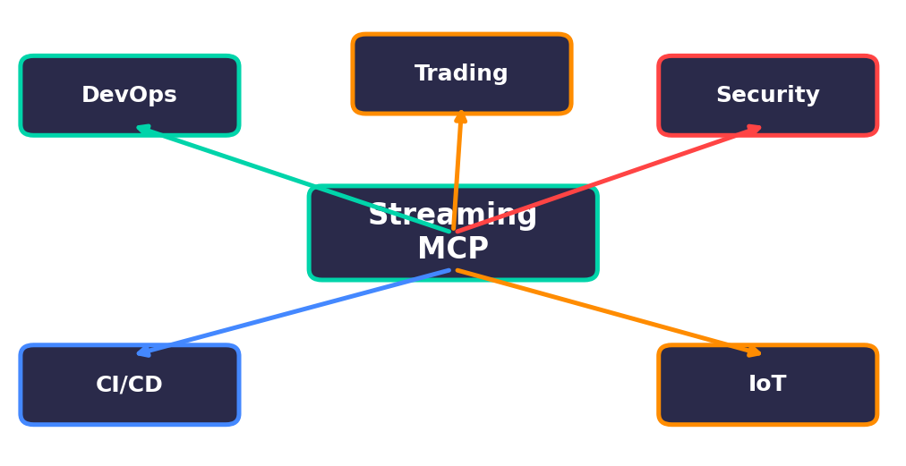
What Streaming MCP Unlocks
DevOps — real-time incident detection and auto-remediation
Trading — live market data feeding AI decision agents
Security — streaming audit logs with Cedar-authorized access
CI/CD — file watchers notifying agents of code changes
IoT — sensor data streaming to predictive maintenance agents
Notes:
TALKING POINTS:
- DevOps: what we demoed. Real-time incident detection, automated triage.
- Trading: live market data, latency matters, polling is not an option.
- Security: audit logs with Cedar access control. SOC agent gets alerts; readonly gets summaries.
- CI/CD: file watchers trigger agents on code changes. Auto-test, security check, update docs.
- IoT: sensor data to predictive maintenance. Detect anomalies before equipment fails.
- Common thread: any domain where waiting to be asked is too slow.

Slide 12
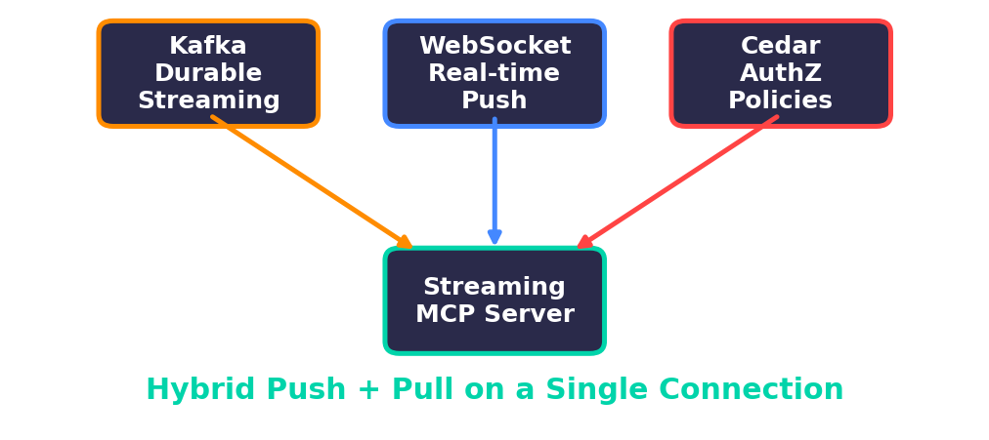
Key Takeaways
MCP doesn't have to be request/response only
Kafka (Confluent 7.6.0) + WebSocket = durable, scalable streaming bridge
Cedar provides declarative, auditable authorization for MCP
Hybrid protocol (push + pull) on single connection is the sweet spot
All open source — Python 3.9+, Docker, ~200 lines of code
Notes:
TALKING POINTS:
- MCP is extensible beyond request/response. Streaming is a natural extension.
- Kafka + WebSocket: battle-tested, widely deployed, well-understood.
- Cedar: declarative, auditable policies. Default deny = start secure, open up explicitly.
- Hybrid push + pull on one connection is the key design decision.
- The diagram shows Kafka + WebSocket + Cedar converging into the streaming MCP server.

Slide 13
Thank You & Q&A
github.com/hakohli/mcp-streaming-demo
All open source: Kafka · Cedar · WebSockets · Python
Notes:
TALKING POINTS:
- Complete working code on GitHub: github.com/hakohli/mcp-streaming-demo
- Stack: Confluent Kafka 7.6.0, Cedar, WebSockets 15.0.1, Python 3.9+.
- To run: docker compose up -d, then streaming_mcp_server.py, log_simulator.py, agent_client.py.
- Happy to take questions on architecture, Cedar policies, Kafka integration.
- Interested in contributing? SSE transport, multi-topic subscriptions, persistent agent state — let's talk.

