Slide 1
Reading file and sorting them using Comparator
Khaliunaa Baasandorj

Slide 2
Outline
Reading Text Files
Storing in Collection
Sorting them using Comparator

Slide 3
Reading Text Files /different ways to read files/
FileReader
BufferedReader
Scanner

Slide 4
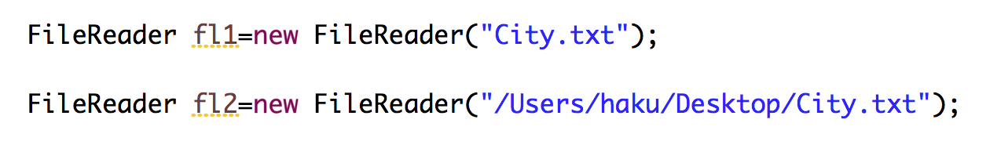
Reading Text Files
FileReader
Window's file system
FileReader
BufferedReader/Scanner

Slide 5
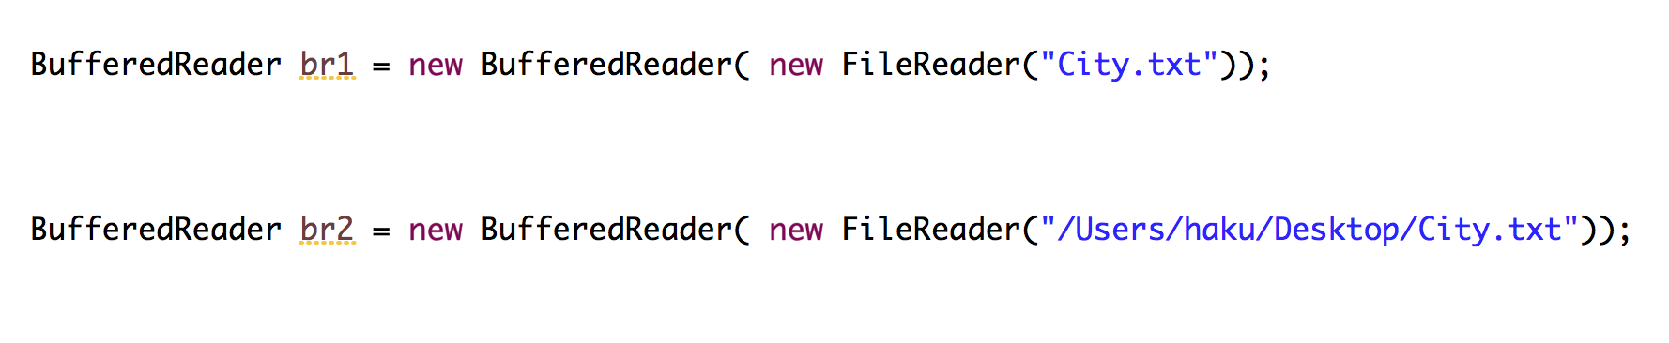
Reading Text Files
BufferedReader

Slide 6
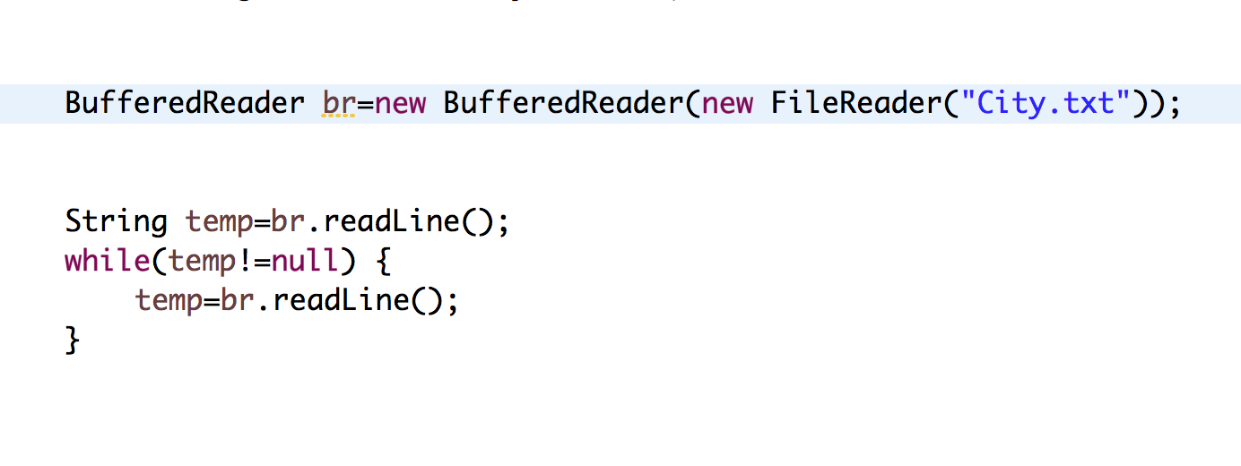
Reading Text Files
BufferedReader

Slide 7
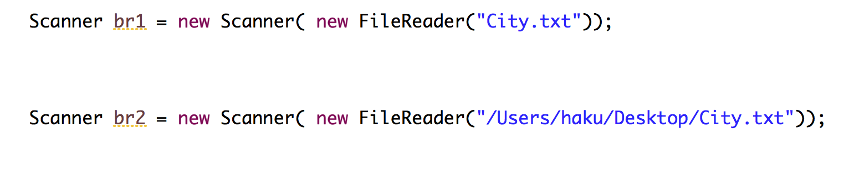
Reading Text Files
Scanner

Slide 8
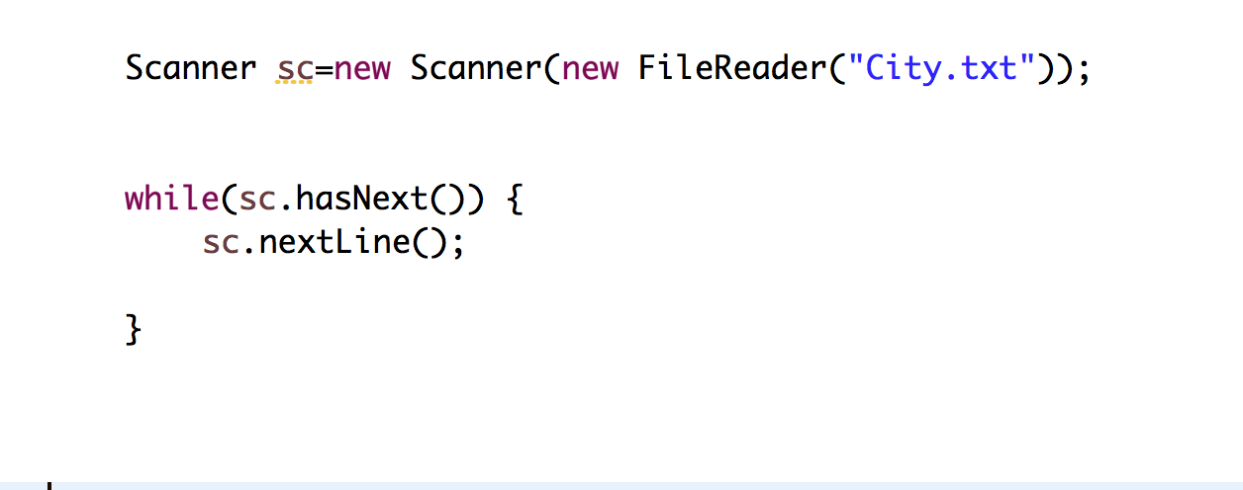
Reading Text Files
Scanner

Slide 9
Comparable vs Comparator (summary of the class)

Slide 10
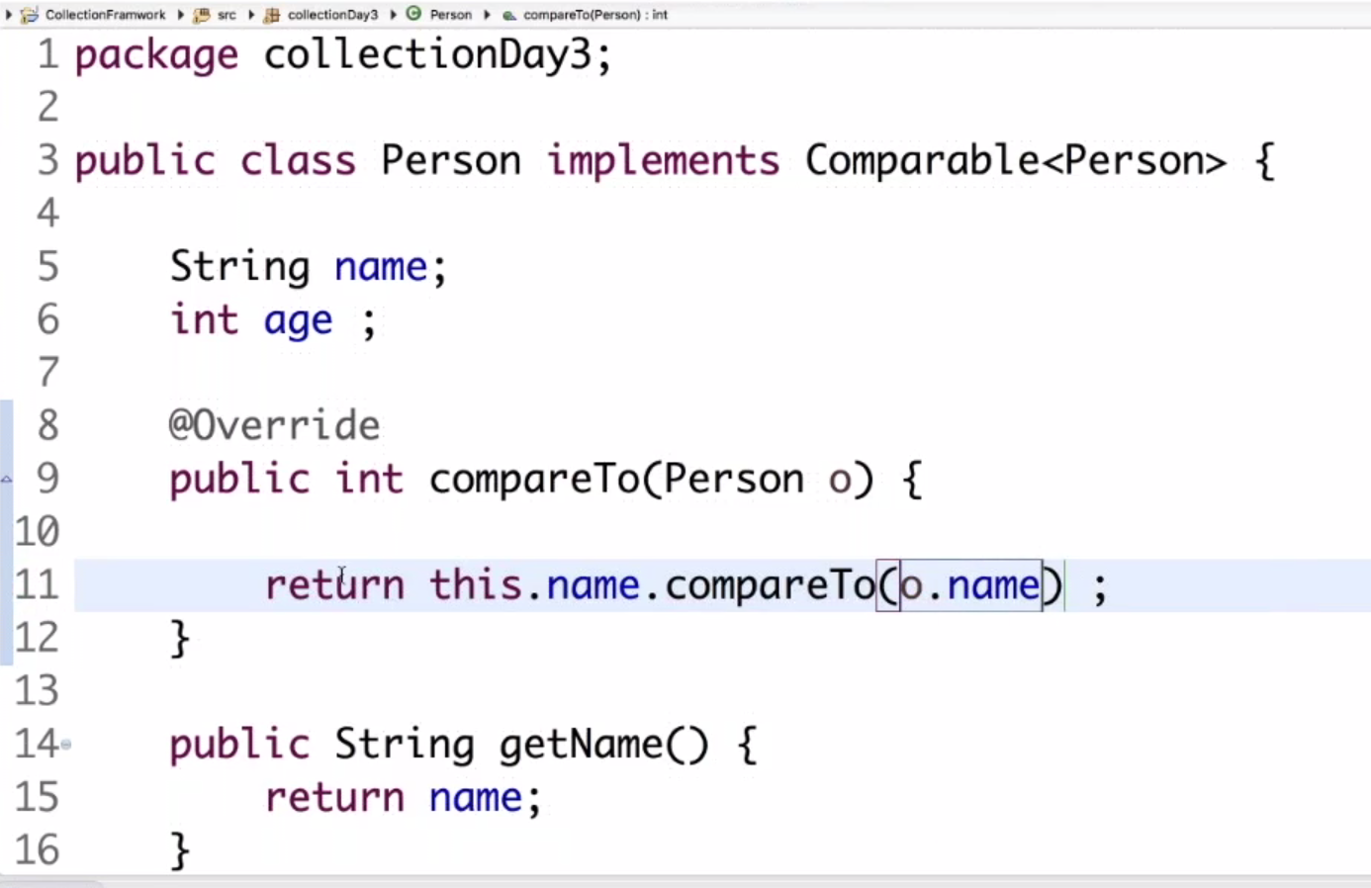
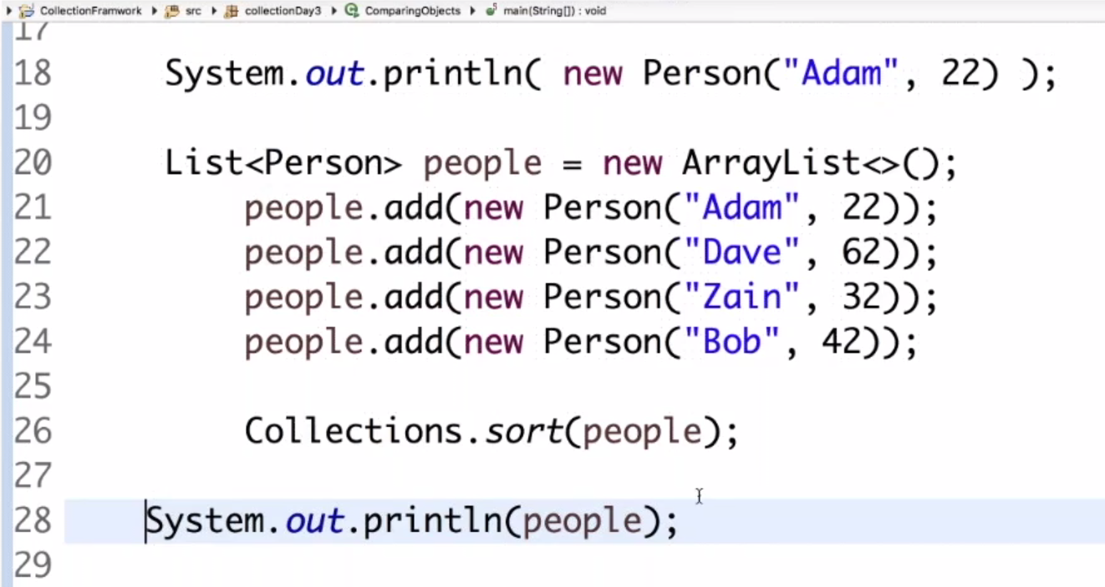
Comparable

Slide 11
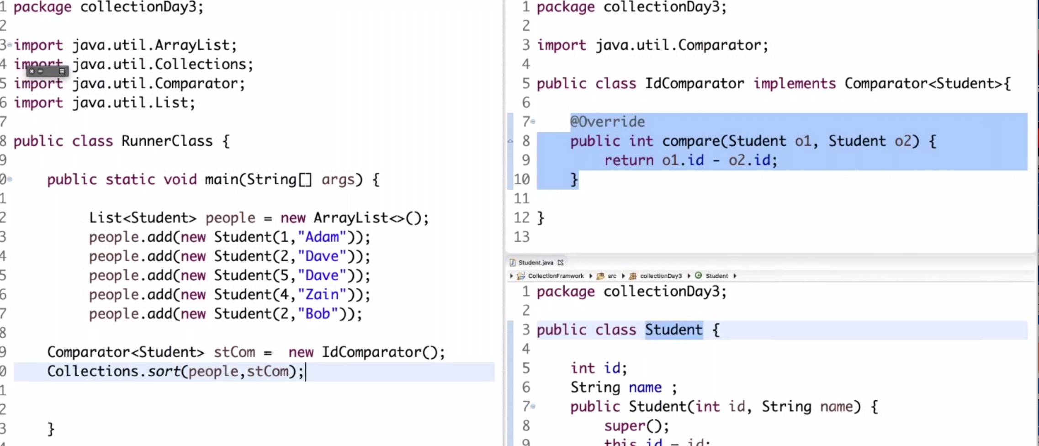
Comparator

