Slide 1


Implementation of the "ArtF" Method for Sustainable World Knowledge
Demonstration with talkingPC.html
AI Q&A using Semantic Inline Markup
A White Cane for AI:
  Sept. 11, 2026
  Art F (福田伯堂=FUKUDA Hakudo)本名: 博同=FUKUDA Hroatsu
Notes:
For visually impaired users: please press the Tab key to jump to the next link.
A White Cane for AI:
Implementation of the "ArtF" Method for Sustainable World Knowledge
Demonstration with talkingPC.html
AI Q&A using Semantic Inline Markup
September 11, 2026
painter name: Art F japanese: FUKUDA Ha ku dou
Real name: FUKUDA Hiro atsu

Slide 2
Teach AI to Sing and Achieve an 80% Reduction in Token Usage
- The Semantic World of a 2017 Paper on the Japanese Swordsmith Nobukuni -
Structural change due to an urgent issue Demonstration: index (Webpage & mail)
緊急課題で構成変更
  エージェントAIのトークン電力問題：
    先行研究
The AI Power & Token Crisis
  Agentic AI‘s self-reasoning loops create massive token overhead and excessive power consumption.
    Prior Research.
Notes:
Teach AI to Sing and Achieve an 80% Reduction in Token Usage
- The Semantic World of a 2017 Paper on the Japanese Swordsmith Nobukuni –
Structural change due to an urgent issue
Demonstration: index (webpage & mail)
The AI Power & Token Crisis
Agentic AI‘s self-reasoning loops create massive token overhead and excessive power consumption. Prior Research.

Slide 3
For details on this topic, please see the separate presentation.
- The Semantic World of a 2017 Paper on the Japanese Swordsmith Nobukuni -
Demo: index 2 (Webpage & mail) (1) :
提示(2)
Semantic Structuring of ArtF
2017 Nobukuni Swordsmith Paper (2)
SIM: Semantic Inline Markup
Structuring & Identification:
  SF: Semantic Folder & SID: Semantic ID &SIM
  ArtFの意味付け世界
  2017年「刀匠信国論文」(2)
  ドメイン構造化のための
    SF: 意味フォルダ
    SID :意味ID
  SIM: 本文内意味記号
GitHub:
(2) ResearchMap URL: https://researchmap.jp/read0058080/published_papers/53115113
Notes:
For details on this topic, please see the separate presentation.
- The Semantic World of a 2017 Paper on the Japanese Swordsmith Nobukuni -
Demo: index 2 (webpage & mail) Press the Tab and Enter key to go to reference 1.
Semantic Structuring of ArtF
2017 Nobukuni Swordsmith Paper.
Press the Tab and Enter key to go to reference2.
SIM: Semantic Inline Markup
(in-text semantic marker)
・Structuring & Identification
For structuring the domain
SF: Semantic Folder & SID: Semantic ID

Slide 4
For details on this topic, please see the separate presentation.
Demo: index 3 (Webpage & mail) (1) :
実演 3
"Building a 1000-Year Database for the Web“
ArtF's Four-Part Toolkit
Semantic World
Multi-Faceted Thesaurus
Educational, Multilingual, General-Purpose Program
Instructions for AI Agents
  「1000年DB-Web構築」ArtFの4点セット
  Semantic World
  多面的シソーラス
  教育的・多言語・汎用プログラム
  AIへの指示書
GitHub:
(2) ResearchMap URL: https://researchmap.jp/read0058080/published_papers/53115113
Notes:
For details on this topic, please see the separate presentation.
Demo: index 3 (Webpage & mail) : Press the Tab and Enter key to go to reference 1.
"Building a 1000-Year Database for the Web“
ArtF's Four-Part Toolkit
Semantic World
Multi-Faceted Thesaurus
Educational, Multilingual, General-Purpose Program
Instructions for AI Agents

Slide 5
For details on this topic, please see the separate presentation.
Demo: index 4 (Webpage and mail)
紹介:4 (Webと)
  デスクトップ「talkingPC.html」
  ヘルパー用「t エンターキー」→ 「talkingPC.html」自動起動
  Tabキーでしゃべる→
  SIM見本をAIが誘導(SIM検索問答)
  英語質問→日本語翻訳 | 日本語解説→英語回答
  検索後:SIM別データ加工→
  別フォルダにDB追加
Desktop File: "talkingPC.html"
Helper Shortcut ("t" + Enter): Auto-Launch of "talkingPC.html"
Tab Key for Voice Input →
AI-Guided SIM Sample (SIM Search Q&A)
English Question → Japanese Translation │
Japanese Explanation → English Answer
◆ Post-Search: SIM-Based Data Processing →
◆ Addition to a New Folder
Notes:
For details on this topic, please see the separate presentation.
Demo: index 4 (Webpage and mail)
Desktop File: "talkingPC.html"
◆ Helper Shortcut ("t" + Enter):
Auto-Launch of "talkingPC.html"
◆ Tab Key for Voice Input →
◆ AI-Guided SIM Sample (SIM Search Q&A)
◆ English Question → Japanese Translation │
Japanese Explanation → English Answer
◆ Post-Search: SIM-Based Data Processing →
◆ Addition to a New Folder

Slide 6
  Agentic AI‘s self-reasoning loops create massive token overhead and excessive power consumption.
エージェントAIのトークン電力問題
  The emergence of Large Language Models (LLMs)
  2017 : Transformer Architecture — Vaswani et al. (Google Brain Team) (3)
  2018–2020: Large-Scale Language Models — GPT-3 (4)
  2022: ChatGPT — OpenAI (5)
  Problem: The Square Law
大規模言語モデル（LLM）の登場
〈2017〉
  《トランスフォーマー》構築
〈2018〉-〈2020〉
  【LLM】モデル
〈2022〉: ChatGPT実装
問題点：2乗の法則
  (3) https://arxiv.org/abs/1706.03762 (4) https://arxiv.org/abs/2005.14165 (5) https://openai.com/ja-JP/index/chatgpt/
Notes:
Agentic AI‘s self-reasoning loops create massive token overhead
and excessive power consumption.
The emergence of Large Language Models (LLMs)
2017 — Transformer architecture introduced(by Vaswani and Google Brain ) . Press the Tab key to go to reference 3.
2018–2020 — Large-scale Transformer-based language models developed. Press the Tab key to go to reference 4.
2022– — ChatGPT and generative AI rapidly enter widespread use. Press the Tab key to go to reference 5.
Problem: The Square Law

Slide 7
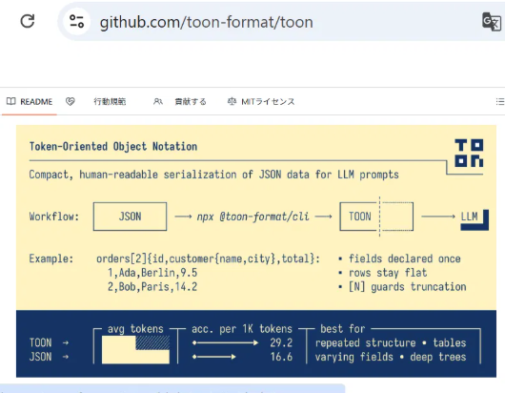
  Agentic AI‘s self-reasoning loops create massive token overhead and excessive power consumption.
  Token Explosion
    2022: ReAct — Reasoning + Acting
    Yao et al. ‘ReAct: Synergizing Reasoning and Acting in Language Models’ (6)
エージェントAIのトークン電力問題
トークン爆発
〈2022〉《ReAct》〔Yao〕 et al, 「LLMに於ける
推論と行動の
相乗効果」
(エージェントAI
同志の推論)
    (6) https://arxiv.org/abs/2210.03629/
Notes:
Agentic AI‘s self-reasoning loops create massive token overhead
and excessive power consumption.
Token Explosion
2022: ReAct — Reasoning + Acting
Yao et al. ‘ReAct: Synergizing Reasoning and Acting in Language Models’
Press the Tab and Enter key to go to reference 6
So, Yao et al. established the foundational reasoning-acting loop behind today's agentic AI.
〔ヤオ〕達は、エージェントAIの中核となる、推論と、行動と観察を組み合わせたモデルを構築した。つまり、AIは前後の文脈で推論するが、それに、以上のモデルにより自動化の仕組みを作った。つまり、AIがRDFを作り、前後の文脈で推論する仕組みで、人間と機械が理解できるようにした。それを発展させて、
推論と行動と観察を組み合わせて、人間の介在なしで生成できる方法をLLM内で統合した。意思決定タスクにおける正確性・解釈可能性・信頼性を高める手法を提案した。

Slide 8
  Agentic AI‘s self-reasoning loops create massive token overhead and excessive power consumption.
エージェントAIのトークン電力問題
  Massive Token Consumption!
  Empirical Evidence
  2026: Bai et al. ‘How Do AI Agents Spend Your Money?’ (7)
  Agentic coding tasks consumed ~1,000× more tokens
    in the studied setting
トークン大爆発!
〈2026〉〔Bai〕 等
「AIエージェント、君の金をどう使うか」
調査対象に限るが、エージェントAIのトークン数は通常のAIに比べ約1,000倍
  (7) https://arxiv.org/abs/2604.22750
Notes:
Agentic AI‘s self-reasoning loops create massive token overhead and excessive power consumption.
Massive Token Consumption!
Empirical Evidence
2026: Bai et al. ‘How Do AI Agents Spend Your Money?’ Press the Tab and Enter key to go to reference 7.
Agentic coding tasks consumed ~1,000× more tokens
in the studied setting.
<!-- Driven mainly by input tokens rather than output.
Usage varies up to 30-fold even on the same task, and more tokens don't guarantee higher accuracy. Efficiency also differs sharply across models — Kimi-K2 and Claude-Sonnet-4.5 use over 1.5 million more tokens on average than GPT-5. →
トークン大爆発！
ベイ氏ら(2026)によると、AIエージェントによるコーディングタスクは、通常のコード推論やチャットの約1000倍のトークンを消費し、そのコストは出力より入力トークンに左右されます。また、同じタスクでも消費量は最大30倍ばらつき、トークンを多く使っても精度が上がるとは限りません。モデル間の効率差も大きく、Kimi-K2やClaude-Sonnet-4.5は、GPT-5より平均150万トークン以上多く消費します。

Slide 9
  Agentic AI‘s self-reasoning loops create massive token overhead and excessive power consumption: countermeasure
エージェントAIの自己推論ループでのトークン激増問題：対策
  TOON(Token-Oriented Object Notation)
  〈2025〉〔 Johann Schopplich 〕(8)
  "A Token-Efficient Alternative to JSON for LLMs“
    Explicit array length & field names → concise, repeated-structure encoding.
  Effect
      ~30–60% token reduction vs. token-heavy JSON (reported)
  Challenges
      Limited gains for deep / non-uniform structures. · Agentic AI: parse failures trigger retries, yielding a net +8–11% token increase in some cases 〔Kutschka & Geiger, 2026 」 (9)
①TOON
    〈2025〉〔Johann Schopplich〕 「 LLM向け→ JSON圧縮」(配列の要素数・項目名明示、繰り返し構造→簡潔表現)
    効果(トークン数の多いJSON比,約30～60%削減報告例)
    課題(文書構造深く不均一=効果が少ない例あり)
    Agentic AIで構文解析失敗→+8～11%の実測例)
  (8) https://github.com/toon-format/toon
  (9) https://arxiv.org/abs/2605.29676
Notes:
Agentic AI‘s self-reasoning loops create massive token overhead
and excessive power consumption: countermeasure
TOON(Token-Oriented Object Notation)
〈2025〉〔 Johann Schopplich 〕 Press the Tab and Enter key to go to reference 8.
"A Token-Efficient Alternative to JSON for LLMs“
Explicit array length & field names → concise, repeated-structure encoding.
Effect
~30–60% token reduction vs. token-heavy JSON (reported)
Challenges
Limited gains for deep / non-uniform structures. · Agentic AI: parse failures trigger retries, yielding a net +8–11% token increase in some cases 〔Kutschka & Geiger, 2026 」 Press the Tab and Enter key to go to reference 9.
トゥーン
〈2025〉〔Johann Schopplich〕 「 JSONをLLM向けに圧縮する記法(配列の要素数・項目名を明示し、繰り返し構造を簡潔に表現)
効果(トークン数の多いJSON比で、約30～60%削減の報告例)課題(文書構造が深い／不均一の場合、効果が少ない場合あり。 Agentic AIで構文解析失敗により、逆に+8～11%の実測例)

Slide 10
  Agentic AI‘s self-reasoning loops create massive token overhead and excessive power consumption: countermeasure
エージェントAIのトークン電力問題：対策2
TRON(Token Reduced Object Notation )
  〈2025〉by Tim Huang. (10)
  〈2026〉Benchmark:〔Lorenz Kutschka〕〔Bernhard Geiger 〕(11)
  "Deduplication-based notation: a shared structure is
  declared once as a "template"; only values are listed thereafter."
  Effect
      Up to 27% token reduction in agentic-loop benchmarks —
      gains scale with the number of repeated/shared structures
  Challenges
      Accuracy drops up to 14% points below the JSON baseline
      When tool calls are few, the deduplication overhead itself may increase the number of tokens.
①TRON
    〈2025〉〔Tim Huang〕作
    〈2026〉〔Lorenz Kutschka〕〔Bernhard Geiger 〕「重複排除方式(ひな型を1度書く、以降は値だけ並べる]
    効果(良い条件で*最大27%**のトークン削減)
    課題(ツール数が少ない場合は、逆に定義の分離自体がオーバーヘッドしトークン数が増加)
  (10) https://tron-format.github.io/ (11) arXiv:2605.29676
Notes:
Agentic AI‘s self-reasoning loops create massive token overhead
and excessive power consumption: countermeasure
TRON(Token Reduced Object Notation )
〈2025〉by Tim Huang.
Press the Tab and Enter key to go to reference 10.
〈2026〉Benchmark:〔Lorenz Kutschka〕〔Bernhard Geiger 〕
Press the Tab and Enter key to go to reference 11.
"Deduplication-based notation: a shared structure is
declared once as a "template"; only values are listed thereafter."
Effect
Up to 27% token reduction in agentic-loop benchmarks —
gains scale with the number of repeated/shared structures
Challenges
Accuracy drops up to 14% points below the JSON baseline
When tool calls are few, the deduplication overhead itself may increase the number of tokens.
エージェントエーアイのトークン電力問題：対策
トロン
「重複排除方式(ひな型を1度書く、以降は値だけ並べる]
効果(良い条件で*最大27%**のトークン削減)
課題(ツール数が少ない場合は、逆に定義の分離自体がオーバーヘッドしトークン数が増加)

Slide 11
  Agentic AI‘s self-reasoning loops create massive token overhead and excessive power consumption.
  Why Does AI Reason?
  Adding meaning and structure to text using tags (XML,RDF etc.)
  XML was standardized by the W3C in 1998. (12)
  XML organizes information in levels, like folders.
  The rules for text structure are defined by DTD or Schema.
  XML can be used to store, search, exchange,
  and reuse information.
AIは何故推論するか？
XMLやRDFが基盤
単なる文字列を人間と機械が理解する仕組み
例1:XML 1998年,標準化機構W3Cの勧告( 注)
構文例：<Person>信国</Person><Era>建武</Era><Work>刀</Work>
タグで文字列に意味付与
階層構造でデータ表示
構造をDTD／Schemaで定義
検索・保存・交換・再利用可能
(12):https://www.w3.org/press-releases/1998/xml10-rec/
Notes:
Agentic AI‘s self-reasoning loops create massive token overhead
Why Does AI Reason?
Adding meaning and structure to text using tags (XML,RDF etc.)
XML was standardized by the W3C in 1998.
Press the Tab and Enter key to go to reference 12.
XML organizes information in levels, like folders.
The rules for text structure are defined by DTD or Schema.
XML can be used to store, search, exchange,
and reuse information.

Slide 12
  Agentic AI‘s self-reasoning loops create massive token overhead and excessive power consumption.
  Why Does AI Reason?
  RDF: Relationship capture via Triples (Subject-Predicate-Object) for human and machine understanding
  W3C Recommendation in 1999 (13)
  Adoption of XML tag-based syntax at the time
  Unique identification via URIs → global data linkage
  Graph-based structure (like multiple tree diagrams connected) — distinct from folder (hierarchical) systems
  Reasoning enabled through the connecting rules (ontology)
AIは何故推論するか？
RDFは主語・述語・目的語で関係表現→人間・機械が理解可能
1999年、標準化機構W3Cの勧告
XMLの記述方式（タグ）を採用(当時）
URI(一意な識別) → 世界的データ連結
フォルダ(階層)方式でなく、グラフ図的(複数の樹木図を連結したような)関係表現
その連結ルール(オントロジー)で推論実現
  13: https://www.w3.org/TR/1999/REC-rdf-syntax-19990222/?utm_source=chatgpt.com
Notes:
Agentic AI‘s self-reasoning loops create massive token overhead
and excessive power consumption.
Why Does AI Reason?
RDF: Relationship capture via Triples (Subject-Predicate-Object) for human and machine understanding
W3C Recommendation in 1999
Press the Tab and Enter key to go to reference 13.
Adoption of XML tag-based syntax at the time
Unique identification via URIs → global data linkage
Graph-based structure (like multiple tree diagrams connected) — distinct from folder (hierarchical) systems
Reasoning enabled through the connecting rules (ontology)

Slide 13
  Agentic AI‘s self-reasoning loops create massive token overhead and excessive power consumption.
  Why Does AI Reason?
  AI reasoning via comparison and examination of context
  Utilization of search, calculation, and other tools
  In case of processing or execution failure
  Re-reasoning and secondary tool deployment
  Increase in unexpected reasoning loops
  Resulting inflation of token consumption
AIは何故推論するか？
AIは前後の情報を比較・検討し推論
検索ツール,計算ツール等使用
その処理に失敗した場合
再度推論しツールを使う
予定外の推論も増える
つまりトークン数が増える
Notes:
Agentic AI‘s self-reasoning loops create massive token overhead
and excessive power consumption.
Why Does AI Reason?
AI reasoning via comparison and examination of context.
Utilization of search, calculation, and other tools.
In case of processing or execution failure.
Re-reasoning and secondary tool deployment.
Increase in unexpected reasoning loops.
Resulting inflation of token consumption.

Slide 14

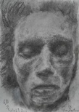
"To Beethoven, who cannot hear: Can you feel the roar of this wild nature?“ Details of "Raging Waves"
Notes:
A aging artist was painting "the vibrant pulse of great nature."
Ah! Beethoven, can you feel the roar of this wild, untamed nature?

Slide 15
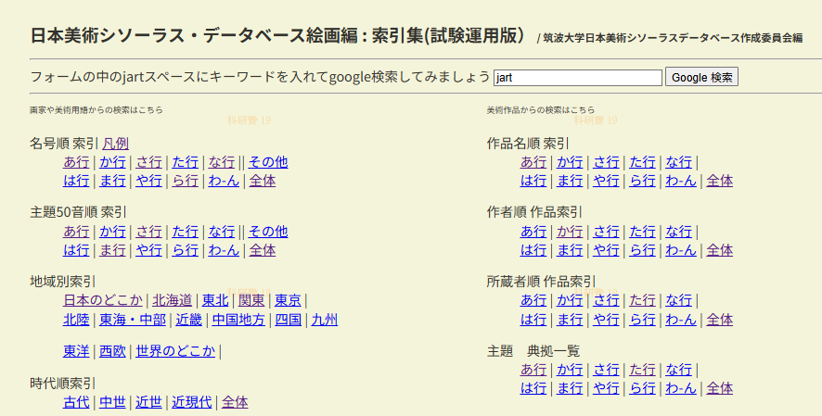
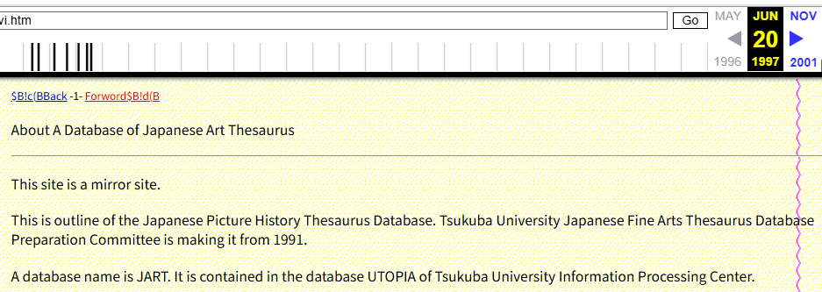
In 1989, the ArtF method appeared.
A Close Encounter ; End of 2025 : The Elderly Artist vs. AI
Q: "Is anyone using the JART system We built in 1990?“
AI: "None found." (Multiple AIs confirmed) URL (13)
Q 1990年頃JARTを作ったが誰か世界で同様システムはあるか？
AI:いや見当たらない(多くのAI)
  URL https://www.tulips.tsukuba.ac.jp/jart/index.html
  (13) About “Japanese Fine Art Thesaurus Database” https://web.archive.org/web/19970620154157/http:/www.libra.titech.ac.jp/~hiroatsu/oldnavi.htm
Notes:
In 1989, the ArtF method appeared.
A Close Encounter ; End of 2025 : The Elderly Artist vs. AI
Elderly Artist asked several AIs: "Is anyone using the JART system We built in 1990?“
The multiple AIs answered. "None found." (Multiple AIs confirmed)
Press the Tab and Enter key to go to URL.
Next: Press the Tab and Enter key to go to reference 13.

Slide 16
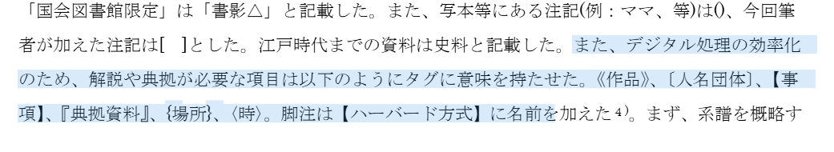
In 1989, the ArtF method appeared
Q: Have you read the 2017 paper on the swordsmith Nobukuni?’
AI was stunned: "An unseen system!“
Upon examining the contents, the AI ​​was astounded. (14)
AI→2017年論文を見た。
「見たことのないシステム」だ！
と驚愕した
  (13) About “Japanese Fine Art Thesaurus Database” https://web.archive.org/web/19970620154157/http:/www.libra.titech.ac.jp/~hiroatsu/oldnavi.htm
  (14「Comprehensive Research on Genealogy of the Nobukuni Group SwordsmithFukuda(2017))
Notes:
In 1989, the ArtF method appeared
Elderly Artist asked too:
Have you read the 2017 paper on the swordsmith Nobukuni?
AI was stunned: "An unseen system!“
Upon examining the contents, the AI ​​was astounded.
Press the Tab and Enter key to go to reference 14.

Slide 17
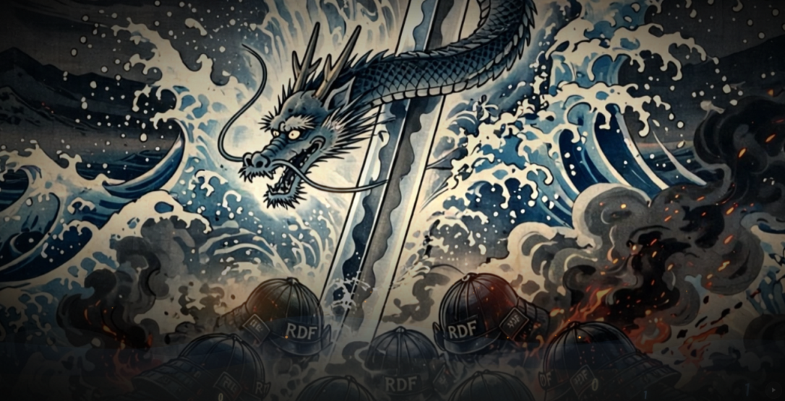
2017 "Swordsmith Nobukuni Paper" Appears
“The armor of RDF built by AI was thick, but a famous Nobukuni sword cut it in two.”
AIは何故おどろいたか？
普通、単なる文字を人と機械が分かるようにRDFが使われている。
さらに、AIは、前後の文脈で意味を推論している。
RDFの鎧は堅かった。
しかし、〔信国〕の名刀で鎧は一刀両断された。
  「日本美術シソーラスデータベース:絵画編」https://www.tulips.tsukuba.ac.jp/jart/index.html
  Japanese Fine Art Thesaurus Database https://web.archive.org/web/19970620154157/http:/www.libra.titech.ac.jp/~hiroatsu/oldnavi.htm
Notes:
Why was the AI surprised?
Normally, RDF is used so that both humans and machines can understand what mere characters (text) mean.
Furthermore, AI infers meaning from the surrounding context.
“The armor of RDF built by AI was thick, but a famous Nobukuni sword cut it in two.”

Slide 18
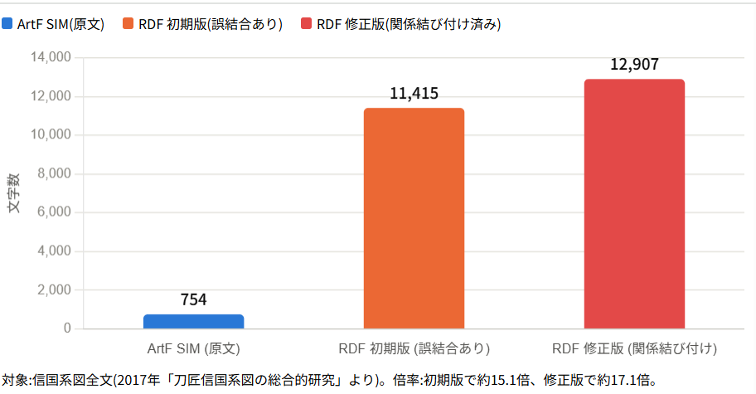
An empirical comparison based on character counts of the lineage presented in the 2017 paper "Swordsmiths Nobukuni School"
【AI】に【白杖】を! ArtF 技法
2017年「刀匠信国論文」：SIM入り系図の例 (Original text of the genealogy)
「信国系図」
〔一代信国〕
延文年中[1356-60]京五条坊門ニ住ス 元来〔来国行〕伝ヲ受 後鎌倉〔貞宗〕伝受 初テ〔信国〕ト打
("Nobukuni Lineage" [First Generation Nobukuni] Resided at Gojō Bōmon in Kyoto during the Enbun era (1356–1360))
〔二代信国〕 後号〔虎熊入道（[Second generation Nobukuni] Later issue [Koyu Nyudo. (後略)
(later omitted)）
Notes:
This slide presents an empirical character-count comparison of a genealogy in the “Nobukuni Swordsmiths” paper, published in 2017, between the ArtF method’s SIM (Semantic Inline Markup) and RDF, a knowledge representation method that is effectively used as a common standard worldwide.
On the right is a comparison of the same content represented in RDF according to the international standard CIDOC-CRM, showing the RDF figures for an initial version, a strict version, and a version in which the relationships in the genealogy are linked to their supporting historical sources.
このスライドは、論文の、ある系図を「ArtF方式のSIM(セマンティック・インライン・マークアップ)と、世界中で通常利用されているRDF方式(主語・述語・目的語で、機械も人も単なる文字列が分かるようにしたもの)」の、文字数実測値の比較です。
画面左は、「ArtF方式のSIM入り系図」です。画面右は、それと国際規格「CIDOC-CRM」に従ったRDF方式の通常版から厳密版の数値」です。

Slide 19
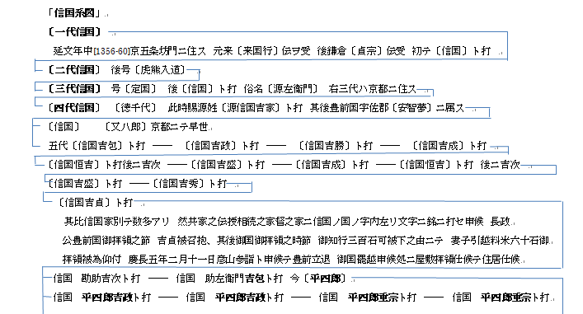
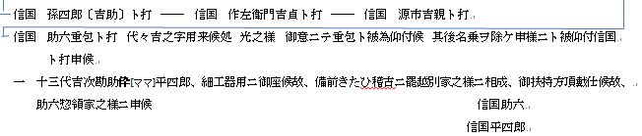
An empirical comparison based on character counts of the lineage presented in the 2017 paper "Swordsmiths Nobukuni School”
【AI】に【白杖】を! ArtF 技法
Original text of the genealogy (Excerpt)
First Generation Nobukuni
During the Enbun era (1356–1360), he resided at Gojō Bōmon in Kyoto.
He originally mastered the tradition of Rai Kuniyuki.
Later, having also mastered the tradition of Sadamune of Kamakura,
he began inscribing his swords with the name "Nobukuni.“
Second Generation Nobukuni: Later known by the religious name Torakuma Nyūdō (Buddhist name)
(Remainder omitted) Character count: 754
Notes:
An empirical comparison based on character counts of the lineage
presented in the 2017 paper "Swordsmiths Nobukuni School”
Original text of the genealogy (Excerpt)
First Generation Nobukuni
During the Enbun era (1356–1360), he resided at Gojō Bōmon in Kyoto.
He originally mastered the tradition of Rai Kuniyuki.
Later, having also mastered the tradition of Sadamune of Kamakura,
he began inscribing his swords with the name "Nobukuni.“
Second Generation Nobukuni: Later known by the religious name Torakuma Nyūdō (Buddhist name)
(Remainder omitted) Character count: 754

Slide 20
An empirical comparison based on character counts of the lineage presented in the 2017 paper "Swordsmiths Nobukuni School"
RDF
@prefix crm: <http://www.cidoc-crm.org/cidoc-crm/> .
@prefix rdfs: <http://www.w3.org/2000/01/rdf-schema#> .
@prefix jart: <http://www.tulips.tsukuba.ac.jp/jart/id/> .
@prefix jartp: <http://www.tulips.tsukuba.ac.jp/jart/prop/> .
jart:person_1 a crm:E21_Person ;
rdfs:label "一代信国"@ja ;
crm:P1_is_identified_by [ a crm:E41_Appellation ; rdfs:label "一代信国"@ja ] .
jart:timespan_1 a crm:E52_Time-Span ;
rdfs:label "延長年中"@ja .
jart:person_1 crm:P4_has_time-span jart:timespan_1 .
jart:place_2 a crm:E53_Place ;
rdfs:label "京五条坊門"@ja .
jart:person_1 crm:P7_took_place_at jart:place_2 .
jart:place_4 a crm:E53_Place ;
rdfs:label "鎌倉"@ja .
jart:person_2 crm:P7_took_place_at jart:place_4 .
jart:person_3 a crm:E21_Person ;
rdfs:label "貞宗"@ja ;
crm:P1_is_identified_by [ a crm:E41_Appellation ; rdfs:label "貞宗"@ja ] .
jart:sword_6 a crm:E22_Man-Made_Object ;
crm:P108i_was_produced_by jart:production_6 ;
crm:P1_is_identified_by [ a crm:E34_Inscription ; rdfs:label "信国"@ja ] .
jart:production_6 a crm:E12_Production ;
crm:P108_has_produced jart:sword_6 ;
crm:P14_carried_out_by jart:person_3 .
jart:person_4 a crm:E21_Person ;
rdfs:label "二代信国"@ja ;
crm:P1_is_identified_by [ a crm:E41_Appellation ; rdfs:label "二代信国"@ja ] .
jart:person_4 jartp:succeededBy_from jart:person_1 . # 世代継承
(Remainder omitted) Character count: 12,907
Notes:
An empirical comparison based on character counts of the lineage
presented in the 2017 paper "Swordsmiths Nobukuni School“
RDF
First, four namespaces such as CRM, RDFS, JART, and JARTP are defined with prefixes, omitting the full URLs.
Next, as an example, person_1 is defined as follows:
jart:person_1 a crm:E21_Person ;
rdfs:label 'First-generation Nobukuni' at ja ;
crm:P1_is_identified_by a crm:E41_Appellation ; rdfs:label 'First-generation Nobukuni' at ja.
Since the full markup is quite extensive, the remainder is omitted. In conclusion, the total character count reaches 12,907."

Slide 21
A Painter's Eye: Observing the Semantic Structure of World Knowledge
【AI】に【白杖】を! ArtF 技法
How did this idea come about?
No correlation with technical AI token issues.
1960s:
  An aspiring young artist accepting an oil portrait commission
  Observation through a painter's eye for 60 years:
  Questioning common sense,
  verifying primal concepts,
  and contemplating the structure of the world
To be continued in Part 2
  この思想はどうして生まれたか？
  AIのトークン問題と関係ない。
  1960年代
  一人の芸術家の卵が
  【油彩肖像画】受注→
  「画人の眼で【観察(60年間)
  常識を疑い原思想の確認
  世界の構造を考えた
  以下、その2に続く
  (ArtF_Explanatory_Article+001)→4aea001.ppsm
Notes:
A Painter's Eye: Observing the Semantic Structure of World Knowledge
How did this idea come about?
No correlation with technical AI token
issues1960s:
An aspiring young artist accepting an oil portrait commission
Observation through a painter's eye for 60 years:
Questioning common sense,
verifying primal concepts,
and contemplating the structure of the world
To be continued in Part 2

