Slide 1


Illustrated Steps on how to use
the OpenMRS' DHIS2 Reporting Module
Aggregating Data from OpenMRS to DHIS2
Christine A. Ceblano
9 October 2013
5:00-6:30 pm

Slide 2
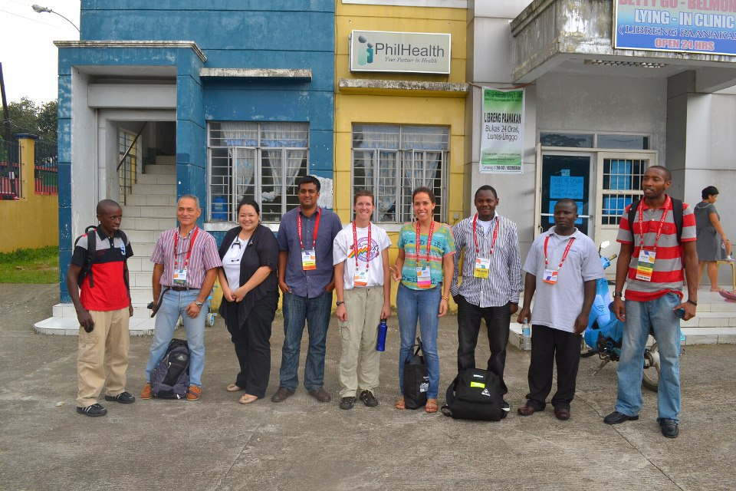


Patient-Specific

Slide 3

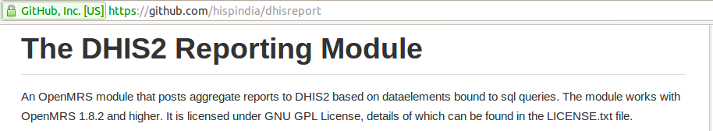


'
“Bob Jolliffe is the author of the OpenMRS' DHIS2 Reporting Module.
Saptarshi Purkayastha also contributed to the module.
HISP India maintains the module that can be found at
https://github.com/hispindia/dhisreport

Slide 4

Anne
________________
_Female_________
_Pregnant________
_BP = 120/80_____
________________
Anne
________________
_Female_________
_Pregnant________
_BP = 120/80_____
________________
Daniel
________________
_Male___________
_BP = 130/80_____
________________
Mary
________________
_Female_________
_Non-pregnant____
_BP = 140/90_____
________________
Kaye
________________
_Female_________
_Pregnant____
_BP = 100/60_____
________________

Slide 5


Slide 6
Person | Population
Concept Attribute | Indicator or Data element Data element category + Data element category options
Form | Dataset
Location | Organization Units

Slide 7
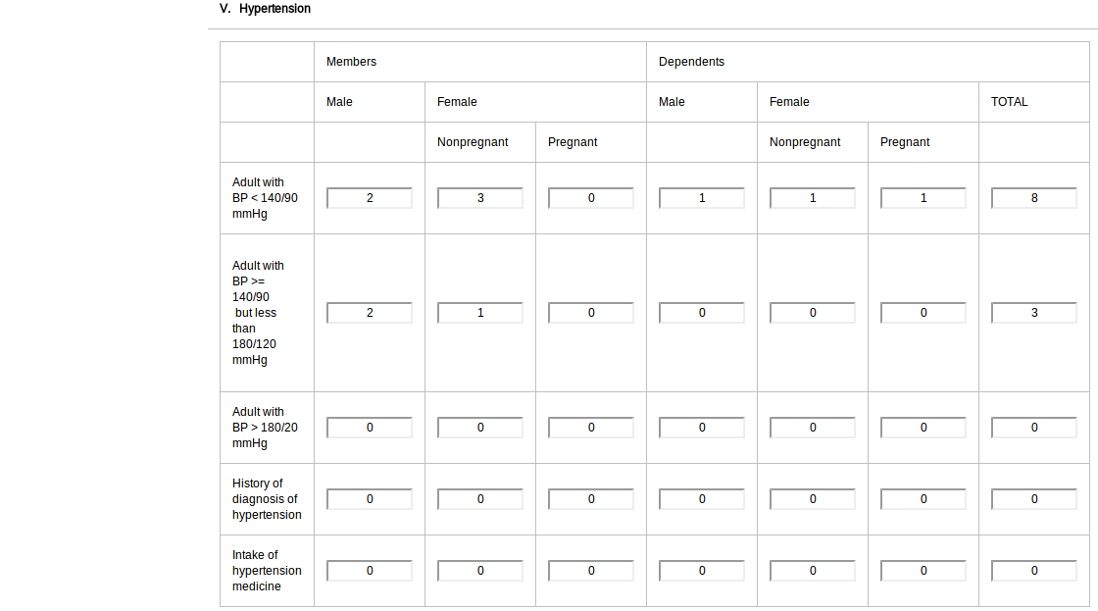

Slide 9
PROCEDURE
O – penMRS setup: omod, location
P – reparation of data and metadata
T – emplate formulation
I – mport template into OpenRMS
C – onnection of OpenMRS to DHIS2
S – ubmit data to DHIS2

Slide 10
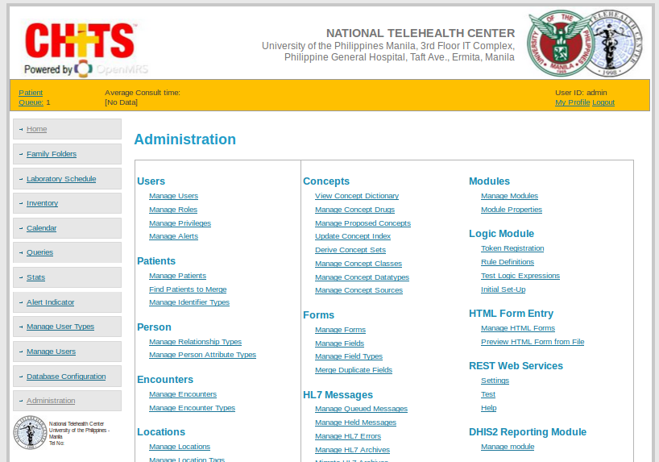
O – penMRS Setup: omod and location
REQUIREMENT: 1. OMOD

Slide 11
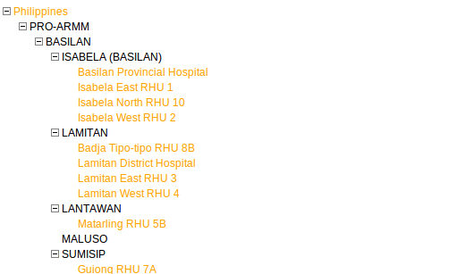
O – penMRS Setup: omod and location
REQUIREMENT: 2. UNIQUE FACILITY ID (USED IN THE DHIS2)
PHIL0000000000
PHIL1000000000
PHIL1000000000
PHIL1100000000
PHIL1100000001
PHIL1100000002
PHIL1100000003
PHIL1100000004
PHIL1200000000
PHIL1200000001
PHIL1200000002
PHIL1200000003
PHIL1200000004
PHIL1300000000
PHIL1300000001
PHIL1400000000
PHIL1500000000
PHIL1500000001
* sample values

Slide 12
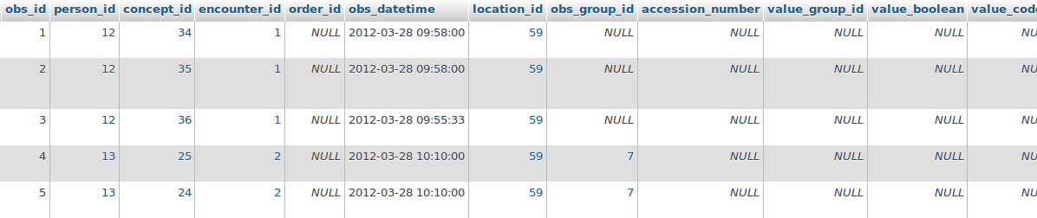
O – penMRS Setup: omod and location
Setting up an OPENMRS' location based on its DHIS2 organizational units' code
location.name
obs.location_id

Slide 13
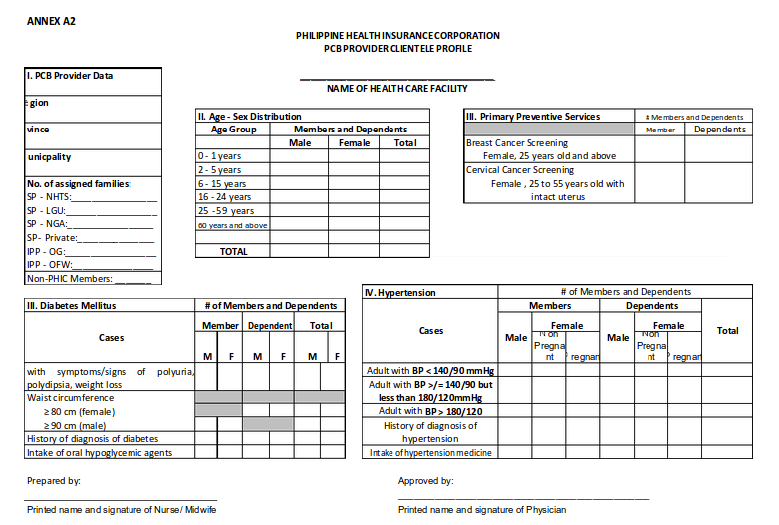
P – reparation of Data and Metadata (Mapping)

Slide 14
P – reparation of Data and Metadata (Mapping)
?
No. of adults with BP < 140/90 that are PhilHealth members,
female, pregnant
OPENMRS | DHIS2
Systolic Blood Pressure (<140) Diastolic Blood Pressure (<90) Pregnant (true) Gender (Female) PhilHealth membership (true) PhilHealth membership expiration (<endofPeriod) | Adult with BP <140/90 Member Female Pregnant
Data Element
Disaggregation

Slide 15
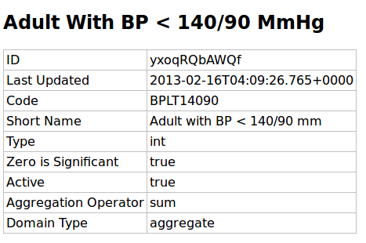
P – reparation of Data and Metadata (Mapping)
Data | Metadata
Adult with BP > 140/90
Member, Female, Pregnant | (same process of getting the metadata from http://philippines.dhis2.org/dhis/api)

Slide 16
T – emplate Formulation
INSERT THE MAPPED METADATA
<?xml version="1.0"?>
<reportTemplates xmlns:d2="http://dhis2.org/schema/dxf/2.0">
<dataElements>
<dataElement uid="yxoqRQbAWQf" code="BPLT14090"
name="Adult With BP Less than 140/90 MmHg" type="int"/>
</dataElements>
<disaggregations>
<disaggregation uid="gfWVfTtytf3" code="gfWVfTtytf3" name="Member,Female, Pregnant"/>
</disaggregations>
<reportTemplate>
<name>PCB - A2 Form</name>
<uid>haWilOVWjx9</uid>
<code>PCBA2</code>
<periodType>Monthly</periodType>
<dataValueTemplates>
<dataValueTemplate dataElement="BPLT14090" disaggregation="gfWVfTtytf3">
<annotation>
SELECT count(DISTINCT …
</annotation>
<dataValueTemplate>
</dataValueTemplates>
</reportTemplate>
</reportTemplates>
*only a fragment of the query (due to space)
Adult with BP Less than 140/90mmHg; Member, Female, Pregnant

Slide 17
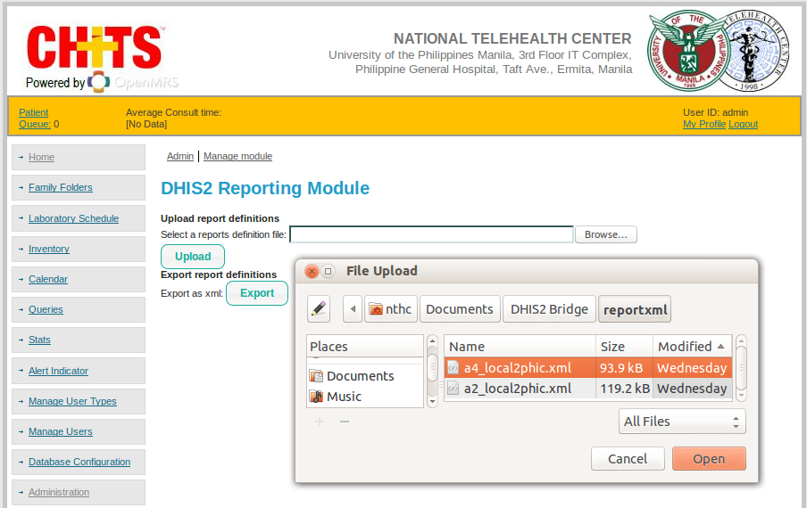
I – Import template into OpenMRS

Slide 18
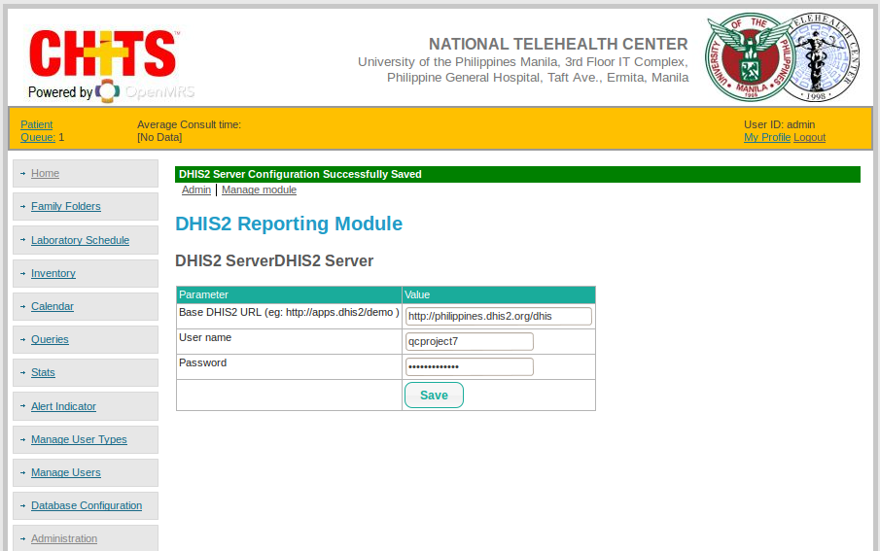
C – onnection of OpenMRS to DHIS2

Slide 19
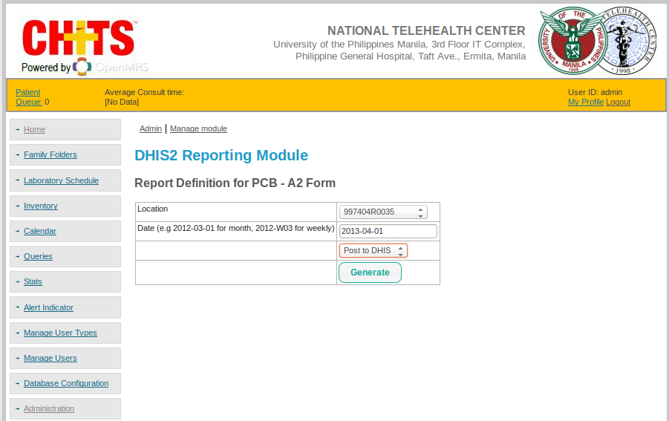
S – ubmit data to DHIS2

Slide 20
STEPS

Slide 21
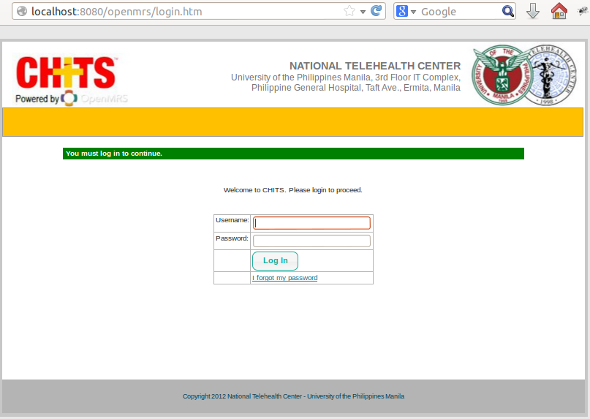
I.
N
A
V
I
G
A
T
E
Go to your CHITS link (i.e. http://localhost:8080/openmrs)

Slide 22
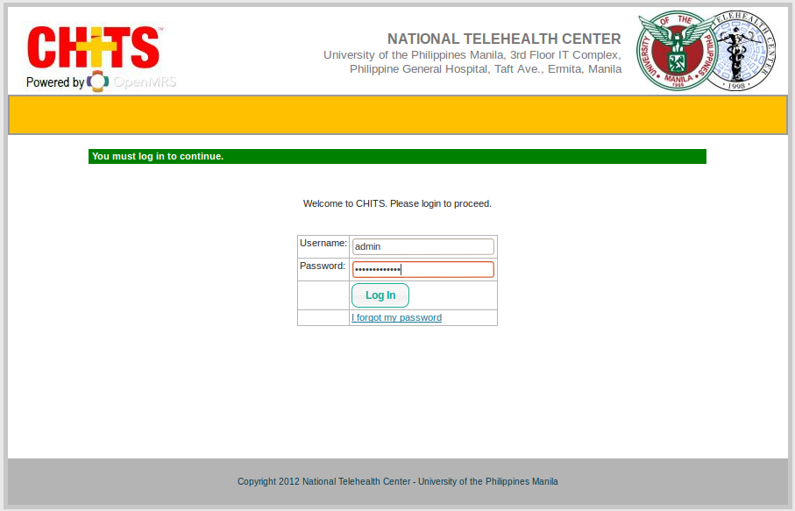
Login using your openmrs credentials

Slide 23
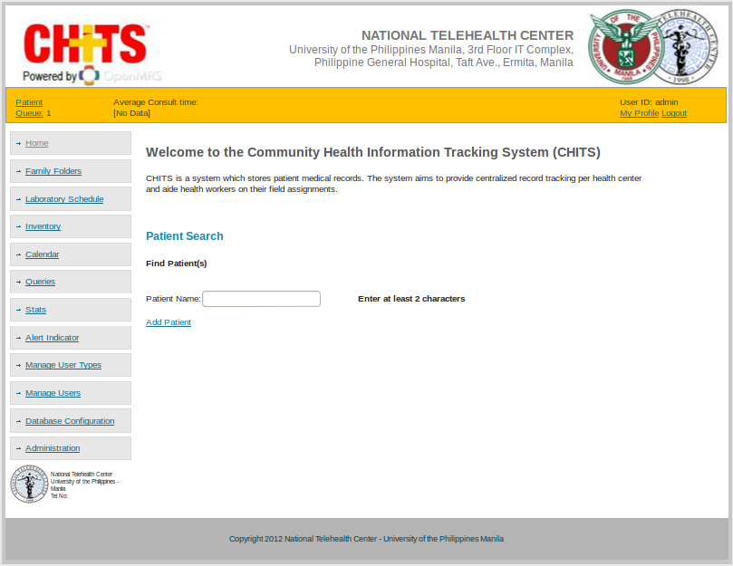
I.
A
C
C
E
S
S
Click “Administration” button (left panel)

Slide 24
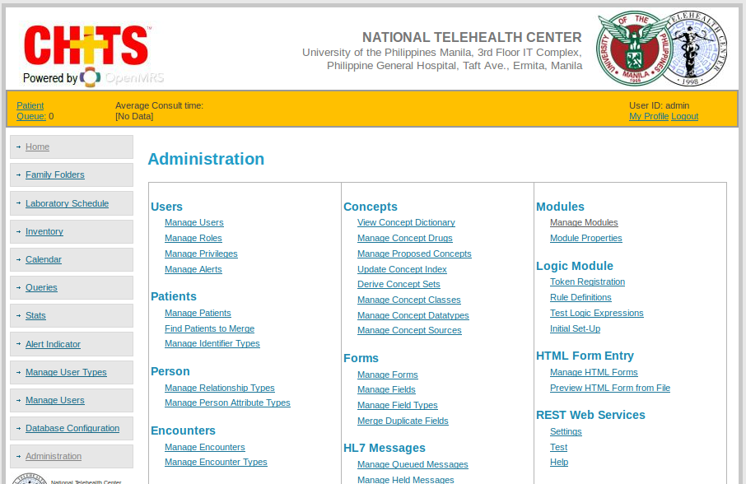
Click the “Manage Module” link under Modules (section)

Slide 25
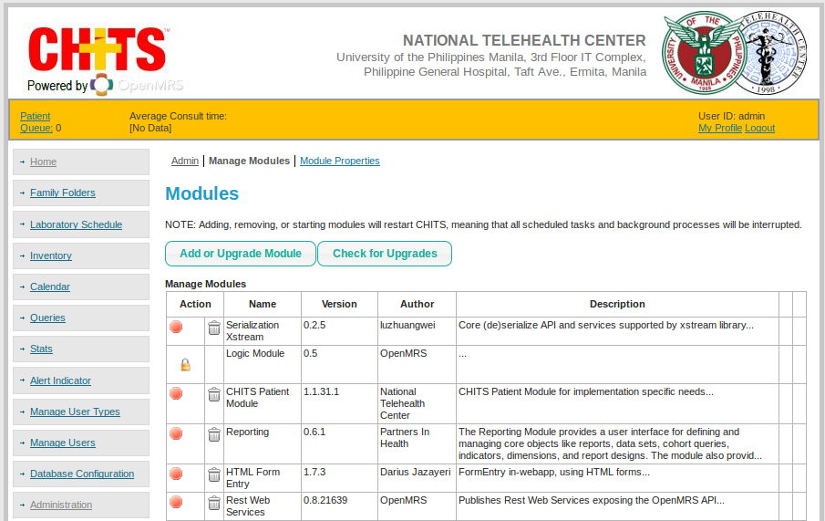
Click “Add or Upgrade Module” (button)

Slide 26
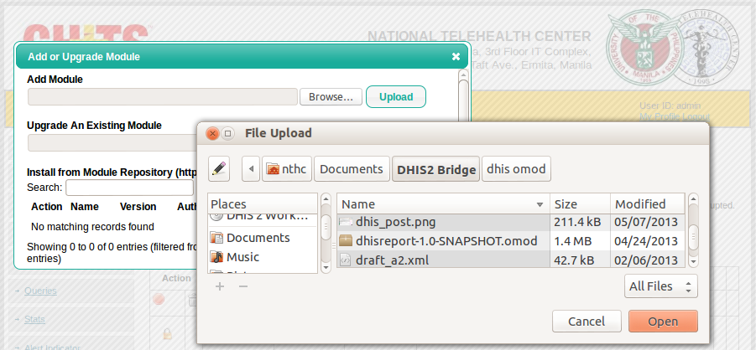
Click “Browse “to “Open” the DHIS2 Reporting Module omod file
(“dhisreport-1.0-SNAPSHOT.omod”) and then “Upload”

Slide 27
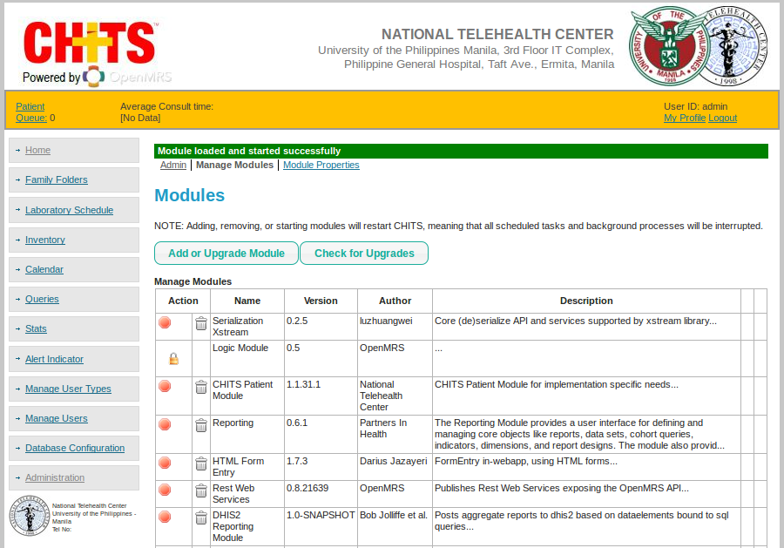
Note that the module named “DHIS2 Reporting Module” will then be listed.
Click “Admin”.

Slide 28
I.
A
C
C
E
S
S
The “DHIS2 Reporting Module” is now added.
To open this module, click the link “Manage Module” below this section.

Slide 29
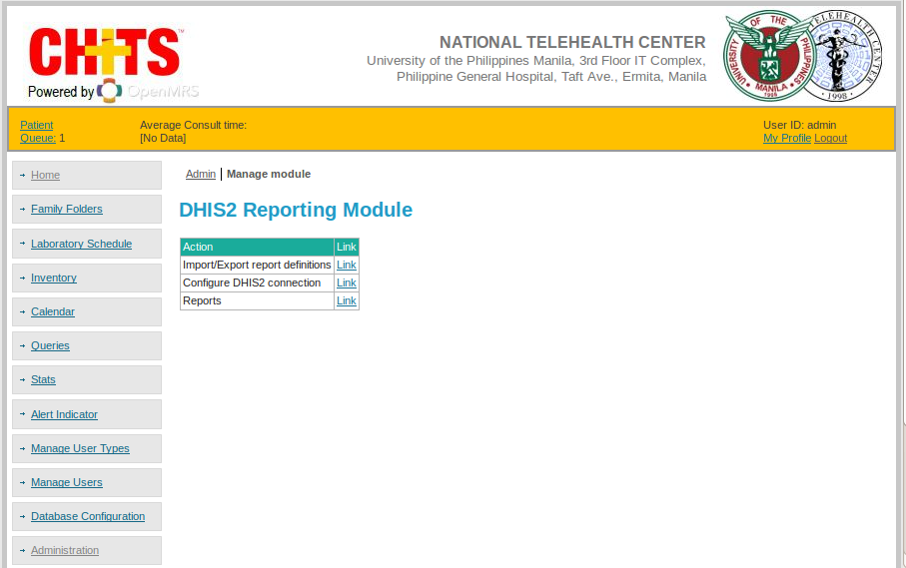
I.
A
C
C
E
S
S
“DHIS2 Reporting Module” page

Slide 30
SETUP THE OPENMRS LOCATION
(Database check c/o Developer):
Setting up an OPENMRS' location based on its DHIS2 organizational units' code
location.name
obs.location_id

Slide 31
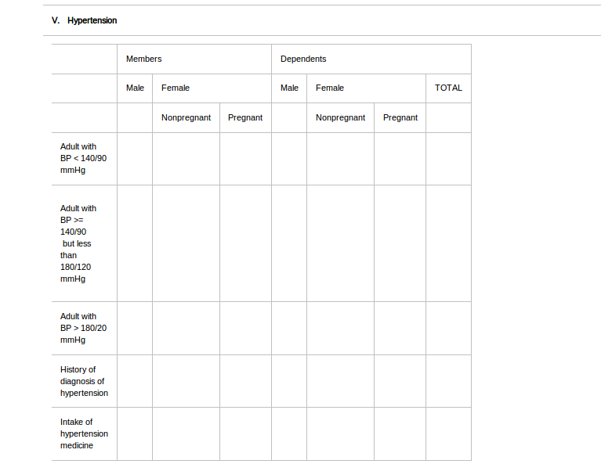
ANALYZE THE HEALTH DATA
Female, pregnant, adult with BP < 140/90 mmHg
1. Data Element: ?
2. Data Element Category: ?
3. Data Element Category Combination: ?

Slide 32
ANALYZE THE HEALTH DATA
Female, pregnant, adult with BP < 140/90 mmHg
1. Data Element: Adult with BP < 140/90 mmHg
2. Data Element Category: Gender with Pregnancy Status, Membership
3. Data Element Category Combination: membership_genderwithps_combo
– There may be other possible ways in dissecting the data element, category, and category combination.
Note that we may also further separate the “Gender with Pregnancy Status” category to two:
Gender and Pregnancy Status. But this is not practiced since it would create an option of “Male, Pregnant”.

Slide 33
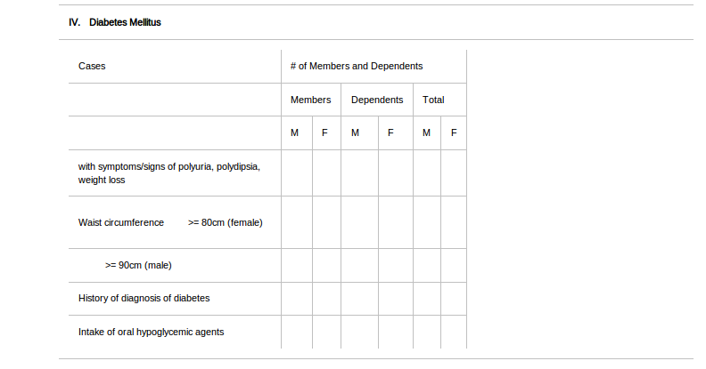
ANALYZE THE HEALTH DATA
Male, Dependents, History of diagnosis of diabetes
1. Data Element: ?
2. Data Element Category: ?
3. Data Element Category Combination: ?

Slide 34
ANALYZE THE HEALTH DATA
Male, Dependents, Intake of oral hypoglycemic agents
1. Data Element: Intake of Oral Hypoglycemics
2. Data Element Category: Gender, Membership
3. Data Element Category Combination: membership_gender_combo

Slide 35
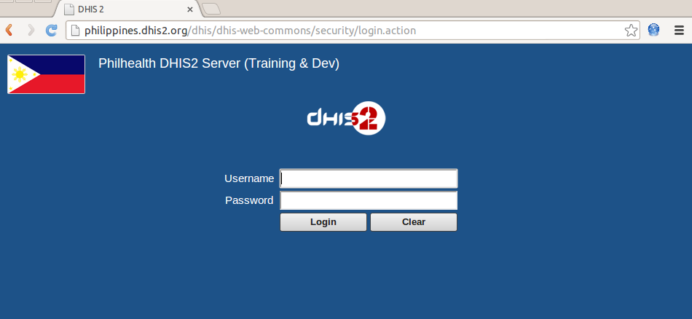
I.
A
C
C
E
S
S
Go to the link of the DHIS in your browser.
(i.e. philippines.dhis2.orgs/dhis )
--Note: this is the test server. You may inquire for the official production server of PhilHealth along with your account.--

Slide 36
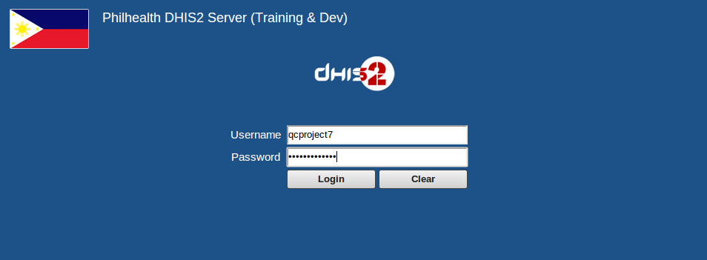
Login using your official PhilHealth's DHIS username and password.

Slide 37
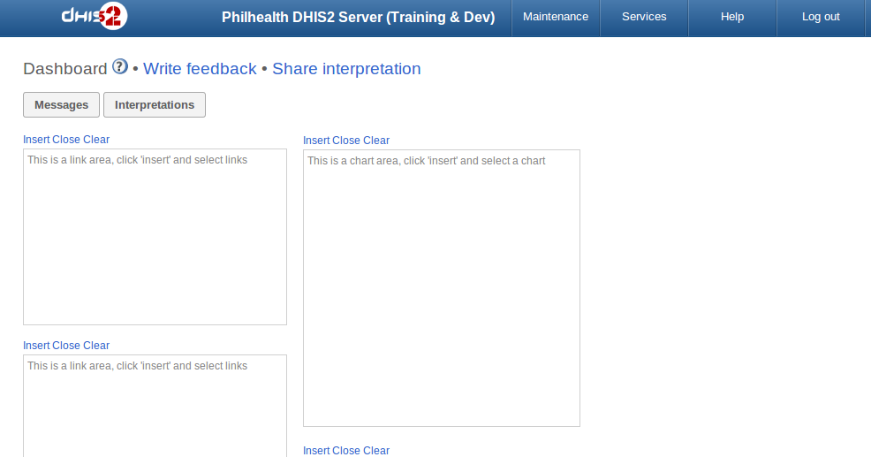
Click the “Maintenance” tab on the top menu

Slide 38
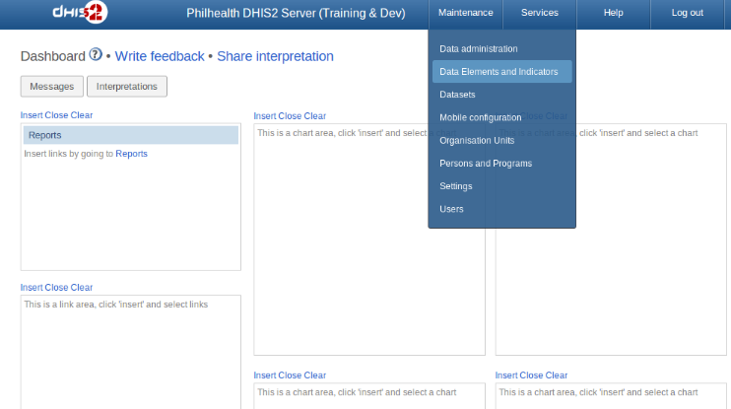
Select the “Data Elements and Indicators” option below the “Maintenance”
of the top menu

Slide 39
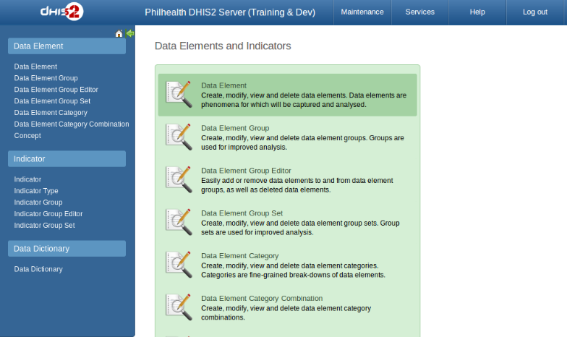
I. CREATING DATA ELEMENT CATEGORY
Click the “Data Element Category” section in the central area.
** Note that before you create a data element, its category combination must be specified.
If that's still not existing, it is recommended to start with
“Data Element Category”, then “Data Element Category Combination” before the “Data Element” itself.

Slide 40
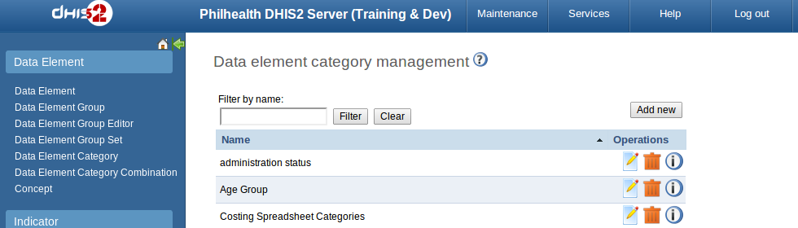
I. CREATING DATA ELEMENT CATEGORY
Click “Add new”

Slide 41
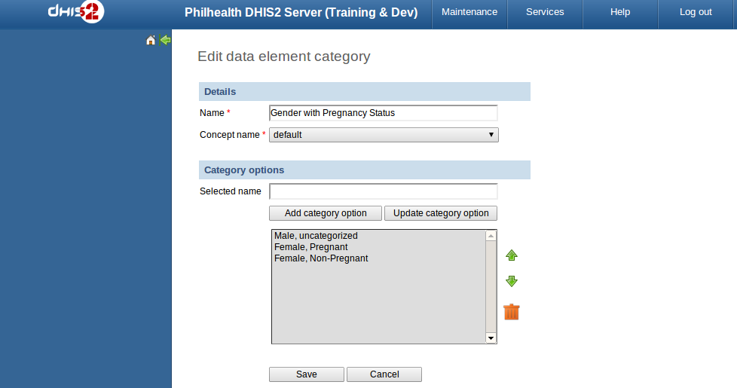

I. CREATING DATA ELEMENT CATEGORY
Fill up the fields for the “Create new data element category” page.
You can make different options by putting one on the “selected name” textfield, then
Click “Add category option”. Click save.

Slide 42
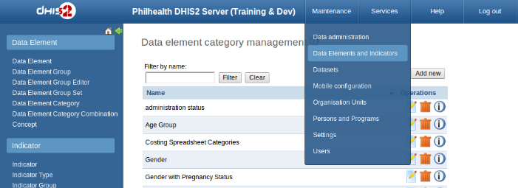
II. CREATING DATA ELEMENT CATEGORY COMBINATION
After adding the needed “Data Element Category”,
go to “Maintenance” > “Data Elements and Indicators” to set the
“Date Element Category Combination”

Slide 43
II. CREATING DATA ELEMENT CATEGORY COMBINATION
Click the “Data Element Category Combination” section in the central area

Slide 44
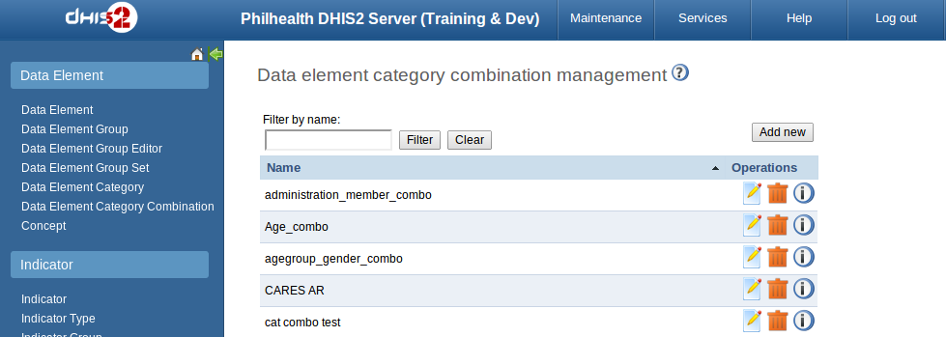
II. CREATING DATA ELEMENT CATEGORY COMBINATION
Click “Add new”

Slide 45
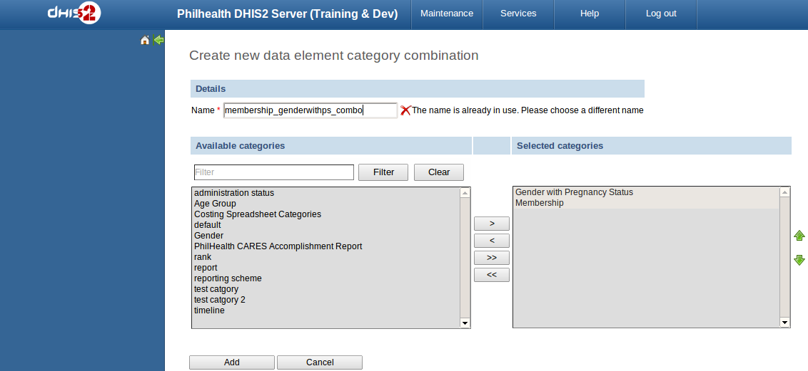
II. CREATING DATA ELEMENT CATEGORY COMBINATION
Click “Add” after naming the combination and selecting its categories.
Note that you can't use the same name when adding metadata.

Slide 46
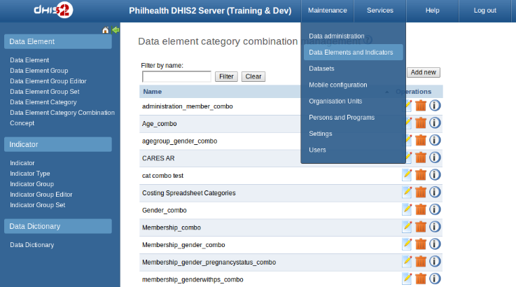
III. CREATING DATA ELEMENT
Now that the data element category exists, we can now create the “Data Element”.
Click again “Data Elements and Indicators”

Slide 47
III. CREATING DATA ELEMENT
Click the “Data Element” section in the central area

Slide 48
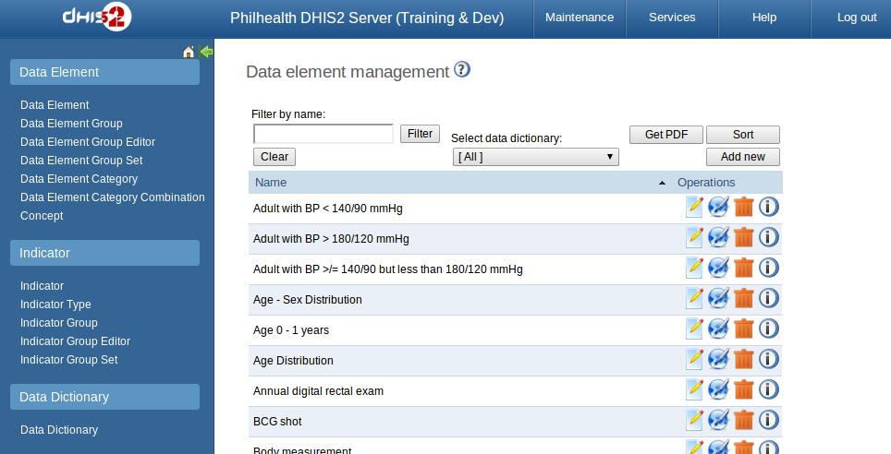
III. CREATING DATA ELEMENT
Click “Add new” button

Slide 49
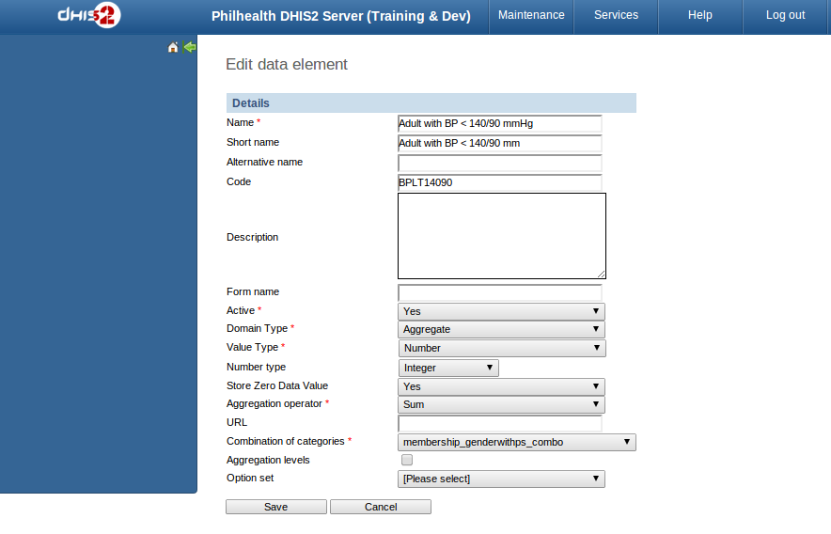

III. CREATING DATA ELEMENT
Fill up the following and make sure that the “code” field is not left blank.

Slide 50
III. CREATING DATA ELEMENT

Slide 51
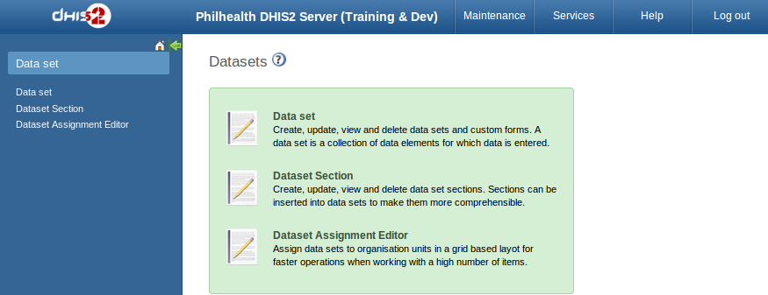
DATA SET
Click “Data set” in the central area

Slide 52
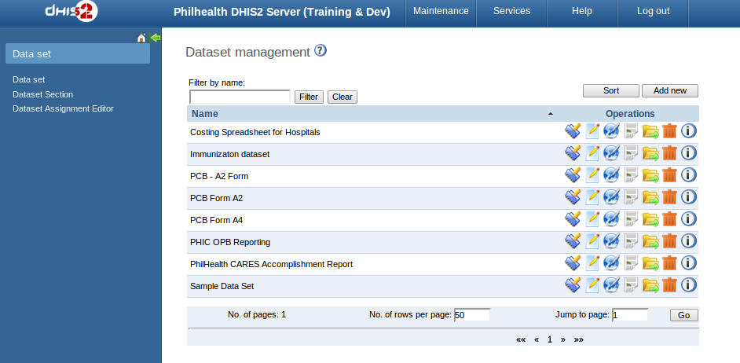
DATA SET
Click “Add new” button

Slide 53
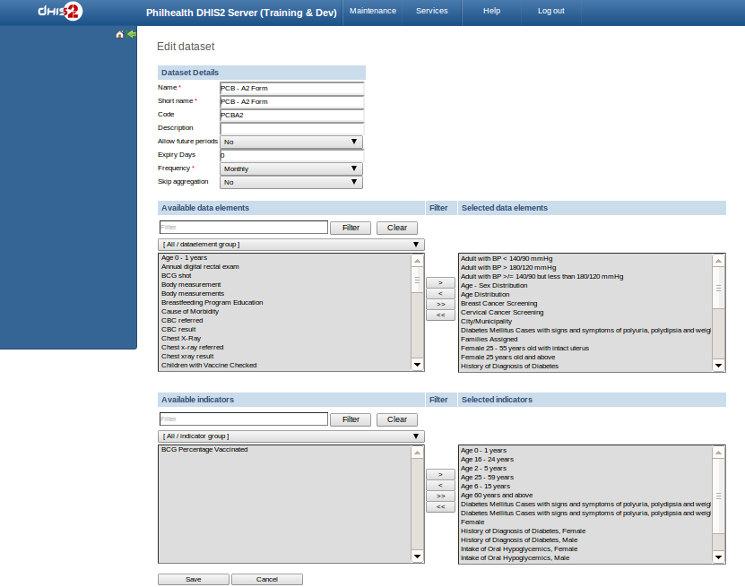
DATA SET
Fill up the fields. Add the needed dataelements / indicators using “>”. Save.

Slide 54
DATA SET
Click the paper-like icon to design the dataentry form.

Slide 55
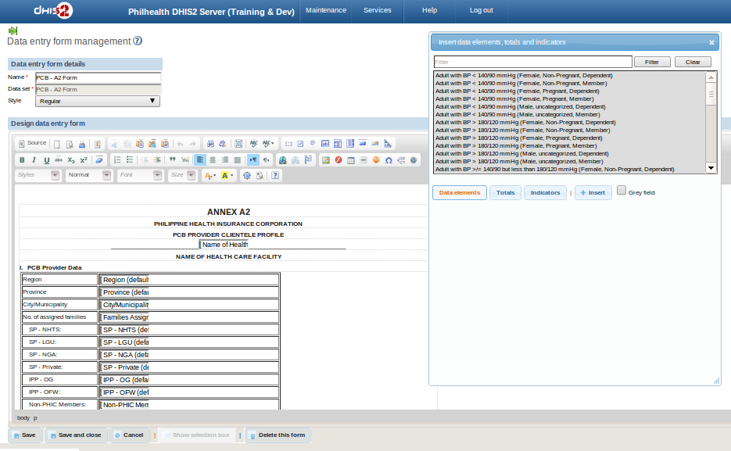
DATA SET
Fill up the the fields. To display the popup for the list of metadata,
click the button “Show Selection box”. After, click “save and close”.
You may also change the code/design using “Source” tab (html).

Slide 56
DATA SET
Note: The first icon opposite the dataset may be used to
assign dataset to organisation units.

Slide 57
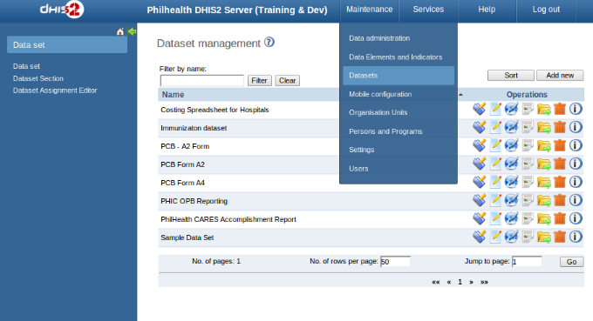
DATA SET
Click “Datasets” under “Maintenance” menu.

Slide 58
Click “Dataset” Assignment Editor to allow specific health facility to use that report form.

Slide 59
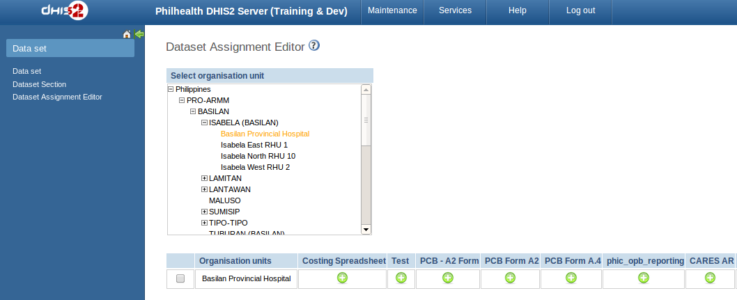
Click for the health facility (it will automatically turned orange once selected). Then click the green circle corresponding to the report form that they could have access.

Slide 60
CREATE THE XML FILE
<?xml version="1.0"?>
<reportTemplates xmlns:d2="http://dhis2.org/schema/dxf/2.0">
<dataElements>
<dataElement uid="*" code="*" name="*" type="*"/>
<dataElement uid="*" code="*" name="*" type="*"/>
</dataElements>
<disaggregations>
<disaggregation uid="*" code="*" name="*"/>
<disaggregation uid="*" code="*" name="*"/>
</disaggregations>
<reportTemplate>
<name>*</name>
<uid>*</uid>
<code>*</code>
<periodType>*</periodType>
<dataValueTemplates>
<dataValueTemplate dataElement=”*” disaggregation=”*”>
<annotation>
*
</annotation>
</dataValueTemplate>
<dataValueTemplate dataElement=”*” disaggregation=”*”>
<annotation>
*
</annotation>
</dataValueTemplate>
</dataValueTemplates>
</reportTemplate>
</reportTemplates>

Slide 61
INSERT THE MAPPED METADATA
<?xml version="1.0"?>
<reportTemplates xmlns:d2="http://dhis2.org/schema/dxf/2.0">
<dataElements>
<dataElement uid="yxoqRQbAWQf" code="BPLT14090"
name="Adult With BP Less than 140/90 MmHg" type="int"/>
</dataElements>
<disaggregations>
<disaggregation uid="gfWVfTtytf3" code="gfWVfTtytf3" name="Member,Female, Pregnant"/>
</disaggregations>
<reportTemplate>
<name>PCB - A2 Form</name>
<uid>haWilOVWjx9</uid>
<code>PCBA2</code>
<periodType>Monthly</periodType>
<dataValueTemplates>
<dataValueTemplate dataElement="BPLT14090" disaggregation="gfWVfTtytf3">
<annotation>
SELECT count(DISTINCT …
</annotation>
<dataValueTemplate>
</dataValueTemplates>
</reportTemplate>
</reportTemplates>
*only a fragment of the query (due to space)
Adult with BP Less than 140/90mmHg; Member, Female, Pregnant

Slide 62
INSERT THE MAPPED METADATA
<?xml version="1.0"?>
<reportTemplates xmlns:d2="http://dhis2.org/schema/dxf/2.0">
<dataElements>
<dataElement uid="yxoqRQbAWQf" code="BPLT14090"
name="Adult With BP Less than 140/90 MmHg" type="int"/>
</dataElements>
<disaggregations>
<disaggregation uid="gfWVfTtytf3" code="gfWVfTtytf3" name="Member,Female, Pregnant"/>
</disaggregations>
<reportTemplate>
<name>PCB - A2 Form</name>
<uid>haWilOVWjx9</uid>
<code>PCBA2</code>
<periodType>Monthly</periodType>
<dataValueTemplates>
<dataValueTemplate dataElement="BPLT14090" disaggregation="gfWVfTtytf3">
<annotation>
SELECT count(DISTINCT …
</annotation>
<dataValueTemplate>
</dataValueTemplates>
</reportTemplate>
</reportTemplates>
*only a fragment of the query (due to space)
Adult with BP Less than 140/90mmHg; Member, Female, Pregnant

Slide 63
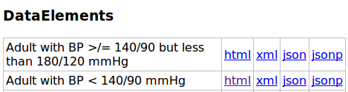
INSERT THE MAPPED METADATA
<dataElement>
1. Go to: http://philippines.dhis2.org/dhis/api/dataElements
2. Click the “html” link opposite the dataeElement
name
uid
code
type
3. In the xml, replace the value for dataElement:
uid = “<ID>” code = “<Code>”name=”<dataElementName>”
<dataElements>
<dataElement uid="yxoqRQbAWQf" code="BPLT14090"
name="Adult With BP Less than 140/90 MmHg" type="int"/>
</dataElements>

Slide 64

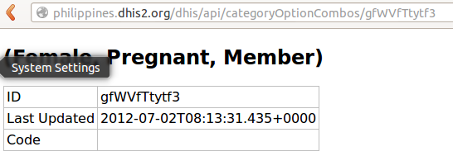
INSERT THE MAPPED METADATA
<disaggregations>
1. Depending on the disaggregation used for that field, go to:
http://philippines.dhis2.org/dhis/api/categoryOptions or
http://philippines.dhis2.org/dhis/api/categoryOptionCombos
2. Click the “html” link opposite the categoryOption/categoryOptionCombo
name
uid, code
3. In the xml, replace the value for disaggregation:
uid = “<ID>” code = “<ID>” name=”<CategoryOption(+-Combos)Name>”
<disaggregations>
<disaggregation uid="gfWVfTtytf3" code="gfWVfTtytf3"
name="Female, Pregnant, Member"/>
</disaggregations>

Slide 65
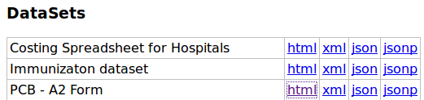
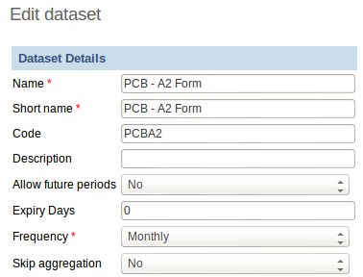
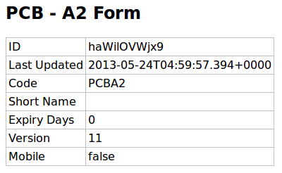
INSERT THE MAPPED METADATA
<reportTemplate>
1. Go to: http://philippines.dhis2.org/dhis/api/dataSets
3. Go to “Maintenance”> “Datasets” >
“Data Set” > Edit Icon of that dataset
2. Click the “html” link opposite the dataSet
name
uid
code
periodType
4. In the xml, replace the value for reportTemplate: uid = “<ID>” code = “<Code>”
name=”dataSetName>” periodType=”<based on the dataSet value for frequency”>
<reportTemplate>
<name>PCB - A2 Form</name>
<uid>haWilOVWjx9</uid>
<code>PCBA2</code>
<periodType>Monthly</periodType>
<dataValueTemplates>
</dataValueTemplates>
</reportTemplate>

Slide 66
CREATE THE QUERY FOR EACH DATA
<dataValueTemplate>
<reportTemplate>
<name>PCB - A2 Form</name>
<uid>haWilOVWjx9</uid>
<code>PCBA2</code>
<periodType>Monthly</periodType>
<dataValueTemplates>
<dataValueTemplate dataElement="BPLT14090" disaggregation="gfWVfTtytf3">
<annotation>
select count(distinct o.person_id) from obs o inner join person p on o.person_id = p.person_id where p.voided = 0 and o.voided = 0
and p.gender = 'F'
and o.concept_id IN ((SELECT concept_id FROM concept_name WHERE name="Systolic Blood Pressure" LIMIT 1),(SELECT concept_id FROM concept_name WHERE name="Diastolic Blood Pressure" LIMIT 1))
and (o.obs_datetime >= :startOfPeriod or o.obs_datetime &lt;= :endOfPeriod)
and o.person_id IN (SELECT pa.person_id FROM person_attribute pa
WHERE pa.person_attribute_type_id IN (SELECT person_attribute_type_id FROM person_attribute_type
WHERE name='CHITS_PHILHEALTH_EXPIRATION')
and DATEDIFF(:endOfPeriod, STR_TO_DATE( `value` , '%m/%d/%Y' )) &lt; 0 and voided = 0 )
and o.person_id NOT IN (
SELECT pa.person_id FROM person_attribute pa WHERE
pa.value = (SELECT concept_id from concept_name WHERE name='Dependent of a PHIC member' LIMIT 1) and voided = 0)
and o.person_id IN
(SELECT o.person_id FROM obs o WHERE o.concept_id = (SELECT concept_id FROM concept_name where name='consult status' LIMIT 1) and o.value_text IN ('CHITS Maternal Care - Active','CHITS Lying-in Admitted'))
and o.person_id IN
(SELECT o.person_id FROM obs o WHERE o.value_numeric &lt; 140 and obs_id IN (SELECT max(obs_id) FROM obs WHERE
concept_id = (SELECT concept_id FROM concept_name WHERE name="Systolic Blood Pressure" LIMIT 1) GROUP BY person_id ))
and o.person_id IN
(SELECT o.person_id FROM obs o WHERE o.value_numeric &lt; 90 and obs_id IN (SELECT max(obs_id) FROM obs WHERE
concept_id = (SELECT concept_id FROM concept_name WHERE name="Diastolic Blood Pressure" LIMIT 1) GROUP BY person_id ))
and o.location_id = :locationId
</annotation>
</dataValueTemplate>
</dataValueTemplates>
</reportTemplate>
DataElement: Adult with BP < 140/90 mmHg Disaggregation: Female, Pregnant, Member
1. In the xml, replace the value for dataValueTemplate:
dataElement = “<Code of the dataElement>” dataElement = “<Code of the categoryOption(+-Combination)>” 2. Put the mysql query inside the annotation tag.

Slide 67
TIPS IN CREATING THE QUERY
1. Make sure that the following variables are found in the query statement.
:startOfPeriod
:endOfPeriod
:locationId
2. Instead of writing the “<” symbol, use “&lt;”.
3. The query should return one and only one value. Do not use two statements.
4. Sending NULL result is not permitted in the query.
5. When searching for count of patients/people with specific attribute or
observation, it is advised to use “COUNT(DISTINCT person_id)...”.
The report templates (xml) for the
PCB A2 and PCB A4 can be found at:
https://github.com/hakuna21/DHIS2_CHITS-OpenMRS

Slide 68
I.
A
C
C
E
S
S
Click “Administration” button (left panel)

Slide 69
I.
A
C
C
E
S
S
The “DHIS2 Reporting Module” is now added.
To open this module, click the link “Manage Module” below this section.

Slide 70
I.
A
C
C
E
S
S
Click “Link” opposite the label of “Import/Export report definitions”.

Slide 71
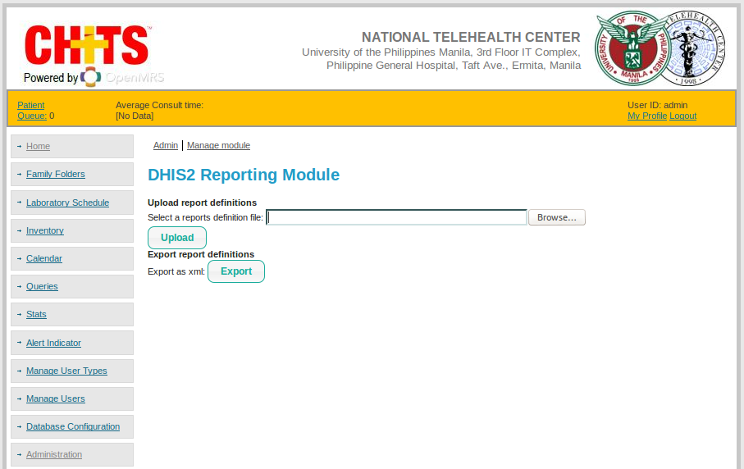
Click “Link” opposite the label of “Import/Export report definitions”.

Slide 72
“Open” the report xml file.

Slide 73
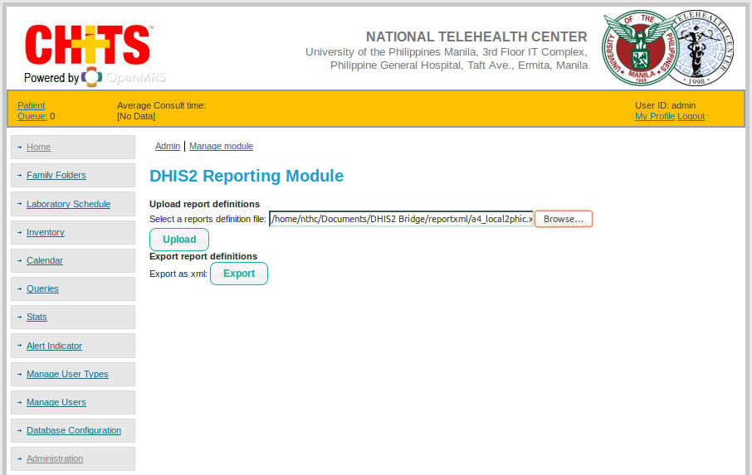
Click “Upload”.

Slide 74
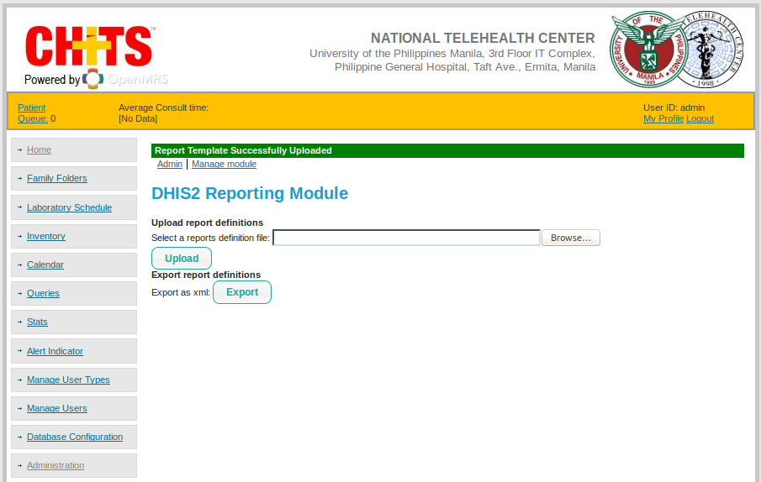
The template import process is finished with notification of
“Report Template Successfully Uploaded”.

Slide 75
I.
A
C
C
E
S
S
Click the “Link” opposite the label “Configure DHIS2 connection”

Slide 76
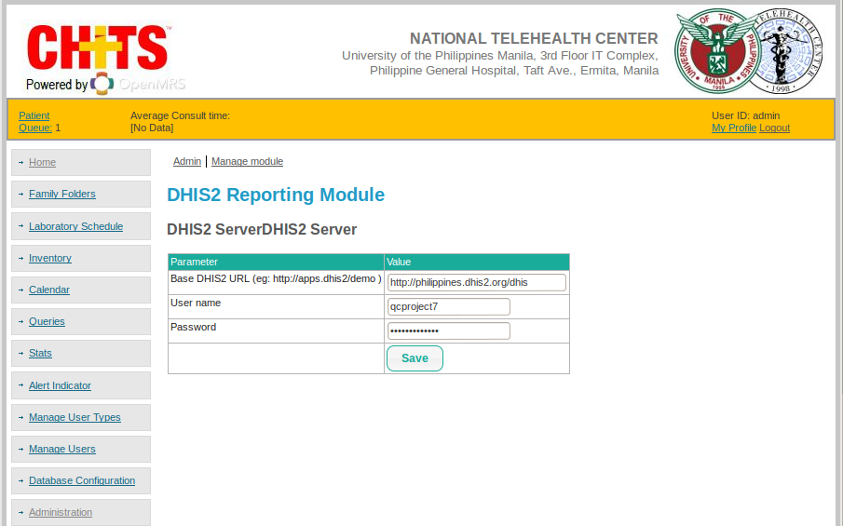
I.
A
C
C
E
S
S
Fill up the fields with the (1) Philhealth's link,
(2) PhilHealth's username and (3) PhilHealth's password.
-- The details will be given to you by the CHITS coordinator--

Slide 77
I.
A
C
C
E
S
S
Click “Save” button.

Slide 78
I.
A
C
C
E
S
S
Click the “Link” opposite the label “Reports”

Slide 79
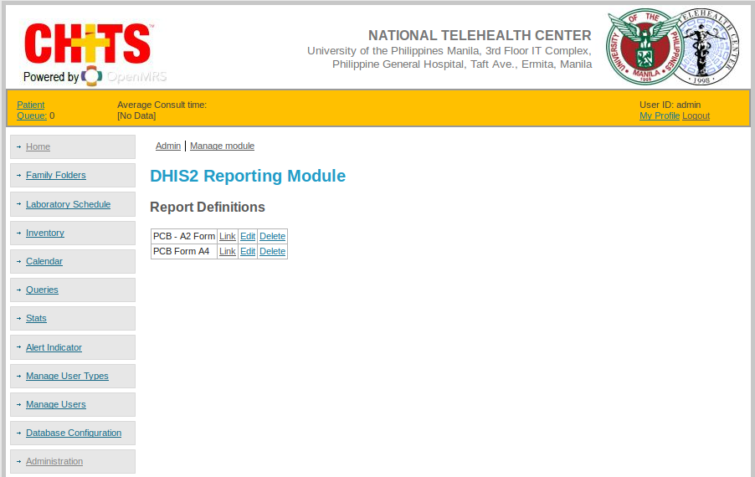
If you wish to submit A2 Form:
Click the “Link” opposite the label “PCB – A2 Form”

Slide 80
If you wish to submit A4 Form:
Click the “Link” opposite the label “PCB Form A4”

Slide 81

The default “Location” is based on your own facility code.
--part of CHITS installation--

Slide 82

Enter the date of the period in “YYYY-MM-DD” format.
(i.e. 2013-04-01)

Slide 83
Change the dropdown from “Preview” to “Post to DHIS”.

Slide 84
Click “Generate” button.
--Note: this will then send the aggregate data to PhilHealth's DHIS
in around 2-4 minutes--

Slide 85
I.
A
C
C
E
S
S
Go to the link of PhilHealth's DHIS on your browser.
(i.e. philippines.dhis2.orgs/dhis )
--Note: this is the test server. The coordinator will give you the official production server of PhilHealth along with your account.--

Slide 86
Login using your official PhilHealth's username and password.

Slide 87
Click the “Maintenance” tab on the top menu

Slide 88

Select “Data Entry” from the dropdown options of “Services”

Slide 89

Select the needed “Data Set” and “Period”.

Slide 90

After changing the “Data Set” and “Period”, the data submitted from CHITS will automatically be viewed.
--Note: you cannot view the data from other health centers (Privacy)--

Slide 91

View the submitted data (PCB A2 Form - I)

Slide 92

View the submitted data (PCB A2 Form - III)

Slide 93

View the submitted data (PCB A2 Form - III)

Slide 94

View the submitted data (PCB A2 Form - IV)

Slide 95
View the submitted data (PCB A2 Form - V)

Slide 96
Select the needed “Data Set” and “Period”.

Slide 97

The data submitted from CHITS will automatically be displayed.

Slide 98

View the submitted data (PCB Form A4 – I, II, III)

Slide 99

View the submitted data (PCB Form A4 – IV, V)

Slide 100

View the submitted data (PCB Form A4 – VI. Primary Preventive Services)

Slide 101

View the submitted data (PCB Form A4 – VI. Diagnostic Examinations)

Slide 102
View the submitted data (PCB Form A4 – IV, V)

Slide 103

Click “Complete” button so the DHIS2's function of
Reporting Rate Summary will detect this submission.

Slide 104

Click “OK” button.

Slide 105


O - Omod
U - Unique Facility Code
R - Report Design
O – OpenMRS Setup: omod and location
P – reparation:of the Metadata and Datasets in DHIS2 (Mapping of Data)
T – Template: Formulation
I - Import: template OpenMRS' Module
C – onnection: of OpenMRS to DHIS2
S – Submit from OpenMRS to DHIS2

Slide 106

“BETTER INFORMATION, BETTER DECISION, BETTER HEALTH.”

Slide 107
THANK YOU.

