Slide 1
Data Structures(5CS203)
Course Objectives:
To make the students understand elementary linear and non-linear data structures and concepts of ADTs.
To develop and improve logical thinking and to make the students capable of applying appropriate data structure for modelling a given problem.
To provide a foundation to analyze and compare various searching and sorting techniques and to select appropriate technique to solve the problem.

Slide 2
Data Structure
A data structure is a special way of organizing and storing data in a computer so that it can be used efficiently. Array, LinkedList, Stack, Queue, Tree, Graph etc. are all data structures that stores the data in a special way so that we can access and use the data efficiently.
Need of Data Structure
Speed: Data structures allows faster retrieval, addition, deletion and modification of records.
Save disk space: Data structure allows efficient storing of data thus allows disk space saving.
Handling multiple requests: Data structure allows multiple data processing requests. For example, one person fetching the record while other person is simultaneously updating the data.

Slide 3
Algorithm
Algorithm is a step-by-step procedure, which defines a set of instructions to be executed in a certain order to get the desired output. Algorithms are generally created independent of underlying languages, i.e. an algorithm can be implemented in more than one programming language.
Characteristics of an Algorithm
Unambiguous− Algorithm should be clear and unambiguous. Each of its steps (or phases), and their inputs/outputs should be clear and must lead to only one meaning.
Input− An algorithm should have 0 or more well-defined inputs.
Output− An algorithm should have 1 or more well-defined outputs, and should match the desired output.
Finiteness− Algorithms must terminate after a finite number of steps.
Feasibility− Should be feasible with the available resources.
Independent− An algorithm should have step-by-step directions, which should be independent of any programming code.

Slide 4
Algorithm
Search Algorithm in Array
Step 1. Start from the leftmost element of arr[] and one by one compare x with each element of arr[].
Step 2. If x matches with an element, return the index.
Step 3. If x doesn’t match with any of elements, return -1.

Slide 5
Pseudocode
One of the most common tool for defining algorithms is pseudocode, which is part English, part structured code.
The English part provides a relaxed syntax that describes what must be done without showing unnecessary details such as error messages. The code part consists of an extended version of the basic algorithmic constructs-sequence, selection, and iteration.
Pseudocode is an English-like representation of the algorithm logic.
Pseudocode is one of the methods that can be used to represent an algorithm.
Example:
Algorithm linearSearch(list, searchTerm):
1 FOR index FROM 0 -> length(list):
1 IF list[index] == searchTerm THEN
1 RETURN index
ENDIF
ENDLOOP
2 RETURN -1
END linearSearch

Slide 6
Pseudocode
  Algorithm Header
  Purpose, Conditions ,Return
Expressions:
  Use statement number
  Variables
  Use standard mathematical symbols to describe numeric and boolean expressions
  Use <- for assignment
  Use = for the equality relationship
  Method declarations:
    Algorithm name(param1, param2)
    Programming concepts
      Decision structures: if … then … [else …]
      While-loops: while… do
      Repeat-loops: repeat … until …
      For- loop: for … do
      Array indexing: A[i], A[i,j]
  Methods:
    Calls: object method(args)
    Returns: return value

Slide 7
Pseudocode- Example
Algorithm sample (pageNumber)
This algorithm reads a file and prints a report.
Pre pageNumber passed by reference
Post Report Printed
pageNumber contains number of pages in report
Return Number of lines printed
1 loop (not end of file)
1 read file
2 if (full page)
1 increment page number
2 write page heading
3 end if
4 write report line
5 increment line count
2 end loop
3 return line count
end sample

Slide 8
Pseudocode- Example
Algorithm deviation
Pre nothing
Post average and numbers with their deviation printed
1 loop (not end of file)
1 read number into array
2 add number into array
3 increment count
2 end loop
3 set average to total /count
4 print average
5 loop(not end of array)
1 set devFromAve to array element – average
2 print array element and devFromAve
6 End loop
end deviation

Slide 9
Abstract Data Type
  Atomic and Composite Data
  Data Type
  Abstract Data Type
  Descriptions of how a data type will work without implementation details.
  Composition of an ADT
    A collection of data
    A set of operations on that data – create, update, query
    Definition: Abstract collection of data elements and their accessing functions, where we are not concerned about how the accessing function will be implemented is referred as Abstract Data Type or ADT in short.
    Examples of ADT
List, Array
Stack, Queue
Tree… and many more

Slide 10
Abstract Data Type
1. Declaration of data
2. Declaration of operations
3. Encapsulation of data and operation
  Array Abstract view
    Store set of elements of int type
    Read elements by position i.e. index
    Modify elements by index
    Perform sorting
Index position | 0 | 1 | 2 | 3
values | 10 | 20 | 30 | 40
Mem. address | 1000 | 1004 | 1008 | 1012

Slide 11
Data Structure
  An implementation of Abstract Data Type
      An organization of data
      A description of operations as functions (C functions)
    Data structures are containers: they hold other data
    Arrays and Lists
    Stack, Queue
    Tree, Binary Tree
    Binary Search Tree
    Definition: A data structure is an aggregation of atomic and composite data into a set with defined relationships.
    In this definition structure means a set of rules that holds the data together.
    In other words, if we take a combination of data and fit them into a structure such that we can define its relating rules, we have made a data structure. Data structures can be nested. Data Structures are mainly classified as linear and non linear data structure.

Slide 12
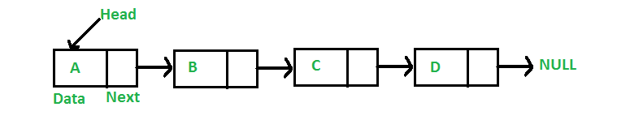
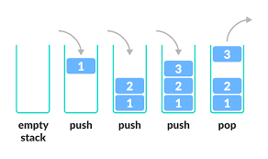
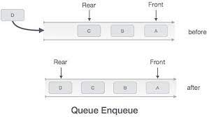
Fig: Linked List
Fig: Stack
Fig: Queue

Slide 13
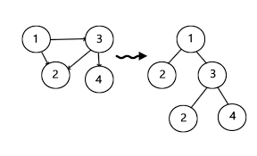
Fig: Tree and Graph

Slide 14
Operations on Data Structure
The data appearing in our data structures are processed by means of certain operations.
Traversing: Accessing each record exactly once so that certain items in the record may be processed.
Searching: Finding the location of the record with a given key value, or finding the locations of all records which satisfy one or more conditions.
Inserting: Adding a new record to the data structure.
Deleting: Removing a record from a data structure.
Sorting: Arranging the records in some logical order (i.e. alphabetically or numerically)
Merging: Combining the record in two different sorted files into a single sorted file.

Slide 15
Algorithmic efficiency
When comparing two different algorithms that solve the same problem, you often find that one algorithm is an order of magnitude more efficient than the other.
Algorithmics : “The systematic study of the fundamental techniques used to design and analyze efficient algorithms.”
The algorithm’s efficiency is expressed as a function of the number of elements to be processed.
The general format is: f(n) = efficiency
If a function is linear—that is, if it contains no loops or recursions—its efficiency is a function of the number of instructions it contains.
Linear Loops
The efficiency of a linear loop is f (n) = n.
for (i = 0; i < 1000; i++)
application code

Slide 16
Algorithmic efficiency
Linear Loop:
The efficiency of this linear loop is f(n) = n/2
Logarithmic Loops:
multiply loop: 2^Iterations < 1000
divide loop: 1000 / 2^Iterations >= 1
The efficiency of a logarithmic loop is f (n) = (log n).
for( i=0; i<1000; i+=2 )
application code
for( i=1; i<1000; i *= 2 ) application code | for( i = 1000; i > 1; i /= 2 ) application code

Slide 17
Nested Loop: iterations = outer loop iterations * inner loop iterations
  Linear Logarithmic:
The efficiency of linear logarithmic loop is f(n) = n log n
  Quadratic:
The efficiency of a Quadratic loop is f (n) = n^2.
Dependent Quadratic:
The efficiency of a Dependent Quadratic loop is f (n) = n * (n+1)/2.
for (i = 0; i < 10; i++)
for (j = 0; j < 10; j *= 2) application code
for (i = 0; i < 10; i++) for (j = 0; j < 10; j++) application code
for (i = 0; i < 10; i++)
for (j = 0; j < i; j++)
application code

Slide 18
Big O notation
Big O notation is used to measure how running time for your program grow as input size grows.
We have shown that the number of statements executed in the function for n elements is a function of the number of elements, expressed as f (n).
Although the equation derived for a function may be complex, a dominant factor in the equation usually determines the order of magnitude of the result.
Therefore, we don’t need to determine the complete measure of efficiency, only the factor that determines the magnitude. This factor is the big-O, as in “on the order of,” and is expressed as O(n)—that is, on the order of n.
This simplification of efficiency is known as big-O analysis.

Slide 19
Big O notation
For example, if an algorithm is quadratic, we would say its efficiency is O(n^2)
The big-O notation can be derived from f (n) using the following steps:
1. In each term, set the coefficient of the term to 1.
2. Keep the largest term in the function and discard the others. Terms are ranked from lowest to highest as shown below
logn n nlogn n^2 n^3 ... n^k 2^n n!
To calculate the big O notation for
f(n)=n(n+1)/2=1/2(n^2)+1/2(n)
First remove all coefficients. This gives us
n^2 + n
After removing smaller factors gives us
n^2
Which in big O notation is stated as
O(f(n)) = O(n^2)

Slide 20
Standard Measures of Efficiency
Efficiency | Big O | Iterations | Estimated Time
Logarithmic | O(log n) | 14 | microseconds
Linear | O(n) | 10,000 | seconds
Linear Logarithmic | O(n(log n)) | 140,000 | seconds
Quadratic | O(n^2) | 10,000^2 | Minutes
Polynomial | O(n^k) | 10,000^k | Hours
Exponential | O(c^n) | 2^10000 | Intractable
Factorial | O(n!) | 10,000! | Intractable

Slide 21
Recursion
The process in which a function calls itself directly or indirectly is called recursion and the corresponding function is called as recursive function.
Direct recursion is the simpler way as it only involves a single step of calling the original function or method or subroutine.
On the other hand, indirect recursion involves several steps. The first call is made by the original method to a second method, which in turn calls the original method. This chain of calls can feature a number of methods or functions.
In simple words, we can say that there is always a variation in the depth of indirect recursion, and this variation in depth depends on the number of methods involved in the process.
Direct recursion can be used to call just a single function by itself. On the other hand, indirect recursion can be used to call more than one method or function with the help of other functions, and that too, a number of times. Indirect recursion doesn’t make overhead while its direct counterpart does.

Slide 22
The recursive procedure must have following two properties so that it will not continue to run indefinitely.
There must certain criteria, called base criteria, for which the procedure does not call itself.
Each time the procedure does call itself (directly or indirectly), it must be closer to the base criteria.
Factorial –
Iterative factorial algorithm definition
1 if n = 0 Factorial(n)= n * (n-1)*(n-2)*……….*3*2*1 if n > 0
Recursive Factorial Algorithm Definition 1 if n = 0 Factorial(n)= n * (Factorial (n-1)) if n > 0

Slide 23
Iterative Factorial Algorithm
Algorithm iterativeFactorial (n)
calculates the factorial of a number using a loop
Pre n is the number to be raised factorially
Post n! is returned
1 set I to 1
2 set factN to 1
3 loop (i <= n)
1 set factN to factN * I
2 increment I
4 end loop
5 return factN
end iterativeFactorial

Slide 24
Recursive Factorial Algorithm
Algorithm recursiveFactorial (n)
calculates the factorial of a number using recursion
Pre n is the number to be raised factorially
Post n! is returned
1 if ( n equals 0)
1 return 1
2 else
1 return ( n * recursiveFactorial ( n – 1 ))
3 end if
end recursiveFactorial

Slide 25
Ackermann Function
The Ackermann function is function with two arguments each of which can be assigned any nonnegative integer: 0,1,2,…….. It is defined as follows:
Definition: (Ackermann Function)
( a ) If m = 0, then A(m, n) = n + 1.
( b ) If m != 0 but n = 0, then A(m, n) = A(m – 1, 1)
( c ) If m != 0 and n != 0, then A(m, n) = A(m – 1, A(m, n – 1))
We have recursive definition, since the definition refers to itself in parts (b) and (c ). When m = 0 A(m , n) is explicitly given.
Use the definition of the Ackermann function to find A(1 , 2)

Slide 26
Ackermann Function
A(1 , 2) = A(0, A(1 , 1))
A(1 , 1) = A(0, A(1 , 0))
A(1 , 0) = A(0 , 1)
A(0, 1) = 1 + 1 = 2
A(1 , 0) = 2
A(1 , 1) = A(0 , 2)
A(0 , 2) = 2 + 1 = 3
A(1 , 1) = 3
A(1 , 2) = A(0 , 3)
A(0 , 3) = 3 + 1 = 4
A(1 , 2) = 4

Slide 27
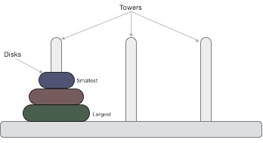
Tower of Hanoi
Tower of Hanoi, is a mathematical puzzle which consists of three towers (pegs) and more than one rings(disks) is as depicted
The problem is to move all the disks to some another tower without violating the sequence of arrangement. A few rules to be followed for Tower of Hanoi are −
Only one disk can be moved among the towers at any given time.
Only the "top" disk can be removed.
No large disk can sit over a small disk.

Slide 28
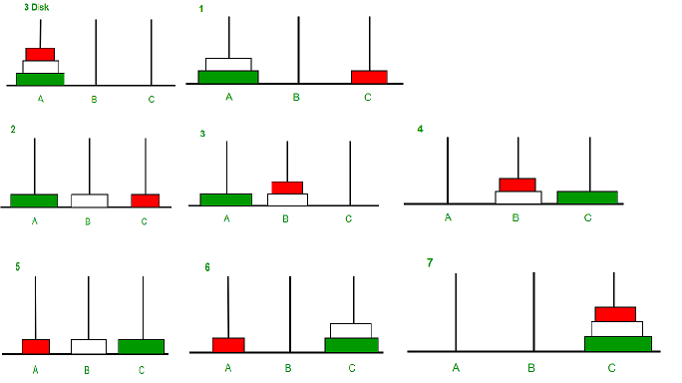

Slide 29
Take an example for 2 disks : Let rod 1 = 'A', rod 2 = 'B', rod 3 = 'C'.
Step 1 : Shift first disk from 'A' to 'B'.
Step 2 : Shift second disk from 'A' to 'C'.
Step 3 : Shift first disk from 'B' to 'C’.
Input : 3
Output :
Disk 1 moved from A to C
Disk 2 moved from A to B
Disk 1 moved from C to B
Disk 3 moved from A to C
Disk 1 moved from B to A
Disk 2 moved from B to C
Disk 1 moved from A to C
The pattern here is :
Shift 'n-1' disks from 'A' to 'B'.
Shift last disk from 'A' to 'C'.
Shift 'n-1' disks from 'B' to 'C'.

Slide 30
TOWER(N, BEG, AUX, END)
This procedure gives a recursive solution to the Towers of Hanoi problem for N disks.
1. If N = 1, then :
(a) Write: BEG 🡪 END
(b) Return.
[End of if structure]
2. [Move N -1 disks from peg BEG to peg AUX.]
Call TOWER(N – 1, BEG, END, AUX)
3. Write: BEG 🡪 END
4. [Move N -1 disks from peg AUX to peg END.]
Call TOWER(N – 1, AUX, BEG, END)
5. Return

Slide 31
Recursion isn't the best way of writing code. If you are writing code recursively, you are probably putting on extra overhead. For example the factorial function could be easily written using a simple for loop. If the code is straight forward an iterative solution is likely faster. In some cases, recursive solutions are much slower. You should use recursion if and only if:
the problem is naturally recursive (you can state it in terms of itself)
a relatively straight forward iterative solution is not available.

Slide 32
Example: Factorial of a number
n! = 1•2•3...n and 0! = 1 (called initial/base case)
So the recursive definition is n! = n*(n-1)!
Algorithm F(n)
if n = 0 then return 1 // base case
else F(n-1)*n // recursive call
Analysis
Basic operation: multiplication during the recursive call
The number of multiplications is given by
M(n) = M(n-1) + 1 (Recursive step)
with the initial condition
M(0) = 0 (Basic step) There are no multiplications
Solve by the method of backward substitutions
M(n) = M(n-1) + 1
= [M(n-2) + 1] + 1 = M(n-2) + 2 substituted M(n-2) for M(n-1)
= [M(n-3) + 1] + 2 = M(n-3) + 3 substituted M(n-3) for M(n-2)
………………..
………………..
= M(n-k) + k (after k step)
Put k = n, we get
M(n) = M(0) + n = 0 + n
Therefore, M(n) = O(n)

Slide 33
Analysis for Tower of Hanoi
M(n) = M(n-1) + 1 + M(n-1) = 2M(n-1) + 1
IC: M(1) = 1
Solve using backward substitution
M(n) = 2M(n-1) + 1
= 2[2M(n-2) + 1] +1 = 2^2M(n-2) + 2+1
=2^2[2M(n-3) +1] + 2+1 = 2^3M(n-3) + 2^2 + 2 + 1
……………………
……………………
M(n) = 2^iM(n-i) + ∑j=0-i2^j = 2^iM(n-i) + 2^i-1 (after ith step)
Put i = n-1, we get
M(n) = 2^n-1M(n-(n-1)) + 2^n-1-1 = 2n-1M(1) + 2^n-1-1 = 2^n-1 + 2^n-1-1 = 2^n-1
Therefore,
M(n) = O(2^n)

