Slide 1


Slide 2
Chapter 2
Collecting and Sharing
Lots of Data

Slide 3
Large Data Files
Is it easy to share data with friends?
What if it’s an image?
What if it’s an mp3?
What if it’s a 2GB movie?

Slide 4
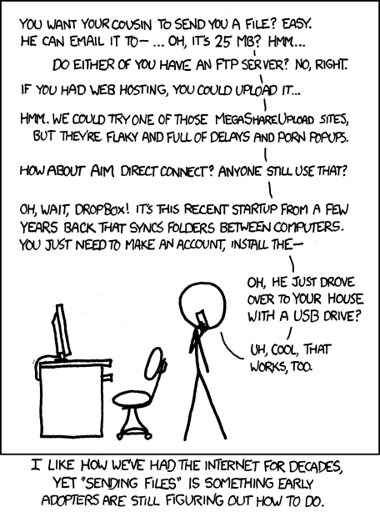
Large Data Files
http://xkcd.com/949/

Slide 5
Suffering from Files
Choosing How to Store the Data
Choosing the Right Data Format
How to Present the Data

Slide 6
Suffering from Files
Choosing How to Store the Data
Physical storage
Share in a scalable and economical manner

Slide 7
Suffering from Files
Choosing the Right Data Format
Who’s your customer / audience?
Programmers.
Spreadsheet users.
Public
Space
Format using the most compact.
Format using the most readable.
Duplicate files in different formats?

Slide 8
Suffering from Files
How to Present the Data
File lists
Data dashboards with visualizations
Web API’s

Slide 9
Solving the problem
“Instead of choosing a file format simply because it is popular or familiar, let’s deploy our data in a format appropriate to our audience.”

Slide 10
Storage: Infrastructure as a Service
In house servers vs Rackspace, Amazon, Google etc.
Infrastructure-as-a-service (IAAS)
many physical machines are connected together in a network cluster,
in some respects acting like a single, large computer.

Slide 11

The Network is Slow
The average global Internet data transfer speed in 2012 was 2.3 megabits per second (Mbps)
United States clocked in at around 5.3 Mbps.
Imagine having to transfer your 25 gigabytes of data from one place to another at a consistent speed of 5.3 Mbps.
At this rate, the transfer will take close to 11 hours.

Slide 12
Choosing the Right Data Format
CSV – Comma Separated Values
Pros
Great for “flat” data (e.g. log data)
Spreadsheets
Sequential access of data
Easy to split
Cons
Not very standardized
Bad at data the doesn’t fit into discrete rows
Not very human readable
https://gist.github.com/rugbyprof/61f9f9e5f703a367d4a3

Slide 13
Choosing the Right Data Format
XML – Extensible Markup Language
Pros
Self describing data
Structured source files
document interoperability
Cons
Holy moly what a lot of tags
Parsers are not friendly

Slide 14
Choosing the Right Data Format
JSON – Javascript Object Notation
Pros
Simple syntax
Key value pairs
Fits with the concept of an “object” as the name suggests
Parsers are much more friendly than XML
Cons
Still a little verbose, not as lean as CSV

Slide 15
CSV, XML, JSON
# CSV example
first_name,last_name,book,date
"Michael", "Manoochehri", "Data Just Right",2013
<!-- XML Example -->
<xml>
<author>Michael Manoochehri</author>
<list>
<book position="1">Data Just Right</book>
</list>
</xml>
// JSON example
{
"name": "Michael”,
"book":{"title":"Data Just Right","date":"2013”}
}

Slide 16
Character Encoding
ASCII
Unicode
UTF-8
UTF-16
If it’s not unicode, convert it

Slide 17
Text Manipulations
Do you have annoying header information in your CSV file? Remove the first two lines of a file and place the result in a new file:
sed '1,2d' file > newfile

Slide 18
Text Manipulations
Is the data in your source file delimited by an odd character, such the caret (^)? Replace those pesky characters with commas via a regular expression.
sed 's/\^/,/g' original_file > new_file

Slide 19
Text Manipulations
When working with extremely large text files with millions of lines, it’s possible to have a bad record on a particular line; but how can you display it? With sed, it’s easy to print out a particular line number, such as line number 3,451,234:
sed '3451234q;d' your_large_file.csv

Slide 20
Text Manipulations
Another great utility for dealing with very large files is split, which, as the name implies, splits large files into smaller ones. For example, if you have a very large file that you need to split into chunks of 500 Mb at most while preserving the integrity of line endings (avoiding broken lines), use this command:
split -C 500m your_large_file.csv

Slide 21
Data Serialization
A data format that can be moved and stored on multiple platforms
Compact is important
Possible to compress, responsible by developer
Question:
Passing data between languages (e.g. c++ and python)

