Slide 1

CS 422:
Machine Learning
Hal Daumé III | UMD CS, UMIACS, Linguistics | me@hal3.name | @haldaume3

Slide 2
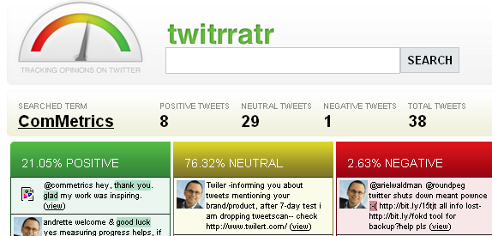





The discipline of predictions...
Classification/regression
Recommender systems
Web search ranking
Planning/control

Slide 3
Your first exam...

Slide 4
switch slides

Slide 5
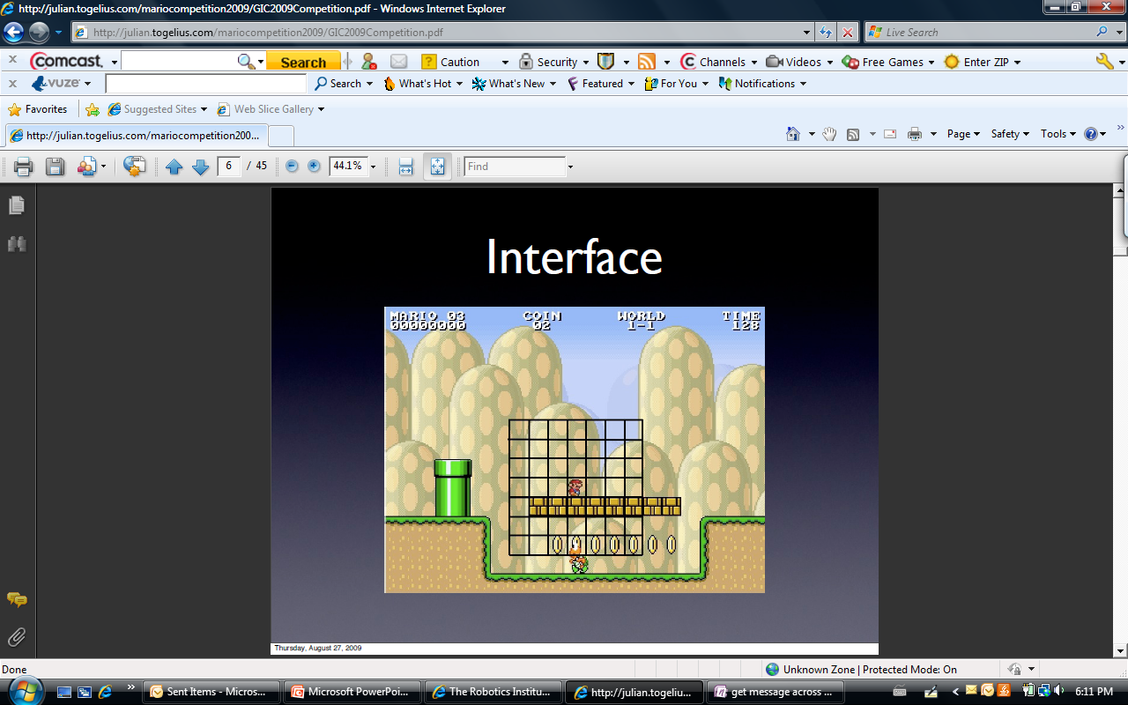
We can play Mario...
From Mario AI competition 2009
Input:
Output:
Jump in {0,1}
Right in {0,1}
Left in {0,1}
Speed in {0,1}
Extracted 27K+ binary features
from last 4 observations
(14 binary features for every cell)

Slide 6
Training (expert)

Slide 7
Test-time execution (classifier)

Slide 8
Test-time execution (DAgger)

