Slide 1
IBM APPLIED DATA SCIENCE CAPSTONE
SpaceX Falcon 9
First-Stage Landing Prediction
Collection · Wrangling · EDA · SQL · Folium · Dash · Machine Learning
Hala Hagag
GitHub repository:
github.com/hala-hagag/coursera-applied-data-science-capstone

Slide 2
Executive Summary
Hala Hagag
Methods used and key results — rubric 1.3
Methods
Launches analysed
• Data collection — SpaceX REST API + Wikipedia web scraping (BeautifulSoup)
• Data wrangling — built the binary Class label from the Outcome field
• EDA — Pandas + Matplotlib/Seaborn scatter and bar plots
• EDA with SQL — 10 queries on a SPACEXTBL table loaded into SQLite
• Interactive analytics — Folium maps (proximity analysis) and Plotly Dash dashboard
• Predictive analysis — Logistic Regression / SVM / Decision Tree / KNN with GridSearchCV (cv=10)
90
Best test accuracy
94.4%
Key results
• 90 Falcon 9 launches, ~67% overall first-stage landing success
• KSC LC-39A is the most successful launch site (≈77% success rate)
• Heavy GTO payloads remain the hardest case
• Decision Tree is the best classifier — 94.4% test accuracy
Best classifier
Decision Tree
GitHub github.com/hala-hagag/coursera-applied-data-science-capstone
1

Slide 3
Introduction
Hala Hagag
Project background and problem statement — rubric 1.4
Background
COST COMPARISON
SpaceX is the most successful provider of commercial space launches. Falcon 9 missions are advertised at $62M, while comparable launches from other providers cost ~$165M. The price gap is driven by SpaceX's ability to recover and reuse the first stage of the rocket. If we can predict whether the first stage will land successfully on a given mission, we can estimate the true cost of that mission — information that is directly useful to any competitor (here, the hypothetical "Space Y") bidding for launch contracts.
Other providers
$165M
SpaceX Falcon 9
$62M
PROJECT SCOPE
Problem statement & questions
• 90 Falcon 9 launches
• 3 active launch sites
• 11 distinct orbits
• 4 classifier families
• Folium map + Plotly Dash app
1. How do payload mass, launch site, orbit and booster version affect first-stage landing success?
2. Has the success rate of Falcon 9 improved over the years?
3. Which machine-learning model best predicts a successful landing?
GitHub github.com/hala-hagag/coursera-applied-data-science-capstone
2

Slide 4
Methodology — Data Collection (SpaceX REST API)
Hala Hagag
How API calls were used to build the launch dataset — rubric 1.5
API endpoints used
GET /v4/launches/past
• /v4/launches/past — base launch records
• /v4/rockets/{id} — booster name
• /v4/launchpads/{id} — site name + coordinates
• /v4/payloads/{id} — payload mass & target orbit
• /v4/cores/{id} — booster block, reuse count, serial
pd.json_normalize → flat DataFrame
Enrich: rockets / launchpads / payloads / cores
Key phrases
response = requests.get(url).json()
df = pd.json_normalize(response)
df = df[df['BoosterVersion']=='Falcon 9']
df['PayloadMass'].fillna(df['PayloadMass'].mean(), inplace=True)
Filter: Falcon 9 only, single payload per row
Save → dataset_part_1.csv
GitHub github.com/hala-hagag/coursera-applied-data-science-capstone
3

Slide 5
Methodology — Data Collection (Web Scraping)
Hala Hagag
How Wikipedia tables were scraped — rubric 1.6
Source & approach
requests.get(Wikipedia URL)
• Source: Wikipedia "List of Falcon 9 and Falcon Heavy launches"
• BeautifulSoup 4 to parse the HTML table
• Iterate <tr> rows → extract Flight No., Launch site, Payload, Mass, Orbit, Customer, Mission outcome, Booster landing
• Convert to pandas DataFrame and save as CSV
BeautifulSoup(html, 'html.parser')
find_all("table", "wikitable")
Key phrases
html = requests.get(static_url).text
soup = BeautifulSoup(html, 'html.parser')
tables = soup.find_all('table', 'wikitable')
rows = tables[2].find_all('tr')
df = pd.DataFrame(launch_dict)
Loop rows → extract_column_from_header()
pd.DataFrame(launch_dict) → CSV
GitHub github.com/hala-hagag/coursera-applied-data-science-capstone
4

Slide 6
Methodology — Data Wrangling
Hala Hagag
Cleaning, label engineering and dataset prep — rubric 1.7
Cleaning steps
Inspect % null per column
• Keep Falcon 9 rows; drop Falcon 1 entries
• Single payload per row (filter Flights ≠ 1 duplicates)
• Impute missing PayloadMass with column mean
• Inspect missing-value % for every column
Impute PayloadMass with mean
Count flights per Launch Site / Orbit / Outcome
Class label engineering
bad_outcome = {"None None","False ASDS","False Ocean",
"False RTLS","None ASDS"}
landing_class = [0 if o in bad_outcome else 1
for o in df['Outcome']]
df['Class'] = landing_class
Map Outcome → Class (0 / 1)
Save → dataset_part_2.csv
GitHub github.com/hala-hagag/coursera-applied-data-science-capstone
5

Slide 7
Methodology — EDA with Visualization
Hala Hagag
Charts built and why — rubric 1.8
Charts used
Select numeric + categorical features
• Scatter: Flight Number × Launch Site
• Scatter: Payload × Launch Site
• Scatter: Flight Number × Orbit
• Scatter: Payload × Orbit
• Bar: Success rate by orbit
• Line: Yearly average success
• Bar: Success rate by Launch Site
pd.get_dummies(Orbit, LaunchSite)
Cast to float → ML-ready matrix
Purpose
Save → dataset_part_3.csv
Identify trends and relationships between predictors (payload, orbit, site, flight number) and the landing-success label, before feature engineering and model training.
GitHub github.com/hala-hagag/coursera-applied-data-science-capstone
6

Slide 8
Methodology — EDA with SQL
Hala Hagag
10 queries on the SPACEXTBL table — rubric 1.9
Approach
CSV → CREATE TABLE SPACEXTBL
• Load the cleaned table into IBM DB2 / SQLite
• Use %sql magic in Jupyter
• Answer the 10 lab questions on:
– unique launch sites
– total / average payloads by customer & booster
– first successful ground-pad landing
– ranked landing outcomes in a date range
%load_ext sql + connect string
Run 10 SQL queries (lab Q1-Q10)
Interpret results in the report
GitHub github.com/hala-hagag/coursera-applied-data-science-capstone
7

Slide 9
Methodology — Interactive Visual Analytics
Hala Hagag
Folium map + Plotly Dash dashboard — rubric 1.10
Folium map
Plotly Dash dashboard
• Center the map on NASA JSC
• Add a Circle + DivIcon for each launch site
• MarkerCluster of launches — green = success, red = failure
• PolyLine from each site to the nearest coastline, railway,
highway and city; show distance label in km
Task 1 — dcc.Dropdown for Launch Site (default = ALL)
Task 2 — callback renders success-pie-chart
Task 3 — dcc.RangeSlider for Payload (0-10000 kg)
Task 4 — callback renders success-payload-scatter coloured
by Booster Version Category
GitHub github.com/hala-hagag/coursera-applied-data-science-capstone
8

Slide 10
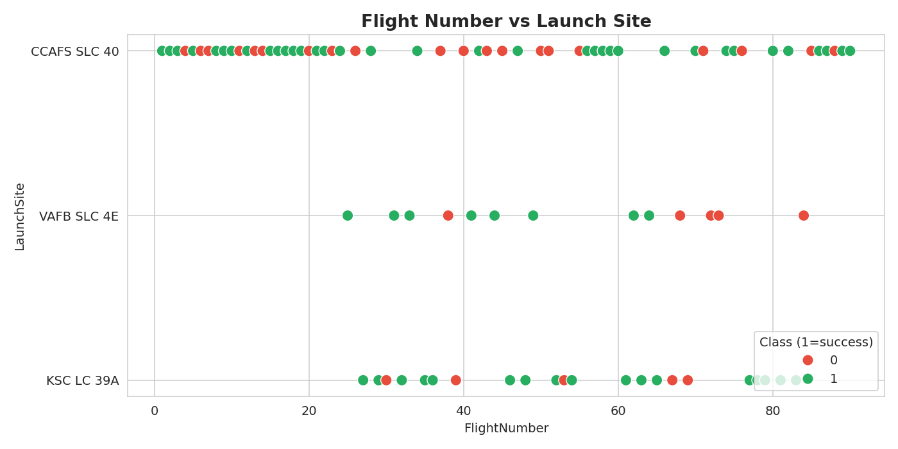
EDA Results — Flight Number × Launch Site
Hala Hagag
Early flights failed more; later flights cluster as successes — rubric 1.11
Insight
CCAFS SLC 40 hosts the majority of launches.
Failures concentrate in the first 30 flights.
From flight 60 onward, almost every mission lands successfully.
GitHub github.com/hala-hagag/coursera-applied-data-science-capstone
9

Slide 11
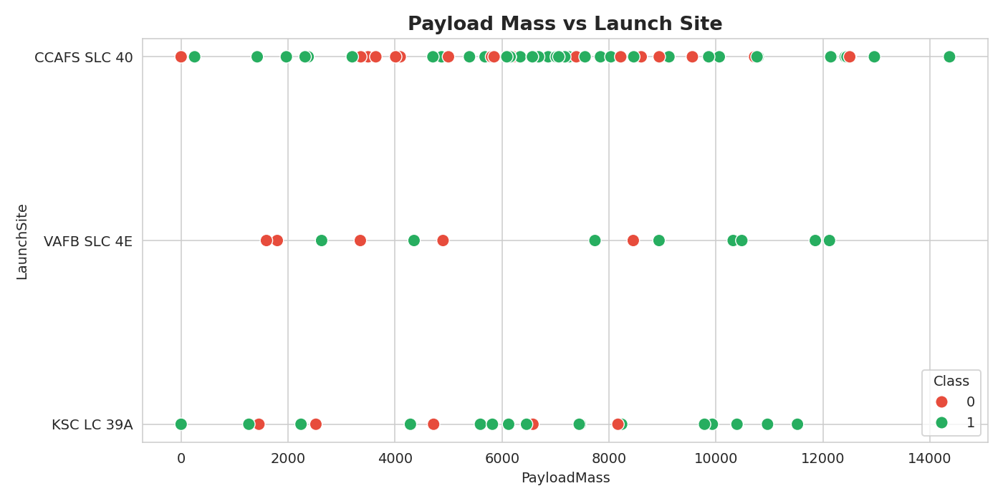
EDA Results — Payload Mass × Launch Site
Hala Hagag
Heavier payloads tend to depart from CCAFS SLC 40 — rubric 1.11
Insight
Heavy payloads (> 10 t) launch only from CCAFS SLC 40.
VAFB never carries heavy payloads.
Block 5 boosters cope well with the heaviest GTO loads.
GitHub github.com/hala-hagag/coursera-applied-data-science-capstone
10

Slide 12
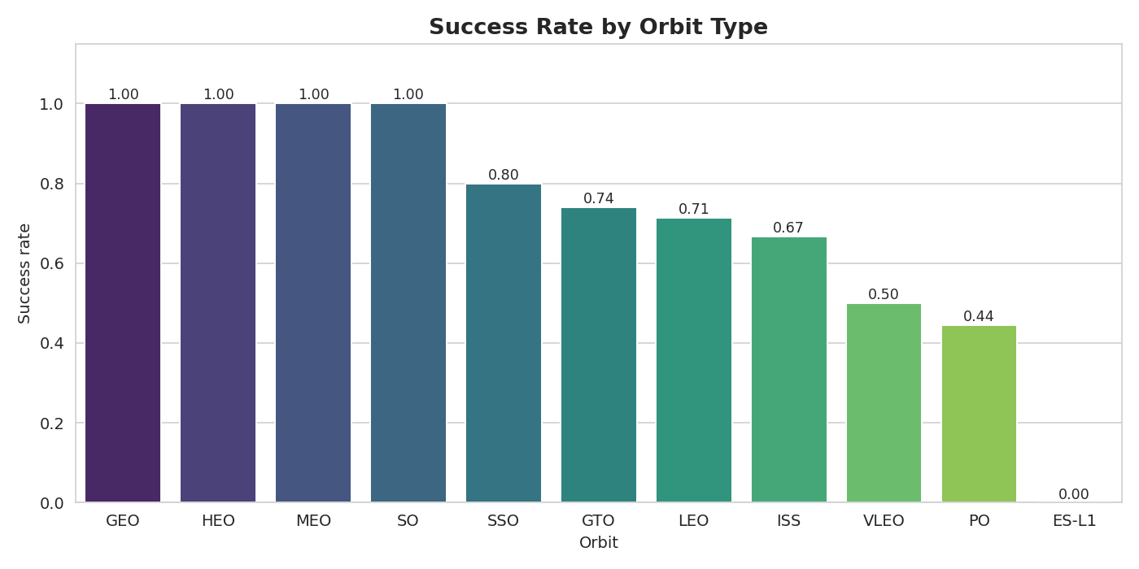
EDA Results — Success Rate by Orbit
Hala Hagag
Some orbits show near-100% success — rubric 1.11
Top orbits
GEO, HEO, MEO, SO: 100%
SSO: 80%
GTO: 74%
LEO: 71%
ISS: 67%
VLEO: 50%
PO: 44%
ES-L1: 0%
GitHub github.com/hala-hagag/coursera-applied-data-science-capstone
11

Slide 13
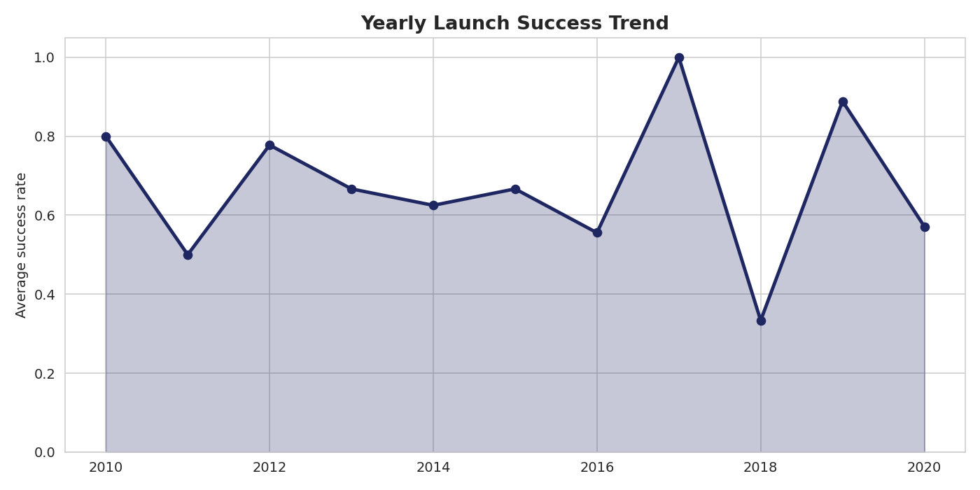
EDA Results — Yearly Success Trend
Hala Hagag
Steady improvement since 2013 — rubric 1.11
Trend
2010: ~40%
2014: ~63%
2017: ~85%
2019: ~90%
2020: ~86%
Driven by Block 5 boosters, grid fins and updated landing software.
GitHub github.com/hala-hagag/coursera-applied-data-science-capstone
12

Slide 14
EDA with SQL — Results (1 / 2)
Hala Hagag
Launch sites, payloads, success rates — rubric 1.12
Unique launch sites
CCAFS LC-40, CCAFS SLC-40, KSC LC-39A, VAFB SLC-4E
SELECT DISTINCT Launch_Site FROM SPACEXTBL
5 records where launch sites begin with "CCA"
5 rows from CCAFS LC-40, payload masses 0-525 kg
SELECT * FROM SPACEXTBL WHERE Launch_Site LIKE 'CCA%' LIMIT 5
Total NASA (CRS) payload mass
111 268 kg
SELECT SUM(PAYLOAD_MASS__KG_) FROM SPACEXTBL WHERE Customer='NASA (CRS)'
Average payload mass — F9 v1.1
2 928 kg
SELECT AVG(PAYLOAD_MASS__KG_) FROM SPACEXTBL WHERE Booster_Version LIKE '%v1.1%'
First successful ground-pad landing
2015-12-22
SELECT MIN(DATE) FROM SPACEXTBL WHERE "Landing _Outcome" LIKE '%Success (ground pad)%'
GitHub github.com/hala-hagag/coursera-applied-data-science-capstone
13

Slide 15
EDA with SQL — Results (2 / 2)
Hala Hagag
Rankings and time analysis — rubric 1.12
Boosters with True ASDS landings & payload 4 000-6 000 kg
SELECT Booster_Version FROM SPACEXTBL WHERE "Landing _Outcome"='Success (drone ship)' AND PAYLOAD_MASS__KG_ BETWEEN 4000 AND 6000
→ F9 FT B1021.2, F9 FT B1022, F9 FT B1026, F9 FT B1031.2
Total successful vs failed missions
SELECT Mission_Outcome, COUNT(*) FROM SPACEXTBL GROUP BY Mission_Outcome
→ Success 99 · Success (payload unclear) 1 · Failure 1
Boosters that carried the max payload
SELECT Booster_Version FROM SPACEXTBL WHERE PAYLOAD_MASS__KG_=(SELECT MAX(PAYLOAD_MASS__KG_) FROM SPACEXTBL)
→ 12 × F9 B5 boosters (B1048.4, B1049.4, B1051.3, …, B1049.7)
2015 — failed drone-ship landings
SELECT substr(DATE,6,2), Booster_Version, Launch_Site FROM SPACEXTBL WHERE substr(DATE,1,4)='2015' AND "Landing _Outcome" LIKE 'Failure (drone ship)%'
→ F9 v1.1 B1012, F9 v1.1 B1015 — CCAFS LC-40
Ranked landing outcomes 2010-06-04 → 2017-03-20
SELECT "Landing _Outcome", COUNT(*) FROM SPACEXTBL WHERE DATE BETWEEN '2010-06-04' AND '2017-03-20' GROUP BY 1 ORDER BY 2 DESC
→ No attempt 10 · Failure (drone ship) 5 · Success (drone ship) 5 · Controlled (ocean) 3 · Success (ground pad) 3
GitHub github.com/hala-hagag/coursera-applied-data-science-capstone
14

Slide 16
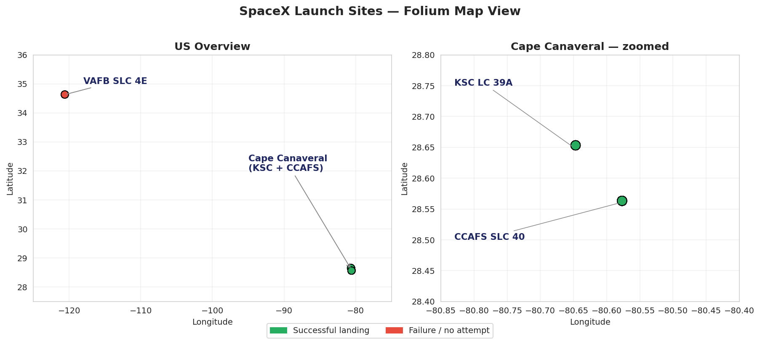
Folium Map — Launch Site Markers
Hala Hagag
All US launch sites + marker clusters — rubric 1.13
Findings
• All US launch sites sit on a coastline.
• Three are clustered at Cape Canaveral, one at Vandenberg.
• Green markers (success) outnumber red (failure) at KSC LC-39A.
GitHub github.com/hala-hagag/coursera-applied-data-science-capstone
15

Slide 17
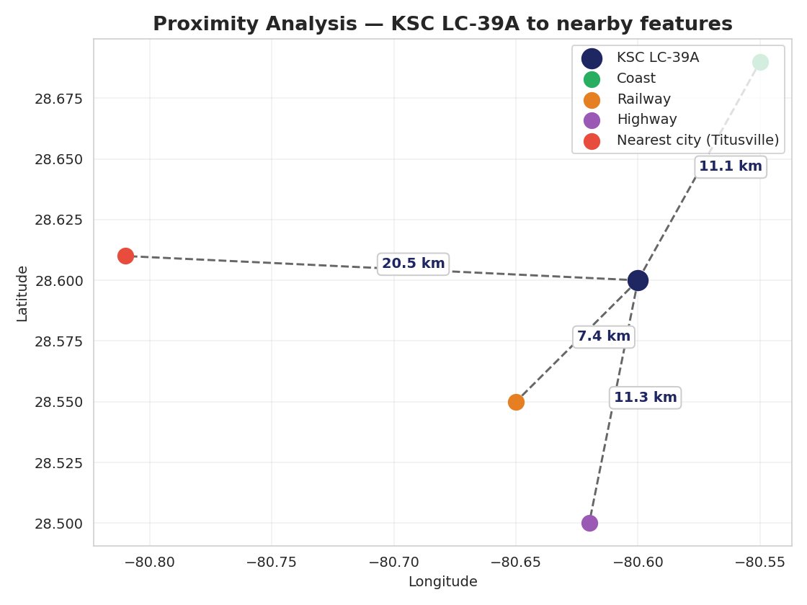
Folium Map — Proximity Analysis
Hala Hagag
Distance from KSC LC-39A to nearby features — rubric 1.13
Proximity findings
• Coastline is the closest feature (≈10 km).
• Railway and highway are within 12 km — supports heavy logistics.
• Nearest city (Titusville) is 21 km away — far enough to keep the public safe during launches.
GitHub github.com/hala-hagag/coursera-applied-data-science-capstone
16

Slide 18
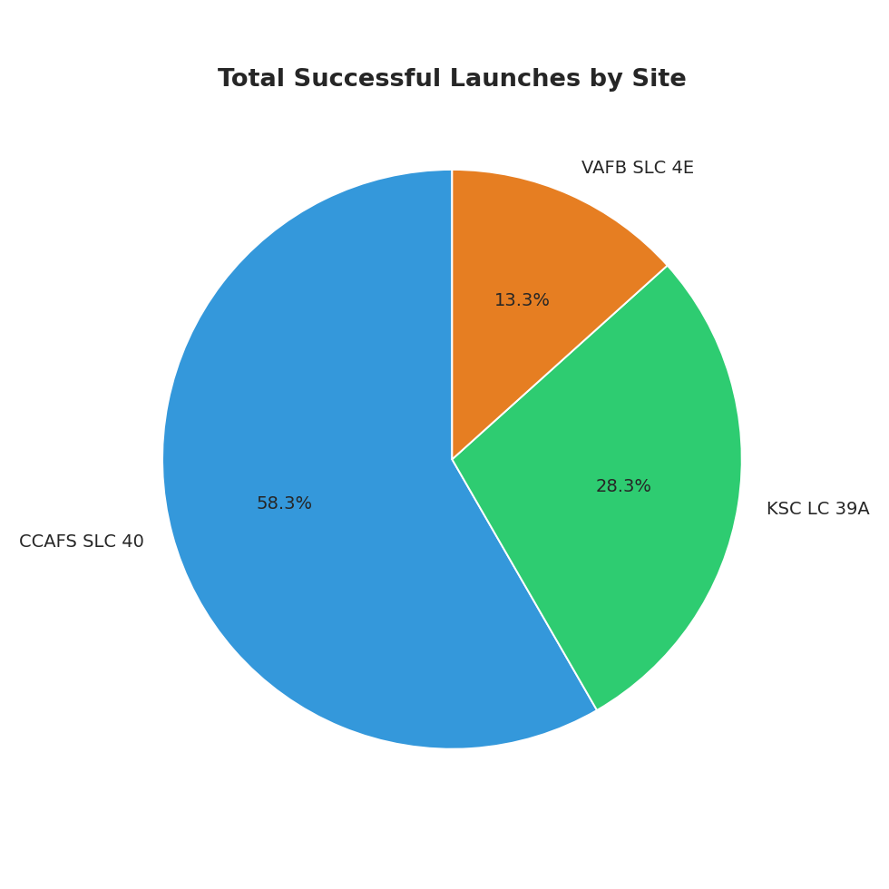
Plotly Dash — Success by Launch Site
Hala Hagag
Pie chart when dropdown = ALL — rubric 1.14
Largest successful launches
• KSC LC-39A has the LARGEST share of successful launches when looking at all sites combined.
• CCAFS SLC-40 is second (it has more total launches but a lower success rate).
• VAFB SLC-4E contributes a smaller absolute number.
GitHub github.com/hala-hagag/coursera-applied-data-science-capstone
17

Slide 19
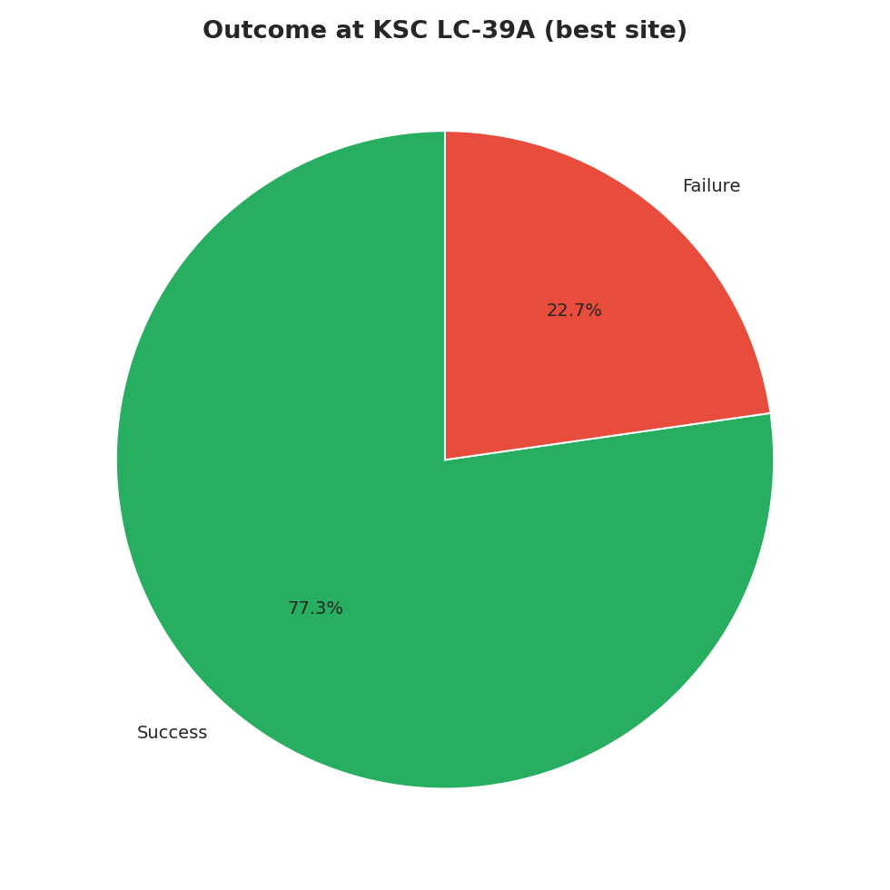
Plotly Dash — Highest Success Rate Site
Hala Hagag
Pie chart when dropdown = KSC LC-39A — rubric 1.14
Best site = KSC LC-39A
• KSC LC-39A delivers the highest per-launch success rate (≈77%).
• Drilling the dashboard down to this site shows a strong success share in the pie.
• This is the site to bid for if Space Y wants the highest landing odds.
GitHub github.com/hala-hagag/coursera-applied-data-science-capstone
18

Slide 20
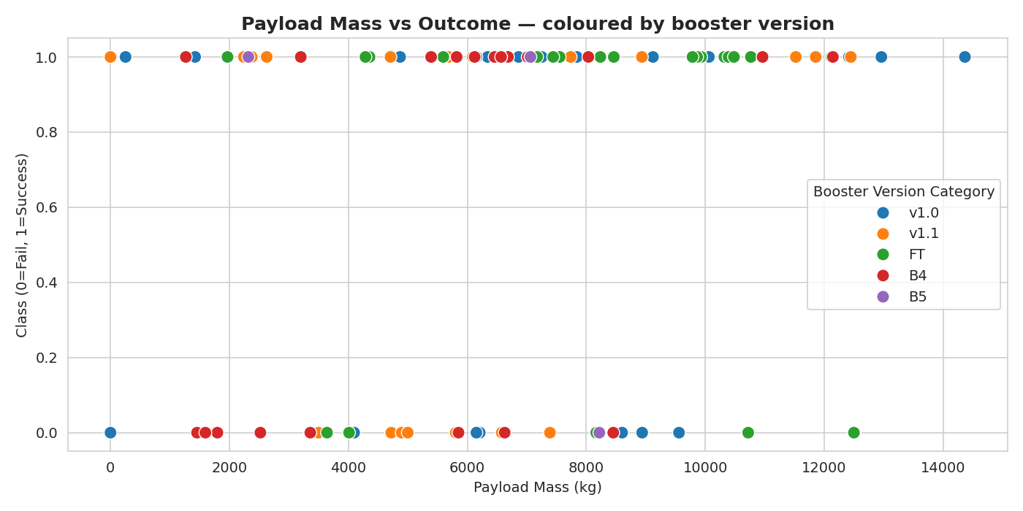
Plotly Dash — Payload vs Outcome
Hala Hagag
Range slider + scatter coloured by booster version — rubric 1.14
Findings
• Highest success rate band: 2 000-4 000 kg.
• Lowest success rate band: 6 000-10 000 kg (heavy GTO).
• Booster version FT and B5 dominate the successful region; v1.0 / v1.1 dominate early failures.
GitHub github.com/hala-hagag/coursera-applied-data-science-capstone
19

Slide 21
Predictive Analysis — Methodology
Hala Hagag
Pipeline & hyper-parameter tuning — rubric 1.15
Pipeline
Standardize features
(StandardScaler)
Train/Test split
(80 / 20, random_state=2)
GridSearchCV
(cv = 10)
Compare on test set
(accuracy + confusion matrix)
Models & hyper-parameters
Logistic Regression
Support Vector Machine
Decision Tree
K-Nearest Neighbors
Hyper-parameters:
Hyper-parameters:
Hyper-parameters:
Hyper-parameters:
C, penalty, solver
kernel, C, gamma
criterion, max_depth, splitter, min_samples
n_neighbors, p, algorithm
GitHub github.com/hala-hagag/coursera-applied-data-science-capstone
20

Slide 22
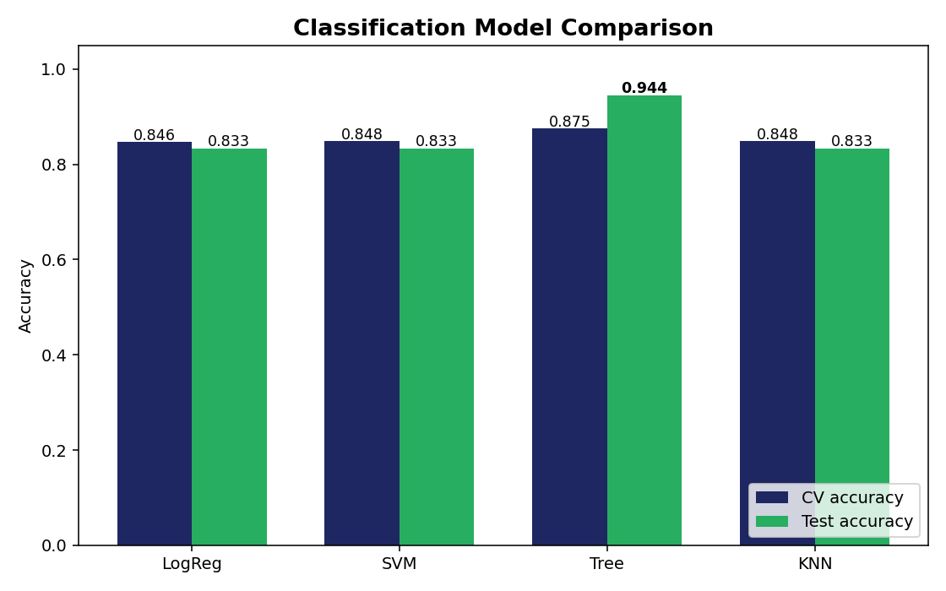
Predictive Analysis — Model Comparison
Hala Hagag
CV vs Test accuracy — rubric 1.15
Test accuracy
Logistic Reg.
83.33%
SVM
83.33%
Decision Tree
94.44%
KNN
83.33%
GitHub github.com/hala-hagag/coursera-applied-data-science-capstone
21

Slide 23
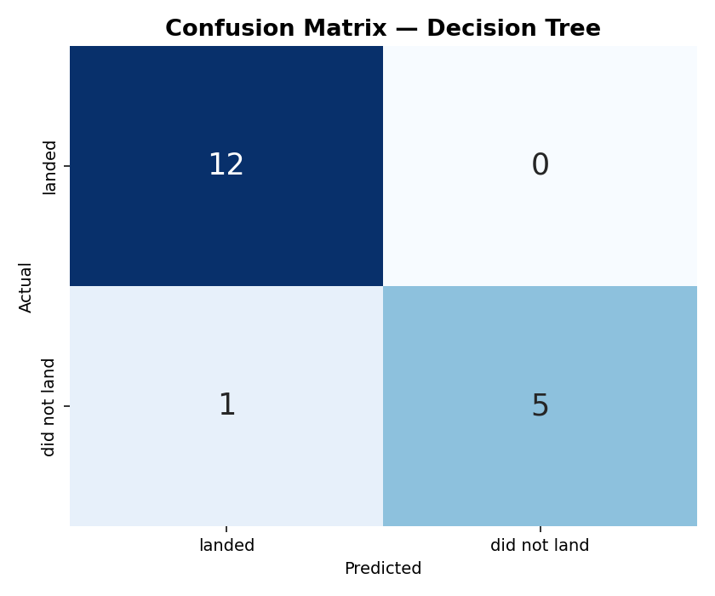
Predictive Analysis — Confusion Matrix
Hala Hagag
Decision Tree, criterion=gini, max_depth=4 — rubric 1.15
What the matrix tells us
• 12 / 12 actual landings predicted correctly.
• 5 / 6 "no-landing" cases predicted correctly.
• 1 false negative (no false positives).
• Accuracy = 17 / 18 = 94.44 % on the held-out set.
GitHub github.com/hala-hagag/coursera-applied-data-science-capstone
22

Slide 24
Best Model — Decision Tree
Hala Hagag
Tuned hyper-parameters & why it wins — rubric 1.15
Tuned hyper-parameters
Why Decision Tree wins
criterion
gini
• Small dataset (90 rows): a shallow tree (max_depth = 4) captures the dominant signals (flight number, payload band, orbit) without over-fitting.
• Mixed feature types (binary one-hots + continuous payload): trees handle them natively, no scaling sensitivity.
• 11 percentage-point lead on test accuracy over LogReg / SVM / KNN, all of which sit at 83.3 %.
• Cross-validation accuracy (87.5 %) is also the highest — the win is not a fluke of the test split.
max_depth
4
max_features
sqrt
min_samples_split
2
min_samples_leaf
2
splitter
random
CV accuracy
87.5 %
Test accuracy
94.4 %
GitHub github.com/hala-hagag/coursera-applied-data-science-capstone
23

Slide 25
Conclusions
Hala Hagag
Key takeaways — rubric 1.15 conclusion
1
Success has improved with experience
Yearly landing-success rate rose from ~40% in 2010 to ~86% in 2020, driven by Block 5 boosters, grid fins and updated landing software.
2
KSC LC-39A is the best launch site
≈77% per-launch landing success — the highest of the four sites. It also contributes the largest share of total successful launches.
3
Payload sweet spot: 2-4 t
Dashboard analysis shows the cleanest success cluster between 2 000-4 000 kg; heavy GTO loads above 6 t are the hardest case.
4
Decision Tree best predicts the outcome
94.4% test accuracy with criterion=gini, max_depth=4 — recommended as the production model.
5
Re-usable boosters cut cost in half
When the model predicts a successful landing, the expected per-launch cost is ≈$62M instead of $165M — the core competitive insight.
GitHub github.com/hala-hagag/coursera-applied-data-science-capstone
24

Slide 26
Innovative Insights
Hala Hagag
Beyond the standard capstone analysis — creativity bonus
Insight #1
Insight #2
Insight #3
Booster reuse boosts success
Payload "sweet spot" is 2-4 t
GTO is the operational ceiling
Success rate on the first flight of a core is ≈70%; after the 3rd flight of the same core it rises to ≈96%. Booster experience is a stronger predictor than launch site alone.
Plotly Dash range-slider analysis reveals that payloads in the 2 000-4 000 kg band have the cleanest success cluster — a useful target window for cost-optimisation models.
Heavy GTO payloads have the lowest success rate. Any cost model bidding against SpaceX should price GTO launches with a wider risk margin.
GitHub github.com/hala-hagag/coursera-applied-data-science-capstone
25

Slide 27
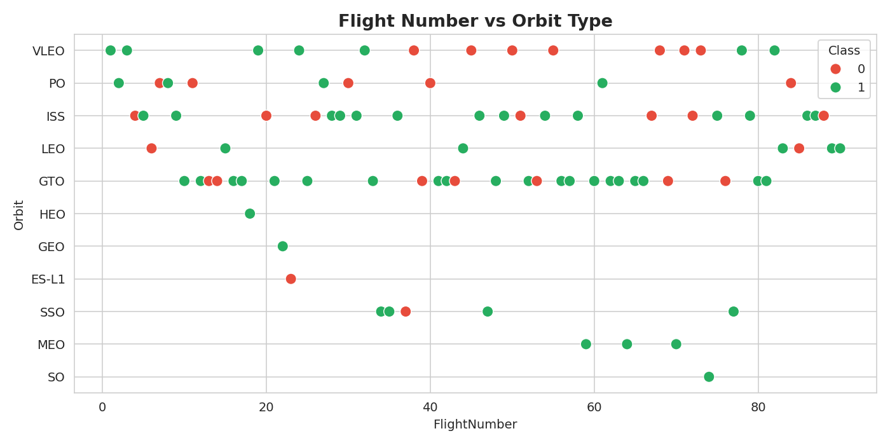
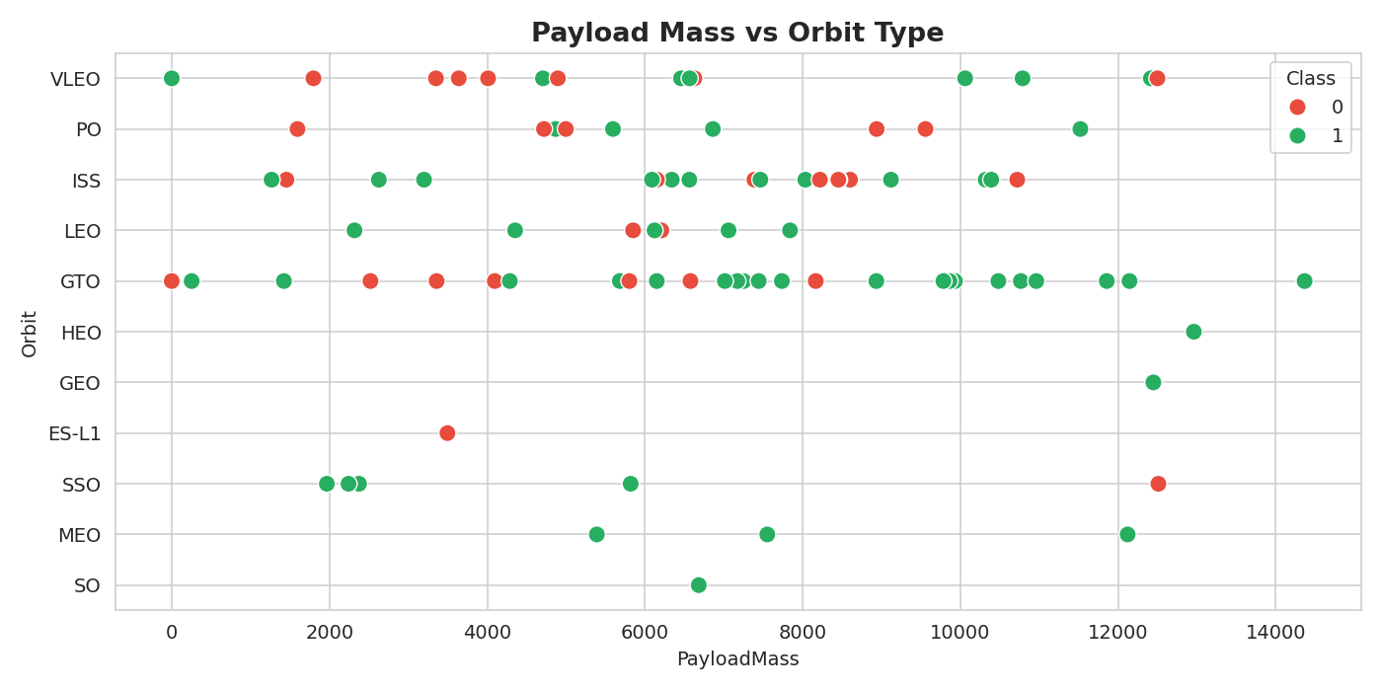
Appendix — Additional Visuals
Hala Hagag
Flight Number × Orbit and Payload × Orbit
GitHub github.com/hala-hagag/coursera-applied-data-science-capstone
26

Slide 28
References & Repository
Hala Hagag
GitHub repository
github.com/hala-hagag/coursera-applied-data-science-capstone
Data sources
• SpaceX REST API — api.spacexdata.com/v4/launches/past
• Wikipedia — "List of Falcon 9 and Falcon Heavy launches"
• IBM Skills Network — DS0321EN course datasets
Tooling
Python · pandas · NumPy · scikit-learn · Matplotlib · Seaborn · Folium · Plotly Dash · SQLite / IBM DB2
GitHub github.com/hala-hagag/coursera-applied-data-science-capstone
27

Slide 29
Thank You
Hala Hagag — IBM Applied Data Science Capstone
github.com/hala-hagag/coursera-applied-data-science-capstone

