Slide 1
Effective coding
(java hands-on)

Slide 2
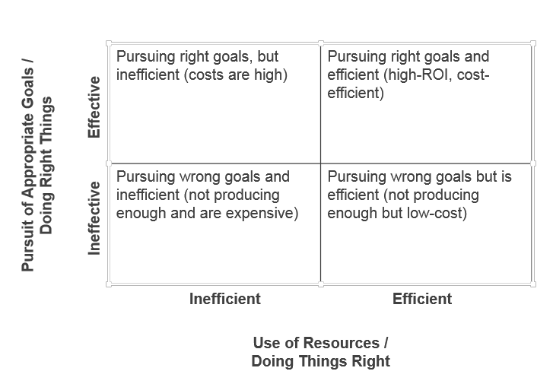
Effective Coding

Slide 3
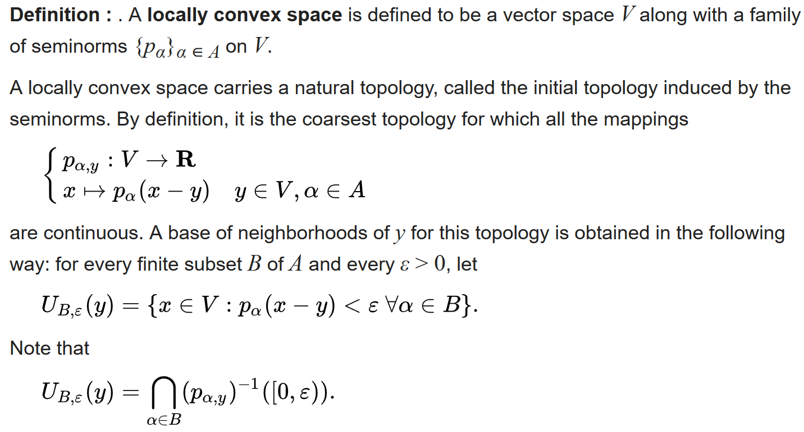

Slide 4
Motivation
Why / How to write effective code:
So that it works well?
So that other people can understand it?
So that future modifications and improvements are less likely to cause headaches?
So that your programs will be pleasant, elegant, and graceful?

Slide 5
Item 1
What is the natural way to create an instance of a class?
→ Object Constructor
But what if:
You need to use a meaningful name for constructors?
You have multiple overloaded constructors and you need to keep readability?
You need to control number on instance to be created?
You need to hide subtypes, and return only the parent type (reduce conceptual weight OR hide internals that can change cross releases OR Wishful thinking)?
Consider static factory methods instead of constructors

Slide 6
Item 2
What is the natural way to create an instance of a class having optional parameters?
→ Telescoping Constructors
→ JavaBeans
But what if:
You need to avoid complicated telescoping when many optional parameters (having identical types)?
You need to enforce state consistency?
You need to ensure immutability?
Consider a builder when faced with many constructor parameters

Slide 7
Item 3
What is the simpler way to enforce singleton property?
→ Private constructor + Public static INSTANCE
But what if:
You need to hide singleton property to API clients?
To avoid reflection attacks?
You need to serialize singleton?
Enforce the singleton property with a private constructor or an enum type

Slide 8
Item 5
How to implement a dependency relationship between two Objects?
→ One way: Hardwiring resource
But what if:
You need to decouple Objects from each other?
You deal with arbitrary number of subtypes?
You start to write unit tests?
Prefer dependency injection over hardwiring resources

Slide 9
Item 6
How to avoid unnecessary object instantiations?
→ Factory methods
→ Singleton
But what if:
You need to reuse functionally equivalent objects ?
You need to avoid recreation of expensive objects & cache them?
Avoid creating unnecessary objects

Slide 10
Item 9
How to guarantee that a resource would be closed once the program is terminated?
→ try - finally
But what if:
Many resources are involved on the same computation (readability)?
An exception occurs on the finally bloc itself?
Prefer try-with-resources to try-finally

Slide 11
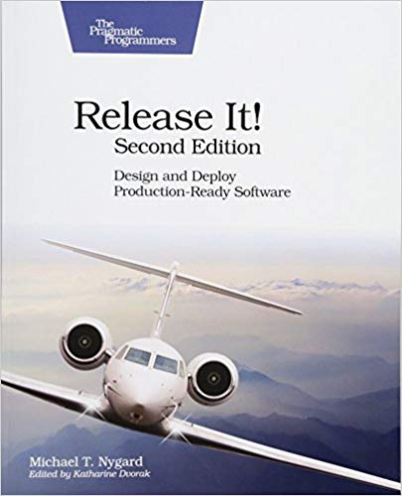

Slide 12
Case Study: The Exception That Grounded an Airline
It started with a planned failover on the database cluster that served the Airline system, moving toward a service-oriented architecture,
At about 2:30 a.m., all the check-in kiosks went red on the monitoring console. Every single one, everywhere in the country, stopped servicing requests at the same time.

Slide 13
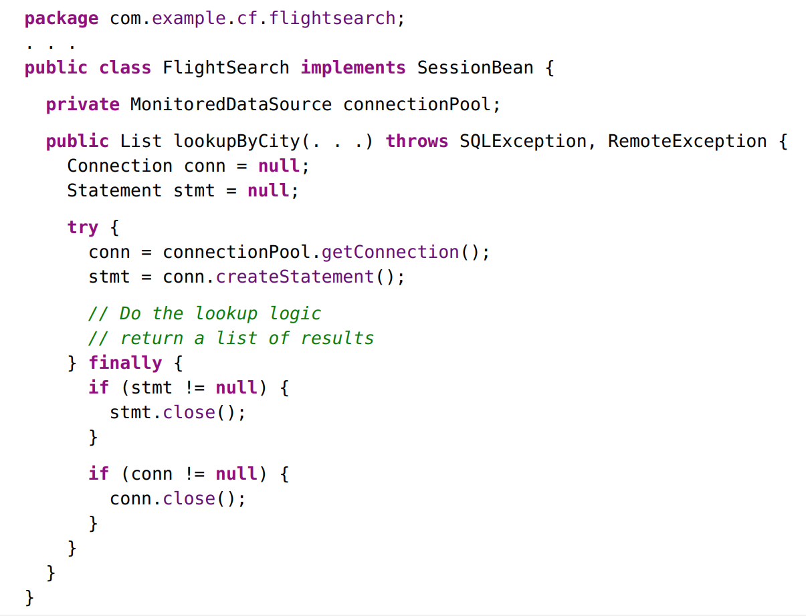

Slide 14
Item 10
How to check that two objects are “the same”?
→ Object.equals (==)
But what if:
You have a notion of logical equality that differs from object identity ?
How to know if overridden equals adhere to its general contract?
Override equals

Slide 15
Item 11
How to search an element inside a list/array of objects?
→ Iterate (loop) over the array and check for equality
But what if:
You are dealing with big-sized arrays?
You are using a java-built-in hash data structure?
Override hashCode

Slide 16
Item 26
How to declare a collection of objects?
→ Simply use raw collection: “ private final Collection myList = …. “
But what if:
I want to avoid casting every object I read from the collection?
I want to control what is inserted in my collection?
Generics (java 5) to the rescue

Slide 17
Item 28
What is an easy way to declare arrays?
→ Simply use: “ private final MyClass[] myArray = …. “
But what if:
I want to guarantee my code to be safe enough (e.g. Avoid ArrayStoreException)?
I need to create more complex structures?
e.g. complex arrays: “ List<? extends Number> [length] “
Arrays and generics don’t mix well.
Prefer Lists over Arrays.

Slide 18
Item 34
How to define a fixed set of constant values?
→ Use String constants
→ Define an abstract class, and possible values as subtypes
But How to:
To ensure fixed-values requirement?
To Enforce type Safety?
Use enums instead of int/String constents.

Slide 19
Item 42
How to declare a function object? (e.g. Strategy / Command pattern ,,,)
→ Anonymous class
But How to:
Avoid Anonymous class verbosity?
To Enforce type Safety?
Use functional interface, aka lambdas.

