Slide 1
Air passenger time series forecasting

Slide 2
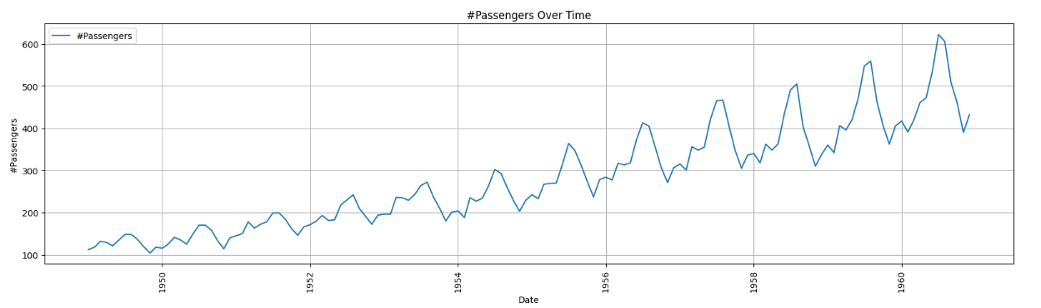
Project overview
Goal: To forecast monthly international airline passengers. Critical for resource planning and capacity management in the aviation sector.
Dataset description
Source: Kaggle
Data: Monthly totals (in thousands)
Period: Jan 1949 – Dec 1960
Traits: Upward trend & multiplicative seasonality

Slide 3
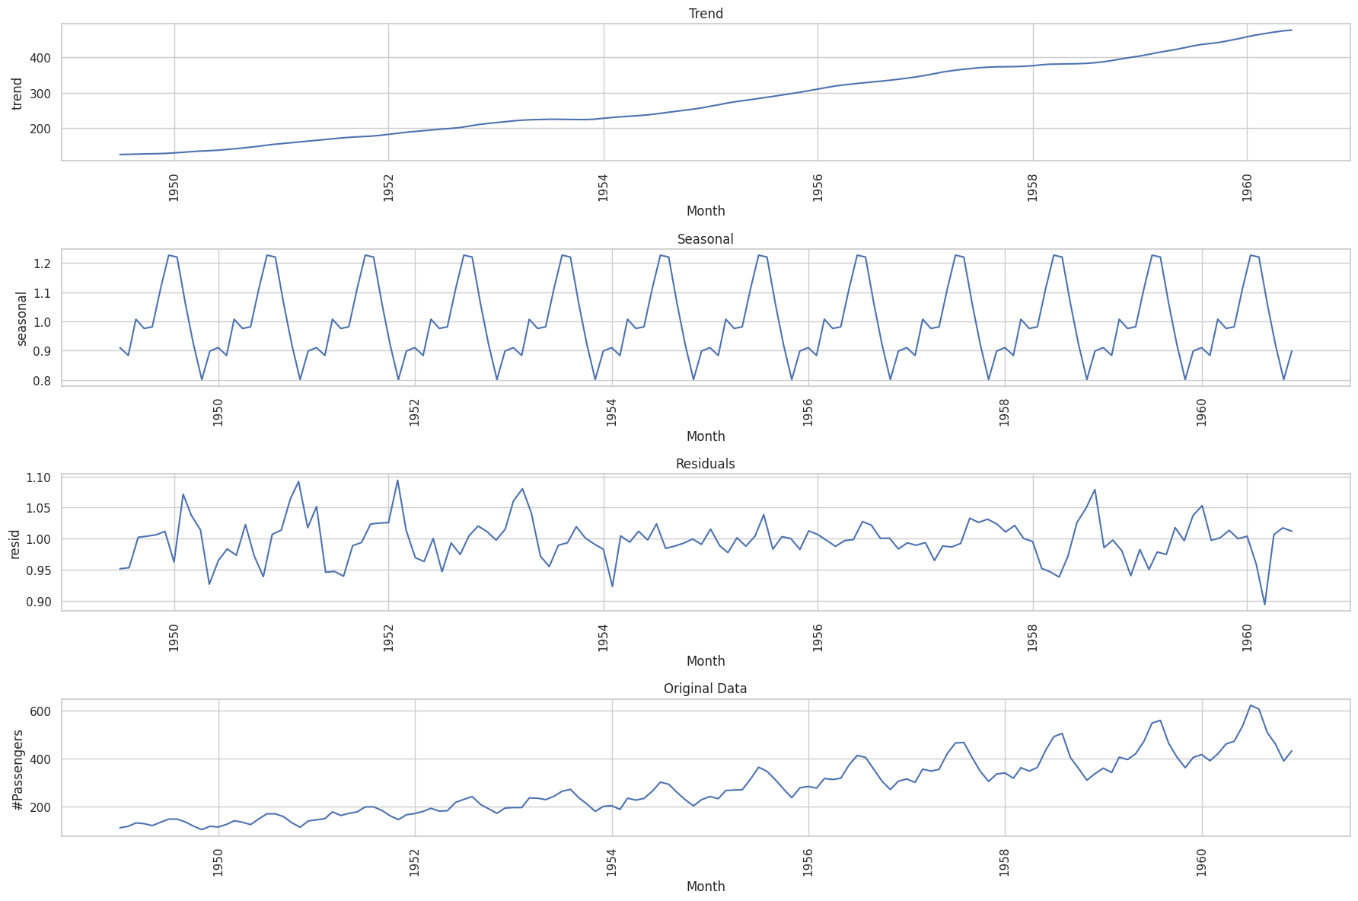
Time series decomposition
Trend: captures the long-term progression in the series, showing a consistent upward movement in passenger volume.
Seasonality: identifies repeating patterns within a fixed period (12 months), reflecting annual travel cycles.
Residuals: the irregular or noise component remaining after trend and seasonality are removed.

Slide 4
Stationarity Analysis
The Issue: Most time series models require the data to be stationary. The original Air Passengers series is non-stationary due to its clear upward trend and increasing variance.
ADF Test: The Augmented Dickey-Fuller (ADF) test statistically verifies stationarity. We test the null hypothesis that a unit root is present in the series.
Series state | ADF statistic | P_value | Result
Original data | 0.815 | 0.991 | Non-stationary
1st differencing | -2.829 | 0.054 | Stationary

Slide 5
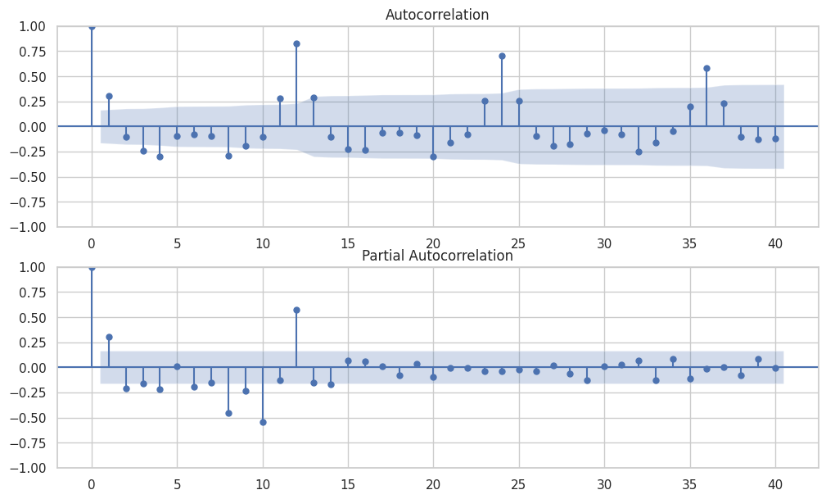
ARIMA model identification
(ACF & PACF)
Significant spikes at seasonal lags (e.g., Lag 12) confirm strong seasonality.
PACF used to identify the order of the Autoregressive (AR) component, denoted as ‘P’.

Slide 6
Data Preprocessing & Split
Missing Values & Detrending: Verified zero missing values. Applied First-order Differencing to remove the linear trend and achieve stationarity.
Scaling & Transformation:
Applied Log Transformation to stabilize variance (addressing multiplicative seasonality) followed by MinMaxScaler for normalization [-1, 1].

Slide 7
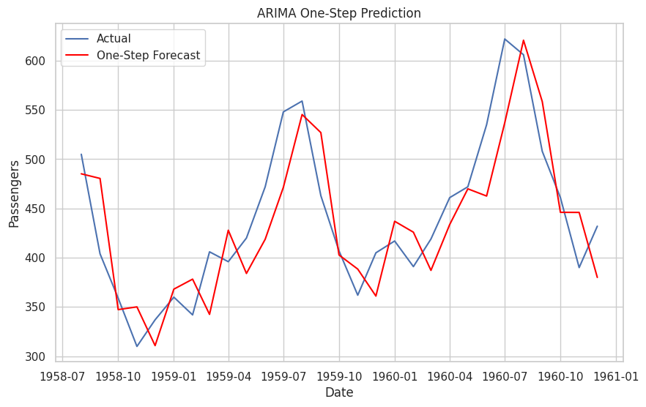
ARIMA ONE-STEP PREDICTION (BASELINE)
Through the one-step-ahead forecast plot,
we observed that the ARIMA model is able to
closely follow the actual values,
indicating its effectiveness in short-term
forecasting after addressing the
non-stationarity of the time series.

Slide 8
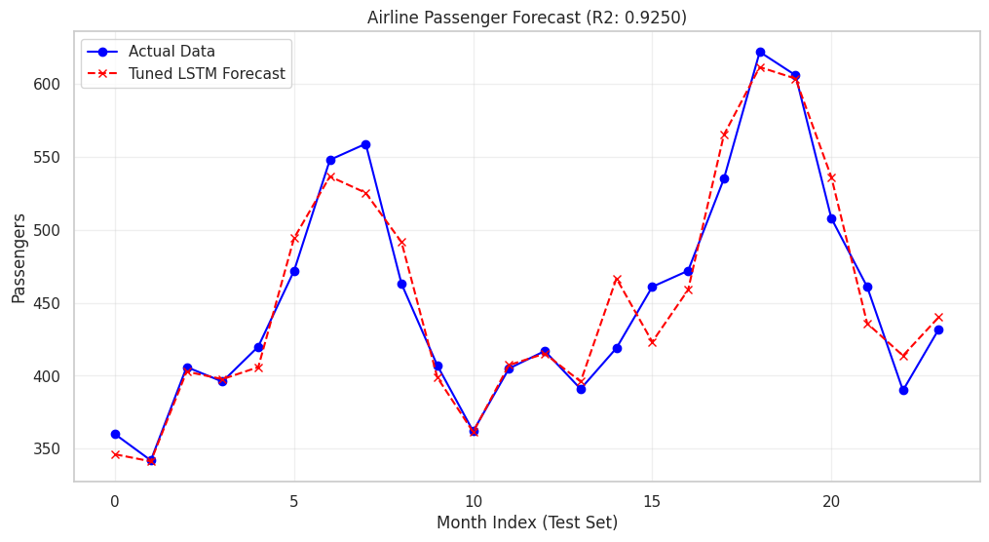
LSTM-Based Time Series
Forecasting Results
The tuned LSTM model shows strong
forecasting performance,
achieving a high R² value and accurately
capturing both trend and seasonal patterns
in the passenger data.

Slide 9
Results & analysis
Metric | ARIMA (baseline) | LSTM (tuned)
RMSE | 44.218 | 20.45
R² | 0.680 | 0.9250

