Slide 1
Air Quality Prediction

Slide 2
Source: The dataset is the Air Quality UCI dataset from the UCI Machine Learning Repository.
Goal: The primary objective is to predict the concentration of Carbon Monoxide (CO(GT)) based on various chemical and environmental sensor readin
Instances: The raw dataset contains 9,357 records.
Features: Originally contains 15 features, including sensors for Nitrogen Oxides (Nox) , Non-Metanic Hydrocarbons (NMHC), Temprature (T), and Humidity(RH).

Slide 3
Data visualization

Slide 4
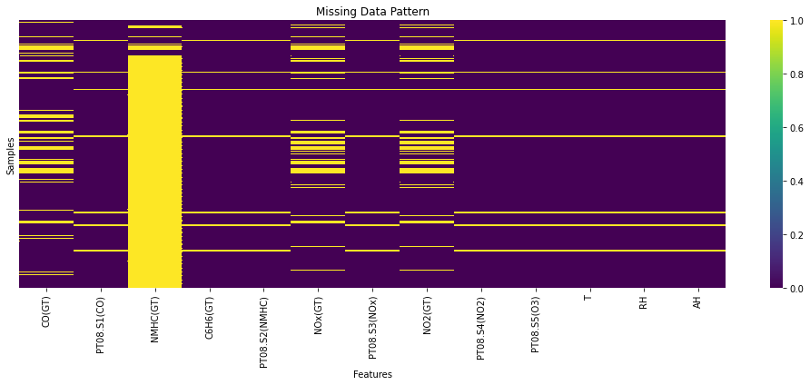
Missing Data Pattern: A heatmap was generated to visualize the distribution of missing values across features before cleaning

Slide 5
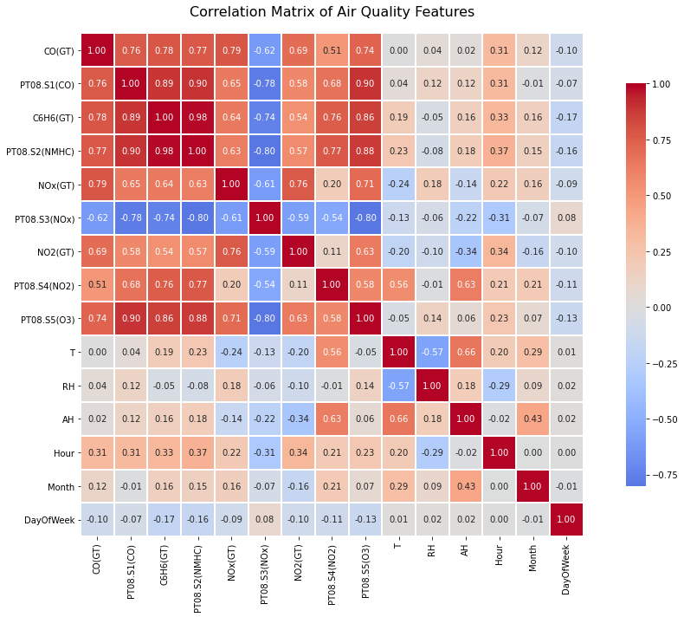
Correlation Matrix: A correlation heatmap was used to identify the relationships between different gas concentrations and environmental factors.

Slide 6
Data Preprocessing

Slide 7
To ensure high-quality model training, the following cleaning steps were performed:
Handling Missing Markers: The dataset uses -200 as a missing value marker; these were replaced with NaN to allow for proper imputation. Feature Engineering: The Date and Time columns were merged into a single DateTime index to handle the data as a Time Series.
Feature Selection: The column NMHC(GT) was dropped because approximately 90% of its values were missing, making it unreliable for training.
Imputation: Remaining missing values were handled using a combination of Forward Fill (ffill) and Backward Fill (bfill).
Duplicates: Duplicate rows were identified and removed to prevent model bias.
Data Scaling: Continuous features were scaled using StandardScaler, which is essential for models like MLP to converge effectively.

Slide 8
Models & Architecture

Slide 9
The data was split into 80% training and 20% testing sets.
Baseline Model: Linear Regression was used as a simple benchmark.
Advanced Models:
  Random Forest Regressor.
  XGBoost Regressor.
  MLP Regressor (Neural Network).

Slide 10
Results & Comparison

Slide 11

The models were evaluated using the R2 Score (Coefficient of Determination) and Mean Squared Error (MSE).
Model | R2 Score (Test) | Status
Random Forest | 0.9150 | Best overall performance.
XGBoost (Tuned) | ~0.914 | Very high accuracy after tuning.
Linear Regression | 0.7876 | Baseline performance.
MLP Regressor | Varies | Performance depends on specific tuning iterations.

Slide 12
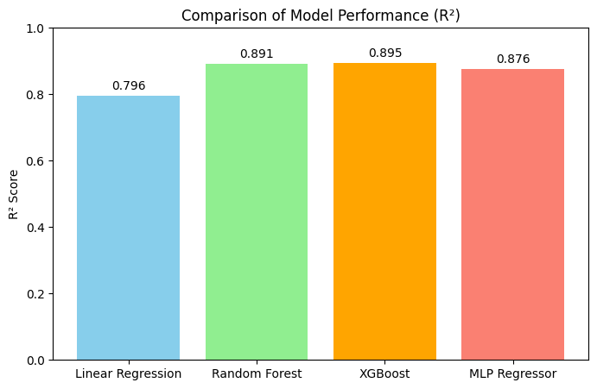
Model comparasion

