Slide 1
Transit Scheduling
3/17/19

Slide 2
Linear modelling of passenger flow
Main idea: people normally don‘t move randomly between stops – station nearby infrustructure affects moving patterns.
x=[x1 x2 x3 x4 x5 x6 x7 x8 x9],
x1 – number of transport hubs (railway stations)
x2 – number of offices
x3 – number of educational facilities
x4 – number of hospitals
x5 – number of municipal buildings
x6 – number of restaurants, cafes
x7 – number of small shops
x8 – number of big shops
x9 – station order within the route.

Slide 3
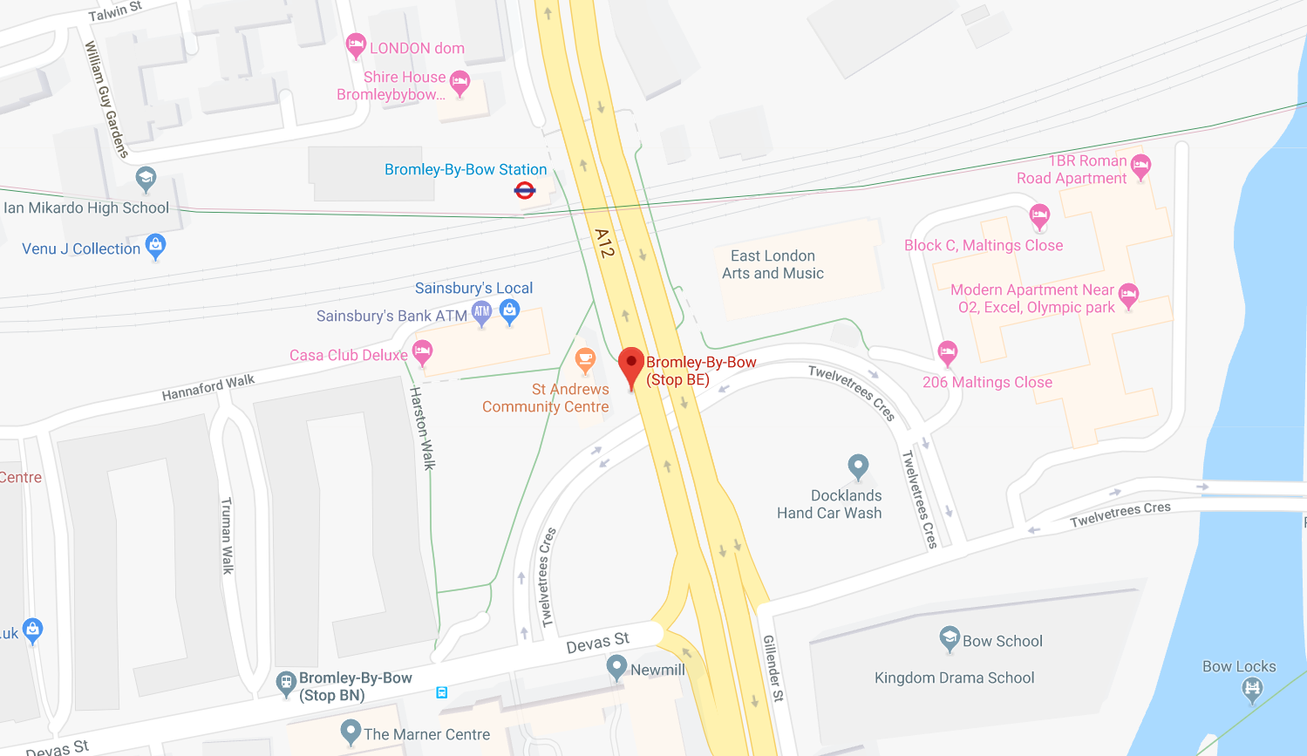
Linear modelling of passenger flow
Vector x example for station 3 ("Bromley-by-Bow station“)
[ 1, 3, 2, 0, 1, 1, 3, 0, 3]
1 railway station
3 offices
2 schools
0 hospitals
1 community center
1 café
3 small shops
0 large shops
3rd station

Slide 4
Linear modelling of passenger flow
Linear system:
A·w = b
b – number of people going from one station to another
A – matrix which represents characteristics of this 2 stations
w – coefficients (weights), that establish relationship between A and b
Construction of A – concatenation of x[1:8] for origin/destination stations and difference in their order
Model training – finding weights:
w=inv(A'A)A'b

Slide 5
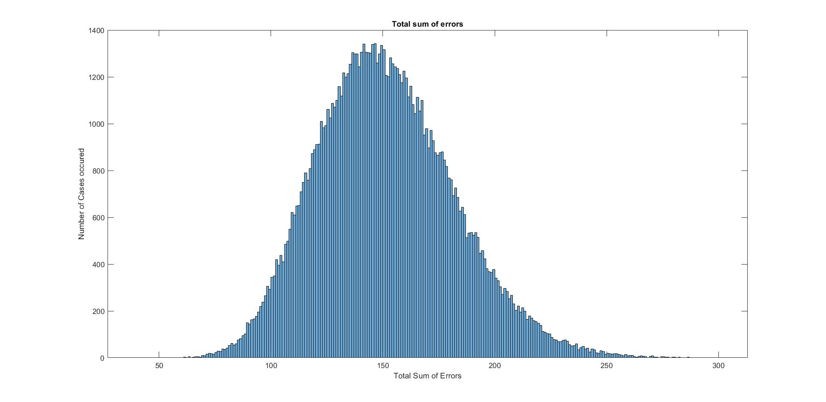
Linear modelling of passenger flow
Relatively large Total sum of Errors, but can we see a pattern?

Slide 6
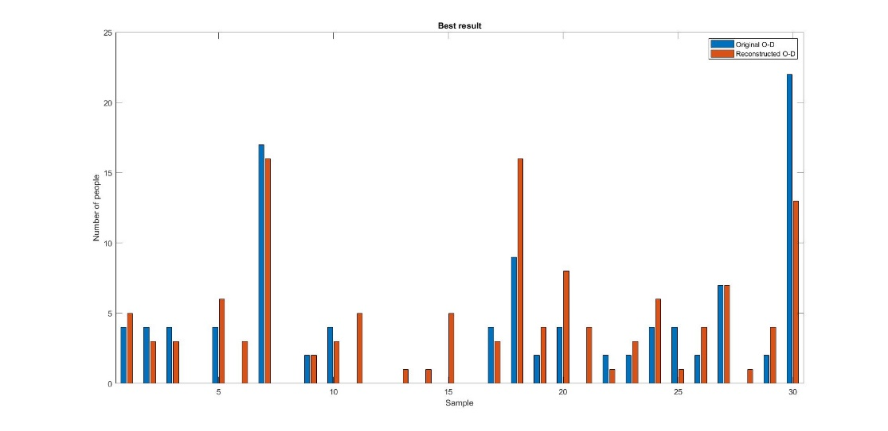
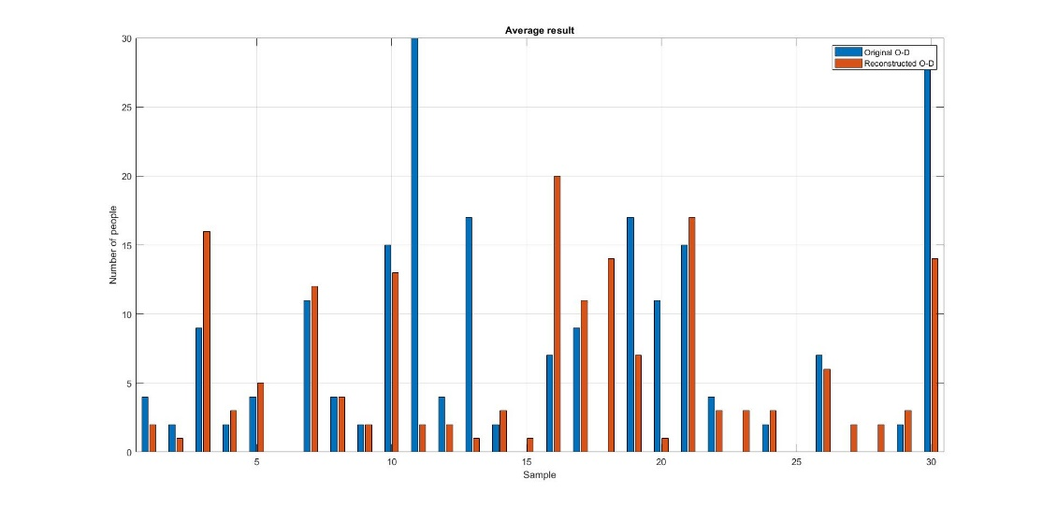
Linear modelling of passenger flow
Smallest error (Upper) and average error (Lower) demonstrate that pattern is traceable.
How to improve?
Find stations that are difficult to describe with a general model and separate them.
Leads to separation of „Bromley-by-Bow station“

Slide 7
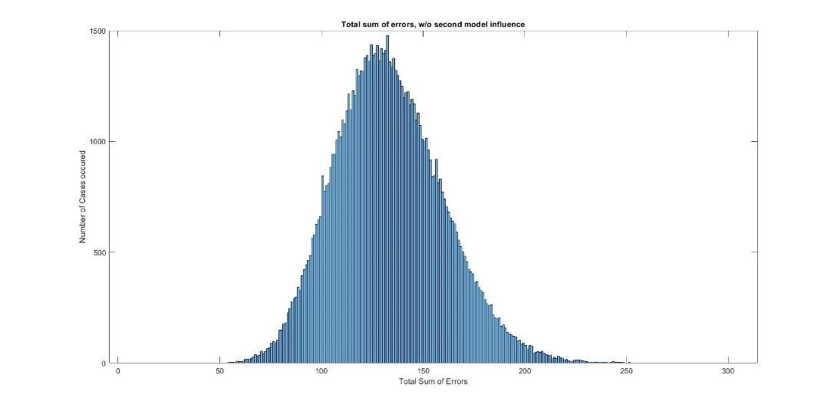
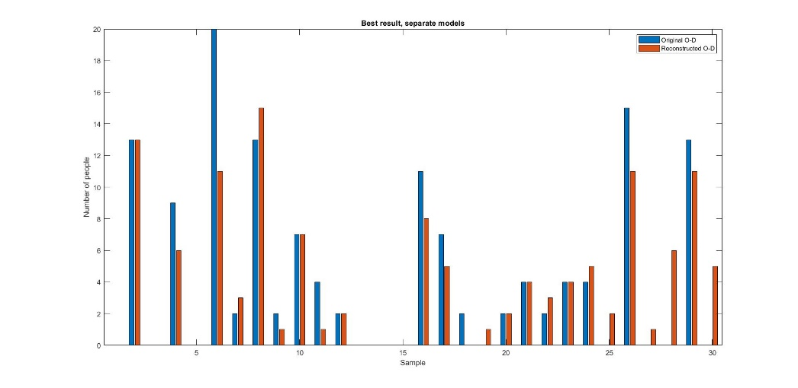
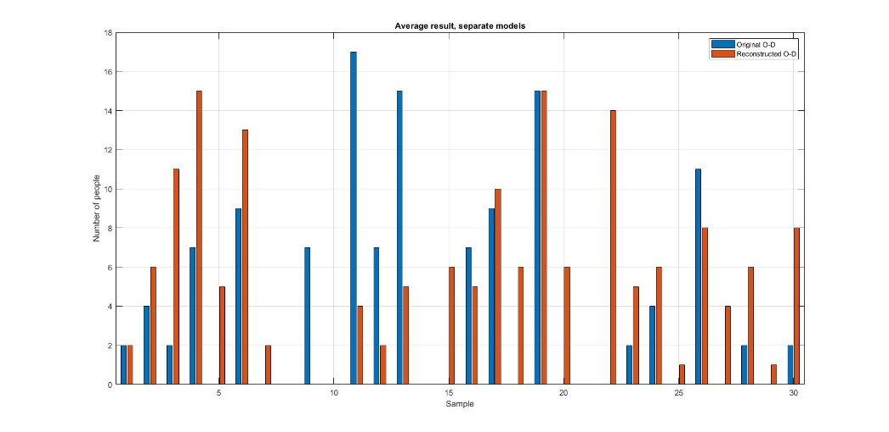
Linear modelling of passenger flow
TSE improvement – 15%
No significant impact on traceability

Slide 8
Linear modelling of passenger flow
Linear model advantages:
Easy to implement
Low computational time, fast
Can be used for rough estimations
Linear model disadvantages:
Unable to track non-linear behaviour (peaks)
Not reliable enough for industry usage
Improvement requires more input and training data, using layered linear models (Neural Networks)

Slide 9
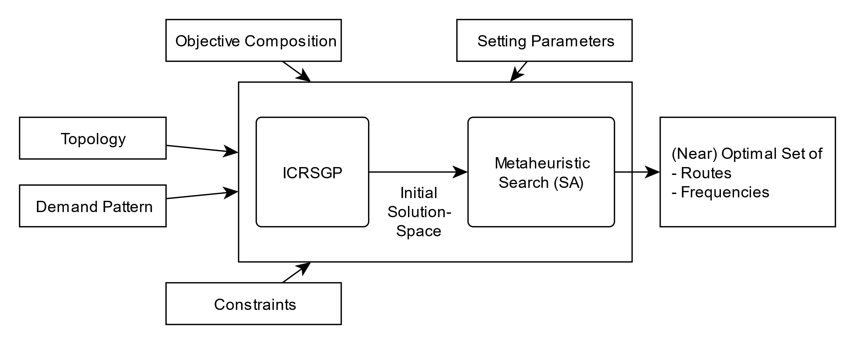
Route Generation and Scheduling

Slide 10
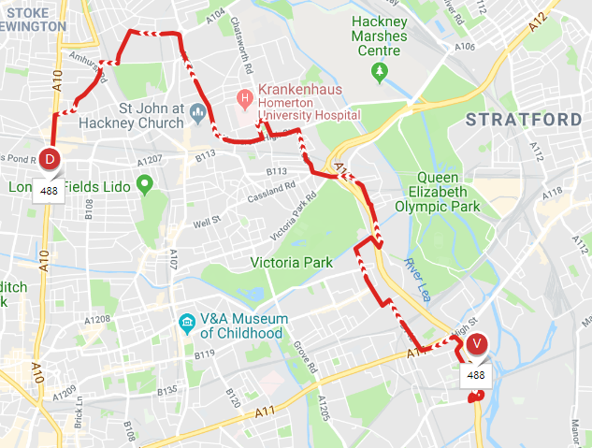
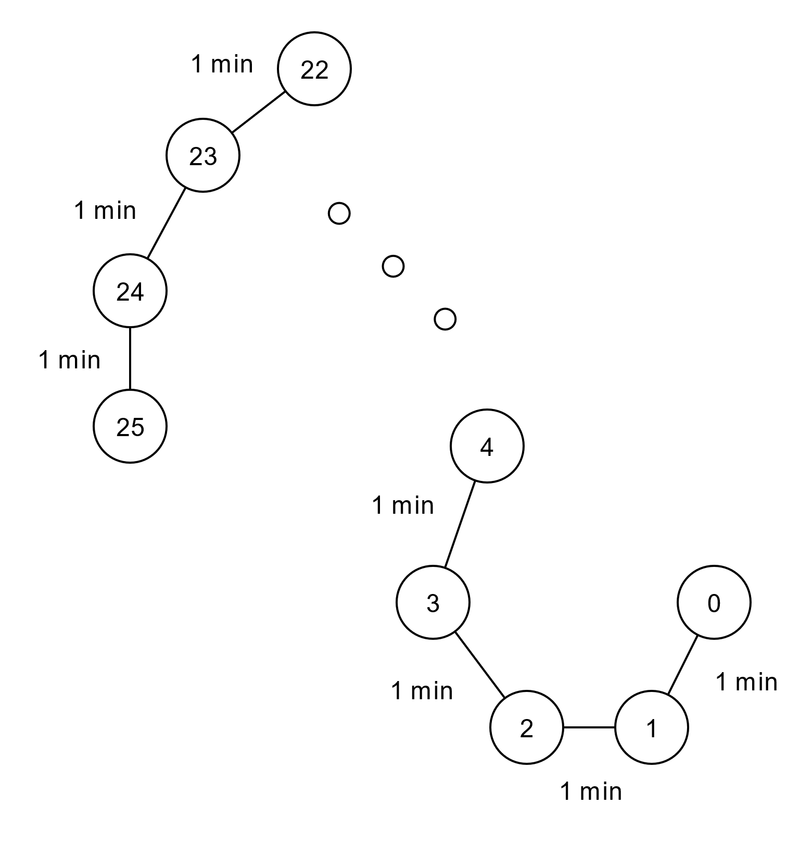
Route Generation and Scheduling - Input
Topology
Constraints
Objective Composition
Setting Parameters
Demand Pattern

Slide 11
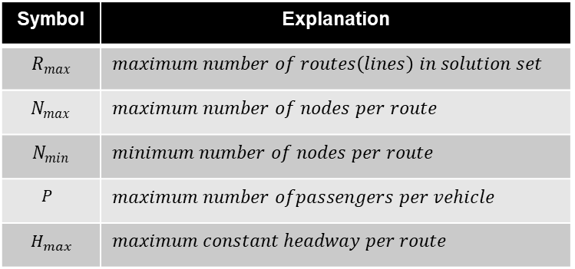
Route Generation and Scheduling - Input
Topology
Constraints
Objective Composition
Setting Parameters
Demand Pattern
Symbol | Explanation
$$R_{max}$$ | $$maximum number of routes\left(lines\right) in solution set$$
$$N_{max}$$ | $$maximum number of nodes per route$$
$$N_{min}$$ | $$minimum number of nodes per route$$
$$P$$ | $$maximum number ofpassengers per vehicle$$
$$H_{max}$$ | $$maximum constant headway per route$$

Slide 12
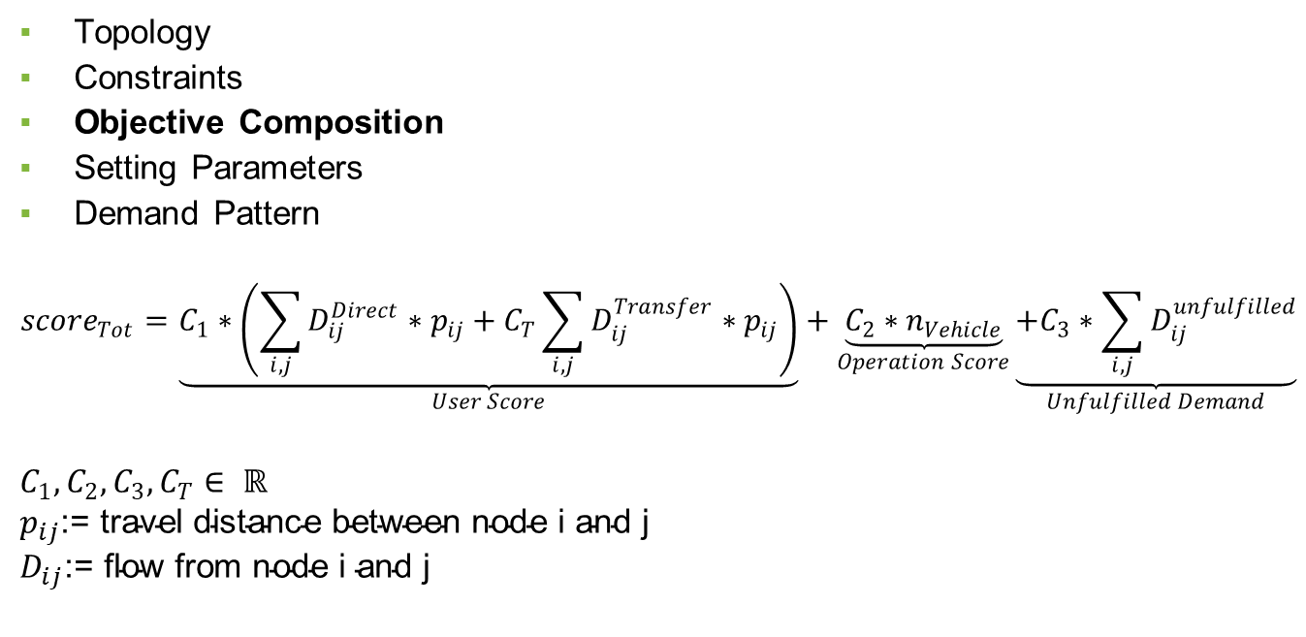
Route Generation and Scheduling - Input
Topology
Constraints
Objective Composition
Setting Parameters
Demand Pattern
$${score}_{Tot}=\underset{User Score}{\underbrace{C_{1}∗\left(\sum_{i,j}{D_{ij}^{Direct}∗p_{ij}}+C_{T}\sum_{i,j}{D_{ij}^{Transfer}∗p_{ij}}\right)}}+\underset{Operation Score}{\underbrace{C_{2}∗n_{Vehicle}}}\underset{Unfulfilled Demand}{\underbrace{+C_{3}∗\sum_{i,j}{D_{ij}^{unfulfilled}}}}$$
$$C_{1}, C_{2}, C_{3}, C_{T}∈ ℝ$$
$$p_{ij}\text{:= }\text{travel} \text{distance} \text{between} \text{node} \text{i} \text{and} \text{j}$$
$$D_{ij}\text{:= }\text{flow} \text{from} \text{node} \text{i} \text{and} \text{j}$$

Slide 13
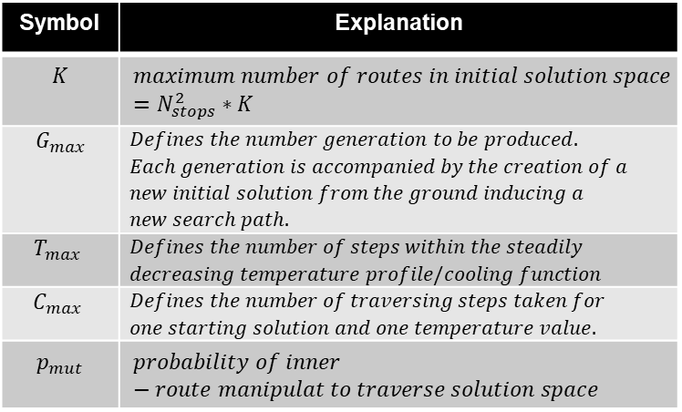
Route Generation and Scheduling - Input
Topology
Constraints
Objective Composition
Setting Parameters
Demand Pattern
Symbol | Explanation
$$K$$ | $$maximum number of routes in initial solution space$$ $$=N_{stops}^{2}∗K$$
$$G_{max}$$ | $$Defines the number generation to be produced.$$ $$Each generation is accompanied by the creation of a$$ $$new initial solution from the ground inducing a$$ $$new search path.$$
$$T_{max}$$ | $$Defines the number of steps within the steadily$$ $$decreasing temperature profile/cooling function$$
$$C_{max}$$ | $$Defines the number of traversing steps taken for$$ $$one starting solution and one temperature value.$$
$$p_{mut}$$ | $$probability of inner−route manipulat to traverse solution space$$

Slide 14
Route Generation and Scheduling - Input
Topology
Constraints
Objective Composition
Setting Parameters
Demand Pattern

Slide 15
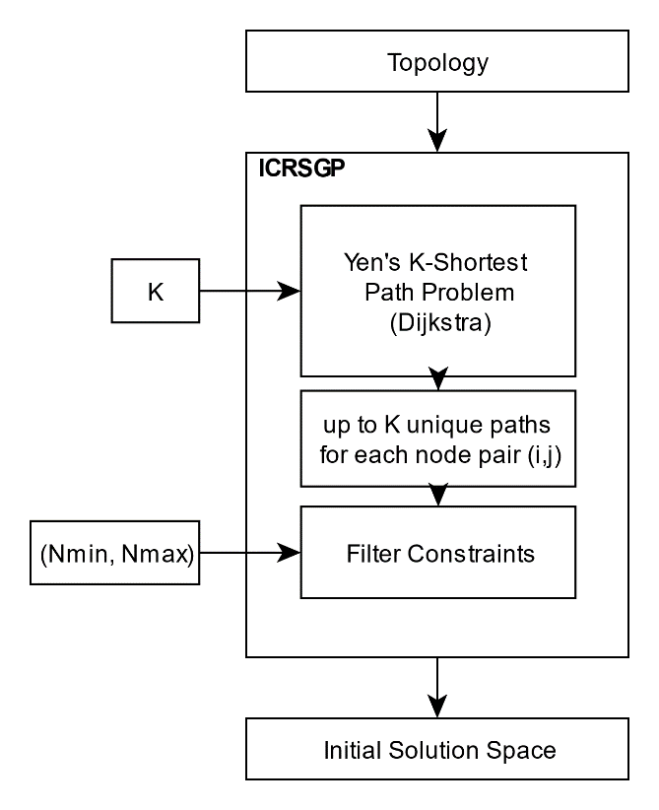
Route Generation and Scheduling-ICRSGP
Use graph topology to extract multiple paths between all node pairs
=> Still thinking about how to add
compact info

Slide 16
Route Generation and Scheduling – Metaheuristic Search(SA)
Using metaheuristic approach inspired by Simulated Annealing to find (near-) optimal solution
Accept worse solution while traversing solution space with certain probability (in contrast to hill climbing)
Possible escape from local optima
Acceptance probability decreases according to cooling profile
Ranking of solution using modified network analysis procedure (NAP*)

Slide 17
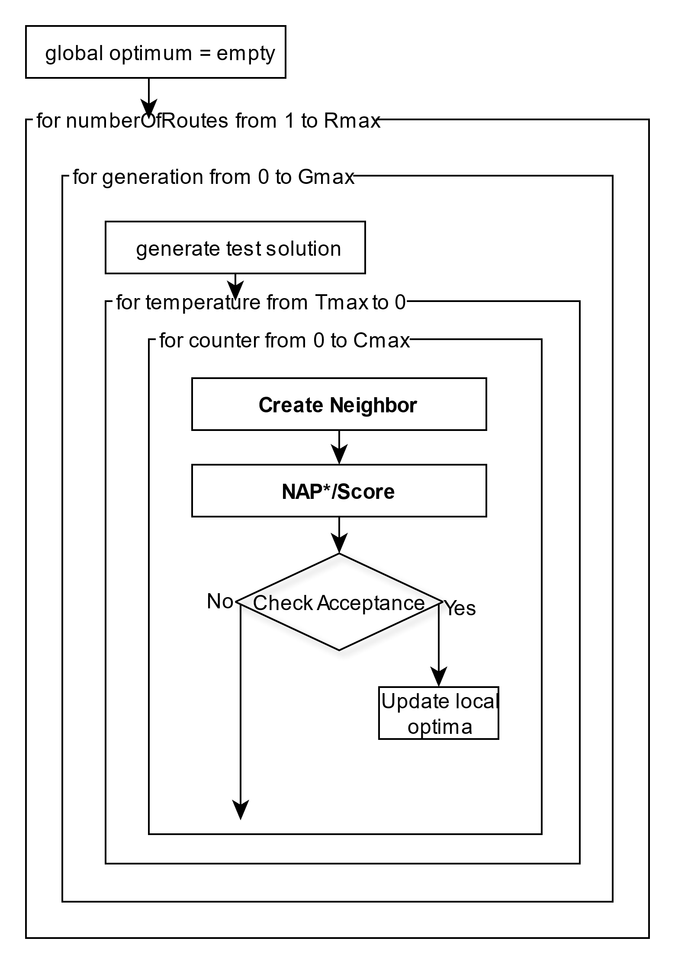
Route Generation and Scheduling – SA

Slide 18
Route Generation and Scheduling – Busline 488
Apply algorithm on busline 488 in london,UK for 6 daytime-periods
Interval | Actual Average Frequency
Early morning | 6 /h
AM peak | 4 /h
Midday | 5 /h
PM peak | 5 /h
Evening | 5 /h
Late evening | 3 /h

Slide 19
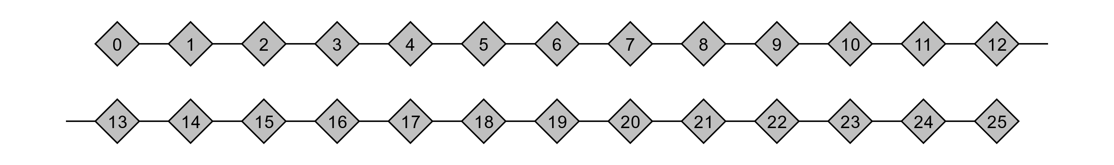
Route Generation and Scheduling – Busline 488
Interval | Calculated Average Frequency
Early morning | 1 /h
AM peak | 5 /h
Midday | 6 /h
PM peak | 4 /h
Evening | 3/h
Late evening | 1 /h

