Slide 1
Transit Scheduling
Rodion Novkin, Gajann Sivarajah, Yingmeng Pan, Long Zhou, Yannik-Noel Misz,
Yuchen Lin, Yunlong Liu, Karthik Boyapathi

Slide 2
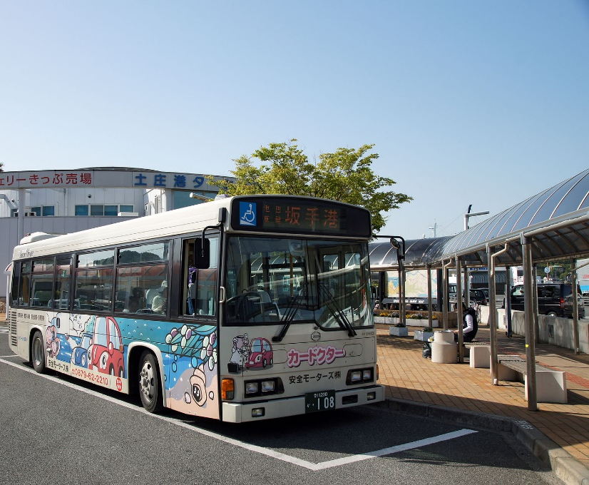
INTRODUCTION
Method I
Linear Model
Simulated Annealing
Method II
Particle Swarm Optimization

Slide 3
Linear modelling of passenger flow
Main idea: people normally don‘t move randomly between stops – station nearby infrustructure affects moving patterns.
x=[x1 x2 x3 x4 x5 x6 x7 x8 x9],
x1 – number of transport hubs (railway stations)
x2 – number of offices
x3 – number of educational facilities
x4 – number of hospitals
x5 – number of municipal buildings
x6 – number of restaurants, cafes
x7 – number of small shops
x8 – number of big shops
x9 – station order within the route.

Slide 4
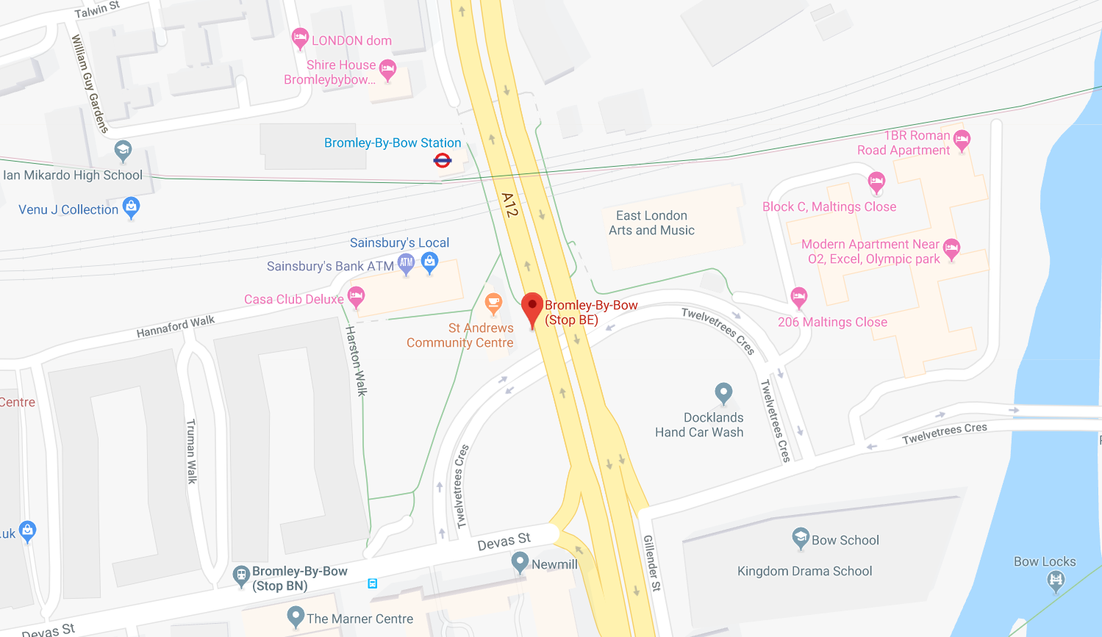
Linear modelling of passenger flow
Vector x example for station 3 ("Bromley-by-Bow station“)
[ 1, 3, 2, 0, 1, 1, 3, 0, 3]
1 railway station
3 offices
2 schools
0 hospitals
1 community center
1 café
3 small shops
0 large shops
3rd station

Slide 5
Linear modelling of passenger flow
Linear system:
A·w = b
b – number of people going from one station to another
A – matrix which represents characteristics of this 2 stations
w – coefficients (weights), that establish relationship between A and b
Construction of A – concatenation of x[1:8] for origin/destination stations and difference in their order
Model training – finding weights:
w=inv(A'A)A'b

Slide 6
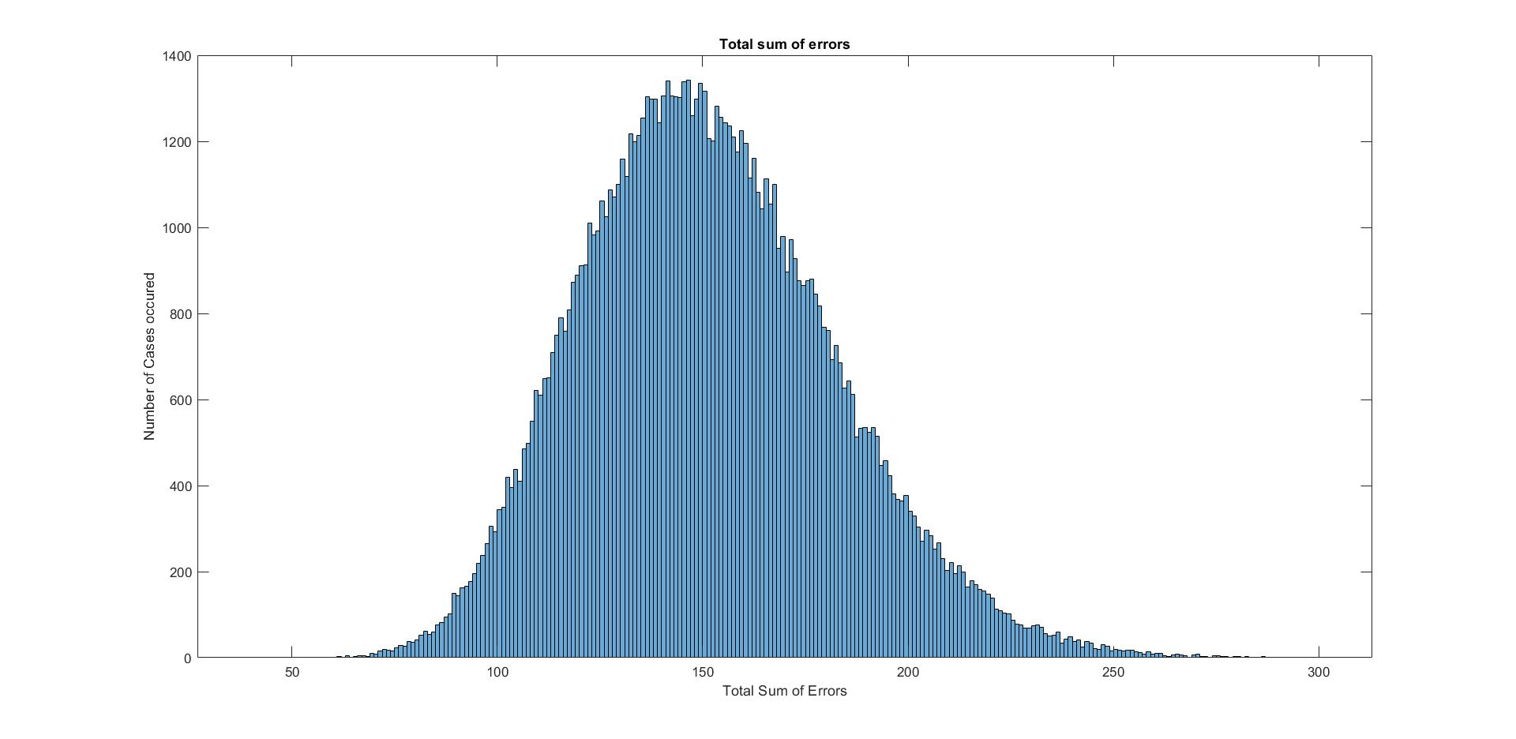
Linear modelling of passenger flow
Relatively large Total sum of Errors, but can we see a pattern?

Slide 7
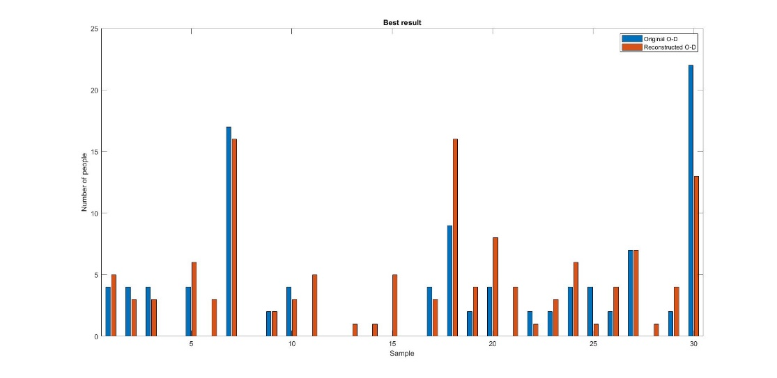
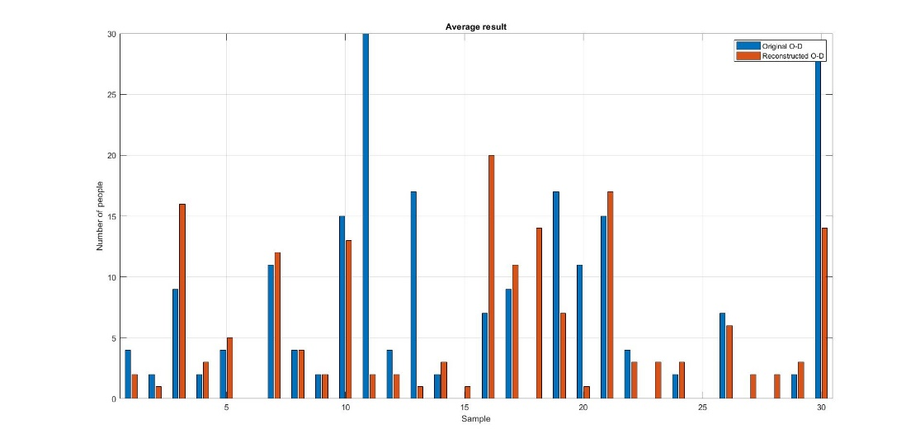
Linear modelling of passenger flow
Smallest error (Upper) and average error (Lower) demonstrate that pattern is traceable.
How to improve?
Find stations that are difficult to describe with a general model and separate them.
Leads to separation of „Bromley-by-Bow station“

Slide 8
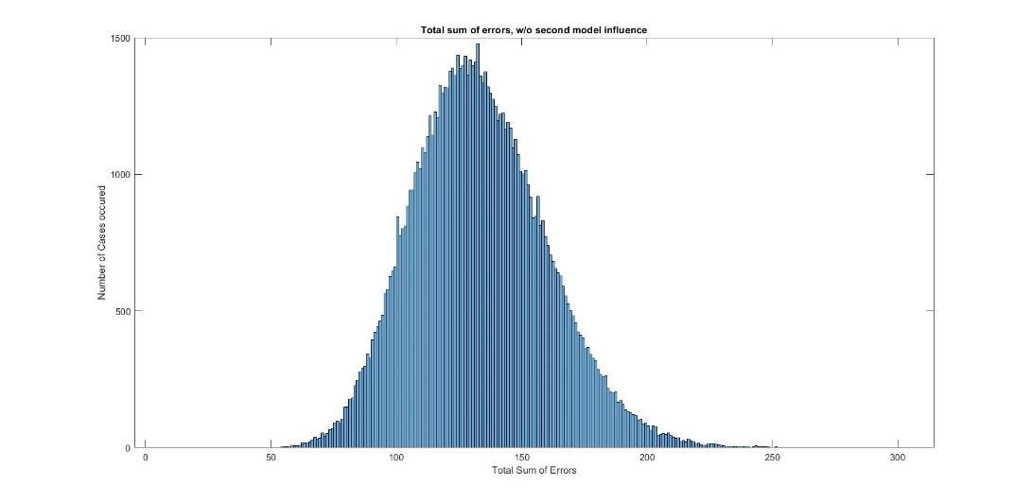
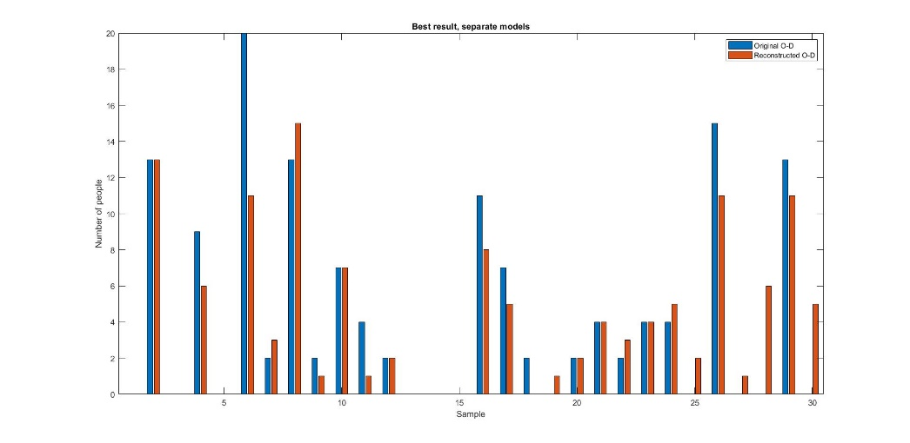
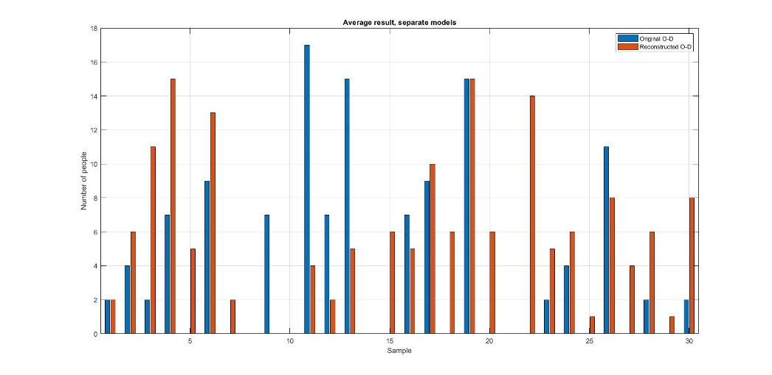
Linear modelling of passenger flow
TSE improvement – 15%
No significant impact on traceability

Slide 9
Linear modelling of passenger flow
Linear model advantages:
Easy to implement
Low computational time, fast
Can be used for rough estimations
Linear model disadvantages:
Unable to track non-linear behaviour (peaks)
Not reliable enough for industry usage
Improvement requires more input and training data, using layered linear models (Neural Networks)

Slide 10
Linear modelling of passenger flow – Prediction I
Train three different linear models
From Train: All trips starting at a train station
To Train: All trips ending at a train station
Normal: All other trips
Use models to predict the AM peak traffic of route 488
Both directions
Without rounding
Use assumptions to predict other time periods
Total passenger count and distribution
Use sampling to get integer values
Inbound
Inbound
Outbound
Inbound
Inbound
Inbound
Outbound
Outbound
Outbound

Slide 11
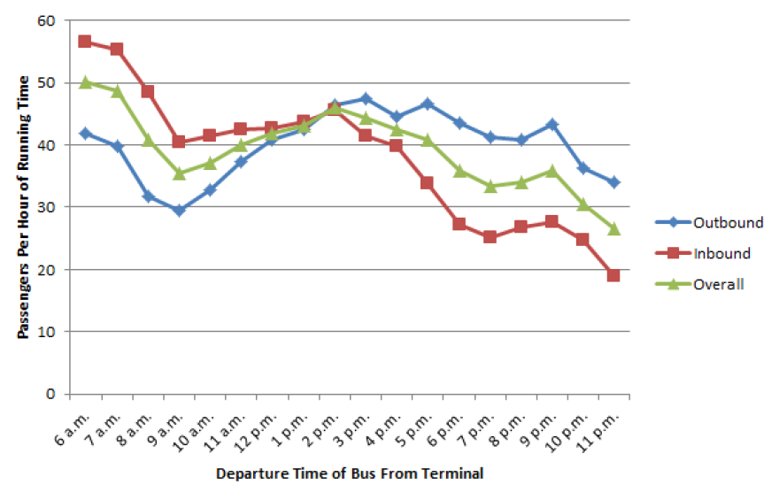
Linear modelling of passenger flow – Prediction II
early morning
AM peak
Midday
PM peak
evening
late evening
Travel directions change over day-time
„Who goes one direction in the morning returns in the afternoon“
Assumption:
Early morning, AM peak share same distribution.
PM peak, evening and late evening with reversed distribution.
Midday is the average of both distributions.
Average weekday passengers per hour of running time on buses in Boston, US over daytime. ^{i}
^{i} Vanderwart, C. (2016). Planning Transit Networks with Origin, Destination and Interchange Inference. Massachusetts Institute of Technology. Bachelor Thesis.

Slide 12
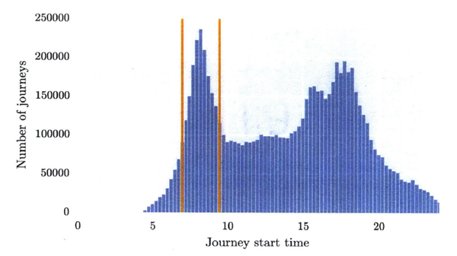
Linear modelling of passenger flow – Prediction III
early morning
AM peak
Midday
PM peak
evening
late evening
Assumption:
Total number of passengers per interval can be estimated from the predicted number in AM peak and the relations in this graph.
Sampling procedure:
For each time interval the absolute passenger number is estimated and rounded. For each passenger a trip is randomly selected with the linear model prediction as probability weight
Histogram of journey start times in London’s public transport.^{i}
^{i} Viggiano, C. A. (2017). Bus Network Sketch Planning with Origin-Destination Travel Data. Massachusetts Institute of Technology. Master Thesis

Slide 13
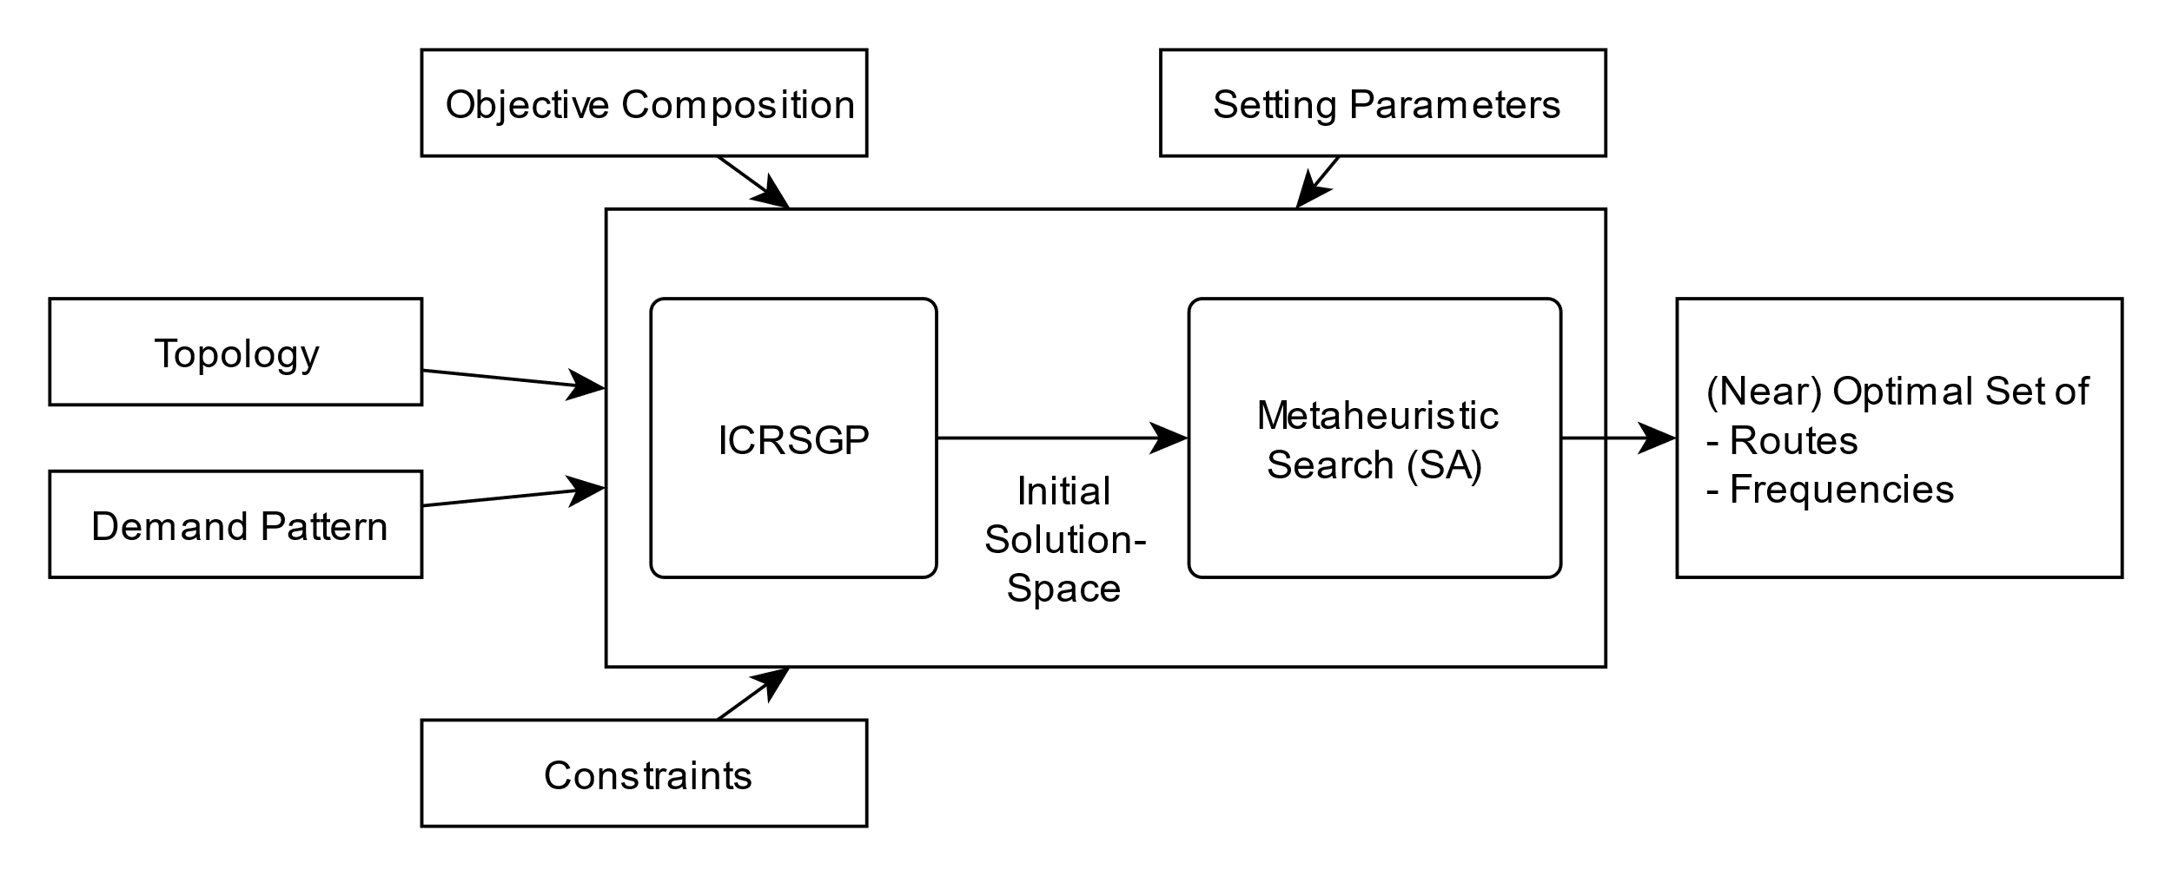
Route Generation and Scheduling

Slide 14
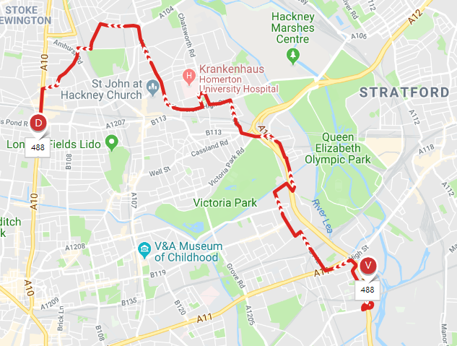
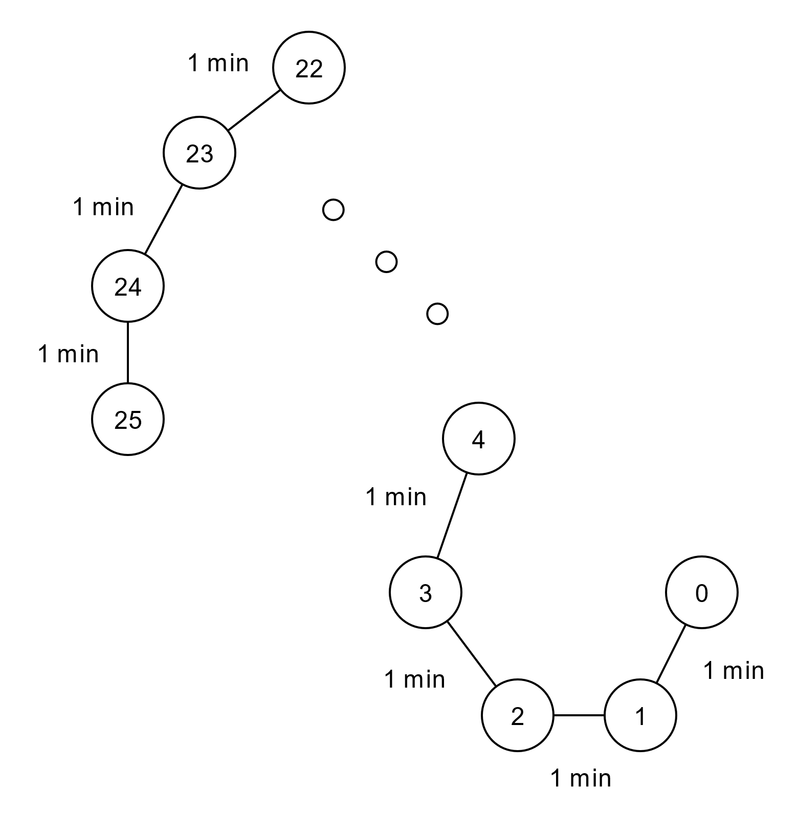
Route Generation and Scheduling - Input
Topology
Constraints
Objective Composition
Setting Parameters
Demand Pattern

Slide 15
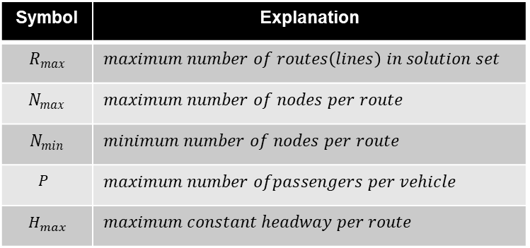
Route Generation and Scheduling - Input
Topology
Constraints
Objective Composition
Setting Parameters
Demand Pattern
Symbol | Explanation
$$R_{max}$$ | $$maximum number of routes\left(lines\right) in solution set$$
$$N_{max}$$ | $$maximum number of nodes per route$$
$$N_{min}$$ | $$minimum number of nodes per route$$
$$P$$ | $$maximum number ofpassengers per vehicle$$
$$H_{max}$$ | $$maximum constant headway per route$$

Slide 16
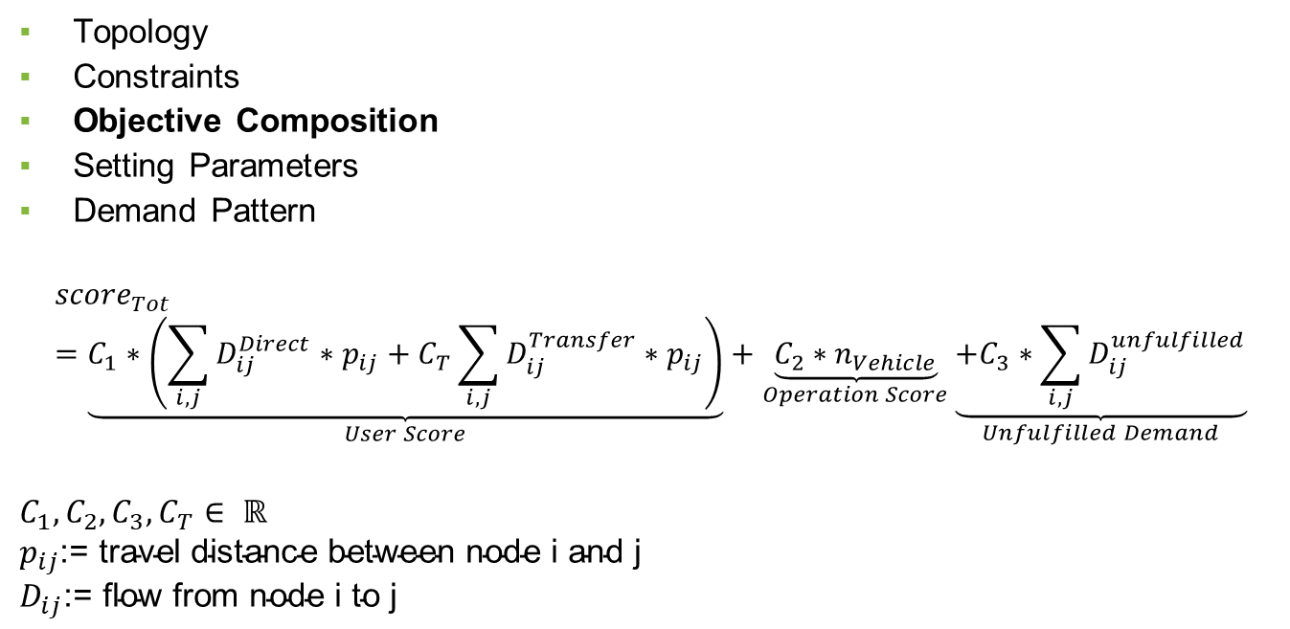
Route Generation and Scheduling - Input
Topology
Constraints
Objective Composition
Setting Parameters
Demand Pattern
$${score}_{Tot}=\underset{User Score}{\underbrace{C_{1}∗\left(\sum_{i,j}{D_{ij}^{Direct}∗p_{ij}}+C_{T}\sum_{i,j}{D_{ij}^{Transfer}∗p_{ij}}\right)}}+\underset{Operation Score}{\underbrace{C_{2}∗n_{Vehicle}}}\underset{Unfulfilled Demand}{\underbrace{+C_{3}∗\sum_{i,j}{D_{ij}^{unfulfilled}}}}$$
$$C_{1}, C_{2}, C_{3}, C_{T}∈ ℝ$$
$$p_{ij}\text{:= }\text{travel} \text{distance} \text{between} \text{node} \text{i} \text{and} \text{j}$$
$$D_{ij}\text{:= }\text{flow} \text{from} \text{node} \text{i} \text{to} \text{j}$$

Slide 17
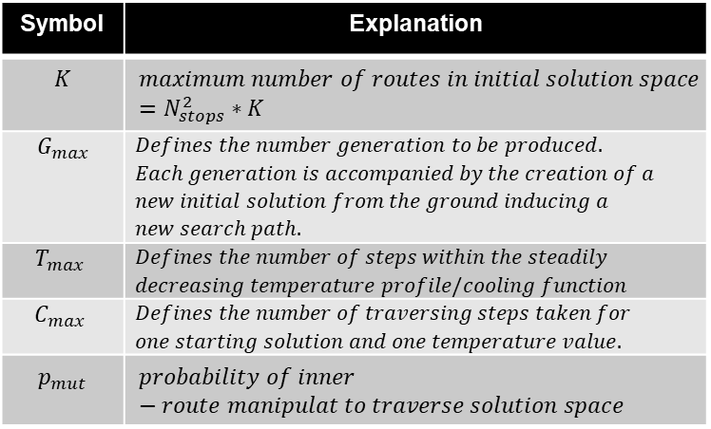
Route Generation and Scheduling - Input
Topology
Constraints
Objective Composition
Setting Parameters
Demand Pattern
Symbol | Explanation
$$K$$ | $$maximum number of routes in initial solution space$$ $$=N_{stops}^{2}∗K$$
$$G_{max}$$ | $$Defines the number generation to be produced.$$ $$Each generation is accompanied by the creation of a$$ $$new initial solution from the ground inducing a$$ $$new search path.$$
$$T_{max}$$ | $$Defines the number of steps within the steadily$$ $$decreasing temperature profile/cooling function$$
$$C_{max}$$ | $$Defines the number of traversing steps taken for$$ $$one starting solution and one temperature value.$$
$$p_{mut}$$ | $$probability of inner−route manipulat to traverse solution space$$

Slide 18
Route Generation and Scheduling - Input
Topology
Constraints
Objective Composition
Setting Parameters
Demand Pattern

Slide 19
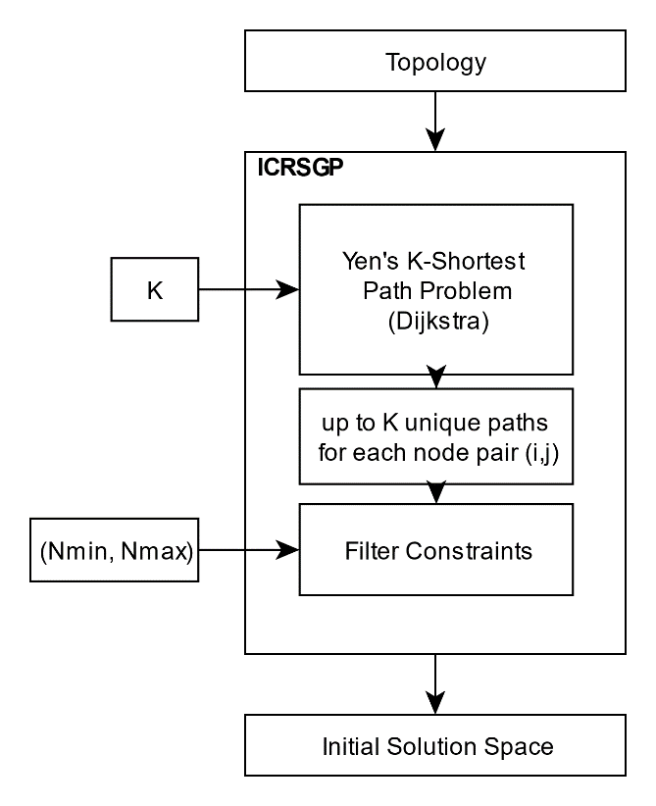
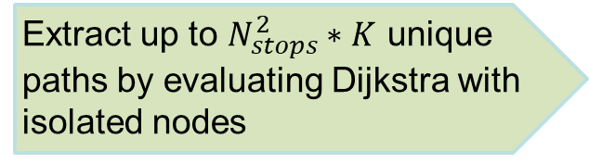
Route Generation and Scheduling-ICRSGP
Use graph topology to extract multiple paths between all node pairs
Extract up to $N_{stops}^{2}∗K$ unique paths by evaluating Dijkstra with isolated nodes

Slide 20
Route Generation and Scheduling-ICRSGP
Use graph topology to extract multiple paths between all node pairs
Remove paths not fitting length constraints

Slide 21
Route Generation and Scheduling – Metaheuristic Search(SA)
Using metaheuristic approach inspired by Simulated Annealing to find (near-) optimal solution
Accept worse solution while traversing solution space with certain probability (in contrast to hill climbing)
Possible escape from local optima
Acceptance probability decreases according to cooling profile
Ranking of solution using modified network analysis procedure (NAP*)

Slide 22
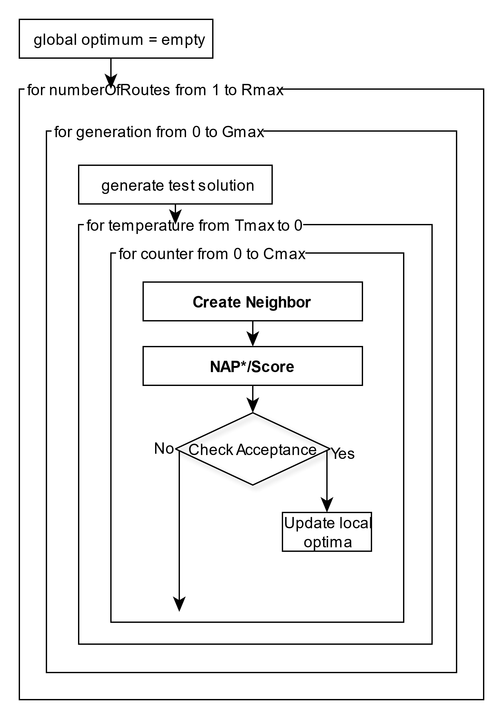
Route Generation and Scheduling – SA

Slide 23
Route Generation and Scheduling – Busline 488
Apply algorithm on busline 488 in london,UK for 6 daytime-periods
Interval | Actual Average Frequency
Early morning | 6 /h
AM peak | 4 /h
Midday | 5 /h
PM peak | 5 /h
Evening | 5 /h
Late evening | 3 /h

Slide 24
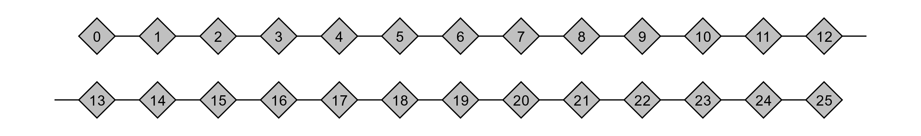
Route Generation and Scheduling – Busline 488
Interval | Calculated Average Frequency
Early morning | 1 /h
AM peak | 5 /h
Midday | 6 /h
PM peak | 4 /h
Evening | 3/h
Late evening | 1 /h

