Slide 1


Applied Data Science Capstone Project: Indonesian Flavours in the West Abraham Suriadi Halim December 2020

Slide 2
Summary
Number of Neighbourhoods in Toronto and New York City
Indonesian Restaurants in Toronto and New York City
Different Restaurants in Toronto and New York City
Restaurant Clusters in Toronto and New York City
Results
Discussion
Conclusion

Slide 3
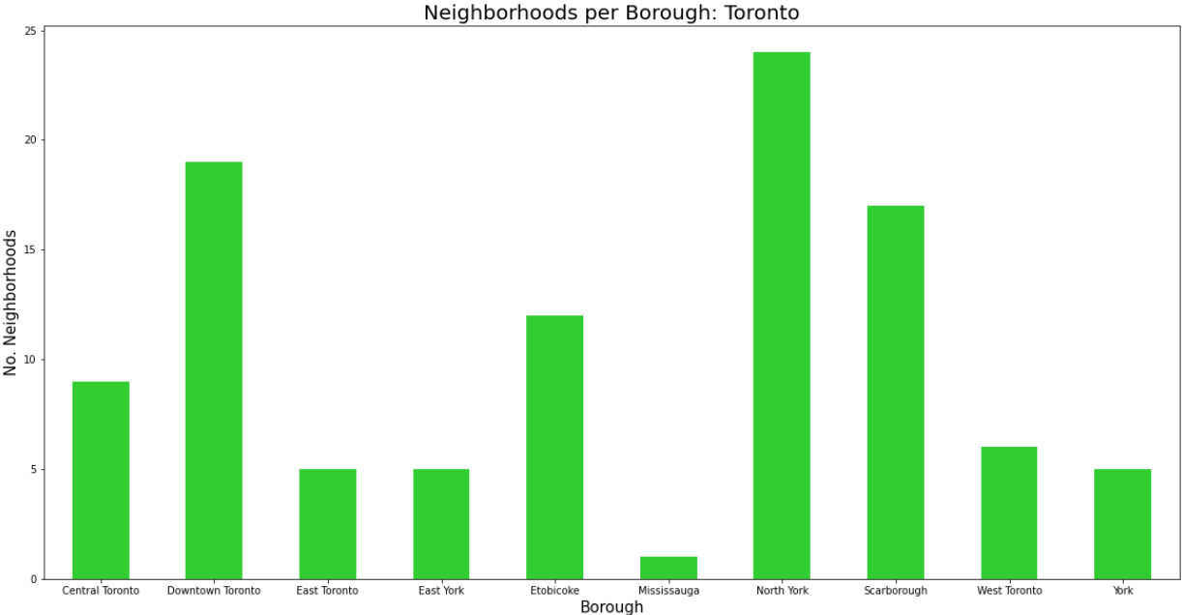
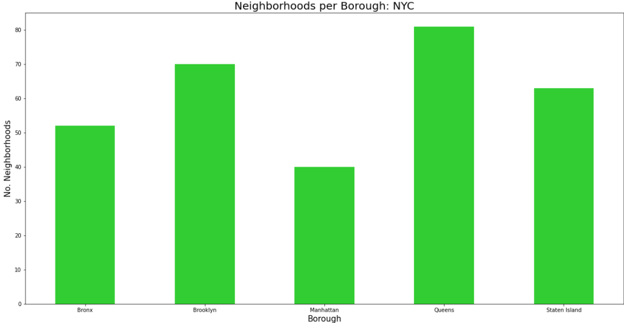
Number of Neighbourhoods
North York is the borough in Toronto with highest number of neighbourhoods
Queens is the borough in New York City with the highest number of neighbourhoods

Slide 4


Indonesian Restaurants
There are no Indonesian restaurants in Toronto
There is only one Indonesian restaurant in New York City – located in the borough with the highest number of neighbourhoods

Slide 5
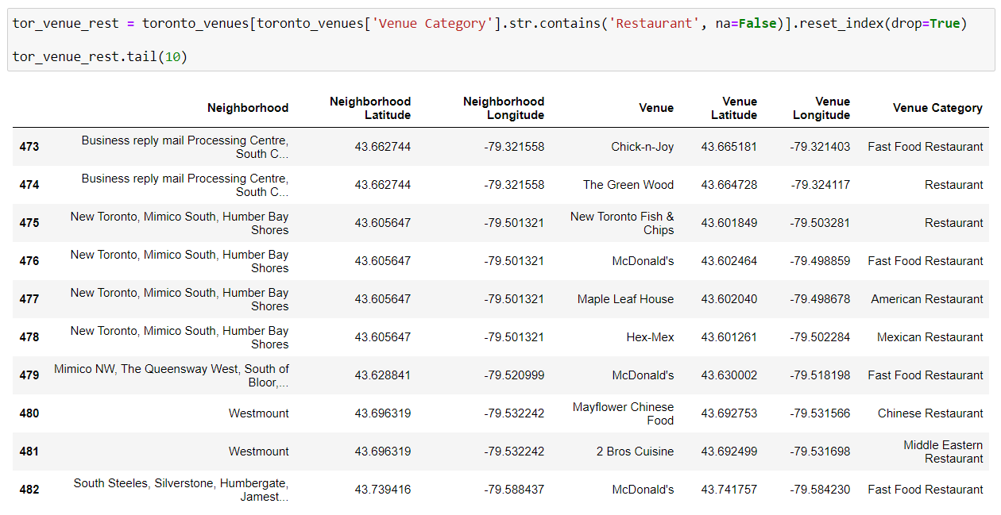
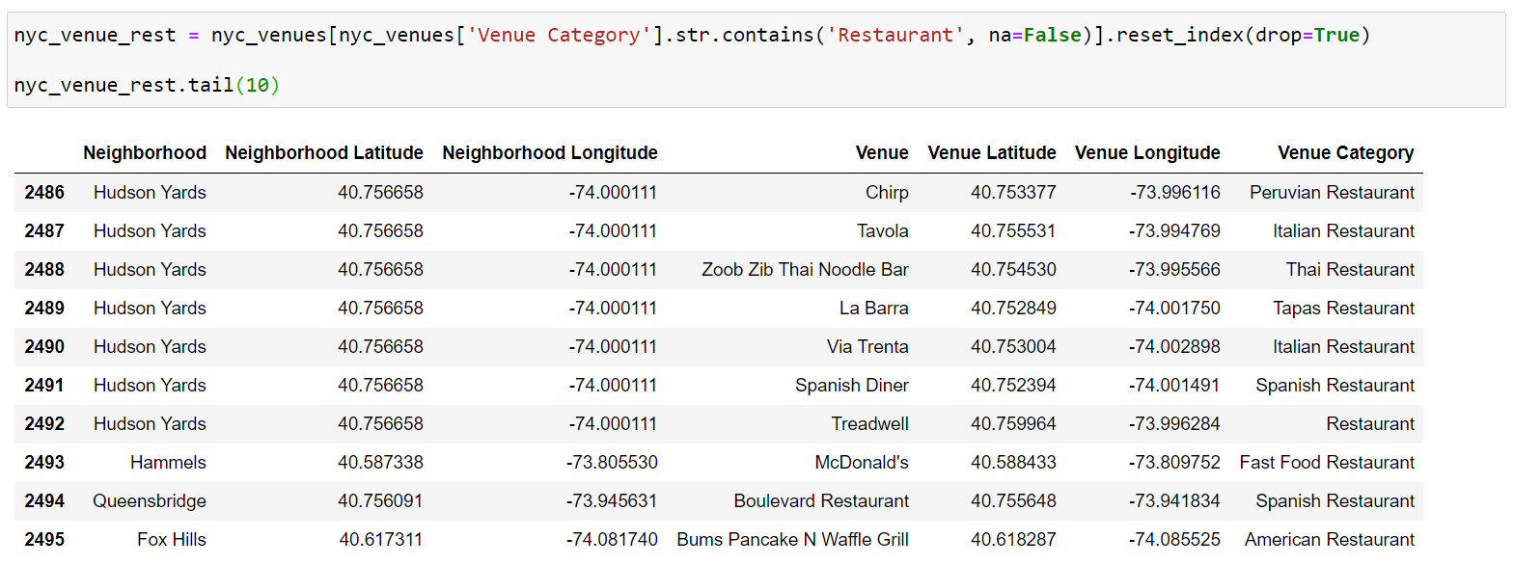
Different Restaurants
Some restaurants in Toronto
Some restaurants in New York City

Slide 6
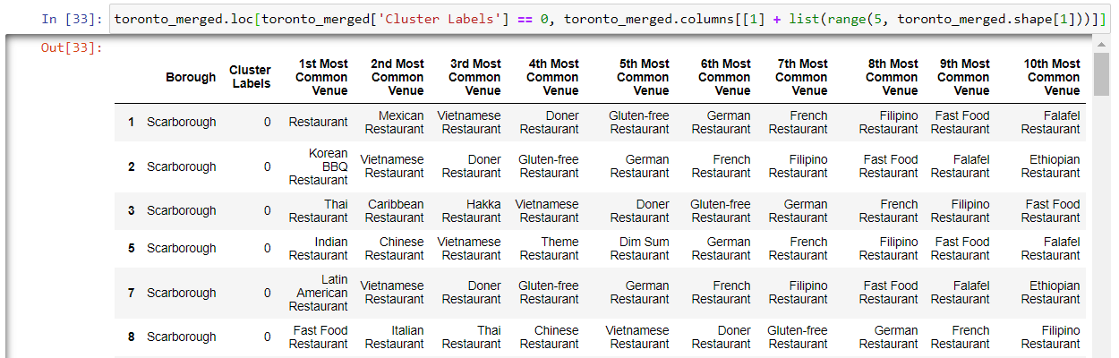
Different Restaurants – Toronto (Cluster 0)
By inspection, there are more Asian-influenced restaurants in the first common venues. This apply for this dataset if seen in the notebook.

Slide 7
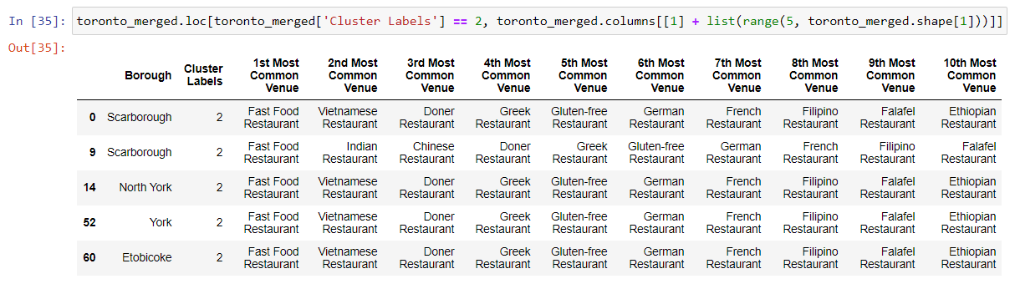
Different Restaurants – Toronto (Cluster 2)
By inspection, there are lesser Asian-influenced restaurants in the list common venues. This cluster is used as an example to represent the other clusters (1, 3 and 4)

Slide 8
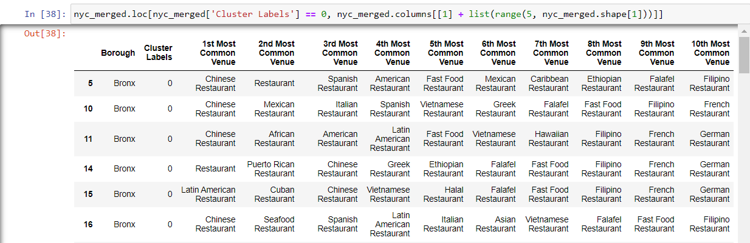
Different Restaurants – New York City (Cluster 0)
By inspection, the first common venues are restaurants with Asian influence. However, other than the first, it differs.

Slide 9
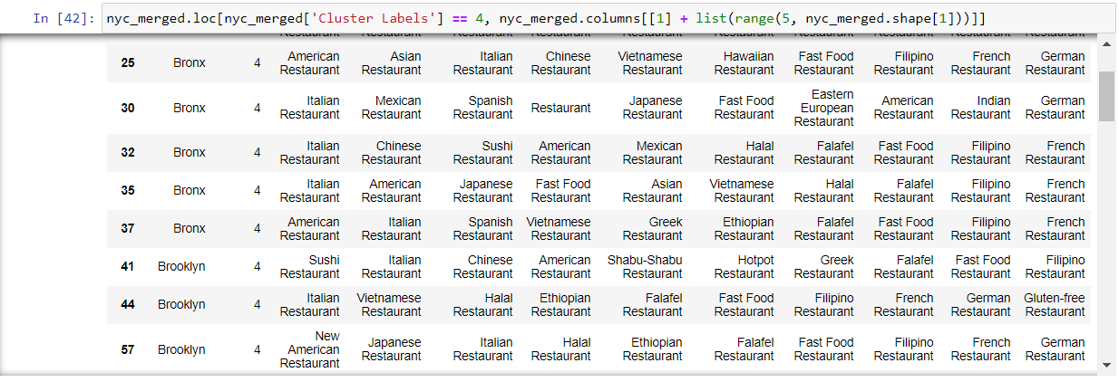
Different Restaurants – New York City (Cluster 4)
By inspection, there are lesser Asian-influenced restaurants in the first common venues. This cluster is an example to represent other clusters (cluster 1, 2 and 3) with similar patterns

Slide 10
Results
There is only one Indonesian restaurant in New York City and none in Toronto
By inspection, cluster 1 (Red) in Toronto has more Asian restaurants as top venues as compared to other clusters in the city
By inspection, cluster 1 (Red) in New York City also has more Asian restaurants as top venues compared to other clusters in the city
In Toronto, Asian restaurants can easily be spotted as common venues all over its different neighbourhoods
In New York City, however, customers in general prefer restaurants under the Western influence such as American restaurants, Fast food restaurants and Spanish restaurants

Slide 11
Discussion
Determining which of the two city is a better location with the used dataset is insufficient
There are other factors to consider such as the population of Indonesian residents, price of rent/land in both cities, et cetera

Slide 12
Conclusion
Based merely on the geographical datasets of Toronto & New York City and the analysis done, Toronto is a better city to open an Indonesian restaurant
Toronto does not yet have such restaurant and its citizens have stronger tendencies to visit restaurants with an Asian influence
Meanwhile, New York City has customers with stronger tendencies to Western flavours, which may be unprofitable for an Asian restaurant (Indonesian) business

