Slide 1

موقع مُعين للأسئلة البرمجية Web Application Moeen

Slide 2
Brief about the project
A Full Stack Web Application moeen to solve the problem of communication between programmers
by providing a platform to ask programming questions and receive assistance from experts.

Slide 3
Technologies used
Front-End using React App
Back-End using Java Spring Boot, Database mySQL.

Slide 4
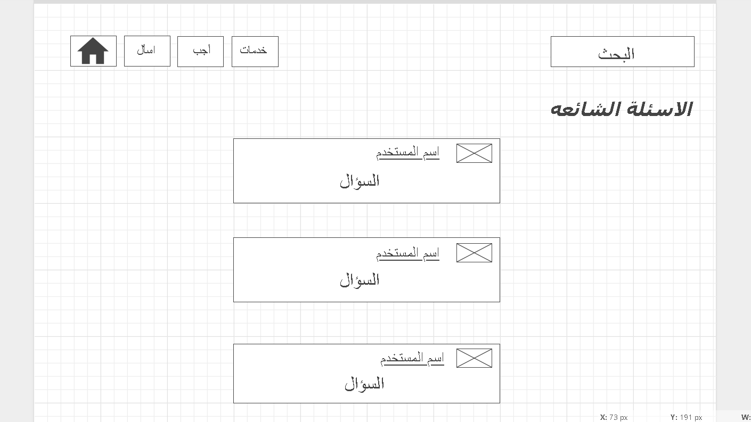
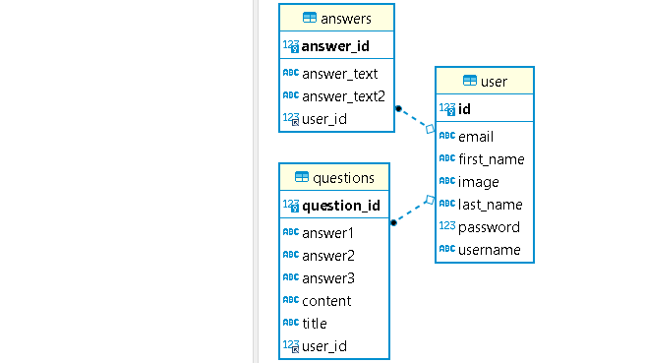
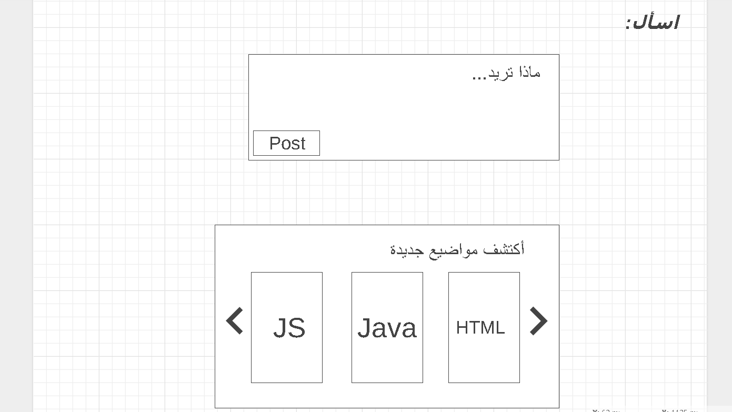
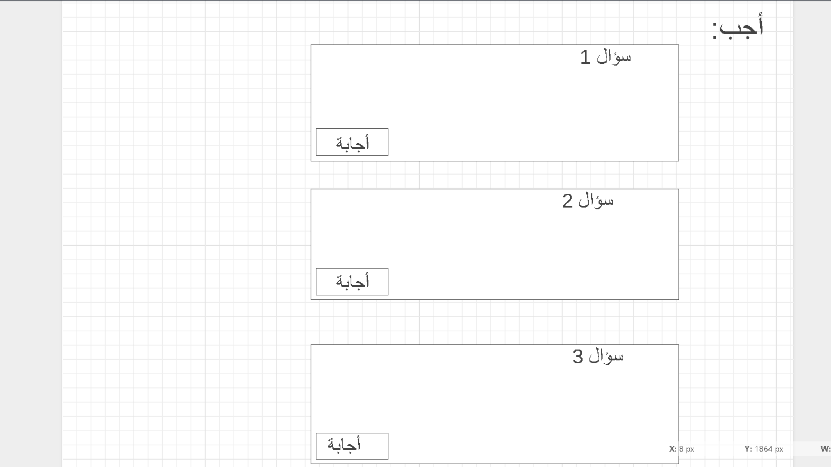
Wireframe _ ERD

Slide 5
Problem statement and Difficult
Th most difficult thing is Login and
Logout
(authentication)

Slide 6
Favorite Part
Styling with CSS and how to create a
Full Stack Web Application

Slide 7
What I learned ?
How to connect the back-end with databases mySQL
How to use API
Working with front and back end in the same project

