Slide 1

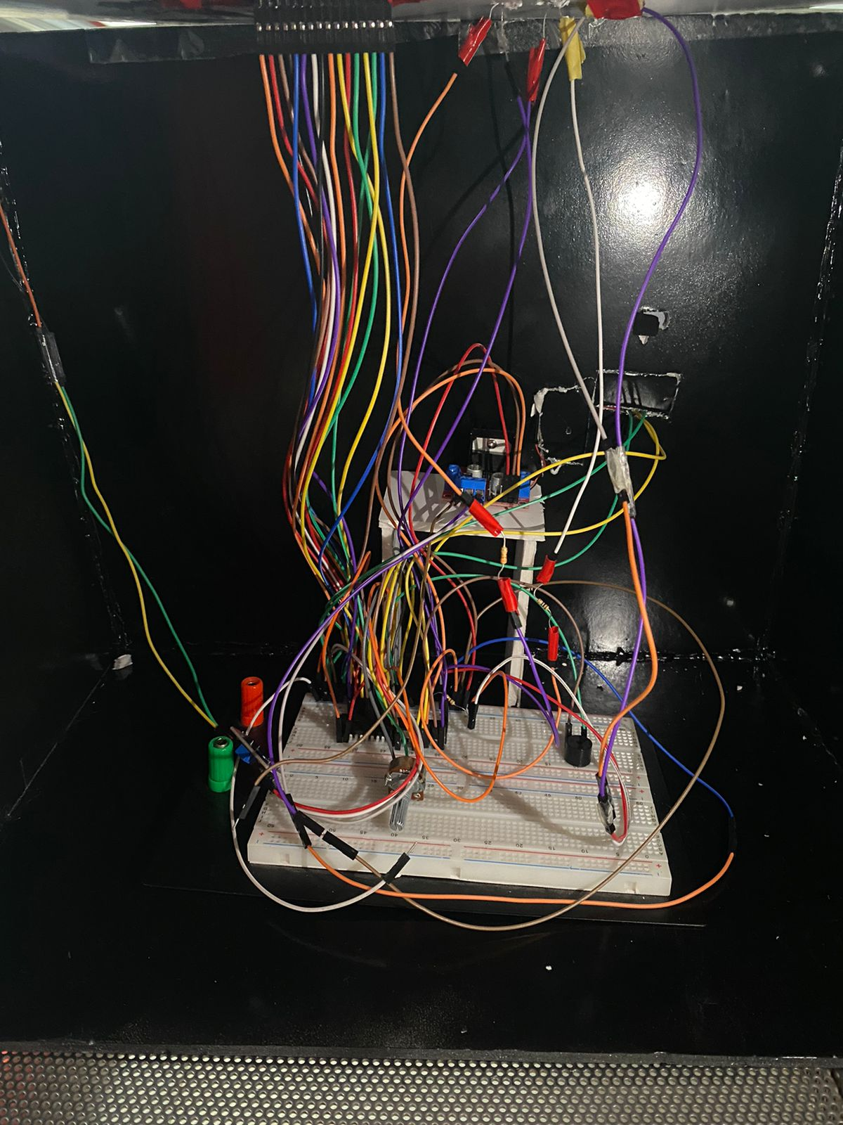
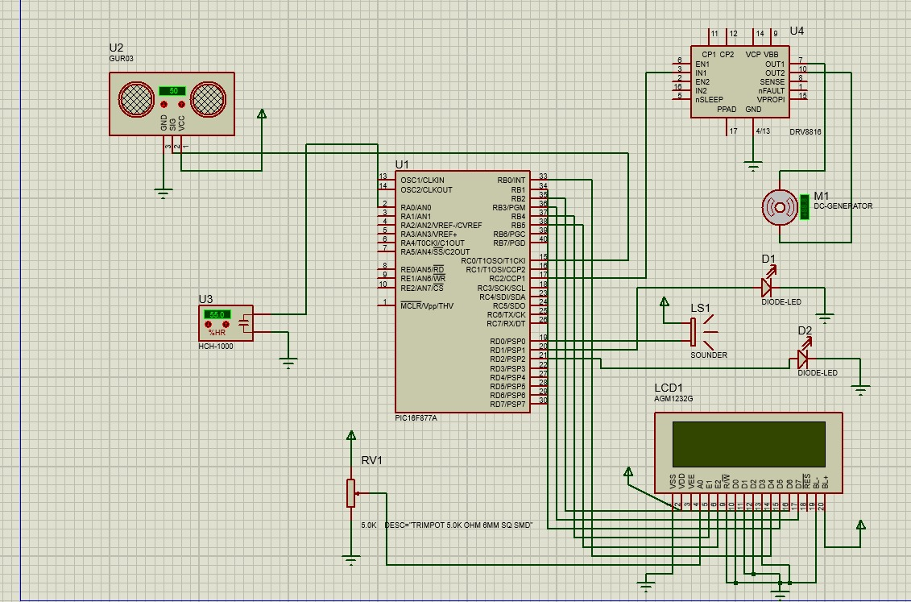
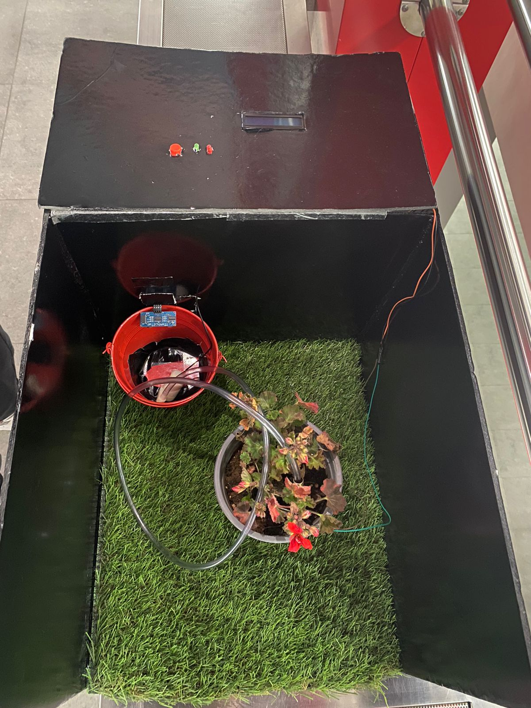
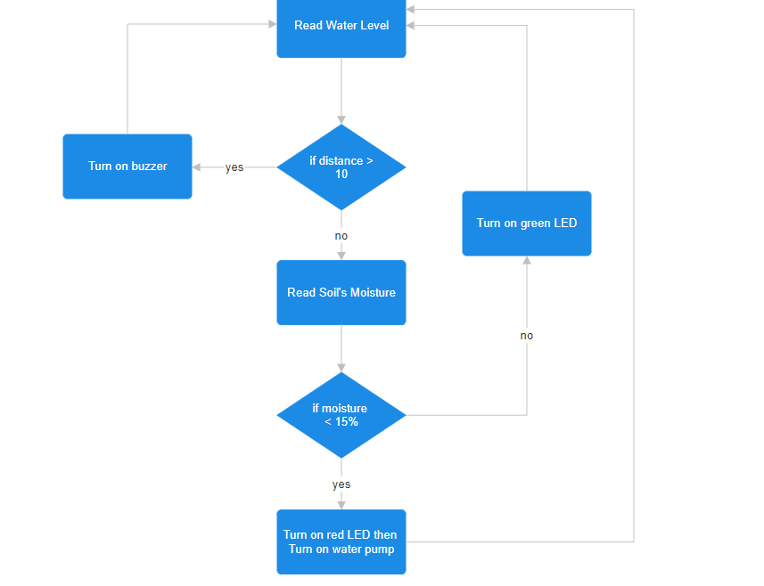
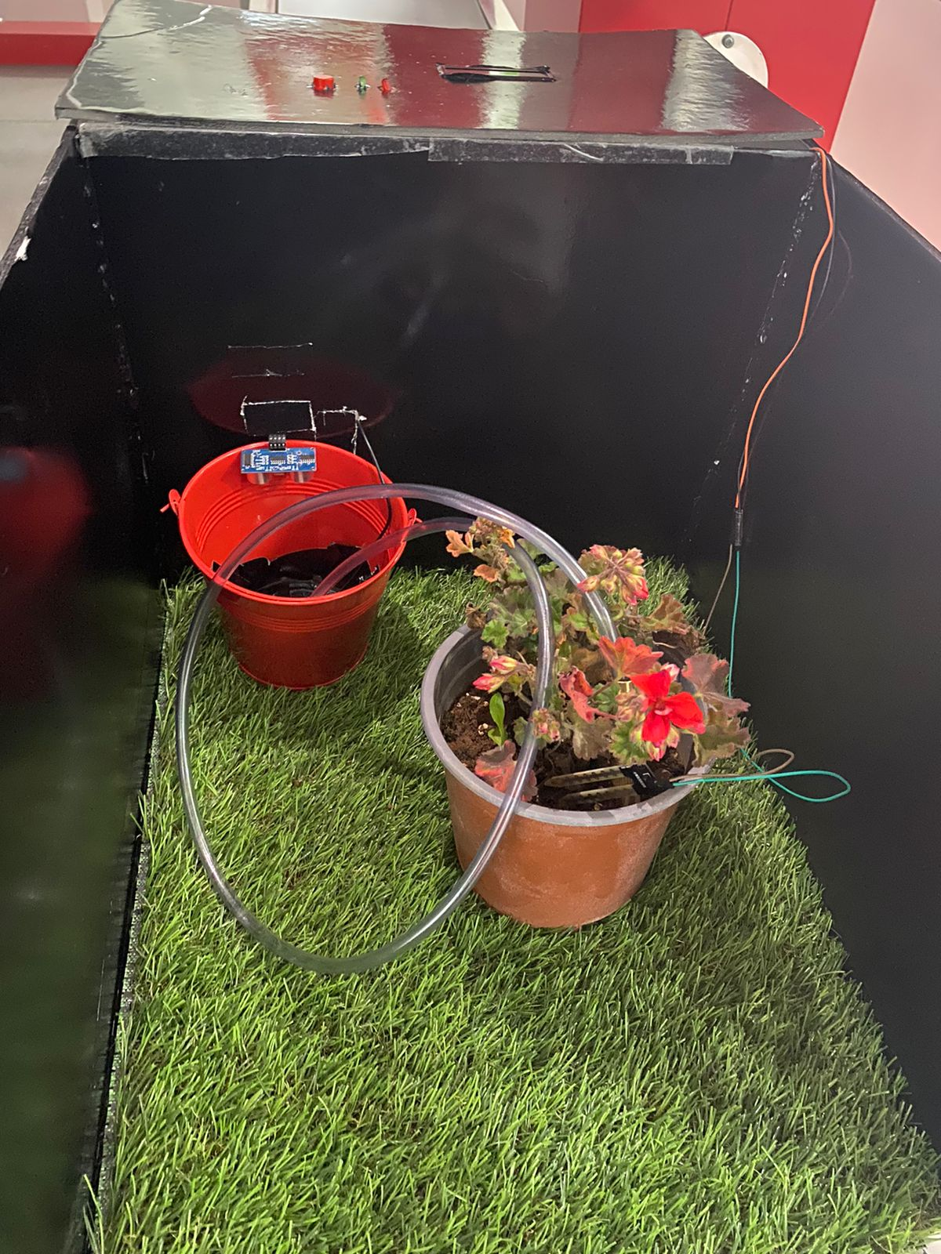
Smart Irrigation System
H. Mohammad, S. Elaydi, and M. Samer
Supervisor: Dr. Anastassia Gharib
Embedded Systems Final Design Project, Fall 2023
King Abdullah II School of Engineering
Princess Sumaya University for Technology
Introduction
The Solar Power Auto-Irrigation System emerges as a transformative solution. This project addresses the inefficiencies of traditional methods by offering a dependable, energy-efficient, and automated alternative for farmers, and any household. It seeks to revolutionize agricultural practices by introducing a sustainable approach to irrigation management.
The system checks if the soil is moist enough, if not it will automatically water the soil. In addition, to checking if the tank has enough water before the process of irrigation.
Results
Firstly, the system checks the water level in the tank, then checks the moisture percentage, if it reads back as low, the system pumps water to the soil. The figures below depict the end result of our system.
Figure 3: Back view of the project
Figure 4: End design
Design
Figure 1: Schematic Design
Figure 2: Flowchart Diagram
Figure 5: End design - Front view
Conclusion
The broader implication of this project extends to both the agricultural sector and households, offering a glimpse into a future where smart technologies play a pivotal role in resource conservation. As we navigate towards a world grappling with water scarcity and ecological concerns, the Solar Power Auto-Irrigation System stands as a beacon of innovation, showcasing the promise of intelligent, eco-friendly solutions for a more resilient and sustainable tomorrow.

