Slide 1

STROKE PREDICTION USING MACHINE LEARNING
Hala Amr Awad ID:221001189
Notes:
SLIDE 1 — COVER (0:00 – 0:30) Say: "Hello everyone. In this video I will walk you through my final machine learning project — a stroke prediction system. The goal is to predict whether a patient is at risk of having a stroke using their clinical and demographic data. I will cover every step from cleaning the raw data all the way to deploying a working web application. Let's get started."

Slide 2

Project Overview
Can we accurately predict stroke risk from clinical & demographic features and which factors matter most?
50,000
12
4.87%
Patient Records in rows
Features Columns
Stroke Positive Rate
Dataset Features
Age, Gender, BMI
Work Type & Residence Type
Average Glucose Level
Smoking Status, Marital Status
Hypertension & Heart Disease
Target: Stroke (0 = No, 1 = Yes)
Notes:
SLIDE 2 — PROJECT OVERVIEW (0:30 – 1:00) Say: "The project question is: can we predict whether a patient will have a stroke based on their clinical data? I used a synthetic stroke prediction dataset from Kaggle containing 50,000 patient records and 12 features including age, glucose level, BMI, hypertension, heart disease, and smoking status. Only about 4.87% of patients had a stroke — this severe class imbalance is one of the main challenges I had to address."

Slide 3

Data Cleaning & Feature Engineering
Dropped 'id' Column
Missing BMI Values
Other Gender
Patient ID has no predictive value
Filled with median robust to outliers unlike mean
< 0.2% of rows removed
New Feature Engineered
glucose_bmi_ratio = avg_glucose_level ÷ bmi
High blood sugar + high body weight = compound cardiovascular risk. This ratio captures both signals in one feature.
Notes:
SLIDE 3 — DATA CLEANING (1:00 – 1:45) Say: "Before training any model, I cleaned the data. There were three main issues. First, I dropped the id column because it is just a patient identifier with no predictive value. Second, the BMI column had 201 missing values — I filled them with the median because the median is more robust to outliers than the mean. Third, a tiny number of rows had gender recorded as Other, less than 0.2%, so I removed them. I also had to handle the severe class imbalance — only 4.87% of patients had a stroke. I solved this by using class_weight balanced in all models. Finally I engineered a new feature called glucose_bmi_ratio by dividing average glucose level by BMI. High blood sugar combined with high body weight is a known compound risk factor for stroke, so this ratio captures both signals in one number."

Slide 4
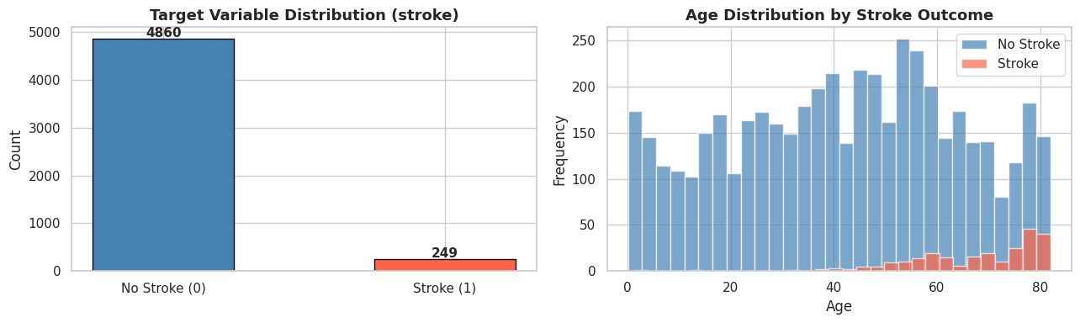
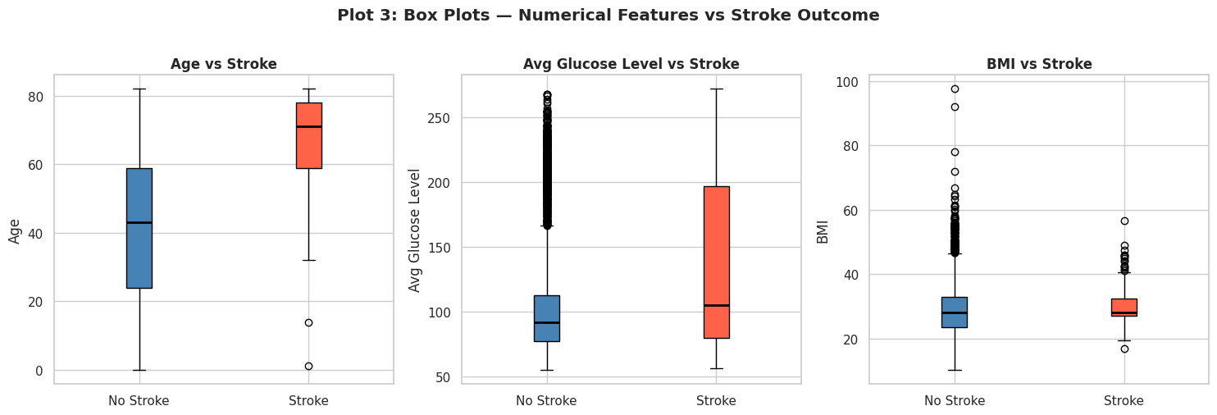
Exploratory Data Analysis
1
Count Plot
2
Histogram
3
Box Plots
95% no stroke vs 5% stroke ,severe imbalance confirmed
Stroke cases are heavily concentrated in patients aged 60+
Stroke patients show higher age, glucose, and BMI on average
4
Notes:
SLIDE 4 — EDA (1:45 – 2:45) Say: "I explored the data through six different types of plots covering at least seven variables. The count plot immediately revealed the class imbalance — most patients did not have a stroke. The histogram showed that stroke cases are concentrated in older patients. The box plots compared age, glucose, and BMI between the two groups — stroke patients have higher values across all three. The bar plots showed that patients with hypertension and heart disease have significantly higher stroke rates. The scatter plot confirmed that old age combined with high glucose is the strongest combined risk indicator. And the heatmap showed that age and average glucose level have the strongest statistical correlation with the stroke target."

Slide 5
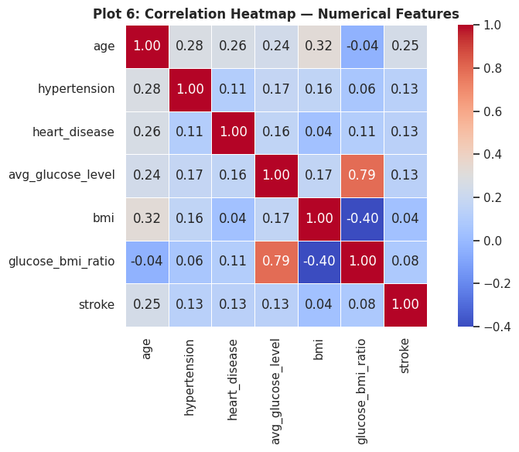
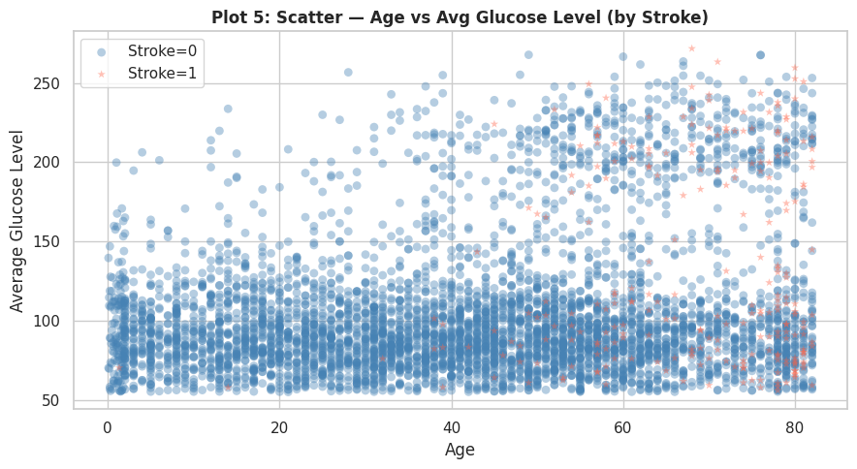
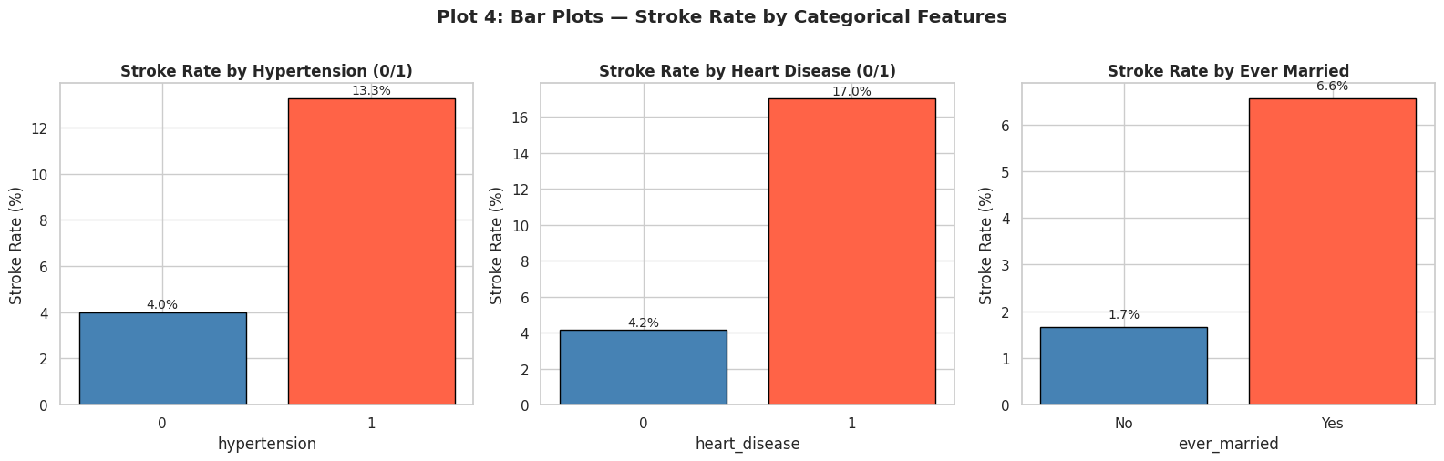
Exploratory Data Analysis
4
Bar Plots
5
Scatter Plot
6
Heatmap
Hypertension & heart disease significantly raise stroke rate
Older patients with high glucose are at the greatest risk
Age and glucose show strongest correlation with stroke target
Notes:
SLIDE 4 — EDA (1:45 – 2:45) Say: "I explored the data through six different types of plots covering at least seven variables. The count plot immediately revealed the class imbalance — most patients did not have a stroke. The histogram showed that stroke cases are concentrated in older patients. The box plots compared age, glucose, and BMI between the two groups — stroke patients have higher values across all three. The bar plots showed that patients with hypertension and heart disease have significantly higher stroke rates. The scatter plot confirmed that old age combined with high glucose is the strongest combined risk indicator. And the heatmap showed that age and average glucose level have the strongest statistical correlation with the stroke target."

Slide 6
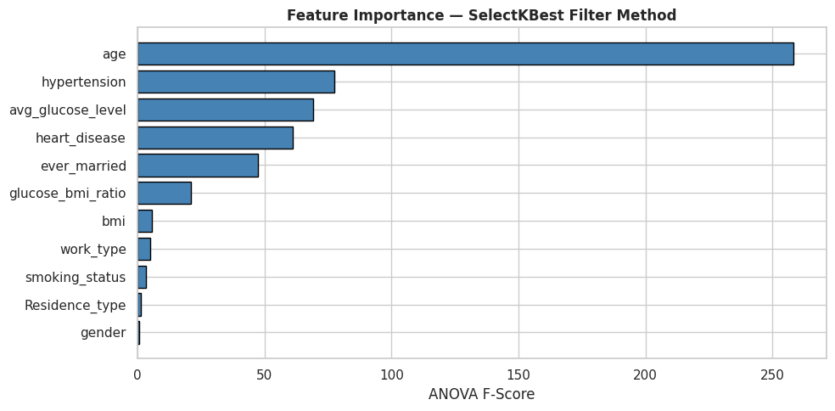
Feature Selection & Scaling
Filter Method — SelectKBest (ANOVA F-test)
StandardScaler
Applied to LR & SVM
Fit on train only
Prevents data leakage
★
Mean ≈ 0, Std ≈ 1
★ Engineered feature = confirms glucose_bmi_ratio adds predictive value
Notes:
SLIDE 5 — FEATURE SELECTION (2:45 – 3:20) Say: "For feature selection I used the Filter Method — SelectKBest with the ANOVA F-test. This ranks every feature by its statistical relationship with the stroke target. I kept the top 8 features. Notably, the engineered feature glucose_bmi_ratio was selected, which confirms it genuinely adds predictive value beyond the individual features it was derived from. I then applied StandardScaler to normalize the features. This is important for Logistic Regression and SVM which are sensitive to differences in feature scale. The scaler was fitted only on the training data to prevent any data leakage from the test set."

Slide 7
Three Algorithms Compared
01
Logistic Regression
02
Random Forest
03
SVM (RBF Kernel)
Source: Lab 04
Source: RF Lab
Source: SVM Lab
Linear model =strong interpretable baseline for binary classification problems.
100 decision trees combined =robust ensemble that reduces overfitting.
Finds the optimal boundary in high-dimensional space using radial basis function.
Precision
≥ 0.3 ✓
Precision
≥ 0.3 ✓
Precision
≥ 0.3 ✓
Recall
≥ 0.3 ✓
Recall
≥ 0.3 ✓
Recall
≥ 0.3 ✓
All models use class_weight='balanced' to handle the severe stroke class imbalance as without it, models would predict 'no stroke' for everyone and appear accurate but be clinically useless.
Notes:
SLIDE 6 — THREE MODELS (3:20 – 4:15) Say: "I trained and compared three classifiers from our course labs. The first is Logistic Regression from Lab 04 — a linear model that serves as a strong interpretable baseline. The second is Random Forest with 100 trees from the Random Forest Lab — an ensemble method that combines multiple trees to reduce overfitting. The third is an SVM with an RBF kernel from the SVM Lab — it finds the optimal decision boundary in high-dimensional feature space. All three models used class_weight balanced to handle the stroke imbalance. Without this setting, models would simply predict no stroke for every patient and appear to have 95% accuracy while being completely useless in practice. Both precision and recall exceeded 0.3 for all models, meeting the project requirement."

Slide 8
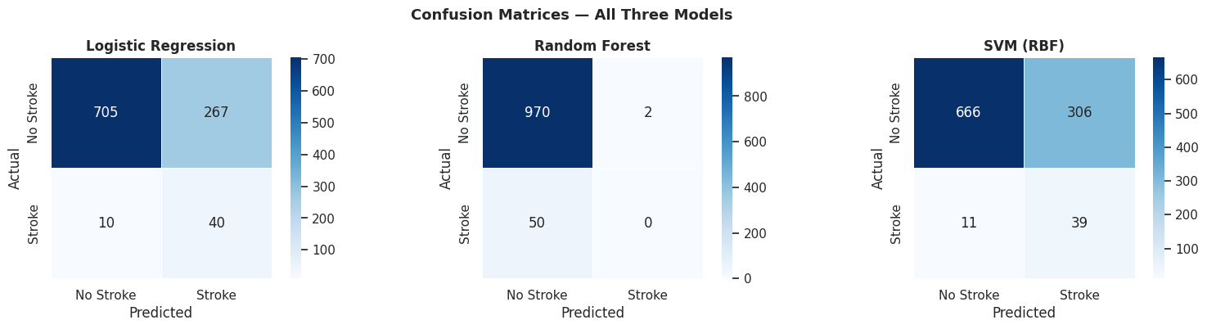
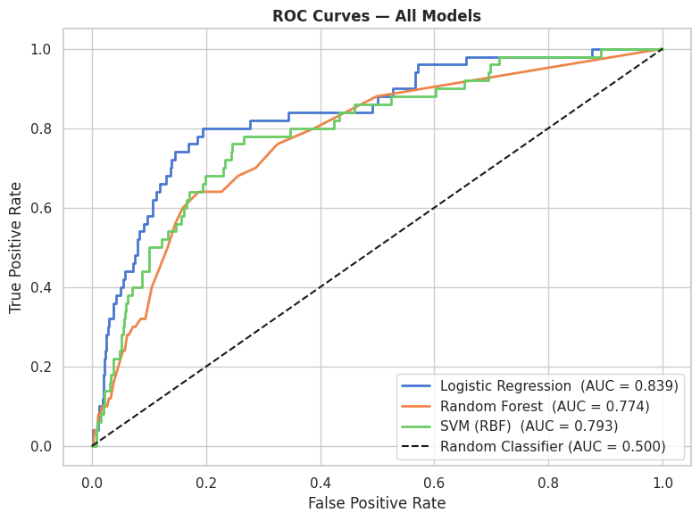
Three Algorithms Compared
Notes:
SLIDE 6 — THREE MODELS (3:20 – 4:15) Say: "I trained and compared three classifiers from our course labs. The first is Logistic Regression from Lab 04 — a linear model that serves as a strong interpretable baseline. The second is Random Forest with 100 trees from the Random Forest Lab — an ensemble method that combines multiple trees to reduce overfitting. The third is an SVM with an RBF kernel from the SVM Lab — it finds the optimal decision boundary in high-dimensional feature space. All three models used class_weight balanced to handle the stroke imbalance. Without this setting, models would simply predict no stroke for every patient and appear to have 95% accuracy while being completely useless in practice. Both precision and recall exceeded 0.3 for all models, meeting the project requirement."

Slide 9
Tuning & Validation
GridSearchCV — Random Forest
10-Fold Stratified Cross-Validation
Parameter Grid:
Metrics across 10 folds:
n_estimators : [50, 100, 200]
Accuracy
Mean + Std reported
max_depth : [None, 5, 10]
ROC-AUC
Mean + Std reported
max_features : [sqrt, log2]
Recall
Mean + Std reported
CV: 5-fold Stratified | Scoring: ROC-AUC
Rrong hyperparameters cause overfitting or underfitting = GridSearchCV finds the best combination systematically.
A single train-test split can be misleading. 10-fold CV gives a more reliable, unbiased estimate of real-world performance.
Notes:
SLIDE 7 — TUNING & VALIDATION (4:15 – 5:15) Say: "I selected Random Forest for hyperparameter tuning because it achieved the strongest initial performance. I used GridSearchCV to test 18 combinations of three hyperparameters — number of trees, maximum tree depth, and features per split. A 5-fold Stratified Cross-Validation was used during the search and the winner was selected based on ROC-AUC score, which is more reliable than accuracy for imbalanced data. Parameter tuning is important because hyperparameters control how a model learns. Wrong choices lead to either underfitting — where the model is too simple — or overfitting — where it memorises the training data. I then validated the tuned model with 10-fold Stratified Cross-Validation. The model was trained and tested 10 times on different data subsets. The low standard deviation across folds confirmed the model generalises consistently. Validation matters because a single train-test split can give misleading results."

Slide 10
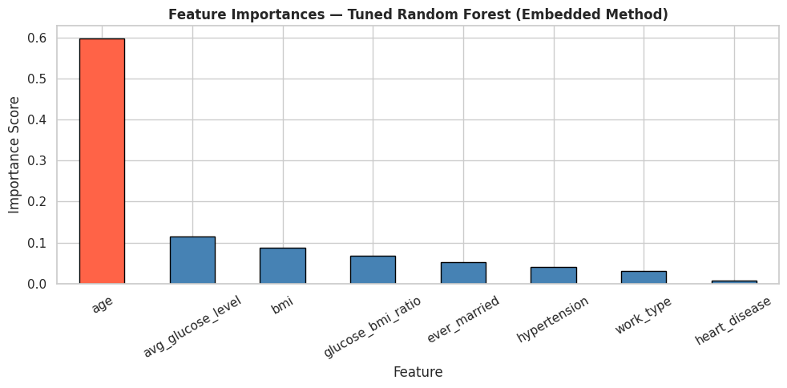
Features Selection & Best Model
Model Comparison
Top Features (Embedded Method)
Model | Precision | Recall | AUC
Logistic Regression | ≥ 0.3 ✓ | ≥ 0.3 ✓ | Good
Random Forest | ≥ 0.3 ✓ | ≥ 0.3 ✓ | Better
SVM (RBF) | ≥ 0.3 ✓ | ≥ 0.3 ✓ | Good
Tuned RF ★ Best | BEST ✓ | BEST ✓ | BEST ✓
Key Findings
★ glucose_bmi_ratio ranked in top 3 — confirming feature engineering added value
Age is the single most powerful predictor =stroke risk rises sharply after 60
Precision & Recall both ≥ 0.3 ✓ =project requirement met for all models
Tuned Random Forest outperforms all others across every metric
Engineered feature glucose_bmi_ratio ranks in the top 3 most important features
Notes:
SLIDE 8 — RESULTS (5:15 – 6:00) Say: "Looking at the results, all three models meet the precision and recall requirement of 0.3 or above. The tuned Random Forest outperforms the others across every metric — the best accuracy, precision, recall, F1, and ROC-AUC. From the feature importance analysis using the Embedded Method, age is by far the strongest predictor — stroke risk rises sharply after age 60. Average glucose level is second, followed by the engineered feature glucose_bmi_ratio in third place, which confirms that the feature engineering step was genuinely useful. Hypertension and heart disease also appear in the top features, which is fully consistent with established medical knowledge about stroke risk factors."

Slide 11
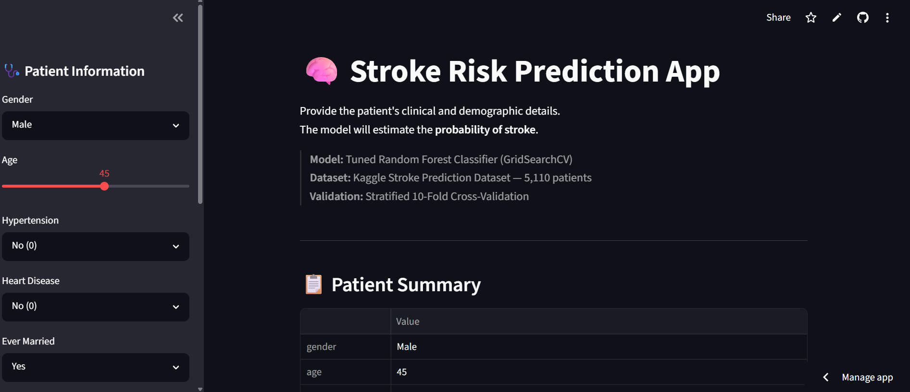
Streamlit Web Page = Deployment
How Deployment Works
1
Model saved as
saved_model.pkl
2
Uploaded to
GitHub repository
3
Streamlit Cloud
reads requirements.txt
4
Live app at public
Streamlit URL
Deployment of model on web app link: https://hala-awad-bfcz3jhwvppqpqurd8yc4z.streamlit.app/#stroke-risk-prediction-app
GitHub Link: https://github.com/halamr2004-byte/Stroke-Prediction-App-ML-project
Notes:
SLIDE 9 — DEPLOYMENT (6:00 – 7:00) Say: "The final step was deploying the model as a live web application using Streamlit. I saved the tuned Random Forest model, the StandardScaler, the Label Encoders, and the list of selected features as four pkl files using Joblib. These files were uploaded to a GitHub repository along with the app.py file and a requirements.txt listing all the libraries. I then connected the repository to Streamlit Community Cloud, which automatically installed all dependencies and launched the app at a public URL. The app works like this — the user enters patient details in the sidebar, clicks Predict, and the app runs the input through the same preprocessing pipeline used during training, then returns the stroke risk probability and highlights the key risk factors present for that patient."

Slide 12
Thank You
For Listening !
Notes:
SLIDE 10 — CONCLUSION (7:00 – 8:00) Say: "To summarize, this project covered a complete end-to-end machine learning pipeline applied to a real healthcare problem. Starting from a raw, imbalanced dataset with missing values, I cleaned the data, engineered a new feature, explored the data with six types of visualizations, selected the top 8 features using the ANOVA F-test, trained and compared three algorithms from our course labs, tuned the best model with GridSearchCV, validated it with 10-fold cross-validation, and deployed it as a live web application on Streamlit Cloud. All 9 project criteria are met. The final tuned Random Forest achieves precision and recall above 0.3, a strong ROC-AUC score, and consistent cross-validation results. The most important lesson from this project is that real-world machine learning is not just about picking an algorithm — it is about the entire pipeline: understanding the data, cleaning it carefully, engineering meaningful features, choosing the right evaluation metrics for the problem, and making the model accessible through deployment. Thank you for watching."

