Slide 1
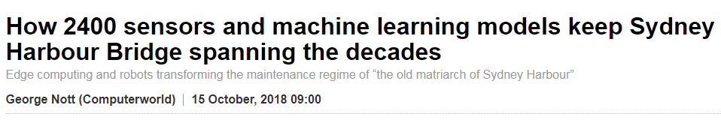
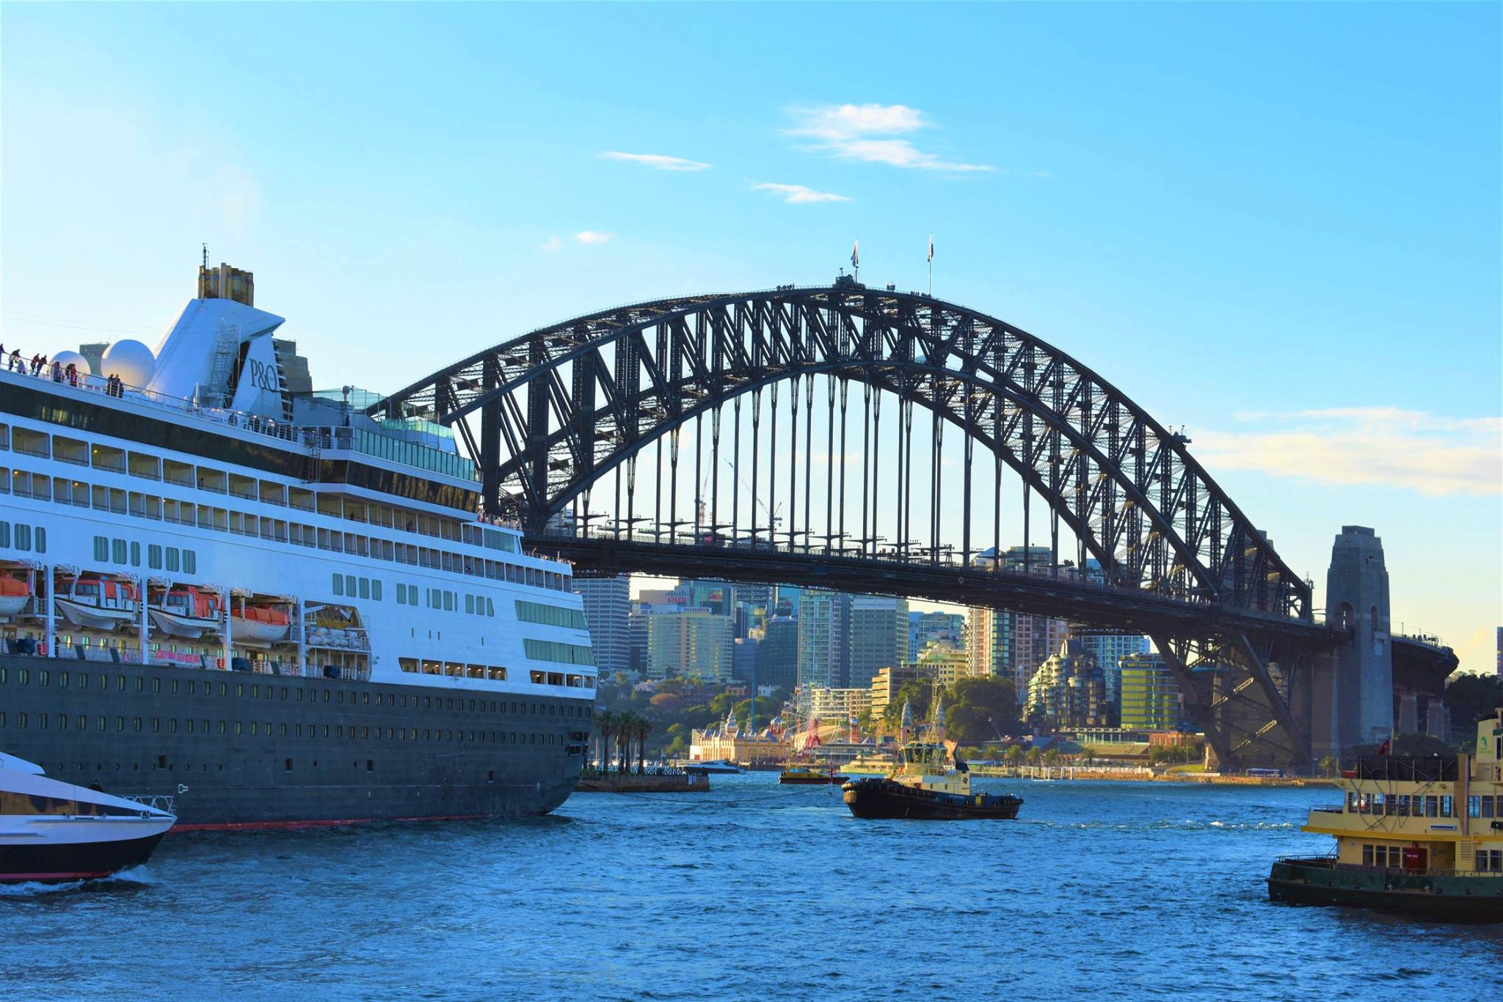
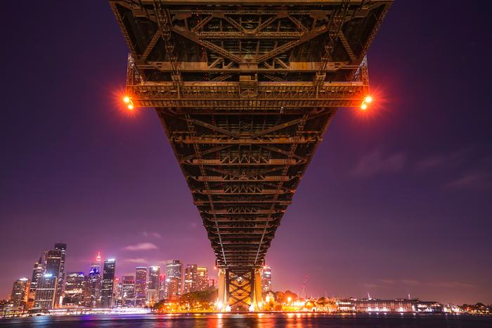
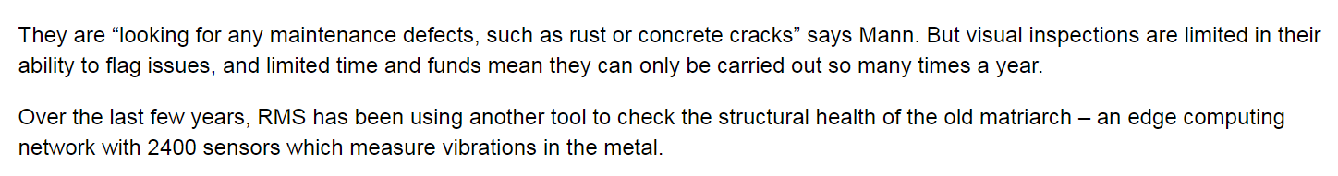
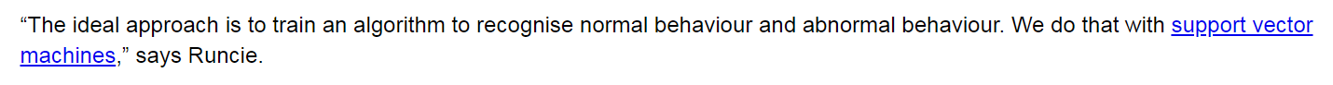
Source: https://www.computerworld.com.au/article/648145/how-2400-sensors-machine-learning-models-keep-sydney-harbour-bridge-spanning-decades/?pp=2

Slide 3
