Slide 1
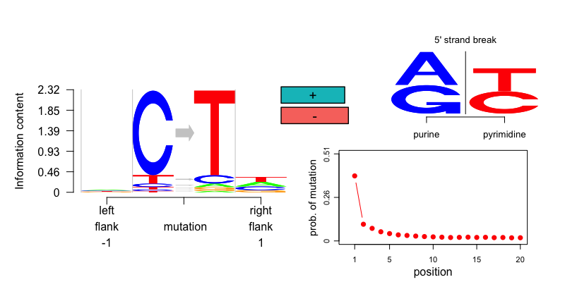
Mutation signature for an example ancient Sardinian data
(MA108)

Slide 2
Mutation signature for an example ancient Sardinian data
(MA108)
Which substitutions are most prominent and how the flanking bases look like. (frequencies are scaled by entropy)

Slide 3
Mutation signature for an example ancient Sardinian data
(MA108)
Is there a strand bias for the mutations?

Slide 4
Mutation signature for an example ancient Sardinian data
(MA108)
Base composition at 5’ strand break (purine enrichment?)

Slide 5
Mutation signature for an example ancient Sardinian data
(MA108)
Prob of mutations from end of reads

Slide 6
Mutation signature for an example ancient Sardinian data
(MA108)
Which substitutions are most prominent and how the flanking bases look like. (frequencies are scaled by entropy)
Base composition at 5’ strand break (purine enrichment?)
Is there a strand bias for the mutations?
Prob of mutations from end of reads

Slide 7
Non UDG treated ancient Sardinian samples (MA*) show high C->T mutations largely owing from DNA damage.

Slide 8
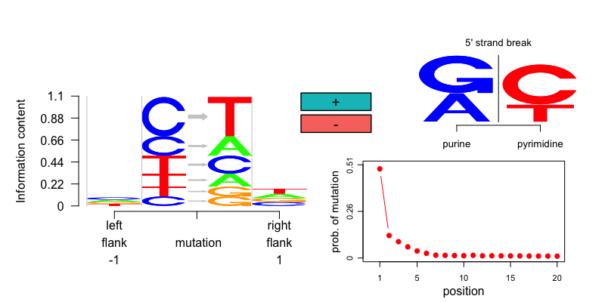
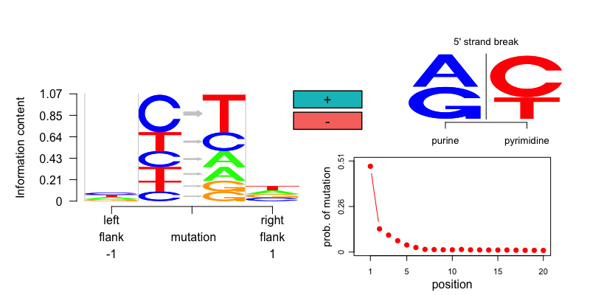
Half UDG treated Sardinian aDNA samples
ISB001
SUA002

Slide 9
Non UDG treated ancient Sardinian samples (MA*) show high C->T mutations largely owing from DNA damage.
Half UDG treatment seems to get rid of many C->T damages, but purine enrichment at the 5’ strand break is preserved, also mutations seem to be largely concentrated at the ends.

Slide 10
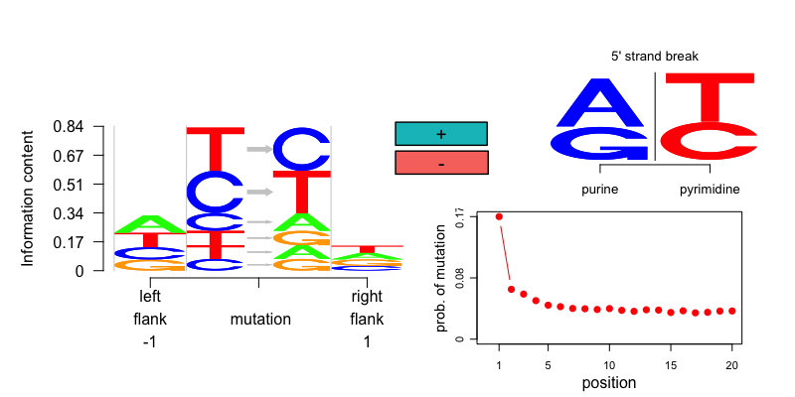
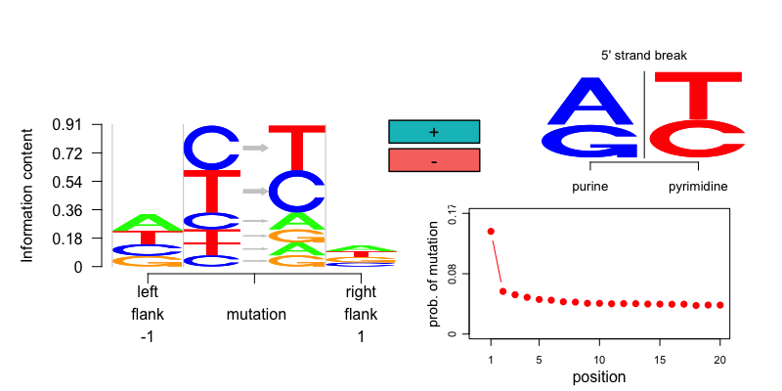
Modern example

Slide 11
Non UDG treated ancient Sardinian samples (MA*) show high C->T mutations largely owing from DNA damage.
Half UDG treatment seems to get rid of many C->T damages, but purine enrichment at the 5’ strand break is preserved, also mutations seem to be largely concentrated at the ends.
For modern samples, the purine enrichment at 5’ strand breaks is not observed. We still see mutations at the ends of the reads, but the pattern is not strong as in ancient DNA.

Slide 12
Clustering and visualization of the pooled data of
Sardinian aDNA samples
50 modern samples from 1000 samples
We perform a Grade of Membership (GoM) model (soft clustering model) based on counts of mutation signatures to represent each sample to have proportional membership in different clusters.

Slide 13
