Slide 1

Applications of
4 case studies
- Comparison of UDG treated aDNA (Lazaridis et al), non UDG treated aDNA (Pinhasi et al) and moderns (1000G)
Large scale aDNA due to Mathieson+
Lindo et al moderns + ancient DNA analysis
Contamination study using simulations and Mathieson et al data

Slide 2
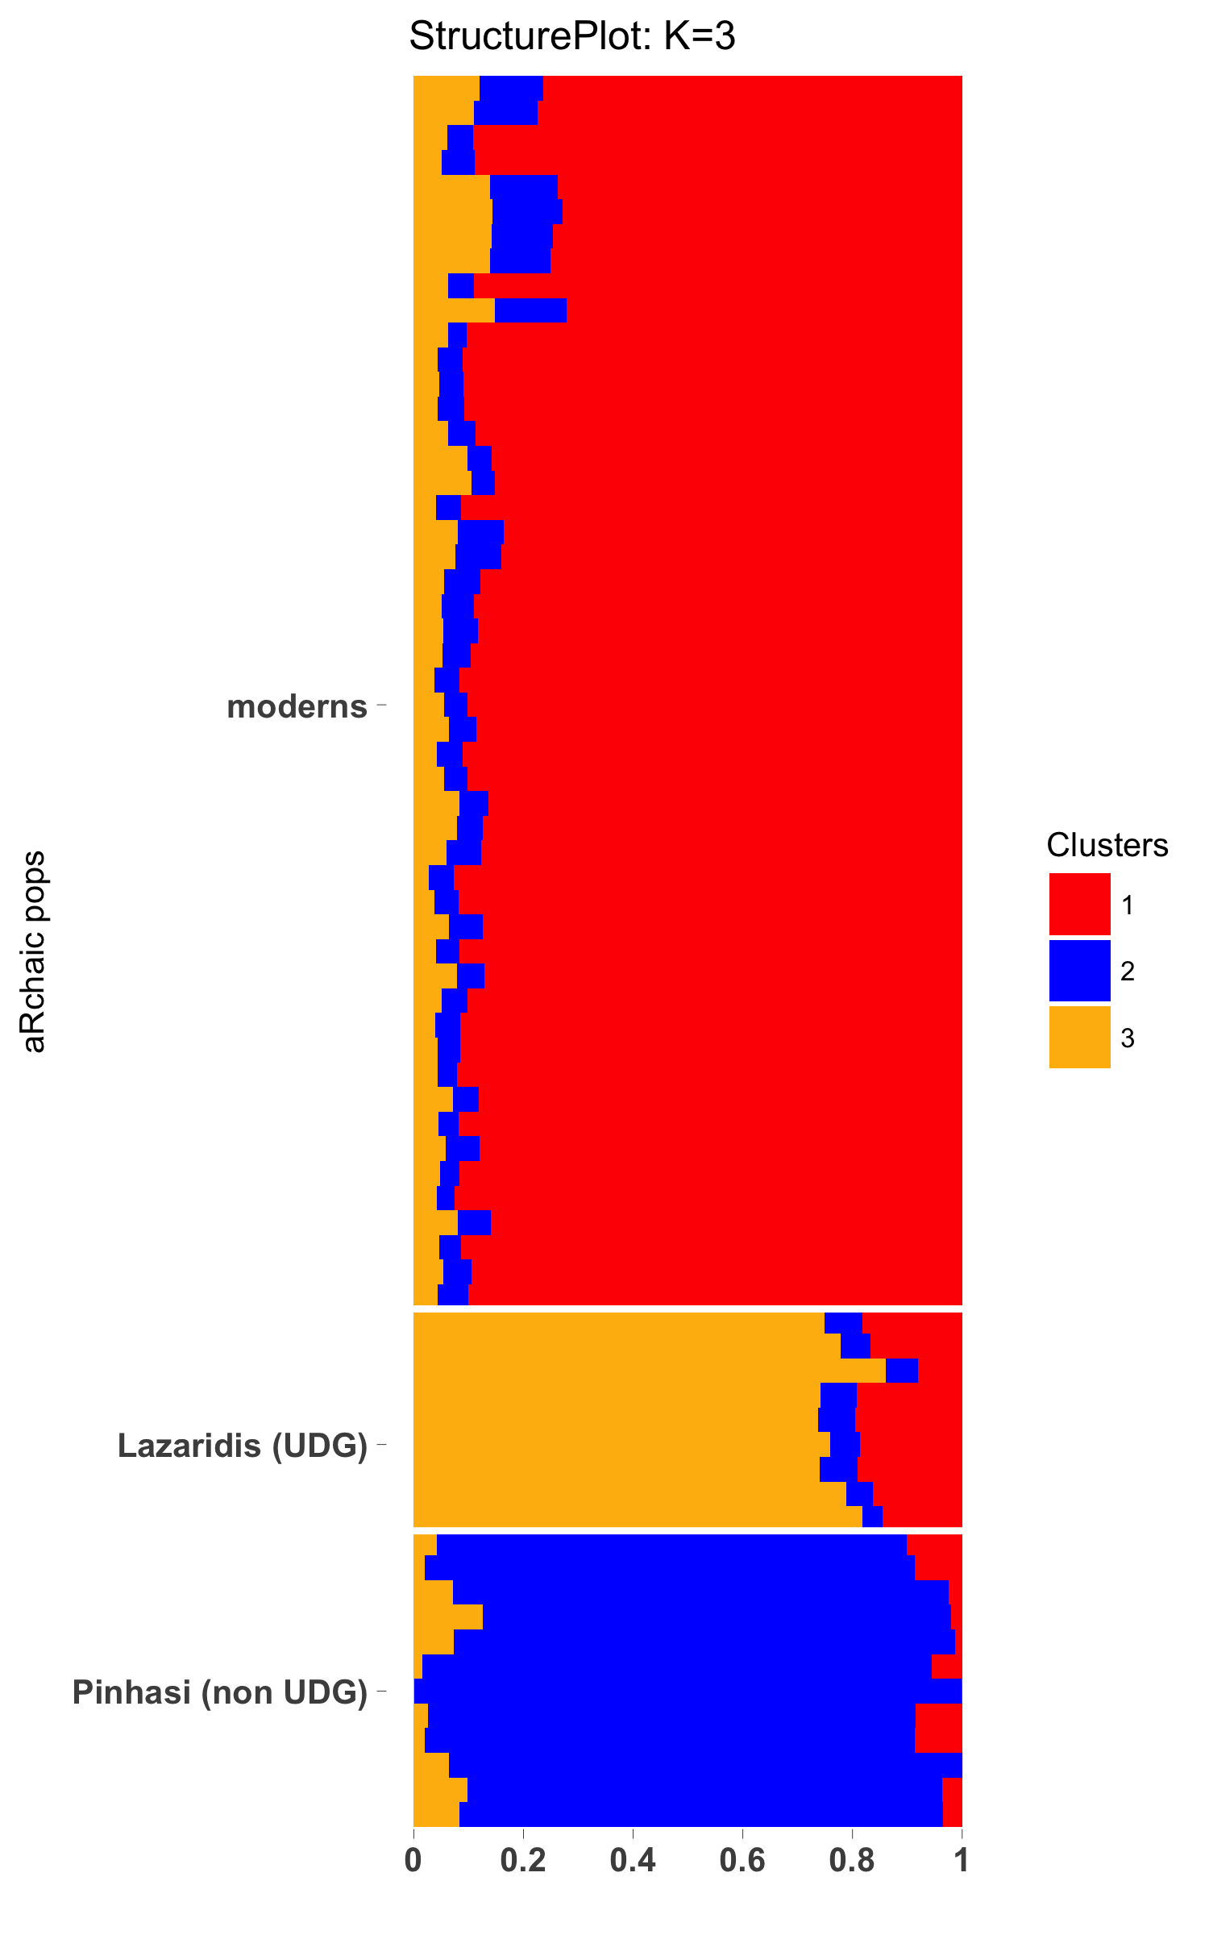
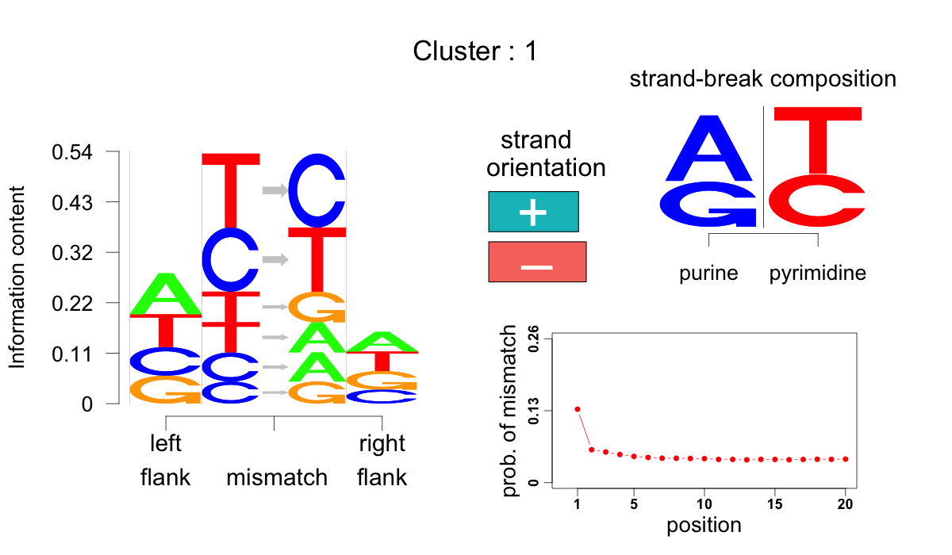
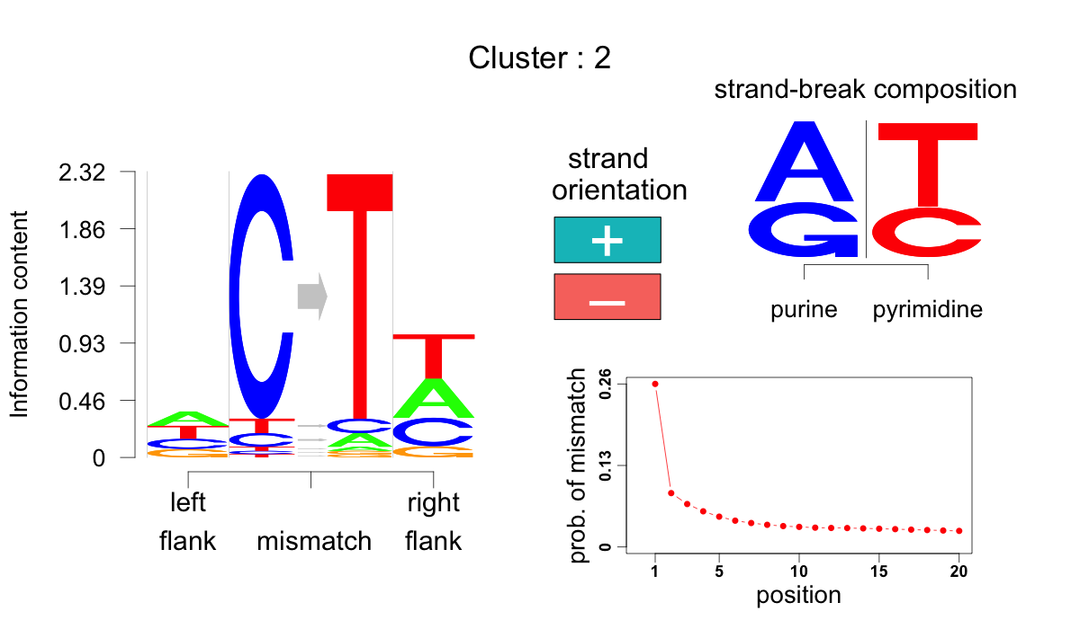
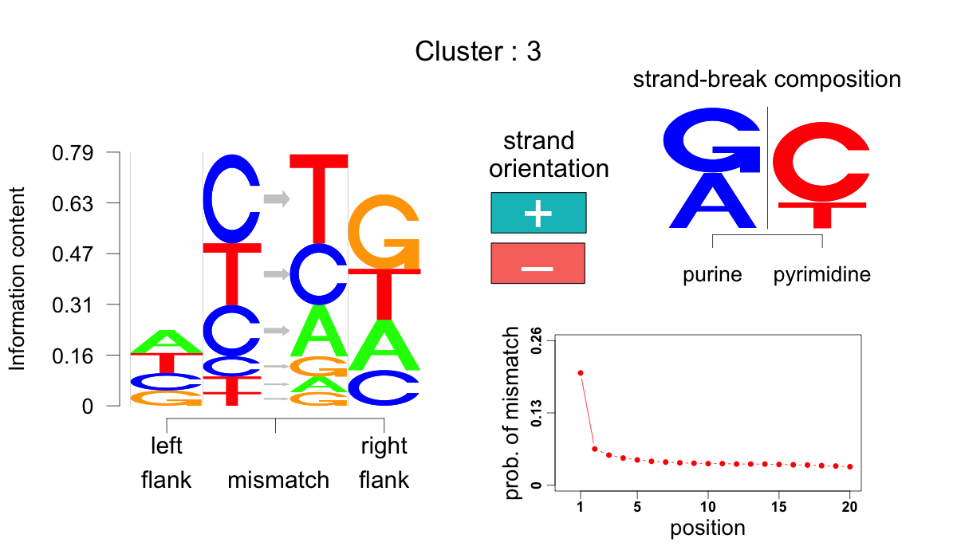
Notes:
Mention three points
1) Cluster 2: non UDG treated ancient DNA samples
seem to have a high grade of membership in this cluster. This cluster is essentially dominated by the C->T mismatch type. Also the C->T mismatches for this cluster have a sharp decreasing trend in occurrence from the ends of the reads.
2) Cluster 1: This cluster is dominantly expressed in the moderns. It has higher T->C and C->T which are basically transitions. This is encouraging that the transitions are more frequent than transversions and the ratio of transition vs transversion may even be close to 2:1 (which is the modern transition transversion ratio)
3) Cluster 3: The UDG treated samples have high grades of memberships in this cluster. This cluster assigns high probabilities to C->T, but not as high as the non UDG treated, but it has higher mutational occurrence at the start of the read, which differentiates them from moderns. Another feature that differentiates them from moderns is the high purine enrichment at the 5' strand breaks.
4) But there is another

Slide 3
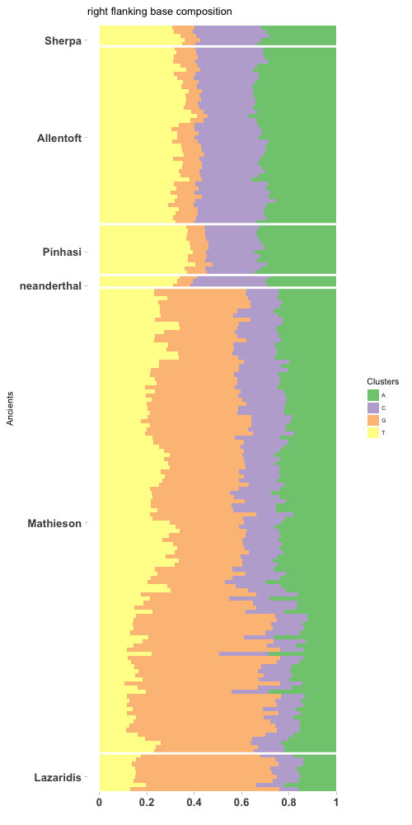
We look at the right flanking base composition for all mutations of type C->T occurring inside 10 bases from start of the read on the “+” strand.
Non UDG treated samples (sherpa, Allentoft, Pinhasi, neanderthal)
UDG treated samples (Mathieson, Lazaridis)

Slide 4
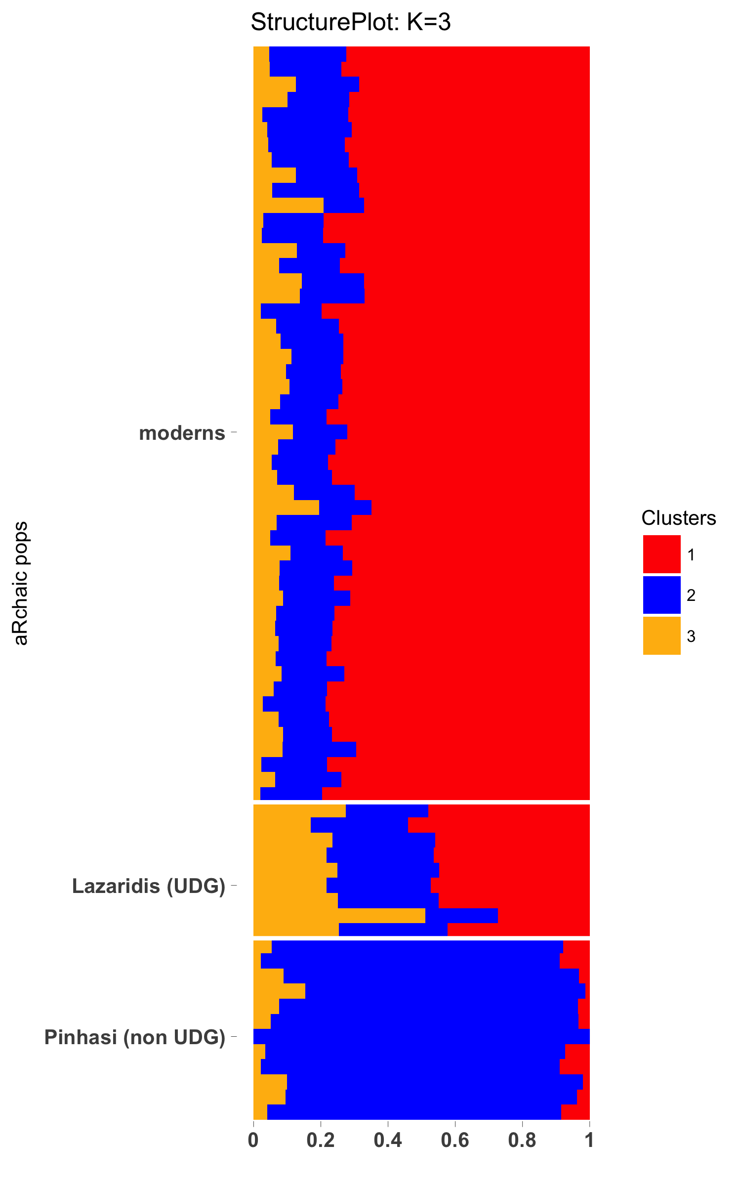
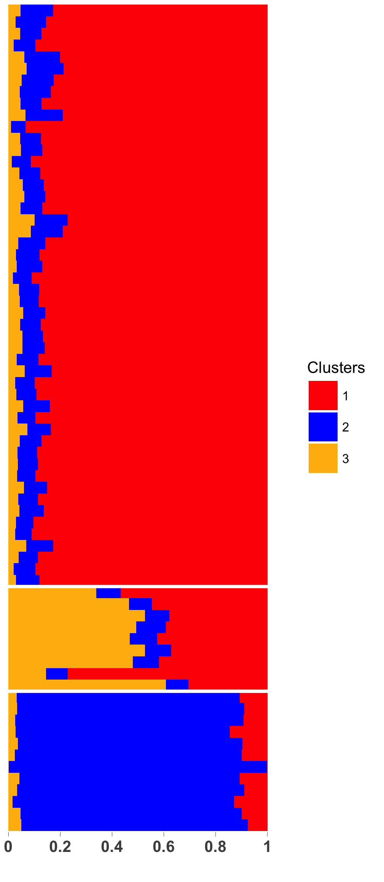
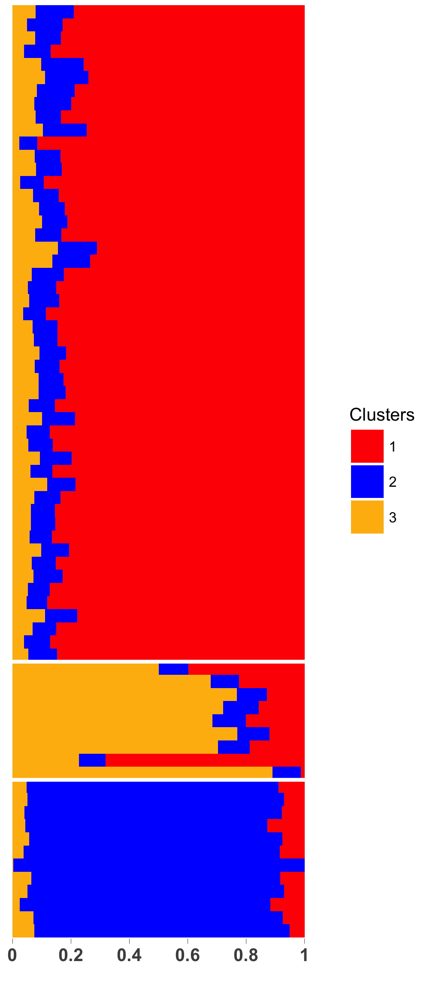
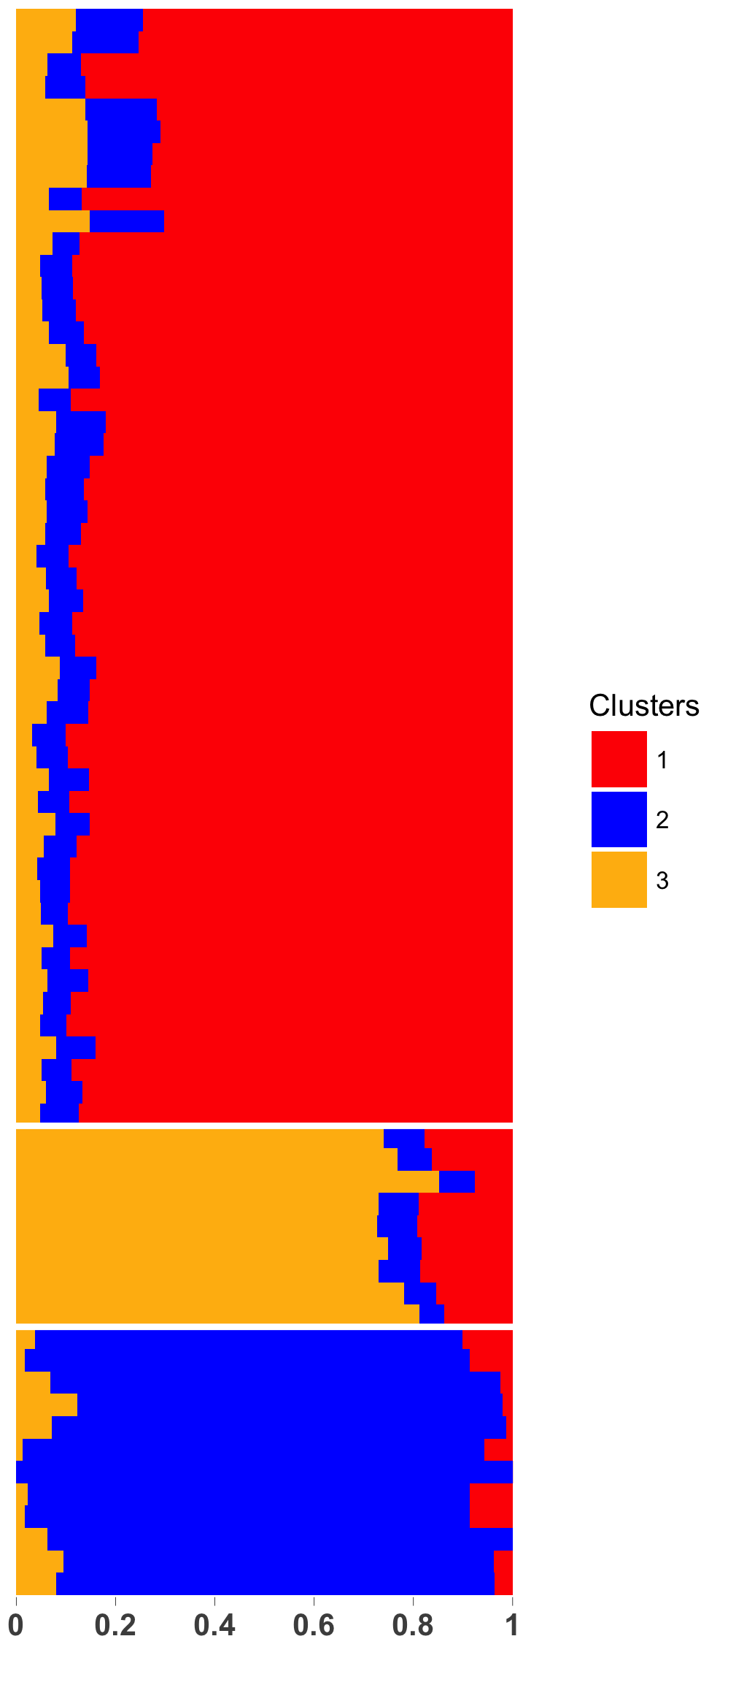
mutation
mutation + position
mutation + flank + pos
without strand
Notes:
This plot shows how aRchaic clustering is sensitive to the choice of features.
Note that if one considers just the mutation type, the distinction between UDG and moderns is not so obvious.
Mutation and position case: The distinction between modern and UDG samples is more prominent because of the sharp fall in C->T patterns at the beginning in UDG and not in moderns.
On accounting for mutation and flanking base and position, the distinction becomes more prominent, this is likely because of CpG site or G right flanking C->T mutations comes into play
But still there is one UDG sample that still looks like a modern. That discrepancy disappers when strand break information is pooled in because UDG samples show purine enrichment at strand breaks which moderns do not show.

Slide 5
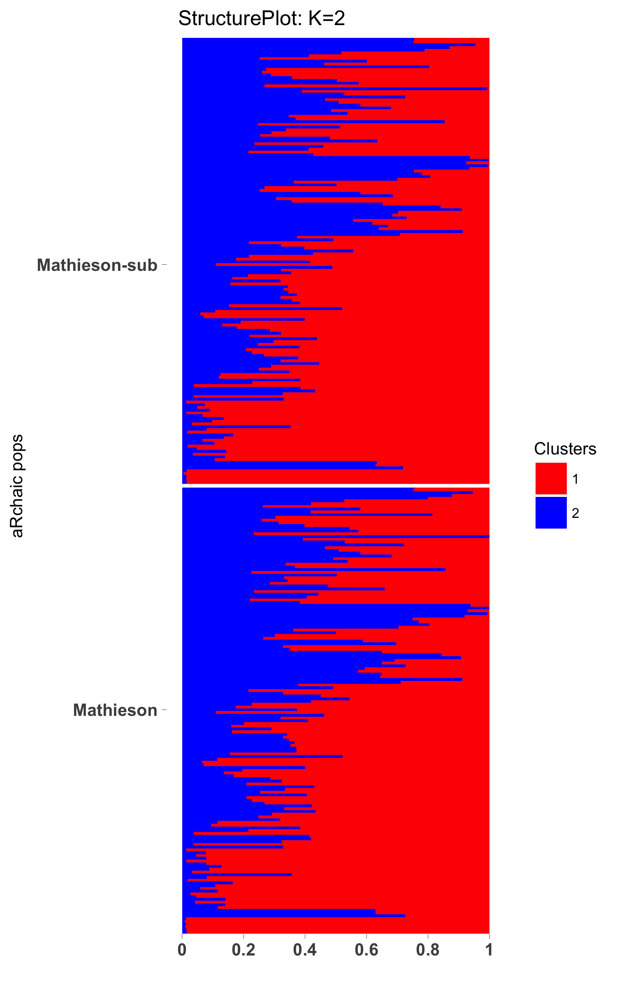
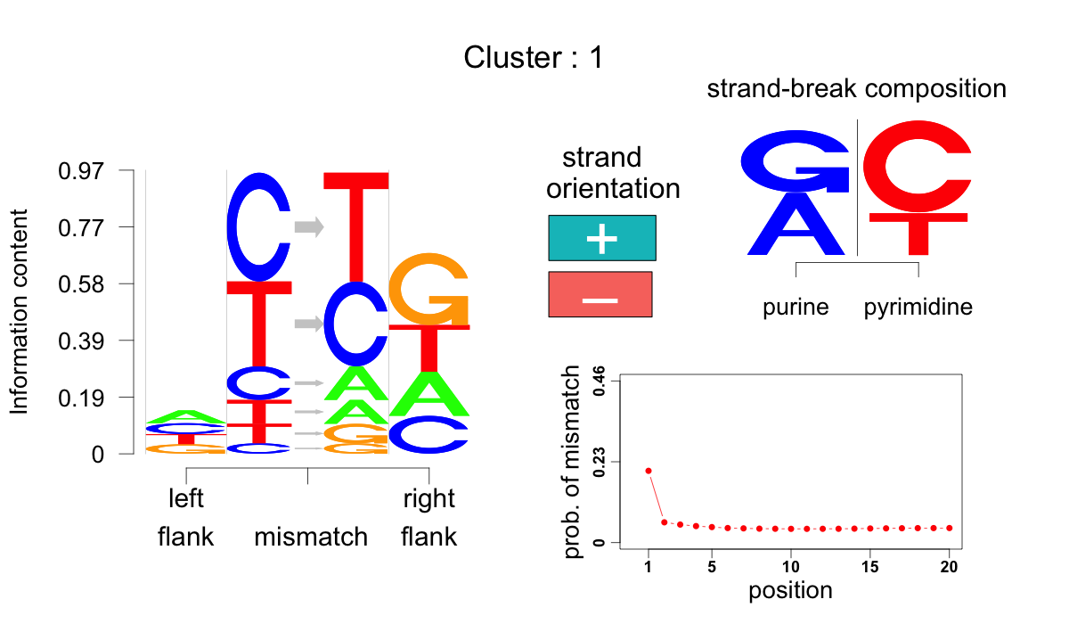
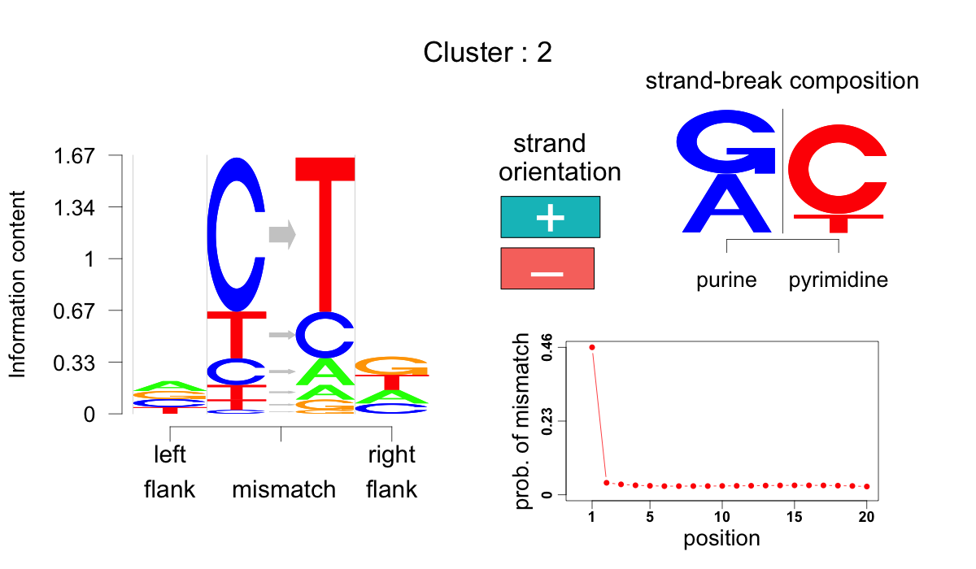
0.1 %
Notes:
This plot tells two stories
Mathieson data are UDG treated, which is characterized by the the very steep trends shown in the mutation trend along the read plot.
1) We did 0.1 % subsampling of the Mathieson BAM files and found the clustering results to be essentially the same.
2) There seems to be variation among the Mathieson samples with some samples having a lot of C->T mismatches at the ends of the reads, while others have fewer C->T mismatches at the ends of the reads.
3) What can we say about the samples that show a lot of C->T changes at the ends of the reads?

Slide 6
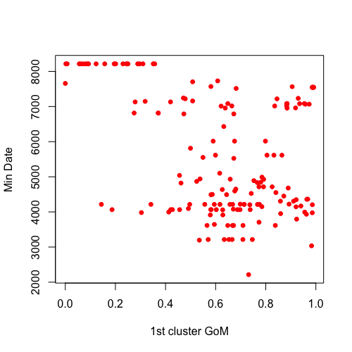
Notes:
This plot tells two stories
Mathieson data are UDG treated, which is characterized by the the very steep trends shown in the mutation trend along the read plot.
1) We did 0.1 % subsampling of the Mathieson BAM files and found the clustering results to be essentially the same.
2) There seems to be variation among the Mathieson samples with some samples having a lot of C->T mismatches at the ends of the reads, while others have fewer C->T mismatches at the ends of the reads.
3) What can we say about the samples that show a lot of C->T changes at the ends of the reads?

Slide 7
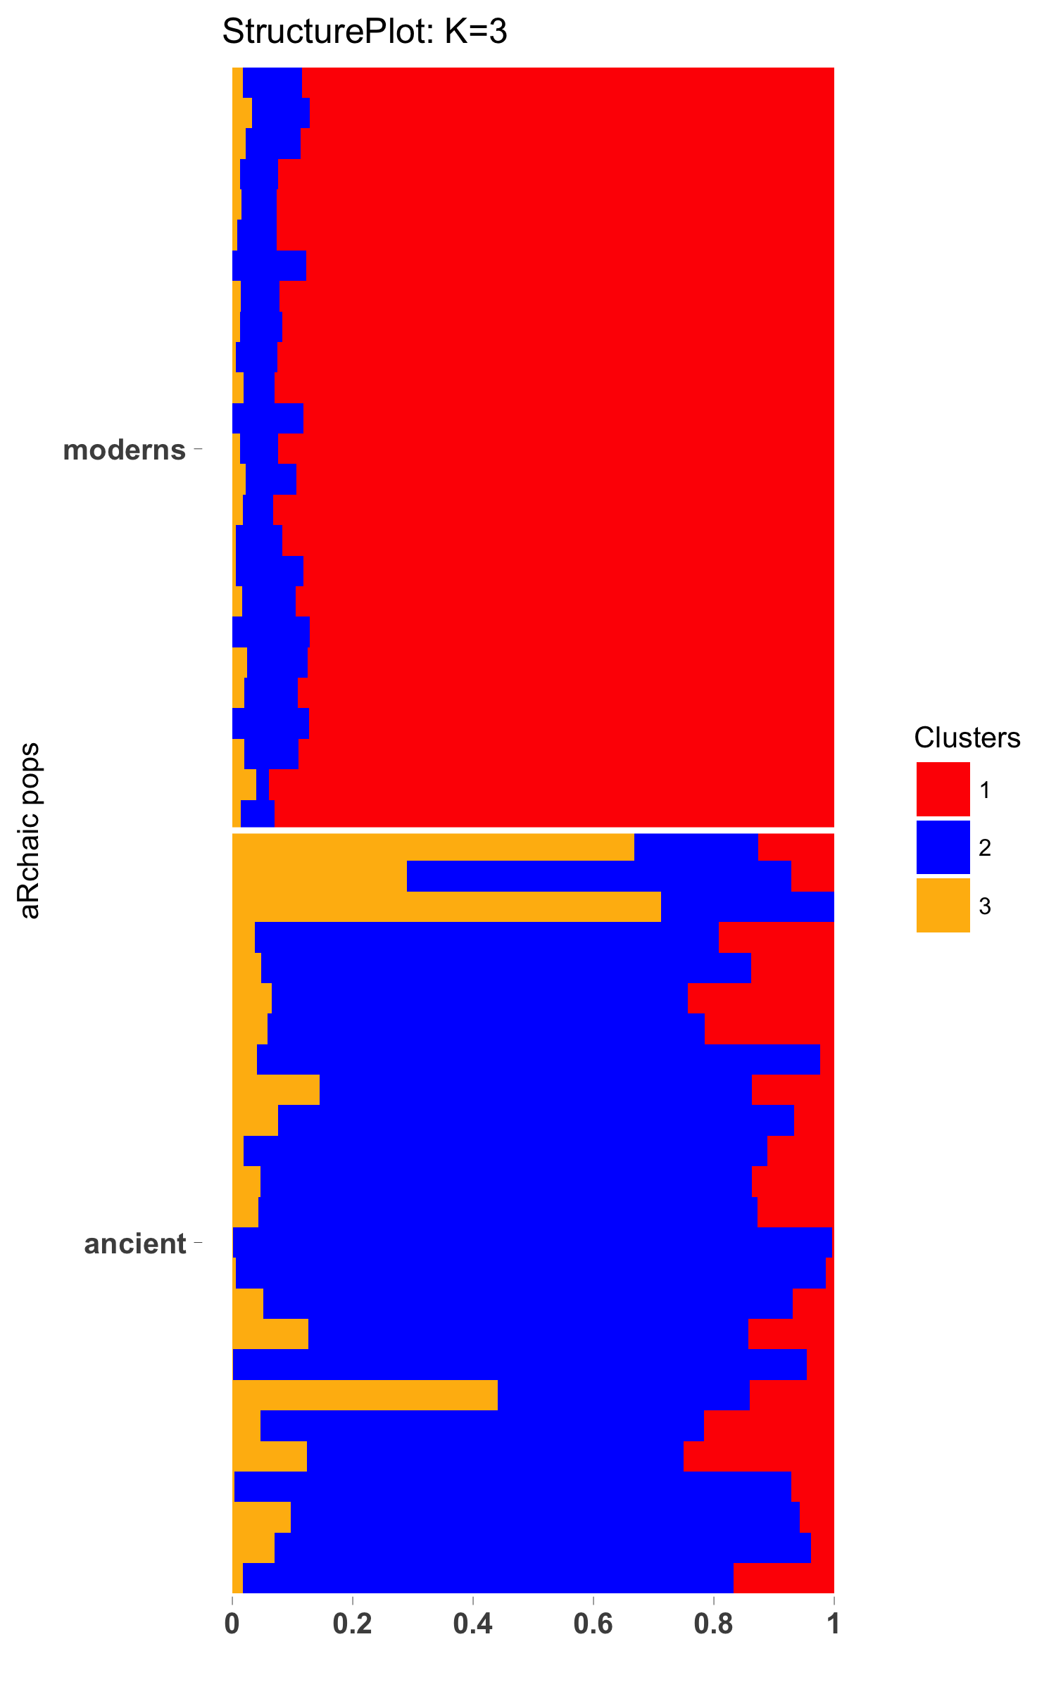
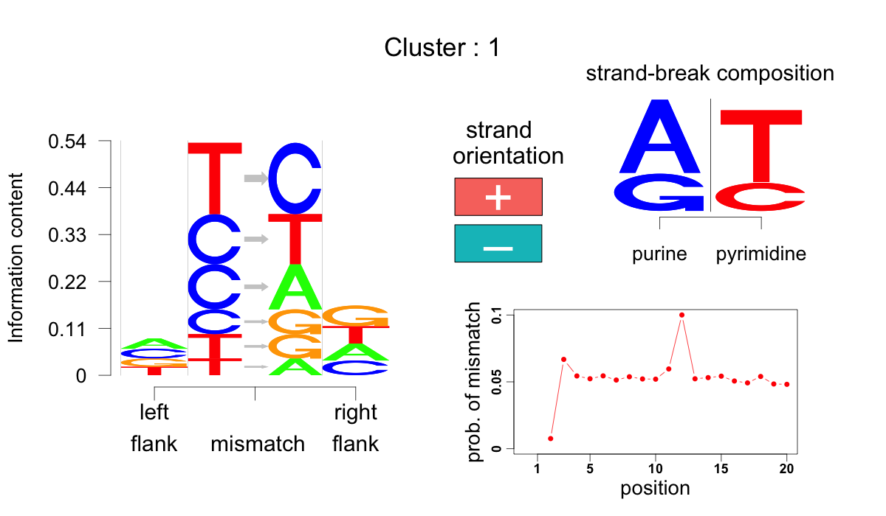
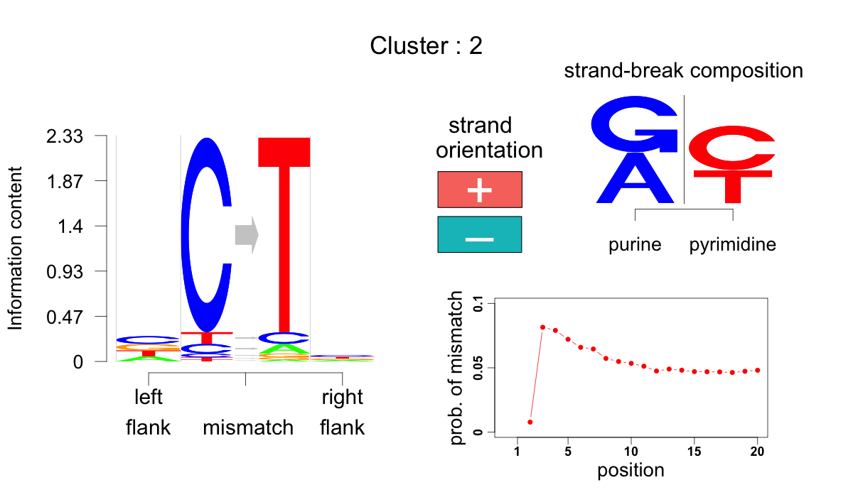
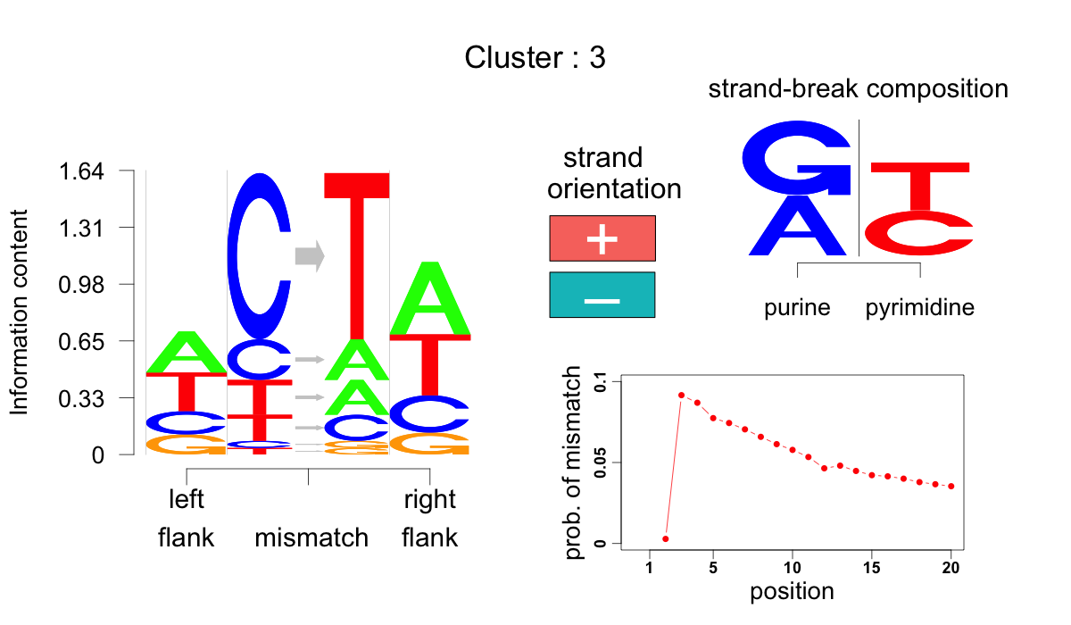
Notes:
This slide reveals two interesting things
The mutational pattern plots look weird because the first 2 bases have been clipped.
1) Cluster 3 seems to be occurring predominantly in two samples - one of them already known as the oldest sample (much older than the others). The flanking bases show a dominance of A and T and T->A mutation, which usually does not show up much in ancient DNA, is dominantly expressed.
2) cluster 2 shows both purine enrichment and the high C->T mutation type prominence very effectively.
3) For cluster 1, which is dominantly represented among the moderns, there seems to be a peak at the 12th position away from the end of the read. This makes us curious, what is the reason behind this blip?

Slide 8
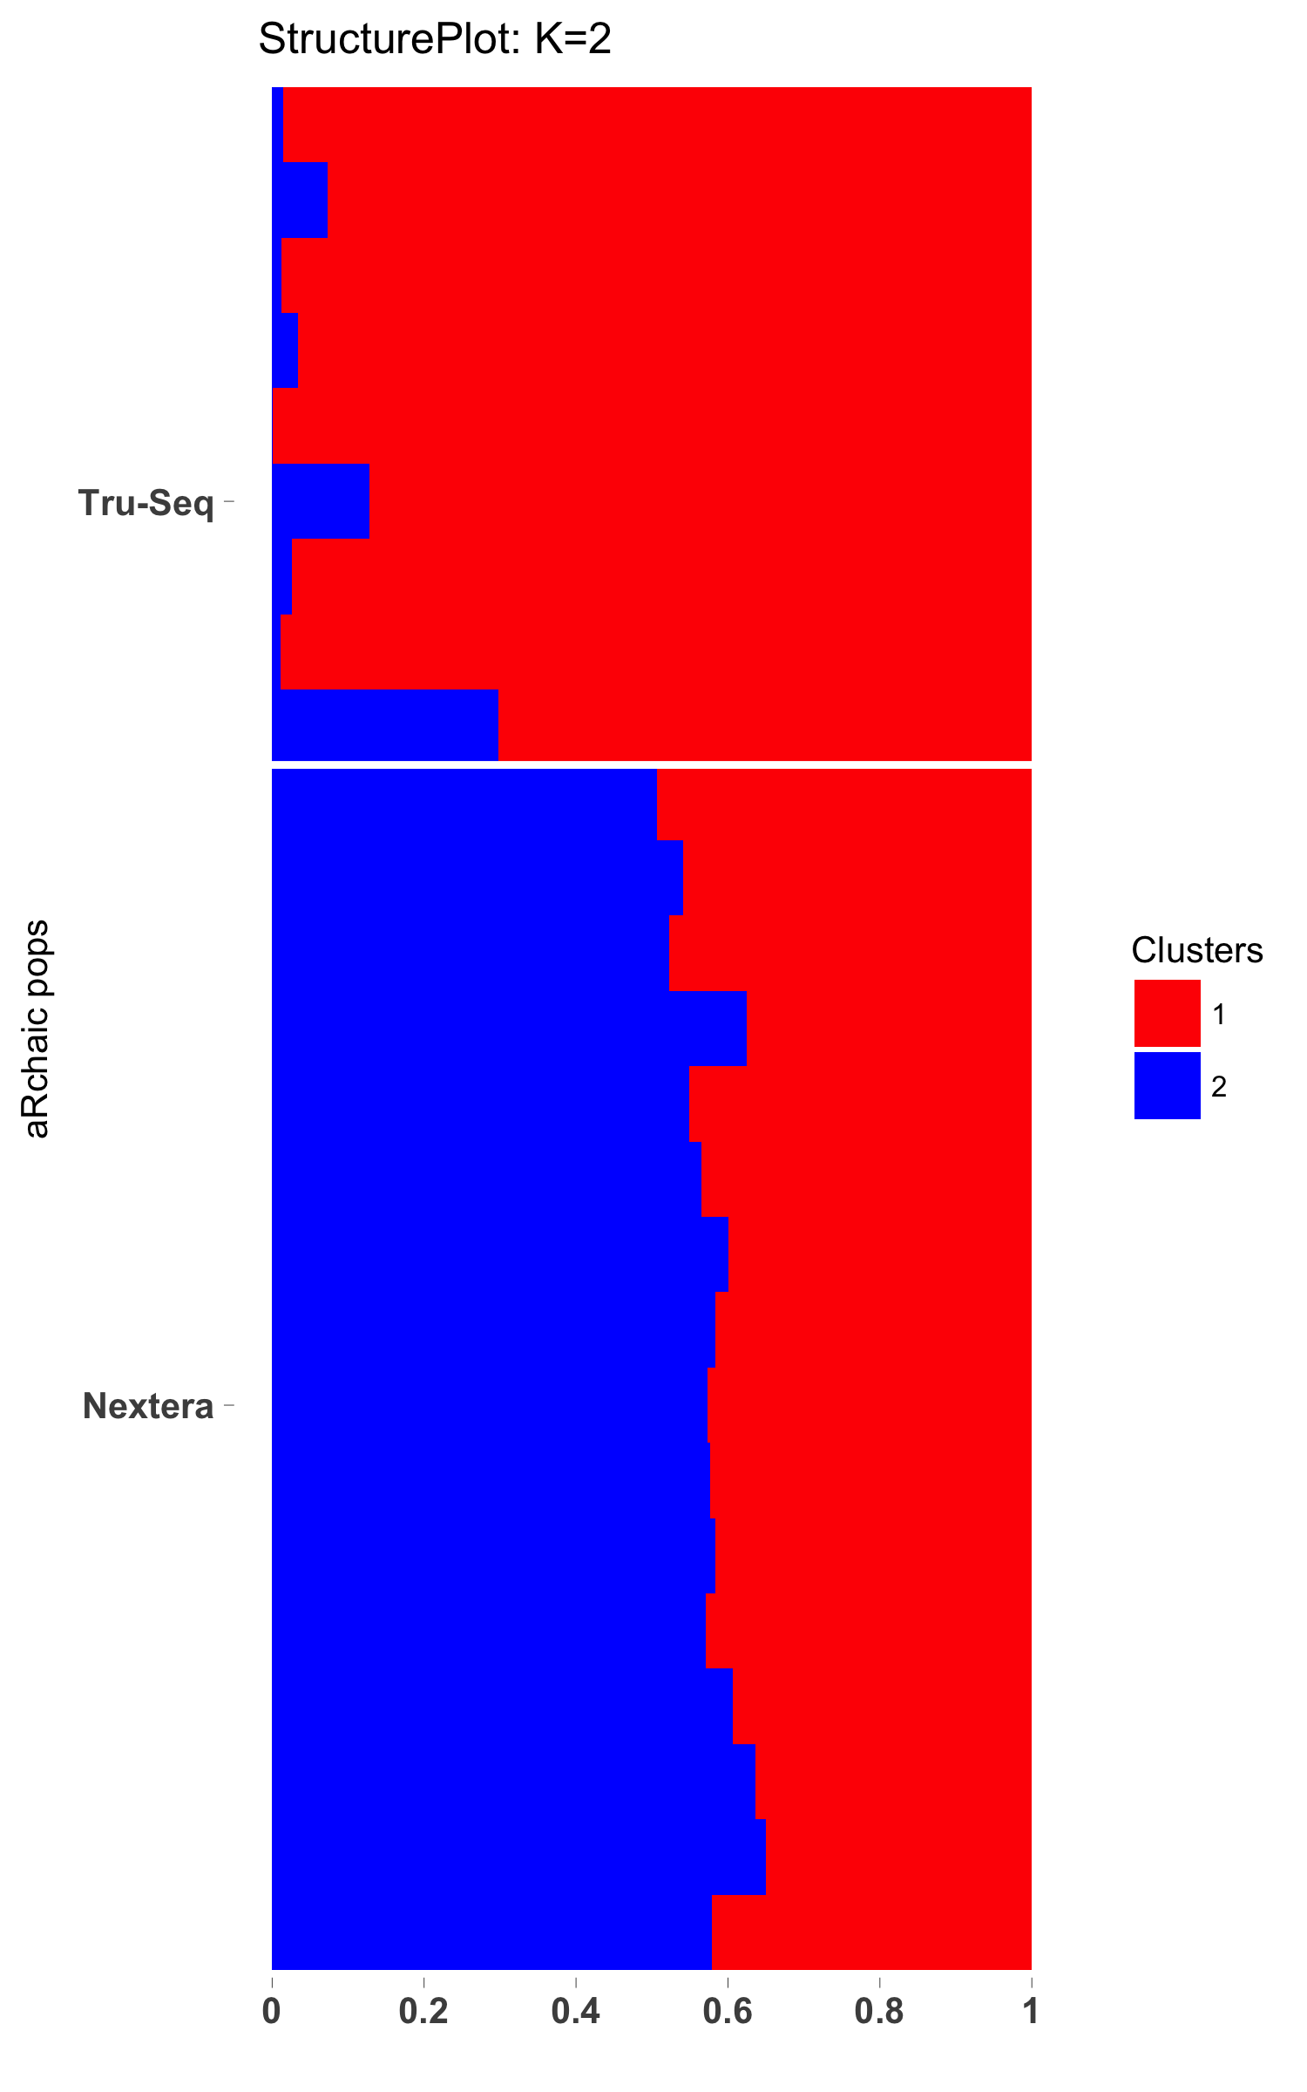
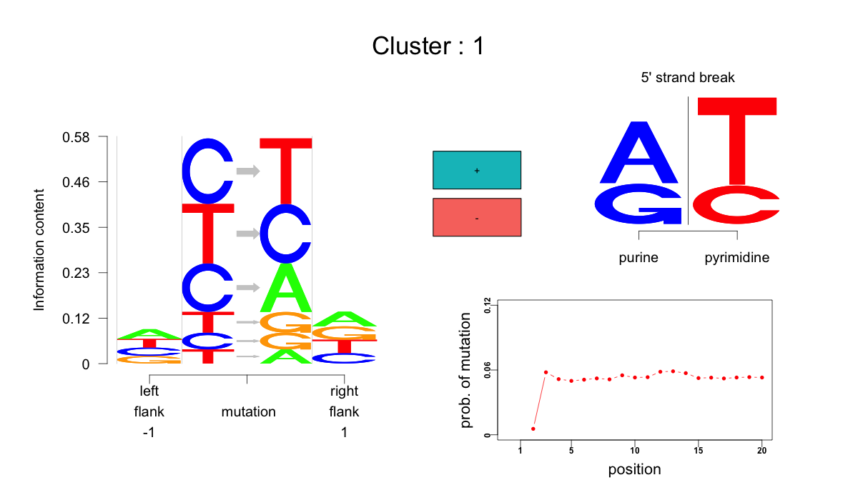
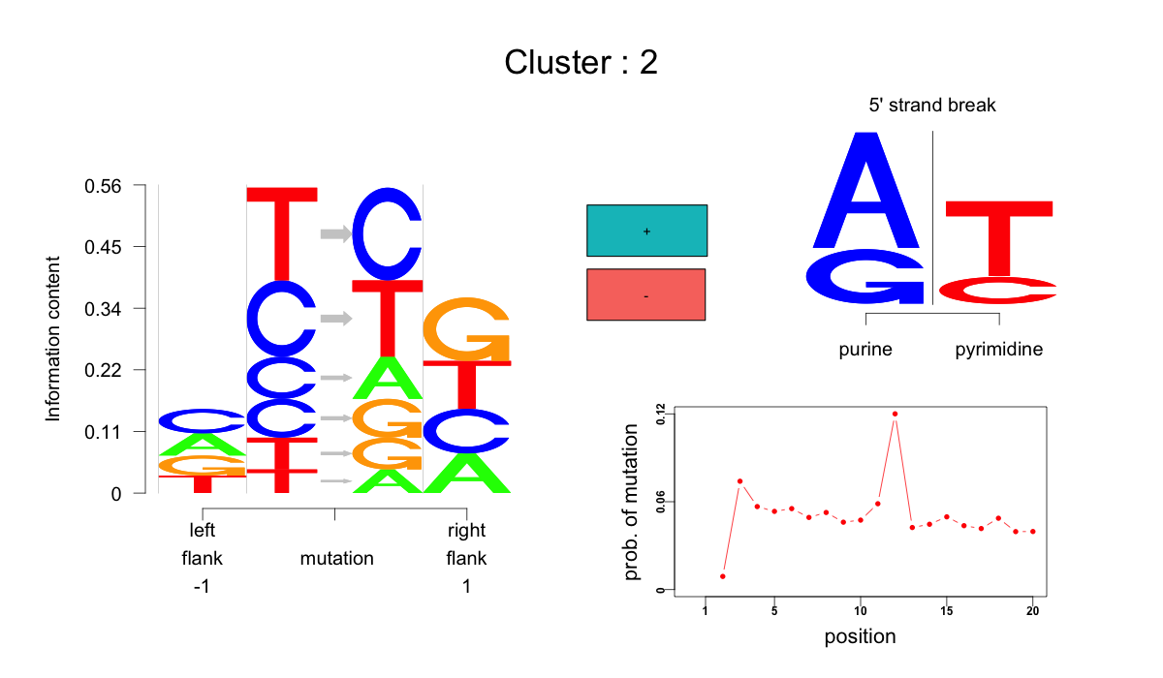

Slide 9
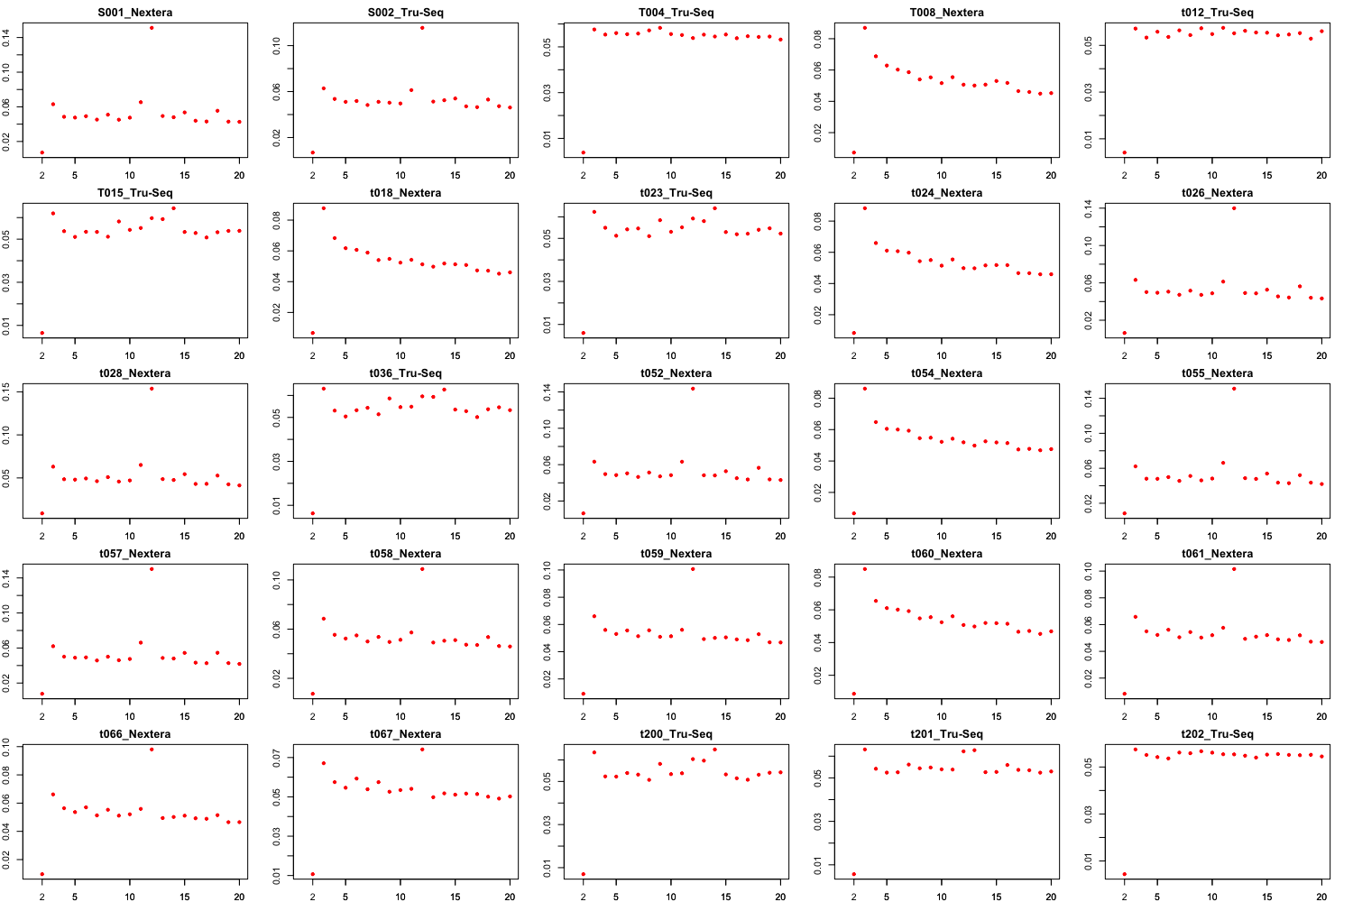

Slide 10
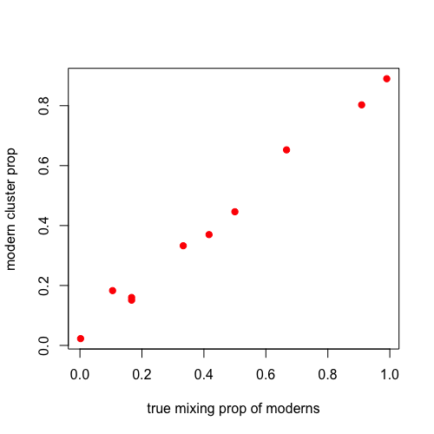
Pinhasi aDNA + moderns + their mixed samples
Pool all mutations from a modern sample and all mutations from an ancient sample and mix them in a certain ratio (normalized also by total number of mutations). Then run aRchaic on these mixed samples with other modern and ancient samples and see whether the grades of membership match with the mixing proportion.

Slide 11
Pinhasi aDNA + moderns + their mixed samples
Pool all mutations from a modern sample and all mutations from an ancient sample and mix them in a certain ratio (normalized also by total number of mutations). Then run aRchaic on these mixed samples with other modern and ancient samples and see whether the grades of membership match with the mixing proportion.
Issues with contamination:
1) aRchaic only takes into account mismatches in calling mixing estimate and essentially throws away those reads that do not contain any mutations. General contamination models take care of that information
2) contemporary DNA that contaminates fossils also degrades to shorter length and accumulates mis-incorporations similar to ancient DNA (Briggs+2007,
Malmström+2005, Sampietro+2006).

Slide 12
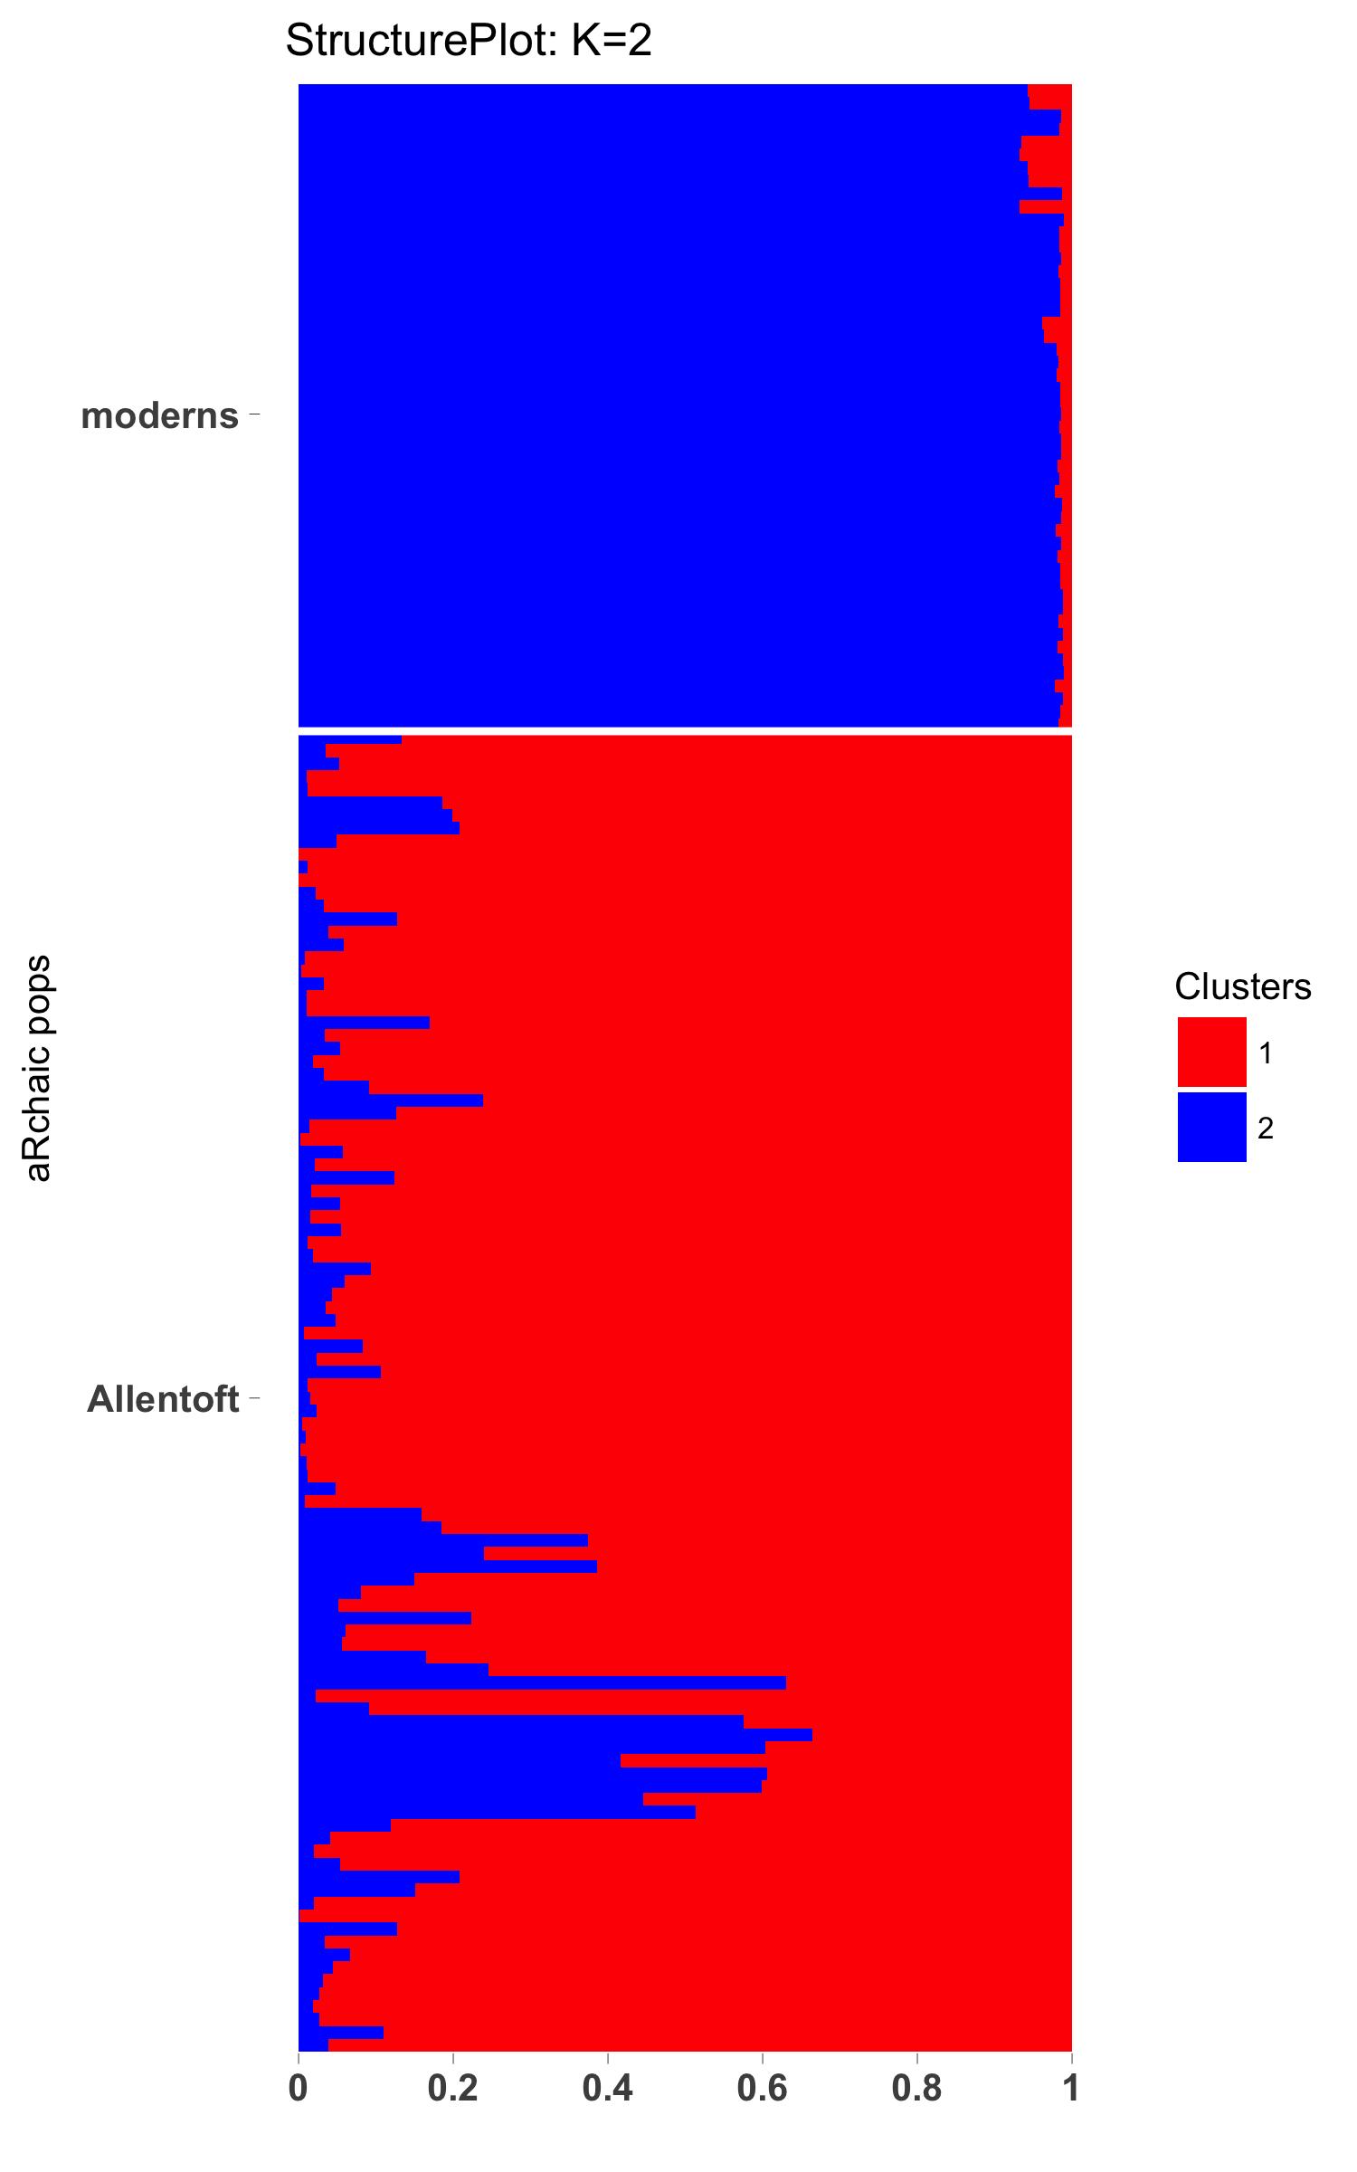
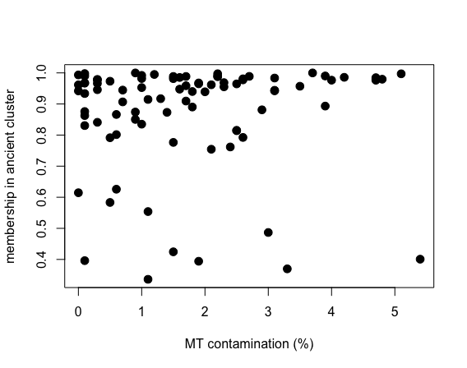
Moderns + Allentoft
mtDNA contamination estimate vs aRchaic comparison

Slide 13
Acknowledgements
Matthew Stephens
John Novembre
Anna Di Rienzo
David Witonsky
John Lindo
Anna Gosling
Choongwong Jeong
John Blischak
Peter Carbonetto
Joe Marcus
Yuichi Shiraishi
Software
aRchaic is available as R package through devtools::install_github(“kkdey/aRchaic”)
Webpage (still under work):
kkdey.github.io/aRchaic

