Slide 1
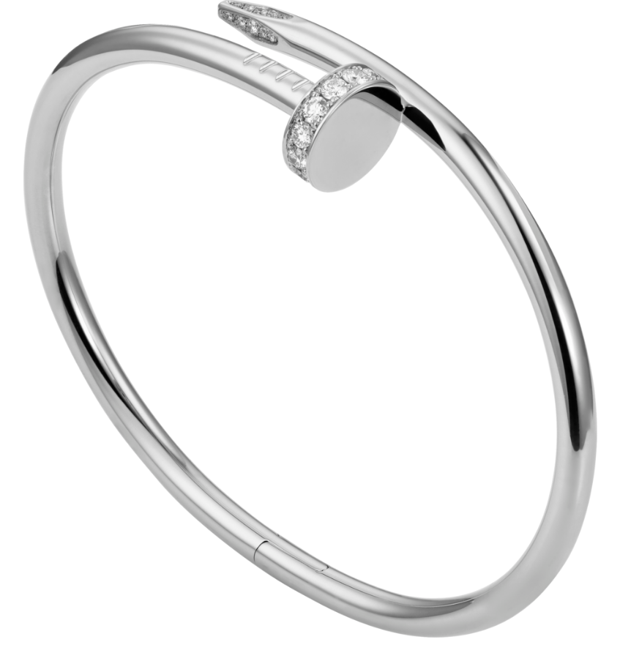
How It’s Made?

Slide 2
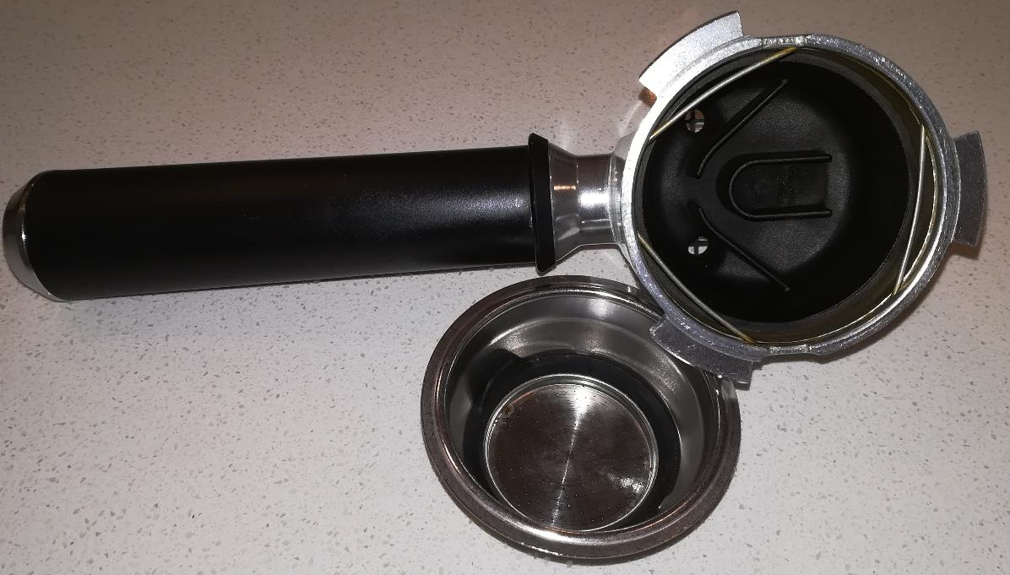
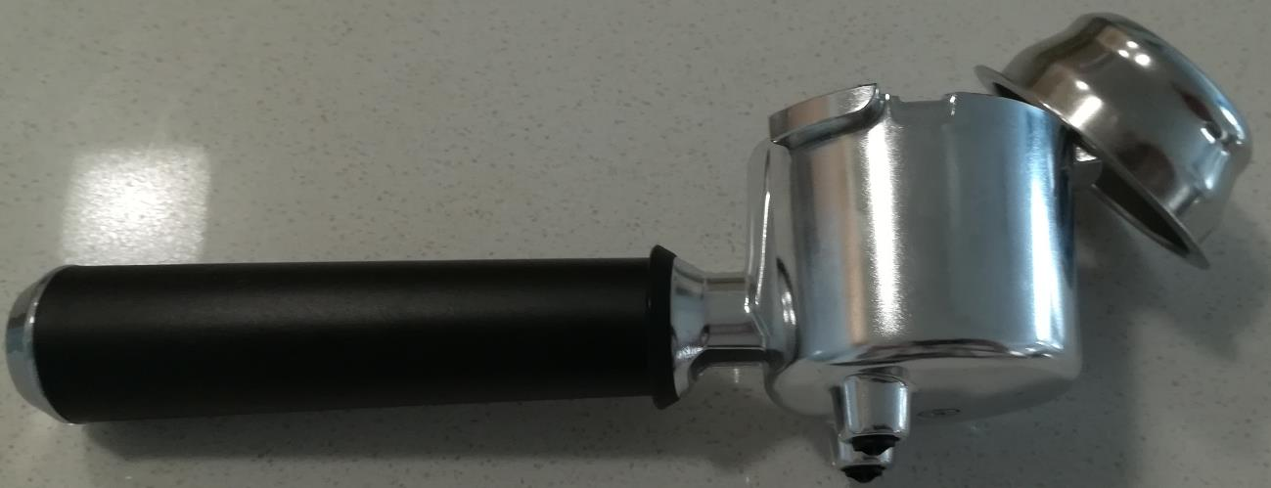
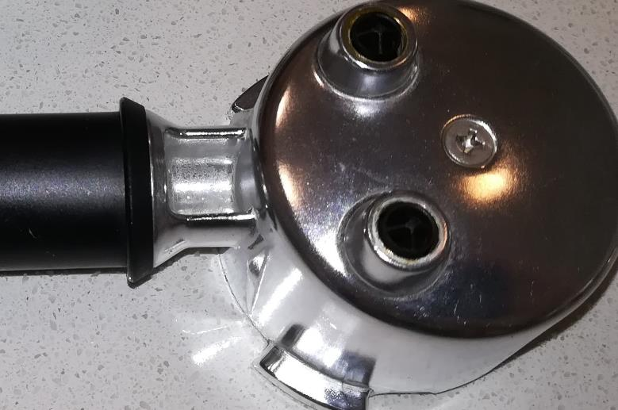
Espresso Filter Holder
By: Ahmad Mohammadpanah
Wire forming (Spring Steel)
Injection Molding
(thermoplastic)
Injection Molding (thermoset)
Thermoforming
(Rubber thermoset)
Casting (Aluminum)
Sheet Metal Forming
(Stainless Steel)
Thread Rolling (Steel)
Injection Molding (thermoset)

Slide 3
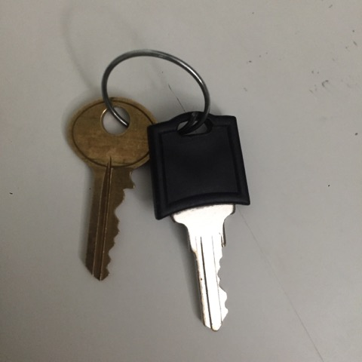
Key ring, copied key, generic key
By: 63205165
Key ring:
Drawing
Dereeling
(Aluminum)
Copy of a key:
Sheet metal blanking
Machining (key cutting)
(Aluminum)
Generic key handle:
Injection molding
(thermoplastic)
Generic key:
Stamping
Blanking
(Aluminum)

