Slide 1
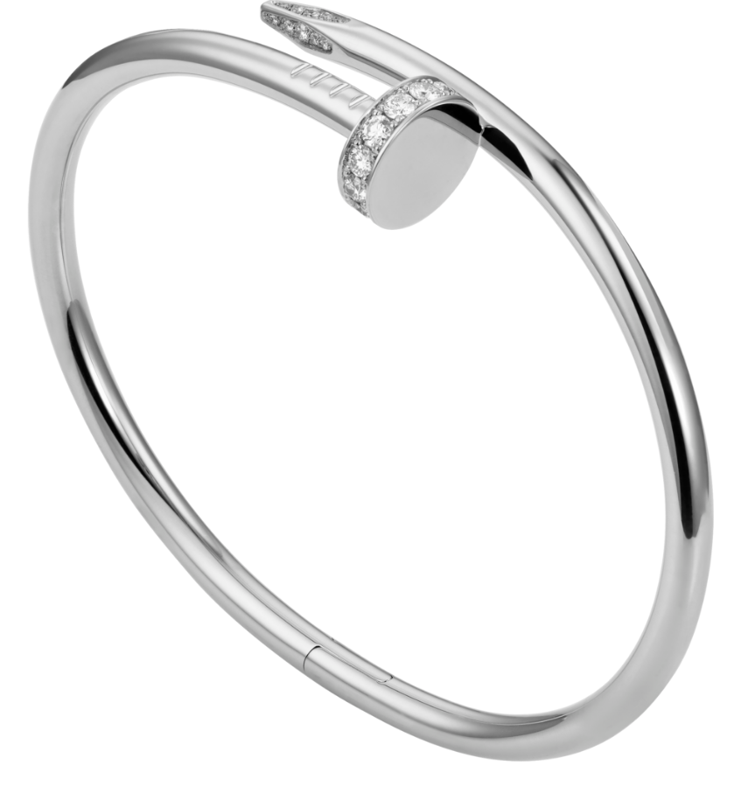
What is the future of Manufacturing?

Slide 2

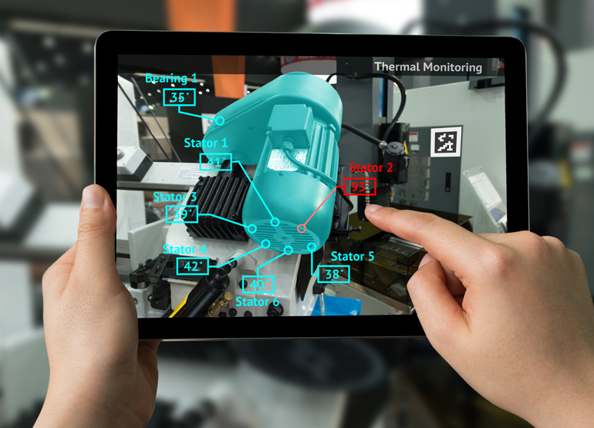
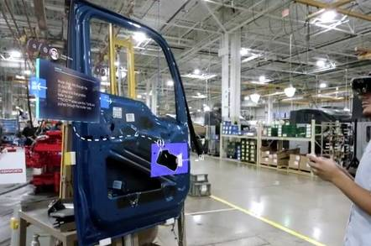
By: 63205165
What do you think will be the Future of Manufacturing?
Augmented reality is a new technology with many potential use cases, manufacturing included. This technology is quite new, so there aren’t many use cases yet, and companies are currently fighting to become the first to own this space. Some sample use cases for streamlining process are:
- Remove need to find faster/more flexible ways to manufacture prototypes, by placing CAD models directly into real space, instead of 3D printing or machining. Ex: Airbus using 3D models to check hydraulics brackets specifications instead of prototyping a physical piece.
- Give visual instruction to front line workers, more intuitive than written instructions. Reduce time needed for supervisor to train people. Tailor help to person based to personal data collected with headset. Manufacturing instructions can be updated easily through software. Ex: Microsoft Guides for front line workers.
Source: https://www.machinedesign.com/industrial-automation/augmented-reality-and-manufacturing
Source: https://regmedia.co.uk/2019/06/10/powerbi-guides.jpg?x=442&y=293&crop=1

