Slide 1
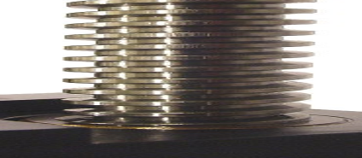
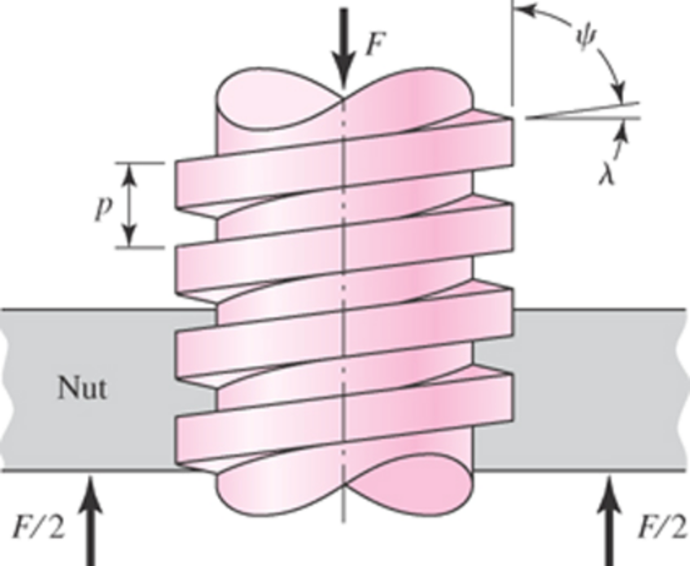
MECH 325
Power Screw Analysis

Slide 2
Objectives
By the end of today’s class, you should be able to:
  Calculate torque for various power screw applications
  Describe the characteristic of self-locking and determine conditions necessary for self-locking
  Describe and quantify the effect of the thread type and nut on raising and lowering torque
  Analyze power screw thread stress
MECH 325

Slide 3
Stresses
Sketch the stress distribution present on the screw threads for an axial load F on the nut and a torque T on the screw
F
MECH 325
T

Slide 4

Origin of Power Screw Torque
Complete the diagrams (represent stresses and torques as point forces on the unrolled incline planes)
Raising Load
Lowering Load
MECH 325

Slide 5
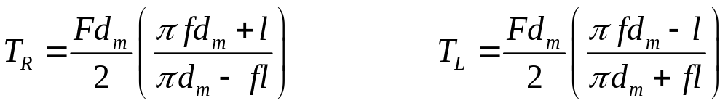
Torque Relationships
Express the driving forces in terms of other known variables:
With some simple geometry, and noting that the driving force (P_{R} or P_{L}) is actually a torque (T_{R} or T_{L}) acting at a distance, we get the two characteristic torque equations
MECH 325

Slide 6
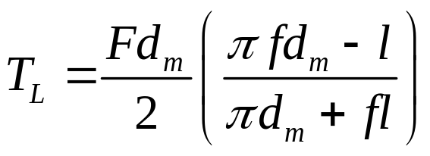
Conditions for Self Locking
Starting with the lowering torque equation:
Self-locking occurs when:
Efficiency, e, is the ratio of raising torque without friction to with friction:
MECH 325

Slide 7
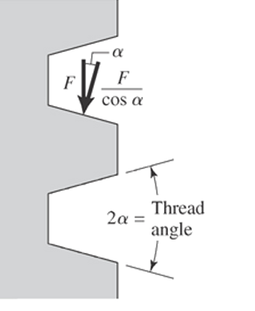
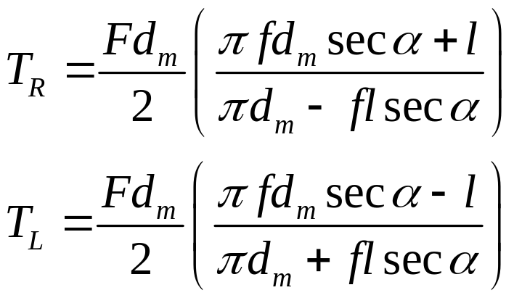
Effect of Thread Angle
Change when ACME threads used:
MECH 325

Slide 8
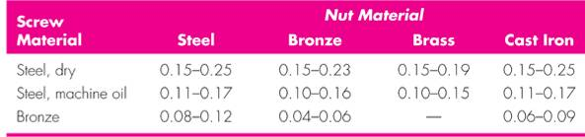
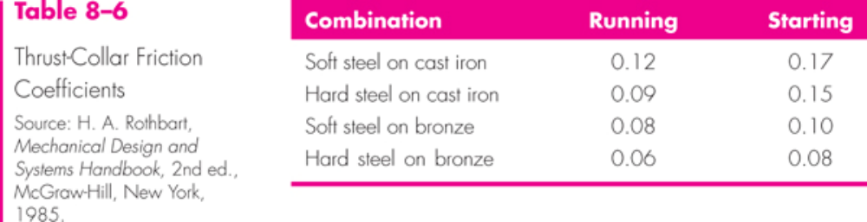
Friction Coefficients
Screw-Nut friction coefficient, f
Thrust collar friction coefficient, f_{c}
MECH 325

Slide 9
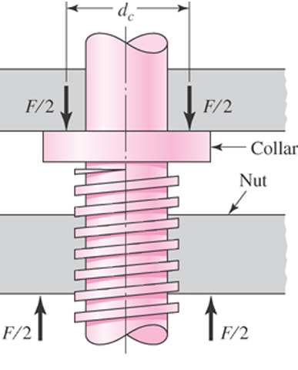
Collar Friction Torque
A thrust collar is needed to carry axial loads
Creates additional frictional torque:
MECH 325

Slide 10
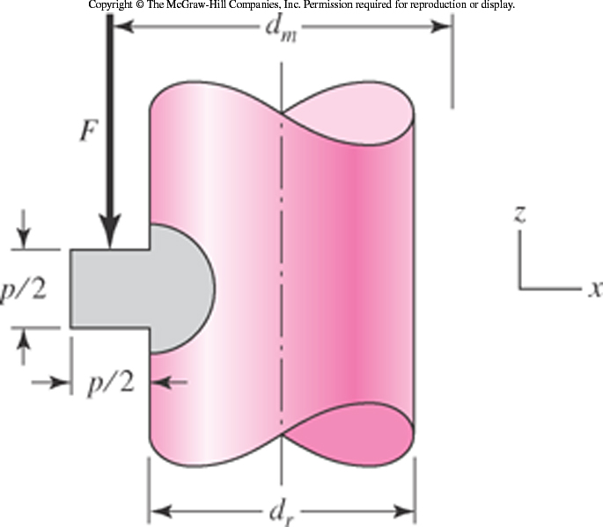
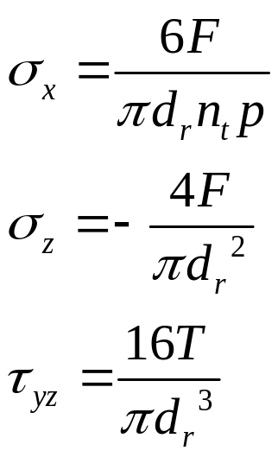
Thread Stress
Thread stress arises from:
Resulting equations:
MECH 325

Slide 11
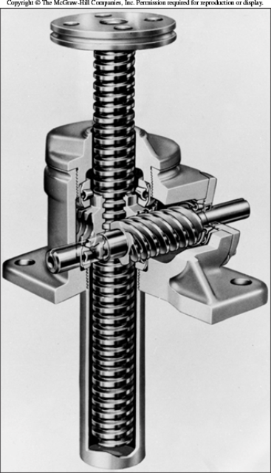
Engaged Threads
Power screw in compression raising an axial load:
  How does the screw deform?
  How does the nut deform?
All threads not equally engaged
  1st engaged thread carries ~38% of load
  2nd engaged thread carries ~25% of load
  3rd engaged thread carries ~18% of load
  … 7th engaged thread carries ~0% of load
MECH 325

Slide 12
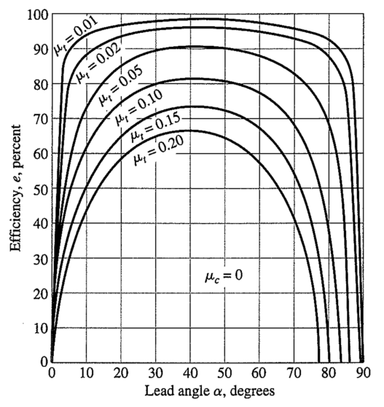
Power Screw Efficiency
f
f
f
f
f
f
f_{c}
λ
MECH 325

Slide 13
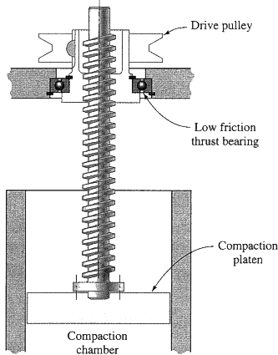

Design Examples
For the designs that follow, will they work as intended?
  If no, how should the design be changed?
  If yes, could the design be further improved?
MECH 325

Slide 14
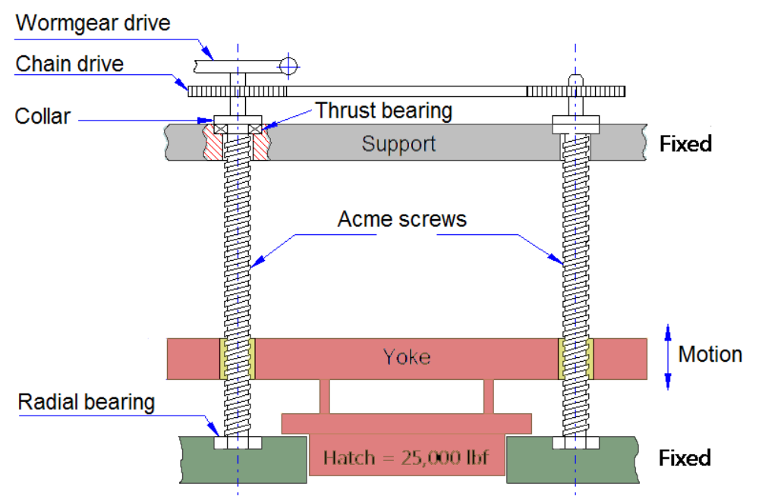
Design Examples
MECH 325

