Slide 1
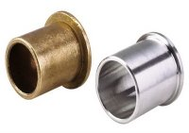
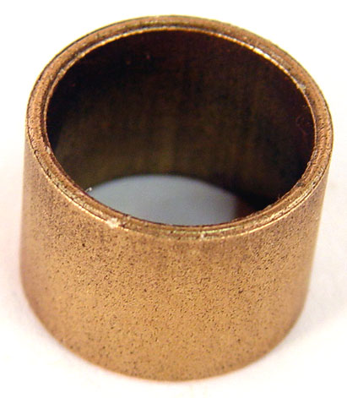
MECH 325
Bushings

Slide 2
Objectives
By the end of this section you should be able to:
Identify types, uses, operating principles, and characteristics of journal bearings
Select a boundary-lubricated bearing for a given application
MECH 325

Slide 3
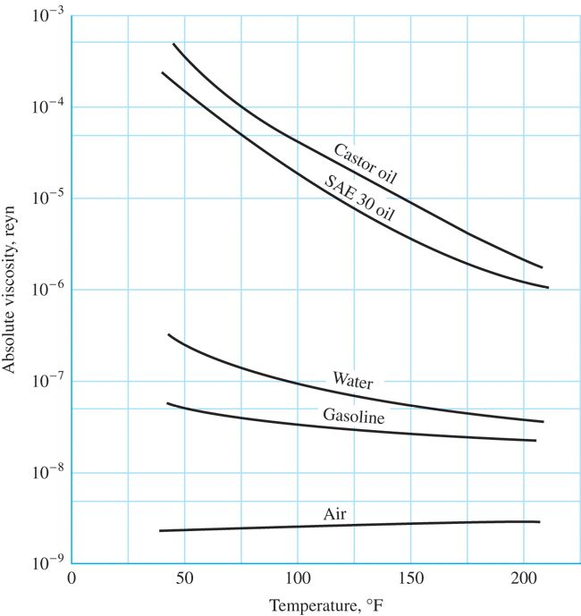
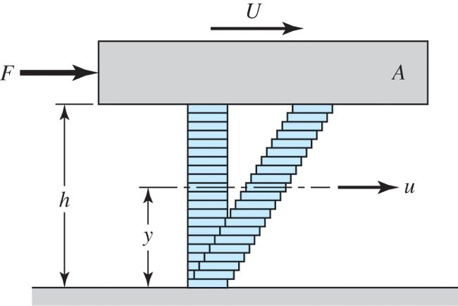
Viscosity
MECH 325

Slide 4
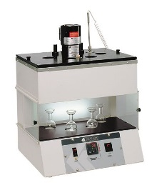
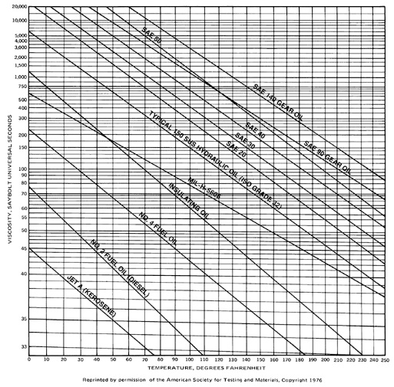
Viscosity
MECH 325

Slide 5
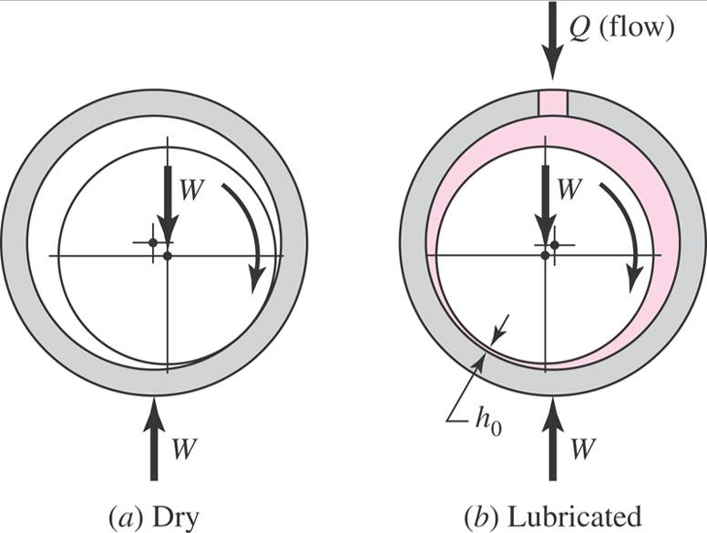
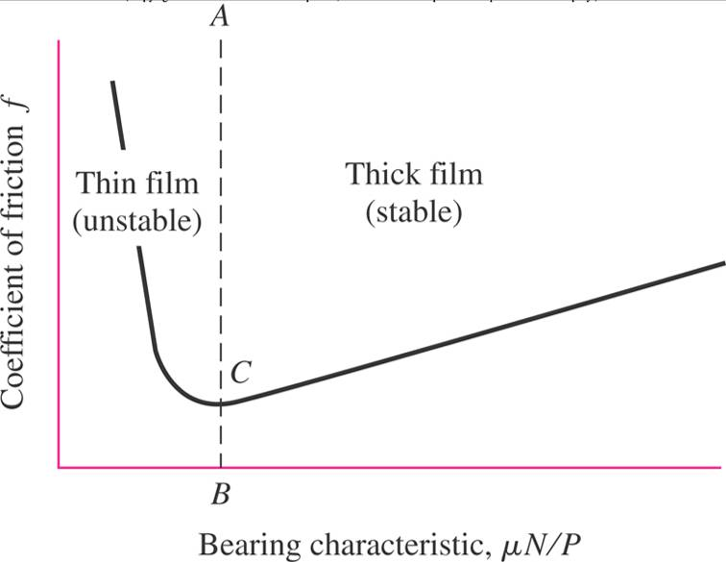
Hydrodynamic Bearings
Rely on thick film of lubricant
Advantages:
Disadvantages:
MECH 325

Slide 6
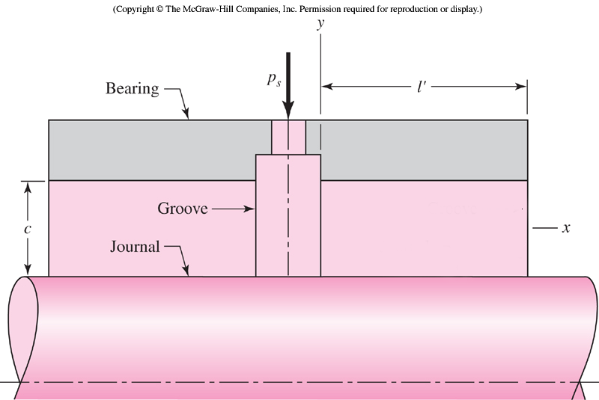
Hydrostatic Bearings
Rely on pressurized fluid source
Advantages:
Disadvantages:
MECH 325

Slide 7
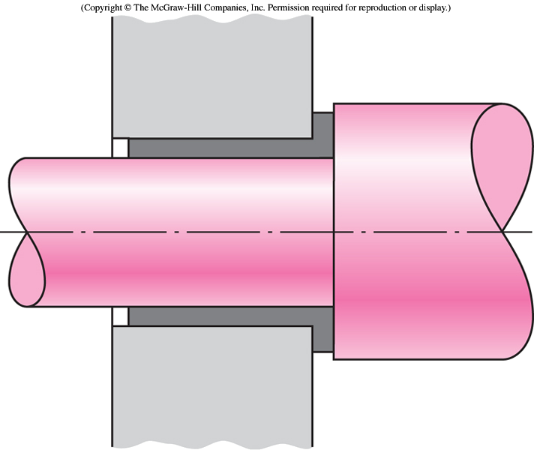
Boundary-Lubricated Bearings
Partial (or no) lubrication
Advantages:
Disadvantages:
MECH 325

Slide 8
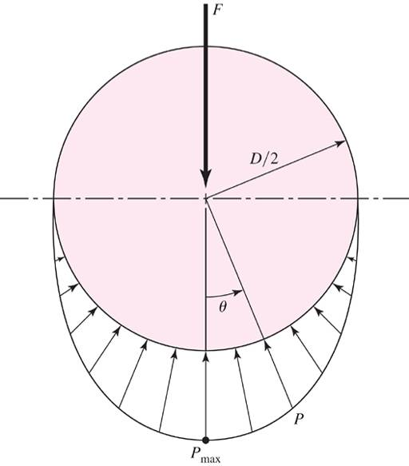
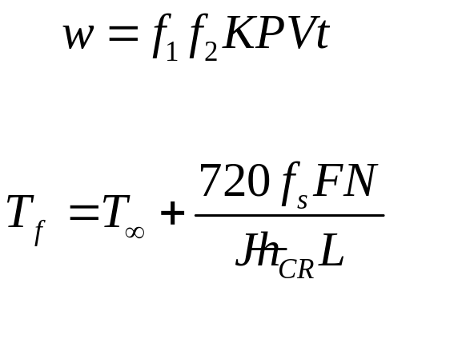
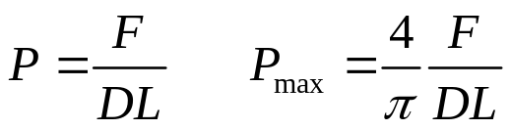
Boundary-Lubricated Bearings
Operating considerations for boundary-lubricated bearings (bushings):
Design considerations
MECH 325

Slide 9
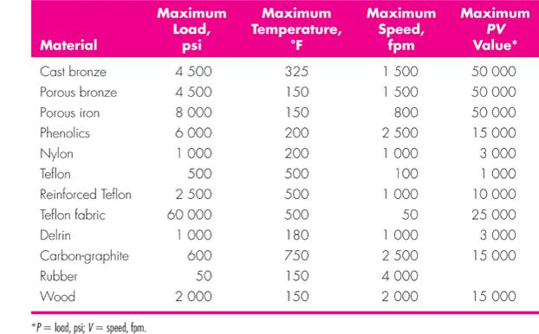
Bushing Operating Limits
MECH 325

Slide 10
Bushing Selection Example
A bushing of 1” diameter x 2” long is subject to a radial load of 225 lbf and rotates at 200 rev/min. The following factors are known or can be assumed:
  f₁ = 1.8 (Table 12-10) ћ_{CR} = 2.7 Btu/(hr∙ft² ∙F)
  f₂ = 1.0 (Table 12-11) J = 778 ft ∙lbf/Btu
  f_{s} = 0.03 Ambient temperature = 70 F
Select a candidate material for this bushing.
MECH 325

