Slide 1
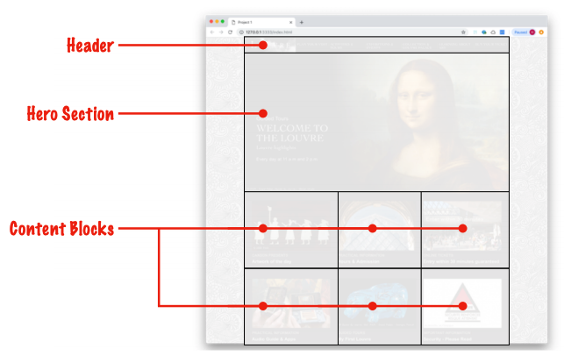
Exercise 0
Front-end programming is composed of three technologies
HTML
CSS
JavaScript
HTML elements are created from HTML tags
<html>
<header></header>
<div class="hero"></div>
<div class="content-blocks"></div>
</html>

Slide 2
Exercise 0
CSS provides styling to web pages by identifying selectors, to which rules are applied
selector
.outline {
min-height: 75px;
outline: 2px solid red;
}
rules

Slide 3
Exercise 0
JavaScript is a full-featured programming language that operates in the user's browser
JavaScript function
let adder = (number1, number2) => {
return number1 + number2
}

Slide 4

Exercise 0
Start by heading to repl.it and signing up for a free account

Slide 5
Exercise 1
A value is a piece of information
"Las Vegas, NV"
110,887
true
A variable is a value to which a name (aka identifier) is attached
let city = "Las Vegas, NV"
let avergeSalary = 110,887
let greatCareer = true
JavaScript variable assignments
name
value
assignment operator

Slide 6
Exercise 2
We commonly use JavaScript to manipulate HTML:
identify the HTML element/s
perform desired operation on the element/s
document.getElementById('first).innerHTML = variable_name
identify element
insert value of variable into element/s

Slide 7
Exercise 3
We use Cascading Stylesheets to style HTML elements:
create a selector/s
set rules for selector/s
Selector
#first {
font-weight: bold;
font-family: 'Avenir Next Condensed';
color: red;
}
Rules

Slide 8
Exercise 4
There are over 125 different HTML elements, but only two dozen or so that are commonly used
Different elements are used for different purposes
<p> for paragraphs
<ol> for numbered lists
<ul> for bullet points
<h1> for titles
<a> for links
Different elements have different default properties, almost all of which can be overridden with CSS

Slide 9
Exercise 5
Normally HTML is written directly by the developer at "design time"
<div class="featured-product">WidgetMaster 2000</div>
At times, we need HTML to be created at "run time" in response to various conditions and/or user actions. For this, we turn to creating HTML with JavaScript.
let attribution = document.createElement('div')
let textNode = document.createTextNode('– Abraham Lincoln')

Slide 10
Exercise 6
Some information we know at design time
let feetInMiles = 5280
Some we need to find based on various conditions and/or user choices
One very simple way of getting information from a user is through the browser's prompt function
let firstName = prompt('What is your first name?')
document.getElementById('firstName').innerHTML = firstName
This is seldom done in production code, but we can use it to begin introducing getting values dynamically
It's common to have content that is partially static and partially dynamic

Slide 11
Exercise 7
HTML elements have various attributes
<div id="deal-of-the-day" class="featured-product">Red Widget</div>
<div class="featured-product">Blue Widget</div>
<div class="featured-product">White Widget</div>
The class attribute is useful in grouping elements that have some commonality that we wish to either style using CSS or manipulate using JavaScript.
.featured-product{
color: red;
}
document.querySelectorAll('.featured-product')

Slide 12
Exercise 8
The browser function, document.querySelector, lets us select from a wide range of criteria
document.querySelector('main') selects by element name
document.querySelctor('.featured-product') selects by class attribute
document.querySelector('#deal-of-the-day') selects by id attribute

Slide 13
Exercise 9
We apply conditional code to situations in which different conditions require different actions
If user has a valid login, let them proceed; else ask them to log in again
If user doesn't have sufficient funds, refuse transfer; else transfer funds
If product is in stock, display it; else do not display it
The most common way we implement this is with an if statement
if (some condition === true ) {
do this
} else {
do that
}

Slide 14
Exercise 10
In this exercise, we learn 3 new HTML elements
<header></header>
<main></main>
<output></output>
We can use elements names as CSS selectors
main {
min-height: 75px;
outline: 2px solid red;
font-family: 'Avenir Next Condensed';
}

