Slide 1
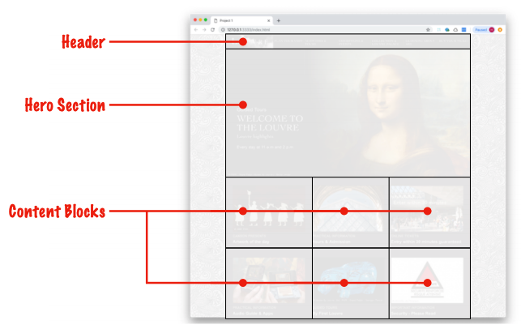
Exercise 0
Front-end programming is composed of three technologies
HTML
CSS
JavaScript
HTML elements are created from HTML tags
<html>
<header></header>
<div class="hero"></div>
<div class="content-blocks"></div>
</html>

Slide 2
Exercise 0
CSS provides styling to web pages by identifying selectors, to which rules are applied
selector
.outline {
min-height: 75px;
outline: 2px solid red;
}
rules

Slide 3
Exercise 0
JavaScript is a full-featured programming language that operates in the user's browser
JavaScript function
let adder = (number1, number2) => {
return number1 + number2
}

Slide 4
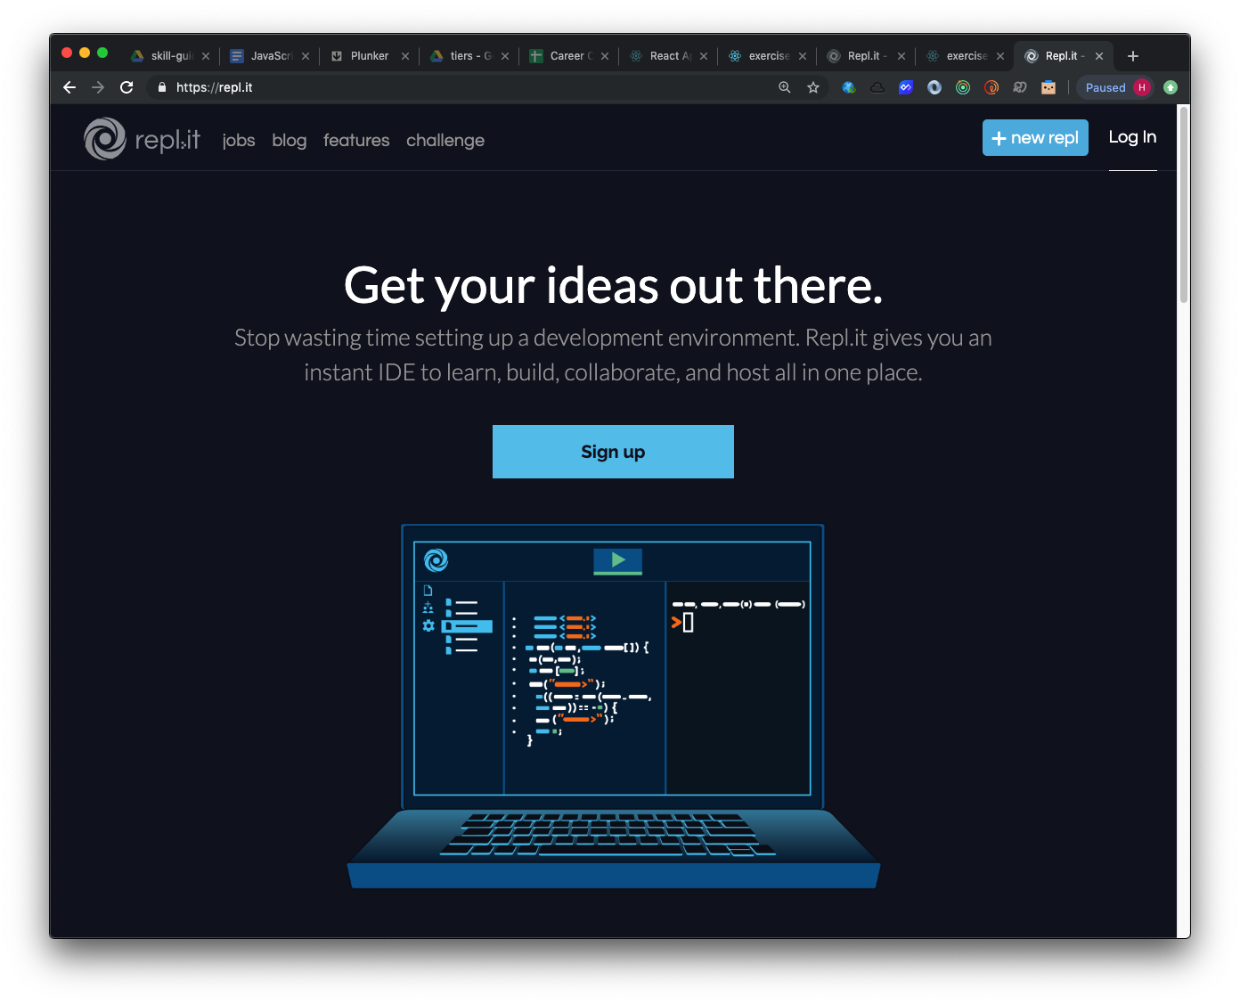
Exercise 0
Start by heading to repl.it and signing up for a free account

Slide 5
Exercise 1
A value is a piece of information
"Las Vegas, NV"
110,887
true
A variable is a value to which a name (aka identifier) is attached
let city = "Las Vegas, NV"
let avergeSalary = 110,887
let greatCareer = true
JavaScript variable assignments
name
value
assignment operator

Slide 6
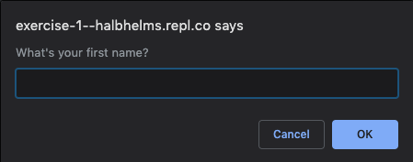
Exercise 1
A value is a piece of information
A variable is a value to which a name (aka identifier) is attached
In this exercise, you'll learn how to use a built-in JavaScript function, prompt, to dynamically set the value of a variable

Slide 7
Exercise 2
We commonly use JavaScript to manipulate HTML:
identify the HTML element/s
perform desired operation on the element/s
document.getElementById('first).innerHTML = variable_name
identify element
insert value of variable into element/s

Slide 8
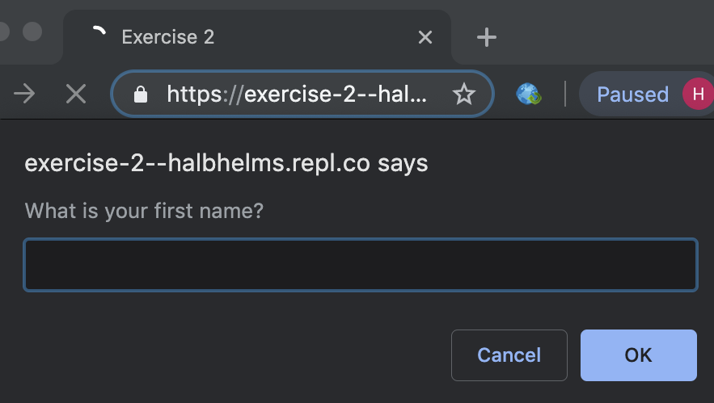
Exercise 2

Slide 9
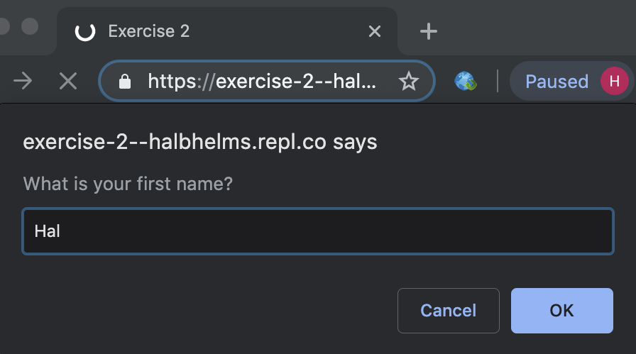
Exercise 2

Slide 10
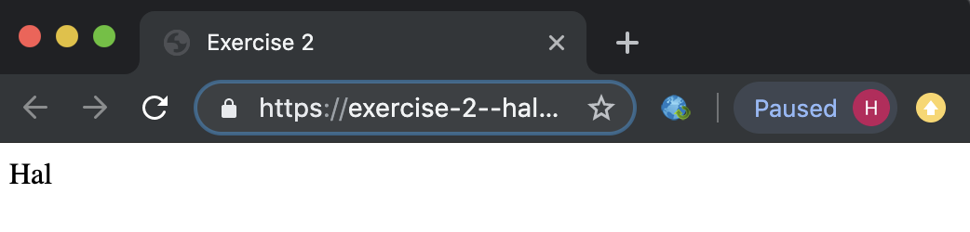
Exercise 2

Slide 11

Exercise 3
We use Cascading Stylesheets to style HTML elements:
create a selector/s
set rules for selector/s
Selector
#first {
font-weight: bold;
font-family: 'Avenir Next Condensed';
color: red;
}
Rules

Slide 12
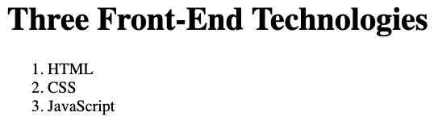
Exercise 4
There are over 125 different HTML elements, but only two dozen or so that are commonly used
Different elements are used for different purposes
<p> for paragraphs
<ol> for numbered lists
<ul> for bullet points
<h1> for titles
<a> for links
Different elements have different default properties, almost all of which can be overridden with CSS

Slide 13

Exercise 5
Normally HTML is written directly by the developer at "design time"
<div class="featured-product">WidgetMaster 2000</div>
At times, we need HTML to be created at "run time" in response to various conditions and/or user actions. For this, we turn to creating HTML with JavaScript.
let attribution = document.createElement('div')
let textNode = document.createTextNode('– Abraham Lincoln')

Slide 14
Exercise 6
Some information we know at design time
let feetInMiles = 5280
Some we need to find based on various conditions and/or user choices
One very simple way of getting information from a user is through the browser's prompt function
let firstName = prompt('What is your first name?')
document.getElementById('firstName').innerHTML = firstName

Slide 15
Exercise 6
This is seldom done in production code, but we can use it to begin introducing getting values dynamically
It's common to have content that is partially static and partially dynamic

Slide 16
Exercise 7
HTML elements have various attributes
<div id="deal-of-the-day" class="featured-product">Red Widget</div>
<div class="featured-product">Blue Widget</div>
<div class="featured-product">White Widget</div>

Slide 17
Exercise 7
You're going to learn a little about using CSS with classes
HTML elements have various attributes
<div id="deal-of-the-day" class="featured-product">Red Widget</div>
<div class="featured-product">Blue Widget</div>
<div class="featured-product">White Widget</div>

Slide 18
Exercise 7
The class attribute is useful in grouping elements that have some commonality that we wish to either style using CSS or manipulate using JavaScript.
.featured-product{
color: red;
}
document.querySelectorAll('.featured-product')

Slide 19
Exercise 8
We've used document.getElementById to capture an element with a given ID
In this exercise, you'll work with an alternate way of capturing an HTML element
The browser function, document.querySelector, lets us select from a wide range of criteria
document.querySelector('main') selects by element name
document.querySelctor('.featured-product') selects by class attribute
document.querySelector('#deal-of-the-day') selects by id attribute

Slide 20
Exercise 9
We apply conditional code to situations in which different conditions require different actions, e.g.
If user has a valid login, let them proceed; else ask them to log in again
If user doesn't have sufficient funds, refuse transfer; else transfer funds
If product is in stock, display it; else do not display it
In this exercise, you'll work with an if statement for the first time

Slide 21
Exercise 9
The most common way we implement conditional code is with an if statement
if (some condition === true ) {
do this
} else {
do that
}

Slide 22
Exercise 9
if (itemInStock === true) {
alert('We have it!')
} else {
alert('Sorry, it is out of stock')
}

Slide 23
Exercise 10
In this exercise, we learn 3 new HTML elements
<header></header>
<main></main>
<output></output>
We can use elements names as CSS selectors
main {
min-height: 75px;
outline: 2px solid red;
font-family: 'Avenir Next Condensed';
}

Slide 24
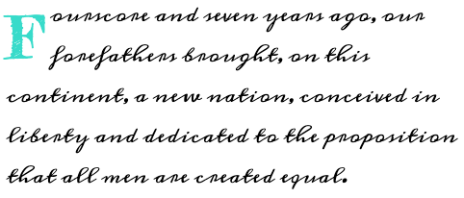
Exercise 11
With CSS, we can change the font type
body {
font-family: 'Meddon';
}

Slide 25
Exercise 11
We can use a wide variety of free fonts from fonts.google.com
We start to explore some of the more interesting effects available with CSS such as a drop cap

Slide 26
Exercise 12
<main>
<div>
<p></p>
</div>
<div>
<div>
<p></p>
</div>
</div>
</main>
We're not limited to broad CSS selectors
main {
}

Slide 27
Exercise 12
<main>
<div>
<p></p>
</div>
<div>
<div>
<p></p>
</div>
</div>
</main>
We're not limited to broad CSS selectors
div {
}

Slide 28
Exercise 12
<main>
<div>
<p></p>
</div>
<div>
<div>
<p></p>
</div>
</div>
</main>
We're not limited to broad CSS selectors
p {
}

Slide 29
Exercise 12
<main>
<div>
<p></p>
</div>
<div>
<div>
<p></p>
</div>
</div>
</main>
We're not limited to broad CSS selectors
main div {
}

Slide 30
Exercise 12
<main>
<div>
<p></p>
</div>
<div>
<div>
<p></p>
</div>
</div>
</main>
We're not limited to broad CSS selectors
div p {
}

Slide 31
Exercise 12
<main>
<div>
<p></p>
</div>
<div>
<div>
<p></p>
</div>
</div>
</main>
We're not limited to broad CSS selectors
main div p {
}

Slide 32
Exercise 12
<main>
<div>
<p></p>
</div>
<div>
<div>
<p></p>
</div>
</div>
</main>
We're not limited to broad CSS selectors
div div p {
color: red;
}

Slide 33
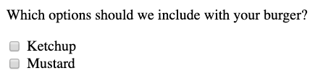
Exercise 13
Checkboxes are useful for allowing users to select multiple options
Clicking on the label is the same as clicking on the checkbox
<input type="checkbox" value="ketchup" id="ketchup" />
<label for="ketchup">Ketchup</label>

Slide 34
Exercise 14
One of the most common ways to introduce interactivity onto a page is through event handlers
Events are generated by the browser when any of a number of things happen. To capture (aka handle) the event, we tie a function to the event trigger.
<input type="checkbox" value="tea" id="tea" onclick="alert('You chose tea')"/>
<label for="tea">Tea</label>
event trigger
function

Slide 35

Exercise 15
We use radio buttons when we want to restrict user choice to a single option
Like checkboxes, we can listen for click events and respond to those
So far, we've only used built-in browser functions (e.g. alert) in response to click events. Soon, we'll learn how to build our own functions. Once we learn that, the programming world begins to open dramatically.

Slide 36
Exercise 16
In this exercise, we'll be dealing with calendar dates
Dates in JavaScript (and in most other programming languages) are, for some inexplicable reason, difficult to work with
Luckily, we don't have to deal with dates very often in the normal course of programming, so the difficulty in working with them becomes more of an annoyance
You'll get some experience working with dates so that, when working with them becomes a necessity, you'll have a background in dealing with them

Slide 37
Exercise 16
In this exercise, we get into one of the core features of JavaScript: objects
Data in programming languages has a specific data type
"CareerChanger": text
42: number
true: boolean

Slide 38
Exercise 16
What data type is this?
person: {
firstName: "Hal",
lastName: "Helms",
residence: "Las Vegas, NV"
}

Slide 39
Exercise 16
This is a JavaScript object
An object holds a collection of properties typically related to the same concept
firstName, lastName, residence are all properties of a person
Another way to define an object is a collection of key: value pairs

Slide 40
Exercise 16
You access an object property by using either:
person.firstName
person['firstName']
If the property name is hyphenated or a number or made up of multiple words, you must use the second accessor pattern
Objects, by means of allowing us to store large bits of related information in a single variable, make life much easier for developers

Slide 41
Exercise 17
CSS is an extremely powerful technology for styling web pages
In addition to doing some of the things you've already seen, it allows us to specify the position of HTML elements on the page
One important thing to understand is that different HTML elements – <div>s, <p>s, <li>s, etc. – have default positioning behaviors
block-level elements position themselves on a new line
inline elements push themselves up against the previous element

Slide 42
Exercise 17
The default positioning behavior can be overridden by changing the value of an element's position property
In this exercise, we'll learn about setting an element's position to inline-block that combines the qualities of block and inline
In later exercises, we'll look at CSS grid, a technology that lets us create complex layouts simply and powerfully

Slide 43
Exercise 18
If you were to condense JavaScript to its essence, I would say you would arrive at the function
In past exercises, we've worked with built-in functions such as alert and prompt.
In this exercise, we begin writing our own, custom functions.

Slide 44
Exercise 18
Functions have evolved over the life of JavaScript. We're going to be working with one of the latest versions of JavaScript functions called arrow functions.
The function pattern will be using throughout the rest of these lessons is this:
let functionName = (arg1,...,argN) => {
// function body here
}

Slide 45
Exercise 18
Functions are like little machines
They have a clear purpose (usually a small one) and they don't do anything until they're engaged
We engage functions by calling (aka invoking) them
let adder = (num1, num2) => {
return num1 + num2
}
adder(10,20)
JavaScript function
Calling the function

Slide 46
Exercise 18
One of the most common uses for functions is reacting to browser events (e.g. clicking a button, entering text, moving an element)
In this exercise, you'll learn one of the simplest ways to connect an event to a custom function – by using an onclick event handler and pointing it to your function

Slide 47
Exercise 18
When the specified event occurs (an element is clicked in this case), the function will be called
<button onclick="myFunction">Click me</button>
Make sure you understand this exercise before going forward; functions are integral to JavaScript

Slide 48
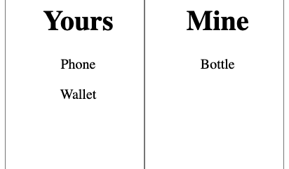
Exercise 19
In this exercise, you'll get more practice creating custom functions and assigning them to events
You'll create a function that will simulate (badly) moving items from one list to another
Although I don't call attention to it, check out the CSS briefly

Slide 49
Exercise 21
The technology that makes the Web the Web is the link
You can link to other pages on your site or to other sites
Using the target attribute, you can specify whether the linked page should load in the current browser window or a separate one

Slide 50
Exercise 22
In an earlier exercise, I said that the heart of JavaScript is the function – specifically the custom functions you write yourself
In this exercise, you'll get more practice creating your own functions, including functions that call other functions
Pay special attention to this exercise owing to the importance of functions in JavaScript

Slide 51
Exercise 23
This exercise gives you more experience working with CSS
Because CSS offers a great many options for styling, the best way to learn CSS is gradually
In all of these exercises, feel free to make adjustments to the CSS in order to get a feel for what CSS can do

Slide 52
Exercise 24
HTML forms are an integral part of web applications
In this exercise, you'll take baby steps towards working with forms

Slide 53
Exercise 25
In this exercise, you'll combine links with CSS to produce a nav bar
And, in this exercise, I ask you to do something very scary: wipe out an existing file and recreate it
You want to get to the point where you're not afraid to get rid of code – either because it's at a point where it's easier to start fresh or because you want to improve existing code that already is working (aka refactoring)

Slide 54
Exercise 26
HTML, when first conceived, came with a default set of behaviors
One of these was for forms
In modern development, we rely less on default behavior and more on creating our own, custom behavior

Slide 55
Exercise 26
A common pattern in web development is to prevent the default submit behavior of forms, relying instead on putting form inputs into a JavaScript object
In this exercise, you'll get practice adding inputs to an object

Slide 56
Exercise 27
When you combine JavaScript objects with JavaScript functions, you can accomplish great things
In this exercise, you'll do just that – and get even closer to what professional programmers do on a daily basis

Slide 57
Exercise 28
Back to work on integrating HTML forms with JavaScript

