Slide 1
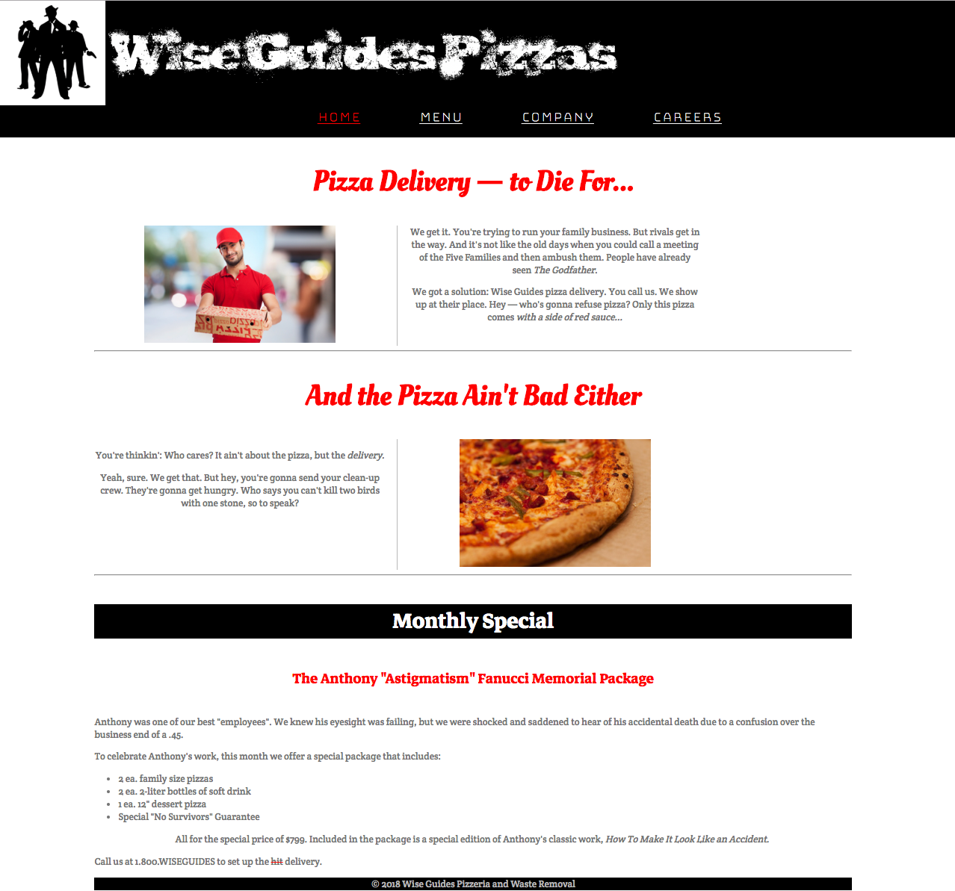
Wise Guides Pizzas

