Slide 1

Basic Details of the Team and Problem Statement
Ministry/Organization Name/Student Innovation:
PS Code: 1362
Problem Statement Title: Student dropout analysis for School Education.
Team Name: Ghete Gho
Team Leader Name:Aritro Saha(21BLC1174)
Institute Code (AISHE): C-49441
Institute Name: Vellore Institute Of Technology, Chennai
Theme Name: Smart Education.

Slide 2
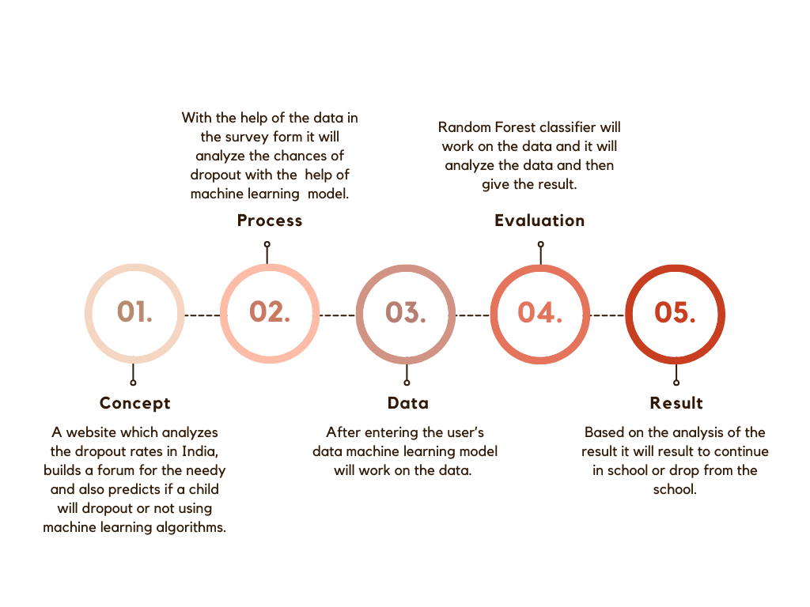
Idea/Approach Details
In an effort to address the critical issue of student dropout rates in educational institutions, we have developed a comprehensive data analysis system that leverages Machine Learning (ML) techniques with the help of Logistic Regression Classification and Random Forest Classifier.
Model which can do the analysis and the heart of this system is a web-based platform that allows users to interact with the data and access the analysis results seamlessly.
Users can input current student data to predict the risk of dropout for individual students. This allows early intervention and support for at-risk students.This can be done with the help of Random Forest Classifier Model.
We provide interactive data visualizations and comprehensive reports that highlight trends, patterns, and key insights. These visualizations include bar charts, line graphs, and etc.
Based on the analysis, our system offers recommendations for intervention strategies that educational institutions can implement to reduce dropout rates.
Our system identifies the most influential factors contributing to student dropout. This information helps educational institutions understand the root causes.

Slide 3
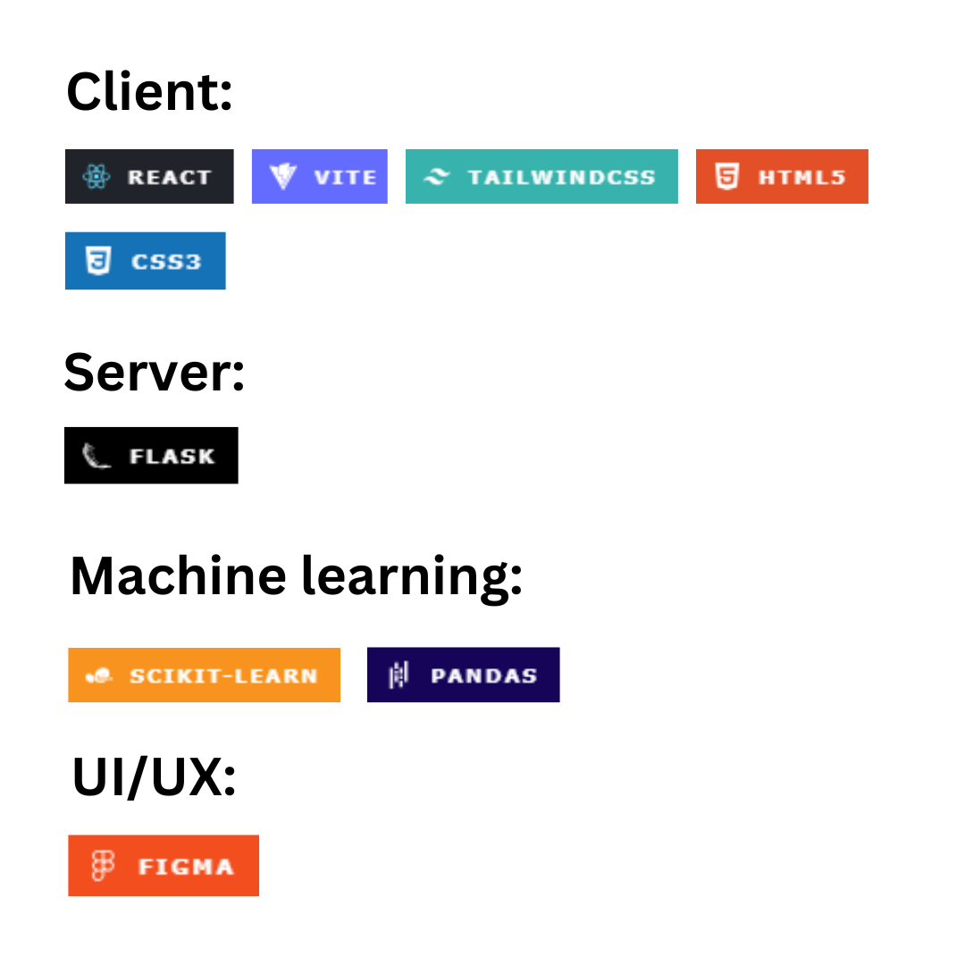
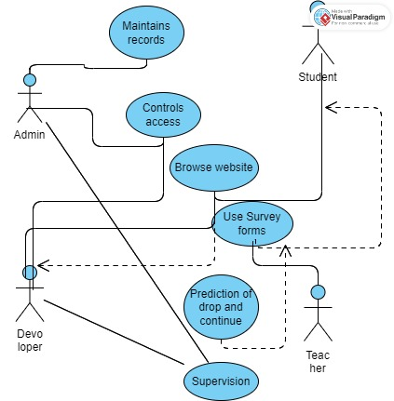

Slide 4
Idea/Approach Details
Describe your Use Cases here
Describe your Dependencies / Show stopper here
ML models can predict which students are at a higher risk of dropping out based on historical data and current performance. Institutions can use this information to provide targeted support.
Websites shows many free courses for those who are dropping out due to financial reasons.
The web page can provide a platform for teachers and parents to access information about a student's risk of dropping out.
People can donate money for the needy students to provide them education and prevent the dropout.
It will have a special forum section which will give opportunity to the students who are not ready to disclose of dropout reasons publicly and the sessions will be monitored and solutions will also provided by many experts
AI chat based helper integrated through Llama-2 model will be introduced shortly.
Incomplete or inaccurate data can lead to incorrect predictions and recommendations. Ensuring data quality and availability is a significant challenge, especially in educational settings where data may be scattered .
ML models can inherit biases from the data they are trained on. Ensuring fairness in predictions and avoiding discriminatory outcomes is a critical ethical concern.
Legal and ethical issues may arise when implementing interventions based on predictive analytics. Decisions based solely on an ML model's prediction without human judgment can lead to contentious situations.
Relying solely on predictions may lead to neglecting the broader educational context and qualitative aspects of student well-being.
ML models require ongoing maintenance and updates to remain effective. Keeping models up-to-date with changing student demographics and behaviors is a continuous challenge.

Slide 5
Team Member Details
Team Leader Name: Aritro Saha
Branch :BTECH Stream : ECM Year: 3rd
Team Member 1 Name: Sreyashi Dey
Branch :BTECH Stream : CSE Year: 3rd
Team Member 2 Name: Jasti Karthikeya
Branch :BTECH Stream : CSE AI/ML Year: 3rd
Team Member 3 Name: Sujoy Ghosh
Branch :BTECH Stream : ECM Year: 3rd
Team Member 4 Name: Aritra Ganai
Branch :BTECH Stream : CSE Year: 3rd
Team Member 5 Name: Pabak Kundu
Branch :BTECH Stream : CSE CPS Year: 3rd

