Slide 1
Ornament & Crime
Polymorphic CV Generator
The Workshop
Justin Patrizi
Tom Moxon
@HalcyonModular

Slide 2
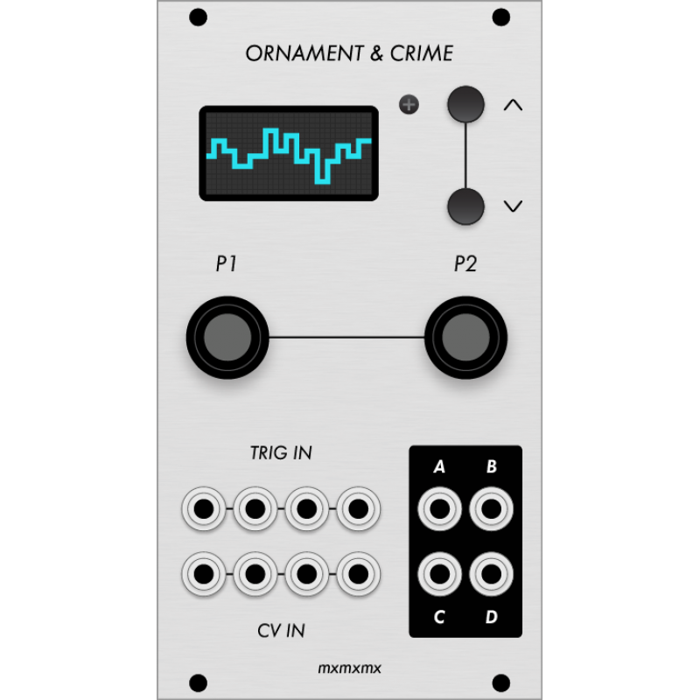
O&C – The Workshop
Introduction
Brief History and Background
Hardware Design, DIY kits, etc.
Open Source Design & Files
O&C Modes (Apps)
Questions
Hand's On Workshop
Next Meeting
http://ornament-and-cri.me

Slide 3
Halcyon Modular
Justin Patrizi – many years of audio design and production. Currently teaching at PNCA.
Tom Moxon – many years of engineering experience, designing integrated circuits and electronics for companies like : Cray Research, Adobe Systems, Hewlett Packard, Silicon Graphics, Hyundai,
Rohm, Emu Systems (Emulator/Drumulator)

Slide 4
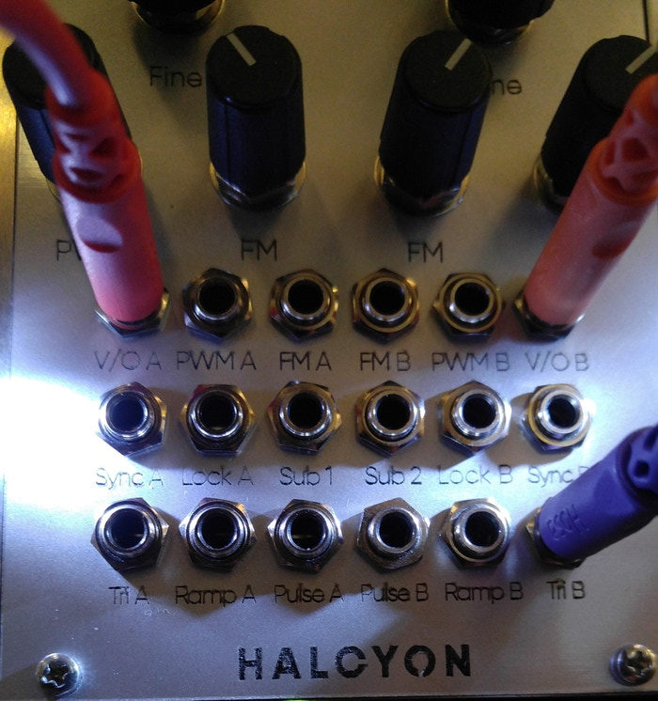
Halcyon Modular
Eurorack Modular Synthesizers
Local - Portland Based
Developing new, pure Analog
and Mixed Signal Designs
Miasma – Dual CEM3340 VCO

Slide 5
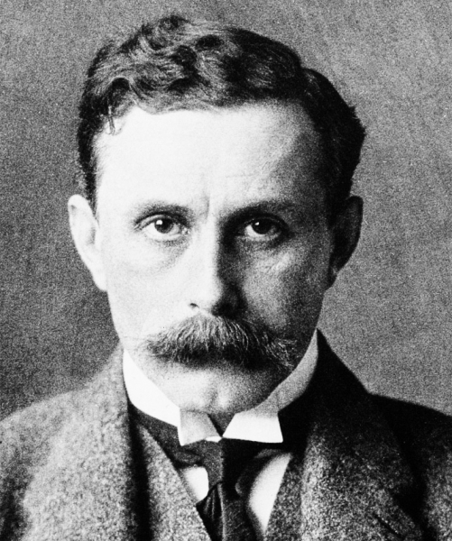
O & C History
Ornament and Crime is an essay and lecture by modernist architect Adolf Loos that criticizes over ornamentation in useful objects -
“The evolution of culture marches with the elimination of ornament from useful objects"
O & C Modules tend to have a “plain” front panel, the usefulness is on the inside...
http://ornament-and-cri.me

Slide 6
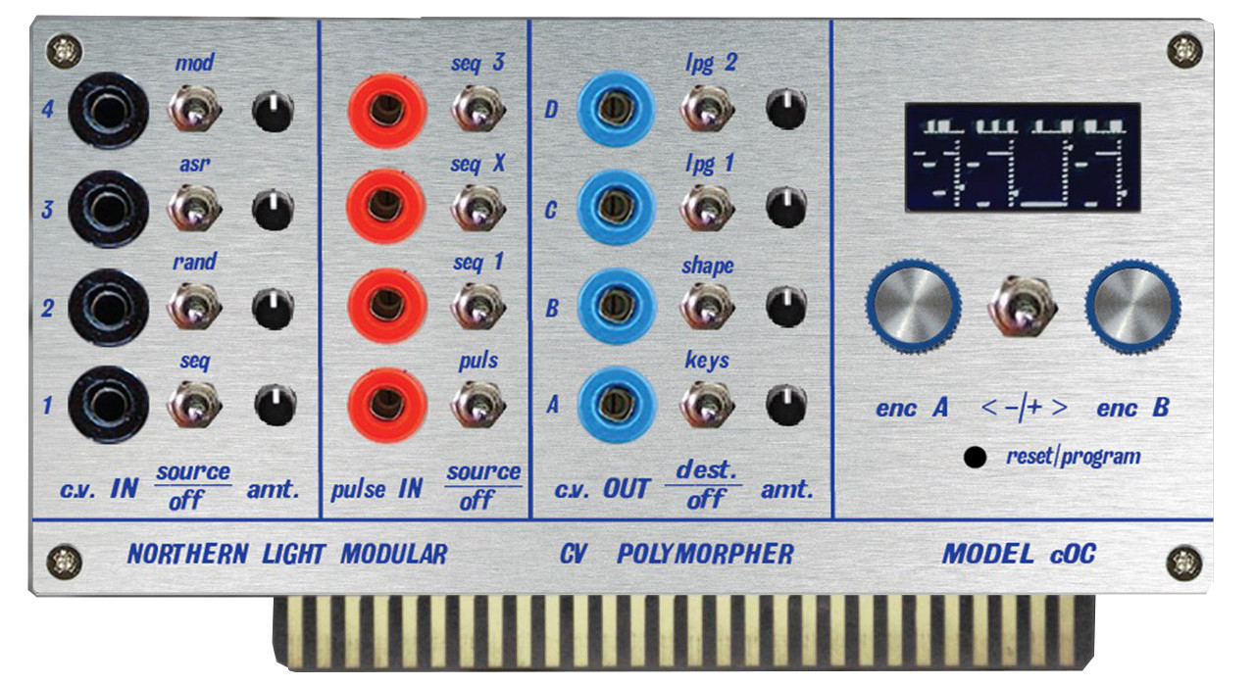
Who did O&C (Hardware)?
Max Stadler (mxmxmx) primary hardware designer
(JakPlugg) micro-Ornament and Crime layout
Many other custom versions (commercial and non)
Image Courtesy of : Northern Light Modular

Slide 7
Who did O&C(Software)?
The Ornament and Crime Polymorphic CV Module is the based on the work of a whole community
Max Stadler (mxmxmx) is the primary designer,
with major software design by Patrick Dowling (pld),
and Tim Churches (bennelong.bicyclist)
The software for several functions is based on work by Olivier Gillet (Mutable Instruments)
Paul Stroffregen (PJRC) Teensy and Arduino libraries
Ville-Matias Heikkilä (viznut) ByteBeat function
Many others...
http://ornament-and-cri.me

Slide 8
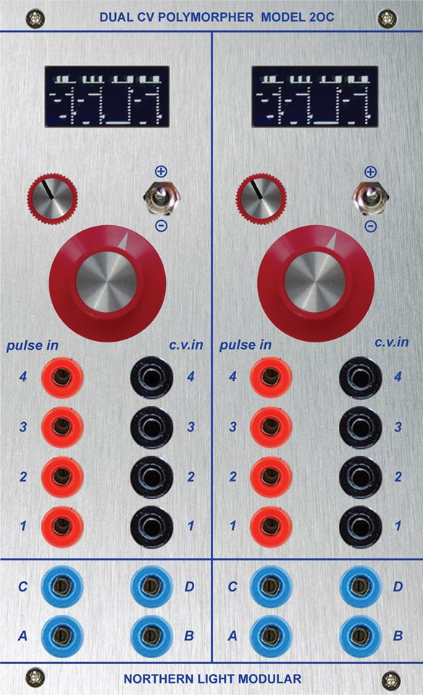
Why O&C?
Amazing synthesizer utility module
We wanted to build some of our own -
so we're here to tell you about this DIY module, why you might want it,
how to build or obtain one, and what
we have learned so far...
The O&C software is open,
you can change it to do what you want!
Image Courtesy of : Northern Light Modular

Slide 9
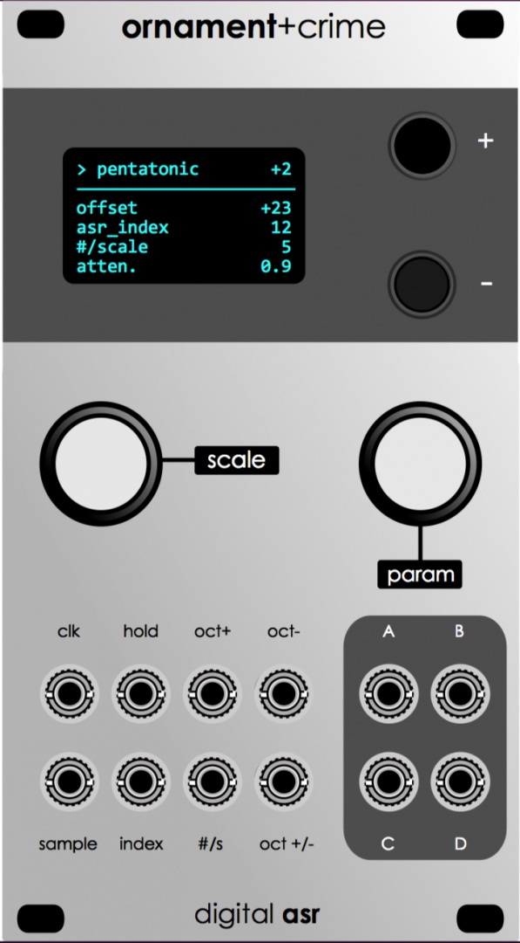
How to get O&C?
Download from http://ornament-and-cri.me
Kits are available from several sources
(details later on)
Kits require surface mount soldering skill
(not for the casual builder)
A few outlets sell assembled modules,
sending a royalty back to the designers
We build our own – there are different models to choose from :
http://ornament-and-cri.me

Slide 10
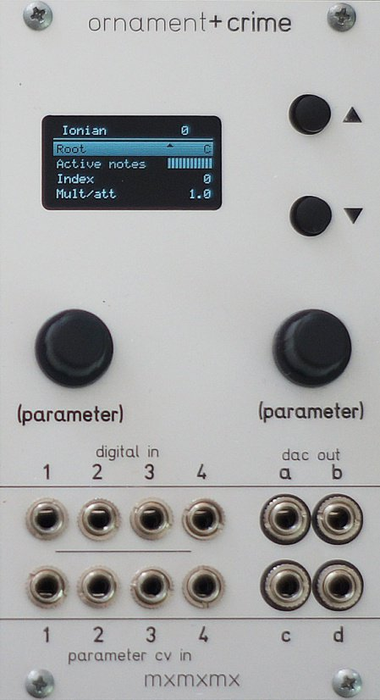
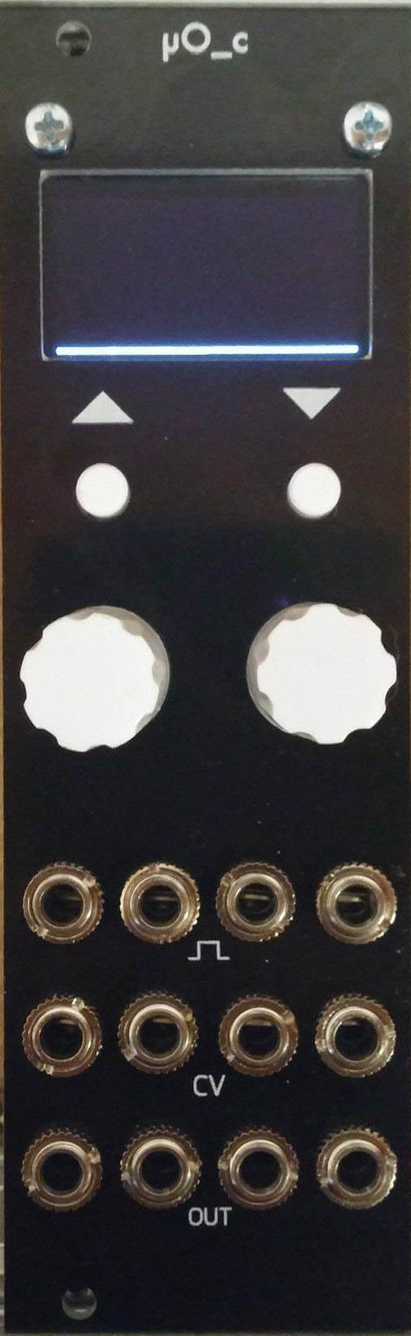
Original vs micro O&C
12 HP vs more compact 8 HP
More intuitive arrangement of jacks
http://ornament-and-cri.me

Slide 11
O&C Basic Design
(Microprocessor)
EN1
Knobs/Buttons
EN2
OLED Display
TR1
TR2
Trigger Inputs
TR3
SPI
TR4
CV1
DAC (X4)
A
CV2
CV Inputs
B
CV Outputs
CV3
C
CV4
D
Teensy3.2
(by PJRC)
O&C Design by mxmxmx
http://ornament-and-cri.me

Slide 12
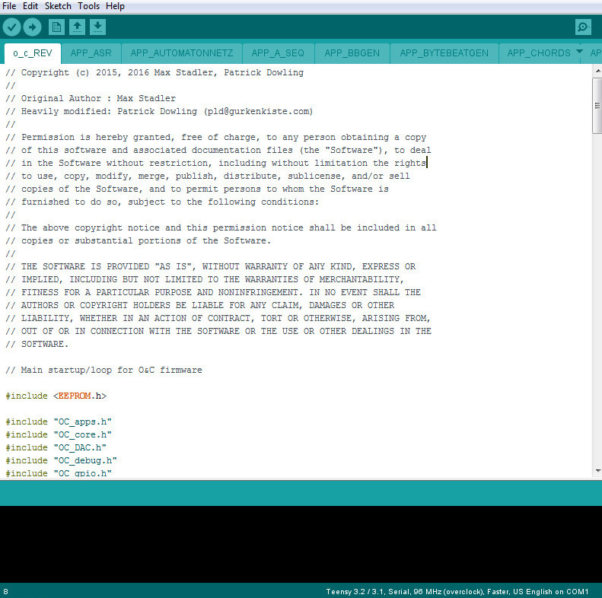
Open Source Firmware
http://ornament-and-cri.me

Slide 13
O&C Modes
The original o_C module was designed to perform a single function: a digital, quantizing version of the classic analogue shift register (ASR)
Now named CopierMaschine, it is an enhanced version of the original quantizing digital emulation of a four stage analogue shift register (ASR)
Many other modes have been added, like quantizers, sequencers, LFOs, random/chaotic CV generators, and more. These modes are selectable on-the-fly, without having to reboot the module or toggle the power.
http://ornament-and-cri.me

Slide 14
O&C General Operation:
Right Encoder Knob scrolls the list of settings
push/click the right encoder knob
to modify the selected setting
Left Encoder Knob changes the channel
in multiple channel modes
Buttons: Operation varies with mode, but they usually halve/double/transpose the current frequency
Screen Saver: Long press on the Up button
http://ornament-and-cri.me

Slide 15
Saving Settings
Long press right encoder, goes to mode menu
Long press right encoder again :
until dot appears next to the mode
This saves the settings for all the modes,
not just the one currently selected
Settings saved in the EEPROM (permanent)
http://ornament-and-cri.me

Slide 16
CopierMaschine
ASR mode is a four-stage sample-and-hold module. Feed a pulse into the left-most Trigger input (TR1),
along with a CV signal (from a LFO, ADSR, etc.)
into the left-most CV input (CV1)
When triggered (TR1) by the clock, the four outputs will be updated; the current sample (CV1) will be present at output A, the previous samples shifted down the remaining outputs :
(S(0)->A, S(-1) > B, S(-2) > C, S(-3) > D)
http://ornament-and-cri.me

Slide 17
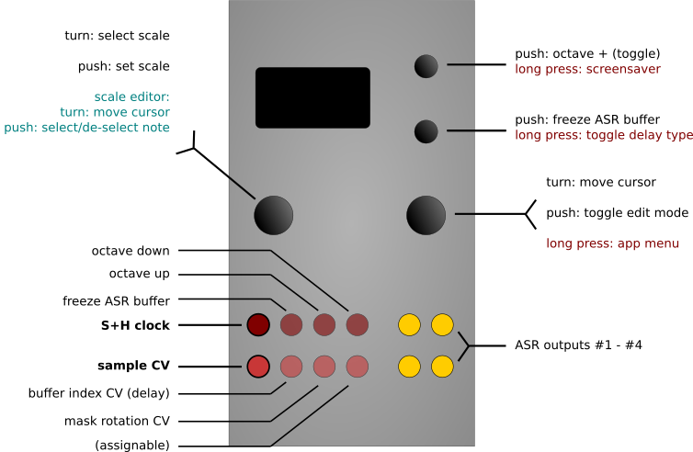
CopierMaschine
http://ornament-and-cri.me

Slide 18
CopierMaschine
I/O Function
TR1 Clock input
TR2 Hold ( = freeze ring buffer)
TR3 Transpose: Octave up, when high
TR4 Transpose: Octave down, when high (overridden by TR3)
CV1 Sample in
CV2 Index: ring buffer index (= “delay”)
CV3 Mask: rotate scale mask
CV4 assignable: octave, root, transpose
(by scale-degrees), buffer-length, or CV input scaling
A, B, C, D Analog Shift Register Outputs 1-4
http://ornament-and-cri.me

Slide 19
CopierMaschine
In addition to acting as a sampling shift register,
CopierMaschine can also Quantize those samples,
enforcing a traditional (or custom) scale, and
masking some of those notes if desired.
CopierMaschine allow CV control of those note masks
for more flexibility
The triggers can also come from other modes,
such as the internal sequencers, for even more fun!
http://ornament-and-cri.me

Slide 20
Harrington 1200
Neo-Riemannian transformation mode for generating triad (three note chord) progressions with the following basic (atomic) tranformations :
P (Parallel): Moves the third up or down a semitone,
thus P(Cmaj) = Cmin, P(Cmin) = Cmaj.
L (Leittonwechsel): Converts a major triad to a minor by shifting the root down a semitone and making the third the root, or from minor to major by moving the fifth up a semitone to become the root.
R (Relative): Converts a major triad to its relative minor, or a minor triad to its relative major.
http://ornament-and-cri.me

Slide 21
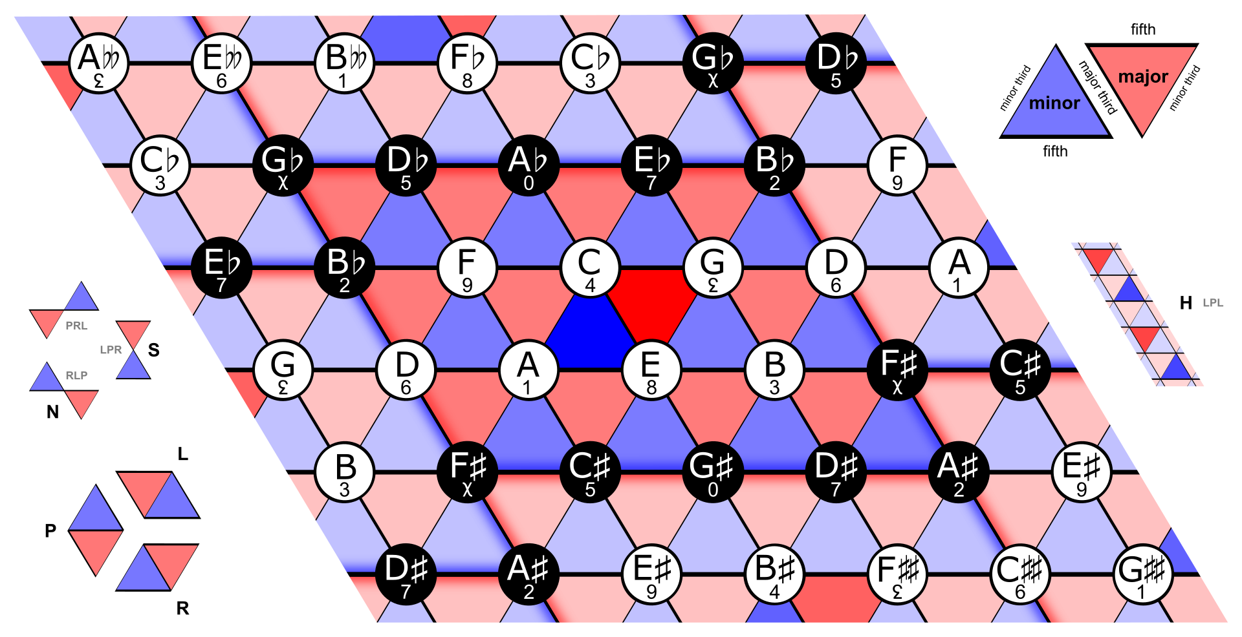
Pitches in the Tonnetz
The Riemannian Tonnetz is a planar array of pitches along three axes,
corresponding to the three consonant intervals.
Major and minor triads are represented by triangles
which tile the plane of the Tonnetz.
http://wikipedia.com

Slide 22
Harrington 1200
Or Secondary Transformations :
N (Nebenverwandt): Exchanges a major triad for its minor subdominant, and a minor triad for its major dominant (e.g. C major and F minor). The “N” transformation is the same as applying R, L, and P successively.
S (Slide): Exchanges two triads that share a third (e.g. C major and C♯ minor); it is the same as applying L, P, and R successively, in that order.
H (Hexatonic): Exchanges a triad for its hexatonic pole (e.g. C major and A♭ minor); it is the same as applying L, P and L transformations successively.
http://ornament-and-cri.me

Slide 23
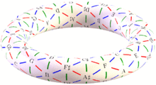
Harrington 1200
Neo-Riemannian theory typically assumes
enharmonic equivalence [G(sharp)= A(flat)]
which wraps the planar graph into a torus
http://wikipedia.com

Slide 24
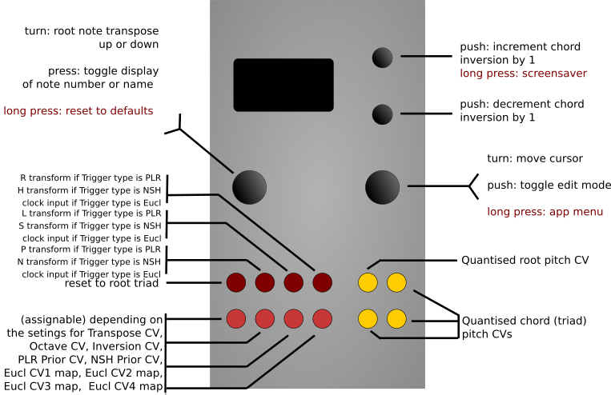
Harrington 1200
http://ornament-and-cri.me

Slide 25
Harrington 1200
I/O Function
TR1 Reset to root triad
TR2 P transform , or N transform, or clock input
TR3 L transform, or S transform, or clock input
TR4 R transform , or H transform , or clock input
CV1 Mapped according to Transpose CV, Octave CV, Inversion CV, etc.
each CV input can be used for multiple internal destinations.
CV2 Ditto
CV3 Ditto
CV4 Ditto
A Quantized root
B, C, D Transformed & inverted triad (also quantized)
http://ornament-and-cri.me

Slide 26
Automatonnetz
This mode also uses the neo-Riemannian transformations (Harrington 1200), but with the sequence of transformations determined by navigating a 5x5 “vector sequencer” grid
On each clock input the dx (delta x) and dy (delta y) values are added to the current position on the grid to determine the next active cell. The position simply wraps around when it reaches the edge of the grid, allowing“backwards” motion
The position and movement can also be fractional, allowing for clock divisions and many different patterns
http://ornament-and-cri.me

Slide 27
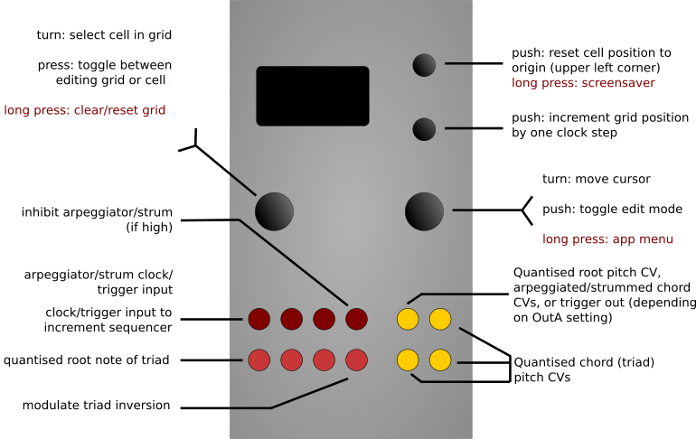
Automatonnetz
http://ornament-and-cri.me

Slide 28
Quantermain
A four channel quantizer, Quantermain integrates the quantizer from the Mutable Instruments Braids module
Quantermain expands it with interactive scale-edit functionalities, supporting 99 different pre-defined scales”
and four fully user-definable scales
Each scale with a maximum of 16 notes per octave and additional finetune and microtonal editing options
The four channels are fully independent, but can be slaved to the same clock and/or track the same CV sources,
http://ornament-and-cri.me

Slide 29
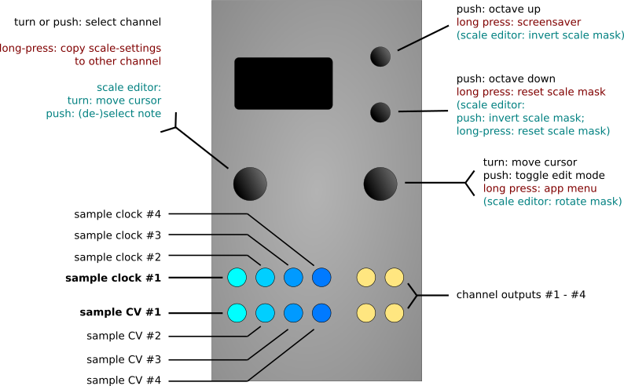
Quantermain
http://ornament-and-cri.me

Slide 30
MetaQ
Meta-Q is a dual-channel quantizer that’s similar to Quantermain, but two channels with more scale options
It has fewer internal CV sources (currently, only LFSR)
but comes with four ‘scale slots’ per channel, which is a package of scale, mask, root and transpose values
‘scale slots’ can be sequenced to provide a lot of additional, structured variation to the input CV sequences
(or the LFSR internal CV source)
http://ornament-and-cri.me

Slide 31
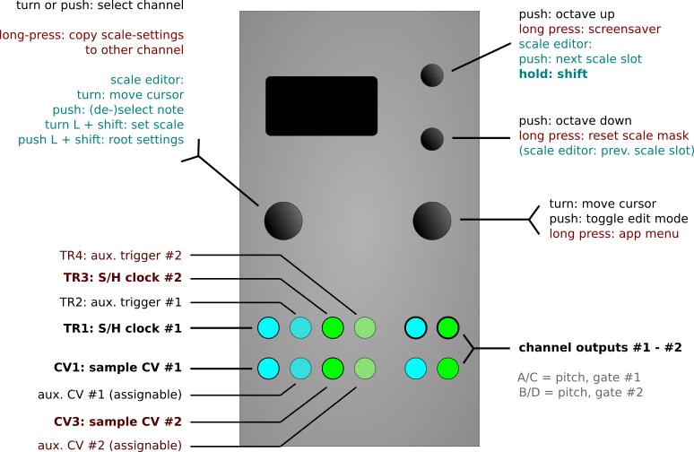
MetaQ
http://ornament-and-cri.me

Slide 32

Quadraturia
Quadraturia is Quadrature Low Frequency Oscillator (QLFO) previously available as the “Easter egg” in the Mutable Instruments Frames module
Quadraturia supports CV control of QLFO frequency
Quadraturia adds CV control over additional LFO parameters
like Wavetable Waveshape, Phase Spread, and Level
http://ornament-and-cri.me

Slide 33
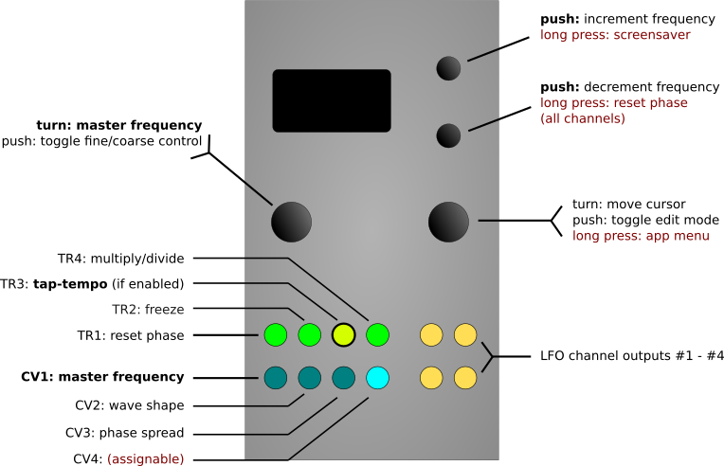
Quadraturia
http://ornament-and-cri.me

Slide 34
Quadraturia
Quadraturia adds “predictive” tap-tempo capability from the Tap LFO mode in the Mutable Peaks module. This allows the period of the LFO waveform output on channel A to be locked to the period of “taps” or pulses input on TR3. This will synchronize to both regular clock inputs as well as regular rhythms with unequal spacing of the taps.
The frequency/period of the output on channels B, C and D will be the same as channel A if the frequency ratio setting for those channels is 1.0 (unity). Otherwise, it will be some multiple or division of the channel A frequency. In other words, the frequency ratio settings for channels B, C and D are honoured in tap tempo mode as well as in normal mode.
http://ornament-and-cri.me

Slide 35
Low-Rents
Low-rents is a port of the Lorenz attractor modulation generator from the “Easter egg” in the Mutable Instruments Streams module, to which Rössler attractors have been added.
Two independent function generators are provided, with each generator calculating both the Lorenz and Rössler functions simultaneously, using the same phase accumulator, but with the rate/speed of each generator independently settable.
Both the Lorenz and the Rössler functions output three values (x, y & z), and various combinations of these can be mapped to the four output channels. The chaotic strange attractors work best as slow modulation functions.
http://ornament-and-cri.me

Slide 36

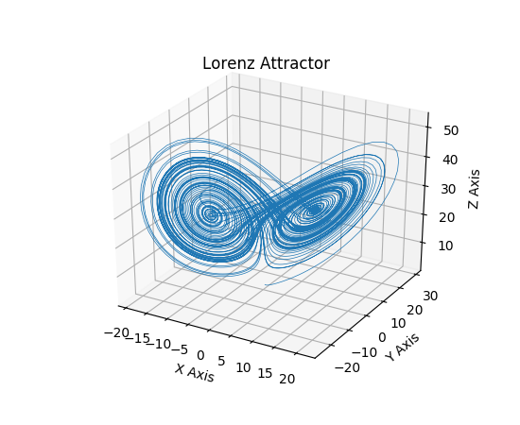
Low-Rents
http://wikipedia.com

Slide 37
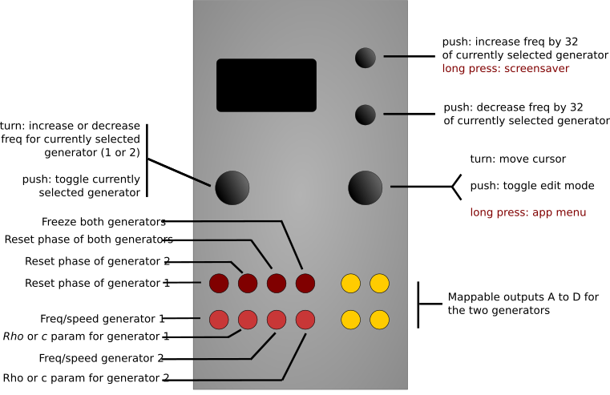
Low-Rents
http://ornament-and-cri.me

Slide 38
Piqued
Piqued is a a port of the envelope generator function from the open-source Mutable Instruments Peaks module
Piqued provides four independently triggered envelopes on output channels A,B,C,and D; with independently mappable voltage-control inputs CV1 to CV4
Piqued provides CV control over envelope duration and/or other parameters for each segment of each envelope.
Segment shape (curves) can be set for each segment of each of the four envelopes
“Euclidean trigger filter” mode turns Piqued into a quad-channel Euclidean poly-rhythm generator, that can output envelopes
http://ornament-and-cri.me

Slide 39
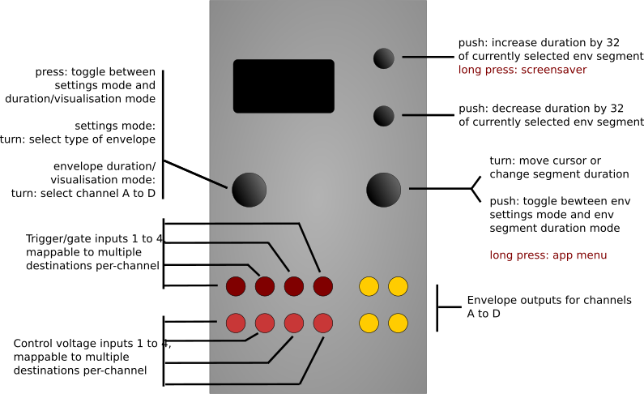
Piqued
http://ornament-and-cri.me

Slide 40
Sequins
Sequins is a basic, dual-channel sequencer
Sequins provides four 16-step sequences per channel,
and CV-control over various channel parameters, including scale mask, octave, pulse width, and clock multiplication
Sequins allows four sequences to be chained in various ways, providing sequences from 4 to up to 64 notes
Sequins data is stored along with the other settings (whenever settings are saved in EEPROM)
http://ornament-and-cri.me

Slide 41
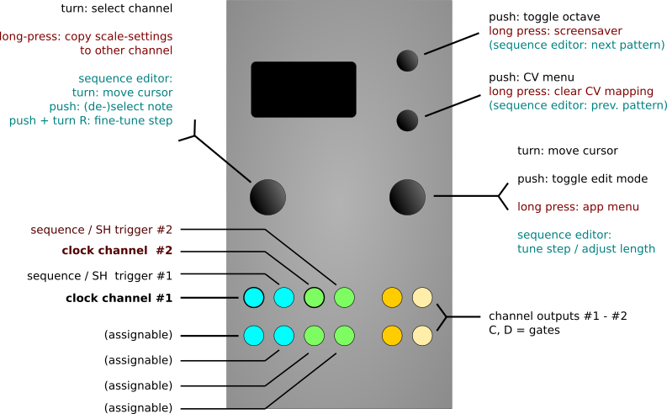
Sequins
http://ornament-and-cri.me

Slide 42
Sequins
When identical sequences are set up on both sequencer channels, and the same clock input is used to drive both channels, then Steve Reich “Piano Phase” type effects can be acheived by setting the mult/div setting for one channel to, say, /32 (divide by 32), and to /31 on the other channel, and then using a fast clock
The two sequences will slowly move out of phase. By varying the division up and done in one channel, the two sequences can be moved in and out of phase as required.
http://ornament-and-cri.me

Slide 43
Dialectic Ping Pong
Dialectic Ping Pong is a port of the bouncing ball envelope generators from the Dead Man’s Catch alternative firmware for the Mutable Instruments Peaks module
These generators implement a simple but effective simulation of the physics of a ball that is thrown into the air with a certain velocity, from a certain height, and which then returns to Earth (or a planet of your choice) under the influence of (configurable) gravity, and then bounces (with a settable “bounce loss” simulating how hard the ball is pumped up, if it is a basketball), before being pulled back to Earth and bouncing again, and so on.
http://ornament-and-cri.me

Slide 44
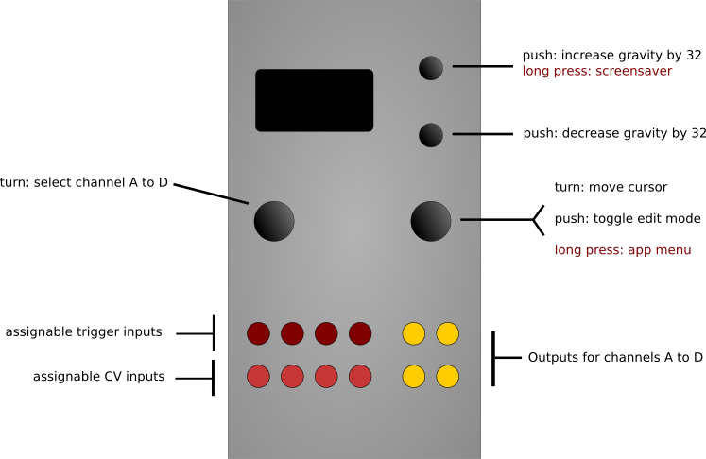
Dialectic Ping Pong
http://ornament-and-cri.me

Slide 45
Viznutcracker, sweet!
An experimental implementation of several bytebeats
signal generators. bytebeats are equations (I.e. recursive functions), expressed usually as a single line of program code, typically involving various bit-level operators, which when evaluated with an incrementing phase value at audio rates produce all manner of harsh digital noises, some of which sound musical, or perhaps, interesting.
bytebeats were first described in 2011 by Ville-Matias Heikkiläviznut (viznut)
http://ornament-and-cri.me

Slide 46
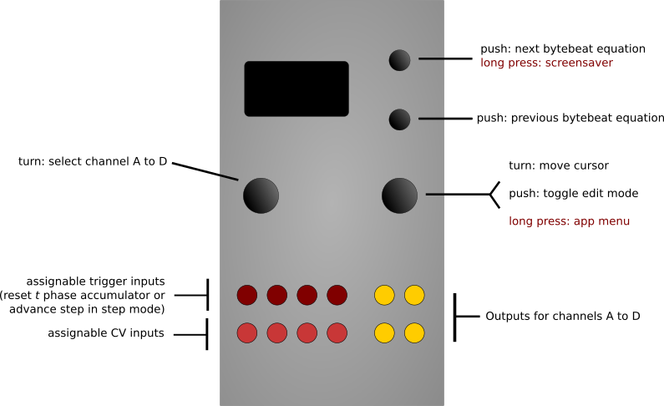
Viznutcracker
http://ornament-and-cri.me

Slide 47
Viznutcracker
Perhaps uniquely amongst byte beat generator modules, the Viznutcracker, sweet! apps permits the byte beat generators to be run at very slow rates, and because the o_C module outputs are DC-coupled, they can therefore be used as sources of stepped control voltages. For example, the outputs can be fed into a quantiser (such as another o_C module) to create potentially interesting pitch sequences (possibly even melodies…). Furthermore, the app allows each byte beat equation to be incremented by an external clock/trigger input, so that these stepped voltages can be generated in synchrony with other external processes.
http://ornament-and-cri.me

Slide 48
Acid Curds
Acid Curds is a basic chord sequencer
Acid Curds provides four 8-step chord progressions
and CV-control over various parameters, including chord type, progression length, direction, voicing, inversion, and more
Acid Curds four chord progressions can be chained in various ways, providing progressions from 1 to up to 32 chords
Acid Curds chords/sequence data is stored along with the other settings (whenever settings are saved in EEPROM)
http://ornament-and-cri.me

Slide 49
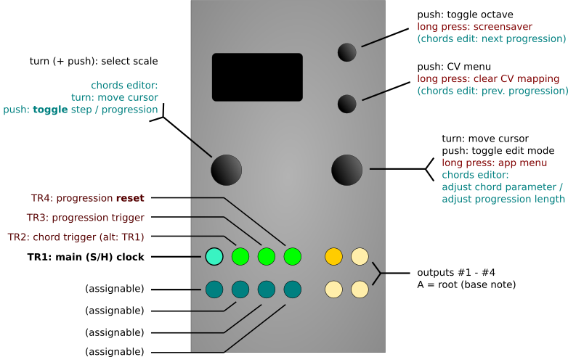
Acid Curds
http://ornament-and-cri.me

Slide 50
Acid Curds
Acid Curds can be used as either a basic quantizer / sample-and-hold type thing, in which case the chords will be formed on the basis of the incoming root CV, or it can be used as a step-sequencer, in which case the chord base-notes and chord properties will be fixed notes (chosen from a given scale) respectively features (inversion, voicing, etc); it’s also possible to combine sequencer and S+H type behaviors.
http://ornament-and-cri.me

Slide 51
References
References mode is a tuning-utility
References comes with a frequency/BPM meter
(via the TR4 input, or TR1 in upside-down mode)
References supports a closed-loop calibration mode
References supports fixed reference output voltages.
These are useful when calibrating other modules,
such as VCOs, or V/O Filters, etc.
http://ornament-and-cri.me

Slide 52
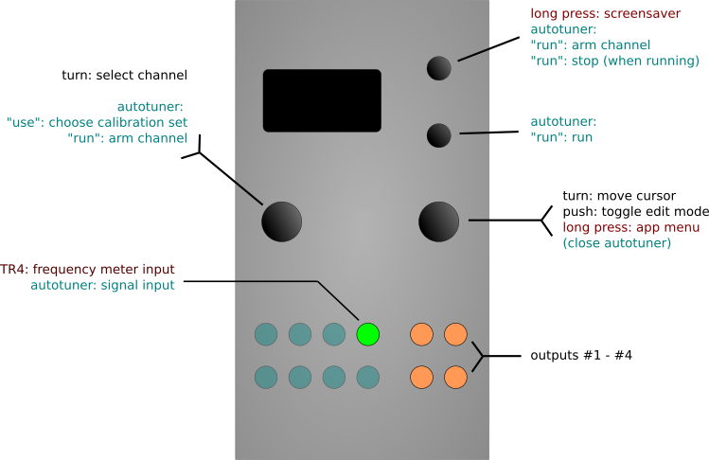
References
http://ornament-and-cri.me

Slide 53
More Online...
Full manual at http://ornament-and-cri.me
(this is just an overview...)
Many good videos at :
VCL (Voltage Control Labs)
DivKid
mylarmelodies
Others...
http://ornament-and-cri.me

Slide 54
Questions/Workshop
Questions?
Workshop -
We have several O&C units built up in racks
These are paired with our new Miasma dual CEM3340 VCOs
Several other basic voice modules (VCO, VCF, VCA, etc.)
We'll do some basic polyphonic and sequencer patches
If you don't understand something, please ask …

Slide 55
Summing Up
Thanks to Modular8 for Hosting!
We brought several O&C demo units
There is more information at :
http://ornament-and-cri.me/
Please sign up on our mailing list for new Workshops
HalcyonModular.com

Slide 56
Thank You!
Tom Moxon
Justin Patrizi
Notes:
http://www.halcyonmodular.com

