Slide 1
Final Year Project
Presentation

Slide 2
Supervisor
Group Members
Dr. Mohammad Nauman
Gohar Nayab (p15-6022)
Ahmad Awan (p15-6026)
Faisal Khan (p15-6058)

Slide 3
Hexapedal Robot Multi Joint Movement using Reinforcement Learning

Slide 4
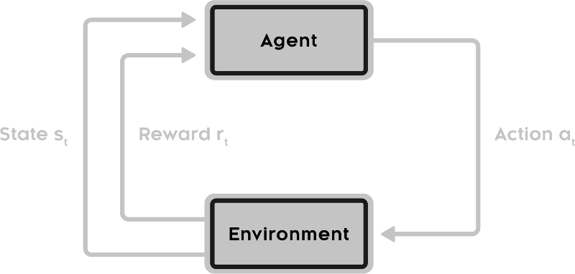
Reinforcement Learning
Based on human psychology.
Concerned with agent and its action.
Reward given after action.
Objective is to find optimal actions to maximize long term expected reward.

Slide 5
Terms
State: S
Model: T(s, a, s`) ≈ P(s` | s, a)
Action: A(s)
Reward: R(s), R(s, a), R(s, a, s`)
Policy: 𝞹(s) → a
Value: V(s)
Q-value: Q(s, a)
Given State S₀ and Action A₀, we will get State S₁ and Reward R₁.

Slide 6
Grid World
A grid with different states.
Value function gives a numerical value to a state.
Q-value function tells how good an action is.
Policy decides which action to take.
Value or Q-value can be used to represent policy.
V(s) = E [R]
R = ∑ₜ₌₀ 𝛄ᵗ rₜ
0.81 | 0.9 | 1 | +1.00
0.73 |  | 0.9 | -1.00
0.66 | 0.73 | 0.81 | 0.73

Slide 7
Bellman Equation
Named after Richard E. Bellman.
Used in optimal control theory.
Writes the value of a decision problem at a certain time.
V(𝒙₀) = maxₐ₀ ( f(𝒙₀, a₀) + 𝛃 V(𝒙₁) )
This equation can be written as
V(s) = maxₐ ( R(s, a) + 𝛄V(s`) )

Slide 8
Value Iteration
Following can be used for value iteration i.e. telling how good each state is.
V ⃰(s) = maxₐ ( R(s, a) + 𝛄 V(s`) ) for optimal value
Initialize V(s) = 0 ∀ S
Keep 𝛄 = 0.9
0 | 0 | 0 | +1.00
0 |  | 0 | -1.00
0 | 0 | 0 | 0

Slide 9
V(s) = max( (1 + 0.9(0)), (0 + 0.9(0)), (0 + 0.9(0)))
V(s) = max( 1, 0, 0)
V(s) = 1`
0 | 0 | 0 | +1.00
0 |  | 0 | -1.00
0 | 0 | 0 | 0
0 | 0 | 1 | +1.00
0 |  | 0 | -1.00
0 | 0 | 0 | 0

Slide 10
V(s) = max( (-1 + 0.9(0)), (0 + 0.9(1)), (0 + 0.9(0)))
V(s) = max( -1, 0.9, 0)
V(s) = 0.9
0 | 0 | 1 | +1.00
0 |  | 0 | -1.00
0 | 0 | 0 | 0
0 | 0 | 1 | +1.00
0 |  | 0.9 | -1.00
0 | 0 | 0 | 0

Slide 11
V(s) = max( (0 + 0.9(0)), (0 + 0.9(1)), (0 + 0.9(0)))
V(s) = max( 0, 0.9, 0)
V(s) = 0.9
0 | 0 | 1 | +1.00
0 |  | 0.9 | -1.00
0 | 0 | 0 | 0
0 | 0.9 | 1 | +1.00
0 |  | 0.9 | -1.00
0 | 0 | 0 | 0

Slide 12
Policy Iteration
Following can be used for policy iteration i.e. which action to take.
V ℼ(s) = arg maxₐ ( R(s, a) + 𝛄 V(s`) ) for optimal policy
Initialize V(s) = 0 and V ℼ(s) = None ∀ S
Keep 𝛄 = 0.9

Slide 13
V(s) = arg max( (1 + 0.9(0)), (0 + 0.9(0)), (0 + 0.9(0)))
V(s) = arg max( 1, 0, 0)
V(s) = 0 // Right
0 | 0 | 1 | +1.00
0 |  | 0 | -1.00
0 | 0 | 0 | 0
0 | 0 | → | +1.00
0 |  | 0 | -1.00
0 | 0 | 0 | 0

Slide 14
All values can be changed to policy.
0.81 | 0.9 | 1 | +1.00
0.73 |  | 0.9 | -1.00
0.66 | 0.73 | 0.81 | 0.73
→ | → | → | +1.00
↑ |  | ↑ | -1.00
↑ | → | ↑ | ←

Slide 15
Our Problem formulation
Actions:
For each state we had 18 action
Leg1:- 'Leg1_up','Leg1_down','Leg1_forw',
Leg2:- 'Leg2_up','Leg2_down','Leg2_forw',
Leg3:- 'Leg3_up','Leg3_down','Leg3_forw',
Leg4:- 'Leg4_up','Leg4_down','Leg4_forw',
Leg5:- 'Leg5_up','Leg5_down','Leg5_forw',
Leg6:- 'Leg6_up','Leg6_down','Leg6_forw'

Slide 16
State space:
(18x18x18x18x18x18) = 34,012,224
Reward:
Distance in X-axis direction.
Collision of leg with ground.
Height from the floor.

Slide 17
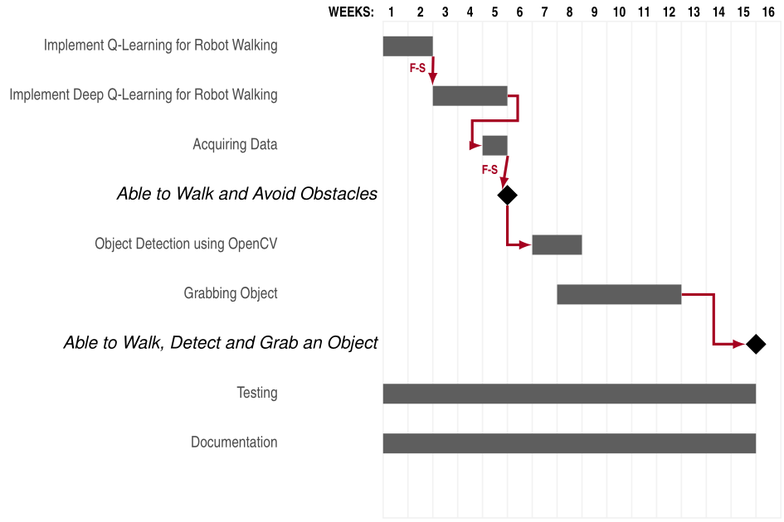
Gantt Chart

