Slide 1
Computer Organization and Assembly Language Programming
Lecture-1

Slide 2
Course Introduction
This course is design to understand the basics organization of computers and assembly language programming.

Slide 3

Basic Computer Organization
Following are the basic components of computer.
  Processor.
  Memory.
  Input / Output Devices.
  Buses.

Slide 4
Basic Computer Organization
Processor
Memory
I/O

Slide 5
Basic Computer Organization
Processor: Used to perform operations.
Memory: Used to store instructions and data.
Input / Output: Used to provide input and output.
Buses: Used to carry data.

Slide 6
Basic Computer Organization
Processor
Operation
Memory Data

Slide 7
Memory
Memory is use to store data.
Memory contains memory cells to store data.
Memory cells also known as word.
Word is a combination of 1 or more bytes that is handled as a single unit.
These memory cells are arranged in rows and columns.
Each memory cell is identified by the unique address in memory.

Slide 8
Dimensions of Memory
Horizontal Dimensions = Width of Memory Cell
00000000
A(01000001)
Vertical Dimensions
=
Size of
Memory
00000001
Binary
Addresses
Of
Memory
Cells
00100011
00100100
00100101

Slide 9
Buses
Carries data from processor to memory and vice versa.
We have three types of buses.
  Address Buses.
  Data Buses.
  Control Buses.

Slide 10
Address Buses
These buses are used to carry the address of the memory location from processor to memory.
These buses are unidirectional.
Address always travel from processor to memory.

Slide 11
Data Bus
Data bus carries data between the devices.
It is bidirectional bus.
Data travels from memory to processor and processor to memory in both directions.

Slide 12
Control Bus
Control bus carries control signal (Interrupts).
This bus is also bidirectional.
This bus carries control signals to control the devices.

Slide 13
Basic Computer Organization
Processor
Address Bus
Memory
Data Bus
Control Bus

Slide 14
Basic Computer Organization
Processor
Memory
Control Bus

Slide 15
Basic Computer Organization
REGISTERS

Slide 16
Registers
Registers are temporary memory locations.
It is read write memory.
It is volatile memory.
It is the fastest memory available.
Limited in sizes.
Directly attach to ALU.

Slide 17
Registers
We have two types of registers.
General Purpose Registers.
Specific Purpose Registers.

Slide 18
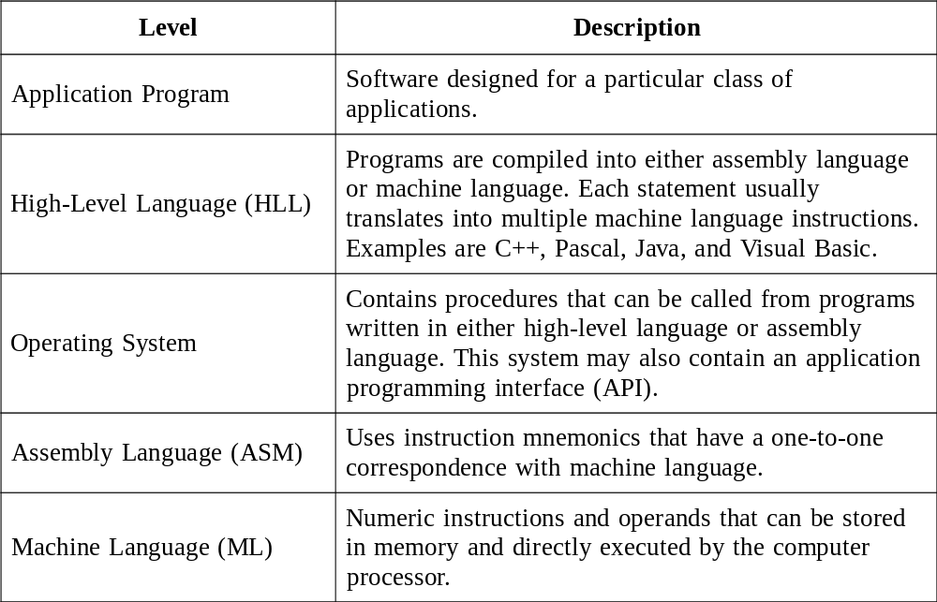
Table 1. Software Hierarchy Levels.

Slide 19
Essential Tools
An assembler is a program that converts source-code programs into a machine language (object file).
A linker joins together two or more object files and produces a single executable file.
A debugger loads an executable program, displays the source code, and lets the programmer step through the program one instruction at a time, and display and modify memory.

Slide 20
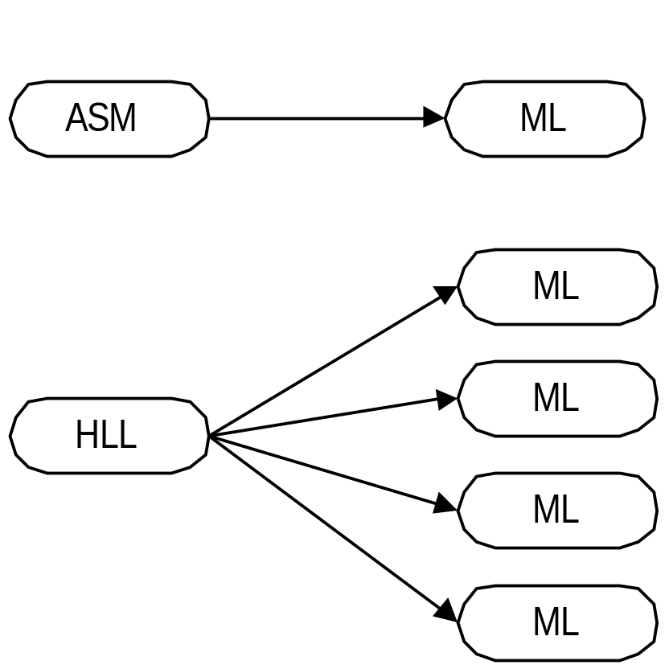
Figure 1. Machine Language Generation by ASM and HLL programs.

Slide 21
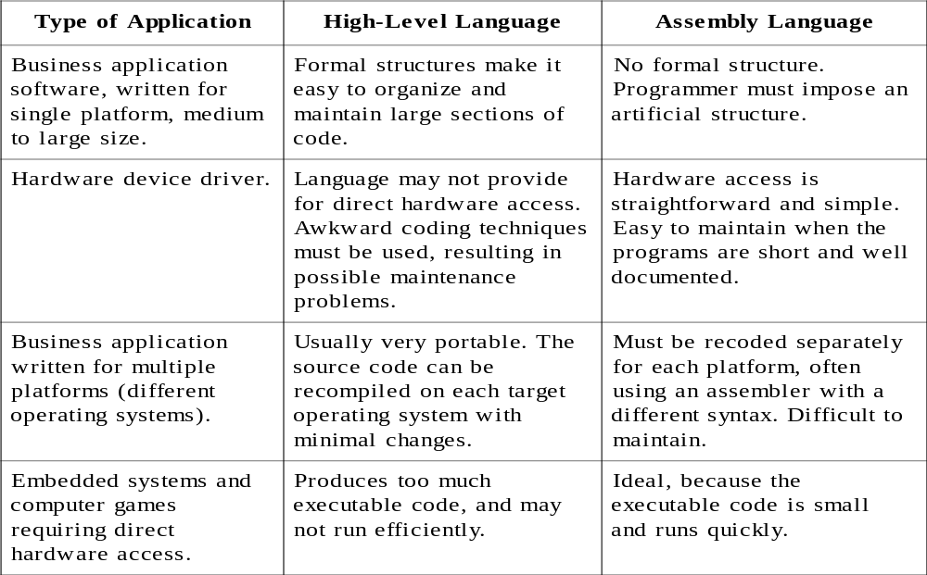
Table 2. Comparison of Assembly Language to HLLs.

Slide 22
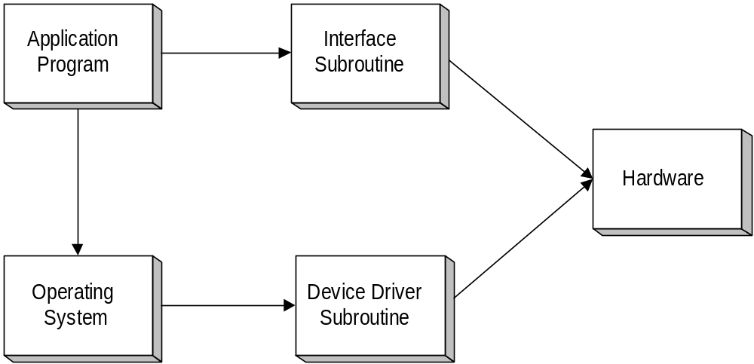
Figure 2. Assembly Language Subroutines Used as Hardware Interfaces.

Slide 23
Machine Language
Consists of binary numbers
The "native" language of the computer
Each ML instruction contains an op code (operation code) and zero or more operands.
Examples:
Opcode Operand Meaning
-------------------------------------------------
40 increment the AX register
05 0005 add 0005 to AX

Slide 24
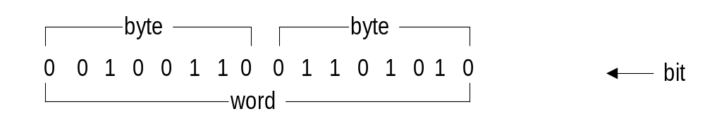
Page 7: Bits, Bytes, and Doublewords:
Each 1 or 0 is called a bit.

Slide 25
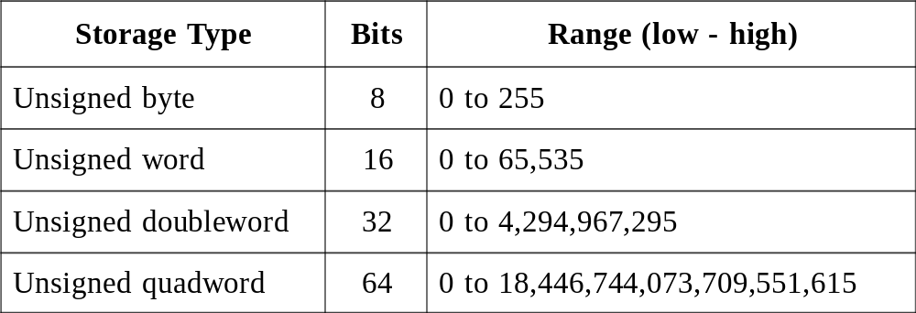
  Table 3. Storage Sizes and Ranges of Unsigned Integers.

Slide 26
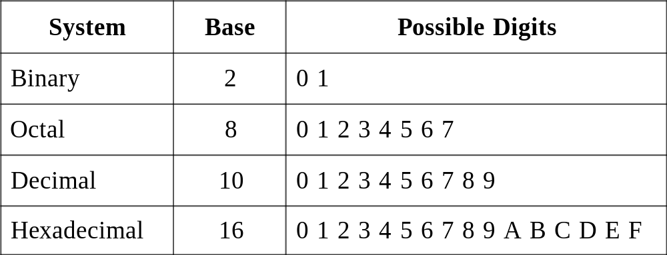
  Table 4. Digits in Various Number Systems.

Slide 27
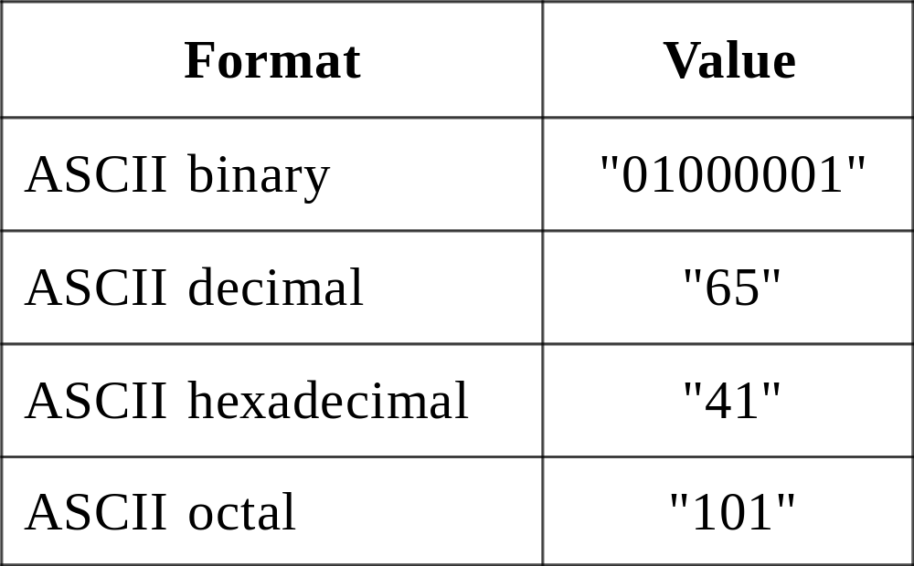
Page 9. ASCII Digit String.

Slide 28
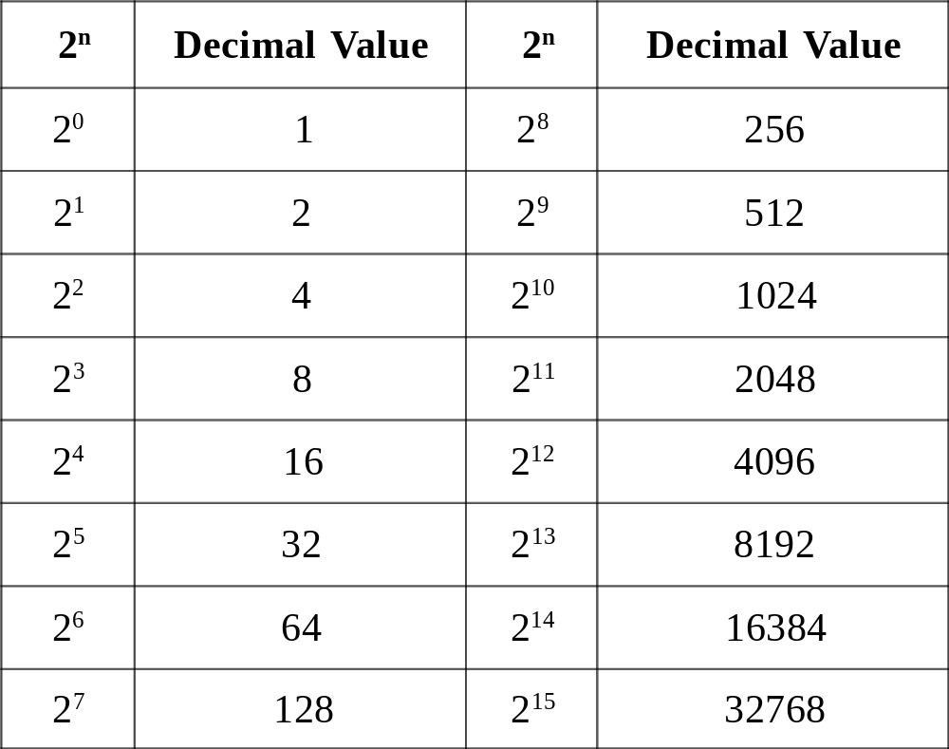
  Table 5. Binary Bit Position Values.

Slide 29
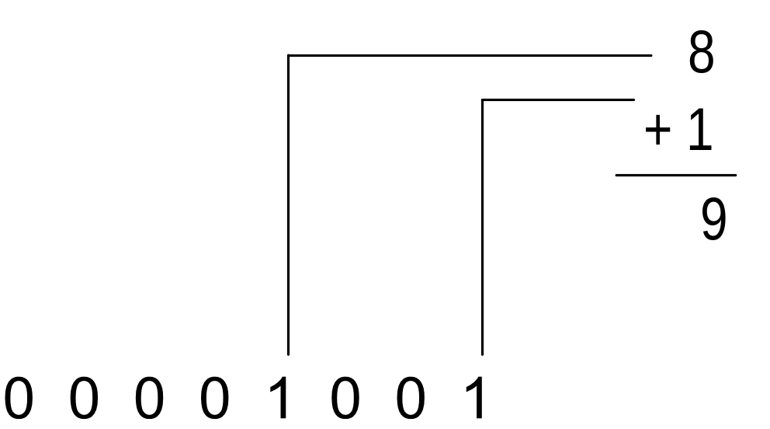
Figure 3. Converting Binary to Decimal.

Slide 30
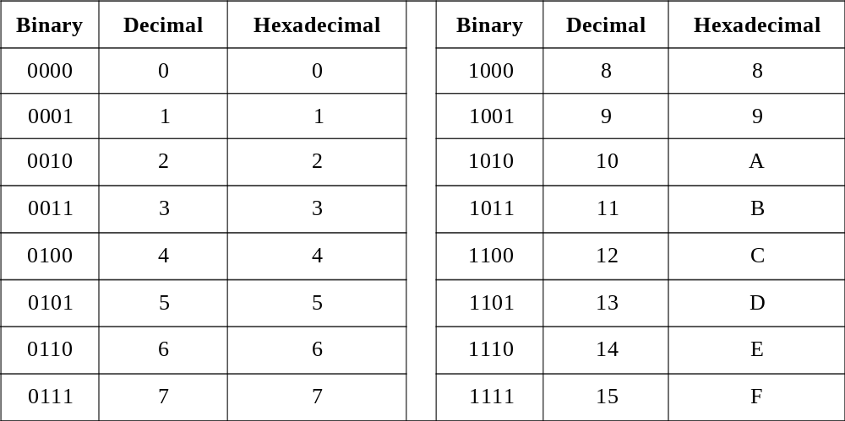
  Table 6. Binary, Decimal, and Hexadecimal Equivalents.

Slide 31
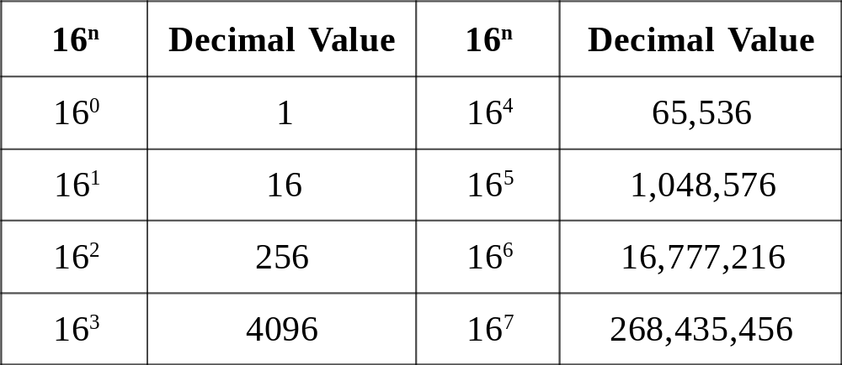
  Table 7. Powers of 16, in Decimal.

Slide 32
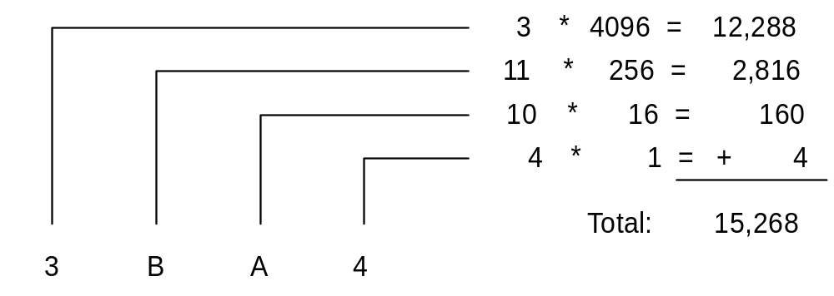
Figure 4. Converting 3BA4 Hexadecimal to Decimal.

Slide 33
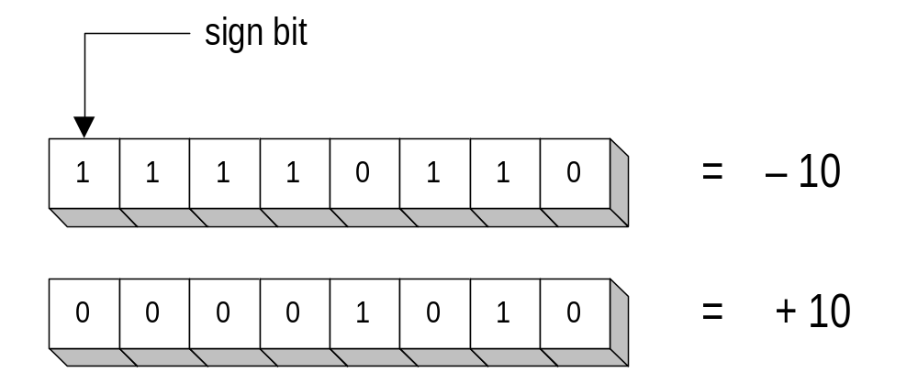
1.2.4 Signed Numbers

Slide 34
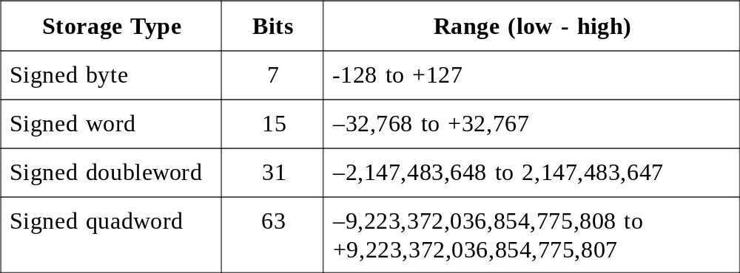
Table 8. Signed Integer Storage and Ranges.

Slide 35
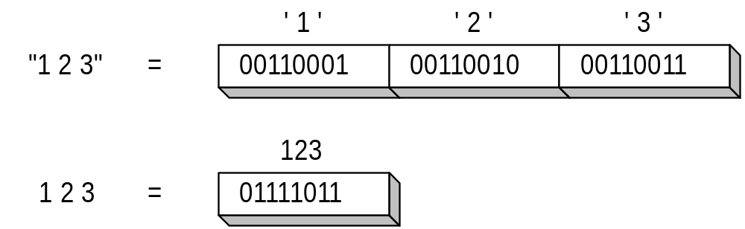
1.2.5 Character Storage
Page 14. ASCII Representation of 123:

Slide 36
1.3 Introducing Assembly Language
An instruction is a symbolic representation of a single machine instruction
Consists of:
  label always optional
  mnemonic always required
  operand(s) required by some instructions
  comment always optional
Examples:
start: mov ax,20 ; initialize the AX register
inc bx ; increment the BX register
stc ; set the Carry flag

Slide 37
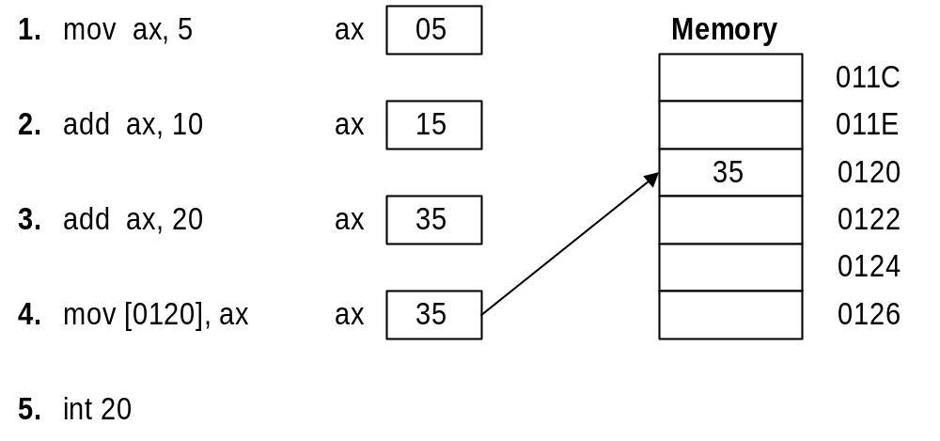
Figure 5. Sample Program Written in Debug.

Slide 38

The End

