Slide 1
Lecture 2
Growth of Functions - Asymptotic Notations

Slide 2
Growth of Functions
We can sometimes determine the exact running time of the algorithm, however, the extra precision is not usually worth the effort of computing it.
For large inputs, the multiplicative constants and lower order terms of an exact running time are dominated by the effects of the input size itself.
Instructor:- Mr. Fazl-e-Basit

Slide 3
Things to consider when Analyzing Algorithms
Ignore constants. For example,
  f(n) = 25n²
  or
  f(n) = 25n² + 2000
  f(n) = O (n²)
Ignore small terms
  f(n) = 25n³+ 30n² + 10n
  f(n) = O (n³)
Application Independent
i.e. not dependent on any tool, platform or application.
Instructor:- Mr. Fazl-e-Basit

Slide 4
Asymptotic Performance
In this course, we care most about asymptotic performance. i.e.
  How does the algorithm behave as the problem size gets very large?
    Running time
    Memory/storage requirements
    Bandwidth/power requirements/logic gates/etc.
Instructor:- Mr. Fazl-e-Basit

Slide 5
When we look at the input sizes large enough to make only the order of growth of the running time relevant, we are studying the asymptotic efficiency of the algorithm.
That is we are concerned with how the running time of the algorithm increases with the size of the input in the limit, as the size of the input increases without any bound.
We will study standard methods for simplifying the asymptotic analysis of the algorithm. We will begin with by defining several types of “asymptotic notations” like Theta ( Θ ) Notation, Big-Oh ( O ) Notation and Omega ( Ω ) Notation.
Instructor:- Mr. Fazl-e-Basit

Slide 6
Theta Notation ( Θ )
For a given function g(n), we denote by Θ( g(n) ) the set of functions
Θ( g(n) ) = { f(n) : there exist positive constants c1,c2 and n0 such that
0 ≤ c1.g(n) ≤ f(n) ≤ c2.g(n) for all n ≥ n0 }¹
¹ colon in set means “such that”
Instructor:- Mr. Fazl-e-Basit

Slide 7
A function f(n) belongs to the set Θ( g(n) ) if there exist positive constants c1 and c2 such that it can be sandwiched between c1g(n) and c2g(n) for sufficiently large n.
Since Θ( g(n) ) is a set, we could write
f(n) Є Θ( g(n) ) to indicate that f(n) is a member of Θ( g(n) ). Instead we will usually write
f(n) = Θ( g(n) ).
Є means “belongs to”
Instructor:- Mr. Fazl-e-Basit

Slide 8
C2.g(n)
f(n)
C1.g(n)
f(n) = Θ( g(n) )
n0
n
In the above figure, for all values of n to the right of n0, the value of f(n) lies at or above C1.g(n) and at or below C2.g(n).
In other words, for all n ≥ n0, the function f(n) is equal to g(n) to within constant factor.
We say that g(n) is asymptotic tight bound for f(n).
Instructor:- Mr. Fazl-e-Basit

Slide 9
Lets us justify this intuition by using the formal definition to show that f(n) = n²/2-3n = Θ( n² ).
To do so we must find the constants c1,c2, and n0 such that
c1.n² ≤ n²/2-3n ≤ c2.n²
for all n ≥ n0. dividing by n²
c1 ≤ 1/2-3/n ≤ c2
The right hand side inequality can be made to hold for any value of n ≥ 1 by choosing c2 ≥ ½.
Likewise , the left hand side inequality can be made to hold for any value of n ≥ 7 by choosing c1 ≤ 1/14. Thus, by choosing c1=1/14 , c2=1/2 and
n0 = 7, we can verify that n²/2-3n = Θ( n² ).
Instructor:- Mr. Fazl-e-Basit

Slide 10
In above example, certainly other choices for the constants exist, but the important thing is that some choice exists.
Since any constant is a degree-0 polynomial, we can express any constant function as Θ( n⁰ ) or Θ( 1 ). We shall always use the notation Θ( 1 ) to mean either constant or constant function with respective to some variable.
Instructor:- Mr. Fazl-e-Basit

Slide 11
Big-Oh Notation (O )
When we have only an asymptotic upper bound, we use O – notation. For a given function g(n), we denote by O( g(n) ) the set of functions
O( g(n) ) = { f(n) : there exist positive constants c, and n0 such that
0 ≤ f(n) ≤ c.g(n) for all n ≥ n0 }¹
Instructor:- Mr. Fazl-e-Basit

Slide 12
c.g(n)
f(n)
n0
n
f(n) = O( g(n) )
Instructor:- Mr. Fazl-e-Basit

Slide 13
We write f(n) = O( g(n) ) to indicate that f(n) is a member of the set O( g(n) ).
Note that f(n) = Θ( g(n) ) implies f(n) = O( g(n) ), since Θ notation is stronger notation than O notation. So for quadratic function an²+bn + c, where a>0, is in Θ( n² ) also shows that any quadratic function is in O( n² ).
Instructor:- Mr. Fazl-e-Basit

Slide 14
Omega Notation ( Ω )
Just as O-notation provides an upper bound on a function, Ω notation provides an asymptotic lower bound. For a given function g(n), we denote by Ω( g(n) ) the set of functions
Ω( g(n) ) = { f(n) : there exist positive constants c, and n0 such that
0 ≤ c.g(n) ≤ f(n) for all n ≥ n0 }¹
Instructor:- Mr. Fazl-e-Basit

Slide 15
f(n)
c.g(n)
n0
n
f(n) = Ω( g(n) )
Instructor:- Mr. Fazl-e-Basit

Slide 16
Example:
Objective is to find the maximum of an
unordered set having N elements.
  Input : An unordered list.
  Output : Maximum of input set.
Algorithm
  int Max = 0 //assume S[N] is filled with +ve numbers
  For (int I = 0;I<N;I++)
  {
  If (S[I] > Max)
  Max = S[I]
  }
  cout<< Max
Instructor:- Mr. Fazl-e-Basit

Slide 17
Simple Analysis of previous Algorithm
Instruction No of times Executed cost
1 1 1
2 N N
3 - -
4 N N
5 N N
6 - -
7 1 1
So f(n) = 1 + N + N + N + 1 = 2 + 3N = 3N+2
so f(n) = O (N) or O (n)
Instructor:- Mr. Fazl-e-Basit

Slide 18
NOTE : we always look for worst case of each instruction to be executed while finding Big-Oh (O). (Assume all instructions take unit time in above example).
The worst case running time of an algorithm is an upper bound on the running time for an input.
Knowing it, gives us guarantee that algorithm will never take any longer.
We need not make some educated guess about the running time and hope that it never gets much worse.
Instructor:- Mr. Fazl-e-Basit

Slide 19
Types of Functions
(Bounding Functions )
Constant Function: O ( 1 )
  For example, addition of two numbers will take same for Worst case, Best case and Average case.
Logarithmic Function: O ( log(n) )
Linear Function : O ( n )
O ( n.log(n) )
Quadratic Function : O (n²)
Cubic Function : O ( n³ )
Polynomial Function : O ( n^{k} )
Exponential Function : O ( 2^{n} )
etc…
Instructor:- Mr. Fazl-e-Basit

Slide 20


Some facts about summation
If c is a constant
And
Instructor:- Mr. Fazl-e-Basit

Slide 21
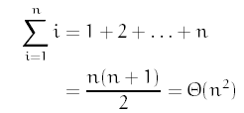
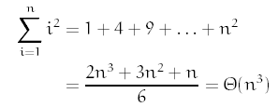
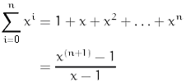
Mathematical Series
If 0 < x < 1 then this is Θ(1), and if x > 1, then this is Θ(x^{n}).
Instructor:- Mr. Fazl-e-Basit

Slide 22
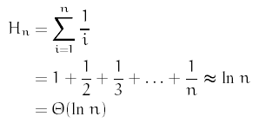
Harmonic series For n ≥ 0
Instructor:- Mr. Fazl-e-Basit

Slide 23
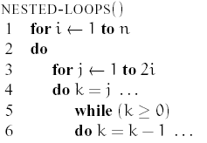
Analysis: A Harder Example
Let us consider a harder example.
How do we analyze the running time of an algorithm that has complex nested loop? The answer is we write out the loops as summations and then solve the summations. To convert loops into summations, we work from inside-out.
Instructor:- Mr. Fazl-e-Basit

Slide 24
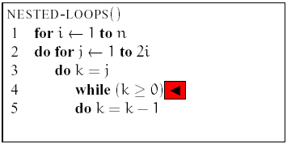

Consider the inner most while loop.
It is executed for k = j, j - 1, j - 2, . . . , 0. Time spent inside the while loop is constant. Let I() be the time spent in the while loop. Thus
Instructor:- Mr. Fazl-e-Basit

Slide 25
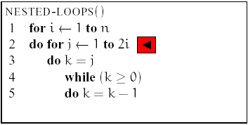
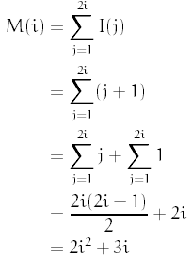
Consider the middle for loop.
Its running time is determined by i. Let M() be the time spent in the for loop:
Instructor:- Mr. Fazl-e-Basit

Slide 26
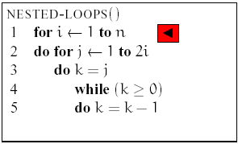
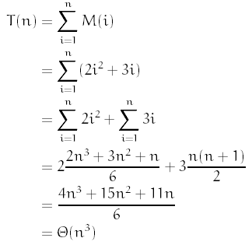
Finally the outer-most for loop.
Let T() be running time of the entire algorithm
Instructor:- Mr. Fazl-e-Basit

Slide 27
Theta Notation ( Θ ) Example
Let f(n) = 8n² + 2n – 3. Let’s show why f(n) is not in some other asymptotic class. First, let’s show that f(n) ≠ Θ (n).
If this were true, we would have had to satisfy both the upper and lower bounds. The lower bound is satisfied because f(n) = 8n² + 2n - 3 does grow at least as fast asymptotically as n.
But the upper bound is false. Upper bounds requires that there exist positive constants c₂ and n₀ such that f(n) ≤ c₂n for all n ≥ n₀.
Instructor:- Mr. Fazl-e-Basit

Slide 28

Informally we know that f(n) = 8n² + 2n – 3 will eventually exceed c₂n no matter how large we make c₂.
To see this, suppose we assume that constants c₂ and n0 did exist such that 8n² + 2n - 3 ≤ c₂n for all n ≥ n₀ since this is true for all sufficiently large n then it must be true in the limit as n tends to infinity. If we divide both sides by n, we have
It is easy to see that in the limit, the left side tends to ∞. So, no matter how large c₂ is, the statement is violated. Thus f(n) ≠ Θ (n).

Slide 29

Let’s show that f(n) ≠ Θ (n³). The idea would be to show that the lower bound f(n) ≥ c₁ n³ for all n ≥ n₀ is violated. (c₁ and n₀ are positive constants). Informally we know this to be true because any cubic function will overtake a quadratic.
If we divide both sides by n³:
The left side tends to 0. The only way to satisfy this is to set c1 = 0. But by hypothesis, c1 is positive. This means that f(n) ≠ Θ (n³).
Instructor:- Mr. Fazl-e-Basit

Slide 30
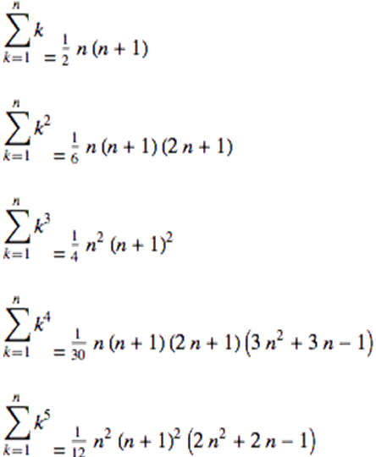
References: Mathematical Series*
* http://mathworld.wolfram.com/PowerSum.html
Instructor:- Mr. Fazl-e-Basit

Slide 31
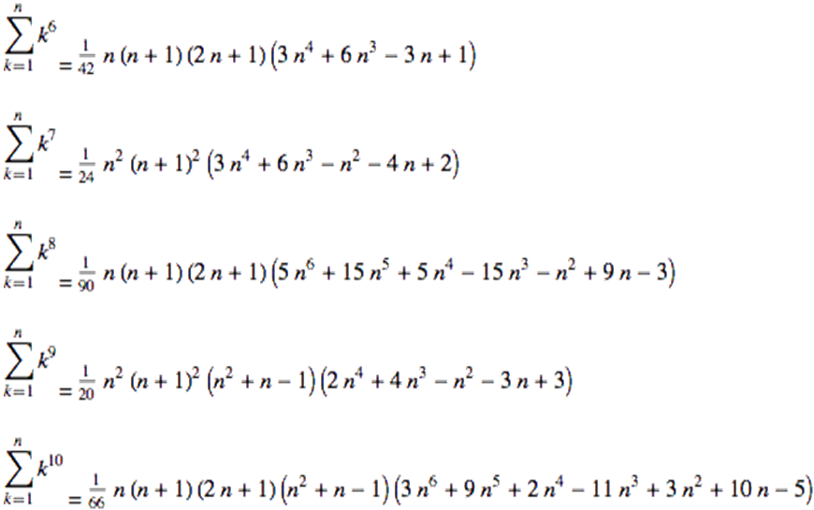
References: Mathematical Series
Instructor:- Mr. Fazl-e-Basit

