Slide 1
In Today’s Lecture
Interaction
Models of Interactionn
Ergonomics
physical aspects of interfaces
industrial interfaces
Common Interaction Styles
command line interface
menus
natural language
question/answer and query dialogue
form-fills and spreadsheets
WIMP Interface
Notes:
1

Slide 2
What is Interaction?
communication

Slide 3
Some Terms of Interaction
domain– the area of work under study
e.g. graphic design
goal – what you want to achieve
e.g. create a solid red triangle
task – how you go about doing it – ultimately in terms of operations or actions
e.g. … select fill tool, click over triangle

Slide 4
Donald Norman’s Model
Norman’s model concentrates on user’s view of the interface
goal
execution
evaluation
system

Slide 5
7 Stages of Action
Establishing the goal
Forming the intention
Specifying the action sequence
Executing the action
Perceiving the system state
Interpreting the system state
Evaluating the system state with respect to the goals and intentions

Slide 6
Using Norman’s Model
Some systems are harder to use than others
Gulf of Execution
user’s formulation of actions ≠ actions allowed by the system
Gulf of Evaluation
user’s expectation of changed system state ≠ actual presentation of this state

Slide 7
Ergonomics
Study of the physical characteristics of interaction
Also known as human factors – but this can also be used to mean much of HCI!
Ergonomics good at defining standards and guidelines for constraining the way we design certain aspects of systems

Slide 8
Physical Aspects of Interfaces
arrangement of controls and displays
controls grouped according to function or frequency of use, or sequentially
surrounding environment
seating arrangements adaptable to cope with all sizes of user
health issues
physical position, environmental conditions (temperature, humidity), lighting, noise,
use of colour
use of red for warning, green for okay, awareness of colour-blindness etc.

Slide 9
Common Interaction Styles
command line interface
menus
natural language
question/answer and query dialogue
form-fills and spreadsheets
WIMP
point and click
three–dimensional interfaces

Slide 10
Command line interface
Way of expressing instructions to the computer directly
function keys, single characters, short abbreviations, whole words, or a combination
suitable for repetitive tasks
better for expert users than novices
offers direct access to system functionality
command names/abbreviations should be meaningful!
Typical example: the Unix system, DOS , Telnet

Slide 11
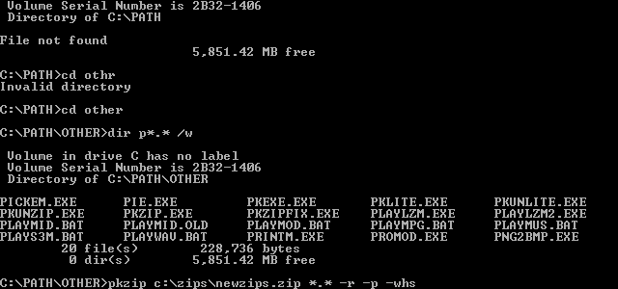
DOS

Slide 12
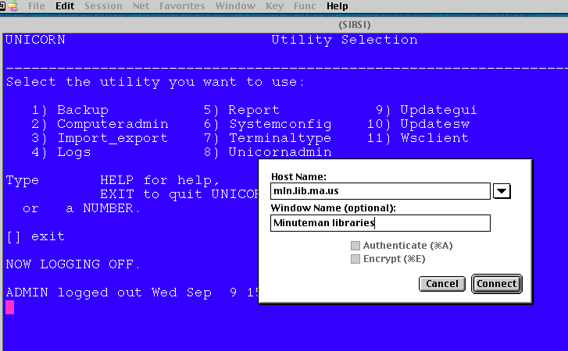
Telnet

Slide 13
Menus
Set of options displayed on the screen
Options visible
less recall - easier to use
rely on recognition so names should be meaningful
Selection by:
numbers, letters, arrow keys, mouse
combination (e.g. mouse plus accelerators)
Often options hierarchically grouped
sensible grouping is needed
Notes:
1

Slide 14
Natural language
Familiar to user
speech recognition or typed natural language
Problems
vague
ambiguous
hard to do well!

Slide 15
Query Interfaces
Question/answer interfaces
user led through interaction via series of questions

Slide 16
Form-fills
Primarily for data entry or data retrieval
Screen like paper form.
Data put in relevant place
Requires
good design
obvious correction facilities

Slide 17
Form-fills

Slide 18
Spreadsheets
first spreadsheet VISICALC, followed by Lotus 1-2-3 MS Excel most common today
sophisticated variation of form-filling.
grid of cells contain a value or a formula
formula can involve values of other cells e.g. sum of all cells in this column
user can enter and alter data spreadsheet maintains consistency

Slide 19
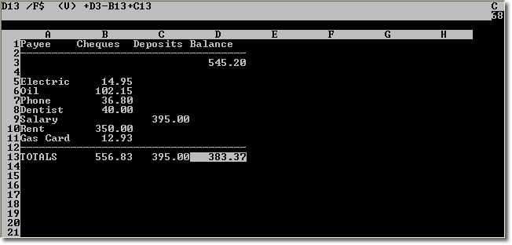
VISICALC

Slide 20
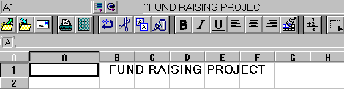
Lotus 1-2-3

Slide 21
MS Excel

Slide 22
WIMP Interface
Windows
Icons
Menus
Pointers
… or windows, icons, mice, and pull-down menus!
default style for majority of interactive computer systems, especially PCs and desktop machines

Slide 23
Windows
Areas of the screen that behave as if they were independent
can contain text or graphics
can be moved or resized
can overlap each other, or can be laid out next to one another (tiled)

Slide 24
Windows
scrollbars
title bars

Slide 25


Icons
small picture or image
represents some object in the interface
often a window or action

Slide 26
Pointers
important component
WIMP style relies on pointing and selecting things
uses mouse, trackpad, joystick, trackball, cursor keys or keyboard shortcuts
wide variety of graphical images

Slide 27
Pull-down Menu

Slide 28
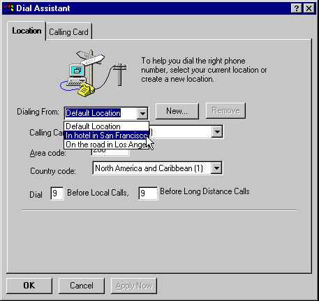
Drop-down Menu

Slide 29
Fall-down Menus

Slide 30
Pop-up Menus

Slide 31
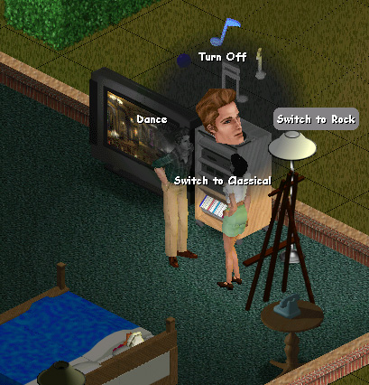
Pie Menu

Slide 32
Menus Extras
Cascading menus
hierarchical menu structure
menu selection opens new menu
Keyboard accelerators
key combinations - same effect as menu item

Slide 33
Keyboard Accelerators
Alt
+
T

Slide 34
Buttons
individual and isolated regions within a display that can be selected to invoke an action
Special kinds
radio buttons – set of mutually exclusive choices
check boxes – set of non-exclusive choices

Slide 35
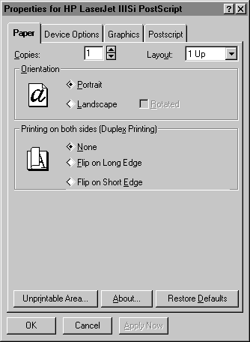
Radio Buttons

Slide 36
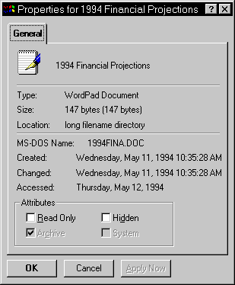
Check Boxes

Slide 37
Toolbars
long lines of icons … … but what do they do?
fast access to common actions
often customizable:
choose which toolbars to see
choose what options are on it

Slide 38
Customization

Slide 39
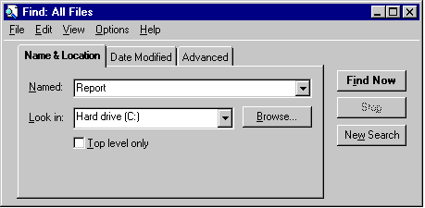
Dialogue Boxes
information windows that pop up to inform of an important event or request information.

