Slide 1
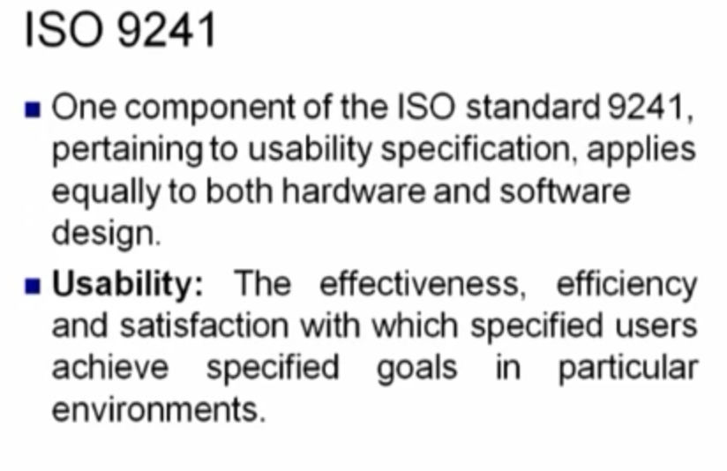

Slide 2
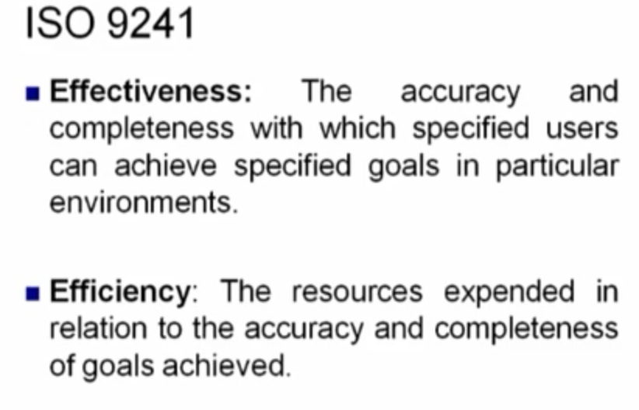

Slide 3
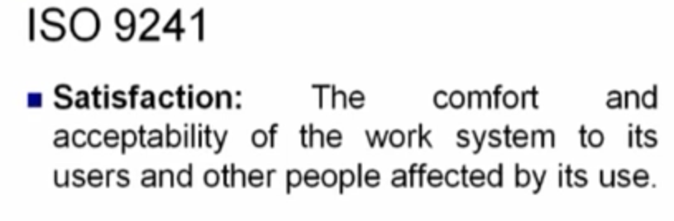

Slide 4
Principles to support usability
Learnability
  the ease with which new users can begin effective interaction and achieve maximal performance
Flexibility
  the multiplicity of ways the user and system exchange information
Robustness
  the level of support provided the user in determining successful achievement and assessment of goal-directed behaviour

Slide 5
Principles of learnability
Predictability
  determining effect of future actions based on past interaction history
  Deterministic behaviour
  operation visibility: refers to how the user is shown the availability of operations that can be performed next.

Slide 6
Principles of learnability (ctd)
Synthesizability
  It is the ability of the user to assess the effect of past operations on the current state.
  The principle of honesty relates to the ability of the user interface to provide an observable and informative account of such change
  immediate vs. eventual honesty

Slide 7
Principles of learnability (ctd)
Familiarity
  The extent to which a user’s knowledge and experience in other real world or computer based domains can be applied when interacting with a new sytem.
  Jordon et al. Refer to this familiarity as the guess ability of the system.
Generalizability
  Support for the user to extend knowledge of specific interaction within and across applications to other similar situations.
  Generalizability can be seen as a form of consistency.

Slide 8
Principles of learnability (ctd)
Consistency
  likeness in input/output behaviour arising from similar situations or task objectives

Slide 9
Principles of flexibility
Dialogue initiative
  Allowing the user freedom from artificial constraints on the input dialog imposed by the system.
  system vs. user pre-emptiveness
Multithreading
  ability of system to support user interaction for more than one task at a time
  concurrent vs. interleaving
Task migratability
  passing responsibility for task execution between user and system

Slide 10
Principles of flexibility (ctd)
Substitutivity
  allowing equivalent values of input and output to be substituted for each other
  representation multiplicity; equal opportunity
Customizability
  modifiability of the user interface by user or system

Slide 11
Principles of robustness
Observability
  ability of user to evaluate the internal state of the system from its perceivable representation
Recoverability
  ability of user to take corrective action once an error has been recognized
  forward/backward recovery

Slide 12
Principles of robustness (ctd)
Responsiveness
  how the user perceives the rate of communication with the system
  Stability
Task conformance
  degree to which system services support all of the user's tasks
  task completeness

