Slide 1
DESIGN RULES

Slide 2
SHNEIDERMAN’S 8 GOLDEN RULES

Slide 3
Shneiderman’s 8 Golden Rules
1. Strive for consistency
2. Cater to Universal Usability (Enable frequent users to use shortcuts)
3. Offer informative feedback
4. Design dialogs to yield closure
5. Offer error prevention and simple error handling
6. Permit easy reversal of actions
7. Support internal locus of control
8. Reduce short-term memory load

Slide 4
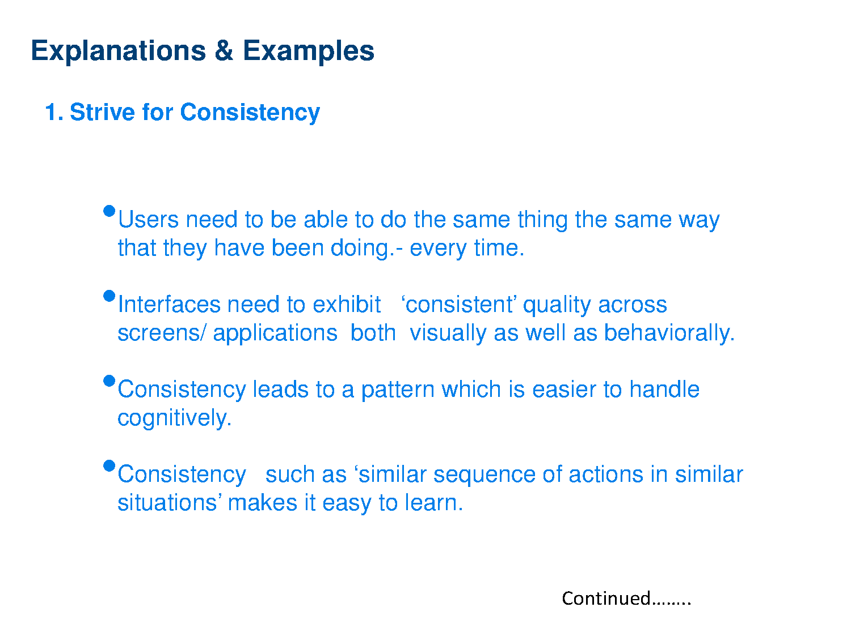

Slide 5
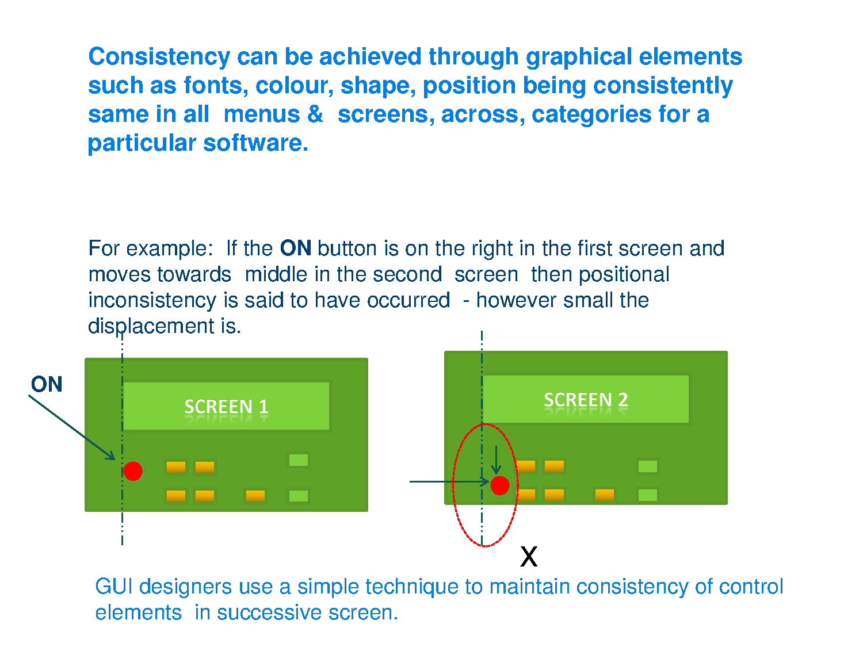

Slide 6
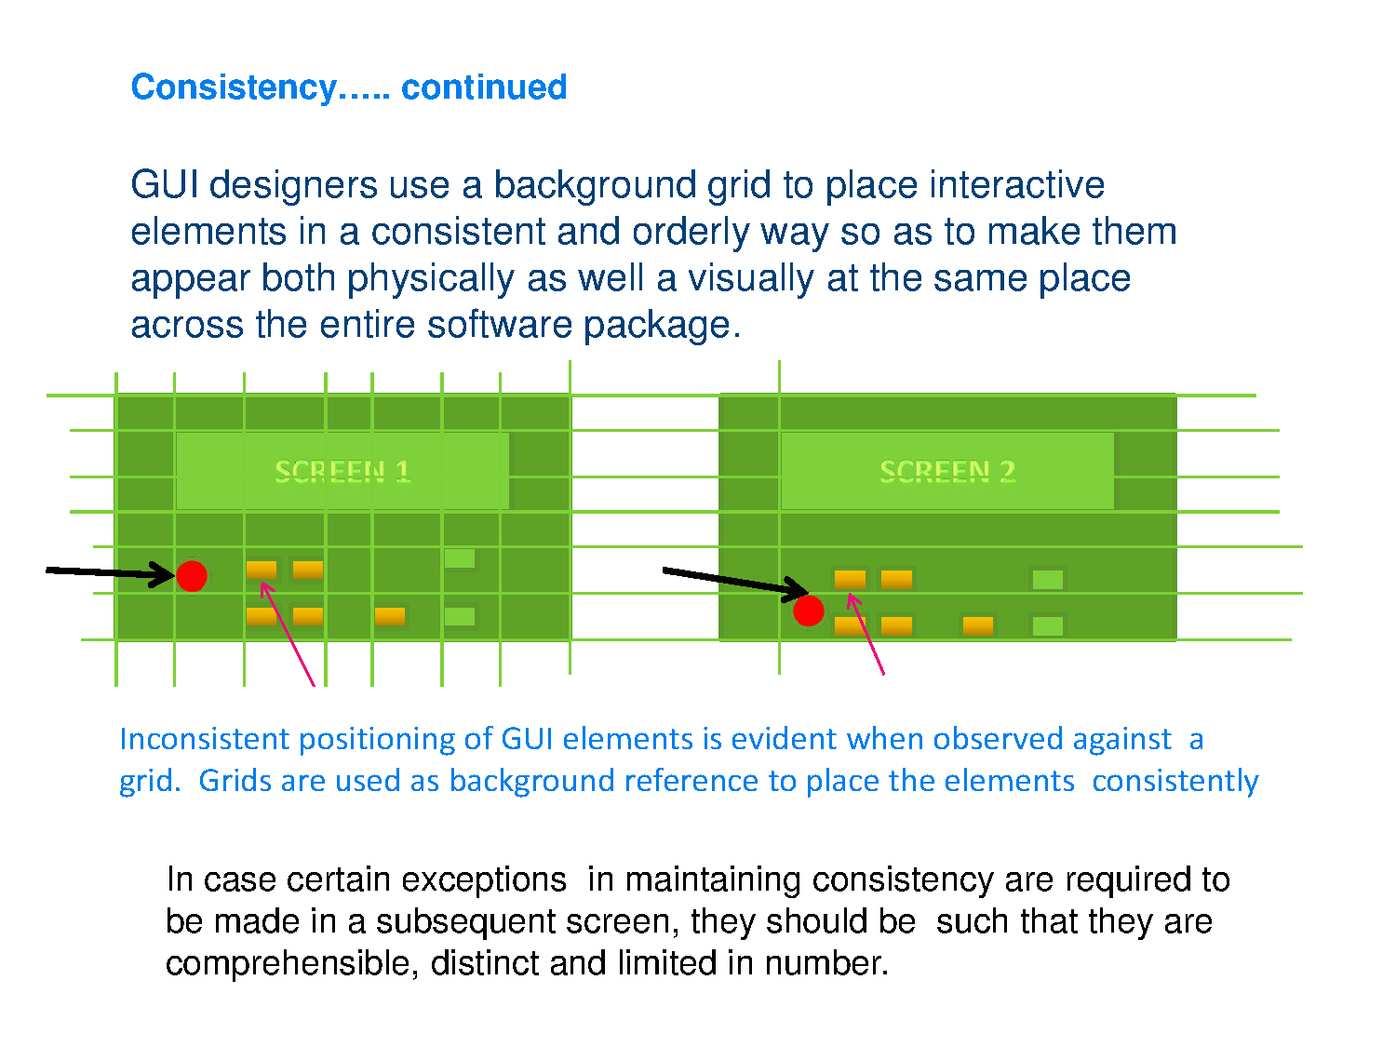

Slide 7
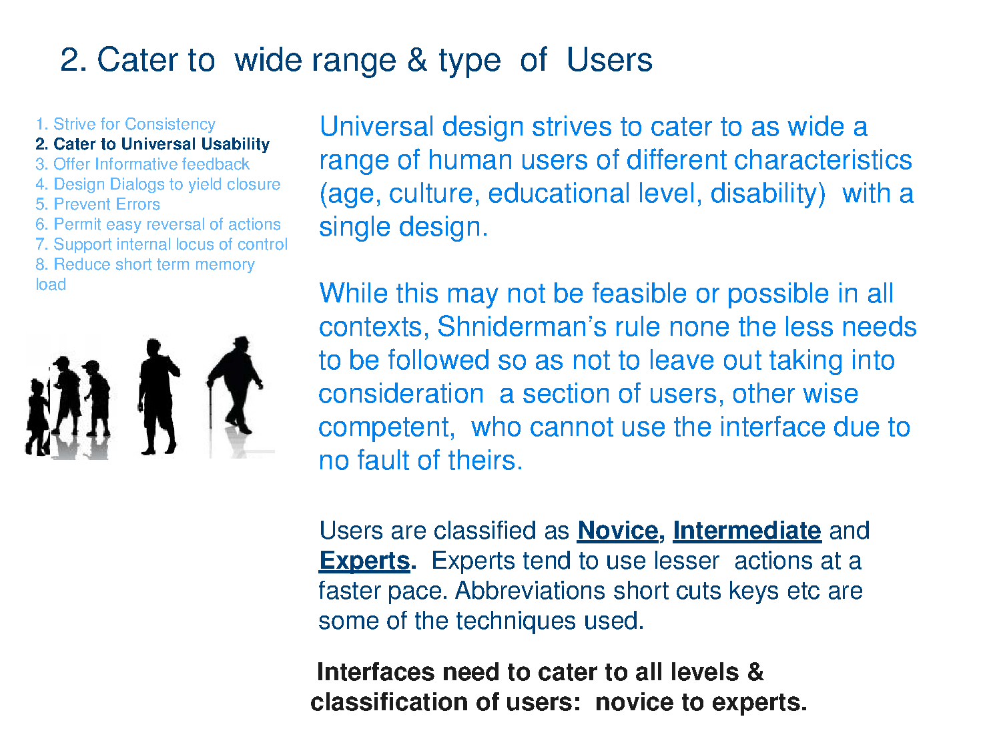

Slide 8
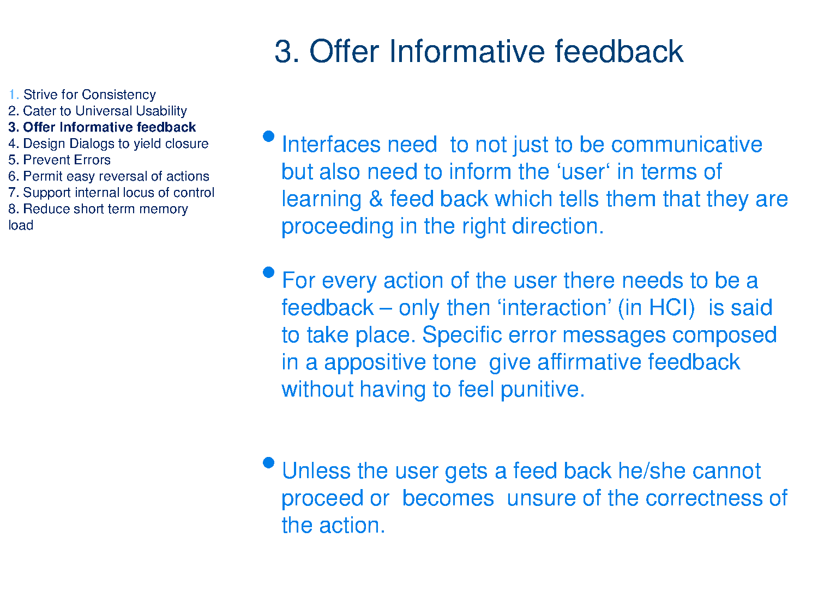

Slide 9
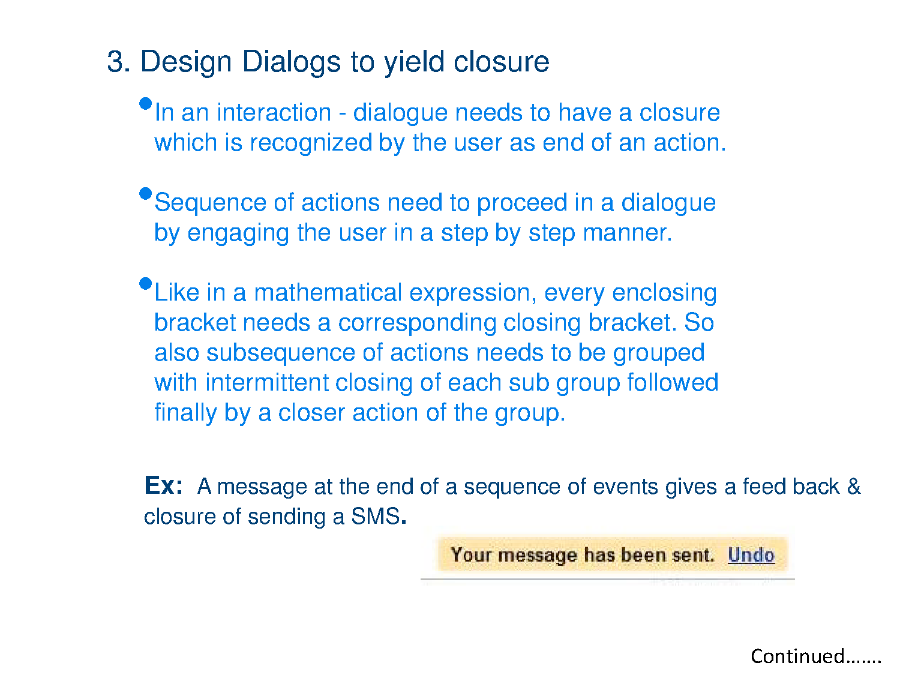
4.

Slide 10
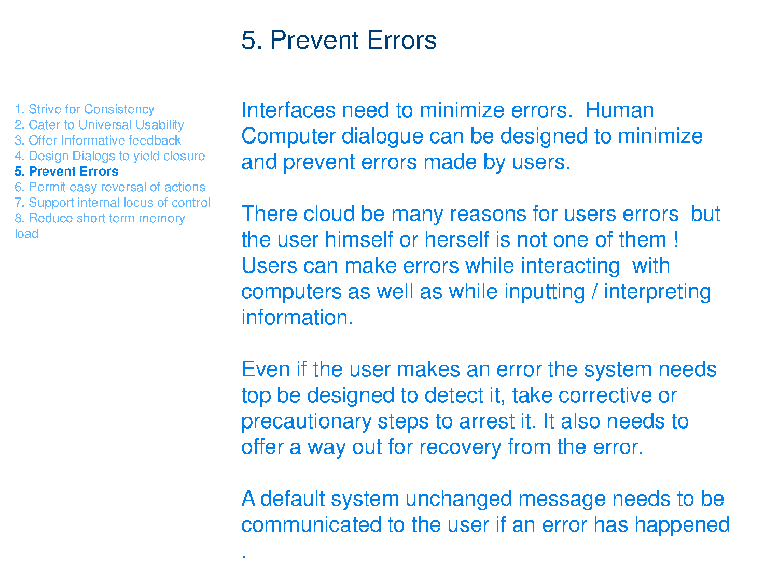

Slide 11
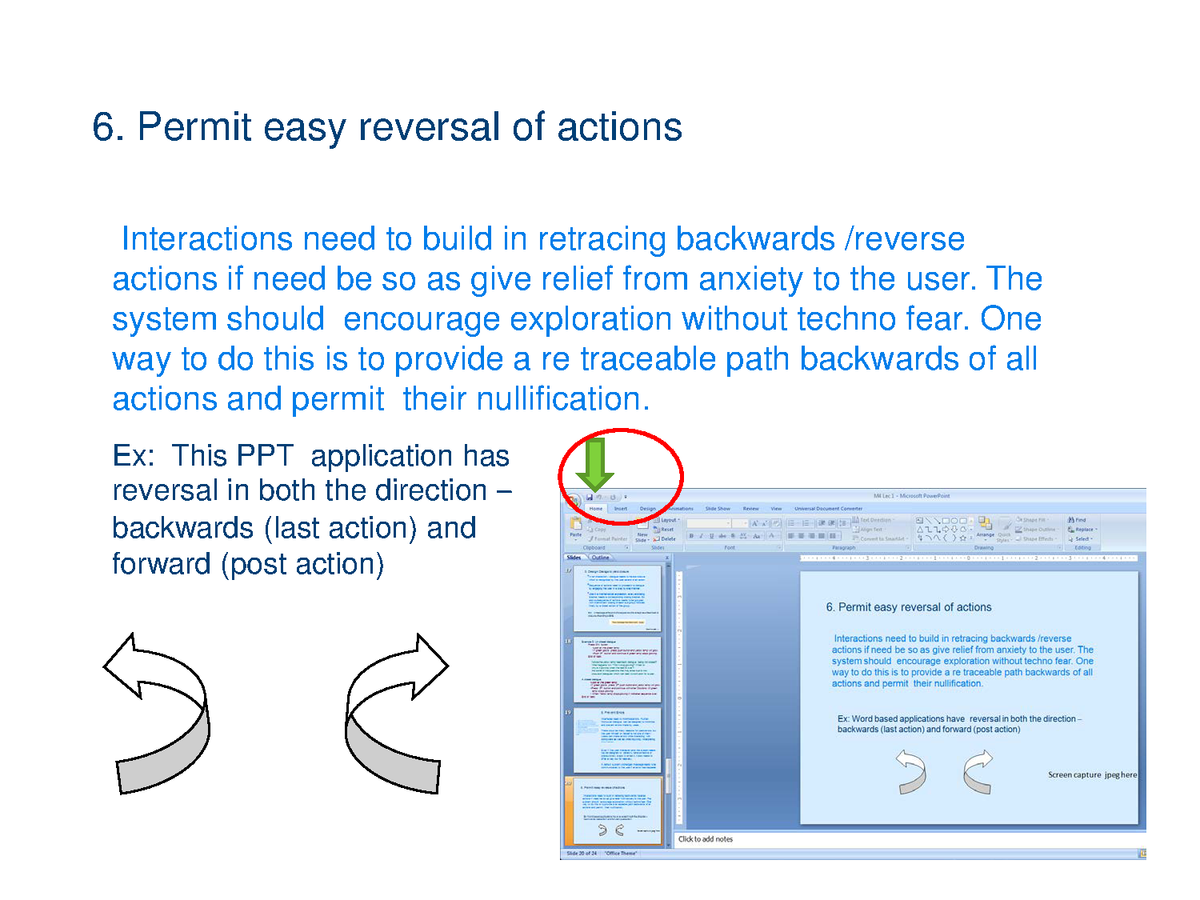

Slide 12
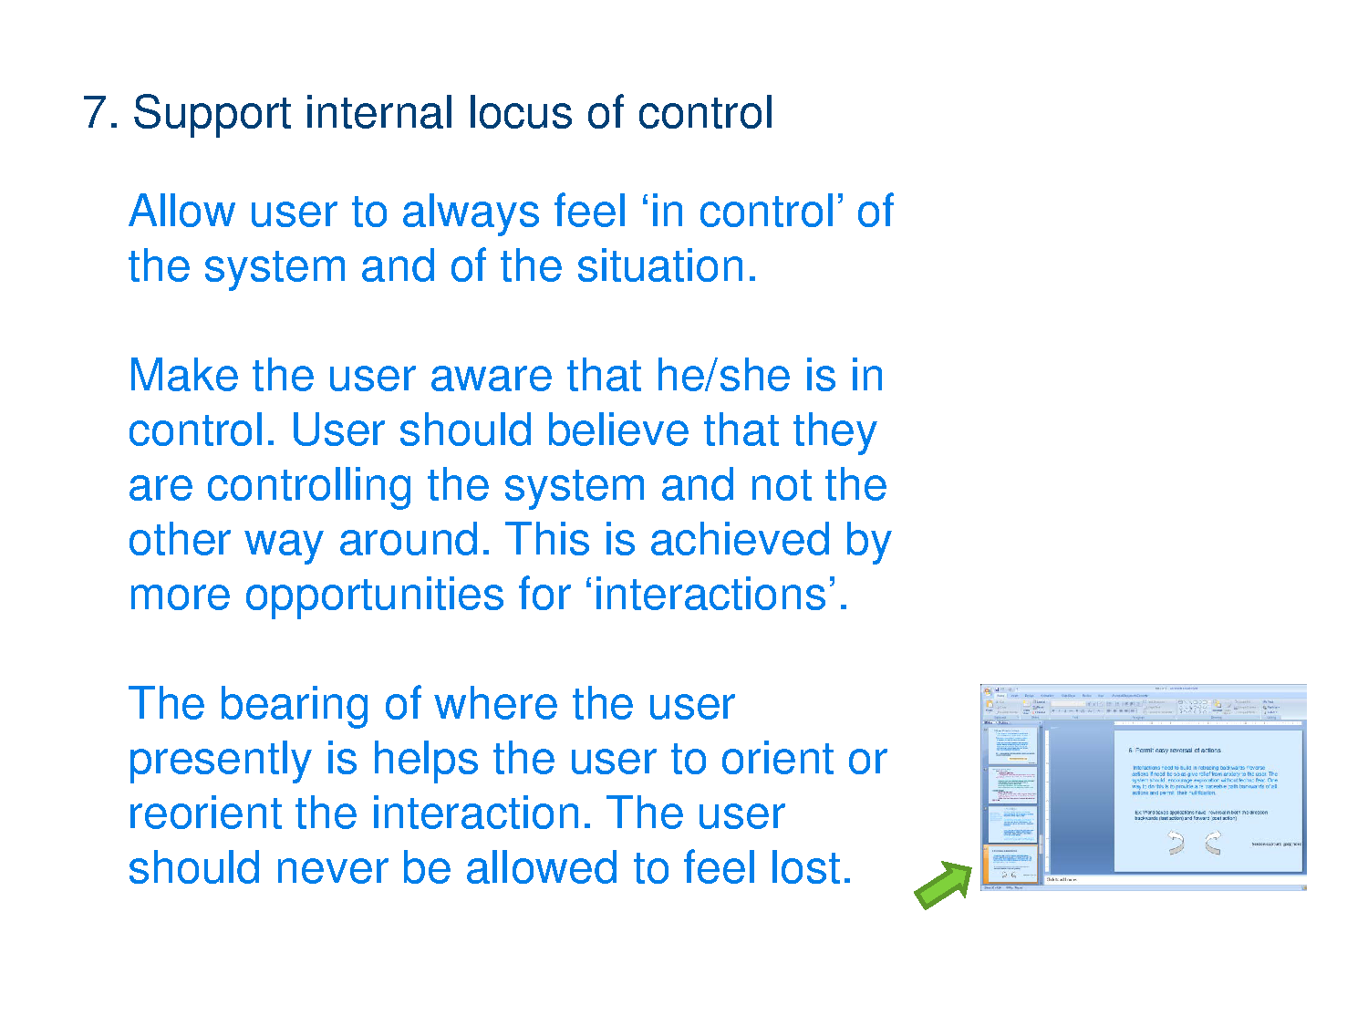

Slide 13
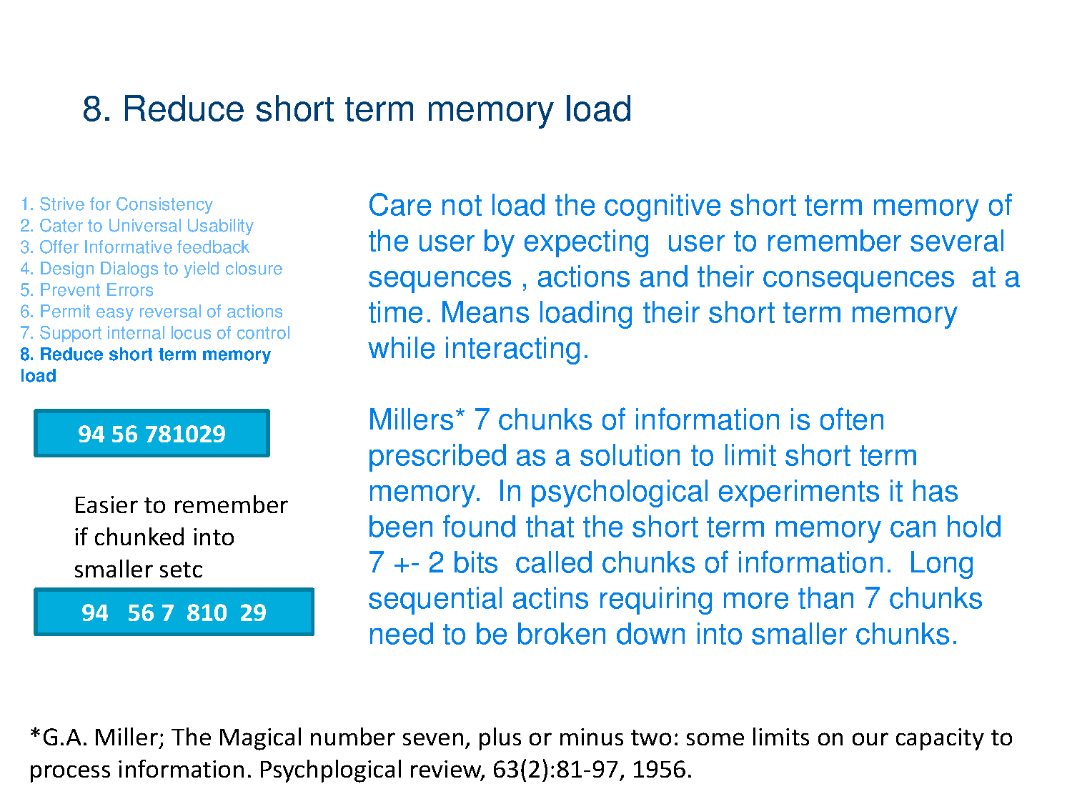

Slide 14
