Slide 1
Memory
There are three types of memory function:
Sensory memories
Short-term memory or working memory
Long-term memory
Attention
Rehearsal

Slide 2
sensory memory
Buffers for stimuli received through senses
  iconic memory: visual stimuli
  echoic memory: aural stimuli
  haptic memory: tactile stimuli
Continuously overwritten

Slide 3
Short-term memory (STM)
  limited capacity - 7± 2 chunks

Slide 4
Examples
265397620853
212348278493202
0121 414 2626
HEC ATR ANU PTH ETR EET
The successful formation of a chunk is known as closure

Slide 5
Long-term memory (LTM)
Repository for all our knowledge
  slow access
  slow decay
  huge or unlimited capacity
Two types
  episodic – serial memory of events
  semantic – structured memory of facts, concepts, skills
  semantic LTM derived from episodic LTM

Slide 6
Long-term memory (cont.)
Semantic memory structure
  provides access to information
  represents relationships between bits of information
  supports inference
Model: semantic network
  inheritance – child nodes inherit properties of parent nodes
  relationships between bits of information explicit
  supports inference through inheritance

Slide 7
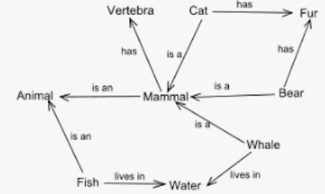
LTM - semantic network

Slide 8

LTM - semantic network

Slide 9
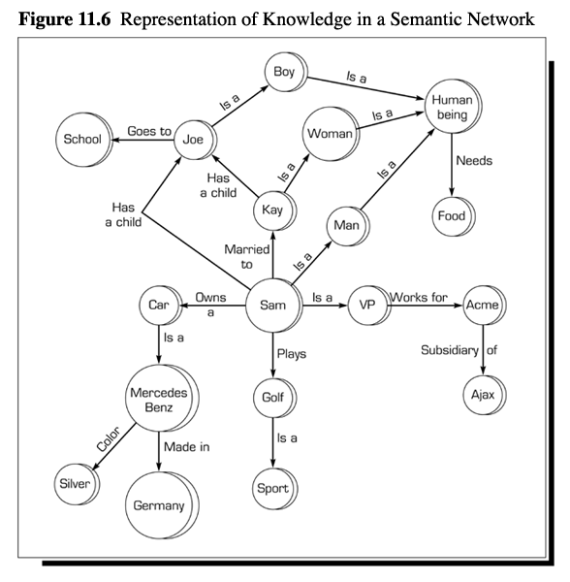
Semantic Networks

Slide 10
Models of LTM - Frames
Information organized in data structures
Slots in structure instantiated with values for instance of data
Type–subtype relationships
DOG
Fixed
legs: 4
Default
diet: carniverous
sound: bark
Variable
size:
colour
COLLIE
Fixed
breed of: DOG
type: sheepdog
Default
size: 65 cm
Variable
colour

Slide 11
Models of LTM - Production rules
Condition/action rules
  if condition is matched
  then use rule to determine action.
IF dog is wagging tail
THEN pat dog
IF dog is growling
THEN run away

Slide 12
Thinking
Reasoning
deduction, induction, abduction
Problem solving

Slide 13
Deductive Reasoning
Deduction:
  derive logically necessary conclusion from given premises.
  e.g. If it is Friday then she will go to work
  It is Friday
  Therefore she will go to work.
Logical conclusion not necessarily true:
  e.g. If it is raining then the ground is dry
  It is raining
  Therefore the ground is dry
Often truth and logical validity clash …
Notes:
Monkeys like Bananas
Lucky is Monkey Lucky likes Bananas
Rule
Case
Result

Slide 14
Inductive Reasoning
Induction:
  generalize from cases seen to cases unseen
  e.g. all elephants we have seen have trunks
  therefore all elephants have trunks.
Humans not good at using negative evidence
  e.g. Wason's cards.
Notes:
Case
Result
Rule

Slide 15
Wason's cards
7 E 4 K
If a card has a vowel on one side it has an even number on the other
Is this true?
How many cards do you need to turn over to find out?
…. and which cards?

Slide 16
Abductive reasoning
reasoning from event to cause
  e.g. Sam drives fast when drunk.
  If I see Sam driving fast, assume drunk.
Unreliable:
  can lead to false explanations

Slide 17
Problem solving
Process of finding solution to unfamiliar task using knowledge.
Several theories:

Slide 18
Classical Approach
The classical approach to solving a problem is pretty simple. Given a problem at hand, use hit and trial method to check for various solutions to that problem. This hit and trial approach usually works well for trivial problems and is referred to as the classical approach to problem solving.

Slide 19
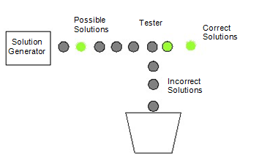
Generate and Test
This is a technical name given to the classical way of solving problems where we generate different combinations to solve our problem, and the one which solves the problem is taken as the correct solution. The rest of the combinations that we try are considered as incorrect solutions and hence are destroyed.

Slide 20
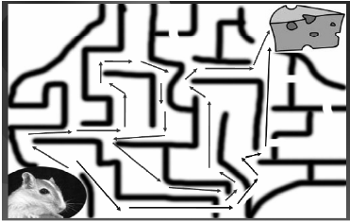
Problem solving (cont.)
Problem space theory
  problem space comprises problem states
  problem solving involves generating states using legal operators
  heuristics may be employed to select operators
  e.g. means-ends analysis ( initial state is compared with goal state and an operator chosen to reduce the difference between the two)

Slide 21
Components of Problem Solving
They are namely:
Problem Statement,
Goal State,
Solution Space
and Operators.

Slide 22
Problem Statement
The two major things that we get to know about the problem is the Information about what is to be done and constraints to which our solution should comply.
For example, taking the same example of the mouse, problem statement will tell us things like, the mouse has to reach the cheese as soon as possible and in case it is unable to find a path within an hour, it might die of hunger.

Slide 23
Goal State
what should be the output of our procedure in order to solve the problem.
For example in the case of mouse, the ultimate aim is to reach the cheese. The state of world when mouse will be beside the cheese and probably eating it defines the aim. This state of world is also referred to as the Goal State or the state that represents the solution of the problem.

Slide 24
Solution Space
We have to go though a certain amount of states of nature to reach the solution.
For example when the mouse was in the lower left corner of the maze, represents a state i.e. the start state. When it was stuck in some corner of the maze represents a state. When it was stuck somewhere else represents another state When it was traveling on a path represents some other state and finally when it reaches the cheese represents a state called the goal state.
The set of the start state, the goal state and all the intermediate states constitutes something which is called a solution space.

Slide 25
Operators
The traveling inside a solution space requires something called as “operators”.
In case of the mouse example, turn left, turn right, go straight are the operators which help us travel inside the solution space.
In short the action that takes us from one state to the other is referred to as an operator.
So while solving a problem we should clearly know that what are the operators that we can use in order to reach the goal state from the starting state.
The sequence of these operators is actually the solution to our problem.

Slide 26
Problem solving (cont.)
Analogy
  How people solve novel problems?
  analogical mapping:
    Similarities between the known domain and the new one are noted and
    operators from the known domain are transferred to the new one.

Slide 27
Emotion
Cannon: emotion is a psychological response to a stimuli
Emotion clearly involves both cognitive and physical responses to stimuli

Slide 28
Emotion (cont.)
The biological response to physical stimuli is called affect
Affect influences how we respond to situations
  positive → creative problem solving
  negative → narrow thinking
  “Negative affect can make it harder to do even easy tasks; positive affect can make it easier to do difficult tasks”
        (Donald Norman)

Slide 29
Emotion (cont.)
Implications for interface design
  stress will increase the difficulty of problem solving
  relaxed users will be more forgiving of shortcomings in design
  aesthetically pleasing and rewarding interfaces will increase positive affect

Slide 30
Individual differences
We should be aware of individual differences so that we can account for them as far as possible within our designs.
We all differ in looks, feelings, intellectual abilities, learning abilities and so on.
Individual differences complicate design
We must permit people with widely varying characteristics to satisfactorily and comfortably learn the task or job, or use the Web site.

Slide 31
Individual differences
long term
– gender, physical and intellectual abilities
short term
– effect of stress or fatigue
changing
– age
Ask yourself:
will design decision exclude section of user population?

