Slide 1
Chapter Four
Utility

Slide 2
Preferences - A Reminder
x y: x is preferred strictly to y.
x ∼ y: x and y are equally preferred.
x y: x is preferred at least as much as is y.
❐

~

Slide 3
Preferences - A Reminder
Completeness: For any two bundles x and y it is always possible to state either that
x y
or that
y x.

~

~

Slide 4
Preferences - A Reminder
Reflexivity: Any bundle x is always at least as preferred as itself; i.e.
x x.

~

Slide 5
Preferences - A Reminder
Transitivity: If
x is at least as preferred as y, and
y is at least as preferred as z, then
x is at least as preferred as z; i.e.
x y and y z x z.



~
~
~

Slide 6
Utility Functions
A preference relation that is complete, reflexive, transitive and continuous can be represented by a continuous utility function.
Continuity means that small changes to a consumption bundle cause only small changes to the preference level.

Slide 7
Utility Functions
A utility function U(x) represents a preference relation if and only if:
x’ x” U(x’) > U(x”)
x’ x” U(x’) < U(x”)
x’ ∼ x” U(x’) = U(x”).

~
❐
❐

Slide 8
Utility Functions
Utility is an ordinal (i.e. ordering) concept.
E.g. if U(x) = 6 and U(y) = 2 then bundle x is strictly preferred to bundle y. But x is not preferred three times as much as is y.

Slide 9
Utility Functions & Indiff. Curves
Consider the bundles (4,1), (2,3) and (2,2).
Suppose (2,3) (4,1) ∼ (2,2).
Assign to these bundles any numbers that preserve the preference ordering;
e.g. U(2,3) = 6 > U(4,1) = U(2,2) = 4.
Call these numbers utility levels.
❐

Slide 10
Utility Functions & Indiff. Curves
An indifference curve contains equally preferred bundles.
Equal preference ⇒ same utility level.
Therefore, all bundles in an indifference curve have the same utility level.

Slide 11
Utility Functions & Indiff. Curves
So the bundles (4,1) and (2,2) are in the indiff. curve with utility level U ≡ 4
But the bundle (2,3) is in the indiff. curve with utility level U ≡ 6.
On an indifference curve diagram, this preference information looks as follows:

Slide 12
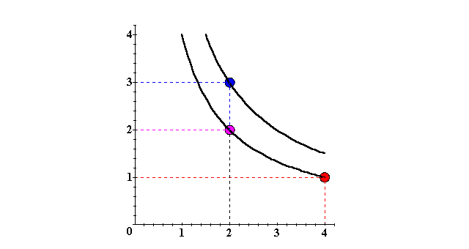
Utility Functions & Indiff. Curves
x₂
(2,3) (2,2) ∼ (4,1)
❐
U ≡ 6
U ≡ 4
x₁

Slide 13
Utility Functions & Indiff. Curves
Another way to visualize this same information is to plot the utility level on a vertical axis.

Slide 14
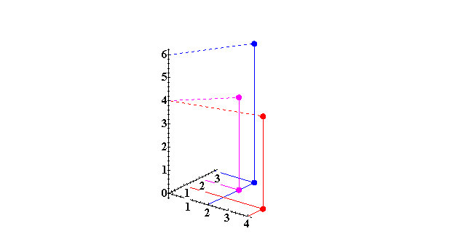
Utility Functions & Indiff. Curves
3D plot of consumption & utility levels for 3 bundles
Utility
U(2,3) = 6
U(2,2) = 4
U(4,1) = 4
x₂
x₁

Slide 15
Utility Functions & Indiff. Curves
This 3D visualization of preferences can be made more informative by adding into it the two indifference curves.

Slide 16
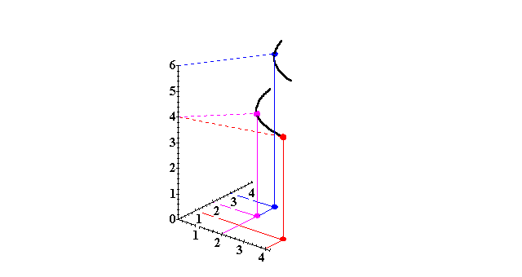
Utility Functions & Indiff. Curves
Utility
U ≡ 6
U ≡ 4
x₂
Higher indifference
curves contain
more preferred
bundles.
x₁

Slide 17
Utility Functions & Indiff. Curves
Comparing more bundles will create a larger collection of all indifference curves and a better description of the consumer’s preferences.

Slide 18
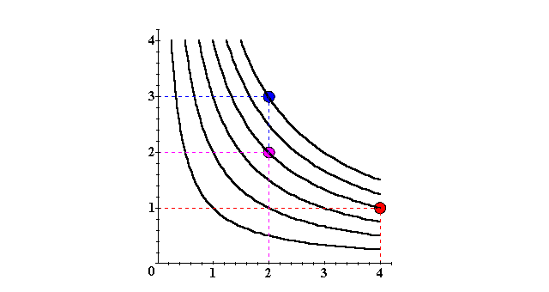
Utility Functions & Indiff. Curves
x₂
U ≡ 6
U ≡ 4
U ≡ 2
x₁

Slide 19
Utility Functions & Indiff. Curves
As before, this can be visualized in 3D by plotting each indifference curve at the height of its utility index.

Slide 20
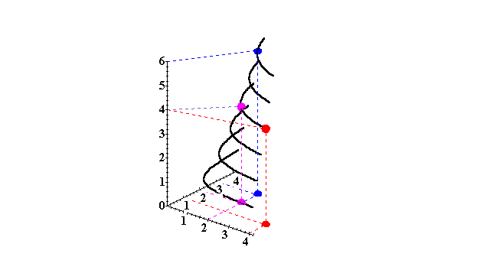
Utility Functions & Indiff. Curves
Utility
U ≡ 6
U ≡ 5
U ≡ 4
x₂
U ≡ 3
U ≡ 2
U ≡ 1
x₁

Slide 21
Utility Functions & Indiff. Curves
Comparing all possible consumption bundles gives the complete collection of the consumer’s indifference curves, each with its assigned utility level.
This complete collection of indifference curves completely represents the consumer’s preferences.

Slide 22
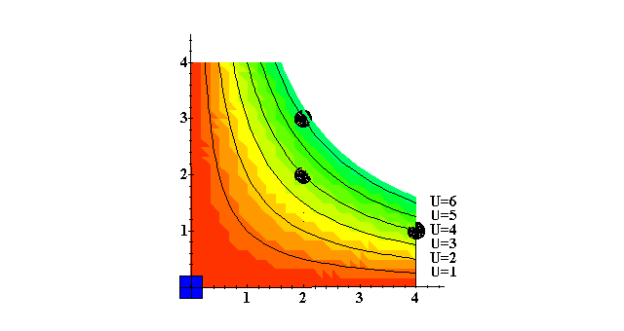
Utility Functions & Indiff. Curves
x₂
x₁

Slide 23
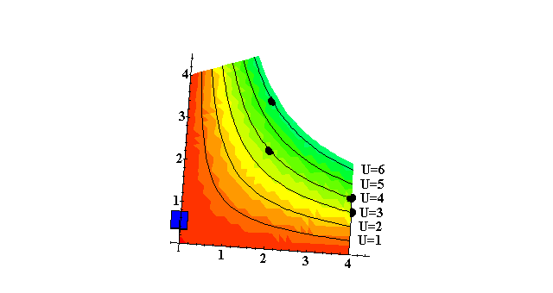
Utility Functions & Indiff. Curves
x₂
x₁

Slide 24
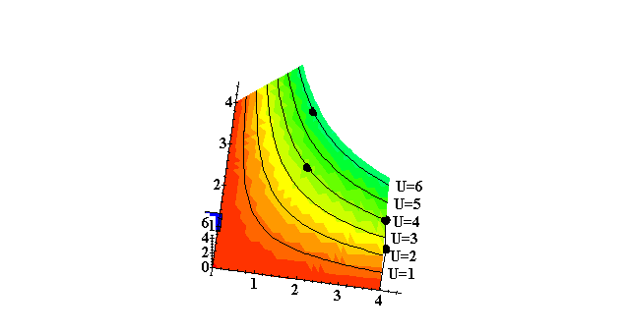
Utility Functions & Indiff. Curves
x₂
x₁

Slide 25
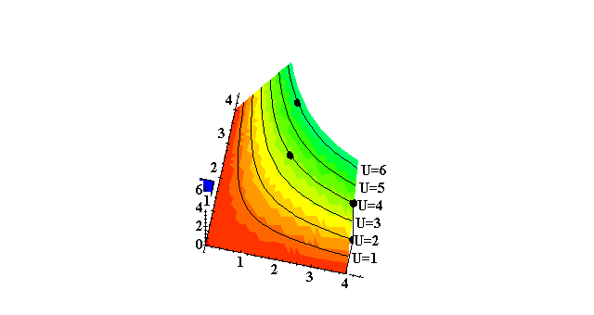
Utility Functions & Indiff. Curves
x₂
x₁

Slide 26
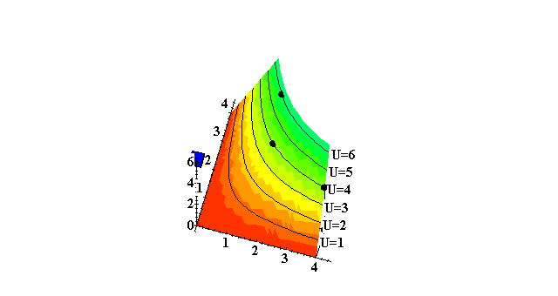
Utility Functions & Indiff. Curves
x₂
x₁

Slide 27

Utility Functions & Indiff. Curves
x₂
x₁

Slide 28
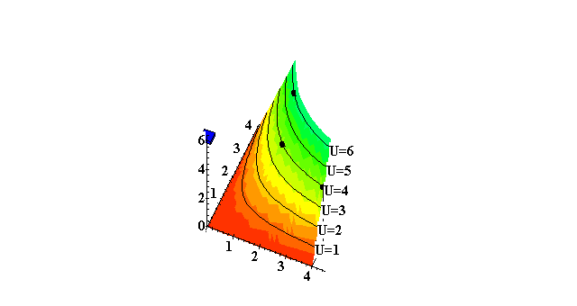
Utility Functions & Indiff. Curves
x₁

Slide 29
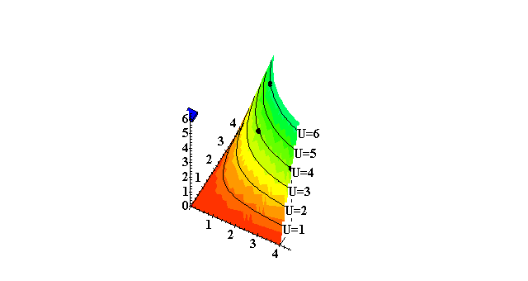
Utility Functions & Indiff. Curves
x₁

Slide 30
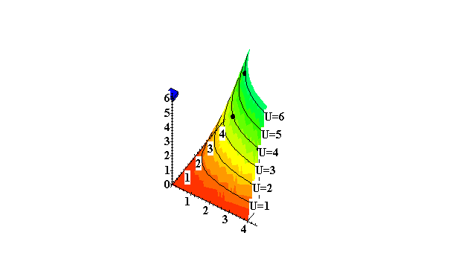
Utility Functions & Indiff. Curves
x₁

Slide 31
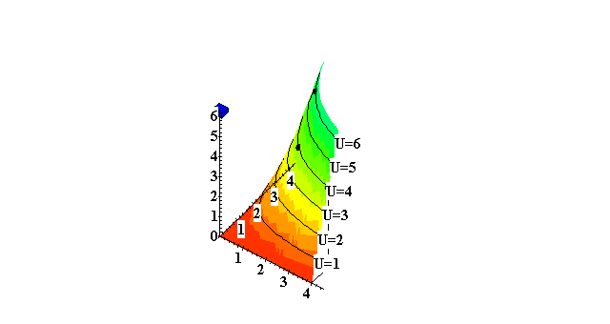
Utility Functions & Indiff. Curves
x₁

Slide 32
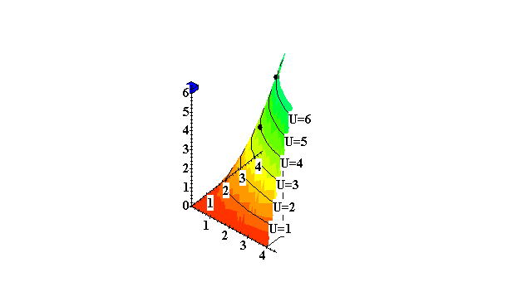
Utility Functions & Indiff. Curves
x₁

Slide 33
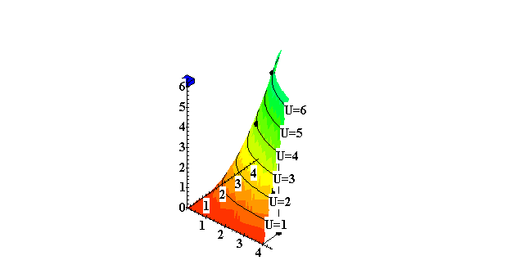
Utility Functions & Indiff. Curves
x₁

Slide 34
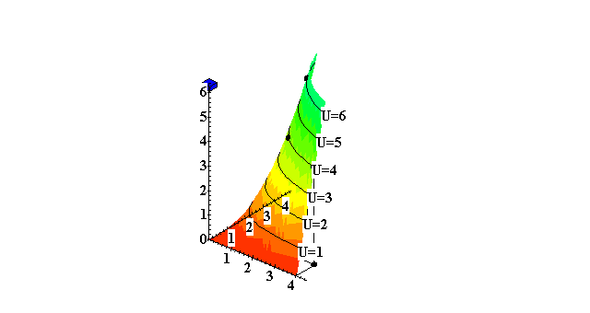
Utility Functions & Indiff. Curves
x₁

Slide 35
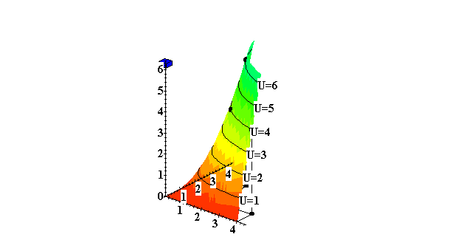
Utility Functions & Indiff. Curves
x₁

Slide 36
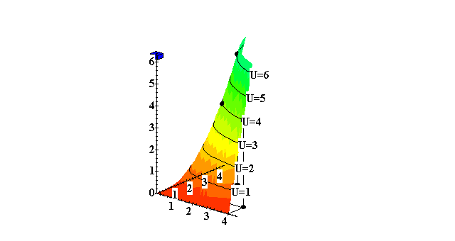
Utility Functions & Indiff. Curves
x₁

Slide 37
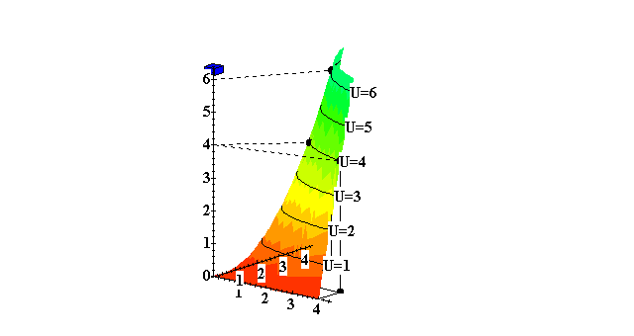

Utility Functions & Indiff. Curves
x₁

Slide 38
Utility Functions & Indiff. Curves
The collection of all indifference curves for a given preference relation is an indifference map.
An indifference map is equivalent to a utility function; each is the other.

Slide 39
Utility Functions
There is no unique utility function representation of a preference relation.
Suppose U(x₁,x₂) = x₁x₂ represents a preference relation.
Again consider the bundles (4,1),
(2,3) and (2,2).

Slide 40
Utility Functions
U(x₁,x₂) = x₁x₂, so
U(2,3) = 6 > U(4,1) = U(2,2) = 4;
that is, (2,3) (4,1) ∼ (2,2).
❐

Slide 41
Utility Functions
❐
U(x₁,x₂) = x₁x₂ (2,3) (4,1) ∼ (2,2).
Define V = U².

Slide 42
Utility Functions
❐
U(x₁,x₂) = x₁x₂ (2,3) (4,1) ∼ (2,2).
Define V = U².
Then V(x₁,x₂) = x₁²x₂² and
V(2,3) = 36 > V(4,1) = V(2,2) = 16
so again
(2,3) (4,1) ∼ (2,2).
V preserves the same order as U and so represents the same preferences.
❐

Slide 43
Utility Functions
❐
U(x₁,x₂) = x₁x₂ (2,3) (4,1) ∼ (2,2).
Define W = 2U + 10.

Slide 44
Utility Functions
❐
U(x₁,x₂) = x₁x₂ (2,3) (4,1) ∼ (2,2).
Define W = 2U + 10.
Then W(x₁,x₂) = 2x₁x₂+10 so
W(2,3) = 22 > W(4,1) = W(2,2) = 18. Again,
(2,3) (4,1) ∼ (2,2).
W preserves the same order as U and V and so represents the same preferences.
❐

Slide 45
Utility Functions
If
  U is a utility function that represents a preference relation and
  f is a strictly increasing function,
then V = f(U) is also a utility function
representing .

~

~

Slide 46
Goods, Bads and Neutrals
A good is a commodity unit which increases utility (gives a more preferred bundle).
A bad is a commodity unit which decreases utility (gives a less preferred bundle).
A neutral is a commodity unit which does not change utility (gives an equally preferred bundle).

Slide 47
Goods, Bads and Neutrals
Utility
Utility
function
Units of
water are
goods
Units of
water are
bads
x’
Water
Around x’ units, a little extra water is a neutral.

Slide 48
Some Other Utility Functions and Their Indifference Curves
Instead of U(x₁,x₂) = x₁x₂ consider
V(x₁,x₂) = x₁ + x₂.
What do the indifference curves for this “perfect substitution” utility function look like?

Slide 49
Perfect Substitution Indifference Curves
x₂
x₁ + x₂ = 5
13
x₁ + x₂ = 9
9
x₁ + x₂ = 13
5
V(x₁,x₂) = x₁ + x₂.
5
9
13
x₁

Slide 50
Perfect Substitution Indifference Curves
x₂
x₁ + x₂ = 5
13
x₁ + x₂ = 9
9
x₁ + x₂ = 13
5
V(x₁,x₂) = x₁ + x₂.
5
9
13
x₁
All are linear and parallel.

Slide 51
Some Other Utility Functions and Their Indifference Curves
Instead of U(x₁,x₂) = x₁x₂ or
V(x₁,x₂) = x₁ + x₂, consider
W(x₁,x₂) = min{x₁,x₂}.
What do the indifference curves for this “perfect complementarity” utility function look like?

Slide 52
Perfect Complementarity Indifference Curves
x₂
45º
W(x₁,x₂) = min{x₁,x₂}
8
min{x₁,x₂} = 8
5
min{x₁,x₂} = 5
3
min{x₁,x₂} = 3
3
5
8
x₁

Slide 53
Perfect Complementarity Indifference Curves
x₂
45º
W(x₁,x₂) = min{x₁,x₂}
8
min{x₁,x₂} = 8
5
min{x₁,x₂} = 5
3
min{x₁,x₂} = 3
3
5
8
x₁
All are right-angled with vertices on a ray
from the origin.

Slide 54
Some Other Utility Functions and Their Indifference Curves
A utility function of the form
U(x₁,x₂) = f(x₁) + x₂
is linear in just x₂ and is called quasi-linear.
E.g. U(x₁,x₂) = 2x₁^{1/2} + x₂.

Slide 55
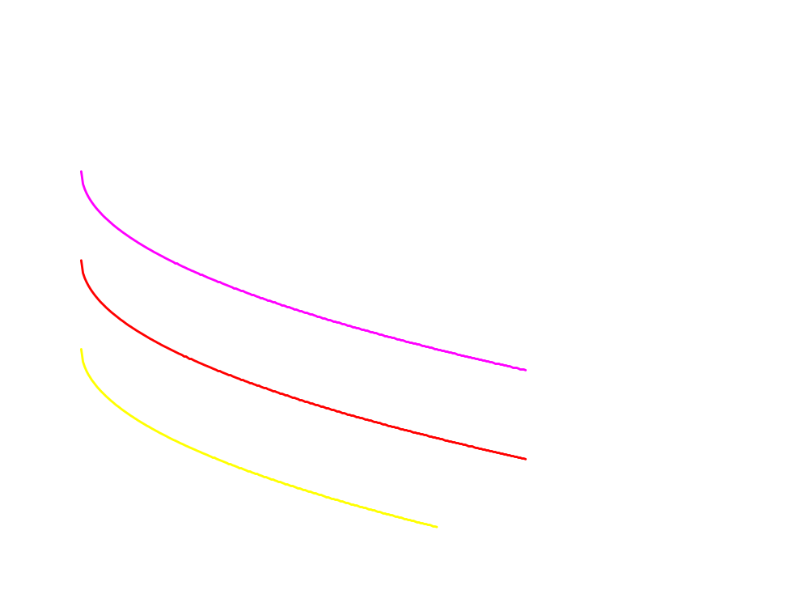
Quasi-linear Indifference Curves
x₂
Each curve is a vertically shifted copy of the others.
x₁

Slide 56
Some Other Utility Functions and Their Indifference Curves
Any utility function of the form
U(x₁,x₂) = x₁ª x₂^{b}
with a > 0 and b > 0 is called a Cobb-Douglas utility function.
E.g. U(x₁,x₂) = x₁^{1/2} x₂^{1/2} (a = b = 1/2)
V(x₁,x₂) = x₁ x₂³ (a = 1, b = 3)

Slide 57
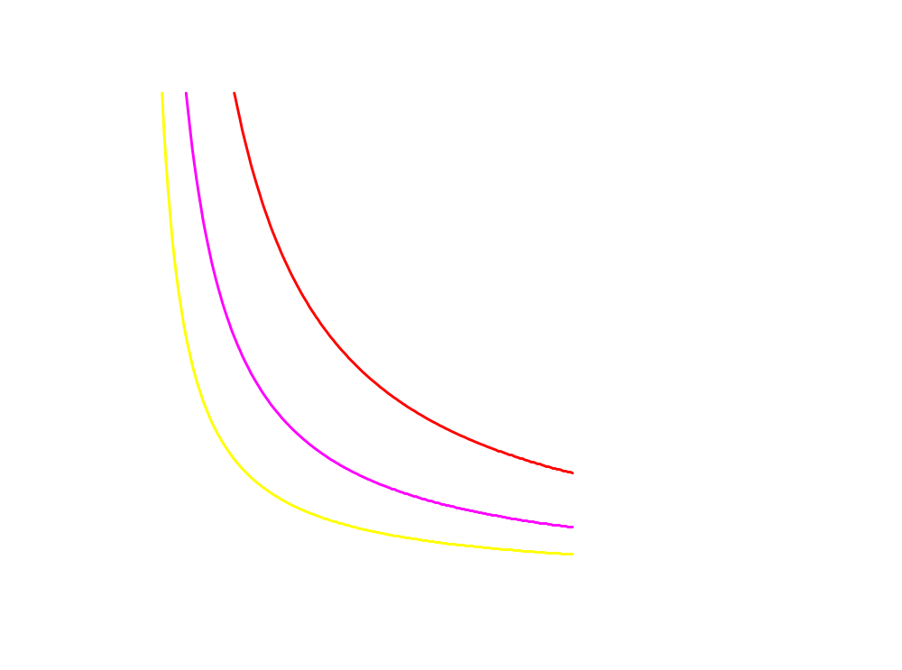
Cobb-Douglas Indifference Curves
x₂
All curves are hyperbolic,
asymptoting to, but never
touching any axis.
x₁

Slide 58
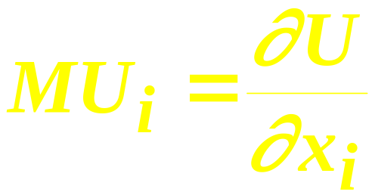
Marginal Utilities
Marginal means “incremental”.
The marginal utility of commodity i is the rate-of-change of total utility as the quantity of commodity i consumed changes; i.e.

Slide 59
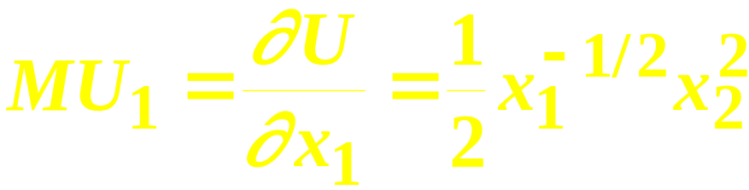
Marginal Utilities
E.g. if U(x₁,x₂) = x₁^{1/2} x₂² then

Slide 60
Marginal Utilities
E.g. if U(x₁,x₂) = x₁^{1/2} x₂² then

Slide 61
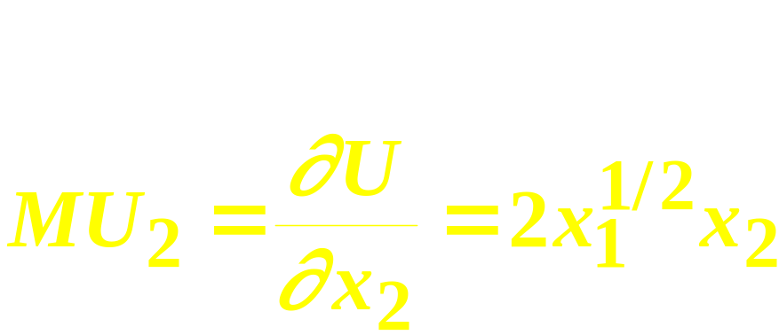
Marginal Utilities
E.g. if U(x₁,x₂) = x₁^{1/2} x₂² then

Slide 62
Marginal Utilities
E.g. if U(x₁,x₂) = x₁^{1/2} x₂² then

Slide 63
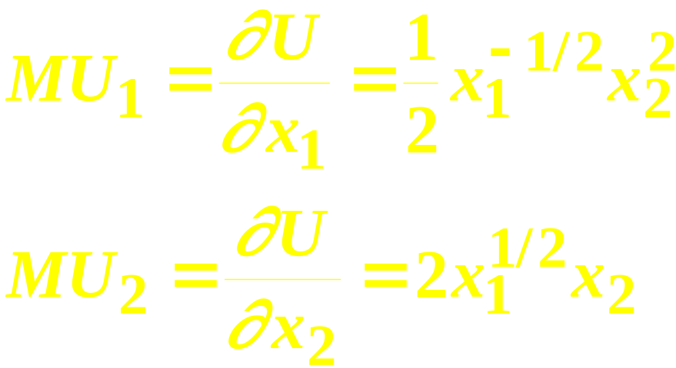
Marginal Utilities
So, if U(x₁,x₂) = x₁^{1/2} x₂² then

Slide 64
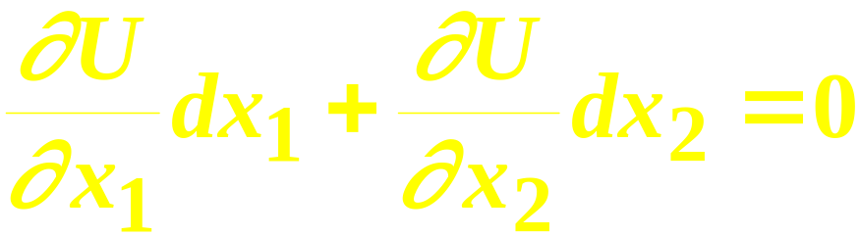
Marginal Utilities and Marginal Rates-of-Substitution
The general equation for an indifference curve is
U(x₁,x₂) ≡ k, a constant.
Totally differentiating this identity gives

Slide 65
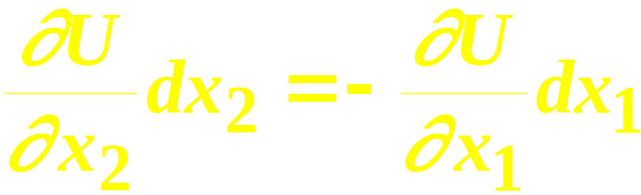
Marginal Utilities and Marginal Rates-of-Substitution
rearranged is

Slide 66

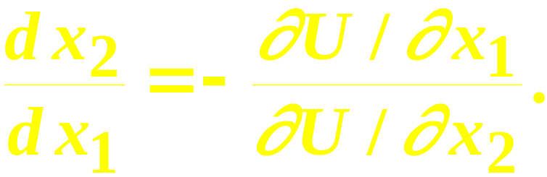
Marginal Utilities and Marginal Rates-of-Substitution
And
rearranged is
This is the MRS.

Slide 67
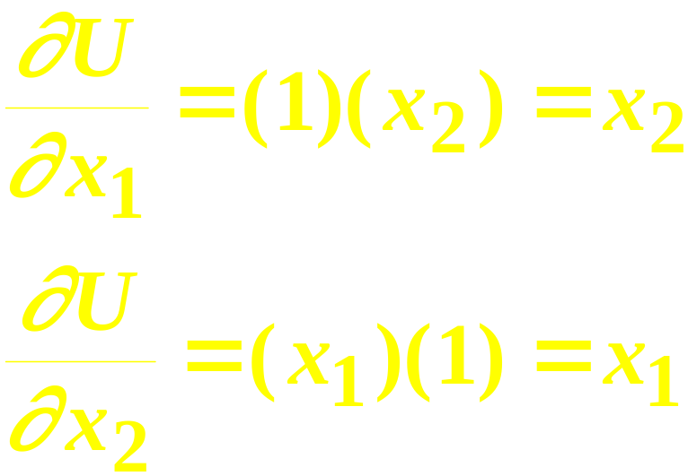
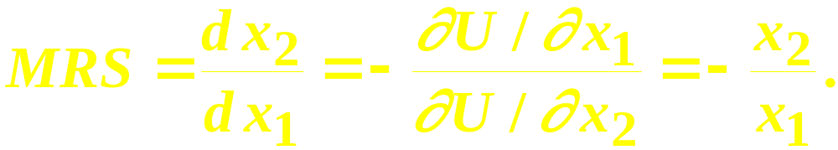
Marg. Utilities & Marg. Rates-of-Substitution; An example
Suppose U(x₁,x₂) = x₁x₂. Then
so

Slide 68
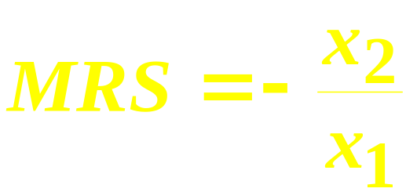
Marg. Utilities & Marg. Rates-of-Substitution; An example
U(x₁,x₂) = x₁x₂;
x₂
8
MRS(1,8) = - 8/1 = -8
MRS(6,6) = - 6/6 = -1.
6
U = 36
U = 8
1
6
x₁

Slide 69
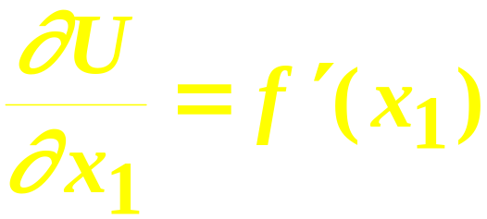
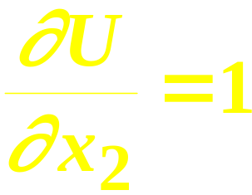
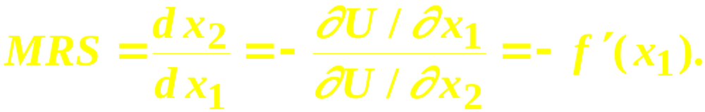
Marg. Rates-of-Substitution for Quasi-linear Utility Functions
A quasi-linear utility function is of the form U(x₁,x₂) = f(x₁) + x₂.
so

Slide 70
Marg. Rates-of-Substitution for Quasi-linear Utility Functions
′
MRS = - f (x₁) does not depend upon x₂ so the slope of indifference curves for a quasi-linear utility function is constant along any line for which x₁ is constant. What does that make the indifference map for a quasi-linear utility function look like?

Slide 71
Marg. Rates-of-Substitution for Quasi-linear Utility Functions
x₂
MRS =
- f(x₁’)
Each curve is a vertically shifted copy of the others.
MRS = -f(x₁”)
MRS is a constant
along any line for which x₁ is
constant.
x₁’
x₁”
x₁

Slide 72
Monotonic Transformations & Marginal Rates-of-Substitution
Applying a monotonic transformation to a utility function representing a preference relation simply creates another utility function representing the same preference relation.
What happens to marginal rates-of-substitution when a monotonic transformation is applied?

Slide 73
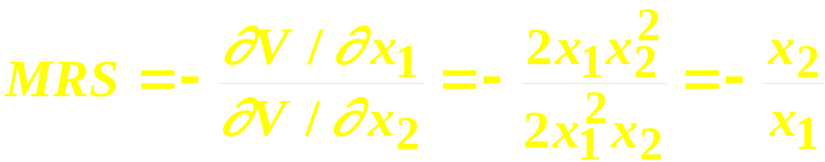
Monotonic Transformations & Marginal Rates-of-Substitution
For U(x₁,x₂) = x₁x₂ the MRS = - x₂/x₁.
Create V = U²; i.e. V(x₁,x₂) = x₁²x₂². What is the MRS for V?
which is the same as the MRS for U.

Slide 74
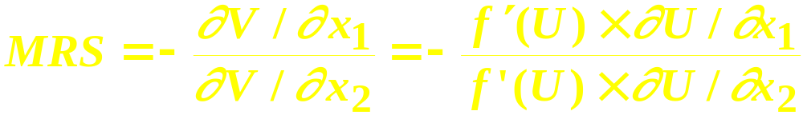
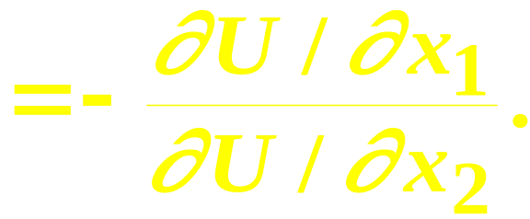
Monotonic Transformations & Marginal Rates-of-Substitution
More generally, if V = f(U) where f is a strictly increasing function, then
So MRS is unchanged by a positive
monotonic transformation.

