Slide 1
Chapter Eighteen
Technology

Slide 2
Technologies
A technology is a process by which inputs are converted to an output.
E.g. labor, a computer, a projector, electricity, and software are being combined to produce this lecture.

Slide 3
Technologies
Usually several technologies will produce the same product -- a blackboard and chalk can be used instead of a computer and a projector.
Which technology is “best”?
How do we compare technologies?

Slide 4
Input Bundles
x_{i} denotes the amount used of input i; i.e. the level of input i.
An input bundle is a vector of the input levels; (x₁, x₂, … , x_{n}).
E.g. (x₁, x₂, x₃) = (6, 0, 9⋅3).

Slide 5
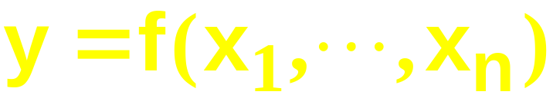
Production Functions
y denotes the output level.
The technology’s production function states the maximum amount of output possible from an input bundle.

Slide 6
Production Functions
One input, one output
Output Level
y = f(x) is the
production
function.
y’
y’ = f(x’) is the maximal output level obtainable from x’ input units.
x’
x
Input Level

Slide 7
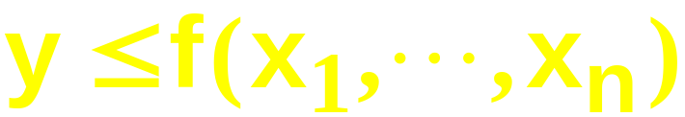
Technology Sets
A production plan is an input bundle and an output level; (x₁, … , x_{n}, y).
A production plan is feasible if
The collection of all feasible production plans is the technology set.

Slide 8
Technology Sets
One input, one output
Output Level
y = f(x) is the
production
function.
y’
y’ = f(x’) is the maximal output level obtainable from x’ input units.
y”
y” = f(x’) is an output level that is feasible from x’ input units.
x’
x
Input Level

Slide 9
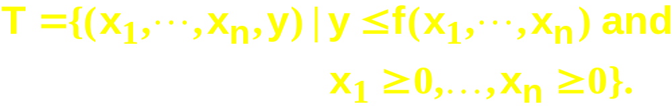
Technology Sets
The technology set is

Slide 10
Technology Sets
One input, one output
Output Level
y’
The technology
set
y”
x’
x
Input Level

Slide 11
Technology Sets
One input, one output
Output Level
Technically
efficient plans
y’
The technology
set
Technically
inefficient
plans
y”
x’
x
Input Level

Slide 12
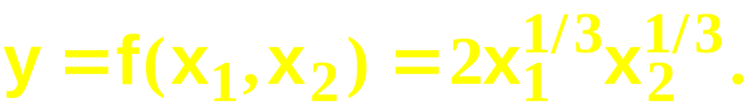
Technologies with Multiple Inputs
What does a technology look like when there is more than one input?
The two input case: Input levels are x₁ and x₂. Output level is y.
Suppose the production function is

Slide 13
Technologies with Multiple Inputs
E.g. the maximal output level possible from the input bundle
(x₁, x₂) = (1, 8) is
And the maximal output level possible from (x₁,x₂) = (8,8) is

Slide 14
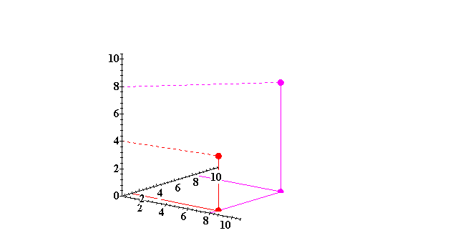
Technologies with Multiple Inputs
Output, y
x₂
(8,8)
(8,1)
x₁

Slide 15
Technologies with Multiple Inputs
The y output unit isoquant is the set of all input bundles that yield at most the same output level y.

Slide 16
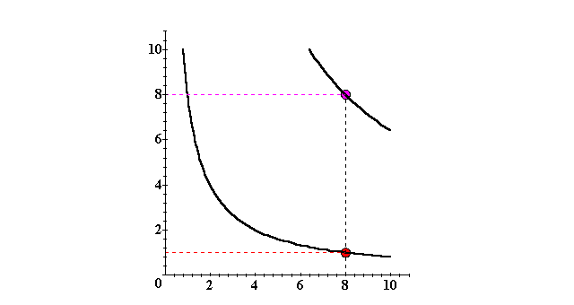
Isoquants with Two Variable Inputs
x₂
y ≡ 8
y ≡ 4
x₁

Slide 17
Isoquants with Two Variable Inputs
Isoquants can be graphed by adding an output level axis and displaying each isoquant at the height of the isoquant’s output level.

Slide 18
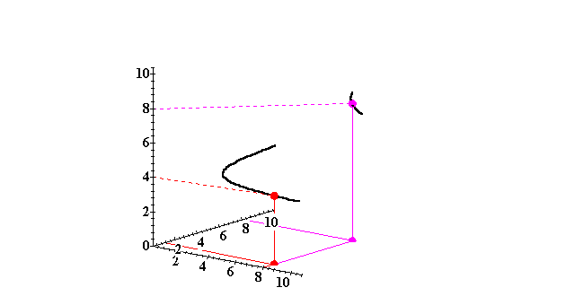
Isoquants with Two Variable Inputs
Output, y
y ≡ 8
x₂
y ≡ 4
x₁

Slide 19
Isoquants with Two Variable Inputs
More isoquants tell us more about the technology.

Slide 20
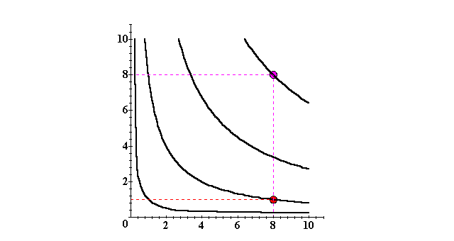
Isoquants with Two Variable Inputs
x₂
y ≡ 8
y ≡ 6
y ≡ 4
y ≡ 2
x₁

Slide 21
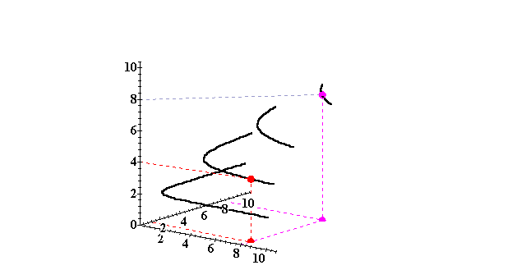
Isoquants with Two Variable Inputs
Output, y
y ≡ 8
y ≡ 6
x₂
y ≡ 4
y ≡ 2
x₁

Slide 22
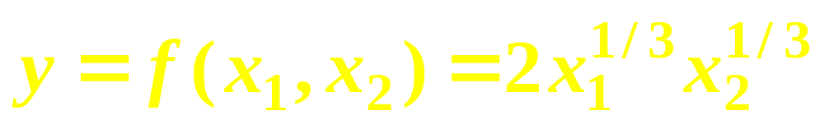
Technologies with Multiple Inputs
The complete collection of isoquants is the isoquant map.
The isoquant map is equivalent to the production function -- each is the other.
E.g.

Slide 23
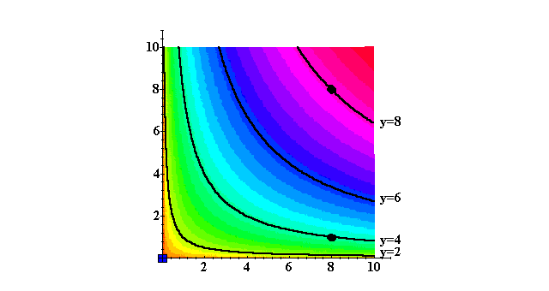
Technologies with Multiple Inputs
x₂
y
x₁

Slide 24
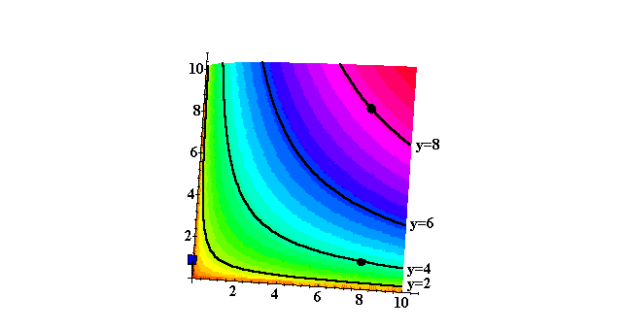
Technologies with Multiple Inputs
x₂
y
x₁

Slide 25
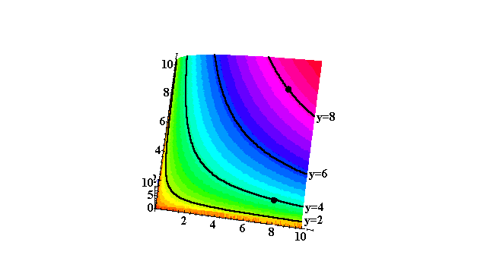
Technologies with Multiple Inputs
x₂
y
x₁

Slide 26
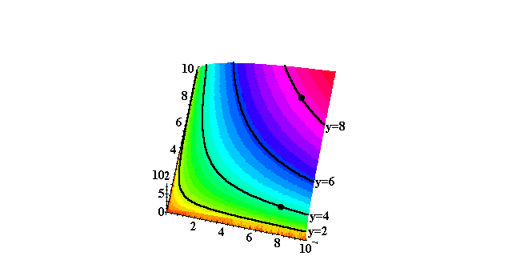
Technologies with Multiple Inputs
x₂
y
x₁

Slide 27
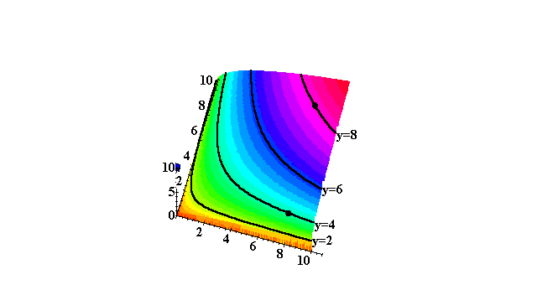
Technologies with Multiple Inputs
x₂
y
x₁

Slide 28
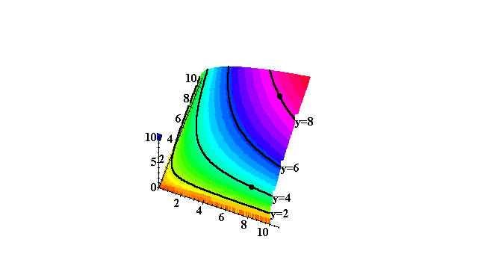
Technologies with Multiple Inputs
x₂
y
x₁

Slide 29
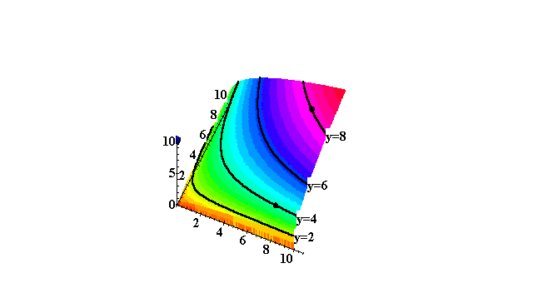
Technologies with Multiple Inputs
y
x₁

Slide 30
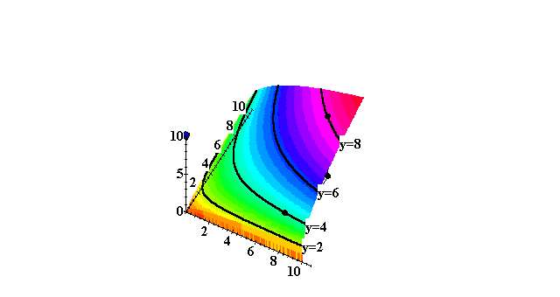
Technologies with Multiple Inputs
y
x₁

Slide 31
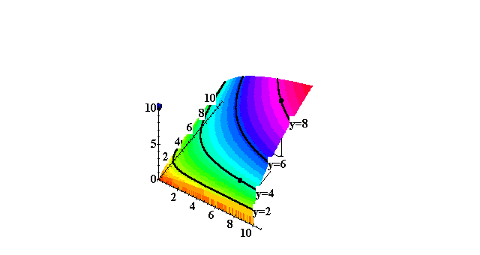
Technologies with Multiple Inputs
y
x₁

Slide 32
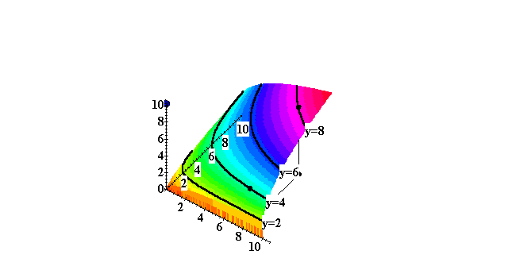
Technologies with Multiple Inputs
y
x₁

Slide 33
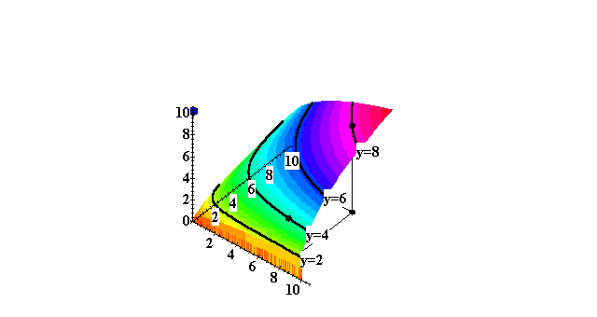
Technologies with Multiple Inputs
y
x₁

Slide 34
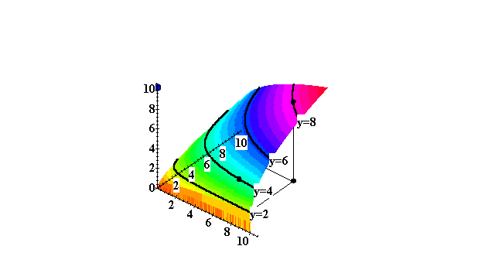
Technologies with Multiple Inputs
y
x₁

Slide 35
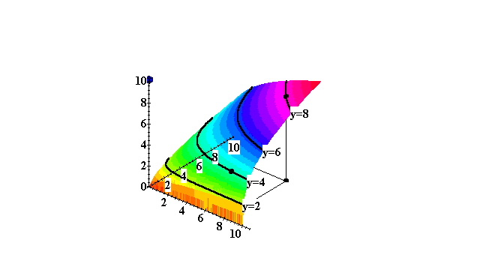
Technologies with Multiple Inputs
y
x₁

Slide 36
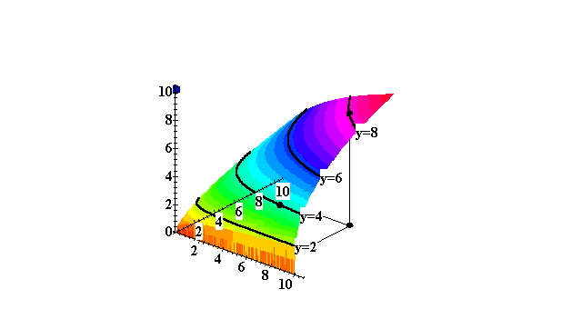
Technologies with Multiple Inputs
y
x₁

Slide 37

Technologies with Multiple Inputs
y
x₁

Slide 38
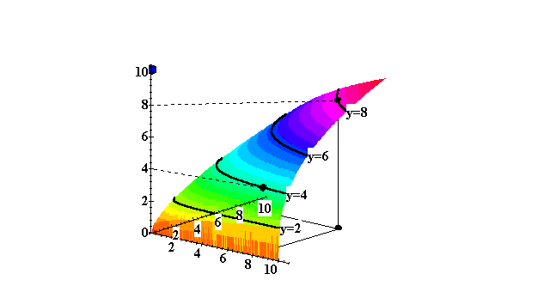

Technologies with Multiple Inputs
y
x₁

Slide 39

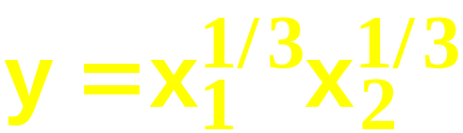
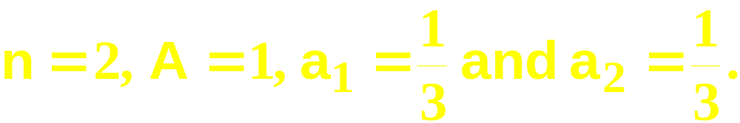
Cobb-Douglas Technologies
A Cobb-Douglas production function is of the form
E.g.
with

Slide 40
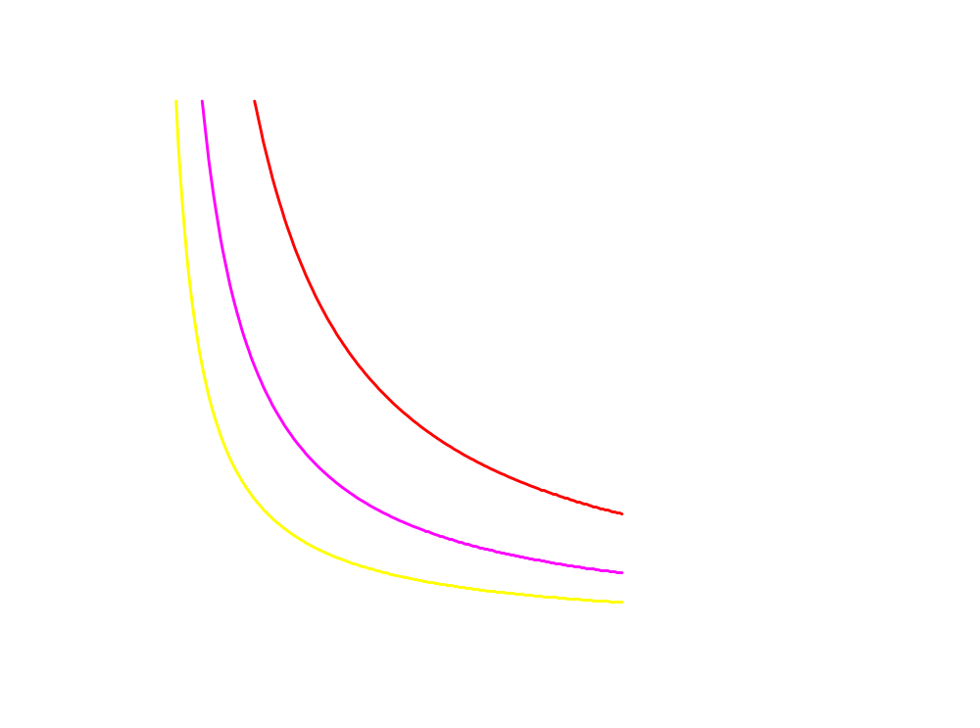
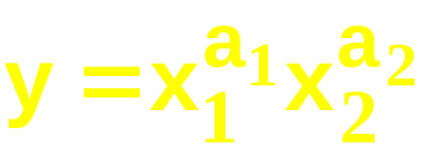
Cobb-Douglas Technologies
x₂
All isoquants are hyperbolic,
asymptoting to, but never
touching any axis.
x₁

Slide 41
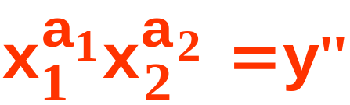
Cobb-Douglas Technologies
x₂
All isoquants are hyperbolic,
asymptoting to, but never
touching any axis.
x₁

Slide 42
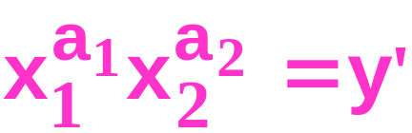
Cobb-Douglas Technologies
x₂
All isoquants are hyperbolic,
asymptoting to, but never
touching any axis.
x₁

Slide 43


Cobb-Douglas Technologies
x₂
All isoquants are hyperbolic,
asymptoting to, but never
touching any axis.
>
x₁

Slide 44
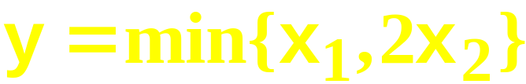
Fixed-Proportions Technologies
A fixed-proportions production function is of the form
E.g.
with

Slide 45
Fixed-Proportions Technologies
x₂
x₁ = 2x₂
7
min{x₁,2x₂} = 14
4
min{x₁,2x₂} = 8
2
min{x₁,2x₂} = 4
4
8
14
x₁

Slide 46
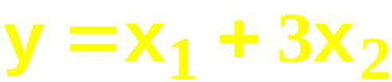
Perfect-Substitutes Technologies
A perfect-substitutes production function is of the form
E.g.
with

Slide 47
Perfect-Substitution Technologies
x₂
x₁ + 3x₂ = 18
x₁ + 3x₂ = 36
x₁ + 3x₂ = 48
8
6
All are linear and parallel
3
9
18
24
x₁

Slide 48
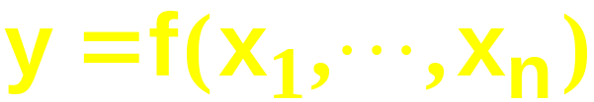
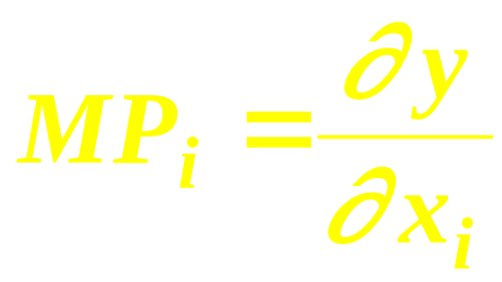
Marginal (Physical) Products
The marginal product of input i is the rate-of-change of the output level as the level of input i changes, holding all other input levels fixed.
That is,

Slide 49
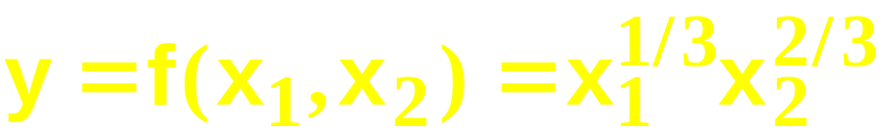
Marginal (Physical) Products
E.g. if
then the marginal product of input 1 is

Slide 50
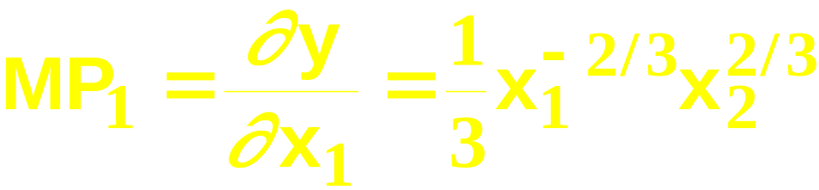
Marginal (Physical) Products
E.g. if
then the marginal product of input 1 is

Slide 51
Marginal (Physical) Products
E.g. if
then the marginal product of input 1 is
and the marginal product of input 2 is

Slide 52
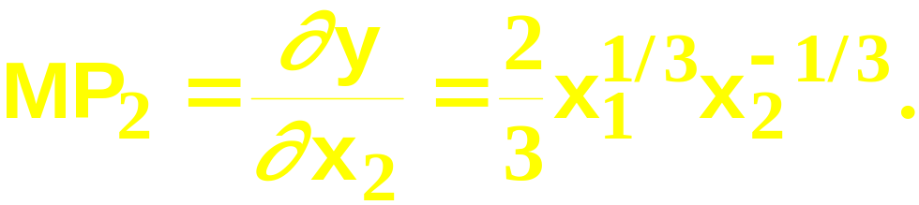
Marginal (Physical) Products
E.g. if
then the marginal product of input 1 is
and the marginal product of input 2 is

Slide 53
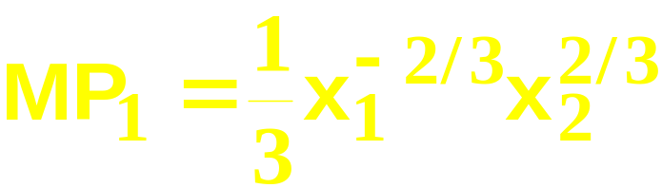
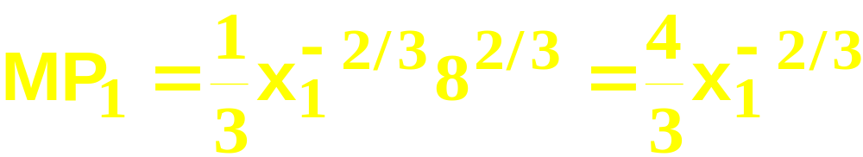
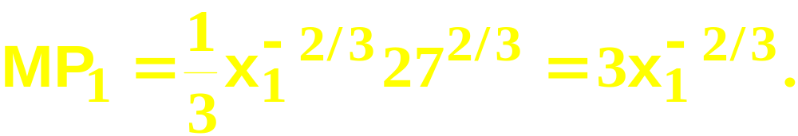
Marginal (Physical) Products
Typically the marginal product of one
input depends upon the amount used of other inputs. E.g. if
then,
if x₂ = 8,
and if x₂ = 27 then

Slide 54
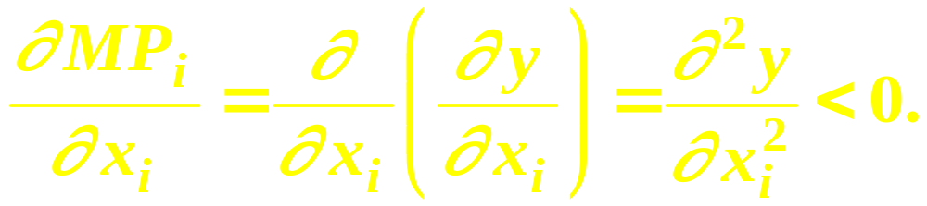
Marginal (Physical) Products
The marginal product of input i is diminishing if it becomes smaller as the level of input i increases. That is, if

Slide 55
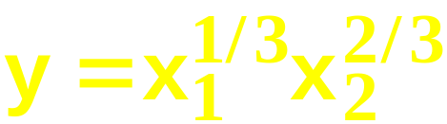
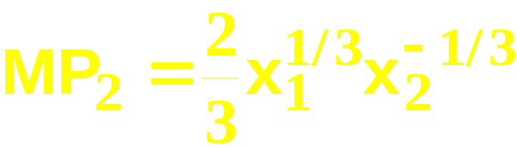
Marginal (Physical) Products
E.g. if
then
and

Slide 56
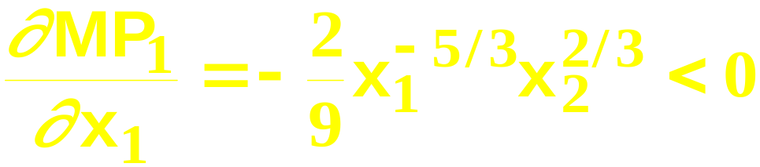
Marginal (Physical) Products
E.g. if
then
and
so

Slide 57
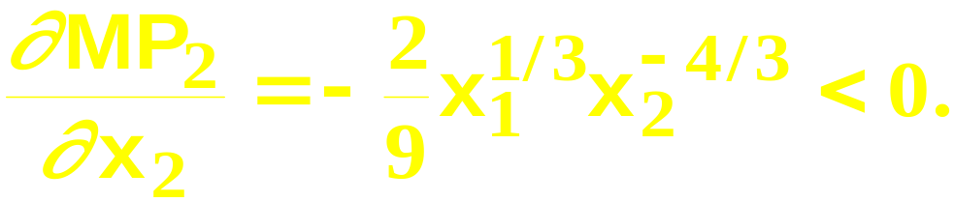
Marginal (Physical) Products
E.g. if
then
and
so
and

Slide 58
Marginal (Physical) Products
E.g. if
then
and
so
and
Both marginal products are diminishing.

Slide 59
Returns-to-Scale
Marginal products describe the change in output level as a single input level changes.
Returns-to-scale describes how the output level changes as all input levels change in direct proportion (e.g. all input levels doubled, or halved).

Slide 60
Returns-to-Scale
If, for any input bundle (x₁,…,x_{n}),
then the technology described by the
production function f exhibits constant
returns-to-scale.
E.g. (k = 2) doubling all input levels
doubles the output level.

Slide 61
Returns-to-Scale
One input, one output
Output Level
y = f(x)
2y’
Constant
returns-to-scale
y’
x’
2x’
x
Input Level

Slide 62
Returns-to-Scale
If, for any input bundle (x₁,…,x_{n}),
then the technology exhibits diminishing
returns-to-scale.
E.g. (k = 2) doubling all input levels less
than doubles the output level.

Slide 63
Returns-to-Scale
One input, one output
Output Level
2f(x’)
y = f(x)
f(2x’)
Decreasing
returns-to-scale
f(x’)
x’
2x’
x
Input Level

Slide 64
Returns-to-Scale
If, for any input bundle (x₁,…,x_{n}),
then the technology exhibits increasing
returns-to-scale.
E.g. (k = 2) doubling all input levels
more than doubles the output level.

Slide 65
Returns-to-Scale
One input, one output
Output Level
Increasing
returns-to-scale
y = f(x)
f(2x’)
2f(x’)
f(x’)
x’
2x’
x
Input Level

Slide 66
Returns-to-Scale
A single technology can ‘locally’ exhibit different returns-to-scale.

Slide 67
Returns-to-Scale
One input, one output
Output Level
y = f(x)
Increasing
returns-to-scale
Decreasing
returns-to-scale
x
Input Level

Slide 68
Examples of Returns-to-Scale
The perfect-substitutes production
function is
Expand all input levels proportionately
by k. The output level becomes

Slide 69
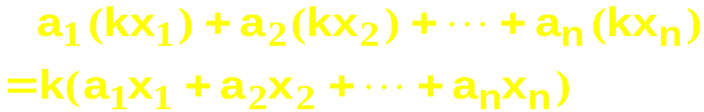
Examples of Returns-to-Scale
The perfect-substitutes production
function is
Expand all input levels proportionately
by k. The output level becomes

Slide 70
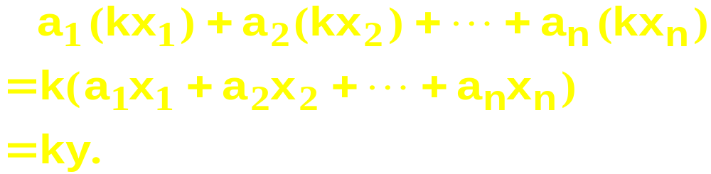
Examples of Returns-to-Scale
The perfect-substitutes production
function is
Expand all input levels proportionately
by k. The output level becomes
The perfect-substitutes production
function exhibits constant returns-to-scale.

Slide 71
Examples of Returns-to-Scale
The perfect-complements production
function is
Expand all input levels proportionately
by k. The output level becomes

Slide 72
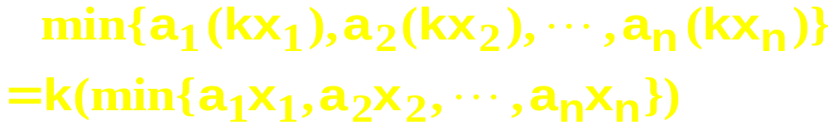
Examples of Returns-to-Scale
The perfect-complements production
function is
Expand all input levels proportionately
by k. The output level becomes

Slide 73
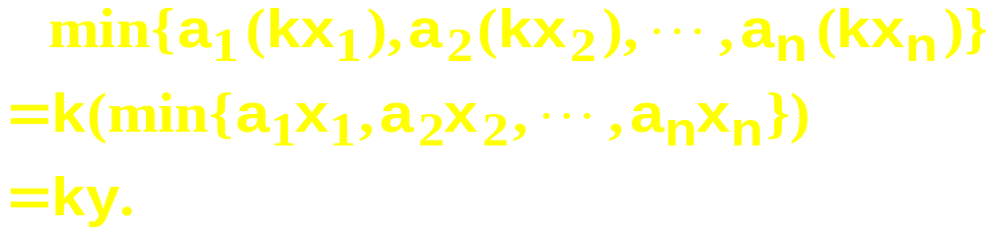
Examples of Returns-to-Scale
The perfect-complements production
function is
Expand all input levels proportionately
by k. The output level becomes
The perfect-complements production
function exhibits constant returns-to-scale.

Slide 74


Examples of Returns-to-Scale
The Cobb-Douglas production function is
Expand all input levels proportionately
by k. The output level becomes

Slide 75

Examples of Returns-to-Scale
The Cobb-Douglas production function is
Expand all input levels proportionately
by k. The output level becomes

Slide 76

Examples of Returns-to-Scale
The Cobb-Douglas production function is
Expand all input levels proportionately
by k. The output level becomes

Slide 77

Examples of Returns-to-Scale
The Cobb-Douglas production function is
Expand all input levels proportionately
by k. The output level becomes

Slide 78
Examples of Returns-to-Scale
The Cobb-Douglas production function is
The Cobb-Douglas technology’s returns-
to-scale is
constant if a₁+ … + a_{n} = 1

Slide 79
Examples of Returns-to-Scale
The Cobb-Douglas production function is
The Cobb-Douglas technology’s returns-
to-scale is
constant if a₁+ … + a_{n} = 1
increasing if a₁+ … + a_{n} > 1

Slide 80
Examples of Returns-to-Scale
The Cobb-Douglas production function is
The Cobb-Douglas technology’s returns-
to-scale is
constant if a₁+ … + a_{n} = 1
increasing if a₁+ … + a_{n} > 1
decreasing if a₁+ … + a_{n} < 1.

Slide 81
Returns-to-Scale
Q: Can a technology exhibit increasing returns-to-scale even though all of its marginal products are diminishing?

Slide 82

Returns-to-Scale
Q: Can a technology exhibit increasing returns-to-scale even if all of its marginal products are diminishing?
A: Yes.
E.g.

Slide 83


Returns-to-Scale
so this technology exhibits
increasing returns-to-scale.

Slide 84

Returns-to-Scale
so this technology exhibits
increasing returns-to-scale.
But
diminishes as x₁
increases

Slide 85

Returns-to-Scale
so this technology exhibits
increasing returns-to-scale.
But
diminishes as x₁
increases and
diminishes as x₁
increases.

Slide 86
Returns-to-Scale
So a technology can exhibit increasing returns-to-scale even if all of its marginal products are diminishing. Why?

Slide 87
Returns-to-Scale
A marginal product is the rate-of-change of output as one input level increases, holding all other input levels fixed.
Marginal product diminishes because the other input levels are fixed, so the increasing input’s units have each less and less of other inputs with which to work.

Slide 88
Returns-to-Scale
When all input levels are increased proportionately, there need be no diminution of marginal products since each input will always have the same amount of other inputs with which to work. Input productivities need not fall and so returns-to-scale can be constant or increasing.

Slide 89
Technical Rate-of-Substitution
At what rate can a firm substitute one input for another without changing its output level?

Slide 90
Technical Rate-of-Substitution
x₂
y≡100
x₁

Slide 91
Technical Rate-of-Substitution
The slope is the rate at which input 2 must be given up as input 1’s level is increased so as not to change the output level. The slope of an isoquant is its technical rate-of-substitution.
x₂
y≡100
x₁

Slide 92
Technical Rate-of-Substitution
How is a technical rate-of-substitution computed?

Slide 93


Technical Rate-of-Substitution
How is a technical rate-of-substitution computed?
The production function is
A small change (dx₁, dx₂) in the input bundle causes a change to the output level of

Slide 94

Technical Rate-of-Substitution
But dy = 0 since there is to be no change
to the output level, so the changes dx₁
and dx₂ to the input levels must satisfy

Slide 95



Technical Rate-of-Substitution
rearranges to
so

Slide 96

Technical Rate-of-Substitution
is the rate at which input 2 must be given
up as input 1 increases so as to keep
the output level constant. It is the slope
of the isoquant.

Slide 97




Technical Rate-of-Substitution; A Cobb-Douglas Example
so
and
The technical rate-of-substitution is

Slide 98


Technical Rate-of-Substitution; A Cobb-Douglas Example
x₂
x₁

Slide 99
Technical Rate-of-Substitution; A Cobb-Douglas Example
x₂
8
4
x₁

Slide 100
Technical Rate-of-Substitution; A Cobb-Douglas Example
x₂
6
12
x₁

Slide 101
Well-Behaved Technologies
A well-behaved technology is
  monotonic, and
  convex.

Slide 102
Well-Behaved Technologies - Monotonicity
Monotonicity: More of any input generates more output.
y
y
monotonic
not
monotonic
x
x

Slide 103
Well-Behaved Technologies - Convexity
Convexity: If the input bundles x’ and x” both provide y units of output then the mixture tx’ + (1-t)x” provides at least y units of output, for any 0 < t < 1.

Slide 104
Well-Behaved Technologies - Convexity
x₂
y≡100
x₁

Slide 105

Well-Behaved Technologies - Convexity
x₂
y≡100
x₁

Slide 106
Well-Behaved Technologies - Convexity
x₂
y≡120
y≡100
x₁

Slide 107
Well-Behaved Technologies - Convexity
x₂
Convexity implies that the TRS
increases (becomes less
negative) as x₁ increases.
x₁

Slide 108
Well-Behaved Technologies
higher output
x₂
y≡200
y≡50
y≡100
x₁

Slide 109
The Long-Run and the Short-Runs
The long-run is the circumstance in which a firm is unrestricted in its choice of all input levels.
There are many possible short-runs.
A short-run is a circumstance in which a firm is restricted in some way in its choice of at least one input level.

Slide 110
The Long-Run and the Short-Runs
Examples of restrictions that place a firm into a short-run:
  temporarily being unable to install, or remove, machinery
  being required by law to meet affirmative action quotas
  having to meet domestic content regulations.

Slide 111
The Long-Run and the Short-Runs
A useful way to think of the long-run is that the firm can choose as it pleases in which short-run circumstance to be.

Slide 112
The Long-Run and the Short-Runs
What do short-run restrictions imply for a firm’s technology?
Suppose the short-run restriction is fixing the level of input 2.
Input 2 is thus a fixed input in the short-run. Input 1 remains variable.

Slide 113

The Long-Run and the Short-Runs
x₂
y
x₁

Slide 114

The Long-Run and the Short-Runs
x₂
y
x₁

Slide 115

The Long-Run and the Short-Runs
x₂
y
x₁

Slide 116

The Long-Run and the Short-Runs
x₂
y
x₁

Slide 117

The Long-Run and the Short-Runs
x₂
y
x₁

Slide 118

The Long-Run and the Short-Runs
x₂
y
x₁

Slide 119

The Long-Run and the Short-Runs
x₂
y
x₁

Slide 120

The Long-Run and the Short-Runs
y
x₂
x₁

Slide 121

The Long-Run and the Short-Runs
y
x₂
x₁

Slide 122

The Long-Run and the Short-Runs
y
x₂
x₁

Slide 123

The Long-Run and the Short-Runs
y
x₁

Slide 124

The Long-Run and the Short-Runs
y
x₁

Slide 125

The Long-Run and the Short-Runs
y
x₁
Four short-run production functions.

Slide 126



The Long-Run and the Short-Runs
is the long-run production
function (both x₁ and x₂ are variable).
The short-run production function when
x₂ ≡ 1 is
The short-run production function when
x₂ ≡ 10 is

Slide 127




The Long-Run and the Short-Runs
y
x₁
Four short-run production functions.

