Slide 1
Chapter Nineteen
Profit-Maximization

Slide 2
Economic Profit
A firm uses inputs j = 1…,m to make products i = 1,…n.
Output levels are y₁,…,y_{n}.
Input levels are x₁,…,x_{m}.
Product prices are p₁,…,p_{n}.
Input prices are w₁,…,w_{m.}

Slide 3
The Competitive Firm
The competitive firm takes all output prices p₁,…,p_{n} and all input prices w₁,…,w_{m} as given constants.

Slide 4

Economic Profit
The economic profit generated by the production plan (x₁,…,x_{m},y₁,…,y_{n}) is

Slide 5
Economic Profit
Output and input levels are typically flows.
E.g. x₁ might be the number of labor units used per hour.
And y₃ might be the number of cars produced per hour.
Consequently, profit is typically a flow also; e.g. the number of dollars of profit earned per hour.

Slide 6
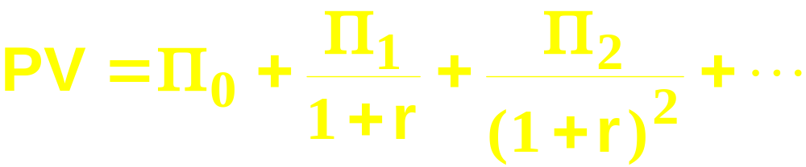
Economic Profit
How do we value a firm?
Suppose the firm’s stream of periodic economic profits is Π₀, Π₁, Π₂, … and r is the rate of interest.
Then the present-value of the firm’s economic profit stream is

Slide 7
Economic Profit
A competitive firm seeks to maximize its present-value.
How?

Slide 8

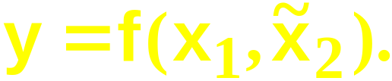
Economic Profit
Suppose the firm is in a short-run circumstance in which
Its short-run production function is

Slide 9


Economic Profit
Suppose the firm is in a short-run circumstance in which
Its short-run production function is
The firm’s fixed cost is
and its profit function is

Slide 10

Short-Run Iso-Profit Lines
A $Π iso-profit line contains all the production plans that provide a profit level $Π .
A $Π iso-profit line’s equation is

Slide 11
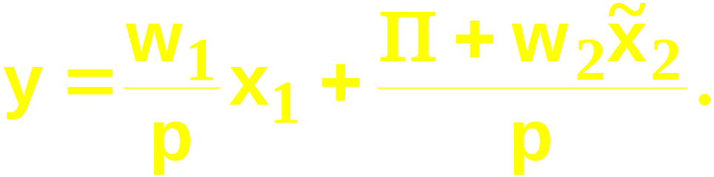
Short-Run Iso-Profit Lines
A $Π iso-profit line contains all the production plans that yield a profit level of $Π .
The equation of a $Π iso-profit line is
I.e.

Slide 12
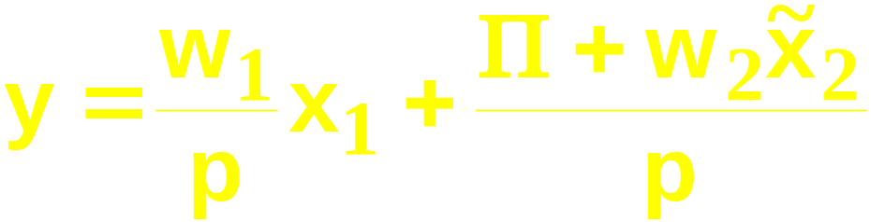
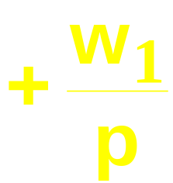
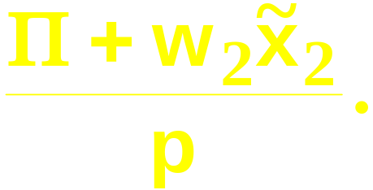
Short-Run Iso-Profit Lines
has a slope of
and a vertical intercept of

Slide 13



Short-Run Iso-Profit Lines
y
Increasing
profit
x₁

Slide 14
Short-Run Profit-Maximization
The firm’s problem is to locate the production plan that attains the highest possible iso-profit line, given the firm’s constraint on choices of production plans.
Q: What is this constraint?

Slide 15
Short-Run Profit-Maximization
The firm’s problem is to locate the production plan that attains the highest possible iso-profit line, given the firm’s constraint on choices of production plans.
Q: What is this constraint?
A: The production function.

Slide 16

Short-Run Profit-Maximization
y
The short-run production function and
technology set for
Technically
inefficient
plans
x₁

Slide 17
Short-Run Profit-Maximization
y
Increasing
profit
x₁

Slide 18


Short-Run Profit-Maximization
y
x₁

Slide 19
Short-Run Profit-Maximization
Given p, w₁ and the short-run
profit-maximizing plan is
y
x₁

Slide 20
Short-Run Profit-Maximization
Given p, w₁ and the short-run
profit-maximizing plan is
And the maximum
possible profit
is
y
x₁

Slide 21
Short-Run Profit-Maximization
At the short-run profit-maximizing plan, the slopes of the short-run production function and the maximal
iso-profit line are
equal.
y
x₁

Slide 22
Short-Run Profit-Maximization
At the short-run profit-maximizing plan, the slopes of the short-run production function and the maximal
iso-profit line are
equal.
y
x₁

Slide 23


Short-Run Profit-Maximization
is the marginal revenue product of
input 1, the rate at which revenue increases
with the amount used of input 1.
If then profit increases with x₁.
If then profit decreases with x₁.

Slide 24
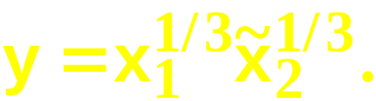
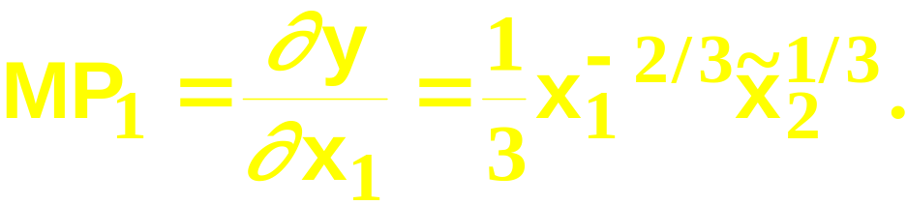

Short-Run Profit-Maximization; A Cobb-Douglas Example
Suppose the short-run production
function is
The marginal product of the variable
input 1 is
The profit-maximizing condition is

Slide 25
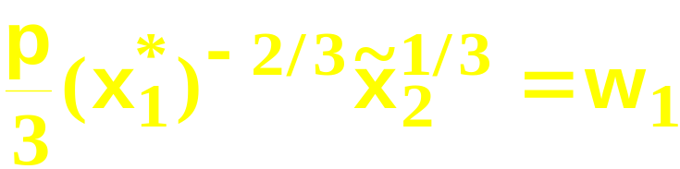
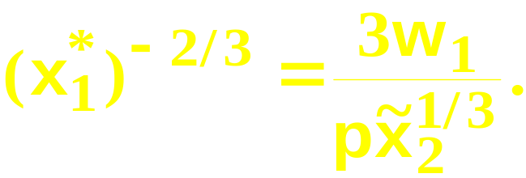
Short-Run Profit-Maximization; A Cobb-Douglas Example
Solving
for x₁ gives

Slide 26
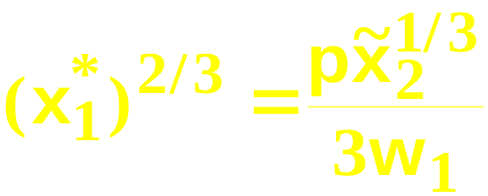
Short-Run Profit-Maximization; A Cobb-Douglas Example
Solving
for x₁ gives
That is,

Slide 27
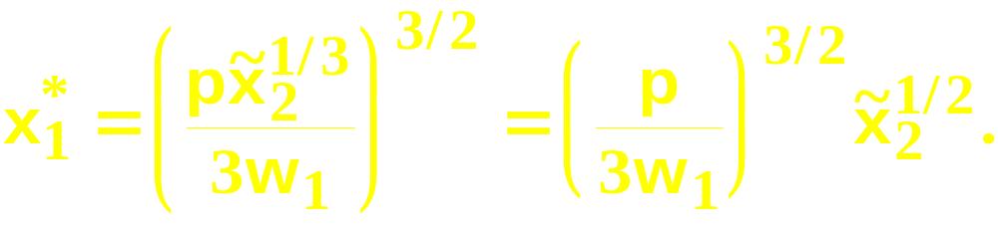
Short-Run Profit-Maximization; A Cobb-Douglas Example
Solving
for x₁ gives
That is,
so

Slide 28
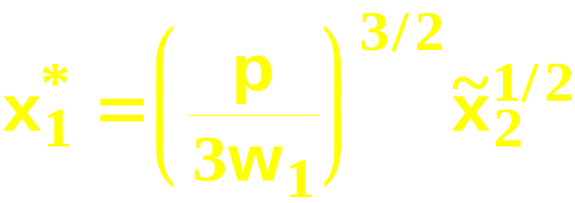
Short-Run Profit-Maximization; A Cobb-Douglas Example
is the firm’s
short-run demand
for input 1 when the level of input 2 is fixed at units.

Slide 29
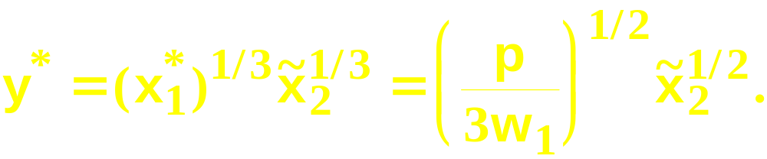
Short-Run Profit-Maximization; A Cobb-Douglas Example
is the firm’s
short-run demand
for input 1 when the level of input 2 is fixed at units.
The firm’s short-run output level is thus

Slide 30
Comparative Statics of Short-Run Profit-Maximization
What happens to the short-run profit-maximizing production plan as the output price p changes?

Slide 31
Comparative Statics of Short-Run Profit-Maximization
The equation of a short-run iso-profit line
is
so an increase in p causes
-- a reduction in the slope, and
-- a reduction in the vertical intercept.

Slide 32


Comparative Statics of Short-Run Profit-Maximization
y
x₁

Slide 33

Comparative Statics of Short-Run Profit-Maximization
y
x₁

Slide 34


Comparative Statics of Short-Run Profit-Maximization
y
x₁

Slide 35
Comparative Statics of Short-Run Profit-Maximization
An increase in p, the price of the firm’s output, causes
  an increase in the firm’s output level (the firm’s supply curve slopes upward), and
  an increase in the level of the firm’s variable input (the firm’s demand curve for its variable input shifts outward).

Slide 36
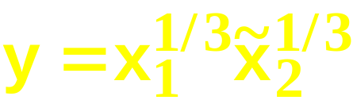
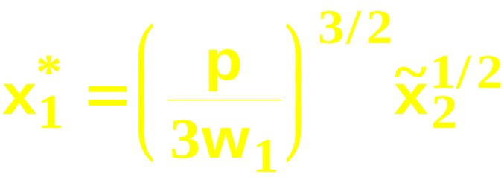
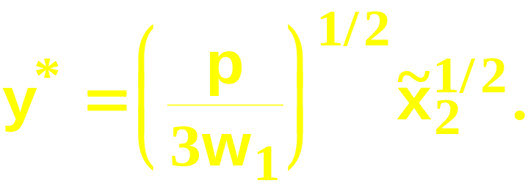
Comparative Statics of Short-Run Profit-Maximization
The Cobb-Douglas example: When
then the firm’s short-run
demand for its variable input 1 is
and its short-run
supply is

Slide 37

Comparative Statics of Short-Run Profit-Maximization
The Cobb-Douglas example: When
then the firm’s short-run
demand for its variable input 1 is
and its short-run
supply is
increases as p increases.

Slide 38

Comparative Statics of Short-Run Profit-Maximization
The Cobb-Douglas example: When
then the firm’s short-run
demand for its variable input 1 is
and its short-run
supply is
increases as p increases.
increases as p increases.

Slide 39
Comparative Statics of Short-Run Profit-Maximization
What happens to the short-run profit-maximizing production plan as the variable input price w₁ changes?

Slide 40
Comparative Statics of Short-Run Profit-Maximization
The equation of a short-run iso-profit line
is
so an increase in w₁ causes
-- an increase in the slope, and
-- no change to the vertical intercept.

Slide 41
Comparative Statics of Short-Run Profit-Maximization
y
x₁

Slide 42
Comparative Statics of Short-Run Profit-Maximization
y
x₁

Slide 43


Comparative Statics of Short-Run Profit-Maximization
y
x₁

Slide 44
Comparative Statics of Short-Run Profit-Maximization
An increase in w₁, the price of the firm’s variable input, causes
  a decrease in the firm’s output level (the firm’s supply curve shifts inward), and
  a decrease in the level of the firm’s variable input (the firm’s demand curve for its variable input slopes downward).

Slide 45
Comparative Statics of Short-Run Profit-Maximization
The Cobb-Douglas example: When
then the firm’s short-run
demand for its variable input 1 is
and its short-run
supply is

Slide 46
Comparative Statics of Short-Run Profit-Maximization
The Cobb-Douglas example: When
then the firm’s short-run
demand for its variable input 1 is
and its short-run
supply is
decreases as w₁ increases.

Slide 47
Comparative Statics of Short-Run Profit-Maximization
The Cobb-Douglas example: When
then the firm’s short-run
demand for its variable input 1 is
and its short-run
supply is
decreases as w₁ increases.
decreases as w₁ increases.

Slide 48
Long-Run Profit-Maximization
Now allow the firm to vary both input levels.
Since no input level is fixed, there are no fixed costs.

Slide 49
Long-Run Profit-Maximization
Both x₁ and x₂ are variable.
Think of the firm as choosing the production plan that maximizes profits for a given value of x₂, and then varying x₂ to find the largest possible profit level.

Slide 50
Long-Run Profit-Maximization
The equation of a long-run iso-profit line
is
so an increase in x₂ causes
-- no change to the slope, and
-- an increase in the vertical intercept.

Slide 51
Long-Run Profit-Maximization
y
x₁

Slide 52

Long-Run Profit-Maximization
y
x₁
Larger levels of input 2 increase the
productivity of input 1.

Slide 53


Long-Run Profit-Maximization
y
The marginal product
of input 2 is
diminishing.
x₁
Larger levels of input 2 increase the
productivity of input 1.

Slide 54
Long-Run Profit-Maximization
y
The marginal product
of input 2 is
diminishing.
x₁
Larger levels of input 2 increase the
productivity of input 1.

Slide 55


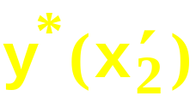
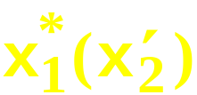
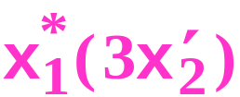

Long-Run Profit-Maximization
for each short-run
production plan.
y
x₁

Slide 56
Long-Run Profit-Maximization
for each short-run
production plan.
y
The marginal product
of input 2 is
diminishing so ...
x₁

Slide 57
Long-Run Profit-Maximization
for each short-run
production plan.
y
the marginal profit
of input 2 is
diminishing.
x₁

Slide 58


Long-Run Profit-Maximization
Profit will increase as x₂ increases so long as the marginal profit of input 2
The profit-maximizing level of input 2 therefore satisfies

Slide 59

Long-Run Profit-Maximization
Profit will increase as x₂ increases so long as the marginal profit of input 2
The profit-maximizing level of input 2 therefore satisfies
And is satisfied in any short-run, so ...

Slide 60
Long-Run Profit-Maximization
The input levels of the long-run profit-maximizing plan satisfy
That is, marginal revenue equals marginal cost for all inputs.
and

Slide 61
Long-Run Profit-Maximization
The Cobb-Douglas example: When
then the firm’s short-run
demand for its variable input 1 is
and its short-run
supply is
Short-run profit is therefore …

Slide 62
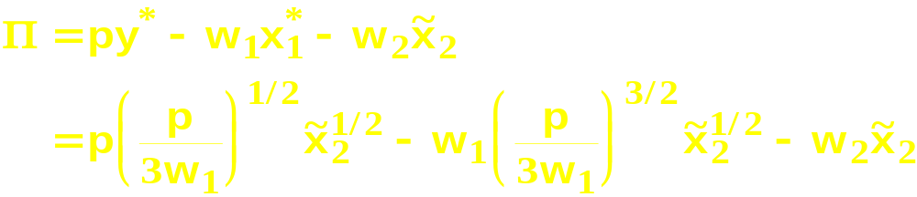
Long-Run Profit-Maximization

Slide 63
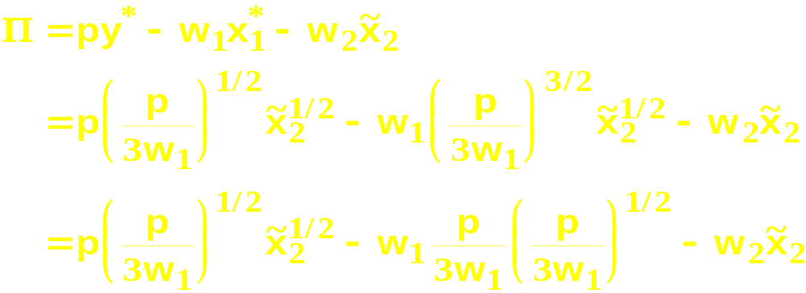
Long-Run Profit-Maximization

Slide 64
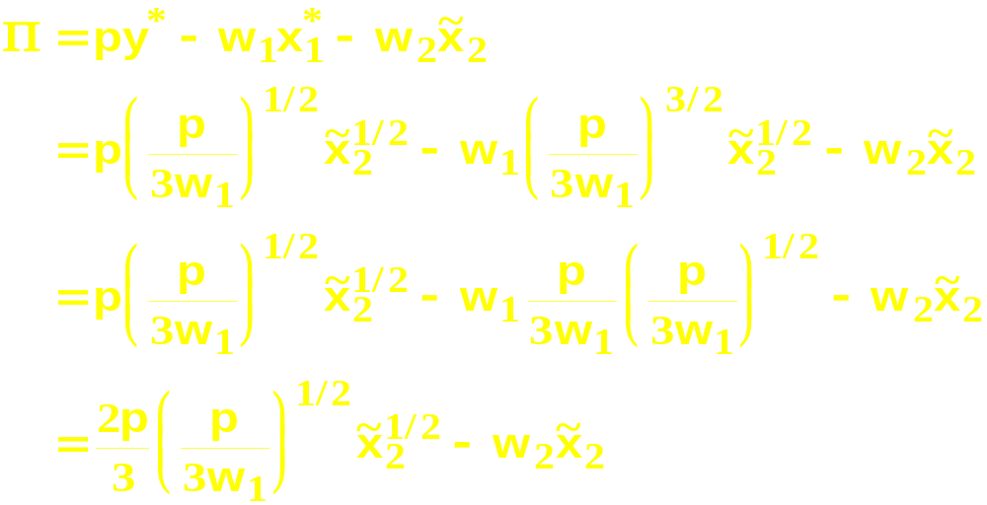
Long-Run Profit-Maximization

Slide 65
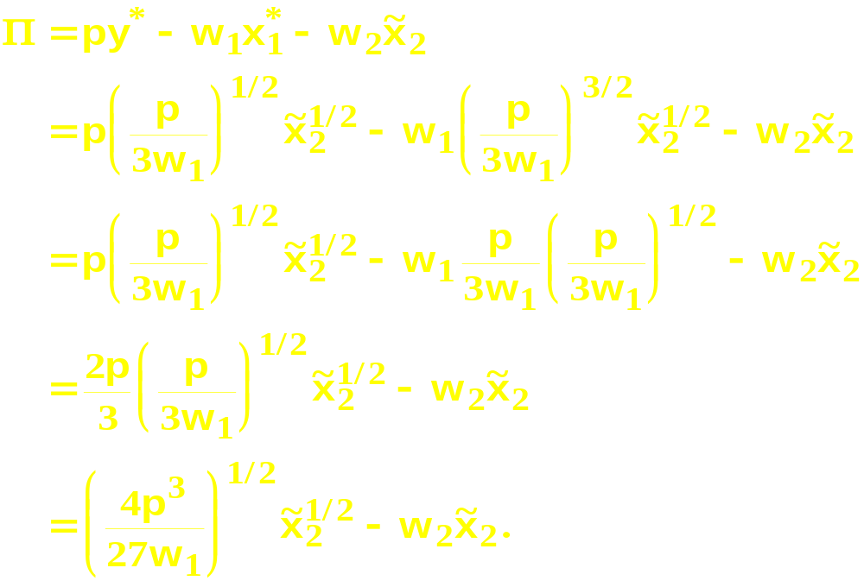
Long-Run Profit-Maximization

Slide 66
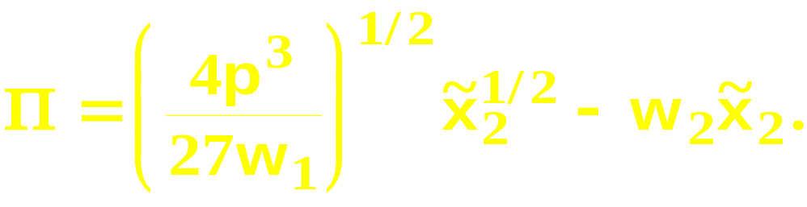
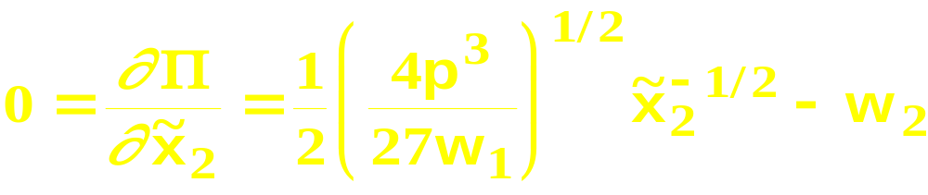
Long-Run Profit-Maximization
What is the long-run profit-maximizing
level of input 2? Solve
to get

Slide 67
Long-Run Profit-Maximization
What is the long-run profit-maximizing
input 1 level? Substitute
into
to get

Slide 68
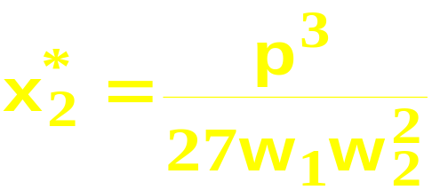
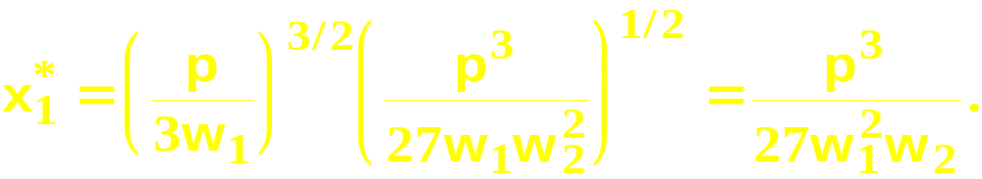
Long-Run Profit-Maximization
What is the long-run profit-maximizing
input 1 level? Substitute
into
to get

Slide 69
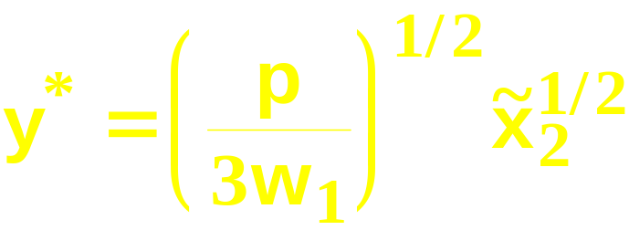
Long-Run Profit-Maximization
What is the long-run profit-maximizing
output level? Substitute
into
to get

Slide 70
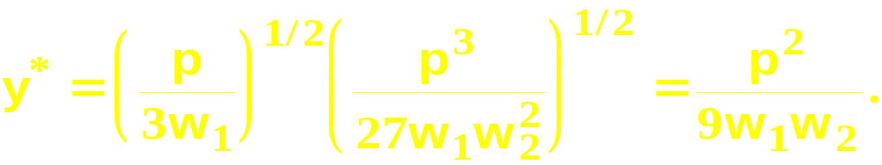
Long-Run Profit-Maximization
What is the long-run profit-maximizing
output level? Substitute
into
to get

Slide 71
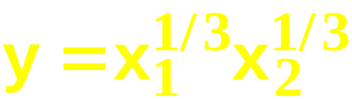
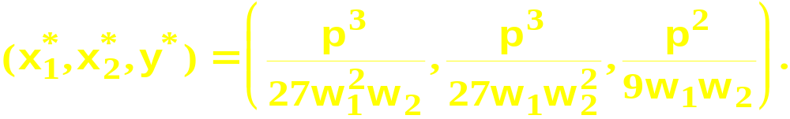
Long-Run Profit-Maximization
So given the prices p, w₁ and w₂, and
the production function
the long-run profit-maximizing production
plan is

Slide 72
Returns-to-Scale and Profit-Maximization
If a competitive firm’s technology exhibits decreasing returns-to-scale then the firm has a single long-run profit-maximizing production plan.

Slide 73

Returns-to Scale and Profit-Maximization
y
y*
Decreasing
returns-to-scale
x*
x

Slide 74
Returns-to-Scale and Profit-Maximization
If a competitive firm’s technology exhibits exhibits increasing returns-to-scale then the firm does not have a profit-maximizing plan.

Slide 75
Returns-to Scale and Profit-Maximization
y
Increasing
profit
y”
y’
Increasing
returns-to-scale
x’
x”
x

Slide 76
Returns-to-Scale and Profit-Maximization
So an increasing returns-to-scale technology is inconsistent with firms being perfectly competitive.

Slide 77
Returns-to-Scale and Profit-Maximization
What if the competitive firm’s technology exhibits constant returns-to-scale?

Slide 78
Returns-to Scale and Profit-Maximization
y
Increasing
profit
y”
Constant
returns-to-scale
y’
x’
x”
x

Slide 79
Returns-to Scale and Profit-Maximization
So if any production plan earns a positive profit, the firm can double up all inputs to produce twice the original output and earn twice the original profit.

Slide 80
Returns-to Scale and Profit-Maximization
Therefore, when a firm’s technology exhibits constant returns-to-scale, earning a positive economic profit is inconsistent with firms being perfectly competitive.
Hence constant returns-to-scale requires that competitive firms earn economic profits of zero.

Slide 81
Returns-to Scale and Profit-Maximization
y
Π = 0
y”
Constant
returns-to-scale
y’
x’
x”
x

Slide 82
Revealed Profitability
Consider a competitive firm with a technology that exhibits decreasing returns-to-scale.
For a variety of output and input prices we observe the firm’s choices of production plans.
What can we learn from our observations?

Slide 83
Revealed Profitability
If a production plan (x’,y’) is chosen at prices (w’,p’) we deduce that the plan (x’,y’) is revealed to be profit-maximizing for the prices (w’,p’).

Slide 84
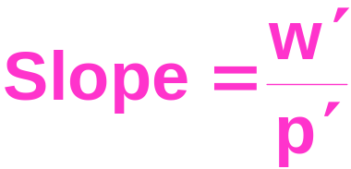


Revealed Profitability
is chosen at prices
y
x

Slide 85
Revealed Profitability
is chosen at prices so
is profit-maximizing at these prices.
y
x

Slide 86


Revealed Profitability
is chosen at prices so
is profit-maximizing at these prices.
y
would give higher
profits, so why is it not
chosen?
x

Slide 87
Revealed Profitability
is chosen at prices so
is profit-maximizing at these prices.
y
would give higher
profits, so why is it not
chosen? Because it is
not a feasible plan.
x

Slide 88
Revealed Profitability
is chosen at prices so
is profit-maximizing at these prices.
y
would give higher
profits, so why is it not
chosen? Because it is
not a feasible plan.
x
So the firm’s technology set must lie under the
iso-profit line.

Slide 89
Revealed Profitability
is chosen at prices so
is profit-maximizing at these prices.
y
The technology
set is somewhere
in here
x
So the firm’s technology set must lie under the
iso-profit line.

Slide 90
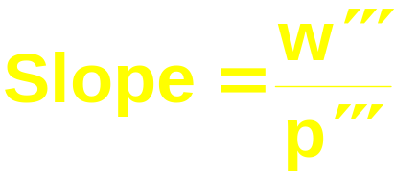


Revealed Profitability
is chosen at prices so
maximizes profit at these prices.
y
would provide higher
profit but it is not chosen
x

Slide 91
Revealed Profitability
is chosen at prices so
maximizes profit at these prices.
y
would provide higher
profit but it is not chosen
because it is not feasible
x

Slide 92
Revealed Profitability
is chosen at prices so
maximizes profit at these prices.
y
would provide higher
profit but it is not chosen
because it is not feasible so
the technology set lies under
the iso-profit line.
x

Slide 93
Revealed Profitability
is chosen at prices so
maximizes profit at these prices.
y
The technology set is
also somewhere in
here.
x

Slide 94
Revealed Profitability
y
The firm’s technology set must lie under
both iso-profit lines
x

Slide 95
Revealed Profitability
y
The firm’s technology set must lie under
both iso-profit lines
The technology set
is somewhere
in this intersection
x

Slide 96
Revealed Profitability
Observing more choices of production plans by the firm in response to different prices for its input and its output gives more information on the location of its technology set.

Slide 97


Revealed Profitability
y
The firm’s technology set must lie under
all the iso-profit lines
x

Slide 98

Revealed Profitability
y
The firm’s technology set must lie under
all the iso-profit lines
x

Slide 99
Revealed Profitability
y
The firm’s technology set must lie under
all the iso-profit lines
x

Slide 100
Revealed Profitability
What else can be learned from the firm’s choices of profit-maximizing production plans?

Slide 101






Revealed Profitability
The firm’s technology set must lie under
all the iso-profit lines
y
is chosen at prices
so
is chosen at prices
so
x

Slide 102
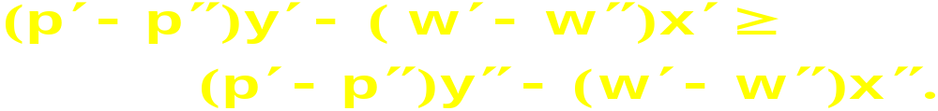
Revealed Profitability
and
so
and
Adding gives

Slide 103
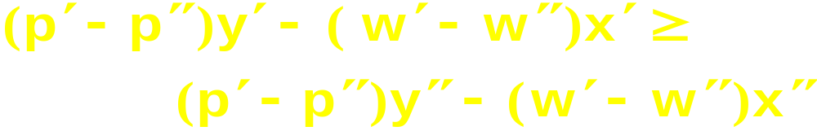

Revealed Profitability
so
That is,
is a necessary implication of profit-
maximization.

Slide 104


Revealed Profitability
is a necessary implication of profit-
maximization.
Suppose the input price does not change.
Then Δw = 0 and profit-maximization
implies ; i.e., a competitive
firm’s output supply curve cannot slope
downward.

Slide 105

Revealed Profitability
is a necessary implication of profit-
maximization.
Suppose the output price does not change.
Then Δp = 0 and profit-maximization
implies ; i.e., a competitive
firm’s input demand curve cannot slope
upward.

