Slide 1
An Introduction to Secure Sockets Layer (SSL)
Application Layer Security Protocol

Slide 2
Overview
Types of encryption
SSL History
Design Goals
Protocol
Problems
Competing Technologies

Slide 3
Types of Encryption
Symmetric Key
  Algorithm uses one key that is shared by sending and receiving parties
  Key is assumed to be transferred over a secure means
    Not very useful for internet communication
  General fast execution of algorithms

Slide 4
Types of Encryption
Asymmetric Key
  Algorithms use multiple keys that are shared by sending and receiving parties
  Keys are assumed to be transferred over a insecure means
  General slower execution of algorithms
  Keys can only decode text encoded with its pair (Public – Private)

Slide 5
What are SSL and TLS?
SSL – Secure Socket Layer
TLS – Transport Layer Security
both provide a secure transport connection between applications (e.g., a web server and a browser)
SSL was developed by Netscape
SSL version 3.0 has been implemented in many web browsers (e.g., Netscape Navigator and MS Internet Explorer) and web servers and widely used on the Internet
SSL v3.0 was specified in an Internet Draft (1996)
it evolved into TLS specified in RFC 2246
TLS can be viewed as SSL v3.1

Slide 6
SSL – Design Goals
Secure transmission between client and server at the lowest level – socket level
  Protocol sits on top of TCP
Peer Authentication
  Server is automatically authenticated, client is optionally
Efficiency
  Session caching
Extensible
  Can use numerous cipher algorithms

Slide 7
SSL – Design Goals – cont.
User transparent
Data integrity
  Message Authentication Code

Slide 8
The Idea
Encrypt the web traffic between two sites, so no one can listen in and get credit card numbers
Uses something called “Secure Sockets Layer” (SSL)

Slide 9
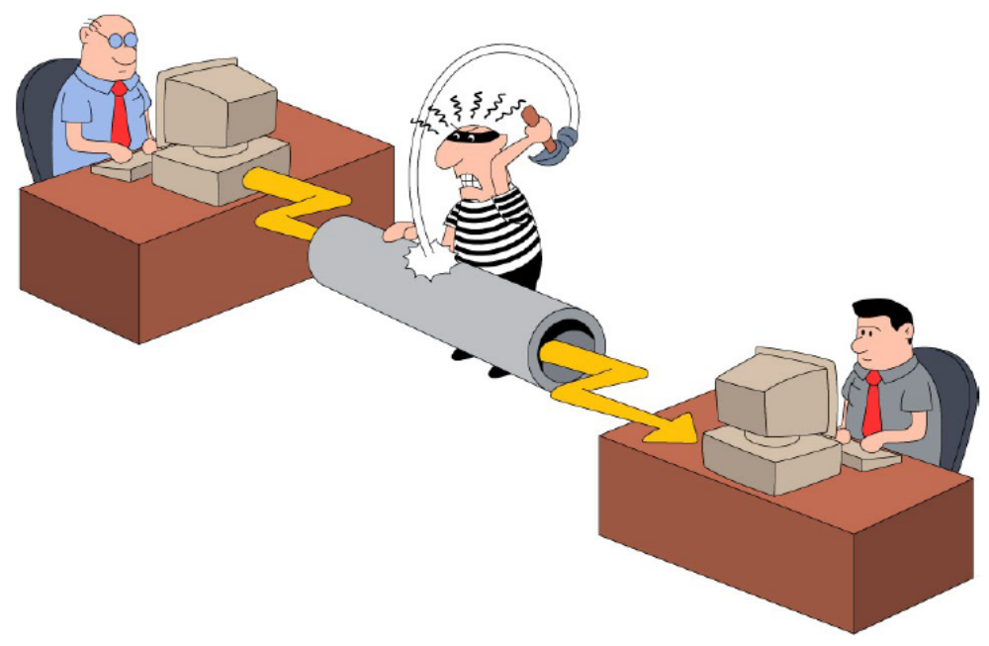
SSL (Secure Socket Layer)

Slide 10
SSL v3.0 Protocol Overview
  SSL is a layered protocol
  SSL takes messages to be transmitted, fragments the data into manageable blocks, optionally compresses the data, applies a MAC, encrypts, and transmits the result
  Received data is decrypted, verified, decompressed, and reassembled, then delivered to higher level clients.
  Connects on port 443 by default
  session-identifier cache timeout value of 100 seconds

Slide 11
SSL components
SSL Handshake Protocol
  negotiation of security algorithms and parameters
  key exchange
  server authentication and optionally client authentication
SSL Record Protocol
  fragmentation
  compression
  message authentication and integrity protection
  encryption
SSL Alert Protocol
  error messages (fatal alerts and warnings)
SSL Change Cipher Spec Protocol
  a single message that indicates the end of the SSL handshake

Slide 12
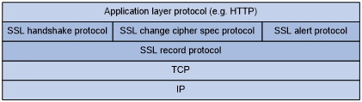
SSL Protocol Stack

Slide 13
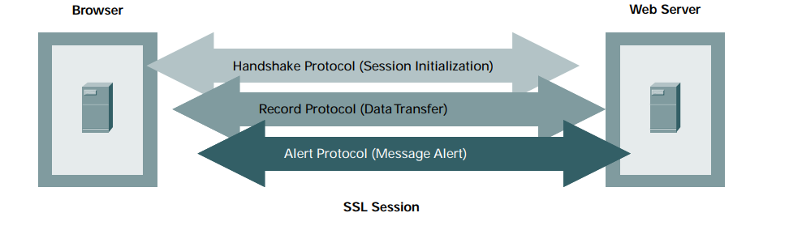
SSL Protocol Stack

Slide 14
SSL Protocols – cont.
Handshaking Protocol
  cryptographic parameters of the session state are produced by the SSL Handshake Protocol
    protocol version
    cryptographic algorithms
    optionally authenticate each other
    use public-key encryption techniques to generate shared secrets

Slide 15
The Implementation
The secure web site includes a digital certificate signed by some certificate authority. The certificate includes the server name, its public key, IP number, and an expiration date. It is typically signed with a 1024 bit key by the CA
The list of certificate authorities that you trust to identify people is available in Netscape by clicking on the lock icon at top; in IE, Internet Options->Content

Slide 16
Certificate
Subject Distinguished Name, Public Key
Issuer Distinguished Name, Signature
Period of Validity Not Before Date, Not After Date
Administrative Info Version, Serial Number
Extended Info

Slide 17
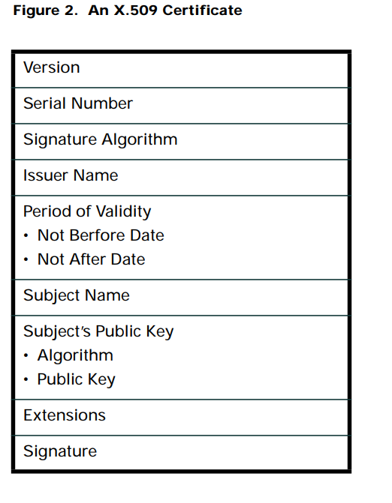

Slide 18
How It Works
The browser reads the site certificate; if it is signed by one of the trusted certificate authorities, browser accepts the certificate as valid
If the certificate is signed by some unknown certificate authority, Netscape will ask you if you want to trust the guy who signed it

Slide 19
How It Works (Basic Protocol )
The browser negotiates a secure session using something like the following protocol:
1: A->B: hello
2: B->A: Hi, I'm Bob, bobs-certificate
3: A->B: prove it
4: B->A: Alice, This Is bob
{ digest[Alice, This Is Bob] } bobs-private-key
5: A->B: ok bob, here is a secret {secret} bobs-public-key
6: B->A: {some message}secret-key

Slide 20
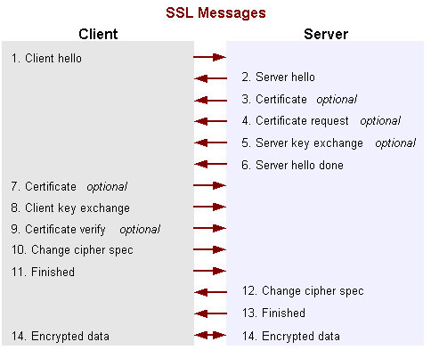
How SSL Works: the Handshake in Detail

Slide 21
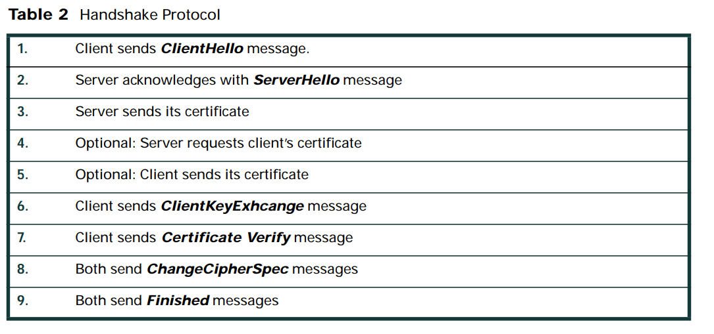

Slide 22
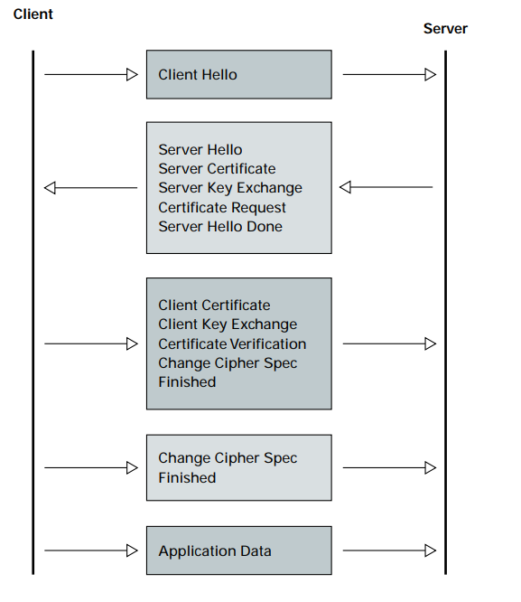

Slide 23
How It Works
Step 1: your browser introduces itself to the secure server
Step 2: the server responds by sending back a message with the certificate included
Step 3: Your browser tells the secure site to prove its identity, that it really is who it says it is.

Slide 24
How It Works
Step 4: The secure server proves who it is by creating a message for the browser, generating a “fingerprint” of that message, and encrypting the “fingerprint” with the private key that is matched to the public key in the certificate. The browser generates the “fingerprint” for the message itself, then decrypts the “fingerprint” generated by the server using the public key provided in the certificate.

Slide 25
How It Works
At this point the browser is sure that the server is who it says it is. It can send it secret messages encrypted with the public key provided in the certificate. The server (and only the server) can decrypt these messages, because only it has the private key.

Slide 26
How It Works
At this point what typically happens is that the browser generates a session key using a completely different encryption algorithm. A new session key is generated for every connection; this does not have to be a public key algorithm. You can use any encryption algorithm you like; usually a faster conventional, non-PK algorithm is used. This is usually 40 or 128 bits long in Netscape.

Slide 27
How It Works
You’ll use a completely different key for encrypting traffic to the web site every time you connect. This makes cracking communication more difficult; you need to discover the keys for every session rather than just one key.

Slide 28
Supported key exchange methods
RSA based (SSL_RSA_with...)
  the secret key (pre-master secret) is encrypted with the server’s public RSA key
  the server’s public key is made available to the client during the exchange
fixed Diffie-Hellman (SSL_DH_RSA_with… or SSL_DH_DSS_with…)
  the server has fix DH parameters contained in a certificate signed by a CA
  the client may have fix DH parameters certified by a CA or it may send an unauthenticated one-time DH public value in the client_key_exchange message
ephemeral Diffie-Hellman (SSL_DHE_RSA_with… or SSL_DHE_DSS_with…)
  both the server and the client generate one-time DH parameters
  the server signs its DH parameters with its private RSA or DSS key
  the client may authenticate itself (if requested by the server) by signing the hash of the handshake messages with its private RSA or DSS key
anonymous Diffie-Hellman
  both the server and the client generate one-time DH parameters
  they send their parameters to the peer without authentication
Fortezza
  Fortezza proprietary key exchange scheme

Slide 29
Server certificate and key exchange messages
certificate
  required for every key exchange method except for anonymous DH
  contains one or a chain of X.509 certificates (up to a known root CA)
  may contain
    public RSA key suitable for encryption, or
    public RSA or DSS key suitable for signing only, or
    fix DH parameters
server_key_exchange
  sent only if the certificate does not contain enough information to complete the key exchange (e.g., the certificate contains an RSA signing key only)
  may contain
    public RSA key (exponent and modulus), or
    DH parameters (p, g, public DH value), or
    Fortezza parameters
  digitally signed
    if DSS: SHA-1 hash of (client_random | server_random | server_params) is signed
    if RSA: MD5 hash and SHA-1 hash of (client_random | server_random | server_params) are concatenated and encrypted with the private RSA key

Slide 30
Certificate request and server hello done msgs
certificate_request
  sent if the client needs to authenticate itself
  specifies which type of certificate is requested (rsa_sign, dss_sign, rsa_fixed_dh, dss_fixed_dh, …)
server_hello_done
  sent to indicate that the server is finished its part of the key exchange
  after sending this message the server waits for client response
  the client should verify that the server provided a valid certificate and the server parameters are acceptable

Slide 31
Client authentication and key exchange
certificate
  sent only if requested by the server
  may contain
    public RSA or DSS key suitable for signing only, or
    fix DH parameters
client_key_exchange
  always sent (but it is empty if the key exchange method is fix DH)
  may contain
    RSA encrypted pre-master secret, or
    client one-time public DH value, or
    Fortezza key exchange parameters
certificate_verify
  sent only if the client sent a certificate
  provides client authentication
  contains signed hash of all the previous handshake messages
    if DSS: SHA-1 hash is signed
    if RSA: MD5 and SHA-1 hash is concatenated and encrypted with the private key
  MD5( master_secret | pad_2 | MD5( handshake_messages | master_secret | pad_1 ) )
  SHA( master_secret | pad_2 | SHA( handshake_messages | master_secret | pad_1 ) )

Slide 32
Finished messages
finished
  sent immediately after the change_cipher_spec message
  first message that uses the newly negotiated algorithms, keys, IVs, etc.
  used to verify that the key exchange and authentication was successful
  contains the MD5 and SHA-1 hash of all the previous handshake messages:
  MD5( master_secret | pad_2 | MD5( handshake_messages | sender | master_secret | pad_1 ) ) |
  SHA( master_secret | pad_2 | SHA( handshake_messages | sender | master_secret | pad_1 ) )
  where “sender” is a code that identifies that the sender is the client or the server (client: 0x434C4E54; server: 0x53525652)

Slide 33
SSL Protocol – cont.
Record Layer Protocol
  Header contains three parts, MAC, Actual Data and Padding Data
    MAC – Message Authentication Code ensures data integrity
      Like a checksum
    Padding – used to make data integral size for block ciphers
  Fragments data
    Restriction, 2^14 bytes or less
  Compresses fragments
    Restriction, never more than 2^14 + 1024 bytes

Slide 34
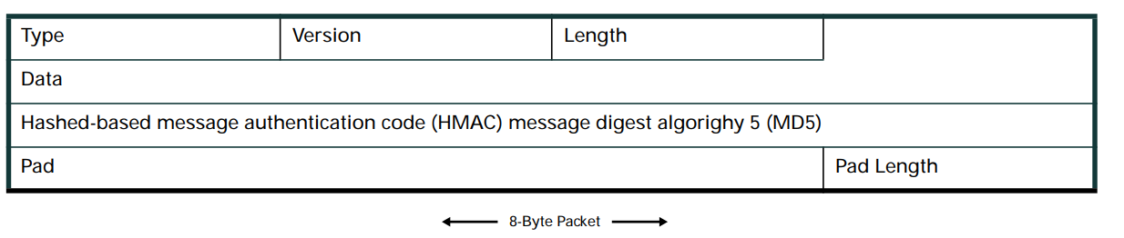

Slide 35
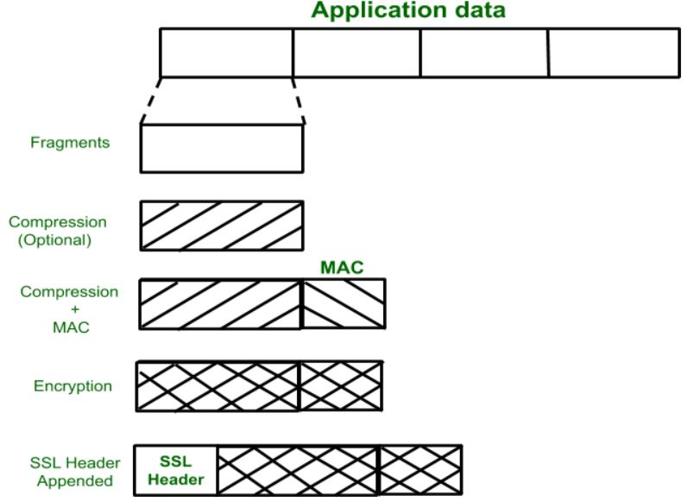

Slide 36
SSL Protocol – cont.
Alert layer
  Alert messages convey the severity of the message and a description of the alert
    close_notify
      Properly ends a session (avoids truncation error)
    All other types of error messages

Slide 37
SSL Protocol – cont.
Change Cipher Spec
  Used to change the cipher algorithm
  The protocol consists of a single message, which is encrypted and compressed under the current (not pending) cipher
    Copies pending to current cipher
  Client and Server both send message to notify the receiver that the cipher should be changed

Slide 38
Security Achieved by the
Secure Sockets Layer (SSL)
Confidentiality
  Encrypt data being sent between client and server, so that passive wiretappers cannot read sensitive data.
Integrity Protection
  Protect against modification of messages by an active wiretapper.
Authentication
  Verify that a peer is who they claim to be. Servers are usually authenticated, and clients may be authenticated if requested by servers

Slide 39
How SSL Achieves Confidentiality
Create a secret key
  Based on information generated by the client with a secure random number generator
Use public keys to exchange the secret key
  The server sends its public key to the client
  The client encrypts the secret key with the server's public key and sends it to the server
  The server decrypts the secret key information with the server’s private key
Encrypt and decrypt data with the secret key
  The client and server use the negotiated algorithm

Slide 40
How SSL Achieves Authentication
Optional
Protocol
  If the client wants to authenticate the server then they follow the protocol in “Authentication with a Public Key Certificate” with the client acting as Bob.
  If the server wants to authenticate the client then they follow the protocol in “Authentication with a Public Key Certificate” with the server acting as Bob.

Slide 41
Web Server Configuration
Secure servers listen on a different port by default than normal web servers. A new instance of the program should listen on port 443 rather than port 80.
To configure Apache: see http://www.modssl.org. The legality of the crypto package used is questionable if used for commercial purposes; the algorithms are encumbered with patent issues

Slide 42
Logistics
To set up a secure server you need to get a certificate. Most people go to verisign (www.verisign.com). Verisign charges $350 for a certificate for one web site; it is tied to that web site name (eg www.nps.navy.mil). For commercial entities they do a search of Dun & Bradstreet to ensure who you are. This is good for one year.
Other Certificate Authorities are www.thawte.com ($125), or any of those listed as signers in Netscape. You can set up your own CA and sign your own certificates.
Notes:
Old rates verify new rates

Slide 43
Certificate Authorities
You can become your own certificate authority. You can sign your own “CA certificate” and start handing out certificates yourself. (See certs for the CAS in netscape)
There are products from MS and Netscape that automate this process; users send in requests, and you return signed certificates.

Slide 44
Certificate Authorities
You become your own certificate authority mostly to hand out certificates to servers that are used internally, or to identify people inside the company.
NPS could become a certificate authority and hand out certificates to web servers on campus, or hand out certificates to users for email that needed to be authenticated

Slide 45
SSL Problems
People have been able to crack SSL encryption to find the key
Many users currently use SSL 2.0 instead of the version 3.0
  Version 2.0 does not authenticate the handshake
Firewalls can’t regulate data
Proxies can’t cache information

Slide 46
Recent Netscape Problem
Communicator 4.72, 4.61
  Man-in-the-middle attack
  correctly checks the certificate conditions at the beginning of a SSL session
  while this SSL session is still alive, all HTTPS connections to that server’s ip address are assumed to be a part of this session (and therefore certificate conditions are not checked again)
    The host name should also be checked in accordance with the SSL specification

Slide 47
Competing Technologies
Transport Layer Security (TLS)
  Internet Engineering Task Force (IETF)
    based on SSL
Secure Electronic Transactions (SET)
  Visa and Mastercard for bankcard transactions
    Makes sure that card holder and certificate holder are the same
    Digital Envelope ( generate rand. Key and sign with recipient’s public key)
PCT (Private Communications Technology)
  Microsoft
    has a second key specifically for authentication and a more robust random number generator

Slide 48
TCP/IP Protocol Stack With TLS/ SSL
TCP/IP Layer
Protocol
Application Layer
HTTP, IMAP, NNTP, Telnet, FTP, etc.
Secure Sockets Layer
SSL
Transport Layer
TCP
Internet Layer
IP

Slide 49
TLS VS SSL
version number
  for TLS the current version number is 3.1
MAC
  TLS uses HMAC
  the MAC covers the version field of the record header too
more alert codes
cipher suites
  TLS doesn’t support Fortezza key exchange and Fortezza encryption
certificate_verify message
  the hash is computed only over the handshake messages
  in SSL the hash contained the master_secret and pads

Slide 50
RSA Cipher Suite
Strongest cipher
  Triple DES 168-bit and SHA-1 message authentication (3.7 * 10⁵⁰)
Strong ciphers
  RC4 128-bit and MD5 (3.4 * 10³⁸ possible keys)
  RC2 128-bit and MD5
  DES 56-bit and SHA-1 (7.2 * 10¹⁶ possible keys)
Exportable cipher suites (France accepts them only with ssl)
  RC4 40-bit and MD5 (1.1 * 10¹²⁾
  RC2 40-bit and MD5
    RC2 is block cipher and RC4 is a stream cipher
    MD5. Message Digest algorithm developed by Rivest
    SHA-1. Secure Hash Algorithm, a hash function used by the U.S. Government

Slide 51
Fortezza Cipher Suite
Strong FORTEZZA ciphers suites
  RC4 128-bit and SHA-1 (3.4 * 10³⁸)
RC4 with SKIPJACK 80-bit encryption and SHA-1
  The SKIPJACK cipher is a classified symmetric-key cryptographic algorithm implemented in FORTEZZA-compliant hardware

Slide 52
Some Links to SSL
Protocol explanations
  http://home.netscape.com/eng/ssl3/ssl-toc.html
  https://aboutssl.org/download-ssl-guide-ebook/

Slide 53
references
M. Bellare, R. Canetti, and H. Krawczyk, \Keying Hash Functions for Message Authentication," Advances in Cryptology|CRYPTO '96 Proceedings, Springer-Verlag, 1996, pp. 1{15.
S. Bellovin, \Problem Areas for the IP Security Protocols", Proceedings of the Sixth USENIX Security Symposium, Usenix Association, 1996, pp.
A. Freier, P. Karlton, and P. Kocher, \The SSL Protocol Version 3.0", ftp://ftp.netscape.com/pub/review/ ssl-spec.tar.Z, March 4 1996, Internet Draft, work in progress. [Koc96] P. Kocher, personal communication, 1996.
V. Voydock and S. Kent, \Security Mechanisms in High-Level Network Protocols", ACM Computing Surveys, v. 5, n. 2, June 1983, pp. 135{171.
Benaloh, B. Lampson, D. Simon, T. Spies, and B. Yee, \Microsoft Corporation's

