Slide 1
Object Oriented Analysis and Design (OOAD)
Lecture 1
Dr. Taimoor Khan
National University of Computer & Emerging Sciences, Peshawar.

Slide 2
Recommended Books
  Craig Larman: Applying UML
  Patterns, Pearson – Prentice Hall, 2005
Recommended books:
  Object Oriented Modeling and Design using UML, 2nd Edition Author(s): Simon Benett, Ray Farmer Publisher: McGraw- Hill
  Introduction to object oriented analysis & design with UML and unified process, Author(s): Stephen R. Schach; McGraw Hill, 2004.
  Object Oriented Analysis & Design with Applications, 2nd Edition Author(s): Grady Booch Publisher: Addison Wesley
National University of Computer & Emerging Sciences, Peshawar.

Slide 3
Object Oriented Analysis and Design (OOAD)
Module Material
  All course related material will be shared on slate.
National University of Computer & Emerging Sciences, Peshawar.

Slide 4
Course Etiquette
Code of conduct
  Copying, cheating or immature behavior will not be tolerated.
You are encouraged to attend to all lectures, (anyway, you already know attendance rules).
You are encouraged to ask questions.
You are also encouraged to offer answers.
The objective of the class is to create together a learning environment.
National University of Computer & Emerging Sciences, Peshawar.

Slide 5
Objectives of the Class
Appreciate Software Engineering:
  Build complex software systems in the context of frequent change using object oriented paradigm.
Understand how to
  Produce a high quality software system within time
  While dealing with complexity and change
Acquire technical knowledge (main emphasis)
Acquire managerial knowledge
National University of Computer & Emerging Sciences, Peshawar.

Slide 6
Recommended Books
  Craig Larman: Applying UML
  Patterns, Pearson – Prentice Hall, 2005
Recommended books:
  Object Oriented Modeling and Design using UML, 2nd Edition Author(s): Simon Benett, Ray Farmer Publisher: McGraw- Hill
  Introduction to object oriented analysis & design with UML and unified process, Author(s): Stephen R. Schach; McGraw Hill, 2004.
  Object Oriented Analysis & Design with Applications, 2nd Edition Author(s): Grady Booch Publisher: Addison Wesley
National University of Computer & Emerging Sciences, Peshawar.

Slide 7
Course Outline
Introduction to the course
Software Development Process
Concept of Object Oriented Programing
Object-Oriented vs. Structured Analysis & Design
Software Development Life Cycle (SDLC)
Waterfall vs. Iterative/Incremental Software Development
Unified Process (UP) & Phases of Unified Process
Unified Modeling Language (UML) Activities during Inception Phase & Domain Modelling Concepts
National University of Computer & Emerging Sciences, Peshawar.

Slide 8
Course Outline (contd…)
Case studies for Use Cases and Requirements.
Case studies covering Use Case diagrams, System Sequence Diagrams (SSD), Sequence Diagrams, Communication Diagrams, Class Diagrams.
Implementation (Mapping Design-to-Code) Issues.
Design Patterns i.e. General Responsibility Assignment Software Patterns (GRASP) Design Patterns and Gang-of-Four (GoF) Design Patterns.
System Integration and Testing.
National University of Computer & Emerging Sciences, Peshawar.

Slide 9
What is ‘Software Engineering’?...
A term used occasionally in 1950s, 1960s
Popularized in 1968 at NATO Software Engineering Conference (http://homepages.cs.ncl.ac.uk/brian.randell/NATO/)
National University of Computer & Emerging Sciences, Peshawar.
Notes:
Large, high quality software systems
Software engineering techniques are needed because large systems cannot be completely understood by one person
Teamwork and co-ordination are required
Key challenge: Dividing up the work and ensuring that the parts of the system work properly together
The end-product that is produced must be of sufficient quality

Slide 10
What is Software?
More than computer programs.
The collection of programs, documentation and configuration data that ensures correct execution.
Three major types:
  Generic Product: Stand alone, Sold on open market.
  Customized Product: For specific customer.
  Embedded Product: Built into hardware.
National University of Computer & Emerging Sciences, Peshawar.

Slide 11
The Nature of Software
Intangible:
  Opposite of physical artifacts, e.g., Computer vs Windows XP
  Hard to understand the development process.
Easy to Reproduce:
  Costly design and construction, cheap manufacturing.
Malleable:
  Easy to change, even without full understanding.
  Untrained people can “hack” something together.
National University of Computer & Emerging Sciences, Peshawar.

Slide 12
Software Development Problems
“Software is not constrained by materials, or governed by physical laws, or by manufacturing process” ---- (Sommerville, Software Engineering)
Allows almost unbounded complexity:
  Exponential growth of complexity w.r.t. to the size of a program: twice the size, four times the complexity;
  Example: Windows XP has 40millions lines of source code (estimation).
National University of Computer & Emerging Sciences, Peshawar.

Slide 13
Software Development Problems
Difficulty in understanding and managing the complexity causes:
  Late completion:
    “vaporware” that are announced but never produced
  Overrunning Cost:
    Denver Airport Automated Baggage System, 2 billions US dollar over budget
  Unreliable
  Maintenance
  Etc…
National University of Computer & Emerging Sciences, Peshawar.

Slide 14
Introduction to OOAD
The proverb “owning a hammer doesn’t make one an architect” is especially true with respect to object technology
Knowing an object language is necessary but insufficient to create object systems
Its about analyzing system requirements in terms of objects and allocating responsibilities to class objects
How would these objects collaborate with each other
What classes should do what

Slide 15
OOA
It emphasizes on finding requirements and problems rather than solutions
Object oriented analysis is a process of analyzing requirements in an object oriented paradigm
It approves some of the requirements while discards others
The requirements are represented in the form of Use cases and personas to make more sense
Based on this OOA the OOD is built

Slide 16
Use Case
Use case consists of a paragraph or so text that presents a scenario of a single system requirement
It is written in simple English that would help realize the importance of the requirement and its contribution to the over all system
There can be many use cases for a system representing its various requirements
It is not an OO activity but it helps in the development of OOD

Slide 17
Use Case
Example
  Use Case “Login to System”
  The User accessing the system is asked for a username and password. On provision of the correct user name and password the user is allowed to enter the system.

Slide 18
Persona
Persona is an imaginary story in which the importance of the required system is highlighted.
It is in the form of a short story
It assumes a person with certain personal details whom the writer know
The writer explains the problems of the person in the persona with the current system and how it is lagging him behind
It also explains what the user actually wants things to be
In this way the requirements of the system are elaborated

Slide 19
OOD
It emphasizes on the conceptual solution in software or hardware that fulfills the requirements
It does not give any implementation details
Design ideas normally exclude low level details that are obvious to the intended customers
Ultimately designs can be implemented in code to give its true and complete realization

Slide 20
OOA vs OOD
In OOA there is an emphasis on finding and describing objects or concepts in the problem domain
For example in flight information system some of the objects are flights, planes and pilot
During OOD there is emphasis on defining software objects and how they collaborate with each other to fulfill requirements
For example a flight object may have attributes like flight duration, departure time, arrival time, source, destination etc.

Slide 21
UML
UML is a standard diagramming notation
UML is not OOAD or a method it is just a diagramming notation
It is useless to learn UML but not really know how to create an excellent OO design or evaluate and improve an existing one
To know how to design is a separate skill

Slide 22
UML perspectives
Conceptual perspective
  The diagrams are interpreted as describing things in a situation of the real world or domain of interest
Specification perspective
  The diagrams (using same notations) describe software abstraction or components with specifications and interfaces but no commitment to a particular implementation
Implementation perspective
  Software implementation in a particular technology

Slide 23
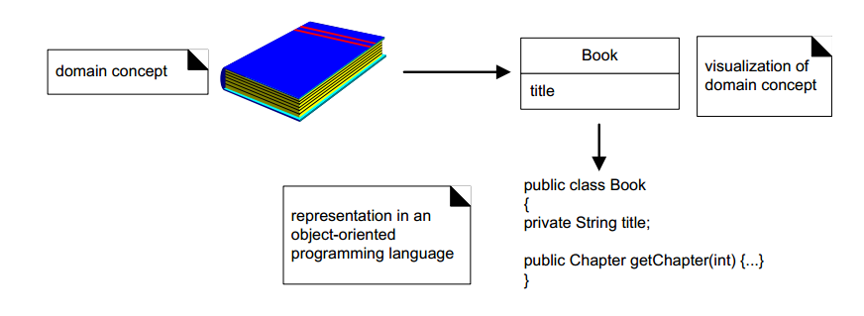
National University of Computer & Emerging Sciences, Peshawar.

Slide 24
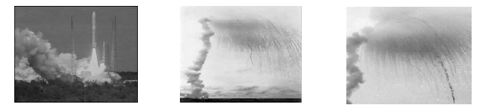
Famous Software Disaster
Software errors cost the U.S. economy $60 billion annually in rework, lost productivity and actual damages
Ariane 5 expandable launch system (Spacecraft launching system was improved from Ariane 4)
National University of Computer & Emerging Sciences, Peshawar.

Slide 25
US $5 hundred million worth of payload were destroyed
Reason:
  Main Navigation Computer crashes after 37
  seconds.
  Caused by a conversion overflow: converting
  floating point number to integer number.
  Reuse of specification of Ariane 4 without taking
  into consideration the new capability.
National University of Computer & Emerging Sciences, Peshawar.

Slide 26
Canada’s Therac-25 radiation therapy machine malfunctioned and delivered lethal radiation doses to patients.
Reason:
  Because of a subtle bug called a race condition, a technician could accidentally configure Therac-25 so the electron beam would fire in high-power mode without the proper patient shielding.
National University of Computer & Emerging Sciences, Peshawar.

Slide 27
EDS Child Support System
In 2004, EDS introduced a highly complex IT system to the U.K.’s Child Support Agency
Reason:
  At the exact same time, the Department for Work and Pensions (DWP) decided to restructure the entire agency. The two pieces of software were completely incompatible, and irreversible errors were introduced as a result. The system somehow managed to overpay 1.9 million people, underpay another 700,000, had US$7 billion in uncollected child support payments, a backlog of 239,000 cases, 36,000 new cases “stuck” in the system, and has cost the UK taxpayers over US$1 billion to date.
National University of Computer & Emerging Sciences, Peshawar.

Slide 28
Limitations of Non-Engineered Software
One of the problems with complex system design is that you cannot foresee the requirements at the beginning of the project.
In many cases, where you think you can start with a set of requirements that specifies the complete properties of your system, you end
up with bugs, as well as erroneous and incomplete software.
.
National University of Computer & Emerging Sciences, Peshawar.

Slide 29
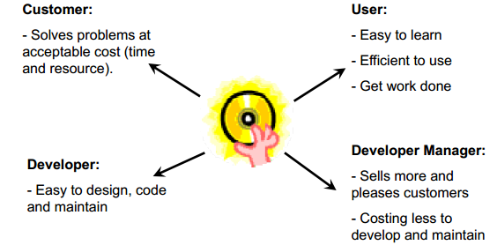
Quality of Good Software
National University of Computer & Emerging Sciences, Peshawar.

Slide 30
Qualities of Good Software
Usability
  Easy to learn and use
Efficiency
Does not waste resources such as CPU time and memory.
Dependability
  Reliable, secure and safe.
Maintainability
  Easily evolved (modified) to meet changing requirement.
Reusability
  Parts can be reused, with minor or no modification.
National University of Computer & Emerging Sciences, Peshawar.

Slide 31
IEEE Standard 610.12:
  The application of a systematic, disciplined,
  quantifiable approach to the development,
  operation, and maintenance of software,
  that is, the application of engineering to
  software.
  “Designing, building and maintaining large
  software systems”. - I. Sommerville
  “Multi-person construction of multi-version
  software”. - D. L. Parnas
National University of Computer & Emerging Sciences, Peshawar.

Slide 32
Software Engineering Myths
A general statement of objectives is sufficient
to begin writing programs - we can fill in the
details later.
  Poor Up-front definition is the major cause of failed software efforts.
If we get behind schedule we can add more , we can add more
programmers and catch up.
  Brooks Law: “Adding people to a late project makes it later.”
National University of Computer & Emerging Sciences, Peshawar.

Slide 33
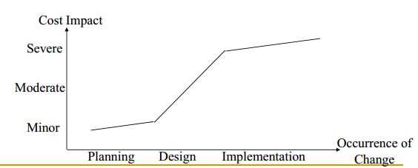
Project requirements continually change,
but change can be easily accommodated
because software is flexible.
National University of Computer & Emerging Sciences, Peshawar.

Slide 34
Software Process Models
The set of activities and associated results
that produce a software product.
Four fundamental process activities
  Software Specification
  Software Development
  Software Validation
  Software Evolution
Organized differently by different Software process models having different levels of detail
National University of Computer & Emerging Sciences, Peshawar.

Slide 35
1. Software Specifications
Customers and Software Engineers define the software to be produced and the constraints on its operations. Typical Stages are,
Feasibility Study:
  Is it possible with the current technologies + within budget?
Domain Analysis:
  What is the background for the software?
Requirements Gathering and Analysis:
  What is it that the user wants?
Requirements Specification:
  Formal documentation on User and System requirements.
Requirements Validation:
  Check for realism consistency and completeness , consistency, and completeness.
National University of Computer & Emerging Sciences, Peshawar.

Slide 36
2. Software Development
Consists of Design and Programming
  System Analyst design the software and decide how the requirement can be implemented.
  Programmers write code to translate the high level design into a real code in a chosen programming langauge
National University of Computer & Emerging Sciences, Peshawar.

Slide 37
3. Software Validation
Software Engineer (or dedicated tester) and Customer:
  Check the software to ensure it meets the customers’ requirements.
Typical Stages:
  Component Testing: Independent testing of individual components in subsystem.
  System Testing: Testing of integrated components.
  Acceptance Testing: Tested with customer supplied data. Final test before operation.
Interactive activity that feedback to previous stages: E.g., an error in component testing triggers re-coding.
National University of Computer & Emerging Sciences, Peshawar.

Slide 38
4. Software Evolution
Customers and Software Engineers:
Define changing requirements.
  Modify the software system to adapt.
  Typical Work:
  Update the system for minor new requirements,
  e.g., changing the telephone number from 7 digits
  to 8 digits, changing the date representation (the
  Millennium Bug).
National University of Computer & Emerging Sciences, Peshawar.

Slide 39
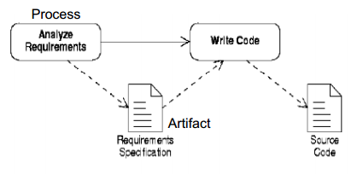
Simple Software Process
In the simplest cases, code is written directly from some statements of requirements.
National University of Computer & Emerging Sciences, Peshawar.

Slide 40
Two processes:
  Analyze requirements’
  ‘Write code’
Two artifacts:
  ‘Requirements specification’
  ‘Source code’
‘Requirements specification’ can be written as:
  an informal outline or
  a highly detailed description.
National University of Computer & Emerging Sciences, Peshawar.

Slide 41
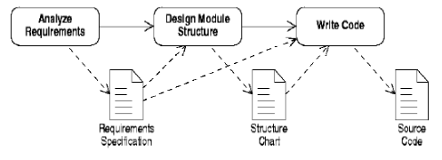
A more Complex Software Process
It is better to design before you code.
On larger projects, intermediate pieces of
documentation are produced.
National University of Computer & Emerging Sciences, Peshawar.

Slide 42
One new process:
  ‘Design module structure’ - splitting the program
  into modules and subroutine
One new artifact:
  ‘Structure chart’ – is based on the information
  contained in the ‘requirements specification’
  Both the ‘requirements specification’ and the
  ‘structure chart’ are used when writing the final
  code.
National University of Computer & Emerging Sciences, Peshawar.

Slide 43
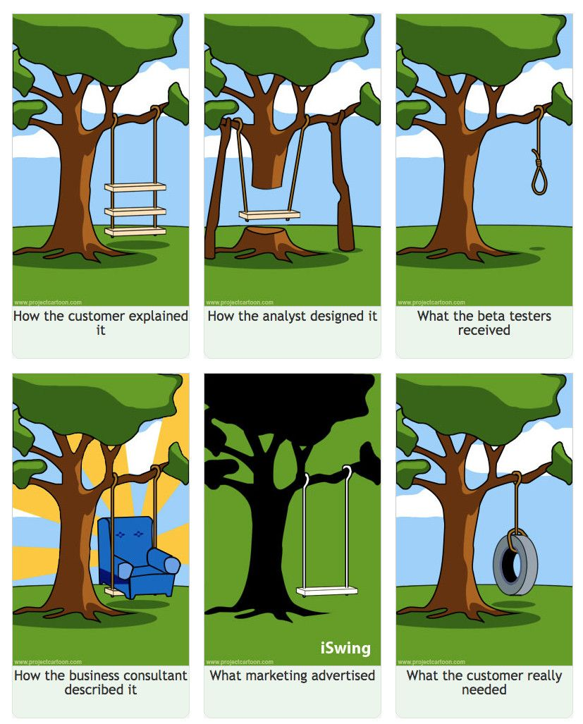
National University of Computer & Emerging Sciences, Peshawar.

