Slide 1
Microservices

Slide 2
Reference Architecture (IBM)
PUBLIC NETWORK
PROVIDER CLOUD
ENTERPRISE NETWORK
Container Environment
MICROSERVICE
MICROSERVICE
MICROSERVICE
MICROSERVICE
Integration
TRANSFORMATION
MICROSERVICE
MICROSERVICE
& CONNECTIVITY
IoT
DEVICES
Application Frameworks
Cloud Services
API
MANAGEMENT
LANGUAGE &
LIBRARIES &
TRACING &
DATA
AI
SECURITY
ANALYTICS
MESSAGING
IoT
RUNTIMES
FRAMEWORKS
LOGGING
SERVICES
PLATFORM
DEVICES
ENTERPRISE
Microservices
USER DIRECTORY
Mesh
CIRCUIT
SERVICE
ROUTING
CONFIGURATION
MICROSERVICES
EDGE
BREAKER
DISCOVERY
SERVICES
MANAGEMENT
SECURITY
SERVICES
Container
ETL
BROWSER
Platform
CONTAINER
CONTAINER
IMAGE
LOAD
CONTAINER
SERVERLESS
ORCHESTRATION
CLUSTER
REPOSITORY
BALANCING
SECURITY
COMPUTING
MANAGEMENT
Infrastructure
ENTERPRISE
VIRTUAL
STORAGE
NETWORK
PROVISION
INFRASTRUCTURE
DATA
INFRASTRUCTURE
SECURITY
DevOps
CONTINUOUS
CONTINUOUS
DEPENDENCY
CONTINUOUS
CONTINUOUS
MONITORING &
CLOUD
PROVISION
BUILD
MANAGEMENT
TESTING
DEPLOY
LOGGING
MANAGEMENT
SERVICES
Notes:
https://www.ibm.com/cloud/architecture/architectures/microservices/reference-architecture

Slide 3
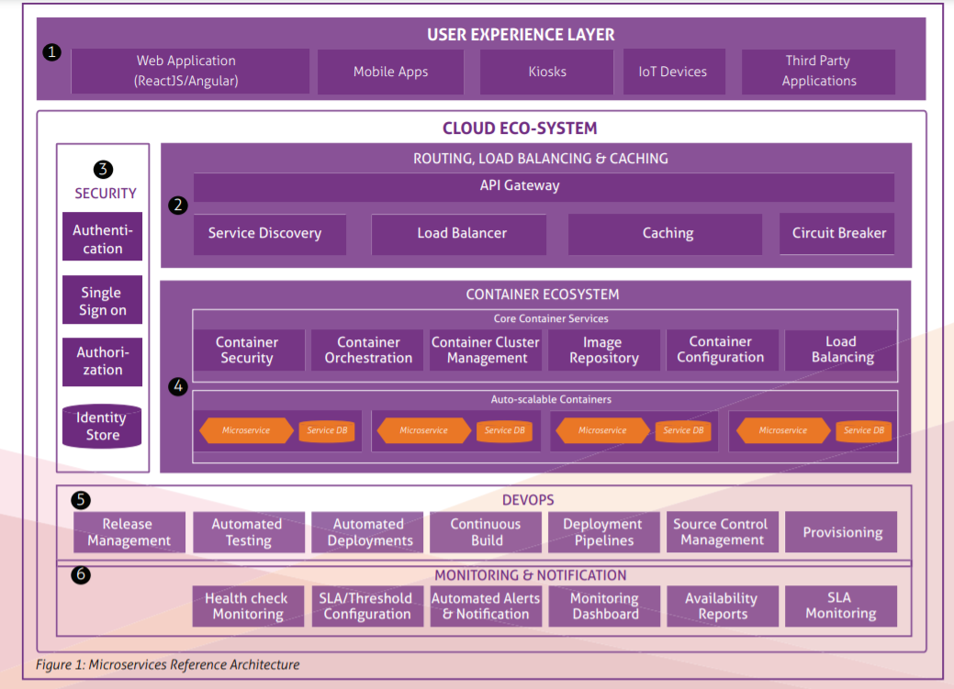
Reference Architecture (Mindtree)
Notes:
https://www.mindtree.com/sites/default/files/2019-11/Microservices%2BArchitecture%2Bfor%2BModern%2BDigital%2BPlatforms%2B-%2BWP_V2.pdf

Slide 4
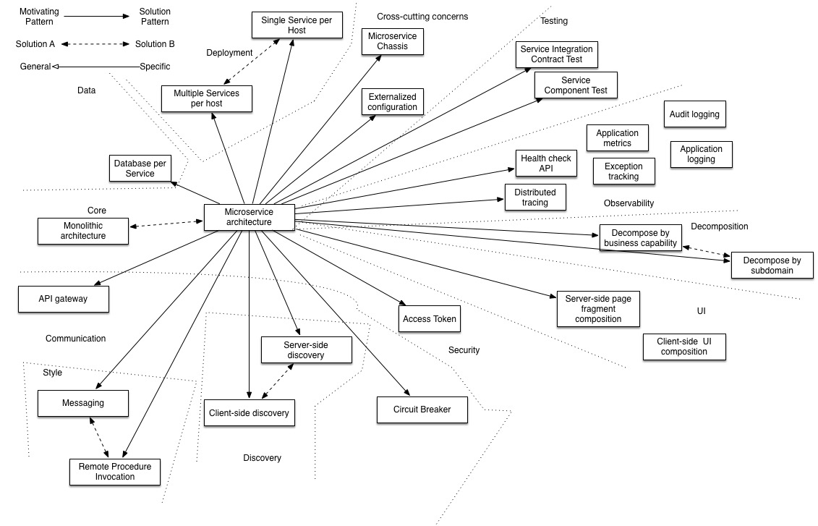
Reference Architecture (microservices.io)
Notes:
https://microservices.io/patterns/microservices.html

Slide 5
Reference Architecture
https://github.com/wso2/reference-architecture/blob/master/api-driven-microservice-architecture.md
https://github.com/ibm-cloud-architecture/refarch-cloudnative-kubernetes
https://github.com/dotnet-architecture/eShopOnContainers

Slide 6
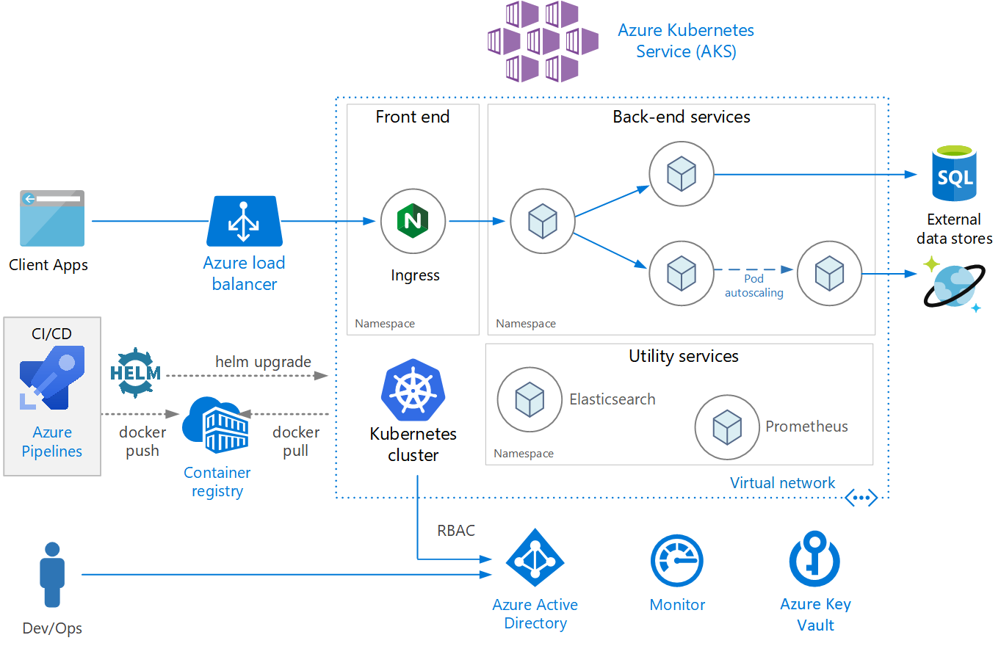
Reference Architecture (Azure )
Notes:
https://docs.microsoft.com/en-us/azure/architecture/reference-architectures/containers/aks-microservices/aks-microservices

