Slide 1
Recognizing Traffic Signs
The goal of this project is to build a model capable of determining the type of traffic sign displayed.
Traffic signs come in pictures mostly, with different colors and shape. The help communicate messages to drivers and pedestrians for overall safety.
Saswati Halder
Saswati Halder

Slide 2
Why Recognizing TRAFFIC SIGN is important?
Deep learning computer vision plays an important role in driver-assistance systems and driverless operations to detect other cars and objects, to avoid collision.
Correctly detecting and recognizing traffic signs is challenging and equally important for these cars to navigate safely, avoid collisions, avoid breaking traffic laws and ultimately contribute towards the success of the cause.

Slide 3
Data Set Details
Data Source : Kaggle
Data already split into train, validation and test set
Train: 34799 data points
Valid.: 4410 data points
Test: 12630 data points
Features are colored images of size 32x32x3 (NumPy array)
Labels are in form of integers ranging from 0 to 42.
Additional file – signnames.csv has 43 classes of label ID from 0-42 and names of those traffic signs
No missing data

Slide 4
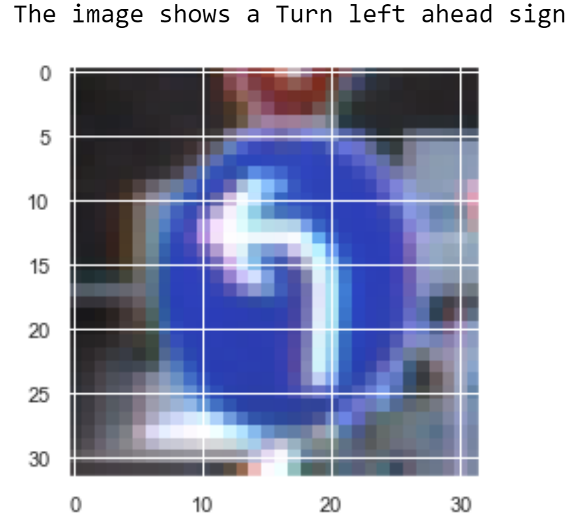
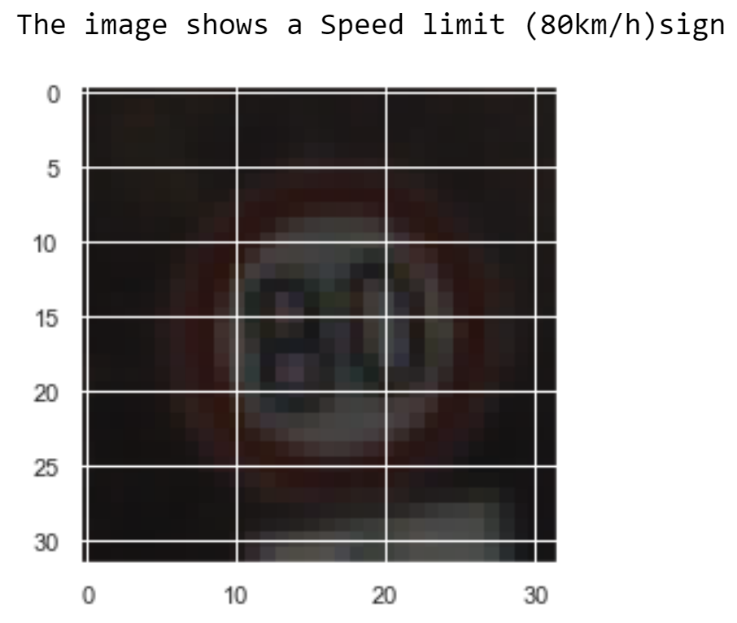
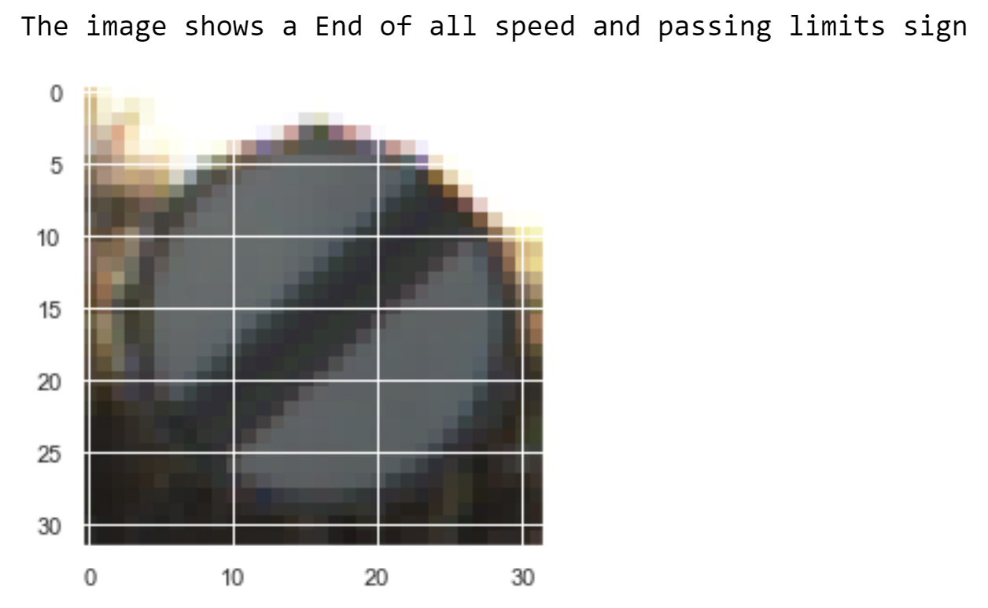
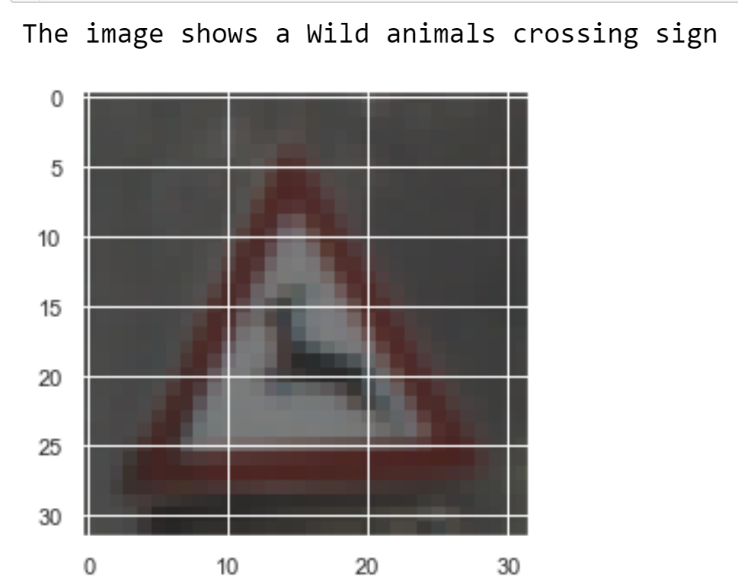
EDA and Data Challenges
The main challenge was that the images were taken under different lighting conditions, from light to dark. With small size, the images lacked clarity with some images quite blurry to even detect with human eye.

Slide 5
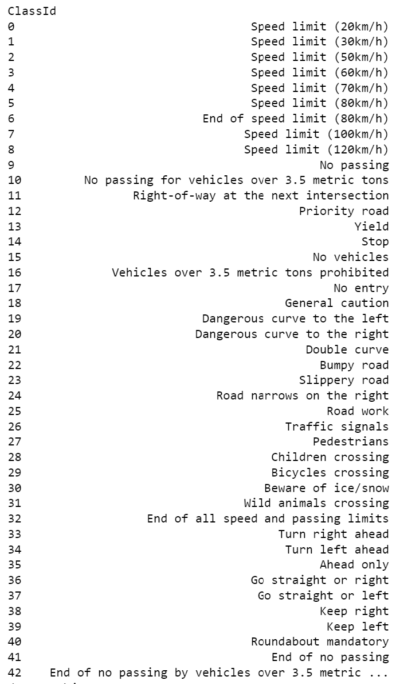
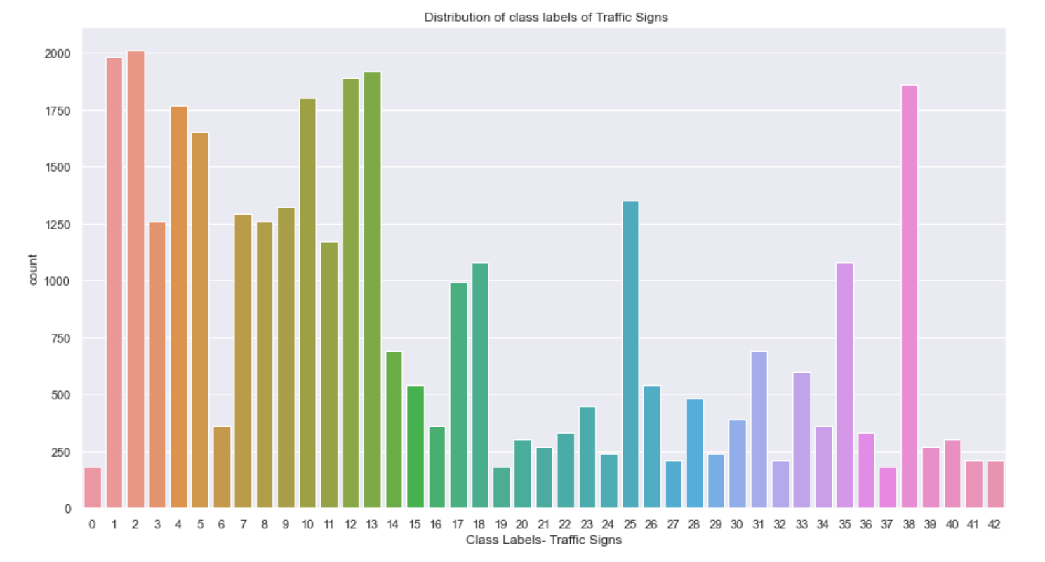
EDA and Data Challenges
Imbalanced class distribution

Slide 6
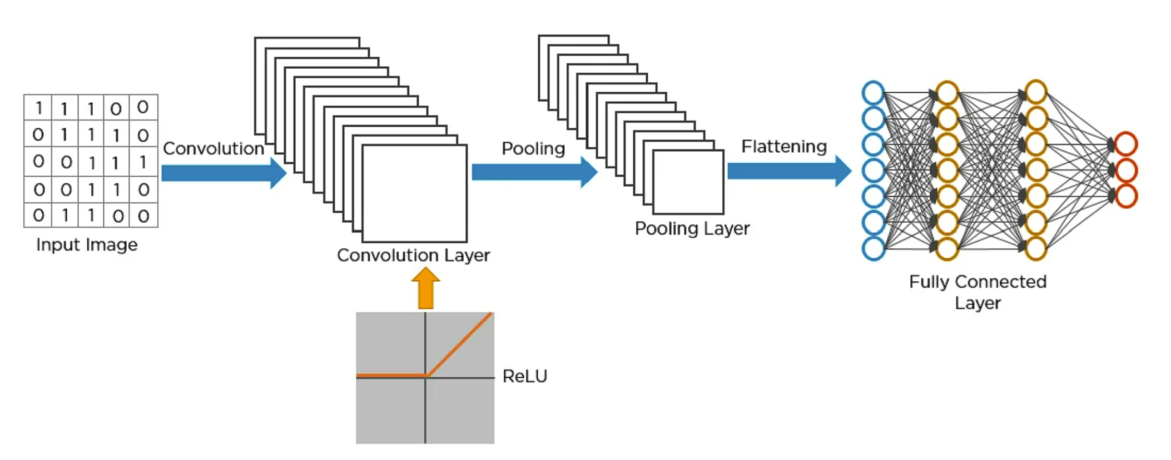
Modeling Approach - CNN
Convolutional Neural Network (CNN) a subset of deep learning, is a powerful neural network model that can be used for image and video processing.
Basic CNN Architecture:
Input Layer
Hidden Layer – Convolutional and Pooling Layers
Flattening Layer
Fully Connected NN Layer
Output Layer

Slide 7
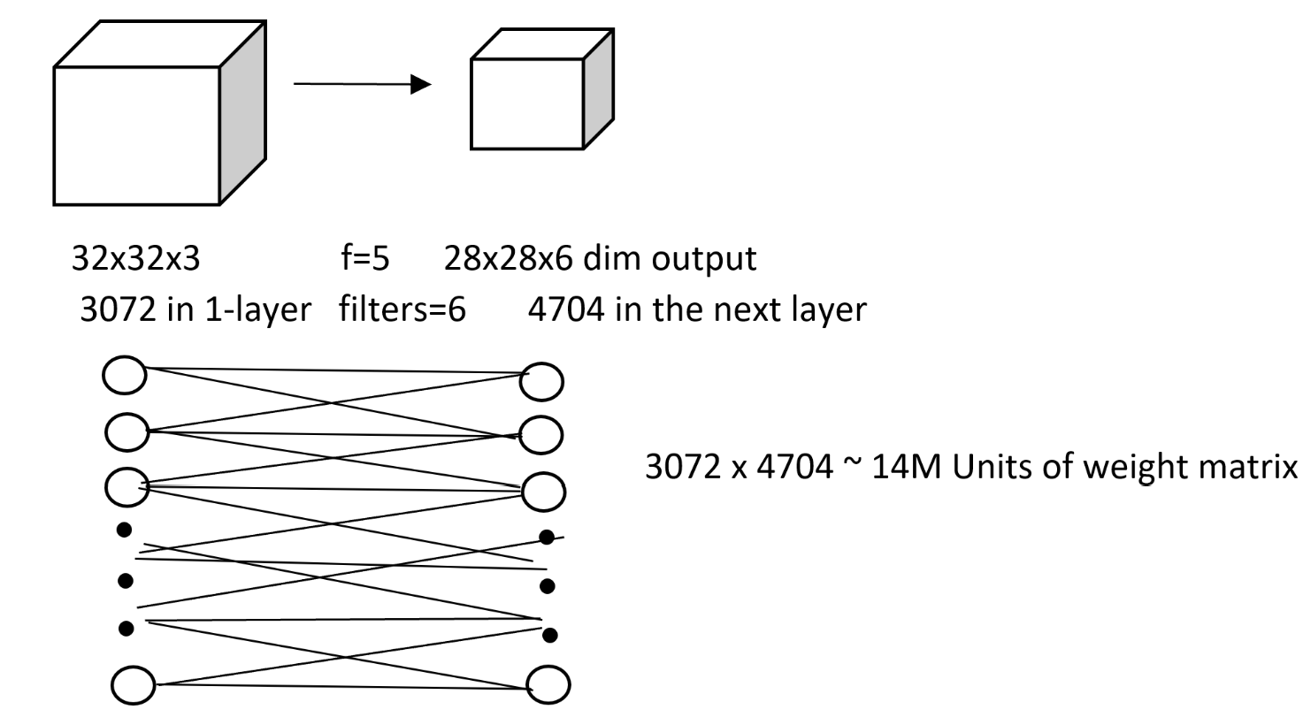
Why Convolution?
Convenience of CNN – Reduces computational load
Parameter Sharing: Less parameters and sharing for similar features.
Sparsity Connection: In each layer, output value depends on small number of inputs

Slide 8
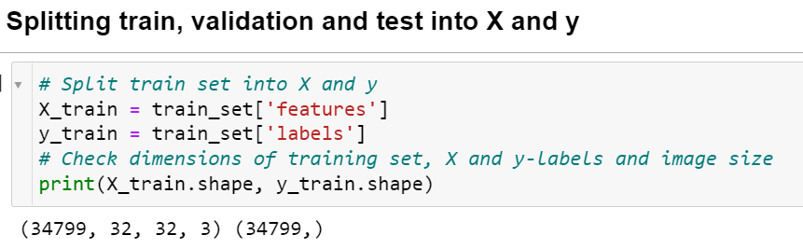
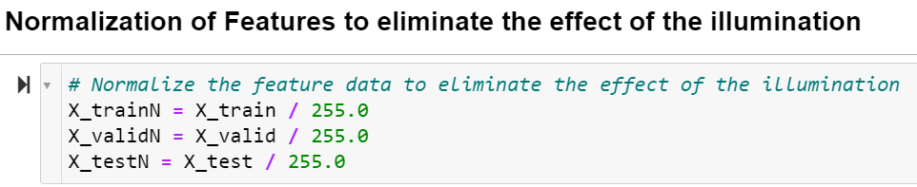
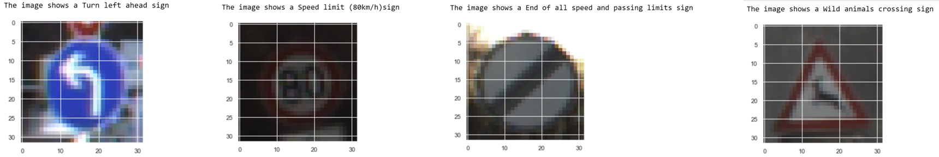
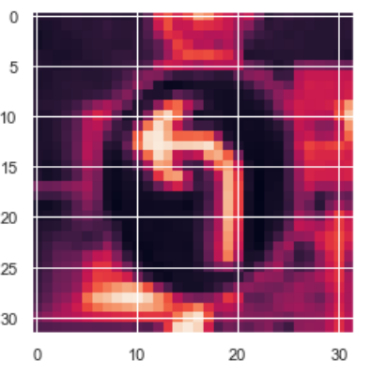
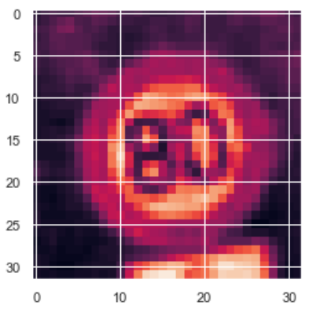
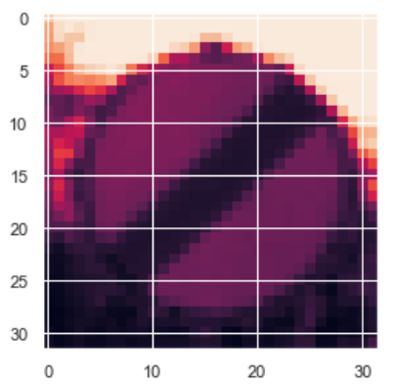
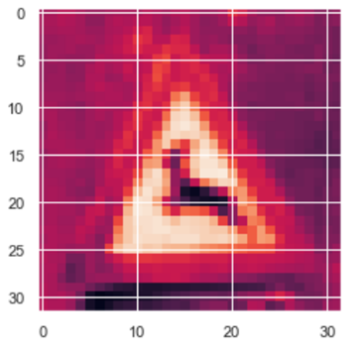
Data Preparation

Slide 9
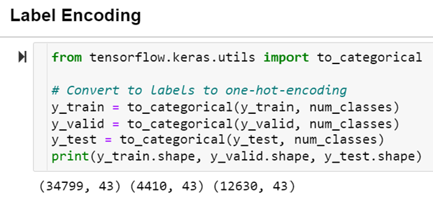
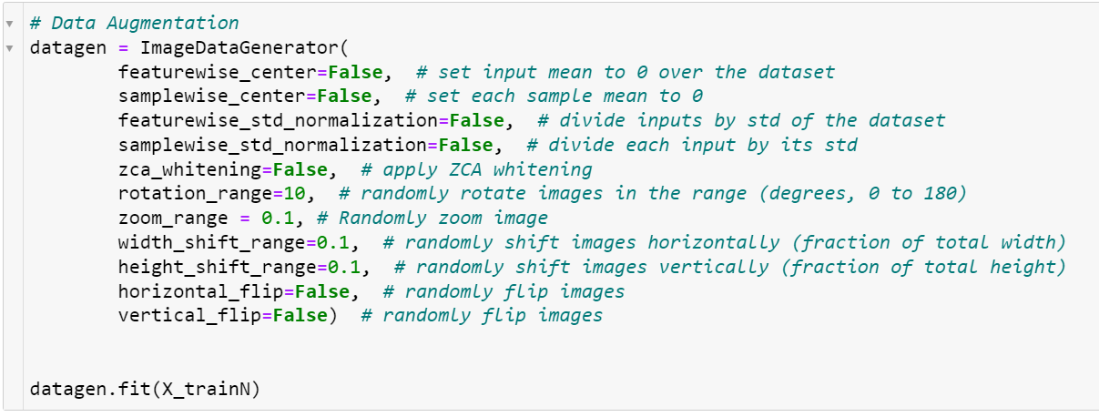
Data Preparation

Slide 10
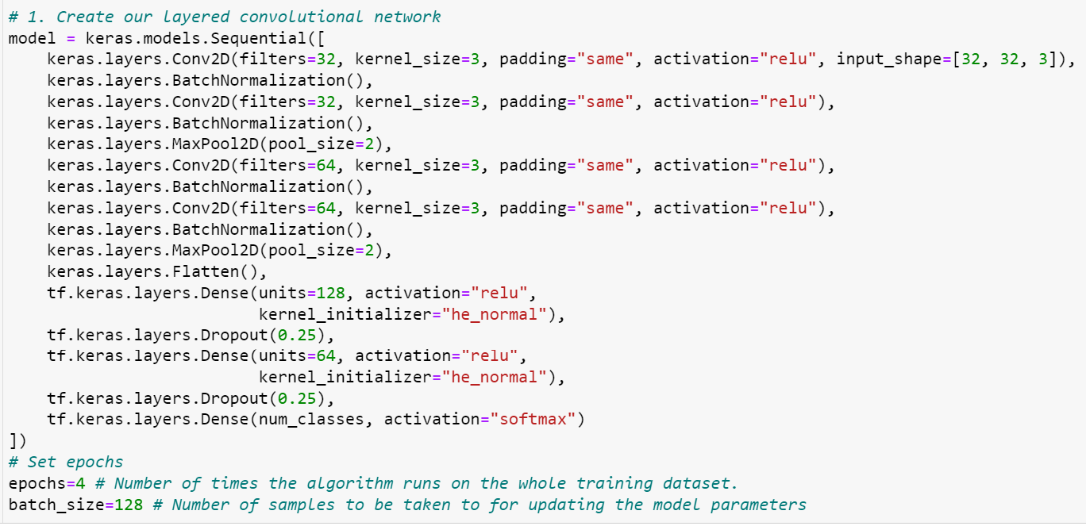

Define our CNN Model

Slide 11

Train A Model – Not normalized
Epochs: 30
Metrics used: Accuracy
Loss Function: Categorical Cross-entropy (labels are one-hot encoded)
Optimizers: RMS (root mean square) prop
Data Augmentation: Yes, X_Train is augmented

Slide 12
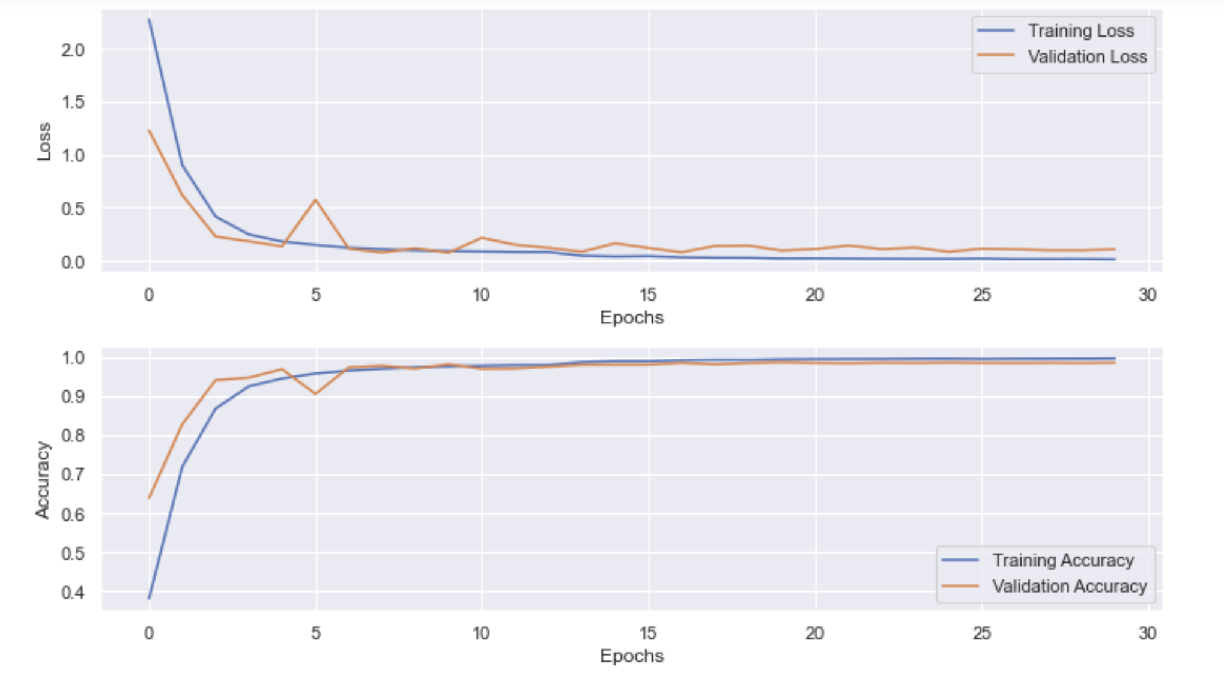
Train A Model – Not normalized
Learning Curves:
Accuracy metrics looks good for train and validation set.
The validation accuracy is high and very close to training accuracy indication that our model is not overfitting.
Epoch 30/30 (Trained Model without normalization)
loss: 0.0119 accuracy: 0.9968 val_loss: 0.1069 val_accuracy: 0.9859
Elapsed time is 58.885 mins

Slide 13
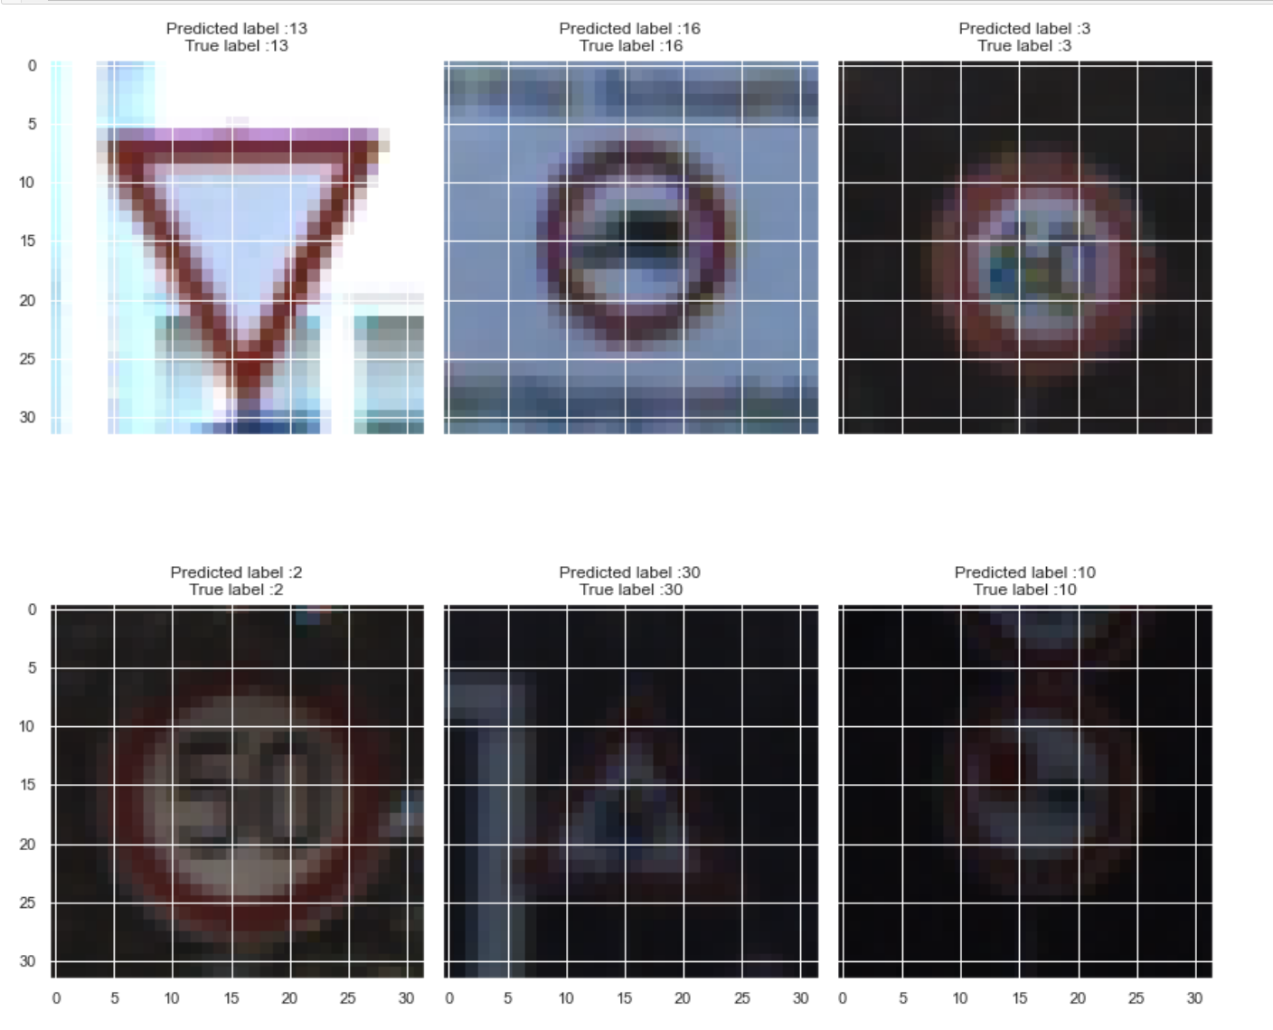
Evaluate Model on Test – Not normalized
Display some correct results:
Accuracy metrics looks really good for feature set that was not normalized
This CNN model was very successful at bringing out the features from the images for correct prediction
Evaluate model on test data:
loss: 0.29 accuracy: 0.9770
Elapsed time is 58.885 mins

Slide 14

Train more Models - Normalized
Epochs: 4
Metrics used: Accuracy
Loss Function: Categorical Cross-entropy (labels are one-hot encoded)
Optimizers:
Adam (adaptive moment estimation)
SGD (stochastic gradient descent )
RMS (root mean square) prop

Slide 15
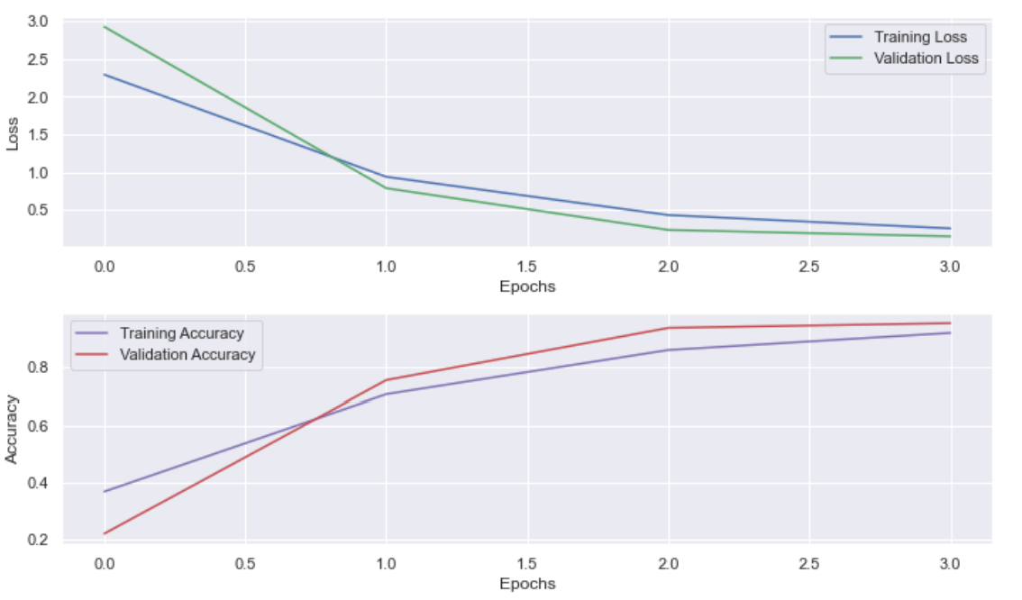
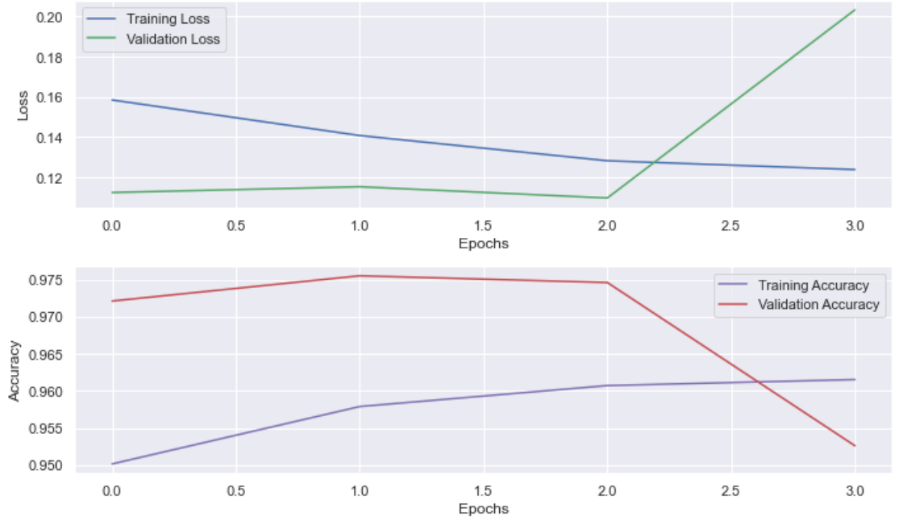
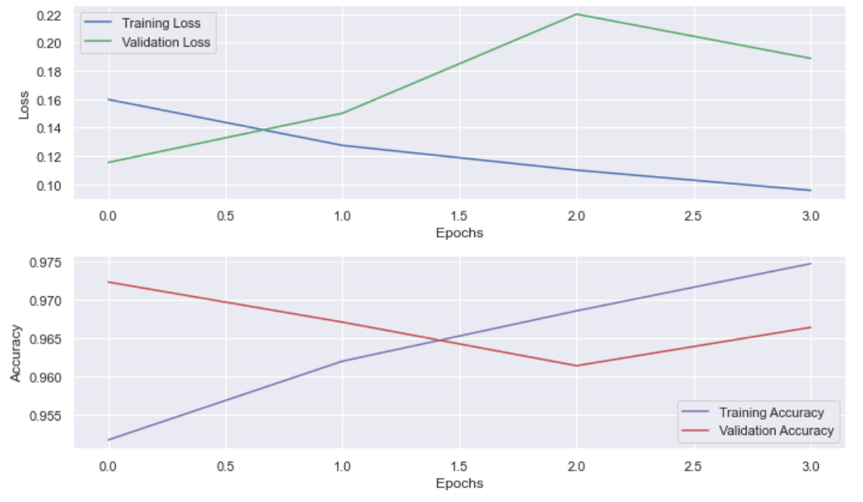
Train our Initial Models'
Adam (adaptive moment estimation)
SGD (stochastic gradient descent )
RMS (root mean square) prop

Slide 16
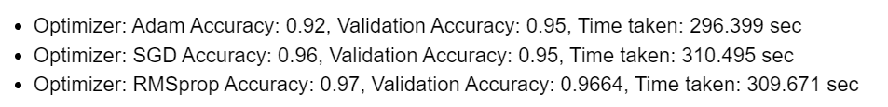
Visualizations and results
With an epoch=4, all the optimizers fair well with the given parameters:
Based on the initial models, select final optimizer:
Rejected SGD since for long runs, it tends to slow down to converge
Rejected Adam since lowest accuracy, although quicker to converge
Selected RMSProp since both train and valid. accuracy looks good and it’s an adaptive learning rate optimizer like Adam.

Slide 17
Hyperparameter Tuning
Batch Normalization and Drop Out layers were added to our CNN layers to regularize and help generalize well.
Except for Adam and RMSprop, the SGD optimizer had momentum=0.9 and Nesterov=True for faster convergence.
For training the model with epochs=30 , “Learning Rate Scheduling” was set as Keras callbacks.
Learning rate scheduling, started with higher learning rate was that decreased by half if preferred accuracy is not reached by certain epochs.

Slide 18
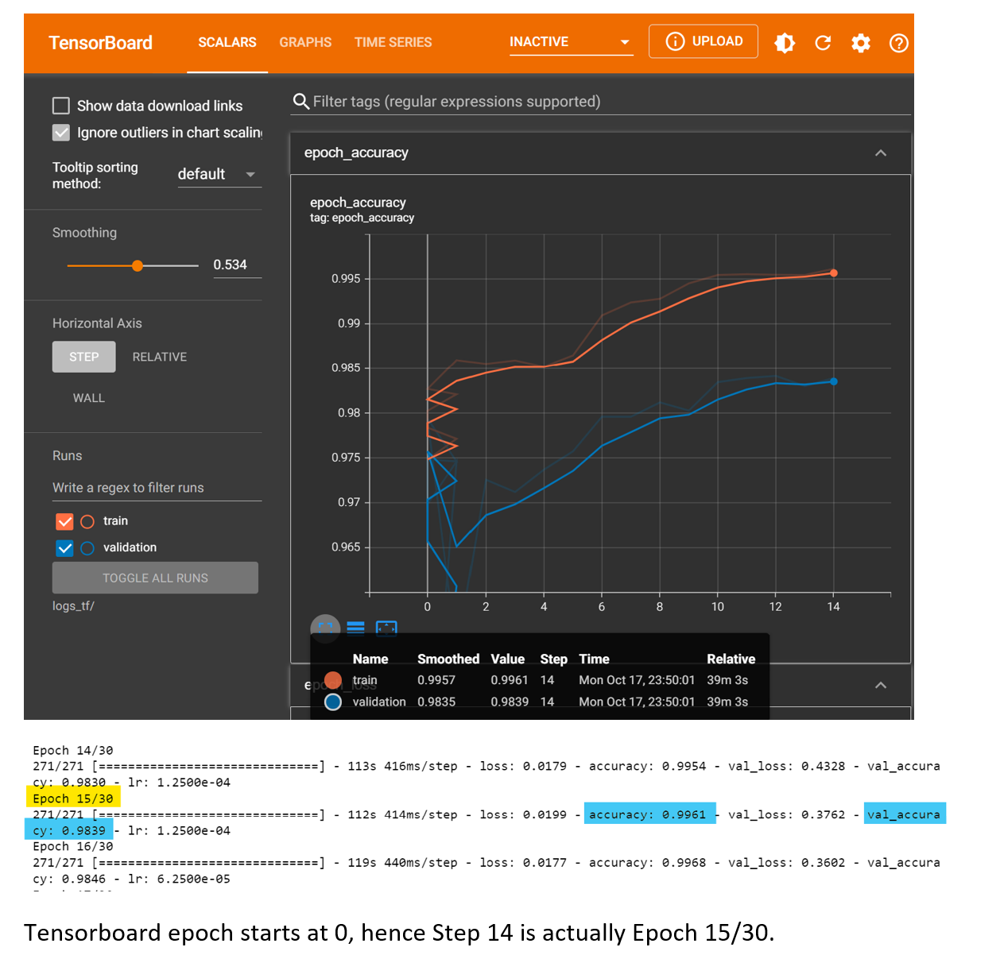
Evaluate final model
Evaluate Model on Test Data:
loss: 0.2434 accuracy: 0.9787
Epoch 30/30 (Trained Model)
loss: 0.0146 accuracy: 0.9967 val_loss: 0.3460 val_accuracy: 0.9846
Elapsed time is 55.161 mins

Slide 19
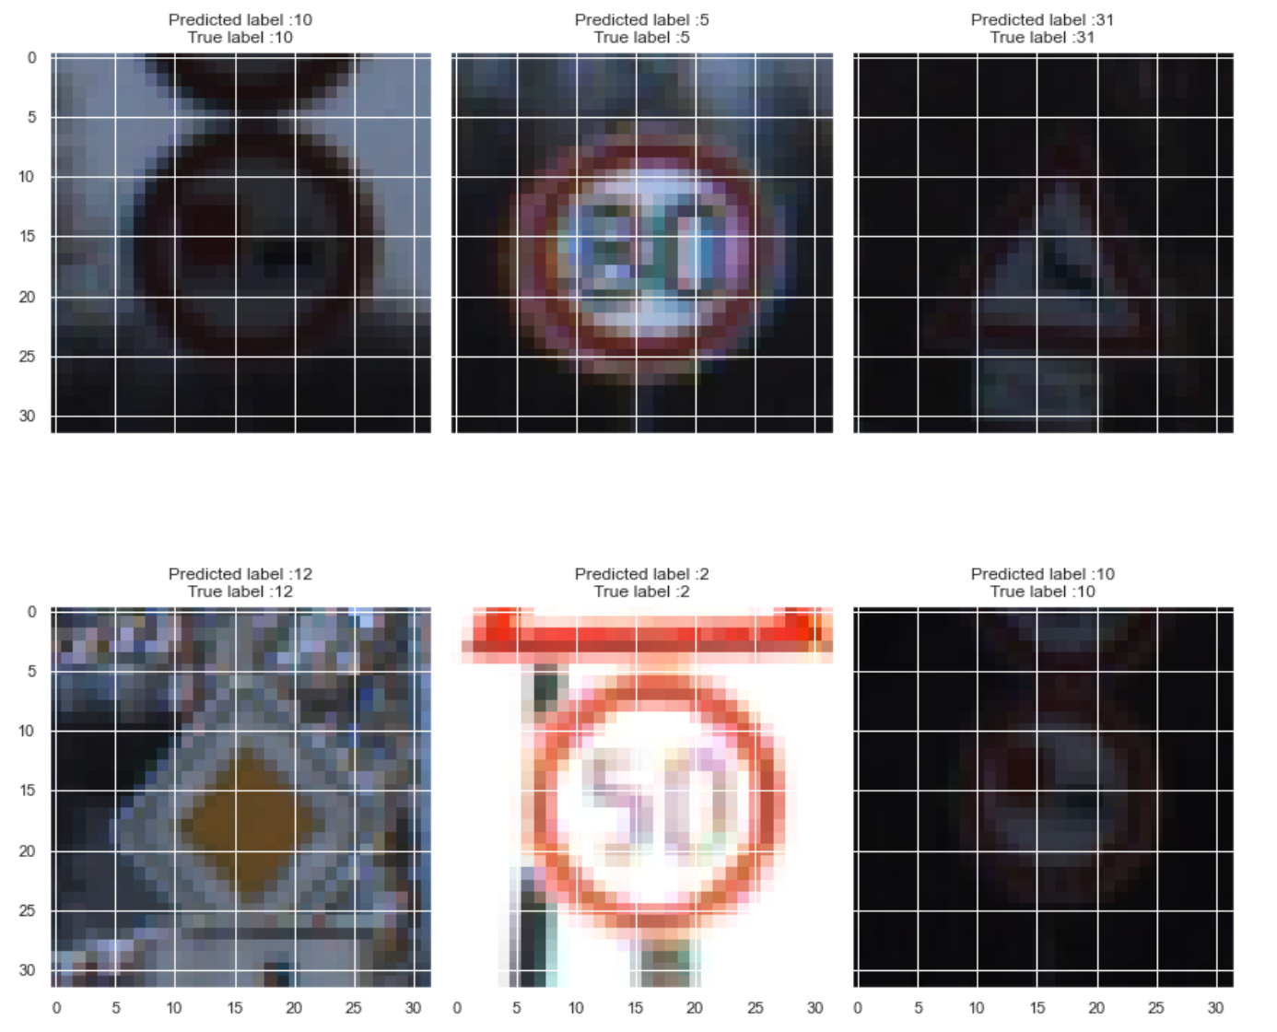
CONCLUSION
I conclude that both the trained CNN models (normalized and not-normalized) performed really well at bringing out distinct features and correctly predicting the traffic signs, with the given images.
Display top 6 correctly predicted results

Slide 20
Credits
Hands-On Machine Learning with Scikit-Learn, Keras, and TensorFlow by Aurélien Géron
Stanford and Coursera Deep Learning Videos by Andrew Ng
https://www.analyticsvidhya.com/blog/2021/10/a-comprehensive-guide-on-deep-learning-optimizers/
https://github.com/ageron
Kaggle.com

Slide 21
Questions?
Thank You All!!

